Slide 1
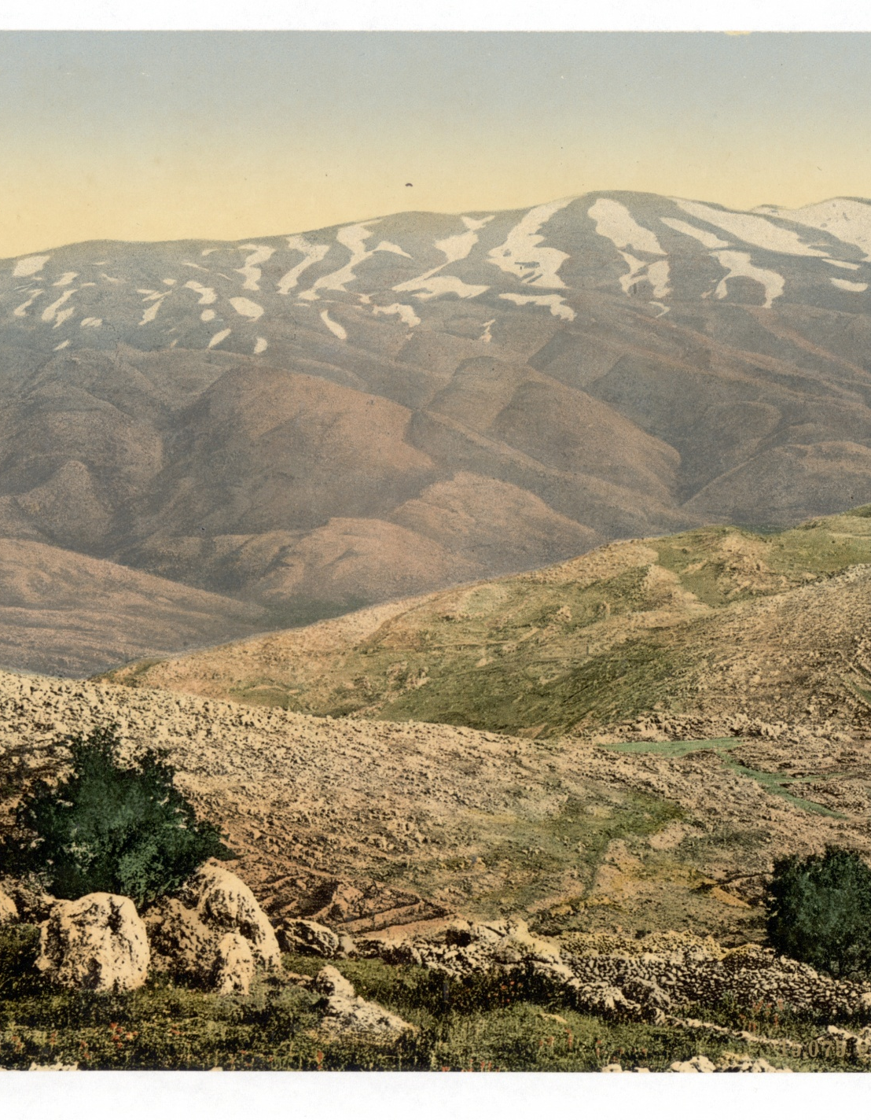
Like The Dew of Mt. Hermon…
Psalm 133 and the Blessing of Unity

Slide 2
133:1: How Good, How Pleasant…
Families would have sung these Songs of Ascents as they were making their journey up to the City of David.
Family tensions have plenty of opportunity to be brought out in the open and dealt with.
Psalm 133 helps to put us in the right mindset for interacting with people whom we may not see eye to eye.

Slide 3
133:2: Like Oil on the Beard…
Oil is an image of plenty and the best things in life (Gen. 27:28).
Oil in Psalm 133 is moving and changing, like human relationships.
Just as Aaron’s oil consecrates him for the priesthood, so oil consecrates us to serve one another.

Slide 4
133:3: There the Lord has Commanded the Blessing
Whereas Israel is fickle and ever changing, God’s provision is sure.
No matter the setting, when God’s people come together, and strive to serve on another in unity, God and his blessing are present there.
There will always be forces working for division, but in spite of this, we serve a God who draws us together to himself.

