Slide 1
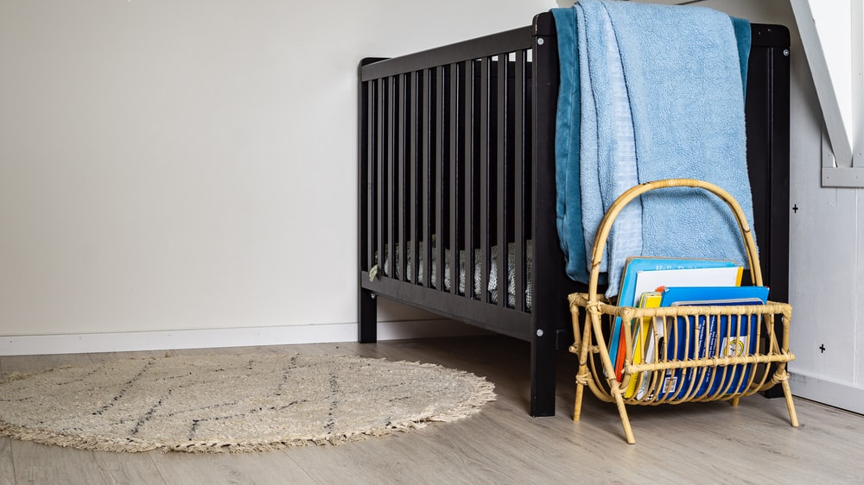
Parenting Myths

Slide 2
“Children Are a Burden”
Parenting Myths…

Slide 3
“The Recipe Myth”
Parenting Myths…

Slide 4
“It’s Impossible to Raise Them to Serve God”
Parenting Myths…

