Slide 1
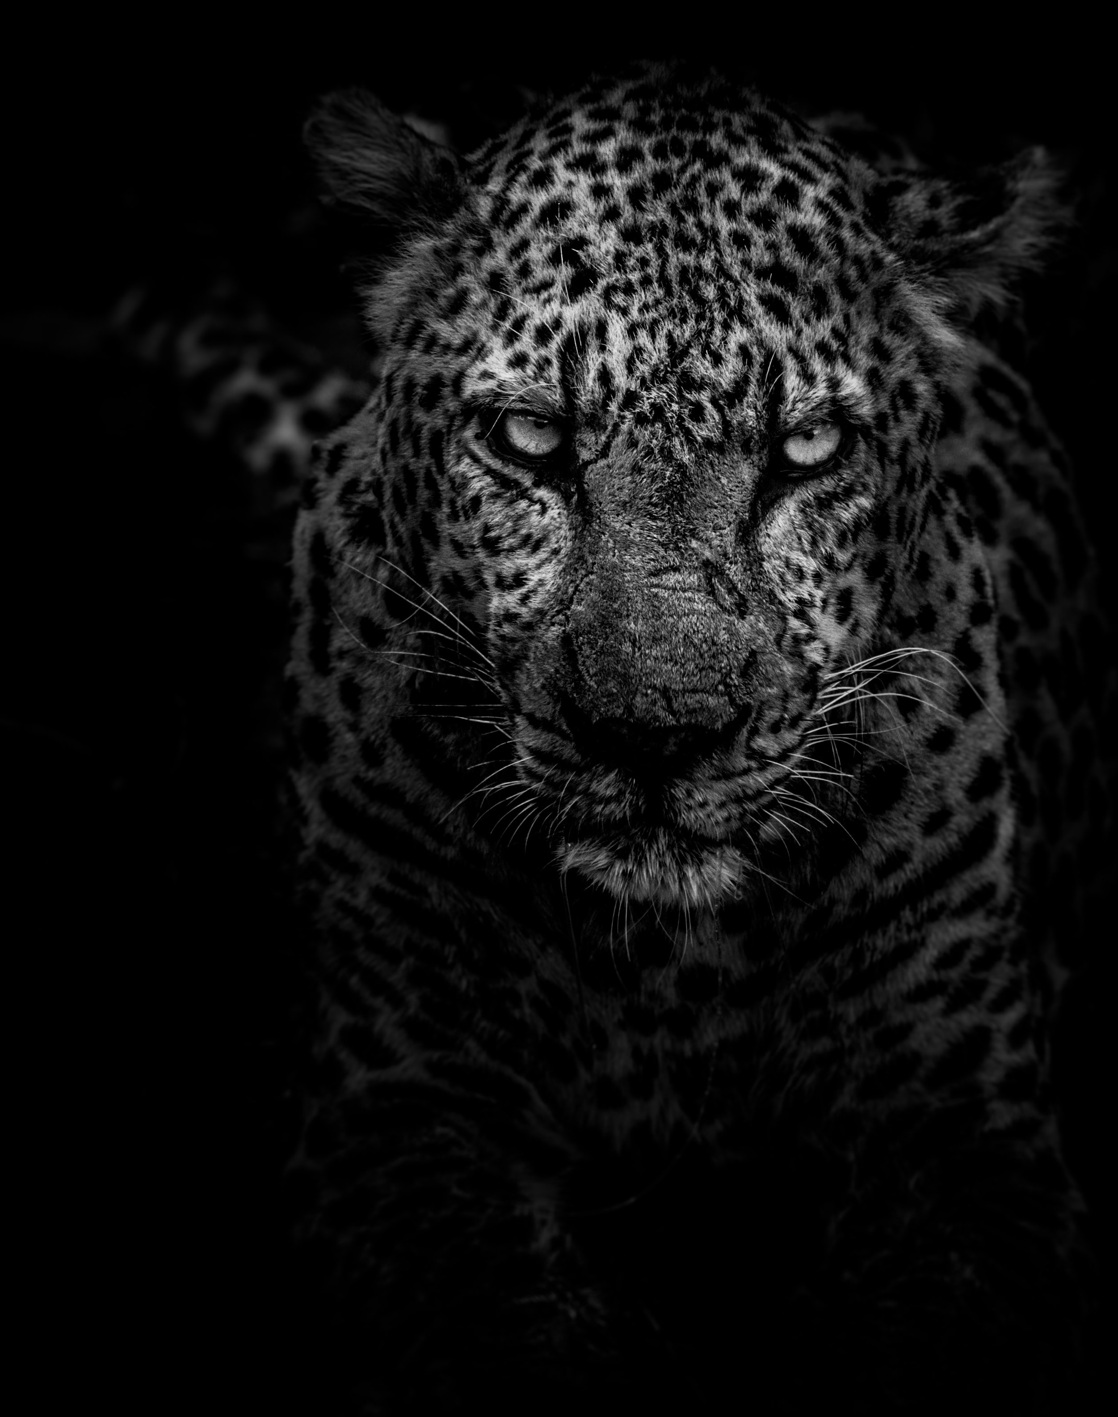
YOU
MUST
RULE
OVER IT
08.24.22
UNIVERSITY CHURCH OF CHRIST

Slide 2
“Do you not know that if you present yourselves to anyone as obedient slaves, you are slaves of the one whom you obey, either of sin, which leads to death, or of obedience, which leads to righteousness?” (Rom. 6:16)
“Let not sin therefore reign in your mortal body, to make you obey its passions” (Rom. 6:12).

Slide 3
(1) SEE IT
Matt. 5:21-22; 27-28
Heb. 12:1; 1 Tim. 6:9
Eph. 6:10-13
2 Cor. 4:1-6; James 1:22-25
Heb. 4:12-13
Psalm 139:23-24

Slide 4
(2) FEAR IT
“Do not fear those who kill the body but cannot kill the soul. Rather fear him who can destroy both soul and body in hell” (Matt. 10:28).
2 Cor. 7:10-11
“Blessed are those who mourn, for they shall be comforted” (Matt. 5:4).

Slide 5
(3) RESIST IT
1 Cor. 10:13-14; 6:18
Rom 13:14, Eph. 4:27
1 Pet. 5:8-9
Eph. 6:10-17
“Confess your sins to one another and pray for one another, that you may be healed” (James 5:16).

Slide 6
(4) KILL IT
“So then, brothers, we are debtors, not to the flesh, to live according to the flesh. For if you live according to the flesh you will die, but if by the Spirit you put to death the deeds of the body, you will live” (Rom. 8:12-13).
2 Cor. 12:10
Eph. 6:17; Heb. 4:12

Slide 7
SEE IT
FEAR IT
RESIST IT
KILL IT

Slide 8
“For if you live according to the flesh you will die, but if by the Spirit you put to death the deeds of the body, you will live” (Rom. 8:13).
“If the Spirit of him who raised Jesus from the dead dwells in you, he who raised Christ Jesus from the dead will also give life to your mortal bodies through his Spirit who dwells in you” (Rom. 8:11).

