Slide 2
What Marriage Teaches Us About COMMUNICATION
– James 3:5-10 -

Slide 3
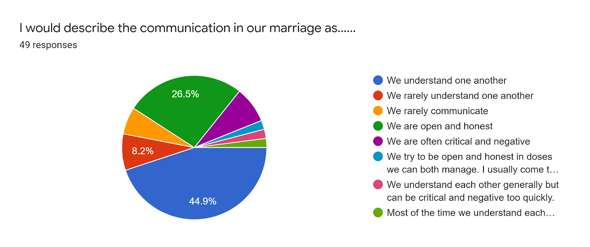

Slide 4
5 T’s to communication: Take Time Together Talking, Not Telling

Slide 5
What is Important to Communication in Marriage?
Where you go
What you say
Attitude with what you say
Touch or no touch
Honesty
Attentiveness
Understanding
Time
Body Language
Listening

Slide 6
The Power of Words
Communication FROM and WITH God is the difference between LIFE and DEATH (Matthew 25:34,41)
God SENDS Words to be RECEIVED (Hebrews 1:1,2)
God hopes the recipient gets the same message the sender intended to communicate…

Slide 7
The Power of Words
Conversation to inform, understand, and connect to your mate - transparency
The understanding of the WORDs brings hopeful results of CONNECTION/ONEness
Every spouse is capable of SENDING and RECEIVING words…

Slide 8
The Power of Words
The 10 most important minutes of a day in marriage.

Slide 9
The Power of Words
“Death and life are in the power of the tongue.” Proverbs 18:21

Slide 10
The Power of Words
Communication is the
lifeblood of marriage
Your “contact list” - Philippians 4:8

Slide 11
Enemies of Communication in Marriage
Be aware of EMOTION
Conversation that punishes your spouse (Ephesians 4:29)
Conversation that forces your way; one-sided (James 4:1,2)
Conversation dwelling on mistakes, past or present (Philippians 3:12-14)
NOISE

Slide 12
Friends of Communication in Marriage
Openness and Honesty (Genesis 2:25; Ephesians 4:15)
Listen to understand your spouse (James 1:19; Proverbs 1:5)
Conversation without distractions (Matthew 12:30)
Conversation with Touch (present or absent)

Slide 13
4 Great Communication Components
Trust
Commitment
Focus
Love

Slide 14
“Lovemaking” in marriage begins with
communication involving…
Expressing yourself to be understood, without judgment or criticism (Ephesians 4:29, Proverbs 10:19)
Listen to understand your spouse (James 1:19)
Actively resolve conflict (Ephesians 4:26, 32)

Slide 15
Admit your need to communicate
Believe your spouse can
Continue to pay attention

Slide 16
What is something positive and encouraging that you could say to your spouse today?
What words can you use to lift his or her spirit?
What words of praise can you speak?
How can you point each other to the truth of God’s Word and His promises?

Slide 17
CONNECT
Communication is what pays attention to the needs of marriage…

