Slide 2
CURRICULUM
Sep 06: Introduction
Sep 13: Its Nature
Sep 20: Its Standard of Authority
Sep 27: False Standards (1)
Oct 04: False Standards (2)
Oct 11: Applying the Standard (1)
Oct 18: Applying the Standard (2)
Oct 25: Local Organization (1)
Nov 01: Local Organization (2)
Nov 08: Local Organization (3)
Nov 15: Nature of Worship
Nov 22: ***No Class***
Nov 29: Elements of Worship
Dec 06: Its Work of Edification
Dec 13: Its Work of Evangelism
Dec 20: Its Work of Benevolence
Dec 27: ***No Class***
Jan 03: ***No Class***
Notes:
Last week when we looked at the various natures of the church, we noted how the church is also referred to as a “kingdom”. And the things that make a kingdom unique are the fact that it has a king, subjects, and a law. The King over God’s saved people is Jesus Christ. We are His subjects. What do you suppose the Law is? It’s the NT. And if we’re going to be faithful subjects/citizens of God’s kingdom, we have to know the law that governs us so we can properly apply it.

Slide 3
Notes:
1 Tim 3:15 – Notice the last phrase. The church is the “pillar and support of the truth”. It is not the creator of the truth, rather the truth is the truth and the church is to do w/the truth what pillars and supports do for a building. The church, the kingdom, is to uphold and support the truth. So, before we learn how God wants His local church organized and how He wants us to worship and work together, we need to talk about this “truth” that the church is to uphold, this “law” that guides us in who to be and what to do.
The next five lessons are going to focus on this. Tonight, we’re going to begin by looking at how we can know that the NT is God’s standard of authority for the church. Then we’ll have two lessons in which we’ll look at false standards of authority that get in the way of that. And then the 2 lessons after that will focus on how we use the NT to interpret God’s truth, a fancy word called “hermeneutics”
PRAYER

Slide 4
The Standard of Authority
Jesus’ Authority
John 12:49-50 – “For I did not speak on My own initiative, but the Father Himself who sent Me has given Me a commandment as to what to say and what to speak. I know that His commandment is eternal life; therefore the things I speak, I speak just as the Father has told Me.”
John 5:19-20 – “Therefore Jesus answered and was saying to them, ‘Truly, truly, I say to you, the Son can do nothing of Himself, unless it is something He sees the Father doing; for whatever the Father does, these things the Son also does in like manner.’”
Notes:
(John 12) Let’s begin by considering how Jesus viewed His role while on this earth (CLICK) – John 12:49-50 – Jesus didn’t come here to flaunt His opinions or ideas that either conformed to or contradicted the present culture. Rather, He came to do His Father’s will. Whatever the Father spoke, that’s what Jesus spoke. It did not matter whether people liked it, whether what He said was popular, whether it was rejected, or whether what He said caused Him to be killed. To Jesus, the Father’s word was predominant in His life; it is what He proclaimed.
His submission to the Father’s authority wasn’t limited simply to His teaching (John 5); it extended to everything that He did (CLICK) – John 5:19-20 – Why would Jesus help someone? Because it’s what the Father would do. Why would Jesus avoid something? It’s because that’s what the Father would do. There’s a phrase we sometimes use, “What Would Jesus Do?” He answers it in this passage – whatever the Father would do, Jesus would do.

Slide 5
The Standard of Authority
Jesus’ Authority
Matt 28:18 – “And Jesus came up and spoke to them, saying, ‘All authority has been given to Me in heaven and on earth.’”
Eph 1:22-23 – “And He put all things in subjection under His feet, and gave Him as head over all things to the church, which is His body, the fullness of Him who fills all in all.”
Notes:
But then something changed. After living a perfect, sinless life in complete obedience, the Father bestowed to Jesus a very special honor. (CLICK) In Matt 28, after Jesus died, was buried, and was raised, He is speaking to His apostles just prior to His ascension back to heaven, and He informs them of a “promotion” if you will. Matt 28:18 – Given to Him by Whom? By the only one who had the authority to give Him this authority, the Father Himself. See, when we refer to Jesus Christ as “Lord”, this is what we are professing. We are professing that Jesus is the one, the only one, who has all power and all authority.
Power and authority over what? (CLICK) Eph 1:22-23 – “All” is all, authority over heaven and earth and every person and thing in it, authority over everything that was, that is, and that will be.

Slide 6
Notes:
Now, what this means is that if Jesus were still here today on Earth, we could solve every single doctrinal disagreement. Because if I have a disagreement with another believer, all the two of us would have to do is travel to wherever Jesus is and ask for the truth regarding the issue at hand. And He’s either going to tell us which one of us is right or that both of us are wrong.
But the issue is, Jesus is no longer here in the flesh. Not only has He risen, He has ascended to heaven and we don’t want to wait until He returns to start sorting things out, because when He returns, question time is over. That will be “Judgment Day”. So, the question is now this: assuming that He didn’t leave us here on Earth to fend for ourselves regarding what His will is, which I think is safe to say, what measures did King Jesus take to enable us, His subjects, those who He is Lord over, to know what we need to know?

Slide 7
The Standard of Authority
Jesus’ Authority
Apostles’ Authority
John 13:20 – “Truly, truly, I say to you, he who receives whomever I send receives Me; and he who receives Me receives Him who sent Me.”
2 Cor 5:20 – “Therefore, we are ambassadors for Christ, as though God were making an appeal through us; we beg you on behalf of Christ, be reconciled to God.”
Notes:
Well, the bible reveals that Jesus actually started this preparation early in His ministry while He was still here on Earth. (CLICK) In John 13, Jesus states the following – John 13:20 – So, from this verse, we learn that Jesus intended to send people in His name, and it also sounds as if those people would have authority given to them by Jesus such that receiving the words of one would be the same as receiving the words of the other. The question is, who were these people that Jesus sent?
(CLICK) He was speaking to the Apostles in that upper room on the night He was betrayed, giving them final instructions before His imminent death. The word “apostle” means “one sent”, and these were the men Jesus sent out into the world, after He ascended back to heaven, to preach the gospel to every creature. And this is important to understand, because it means we cannot say we have received the words of Jesus Christ if we’re not receiving the words of His apostles. Because the apostles were chosen specifically by Christ to be His ambassadors, and in 2 Cor 5 (CLICK), Paul acknowledged this role for himself as well as for the twelve. 2 Cor 5:20 – An ambassador is a person who is the official representative to someone else in a higher position of authority. The United States of America has ambassadors in most foreign countries that serve as authorities to the president. And how it works is if an ambassador gives a promise or makes a request of a foreign state, he is doing so by the authority of the president himself. In the same way, the Apostles of Jesus Christ spoke the very words and will of Jesus Christ, as His chosen ambassadors to this lost world.

Slide 8
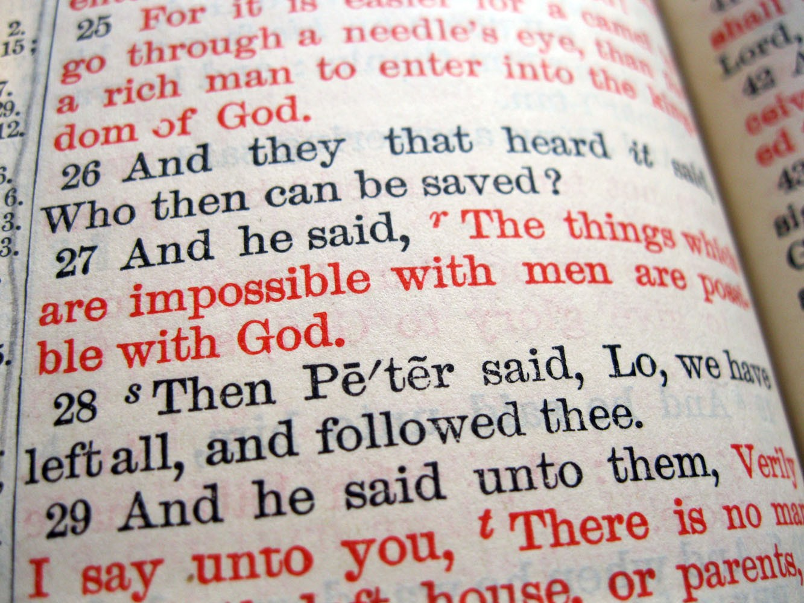
Notes:
So, it’s not just about the words in red is it? Some people I’ve studied w/have stated that while they believe all the bible is important, they will only listen to the “words in red”, those things specifically spoken by Jesus in person. But here we learn that Jesus always intended to send men who would act as His ambassadors, and when He speaks of this intention, are those words not in red? You can’t take all the words in red except for the words in red that say He would send people in His name; that would be inconsistent. So, in our quest to determine the inspiration of the New Testament, we have to consider the words of Jesus’ Apostles.
But this leads to another issue. How do we know who the true Apostles were? How do we know that what these 12 men taught were the actual words of God as opposed to their own ideas and fantasies? Jesus may have come here to do the Father’s will, but He was sinless, He was perfect. The Apostles were far from perfect men. They made all kinds of mistakes, fighting amongst one another over who would be the greatest, showing a great lack of understanding in many of the things Jesus taught during His earthly ministry. In fact, if I’m a person living in the first century, and I’m hungry for some attention, I may be tempted to claim status as Apostle, though I’m not.
So, there’s a two-fold problem with Jesus sending out these specific men: 1) figuring out who the true Apostles were as opposed to pretenders claiming to be Apostles. 2) Ensuring that when the actual Apostles spoke, it was truly God’s word, and not their own words.

Slide 9
The Standard of Authority
Jesus’ Authority
Apostles’ Authority
Apostles’ Power
John 14:26 – “But the Helper, the Holy Spirit, whom the Father will send in My name, He will teach you all things, and bring to your remembrance all that I said to you.”
John 16:12-15 – “I have many more things to say to you, but you cannot bear them now. But when He, the Spirit of truth, comes, He will guide you into all the truth; for He will not speak on His own initiative, but whatever He hears, He will speak; and He will disclose to you what is to come. He will glorify Me, for He will take of Mine and will disclose it to you. All things that the Father has are Mine; therefore I said that He takes of Mine and will disclose it to you.”
Notes:
Well, there are an infinite number of wonderful attributes about Jesus Christ, and one of those things is that He is able to deal with issues like this long before they even became issues in our minds (John 14). Jesus is preparing the Apostles for His imminent death. Imagine being personally commissioned by the Creator of heaven and earth to go preach His gospel. Can you feel the weight? I’d be thinking, “How am I going to do that? Me? I’m nobody special. Why would people listen to me? I don’t have the wisdom or the knowledge to do this. I’ve been a failure and I’m fearful. And there are orators out there who could likely wipe the floor with me”. (CLICK) Well in John 14, Jesus tells the Apostles that He is going to give them help. And not just any help, but help with a capital H.
John 14:26; (CLICK) John 16:12-15 – So, we mentioned two issues. How do we know who the Apostles really are and how do we know that what they say is actually from God? (CLICK) And the answer is that they had the Holy Spirit Himself guiding them, helping them, and empowering them.

Slide 10
The Standard of Authority
Jesus’ Authority
Apostles’ Authority
Apostles’ Power
Mark 16:20 – “And they went out and preached everywhere, while the Lord worked with them, and confirmed the word by the signs that followed.”
Heb 2:4 – “God also testifying with them, both by signs and wonders and by various miracles and by gifts of the Holy Spirit according to His own will.”
Notes:
The Holy Spirit didn’t just give them the words to say, but the power to back up what they said (Mark 16). And in doing so, the Holy Spirit became not only a Helper, but God’s witness that He Himself was with the Apostles. (CLICK) Mark 16:20 – Signs, miraculous healings, the ability to speak in languages they’d never learned, the ability to transfer spiritual gifts to others. There was a reason for giving them this power. (CLICK) Heb 2:4.
Back to our two questions – question #1 was, “How could they tell the difference between a real apostle and a false apostle?” Well, the real apostle could perform an actual miracle; a false apostle could not. Question #2 was, “How do we know whether what they taught was actually from God?” Because if after they taught something, they then backed it up w/a miracle, that was God’s way of witnessing with them and confirming the truth of what was spoken. Through the Holy Spirit, God is saying, “Here is my stamp of approval on what you just heard by the very fact I am allowing a miracle to accompany this teaching”. This was a bullet proof plan from Jesus Christ.
COMMENTS

Slide 11
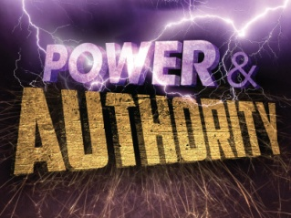
Notes:
So that should solve every issue of doctrinal disagreement, shouldn’t it? Because now I can take a doctrinal disagreement that I have with another believer directly to the twelve apostles and ask them to mediate. Except now we’ve run into the same issue we ran in w/asking Jesus in person. The Apostles are no longer here. So, while Jesus certainly set a plan in motion, to delegate authority to those He sent, what did the Apostles do? Did they have a plan? What did they set in motion so that after their deaths, we could be sure we have the teaching of God Himself, His inspired word?

Slide 12
The Standard of Authority
Jesus’ Authority
Apostles’ Authority
Apostles’ Power
The Written Word
2 Pet 1:12-14 – “Therefore, I will always be ready to remind you of these things, even though you already know them, and have been established in the truth which is present with you. I consider it right, as long as I am in this earthly dwelling, to stir you up by way of reminder, knowing that the laying aside of my earthly dwelling is imminent, as also our Lord Jesus Christ has made clear to me.
2 Pet 1:15 – “And I will also be diligent that at any time after my departure you will be able to call these things to mind.”
Notes:
(2 Pet 1) In his second epistle, Peter reveals that his death is coming soon. 2 Pet 1:12-14 – So, he’s telling them things he’s previously told them, reminding them, because Jesus has made it clear to him that his death was imminent. And he’s concerned that they have access to His teaching when this happens (CLICK) – 2 Pet 1:15 – How is Peter being diligent to ensure they can call things to mind when he isn’t there to remind them in person? Because he wrote the very letter that we’re reading from. (CLICK) This is what the Apostles did. They wrote everything down that we need to know to be what God would have us to be.

Slide 13
The Standard of Authority
Jesus’ Authority
Apostles’ Authority
Apostles’ Power
The Written Word
2 Pet 3:1-2 – “This is now, beloved, the second letter I am writing to you in which I am stirring up your sincere mind by way of reminder, that you should remember the words spoken beforehand by the holy prophets and the commandment of the Lord and Savior spoken by your apostles.”
2 Pet 3:15-16 – “and regard the patience of our Lord as salvation; just as also our beloved brother Paul, according to the wisdom given him, wrote to you, as also in all his letters, speaking in them of these things, in which are some things hard to understand, which the untaught and unstable distort, as they do also the rest of the Scriptures, to their own destruction.”
Notes:
2 Pet 3:1-2 – He’s not telling them anything he hadn’t spoken to them before, he’s merely writing it down so it can be preserved for us, so we can call these things to mind, as we’ve been doing tonight, 2000 years removed from its original writing.
(CLICK) 2 Pet 3:15-16 – So not only were the apostles and prophets urgently writing these things down, but Peter tells us that Paul is doing the same thing.

Slide 14
The Standard of Authority
Jesus’ Authority
Apostles’ Authority
Apostles’ Power
The Written Word
Eph 3:3-5 – “by revelation there was made known to me the mystery, as I wrote before in brief. By referring to this, when you read you can understand my insight into the mystery of Christ, which in other generations was not made known to the sons of men, as it has now been revealed to His holy apostles and prophets in the Spirit.”
Notes:
Paul claimed the same in Eph 3:3-5 – And now, all these letters/writings have been compiled together into one volume, the bible, so that we can have the same words spoken to us as were spoken to the 1st century Christians. Think about it – all we need to do, to know the very will of Almighty God Himself, is to turn to the words of the Apostles and prophets and read what they wrote. All we need to do is rightly divide the instruction, observe the patterns they’ve set for us in regards to Christian living, worship, devotion to God, devotion to man, and strive to mimic what we see in these writings as much as they mimic the Lord. And if all believers would do this, unity would be possible. We don’t have to approach Jesus or the Apostles in person if all of us would strive to approach their words together, with reverence, and patience, and humility, and diligence.
COMMENTS

Slide 15
The Standard of Authority
Jesus’ Authority
Apostles’ Authority
Apostles’ Power
The Written Word
A Complete Word
Jude 3 – “Beloved, while I was making every effort to write you about our common salvation, I felt the necessity to write to you appealing that you contend earnestly for the faith which was once for all handed down to the saints.”
2 Pet 1:3 – “seeing that His divine power has granted to us everything pertaining to life and godliness, through the true knowledge of Him who called us by His own glory and excellence.”
Notes:
And finally (Jude 3), we can’t end a discussion on the NT’s inspiration without noting how the Apostles viewed the permanence and unchangeableness of this written word.
Jude 3 – “Once for all” literally means “once time for all time”, suggesting that there isn’t going to be any future revelation given and neither does there need to be. The writings of the NT, as delivered by the apostles and prophets, contain everything we need to know to be pleasing to God. It is not our job to look for further revelation, but to “contend earnestly for the faith which was once for all delivered to the saints”.
(CLICK) 2 Pet 1:3 – So, if someone from one of the latter-day revelation movements approaches me and suggests that the bible does not contain the full word of God, we need to point them to these verses. If a church or clergy claims to have authority that usurps the authority of the written word, we need to point them to these verses. If a pastor, a reverend, a family member, or friend, teaches us something contradictory to the written word, ask them by what authority they contradict it? Did Jesus send them as He sent the Apostles? And if so, are they able to perform miracles to confirm the word as the Apostles did? If not, why should we believe them?

Slide 16
The Standard of Authority
Jesus’ Authority
Apostles’ Authority
Apostles’ Power
The Written Word
A Complete Word
Gal 1:8 – “But even if we, or an angel from heaven, should preach to you a gospel contrary to what we have preached to you, he is to be accursed!”
2 Tim 3:16-17 – “¹⁶All Scripture is breathed out by God and profitable for teaching, for reproof, for correction, and for training in righteousness, ¹⁷that the man of God may be complete, equipped for every good work.”
Notes:
Gal 1:8 – The truth is, if the teaching doesn’t come from God’s word, it is not from God. It doesn’t matter who says, how well they say it, whether they are published authors, carry degrees from religious institutions, or whether they dress like priests. God designed His word to be the final say so in matters of Christian doctrines and this word will stand when the world is on fire.
How should we view scripture? (CLICK) – 2 Tim 3:16-17. Everything God wants me to both be and do is right here in the bible. I need to read it, study, and learn to apply it. This will complete me and equip me for every good work.

Slide 17
CURRICULUM
Sep 06: Introduction
Sep 13: Its Nature
Sep 20: Its Standard of Authority
Sep 27: False Standards (1)
Oct 04: False Standards (2)
Oct 11: Applying the Standard (1)
Oct 18: Applying the Standard (2)
Oct 25: Local Organization (1)
Nov 01: Local Organization (2)
Nov 08: Local Organization (3)
Nov 15: Nature of Worship
Nov 22: ***No Class***
Nov 29: Elements of Worship
Dec 06: Its Work of Edification
Dec 13: Its Work of Evangelism
Dec 20: Its Work of Benevolence
Dec 27: ***No Class***
Jan 03: ***No Class***
Notes:
However, there are things that compete w/God’s word, false standards of authority that try to take its place. We’ll discuss these in our next class.

