Slide 2
CURRICULUM
Sep 06: Introduction
Sep 13: Its Nature
Sep 20: Its Standard of Authority
Sep 27: False Standards (1)
Oct 04: False Standards (2))
Oct 11: Applying the Standard (1)
Oct 18: Applying the Standard (2)
Oct 25: Local Organization (1)
Nov 01: Local Organization (2)
Nov 08: Local Organization (3)
Nov 15: Nature of Worship
Nov 22: ***No Class***
Nov 29: Elements of Worship
Dec 06: Its Work of Edification
Dec 13: Its Work of Evangelism
Dec 20: Its Work of Benevolence
Dec 27: ***No Class***
Jan 03: ***No Class***
Notes:
(1 Pet 2) Last week, we began a series on the NT church in which we talked about what the church is “not”. We tried clear up misunderstandings about the church while also demonstrating just how much Jesus Christ esteems the church that He built and purchased w/His own blood.
Tonight, we’re going to begin talking about what the church actually “is”. When we think about the office of the eldership, we recognize that there are also other words in the NT used to describe that office, such as overseer and shepherd. And the point is not that they are separate offices, but that they are different ways of looking at the same office.
This is also true of the church. The word “church” is just one way to talk about God’s saved people. But by looking at the other terms used, we can begin to expand our horizons.
PRAYER

Slide 3
“Ekklesia”
Ek
klesia
called
= “called”
out of
= “out of”
“who has
you
darkness
into His marvelous light” (1 Pet 2:9c )
Notes:
If you were to look up the word “church” in a standard English dictionary, how do you suppose they’d define it? “A building”. In fact, Webster’s very first definition = “a building for public and especially Christian worship”. That is not how the bible defines “church”.
(CLICK) – The word “church” comes from the Greek word “ekklesia”. This is a compound word. (CLICK) – It is made up the words “ek”, which means “out of” and (CLICK) the word “kaleo” which means “called”. So, the literal meaning of the word “church” is (CLICK) people that are “called out of” something.
Who are these people and what have they been “called out of?” (CLICK) – 1 Pet 2:9 – “But you are a chosen race, a royal priesthood, a holy nation, a people for God’s own possession, so that you may proclaim the excellencies of Him who has called (CLICK) you out of (CLICK) darkness into His marvelous light;”
“Called” who? (CLICK) “You”. That’s you and me. It’s us. The church is not a building, it is people. It is people who have been “called out of”.

Slide 4
Nature of the Church
Church
1 Pet 2:9 – “But you are a chosen race, a royal priesthood, a holy nation, a people For God’s own possession, so that you may proclaim the excellencies of Him who has called you
2 Thes 2:14 – “It was for this He called you through our gospel, that you may gain the glory of our Lord Jesus Christ.”
out of darkness into His marvelous light;
Notes:
“Called out of” what? (CLICK) – “out of darkness into His marvelous light”. The term “darkness” here refers to “sin, error, misery, spiritual death”. So, Peter is telling these Christians that they’ve been called out of the domain of the devil. But what have they been called into? The antithesis of darkness: “light”. But not just any light, rather “marvelous” light. What makes it marvelous? Because it is “His” marvelous light. We were trapped in darkness and then the story of Jesus Christ was appealing enough that we’d be drawn out of that darkness of sin and into a fellowship w/both Him and others. And what is the term to describe people who have done this? They are called His “church”.
And how does this calling take place? The scriptures reveal this as well (CLICK) – 2 Thes 2:14 – “It was for this He called you through our gospel, that you may gain the glory of our Lord Jesus Christ.”
The gospel of Christ, or the glad tidings, is the good news concerning the Son of God – the fact that He died, was buried, and was raised on the third day; the fact that He has given us commands by which we can be saved. We’re called by this gospel out of this dark world and into a relationship w/the Light “of” the world, Jesus Christ, and then we become the people of God.
So, when we talk about the church, we are talking exclusively about Christians; we are talking about the same thing Peter and Paul talked about when they said we were called out of darkness. The church is not a building; the church is composed of the saved.

Slide 5
Nature of the Church
Church
Kingdom
Col 1:13 – “For He rescued us from the domain of darkness, and transferred us to the kingdom of His beloved Son”
kingdom
Notes:
Now, there is a similar idea to 1 Pet 2:9 that is taught in Col 1:13 – “For He rescued us from the domain of darkness, and transferred us to the kingdom of His beloved Son”.
Same idea, but instead of using the word “church”, (CLICK) Paul uses the word “kingdom”. In 1 Pet 2:9, God’s people were referred to as being “called out of darkness and into His marvelous light”. Here, they are “rescued” from the domain of darkness and “transferred” to the kingdom of His beloved Son. “transferred/translated” carries w/it the idea of removing a people from one country to another. So, we’ve been taken out of the domain and reign of Satan, translated/moved to another, and the term he uses to describe it here is the term “kingdom”.
Now, the idea of a “kingdom” is a different way to look at God’s saved people. There are several facets. A kingdom has a “king”, which in this case is Jesus Christ. It has subjects, which is us. And a kingdom has a law, which is our NT, something we’ll be looking at in more detail next week. It’s the same thing as the “church”, its just that the word “kingdom” brings out a different nature of the church.

Slide 6
Nature of the Church
Church
Kingdom
Col 1:13 – “For He rescued us from the domain of darkness, and transferred us to the kingdom of His beloved Son”
Rev 1:9 – “I, John, your brother and fellow partaker in the tribulation and kingdom and perseverance which are in Jesus, was on the island called Patmos because of the word of God and the testimony of Jesus.”
kingdom
Kingdom
Power
Holy Spirit
Pentecost
Mark 9:1
Acts 1:8
Acts 2:1-4
Notes:
Now, there is some misunderstanding surrounding this concept of the “kingdom”, the predominant confusion being that the kingdom is only something that will come at a future date in heaven rather than being something we experience in the present. Mark 9:1 – “And Jesus was saying to them, ‘Truly I say to you, there are some of those who are standing here who will not taste death until they see the kingdom of God after it has come with power.’” – Now, either we have some really old people walking this earth right now, or the kingdom has already come. And what would it come with? (CLICK) “Power” – Acts 1:8 – “And Jesus was saying to them, ‘Truly I say to you, there are some of those who are standing here who will not taste death until they see the kingdom of God after it has come with power.’” (CLICK) So, the “power” Jesus was referring to was the “Holy Spirit”. When did He come? – Acts 2:1-4 – “When the day of Pentecost had come, they were all together in one place. And suddenly there came from heaven a noise like a violent rushing wind, and it filled the whole house where they were sitting. And there appeared to them tongues as of fire distributing themselves, and they rested on each one of them. And they were all filled with the Holy Spirit and began to speak with other tongues, as the Spirit was giving them utterance.” When did the Holy Spirit come? (CLICK) On Pentecost, the first Pentecost after Jesus’ crucifixion, 50 days to be exact. And what else began on Pentecost? The church (Acts 2:41). So, if the kingdom was to come w/power, and the power was the Holy Spirit, and the Holy Spirit came on Pentecost, than that means (CLICK) the kingdom came on Pentecost.
(CLICK) The Apostle John recognized he was already in the kingdom – Rev 1:9 – “I, John, your brother and fellow partaker in the tribulation and kingdom and perseverance which are in Jesus, was on the island called Patmos because of the word of God and the testimony of Jesus.” John speaks of himself currently being in the kingdom along w/fellow partakers. So, having obeyed the gospel, having a relationship with Christ as one of His children, we are presently in His kingdom as subjects under His authoritative headship. We have a new law and we belong to a different community where we enjoy fellowship with other citizens of that kingdom.
QUESTIONS/COMMENTS

Slide 7
Nature of the Church
Church
Kingdom
Body
Eph 1:22-23 – “²²And He put all things in subjection under His feet, and gave Him as head over all things to the church, ²³which is His body, the fullness of Him who fills all in all.”
Col 2:18-19 – “¹⁸Let no one keep defrauding you of your prize by delighting in self-abasement and the worship of the angels, taking his stand on visions he has seen, inflated without cause by his fleshly mind, ¹⁹and not holding fast to the head, from whom the entire body, being supplied and held together by the joints and ligaments, grows with a growth which is from God.”
body,
Notes:
Eph 1:22-23 – “And He put all things in subjection under His feet, and gave Him as head over all things to the church, which is His body, the fullness of Him who fills all in all.”
The next term is explicitly identified in this text as another way to see the church (CLICK) – Jesus’ body. This is a term in which we’re beginning to see the idea of a “relationship” we enjoy w/Jesus Christ and w/one another.
First, Christ is the head from which we, the body, receive the nourishment we need (CLICK) – Col 2:18-19 – “Let no one keep defrauding you of your prize by delighting in self-abasement and the worship of the angels, taking his stand on visions he has seen, inflated without cause by his fleshly mind, and not holding fast to the head, from whom the entire body, being supplied and held together by the joints and ligaments, grows with a growth which is from God.” – so, as our head, Jesus supplies us members of His body what we cannot provide ourselves, so that we can grow to be what He would have us to be.

Slide 8
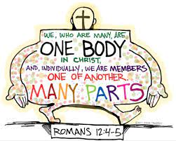
Nature of the Church
Church
Kingdom
Body
Rom 12:4-5 – “⁴For just as we have many members in one body and all the members do not have the same function, ⁵so we, who are many, are one body in Christ, and individually members one of another.”
Eph 4:15b-16 – “we are to grow up in all aspects into Him who is the head, even Christ, ¹⁶from whom the whole body, being fitted and held together by what every joint supplies, according to the proper working of each individual part, causes the growth of the body for the building up of itself in love.”
Notes:
And then, as members of Christ’s body, we are also members of one another – Rom 12:4-5 – “For just as we have many members in one body and all the members do not have the same function, so we, who are many, are one body in Christ, and individually members one of another.” So, the relationship doesn’t end w/just Christ being the head and we the members, but as individual Christians we are to have a relationship w/one another because as the body of Christ, we are members of one another.
What this means is that as His body, we have the responsibility to mutually edify one another, to build up one another. (CLICK) – Eph 4:15b-16 – “we are to grow up in all aspects into Him who is the head, even Christ, from whom the whole body, being fitted and held together by what every joint supplies, according to the proper working of each individual part, causes the growth of the body for the building up of itself in love.”
Meaning, as Christ the head supplies us, we take what He supplies and supply one another. And when we start getting into the organization, worship, and work of the church, this is when the concept of the “body of Christ” will really start to come out.

Slide 9
Nature of the Church
Church
Kingdom
Body
Household
1 Tim 3:15 – “but in case I am delayed, I write so that you will know how one ought to conduct himself in the household of God, which is the church of the living God, the pillar and support of the truth.”
Gal 4:4-6 – “⁴But when the fullness of the time came, God sent forth His Son, born of a woman, born under the Law, ⁵so that He might redeem those who were under the Law, that we might receive the adoption as sons. ⁶Because you are sons, God has sent forth the Spirit of His Son into our hearts, crying, ‘Abba! Father!’”
household
Notes:
1 Tim 3:15 – “but in case I am delayed, I write so that you will know how one ought to conduct himself in the household of God, which is the church of the living God, the pillar and support of the truth.”
What is the church also referred to as? (CLICK) – a household. This metaphor depicts the family environment of the church. The church of Jesus Christ is designed by God to be a family. What do you see in families? Fathers, mothers, brothers, sisters, sons, and daughters. Let’s identify some of them.
God is the Father and Christ is the Son. But through Christ, we also become sons of God (CLICK) – Gal 4:4-6 – “But when the fullness of the time came, God sent forth His Son, born of a woman, born under the Law, so that He might redeem those who were under the Law, that we might receive the adoption as sons. Because you are sons, God has sent forth the Spirit of His Son into our hearts, crying, ‘Abba! Father!’”
What a blessing, to be adopted children in God’s royal family. We’re not slaves, we’re sons and daughters. And as such, we can appeal to God as a child would appeal to His father.

Slide 10
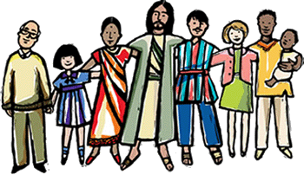
Nature of the Church
Church
Kingdom
Body
Household
Matt 12:46-50 – “⁴⁶While He was still speaking to the crowds, behold, His mother and brothers were standing outside, seeking to speak to Him. ⁴⁷Someone said to Him, ‘Behold, Your mother and Your brothers are standing outside seeking to speak to You.’ ⁴⁸But Jesus answered the one who was telling Him and said, ‘Who is My mother and who are My brothers?’ ⁴⁹And stretching out His hand toward His disciples, He said, ‘Behold My mother and My brothers! ⁵⁰For whoever does the will of My Father who is in heaven, he is My brother and sister and mother.’”
Notes:
What is it about us that allows God to look at former sinners as actual family? Mark 12:46-50 – “While He was still speaking to the crowds, behold, His mother and brothers were standing outside, seeking to speak to Him. Someone said to Him, ‘Behold, Your mother and Your brothers are standing outside seeking to speak to You.’ But Jesus answered the one who was telling Him and said, ‘Who is My mother and who are My brothers?’ And stretching out His hand toward His disciples, He said, ‘Behold My mother and My brothers! For whoever does the will of My Father who is in heaven, he is My brother and sister and mother.’”
What an amazing truth to consider, that to the degree that we do God’s will, Jesus considers us brothers. The very ones whose sins put Him on the cross, when we respond to the gospel call, Jesus, our older brother, considers us His siblings. Family is tight, which is why we use phrases like, “blood is thicker than water”. But in the church, we are all connect through the blood of Christ.

Slide 11
Nature of the Church
Church
Kingdom
Body
Household
Mark 10:28-30 – “²⁸Peter began to say to Him, ‘Behold, we have left everything and followed You.’ ²⁹Jesus said, ‘Truly I say to you, there is no one who has left house or brothers or sisters or mother or father or children or farms, for My sake and for the gospel’s sake, ³⁰but that he will receive a hundred times as much now in the present age, houses and brothers and sisters and mothers and children and farms, along with persecutions; and in the age to come, eternal life.’”
1 Tim 5:1-2 – “¹Do not sharply rebuke an older man, but rather appeal to him as a father, to the younger men as brothers, ²the older women as mothers, and the younger women as sisters, in all purity.”
Gal 6:10 – “while we have opportunity, let us do good to all people, and especially to those who are of the household of the faith.”
Notes:
You know who relates best to this metaphor? It’s the Christians in the world who don’t have physical family. Whether that separation is due to death, or neglect, or persecution, or Christian discipline, that the church is a family brings on full meaning for people such as that – Mark 10:28-30 – “Peter began to say to Him, ‘Behold, we have left everything and followed You.’ Jesus said, ‘Truly I say to you, there is no one who has left house or brothers or sisters or mother or father or children or farms, for My sake and for the gospel’s sake, but that he will receive a hundred times as much now in the present age, houses and brothers and sisters and mothers and children and farms, along with persecutions; and in the age to come, eternal life.’”
And as a family, Christians are to treat one another accordingly (CLICK) – 1 Tim 5:1-2 – “Do not sharply rebuke an older man, but rather appeal to him as a father, to the younger men as brothers, the older women as mothers, and the younger women as sisters, in all purity.”
This is by far the most sentimental way in which God wants us to see His church. We stand up for family, we defend family, we can be partial to family. But there is no family on this earth that demands a stricter, firmer loyalty than of faithful brothers and sisters in Jesus Christ (CLICK) – Gal 6:10 – “while we have opportunity, let us do good to all people, and especially to those who are of the household of the faith.”
COMMENTS/QUESTIONS

Slide 12
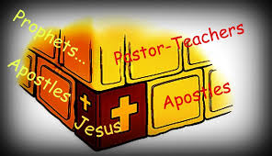
Nature of the Church
Church
Kingdom
Body
Household
Temple
Eph 2:19-22 – “¹⁹So then you are no longer strangers and aliens, but you are fellow citizens with the saints, and are of God’s household, ²⁰having been built on the foundation of the apostles and prophets, Christ Jesus Himself being the corner stone, ²¹in whom the whole building, being fitted together, is growing into a holy temple in the Lord, ²²in whom you also are being built together into a dwelling of God in the Spirit.”
1 Pet 2:5 – “you also, as living stones, are being built up as a spiritual house for a holy priesthood, to offer up spiritual sacrifices acceptable to God through Jesus Christ.”
temple
Notes:
Eph 2:19-22 – “So then you are no longer strangers and aliens, but you are fellow citizens with the saints, and are of God’s household, having been built on the foundation of the apostles and prophets, Christ Jesus Himself being the corner stone, in whom the whole building, being fitted together, is growing into a holy temple in the Lord, in whom you also are being built together into a dwelling of God in the Spirit.”
Now, vs. 19 uses the term “household” like we saw in 1 Tim 3:15. But specifically, this passage is referring to the church as God’s “temple” – (CLICK) – In the OT, the physical temple was built by the Jews at God’s command so that He could have a place to dwell among them. This temple was a magnificent, beautiful structure built with the most valuable metals contained in all the earth. But even as Solomon was dedicating the temple, he admitted that God does not dwell in temples made w/hands. Paul said the same in Acts 17. According to vs. 22, here, what temple does God dwell in? Us. This should not surprise us since we have already seen from Eph 1:23 that the church represents the “fullness” of Christ. (CLICK) – And 1 Pet 2:5, notice what the precious stones are in God’s temple? – 1 Pet 2:5 – “you also, as living stones, are being built up as a spiritual house for a holy priesthood, to offer up spiritual sacrifices acceptable to God through Jesus Christ.”

Slide 13
Nature of the Church
Church
Kingdom
Body
Household
Temple
1 Cor 3:16-17 – “¹⁶Do you not know that you are a temple of God and that the Spirit of God dwells in you? ¹⁷If any man destroys the temple of God, God will destroy him, for the temple of God is holy, and that is what you are.”
2 Cor 6:16-7:1 – “¹⁶Or what agreement has the temple of God with idols? For we are the temple of the living God; just as God said, ‘I will dwell in them and walk among them; And I will be their God, and they shall be My people. ¹⁷Therefore, come out from their midst and be separate,’ says the Lord. ‘And do not touch what is unclean’; And I will welcome you. ¹⁸And I will be a father to you, and you shall be sons and daughters to Me,’ says the Lord Almighty. ¹Therefore, having these promises, beloved, let us cleanse ourselves from all defilement of flesh and spirit, perfecting holiness in the fear of God.”
Notes:
One implication of the church being a holy temple is that God will watch over us and protect us – 1 Cor 3:16-17 – “Do you not know that you are a temple of God and that the Spirit of God dwells in you? If any man destroys the temple of God, God will destroy him, for the temple of God is holy, and that is what you are.”
(CLICK) Another implication of the church being a holy temple is that we must stay pure so that God will continue to dwell within us – 2 Cor 6:16-7:1 – “Or what agreement has the temple of God with idols? For we are the temple of the living God; just as God said, ‘I will dwell in them and walk among them; And I will be their God, and they shall be My people. Therefore, come out from their midst and be separate,’ says the Lord. ‘And do not touch what is unclean; And I will welcome you. And I will be a father to you, and you shall be sons and daughters to Me,’ says the Lord Almighty. Therefore, having these promises, beloved, let us cleanse ourselves from all defilement of flesh and spirit, perfecting holiness in the fear of God.”

Slide 14
Nature of the Church
Church
Kingdom
Body
Household
Temple
Vineyard
John 15:1-5 – “¹I am the true vine, and My Father is the vinedresser. ²Every branch in Me that does not bear fruit, He takes away; and every branch that bears fruit, He prunes it so that it may bear more fruit. ³You are already clean because of the word which I have spoken to you. ⁴Abide in Me, and I in you. As the branch cannot bear fruit of itself unless it abides in the vine, so neither can you unless you abide in Me. ⁵I am the vine, you are the branches; he who abides in Me and I in him, he bears much fruit, for apart from Me you can do nothing.”
Notes:
John 15:1-5 – “I am the true vine, and My Father is the vinedresser. Every branch in Me that does not bear fruit, He takes away; and every branch that bears fruit, He prunes it so that it may bear more fruit. You are already clean because of the word which I have spoken to you. Abide in Me, and I in you. As the branch cannot bear fruit of itself unless it abides in the vine, so neither can you unless you abide in Me. I am the vine, you are the branches; he who abides in Me and I in him, he bears much fruit, for apart from Me you can do nothing.”
As the vineyard, we are connected to Christ in that we receive our ability to bear fruit directly from Him directly, the vine, much like how in as a body, we receive what the head supplies us. But in this metaphor of the church, we are branches that are required to grow and to bear fruit in the world. To bear fruit, Christ prunes us so that we will grow in the right direction. Bu if after pruning us, we still don’t bear fruit, we are told in vs. 2 that Christ will cut us off. This means every Christian will experience discipline to a degree, something all children should expect from a father who loves them.

Slide 15
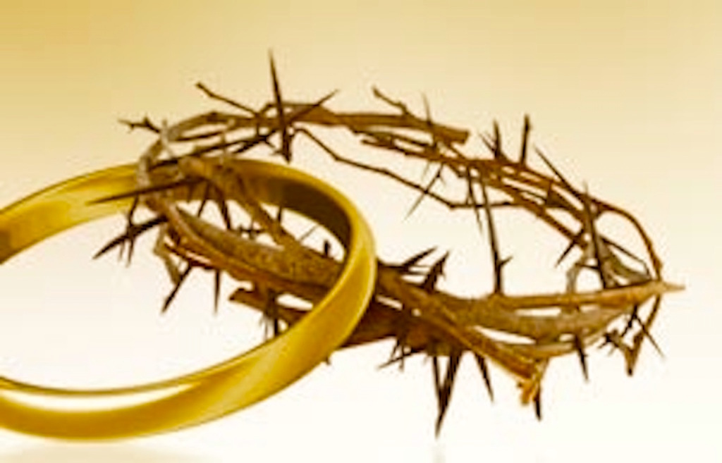
Nature of the Church
Church
Kingdom
Body
Household
Temple
Vineyard
Bride
2 Cor 11:2 – “For I am jealous for you with a godly jealousy; for I betrothed you to one husband, so that to Christ I might present you as a pure virgin.”
Rev 19:7-8 – “‘Let us rejoice and be glad and give the glory to Him, for the marriage of the Lamb has come and His bride has made herself ready.” ⁸It was given to her to clothe herself in fine linen, bright and clean; for the fine linen is the righteous acts of the saints.”
Notes:
2 Cor 11:2 – “For I am jealous for you with a godly jealousy; for I betrothed you to one husband, so that to Christ I might present you as a pure virgin.”
What does this sound like? That we are the bride of Christ. Christ nourishes and cherishes His church by seeing to it that it has everything it needs to sustain itself. It is an intimate relationship that we have with Christ. There is no other earthly relationship that should be as intimate as that of a husband and wife. It is to this degree and more that our relationship should be with Christ. And it is a relationship that extends on through eternity! (CLICK) – Rev 19:7-8 – “‘Let us rejoice and be glad and give the glory to Him, for the marriage of the Lamb has come and His bride has made herself ready.” It was given to her to clothe herself in fine linen, bright and clean; for the fine linen is the righteous acts of the saints.”

Slide 16
CURRICULUM
Sep 06: Introduction
Sep 13: Its Nature
Sep 20: Its Standard of Authority
Sep 27: False Standards (1)
Oct 04: False Standards (2))
Oct 11: Applying the Standard (1)
Oct 18: Applying the Standard (2)
Oct 25: Local Organization (1)
Nov 01: Local Organization (2)
Nov 08: Local Organization (3)
Nov 15: Nature of Worship
Nov 22: ***No Class***
Nov 29: Elements of Worship
Dec 06: Its Work of Edification
Dec 13: Its Work of Evangelism
Dec 20: Its Work of Benevolence
Dec 27: ***No Class***
Jan 03: ***No Class***

