Slide 1
Notes:
The Shulamite is w/Solomon in Jerusalem – he’s making his last pitch to convince her to become one of his wives. He’s promised her she will be preferred above the other wives and concubines, though the evidence suggests this was merely a line. But he is obviously enraptured w/her, confused by the fact that she’s not showing the kind of interest in him that most women do, and he’s starting to lose his composure by repeating some of the same pick-up lines he’d used w/her before.
It’s not working on her because she’s decided on the Shepherd. And as we studied her description of him in chapter 5, we learned that he was a choice specimen, a man among men, so imposing that even the daughters of Jerusalem were like, “Can we have him, too?” (6:1). Her response? “Hands off, he’s all mine.”
As we pick up in the 2nd half of 6:9, Solomon is going to try to convince her that he’s not the only one in the palace who thinks she hung the moon. The maidens, queens, and concubines think the same, and they’re going to make their pitch.
PRAYER5

Slide 2
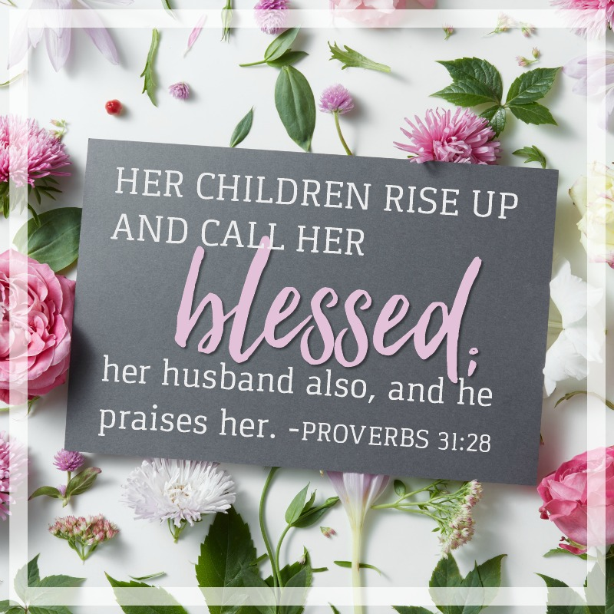
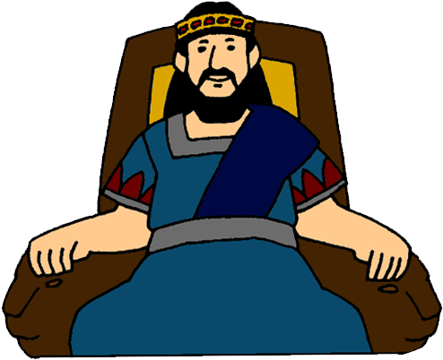
“The maidens saw her and called her blessed, the queens and the concubines also, and they praised her, saying, ¹⁰‘Who is this that grows like the dawn, as beautiful as the full moon, as pure as the sun, as awesome as an army with banners?’” (Song 6:9b-10)
The Women Chime In
One of a kind
Enticing appearance
Transcendental beauty
Confident
Notes:
So, Solomon is still in the midst of his 3rd and final attempt to charm her, and in order to sweeten the deal, he extends his flattery to what the maidens, queens, and concubines think about her – Song 6:9b. Those phrases “call her blessed” and “praised her” (CLICK) are phrases that only appear in Prov 31:28 – so this is the compliment of all compliments you could give a woman, and they believe she’ll have no problem adjusting to palace life. (CLICK) They’re saying she’s truly “one of a kind”.
Song 6:10a – With the first light of dawn, there’s a sense of anticipation. And so, they’re describing her as an epiphany, something rising up from the background (CLICK) that is captivating to behold. And if her initial appearing is so enticing, what will her full manifestation reveal?
Song 6:10b – The sun and moon are so ethereal, they were worshipped. The idea is that her beauty is of a (CLICK) transcendental nature that rivals that of the heavenly bodies. They’re really putting her on a pedestal, but this is dangerous game in dating because if we put them too much on a pedestal, we’re doomed to look at them from afar.
Song 6:10c – banners were carried for distinction so that an army could be easily identified, for discipline so that an army could be organized in its work, for activity as a sign indicating something was about to happen, or a sign of confidence that they were willing to engage the enemy.
Point: even Solomon’s harem think she is out of this world. (CLICK) She is a confident woman that can withstand the wooing of King Solomon himself, something unheard of.

Slide 3
“¹¹I went down to the orchard of nut trees to see the blossoms of the valley, to see whether the vine had budded or the pomegranates had bloomed. ¹²Before I was aware, my soul set me over the chariots of my noble people.” (Song 6:11-12)
Notes:
Now, there is a break between vs. 10 and 11. (CLICK) I think it’s possible that they are questioning what she’s doing there if she’s not ultimately interested in being Solomon’s next wife. And so, she tells them:
Song 6:11-12 – The idea is, “Before I was aware of what was happening, I just got caught up in it all; it just kind of happened”. Best guess – King Solomon is visiting the area near the Shulamite’s village to inspect his vineyards and orchards which he rents to farmers. Solomon’s nobles likely spotted her and thought, “Solomon would flip over her”, then approached her, and asked, “Would you like to meet the king?”. Given the evidence that she was working through some things w/the Shepherd, (CLICK) it seems she’s saying she just got caught up in it all, almost like a “meet-cute”.

Slide 4
You Never Know When You’ll Meet “The One”
Notes:
PRACTICAL APPLICATION – Now, this meet-cute would not materialize, as we’re seeing. But for our single folk, it’s important you understand that you never know when you’re going to meet “the one”.
(CLICK) This is true about Jesus’ 2nd coming, isn’t it? In Luke 12:40, we’re told – “You too, be ready; for the Son of Man is coming at an hour that you do not expect.” We, the bride, don’t know when the Bridegroom will come. The same thing is true of our earthly bride/groom – we don’t know when we’ll meet them for the first time. So, we must be at our best always.
Example – I first met Jenny in Sept 2004 when I was on my way back from visiting another girl up in Kentucky who I had just converted, and was called a few hours beforehand to preach at the church she attended that Sunday evening. I didn’t know who she was, just saw her for the first time from the pulpit. You just never know.
(CLICK) This doesn’t mean to go “peacocking” – don’t over do it. Just carry yourself well, w/dignity, w/confidence, w/self-respect, w/grace.
COMMENTS

Slide 5
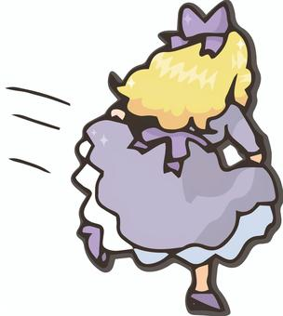
“Why should you gaze at the Shulammite, as at the dance of the two companies?” (Song 6:13b)
“¹³Come back, come back, O Shulammite; come back, come back, that we may gaze at you!” (Song 6:13a)
Notes:
Now, the Shulamite has likely said (CLICK), “I’ve made up my mind – I’m done w/this”, prompting the ladies to jump in w/the king to apply some pressure to get her to stay – Song 6:13a – They think she is a specimen to look at and don’t want her to leave. “Solomon isn’t the only one who likes to look at you!”
(CLICK) But she replies – Song 6:13b – Shulamite’s response (tongue in cheek) – “two companies” = Mahanaim, the place where Jacob was visited by angels (Jacob’s camp and God’s camp). Scholars believe this was a folk dance that young people practiced and had at certain seasons of the year, and she was probably doing this dance when they saw her. Her response seems to be, “I’m not here for your entertainment or personal enjoyment or for you to leer at. You haven’t stopped talking about my physical form since I got here. You’ve praised every inch. What do you want, for me to dance like a circus monkey?”

Slide 6
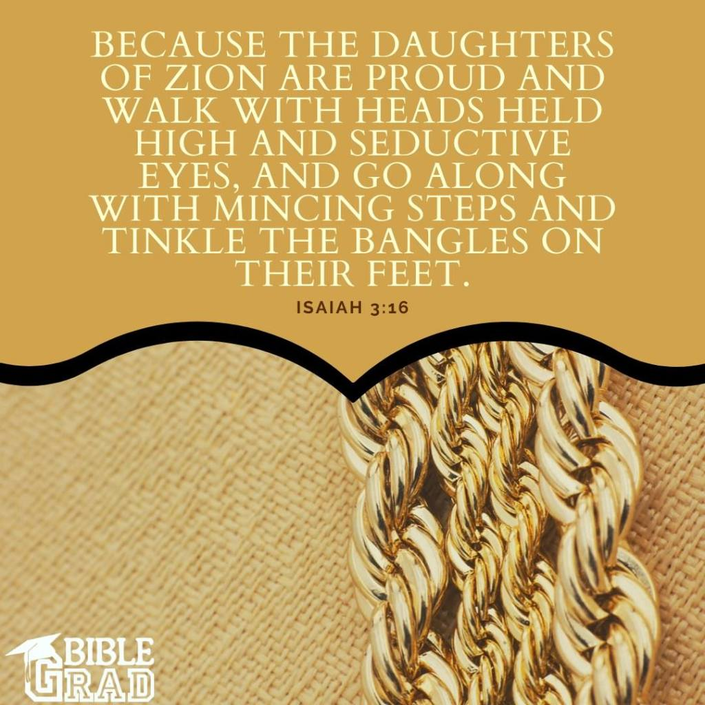
“¹How beautiful are your feet in sandals, O prince’s daughter! The curves of your hips are like jewels, the work of the hands of an artist.” (Song 7:1)
The Harem Make Their Case
Feet (most attractive)
Hips (as if hand-crafted)
Notes:
Seeing that things are not going so well for Solomon, the maidens push the emergency button, and are able to temporarily stop her from leaving. The maidens will now spend the next 5 verses describing her. But unlike Solomon who started w/her head, they start w/her feet, describing her in a sensual way hoping to help Solomon get the girl, but perhaps also because these would definitely be the features highlighted in the kind of dance she described in the previous verse, which some have suggested would have been an ancient version of the belly dance. 10 descriptions – her feet, hips, navel, belly, breast, neck, eyes, nose, head, hair. They’re all physical compliments, an effort to tell her how good she’d look if she were to dance for them.
Song 7:1a – It’s interesting they start here because the feet are typically considered the dirtiest part of the body. But sandals are considered footwear that enhance the feet such that they were considered most attractive, (CLICK) and we do know from passages like Isa 3:16 that women would use the feet as a way to lure men (i.e. high heels). “prince’s daughter” would imply that she is of graceful, royal, noble character. “You’re practically royalty!”
Song 7:1b – “curves of your hips” can mean “graceful legs” or “rounded thighs”. The idea seems to be that they are exquisitely smooth, they look like beautiful craftsmanship, the work of an artisan who’d go to great lengths to make his artifact perfect.

Slide 7
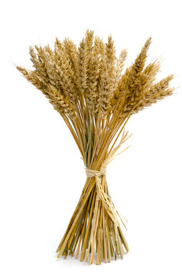
“²Your navel is like a round goblet which never lacks mixed wine; your belly is like a heap of wheat fenced about with lilies.” (Song 7:2)
The Harem Make Their Case
Feet (most attractive)
Hips (as if hand-crafted)
Naval (ready for feasting)
Belly (hourglass figure)
Notes:
Song 7:2a – some Egyptian paintings emphasize the naval, showing it was considered an object of beauty by some in that culture. Like wine, it brings the onlooker joy and delight, and perhaps for the one who has her, it brings the joy of a feast. It makes you wonder if her naval was currently exposed, but it’s possible the harem had helped her dress before meeting Solomon and had gotten a good look at her.
Song 7:2b – this would be an insult in our day, but they’re not saying she’s pot-bellied. Rather, in that day, a heap of wheat would be bound in the middle and look like an hourglass. (CLICK) They’re saying she has an hourglass figure, an enticing thing to a man.

Slide 8
“³Your two breasts are like two fawns, twins of a gazelle.” (Song 7:3)
The Harem Make Their Case
Feet (most attractive)
Hips (as if hand-crafted)
Naval (ready for feasting)
Belly (hourglass figure)
Breast (sprightly; untouchable)
Notes:
Song 7:3 – We’ve seen Solomon use this in 4:5. That they’re like twins is that they match, they’re perfect. Fawns are innocent, soft and gentle, graceful and beautiful, sprightly, we get the gist. And as we noted last time, baby deer are untouchable.

Slide 9
“⁴Your neck is like a tower of ivory, your eyes like the pools in Heshbon by the gate of Bath-rabbim; your nose is like the tower of Lebanon, which faces toward Damascus.” (Song 7:4)
The Harem Make Their Case
Feet (most attractive)
Hips (as if hand-crafted)
Naval (ready for feasting)
Belly (hourglass figure)
Breast (sprightly; untouchable)
Neck (nobility; smoothness)
Eyes (well-collected)
Nose (discerning)
Notes:
Song 7:4a – this is a partial repetition of Solomon’s description of her neck in 4:4 where he compared it to the tower of David, (CLICK) alluding to the symmetry and stateliness, and would be particularly evident if her hair was pulled up. It probably communicates nobility and strength of character. Or it could allude to the artistic smoothness of her neck – smooth as ivory, imposing, and captivating as a tower.
Song 7:4b – “pools of Heshbon” were (CLICK) deep cisterns hewn out of solid rock, and interestingly, the Hebrew word for “eyes” and “pools” is the same. The “gate of Bath-rabbim” was presumably the name of the gate of Heshbon by the pools, and it means “daughter of a multitude”, and it seems to be a place where crowds would gather, likely around the pools. Pools and baths are places that are relaxing to be around because of the calmness, stillness, and tranquility. (CLICK) I’d suggest they are complimenting her on how calm, composed, and well-collected she is in a group, particularly as she is being given the full court press And people like this are nice to be around.
Song 7:4c – the tower of Lebanon was likely the border-fortress built by Solomon in his early reign, whose purpose was to keep an eye on hostile Damascus. They are not saying she has a big nose, and I’d suggest the emphasis is not so much on her physical nose as it is her face (where she’d be “looking”. Her nose is “elevated”, attentive to foes. (CLICK) In other words, she can “smell a rat”. She can discern between good and evil.

Slide 10
“⁵Your head crowns you like Carmel, and the flowing locks of your head are like purple threads; the king is captivated by your tresses.” (Song 7:5)
The Harem Make Their Case
Feet (most attractive)
Hips (as if hand-crafted)
Naval (ready for feasting)
Belly (hourglass figure)
Breast (sprightly; untouchable)
Neck (nobility; smoothness)
Eyes (well-collected)
Nose (discerning)
Head (head held high)
Hair (fit for a king; captivating)
Notes:
Song 7:5a – (CLICK) Mount Carmel was considered the crown of the country, towering over land and sea, with a certain majestic appearance. The idea is that not only did her head rule her form, but that she was someone who because of her features could hold her head high.
Song 7:5b – The purple shellfish from which they’d get their purple dye was found near Carmel. Purple being the color of royalty, they are saying she is fit for a king.
Song 7:5c – Back in 4:1, Solomon compared her head to a flock of goats descending upon Mt. Gilead, meaning her hair was fool of volume, flowing down w/rippling waves. He idea here is that just as 2 of Israel’s mightiest men, Samson and Absalom, were ensnared by their hair long hair, Solomon is ensnared and held captive by hers.
Point: “So, don’t you want to keep being the center of attention?”

Slide 11
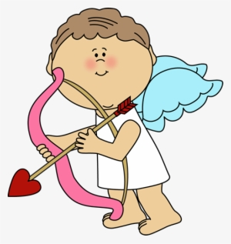
Be Careful Playing Cupid
Notes:
PRACTICAL APPLICATION – Now, I mentioned in an earlier study that the harem seem to not only be Solomon’s wing-women, but also loved playing matchmaking. They’re treating the Shulamite and Solomon like a modern-day Barbie and Ken, trying to create a dream marriage. Why is this dangerous?
First of all, because as we’ve repeatedly seen, love should not be aroused or awaken until it pleases. Applying too much pressure on someone may cause them to rush into something they’re not ready for, and that could end in disaster. And it also can cross lines in which it’s a assume that if someone is single, that’s the worst state a person could be in, which is ridicules. Singlehood is ok – don’t ever let someone tell you otherwise.
Secondly, you’re usually matchmaking between mutual friends, right? And then what happens if it doesn’t work out and even turns ugly? Then you get stuck “picking sides” and that’s never fun.
My suggestion is, it’s ok to make an introduction – but stop there. (CLICK) Let love take a natural course from there, otherwise it gets a little creepy, and this is going to be her farewell advice in 8:4 (for the 4th time).
COMMENTS

Slide 12
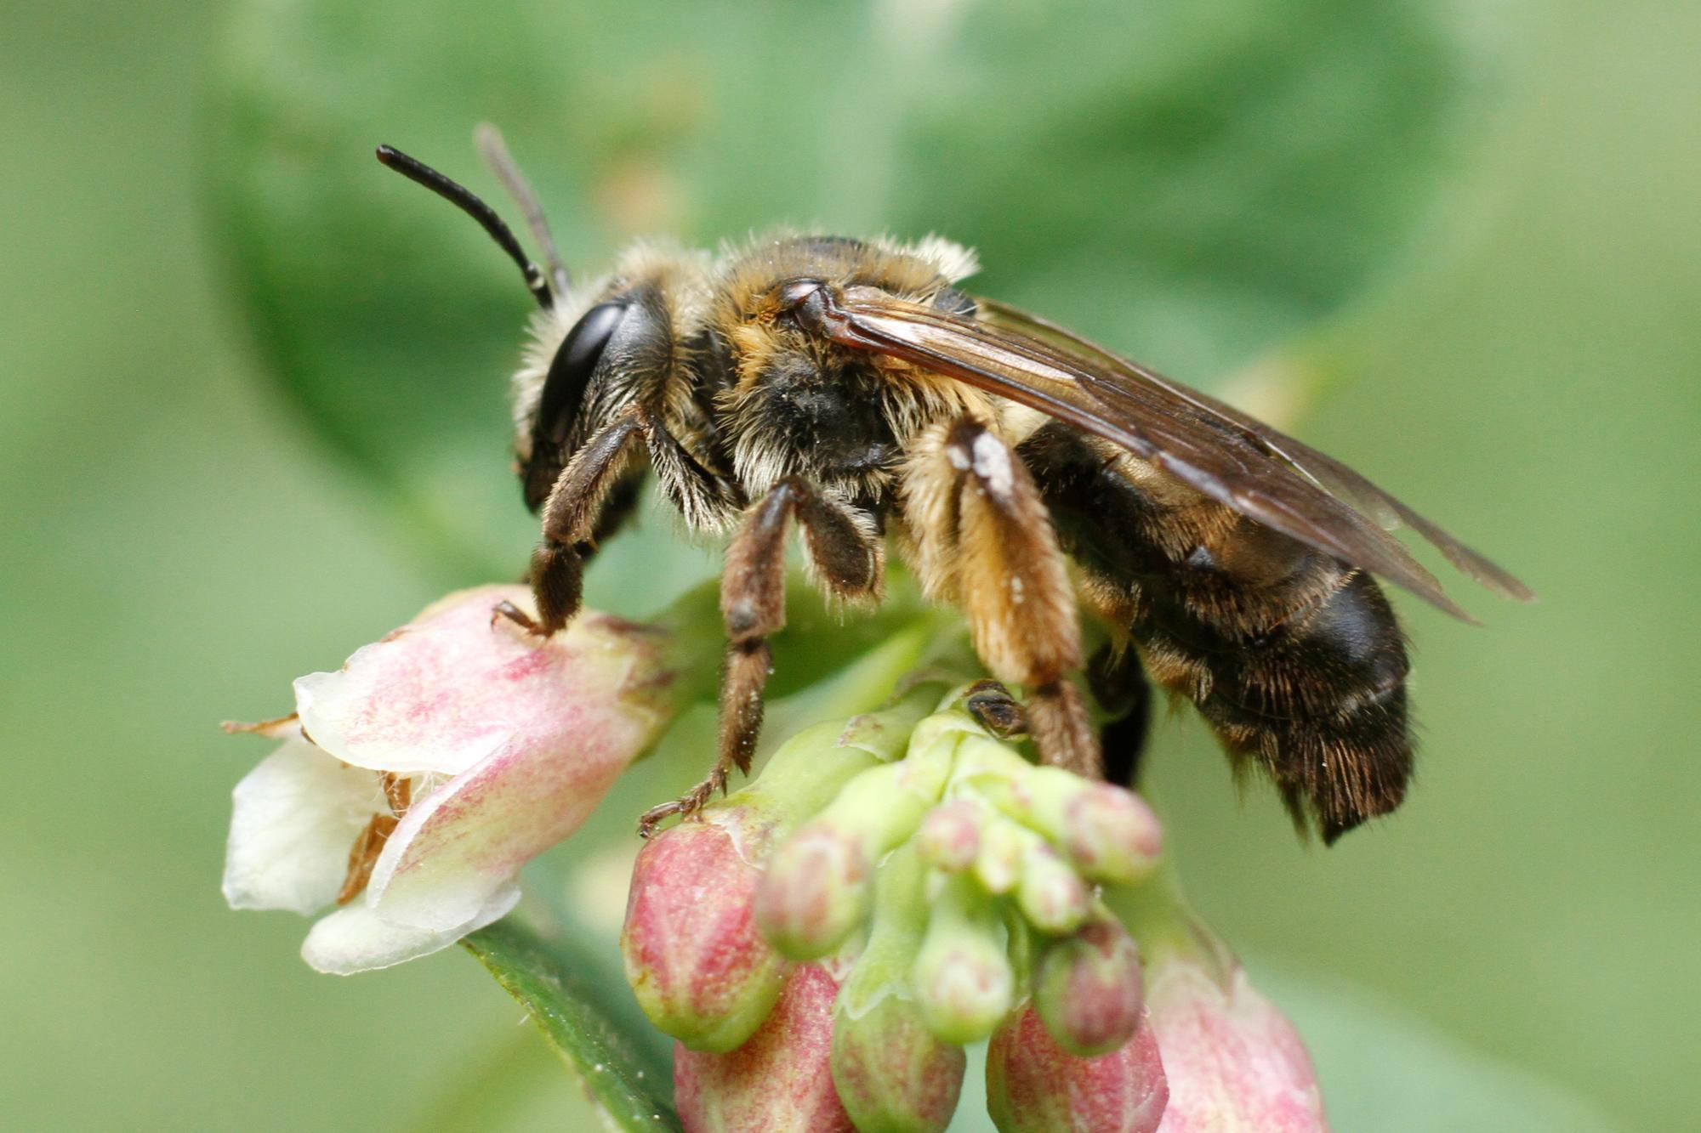
“⁶How beautiful and how delightful you are, my love, with all your charms! ⁷Your stature is like a palm tree, and your breasts are like its clusters. ⁸I said, ‘I will climb the palm tree, I will take hold of its fruit stalks.’ Oh, may your breasts be like clusters of the vine, and the fragrance of your breath like apples, ⁹and your mouth like the best wine!” (Song 7:6-9a)
Notes:
Now, Solomon is going to cut in w/one last try, and it is a heavily, sensual effort. These next few verses are definitely the most sexual of the book. We’re not going to dwell on it, but we’re not going to rush through it either. We want to be sure we get the lesson God intended for us, so just buckle up as we address what is occurring here – Song 7:6-9a.
Again, Solomon is not interested in knowing her as a person. He simply wants her for her body. He sees a delightfully, physically beautiful specimen that he would enjoy having a sexual relationship with in marriage.
(CLICK) Palm trees can be either male or female. The way they’d fertilize the female palm trees is by first climbing the male palm tree to get the pollen, then they’d climb the female palm tree to fertilize it. (CLICK) This is “birds and the bees, flowers and the trees” talk that doesn’t require much of an imagination, does it? Solomon is acting like a hungry man wanting a meal. He’s salivating like a hungry dog. I believe he is telling her that he wants to have a sexual relationship w/her. And the fact that he can tell her breath is “like apples”, this would seem to imply that not only is he ready to take a bite right then and there, but if he can smell her breath, perhaps he’s leaning in to kiss her. He’s ready to feast on sensuality.

Slide 13
The Danger of Pornography
Notes:
PRACTICAL APPLICATION – There are a lot of reasons why the sin of pornography is so bad, so damaging for a person’s psyche. Who are we dealing w/in Solomon? A man who has been w/a lot of women – 140 wives and concubines so far, on his way to 1000. I suspect Solomon is just in a place in his life in which he cannot look at another woman w/o thinking about sex, w/o objectifying them. Remember, the very first thing he said about her was in 1:9 was that she was like a mare among the chariots of Pharaoh, and we talked about the sexual connotation of that. But has his lust satisfied him being that he’s already got 140 women and desires another? (CLICK) The only thing that probably stopped him going past 1000 is the old age he alludes to in Eccl 12:5 where he said the “caperberry is ineffective”, a “caperberry” being an ancient aphrodisiac.
Pornography, as well as just sleeping around, rewires the brain, changing how you’re supposed to view sexuality and romantic relationships, training it to only see women as sexual objects, not human beings created in the image of God. Not someone that you can build a relationship with and become one with emotionally, but just someone you can use and abuse for your selfish pleasure, and Solomon is exhibit A in that he never really could develop a quality relationship w/a woman. In fact, toward the end of his life, they were using him.
COMMENTS

Slide 14
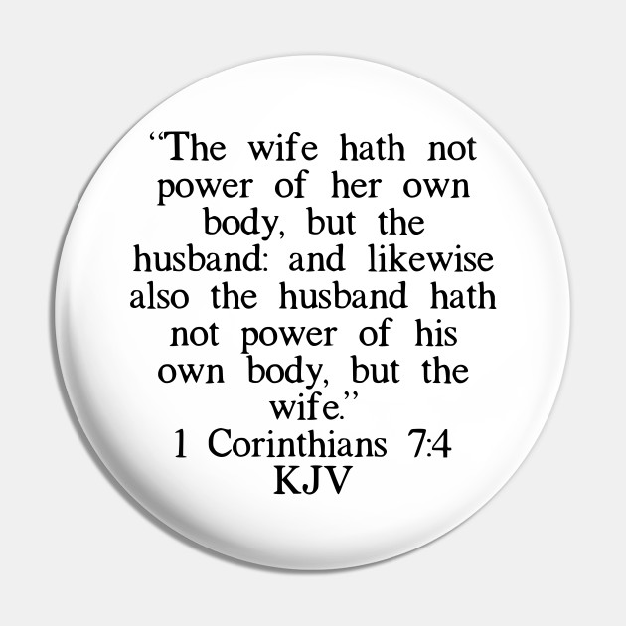
“It goes down smoothly for my beloved, flowing gently through the lips of those who fall asleep. ¹⁰I am my beloved’s, and his desire is for me.” (Song 7:9b-10)
Notes:
Now just like the last time he started getting sensual, the Shulamite cuts him off, and this time for good – Song 7:9b-10 – In other words, “My heart belongs to someone else”. All Solomon’s love amounted to was sensuality. “smoothly” = go straight, glide, uprightly, sweetly, something filled w/equity. She’s saying any sexual relationship is not going to be smooth and ultimately satisfying, anything like God designed it to be, unless it is in marriage w/a man she actually loves. Her “wine” will only go down smoothly for such a one as that – the shepherd. “of those who fall asleep” is the idea that she can’t wait to kiss him, and only him, so that it can be a good night kiss that he falls asleep to. She won’t have to wake up worrying whether the shepherd will still be there or not. What a contrast to the crass allusion Solomon spoke of her regarding a palm tree. (CLICK) Whatever financial security Solomon could offer her, she feels more secure in the shepherd’s love, and that’s what she ultimately valued.
Vs. 10 is a repeat of 6:3 – exclusive commitment and reciprocity of possession, giving themselves to one another, (CLICK) as 1 Cor 7:2-4 teaches for the man and woman. Remember from the last study that we mentioned that one of the curses given to woman in the garden is that “her desire [would] be toward her husband”? Same word here. And I mentioned then that we husbands need to make it easy for our wives to desire us. This was the case between the Shulamite and the Shepherd. Solomon was interested in her body, but he was not interested in her. That the shepherd desired her and not just her body, and that would set their marriage up to be special because they had a real relationship.

Slide 15
Why Sex Only Belongs In Marriage
Notes:
PRACTICAL APPLICATION – This is the reason why sex only belongs in marriage, because there is more going on than simply the physical act. There is an emotional element to it that is either enhanced due to the firm commitment expected between a husband and wife, or it is diminished by being reduced to nothing more than physical satisfaction.
This may be why Paul treats sexual sin more severely than other types of sin (CLICK) – 1 Cor 6:18 – “Flee immorality. Every other sin that a man commits is outside the body, but the immoral man sins against his own body.” Unlike other sins, sexual sin violates the most sacred and foundational covenant God gave for humans to enter into w/one another. When we casually tear apart what God joins together, it has negative effects on us and on others that we can hardly begin to calculate.
Typically, when we warn again sex outside of marriage, we like to limit earthly consequences to things like pregnancy and disease. The truth is, there is an emotional aspect to the sexual relationship that cannot be separated from the physical act, and willful fornication sets us up for these emotional, spiritual wounds – an immense feeling of shame, a loss of our dignity, etc. Only in marriage does this act provide us w/the protection, oneness, and true intimacy God intended. It’s the one place you can physically and emotionally vulnerable to one another, untainted by the selfishness of sin. (CLICK) Heb 13:4 – “Marriage is to be held in honor among all, and the marriage bed is to be undefiled; for fornicators and adulterers God will judge.”
True liberation is not found in being free from marriage; true liberation is found in marriage. Marriage is a secure hedge that protects love as it grows, producing freedom and fulfillment.
COMMENTS

Slide 16
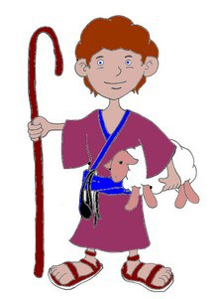
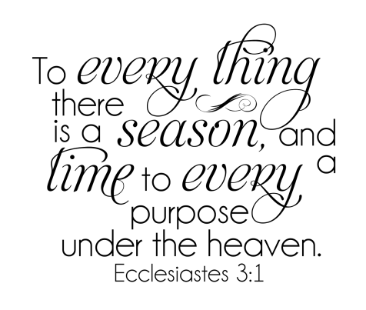
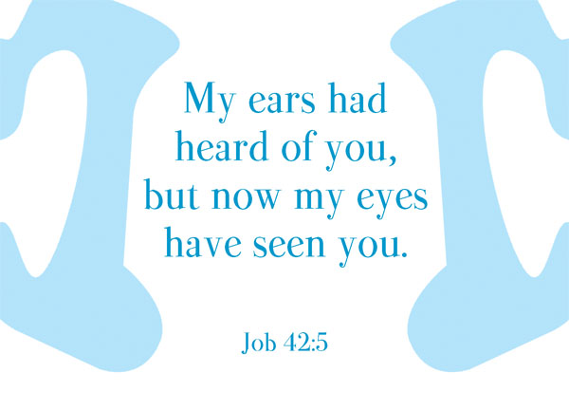
“¹¹Come, my beloved, let us go out into the country, let us spend the night in the villages. ¹²Let us rise early and go to the vineyards; let us see whether the vine has budded and its blossoms have opened, and whether the pomegranates have bloomed. There I will give you my love. ¹³The mandrakes have given forth fragrance; and over our doors are all choice fruits, both new and old, which I have saved up for you, my beloved.” (Song 7:11-13)
Notes:
Song 7:11 – We don’t know if they are actually together or if this is her speaking to herself as if he were there. But she’s stating that she is ready to marry him. This trial has matured her, and now she can give him more than she could before not having experienced the test she had. No more back and forth as we’ve seen – she is ready. (CLICK) It’s kind of like Job who after going through the suffering that he did said, “I had heard of You by the hearing of the ear, but now my eyes see You.” He now had an insight into God he didn’t have before he suffered that he could not have had apart from that experience.
Song 7:12 – Springtime has been used all throughout the book as an emblem of their love (2:10-13). It’s a time when powers and urges once restrained can now burst forth unhindered. “let us rise early” = eagerness. Their desire to spend the night in the villages is not for intimacy, but for witnessing the blossoming of their relationship.
Songs 7:13 – “mandrakes” = believed to be something that provided fertility (Gen 30:4-16). Also thought to be an aphrodisiac. Likely her way of saying she is not only ready to marry, but to start a family. “choice fruits” = experiences they’ve had, both past and new, and her readiness to start making more memories. This girl now has new fruits, new qualities of character that she wasn’t sure of and that nobody could even be sure about, till she had gone through this trial.
Point: Their relationship has now gone from “spring to spring”, experiencing a full cycle of growth, sprouting, and blossoming. (CLICK) There is a time and season for everything (Eccl 3:1,5). There is a time for restraint and a time for embracing.

