Slide 1
Notes:
As we begin the Song of Songs, a reminder that we’re going to be assuming the 3-character drama approach that I introduced last week. This plot is that there is a Shulamite girl in love w/a shepherd boy, but King Solomon makes a play for her. If you’ve studied this before and take a different literal position, don’t fret – most of the principles we can learn from this book are relatively consistent across the literal interpretations, w/few exceptions.
But in the 3-character approach, the first 2 chapters of the book are admitably the most difficult. There’s no introduction that tells us where the characters are, what’s happening, or who is talking to who. It just picks right up w/some dialog and monologue. And so, there’s a slight bit of deduction and guesswork we have to make from the internal evidence that is provided us.
For example, 1:4 tells us that the Shulamite is already in Solomon’s tent and that the daughters of Jerusalem are also there w/her, so it appears she is about to be wooed by Solomon for the first time. But how did she get there?

Slide 2
Setting The Scene
SOS 6:11-12 – “¹¹I went down to the orchard of nut trees to see the blossoms of the valley, to see whether the vine had budded or the pomegranates had bloomed. ¹²Before I was aware, my soul set me over the chariots of my noble people.”
Notes:
Chapter 6 gives us some clues. Here, the Daughters of Jerusalem are trying to sell the Shulamite on Solomon, but the Shulamite has been selling them how awesome the Shepherd is. So, it’s implied that they ask her, “Well then how did you end up here?” (CLICK) – SOS 6:11-12 – The idea is, “Before I was aware of what was happening, I just got caught up in it all; it just kind of happened”.
Best guess – King Solomon is visiting the area near the Shulamite’s village to inspect his vineyards and orchards which he rents to farmers. Solomon’s nobles likely spotted her and thought, “Solomon would flip over her”, then approached her, and asked, “Would you like to meet the king?”, and then she just got caught up in it all. Now, was she there willingly or did Solomon’s nobles just snatch her away? The Law of Moses gives the death penalty for kidnapping (Ex 21:17). I’d suggest she just got caught up in the fancy of this.
And this idea plays well into the story because this would then represent a woman who is torn between a true pure love for a shepherd (CLICK) and the luxurious lifestyle Solomon could offer her. Just imagine being an average woman, and the king comes into town and takes a personal interest in you. What available woman is going to immediately say, “Nah, not interested, I’ve got this smelly shepherd waiting for me.” I think she’s initially enamored and just gets caught up in it, and that this is what’s happening as the book begins.
PRAYER

Slide 3
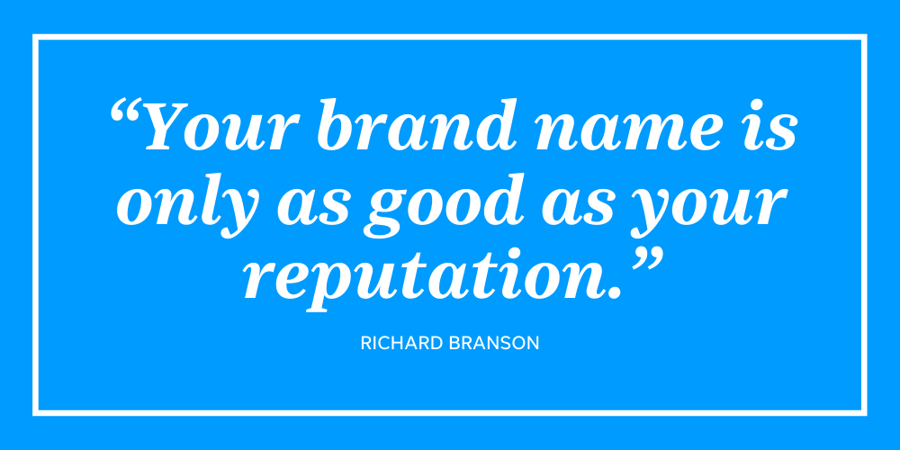
“²May he kiss me with the kisses of his mouth! For your love is better than wine. ³Your oils have a pleasing fragrance, your name is like purified oil; therefore the maidens love you. ⁴Draw me after you and let us run together! The king has brought me into his chambers.” (SOS 1:2-4b)
Shulamite’s Soliloquy
Desires shepherd’s affections
His love is valued, savored, intoxicating
She likes his smell
His high reputation
Notes:
Song 1:1-4a – So the book begins w/her daydreaming about her – the shepherd. She’s soliloquizing, longing to be w/him:
(CLICK) She desires the shepherd’s affection. The New English Bible (NEB) says, “may he smother me with kisses”. The Shulamite is a woman desiring for her shepherd to take some romantic initiative.
(CLICK) She acknowledges that his love for her is “better than wine”. Remember, bible poetry lends itself to the imagination, so there are several ways to look at this. It could suggest that she sees his love as something of the highest quality and value, something that is savored and satisfying. Or, it could be she is saying that his love is intoxicating. Alcohol lowers inhibitions so maybe she’s saying that his love for her makes her lightheaded/dizzy. And for all of us that have been in love, we know exactly what she’s talking about, don’t we?
(CLICK) She then mentions his smell. Oils of that day would be equivalent to our modern-day colognes/perfumes, something used to mask or enhance the natural odor. She likes his smell. In fact, she associates his name/reputation w/that smell which like a strong scent can remain a long time after one’s absence. If you poured out an entire flask of oil in a room, everyone would smell it, right? (CLICK) That’s his reputation – everybody who knows him is impressed w/him, and that makes her impressed w/him.

Slide 4
Listen To Your Friends & Family
Notes:
PRACTICAL APPLICATION – When in a dating relationship, why is it important to listen to friends and family about the person we’re dating? Illustration: “Ryan, don’t you think I know him better than you?!!?” (love is blind). Infatuation blinds us. It robs us of our objectivity. A wise woman chooses a man whom others see to be a man of character. And if she is the only one who thinks he is amazing and no one else does, there is something wrong. While it’s true some close to you may judge your significant other more strictly because they are dating you, they are also the people who are not blind like you will likely be.
(CLICK) Prov 11:14 – “Where there is no guidance the people fall, but in abundance of counselors there is victory.”
COMMENTS
Fortunately for the Shulamite, she is not deluded because even the maidens (virgins of marriageable age) think the world of him. But rather than the fact that they see him as a catch looking like a threat, she seems secure in his love. Notice so far how all senses are invoked except “sight” – hearing, smell, taste, touch. The idea is that love excites all the senses., and yet its interesting nothing is said about his appearance (as if on purpose).

Slide 5
“²May he kiss me with the kisses of his mouth! For your love is better than wine. ³Your oils have a pleasing fragrance, your name is like purified oil; therefore the maidens love you. ⁴Draw me after you and let us run together! The king has brought me into his chambers.” (SOS 1:2-4b)
Shulamite’s Soliloquy
Desires shepherd’s affections
His love is valued, savored, intoxicating
She likes his smell
His high reputation
Desires alone time w/him
Notes:
4) And so – Song 1:4a – like everyone in love, she wants to be with him. It’s similar to the song “Pocket of Sunshine” – “Take Me away, a secret place, a sweet escape, take me away…”. Almost every couple desires alone time somewhere together, away from the world. So, its possible that not long after she arrives in Solomon’s tent, she’s starting to have second thoughts about it, and now there is this inward desire on her part for the shepherd to save her from the king’s advances, because she can’t stop thinking about the shepherd. However, its difficult to know if the nobles have discovered her at this point in her soliloquy.
It’s only in the 2nd part of vs. 4 that we see what’s going on as the scene momentarily shifts to narrative, snapping the Shulamite back to reality, and the reality is…Song 1:4b – So the king, or perhaps those serving the king at his bequest, has now brought her into that area in his tent that would befit a king. And the ones who are present w/her are those “daughters of Jerusalem”, who will not only act as her sounding board throughout the song, but will try to butter her up to marry Solomon.

Slide 6
“We will rejoice in you and be glad; we will extol your love more than wine. Rightly do they love you.” (Song 1:4cd)
The Harem Welcome Her
Happy she’ll be joining them
Will do their part
They recognize her beauty
Notes:
The Daughters of Jerusalem say this about her – Song 1:4c. A few things to note:
1) (CLICK) The shepherd was not the only one who was reputable. Solomon’s harem seem to believe Solomon is, too, and they would be more than happy for her to join them. As we study the song, keep an eye on this contrast – the Shulamite has one idea of what love should be and the daughters of Jerusalem have another idea of what love should be.
2) (CLICK) But believing Solomon to be the cat’s pajamas, they’re going to do everything they can to set them up. (CLICK) Everyone has heard of the “wingman”, but these are Solomon’s “wing women”.
3) (CLICK) “Rightly do they love you” – In other words, “We can see why Solomon’s nobles brought you here”. They’re also very impressed by her beauty, unsurprised at all that Solomon’s nobles would want to introduce her to the king.

Slide 7
“⁵I am black but lovely, O daughters of Jerusalem, like the tents of Kedar, like the curtains of Solomon. ⁶Do not stare at me because I am swarthy, for the sun has burned me. My mother’s sons were angry with me; they made me caretaker of the vineyards, but I have not taken care of my own vineyard.” (Song 1:5-6)
Shulamite’s Response
Manual labor tanned her
Self-conscious, insecure, unworthy of praise, embarrassed?
Enviable and contemptible?
Notes:
Shulamite’s response – Song 1:5-6 – One thing to keep in mind is that the only family of hers ever mentioned is her mother and her brothers. So, many assume the father was not alive.
(CLICK) It seems as if her brothers had mistreated her, a Cinderella type of situation in which she was forced to work. And so, the hardships of manual labor appear to have “disfigured” her in a sense, though that’s a strong word, because she is very beautiful.
(CLICK) So, what’s the motive of her defense about her looks? In that day, fair skin was more attractive than tanned skin because it suggested high financial/social status. She’s a rather modest girl, and so I’d suggest that her tanned features are making her feel insecure, self-conscious, and unworthy of praise in the company of harem because she doesn’t have the pampered, pale, elegant beauty of urban women. And yet, her tanned skin would have given her an exotic look, a rare attractiveness Solomon would not have been used to. Or, there may be a hint of defensiveness in her reply, perhaps detecting a hint of contempt or sarcasm from the harem. Or it could be she is like a lot of women who when you give a compliment, say, “Oh stop it, my hair is just a mess.”
(CLICK) But understanding human nature, it’s reasonable to conclude that to the daughters of Jerusalem, her features made her both enviable and contemptible. “I have not taken care of my vineyard” – vineyards have to be cultivated, cleared of stones, ploughed, and dug. Then it has to be sown, planted, watered, and pruned. Then it has to be walled in and protected. Given what her brothers required of her for their vineyards, she’s saying she wasn’t able to take care of herself as other women would.

Slide 8
Broken Homes Lead To Rushed Romance
Notes:
PRACTICAL APPLICATION – If she’s already in a relationship w/the shepherd, why would she entertain something like this? Despite being in love w/the shepherd, something still drew her to initially entertain Solomon’s proposal.
(CLICK) I want to take a leap here – broken homes can lead to rushed romances, rushed marriages. Why? Because often times it creates a desperation for security and stability that can eclipse that desire for true love. It’s just a curious thing that a girl so in love would even entertain such a prospect. But if her caretakers were mistreating her and putting her out in the field do a level of labor that a man would typically do, it’s not surprising (“take me away, a sweet escape…”)
(CLICK) Before you get married, count the cost of what you’re committing to (Luke 14:28). Honestly ask yourself why you want to marry this person. If it’s for money and security, you’re not going to be happy.
COMMENTS

Slide 9
“⁷Tell me, O you whom my soul loves, where do you pasture your flock, where do you make it lie down at noon? For why should I be like one who veils herself beside the flocks of your companions?” (Song 1:7)
Shulamite Misses The Shepherd
She is initially torn
She wants to know where he is
She valued her reputation
Notes:
Now, for the first of many times, the Shulamite is going to start monologuing out loud about her beloved shepherd in front of the harem. This suggests that though she has been brought to Solomon’s tent, she’s not yet in his presence. We know this because vs. 8 is their response to what she says here (CLICK) – Song 1:7a.
(CLICK) So, while she’s likely in Solomon’s chambers at her own volition, she’s still torn over wanting to be w/the Shepherd.
(CLICK) She’s wondering aloud, “I wonder what he’s doing right now? If I left Solomon’s tent now, I wonder how I could find him?” Remember, he’s a shepherd, so “Where do you make [them] lie down at noon?” means, “When is your lunch break so I can spend time with you?”
But she doesn’t want to pursue him like other women would of that day – Song 1:7b.
3) (CLICK) Veiled women in that time were often identified w/having low sexual morals. Remember what we learned about her from chapter 8 last week – she is not “loose” and would not want to be seen that way. She is a young lady of dignity, not a wandering harlot among other shepherds just looking for the first man that would show interest. She has integrity and understands that her reputation, what others think, actually matters. She wants to be as reputable in character as he is in his character.

Slide 10
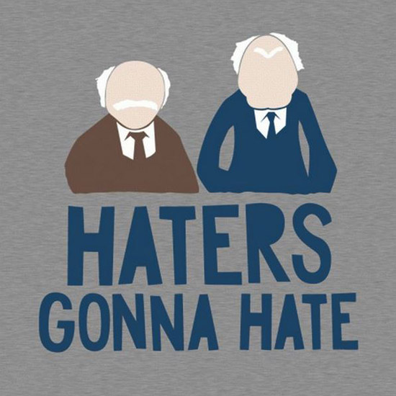
“⁸If you yourself do not know, most beautiful among women, go forth on the trail of the flock and pasture your young goats by the tents of the shepherds.” (Song 1:8)
The Harem’s Shock
“You don’t HAVE to be here!”
“You’d trade Solomon for a shepherd?!?!?”
The harem now know something about her that Solomon doesn’t
Notes:
And we know she’s saying all this out loud because the daughters of Jerusalem’s response seems to be that of shock (CLICK) – Song 1:8.
(CLICK) I’d suggest they seem surprised that she’s actually daydreaming about some other man when she’s had the so-called honor of being invited to Solomon’s chambers. They think Solomon hung the moon and that no other man could compete w/him. In other words, “You don’t have to be here!”
(CLICK) And that phrase, “Most beautiful among women” could be contempt or mocking, as if to say, “Well, if you think your such hot stuff that you don’t even want Solomon, or if you’re dumb enough to want to marry a dirty ole shepherd, you just go on to where the shepherds are and don’t waste Solomon’s time.” (CLICK) – Haters gonna hate, but this does imply she is free to leave anytime she wants (not there against her will).
(CLICK) And so, this adds an element of drama to the story because Solomon is now going to arrive and is about to speak for the first time and these daughters of Jerusalem know a little something about this Shulamite that Solomon doesn’t – she’s in love w/another man. This is some serious daytime drama!

Slide 11
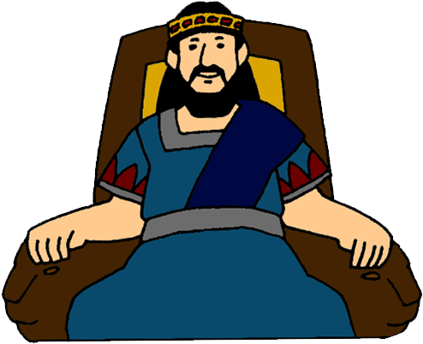
“⁹To me, my darling, you are like my mare among the chariots of Pharaoh. ¹⁰Your cheeks are lovely with ornaments, your neck with string of beads.” (Song 1:9-10)
Notes:
And what is the first thing Solomon says? (CLICK) Song 1:9 – Now, it wouldn’t work today to tell a woman she looks like a horse. All throughout the song, Solomon employs eastern methods of complimenting women that are a bit lost in translation to us, so most will require a bit of explanation:
A Pharaoh would only use stallions for his chariots. History tells us that during war, a common tactic of the enemy against the chariots of Egypt was to release a bunch of mares into the battle, fillies who were in heat, because this would drive the stallions crazy and throw the chariots into disarray.
You see what he’s saying here? The first words out of his mouth is (CLICK), “Baby, your beauty would stir the passions of the strongest men (stallions)”. She has animal magnetism; her presence is alluring. This is the first of many carnal pickup lines we’ll see from Solomon. Well, to Solomon, she may have seemed like a “mare”, but he was her “nightmare”. The shepherd was her “day stallion”.
Song 1:10 – In other words, “Not only are you beautiful, imagine how much that beauty would be enhanced if you had my jewelry, my decorative resources, at your disposal?” Now for a girl forced to work in the fields all day and not able to keep herself up as well as she’d like, that’s an appealing prospect, isn’t it?

Slide 12
“We will make for you ornaments of gold with beads of silver.” (Song 1:11)
Israelite Edition
Notes:
And the Daughters of Jerusalem jump all over this – Song 1:11 – They want her to join them, and everyone knows that jewelry is a very enticing thing to a woman (CLICK) – “every kiss begins w/Kay”. They’re saying, “We’re going to inundate you w/all the jewels you could ever want.” (CLICK) They want to give this tanned, peasant girl an “extreme makeover” – Israelite addition.

Slide 13
Love Can’t Be Bought
Notes:
PRACTICAL APPLICATION – It’s important to note that love can’t be bought no matter how hard you may try. It must be freely given, or it’s not real love. A great way to look at this is to think about why God loves us. It’s not because we’re intrinsically great people. Rom 5:8 says we were His enemies when Jesus died for us. Love is either freely given, or it’s not love. And for those of you in dating relationships who think that the more you shower your significant other w/money and gifts, the more they’ll love you, think again. Often, it’s the opposite that’s true in that they’ll be more prone to use you.
The greatest gift God ever gave us was His love.
COMMENTS

Slide 14
“¹²While the king was at his table, my perfume gave forth its fragrance. ¹³My beloved is to me a pouch of myrrh which lies all night between my breasts. ¹⁴My beloved is to me a cluster of henna blossoms in the vineyards of Engedi.” (Song 1:12-14)
“¹⁵How beautiful you are, my darling, how beautiful you are! Your eyes are like doves.” (Song 1:15)
Shepherd vs . Solomon
Competing scents
Competing gifts
Time together
Shelter
Safety/security
Notes:
Now, as we begin vs. 12, it appears she is now dining w/the king, and as she smells her own perfume, her thoughts once again drift to the shepherd (CLICK) – Song 1:12-14.
(CLICK) The perfume she’s referring to here is called “spikenard”, and it is a very expensive fragrance, and so I’d suggest that this is something Solomon might have gifted her w/before they sat down to dine.
(CLICK)And yet, despite this expensive gift, her mind keeps wandering back to the Shepherd, and it is his fragrance that ultimately attracts her. And it would be a simple fragrance, perhaps from vs. 13, something the shepherd had also gifted her with, some myrrh bundled up into a simple pouch that she could wear as a necklace under her clothing, near her heart, to be something she remember him by. It sustains her while they aren’t together. The idea would be that she’s not impressed w/the expensive perfume, but of the thoughtful, simple gift of her beloved which took little effort for him to make. But as just read, the harem wants to replace this w/jewelry more befitting palace standards.
The comparison to the Valley of Engedi is interesting. (CLICK) This place was a famous oasis in the Judean wilderness west of the Dead Sea, lush w/water and life, but it is a tiny paradise surrounded by a very barren environment. (CLICK) And the henna blossom came from a henna hedge which was commonly grown around a vineyard because it has very thorny branches. And so, it would protect a vineyard, a valuable crop from hungry animals, or men who liked to prey after beautiful women just for their looks. So, if you combine the metaphors, what is she saying?
(CLICK) To the Shulamite, the shepherd was like this – an oasis of delight in an otherwise barren wasteland in which she found refreshment and shelter from the world. She values time w/the shepherd as well as the safety and security he offers her.

Slide 15
The Greatest Gift Is Time Together
Notes:
PRACTICAL APPLICATION – A happy relationship is one in which after a long hard day, you can retire into one another’s company, forgetting the trials, and find joy w/each other. While Solomon’s tent and all the luxuries it afford felt like a barren, desert wasteland that couldn’t give her what she really need/wanted.
(CLICK) It’s not that gift giving isn’t important. If my suspicion is right that she was carrying a pouch of myrrh around her neck that the shepherd had given her, she cherished it. But the greatest thing she longed for, according to her own daydreaming, was quality time w/him. Those who are dating don’t seem to have as much of a hang-up w/this. But for those of us who are married, who can often get busy and distracted w/life, this is a point that serves as a friendly reminder.
COMMENTS

