Slide 1
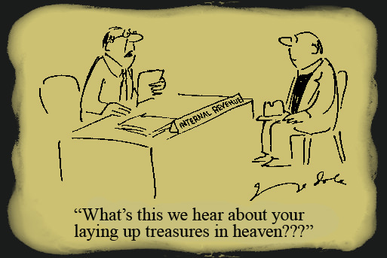
Notes:
The central theme of Matt 5 centers around the 2nd greatest command of loving our neighbors as ourselves. When we love our neighbor, we are seeking his best interest in the same way that we would seek our own. And so we will not hatefully despise them, or lust after them, we will not divorce our wife for just any cause, we will not lie, we will not seek vengeance over harm suffered. Instead, we will love our neighbor even if he is our enemy, always looking out for his best interest.
However, Matt 6 focuses more on the greatest commandment, that of loving God with all of our heart, mind, and strength. When we love God in that way, He is at the center of everything we do, especially our worship. The Pharisees worship was about them and their egos. But our righteousness must exceed that shallow piety, particularly when we give, pray, and fast.
What Jesus is really confronting in Matt 6:1-18 is pride. But in the next verses, He’s is going to focus on another thing that rivals true righteousness, and that is materialism.

Slide 2
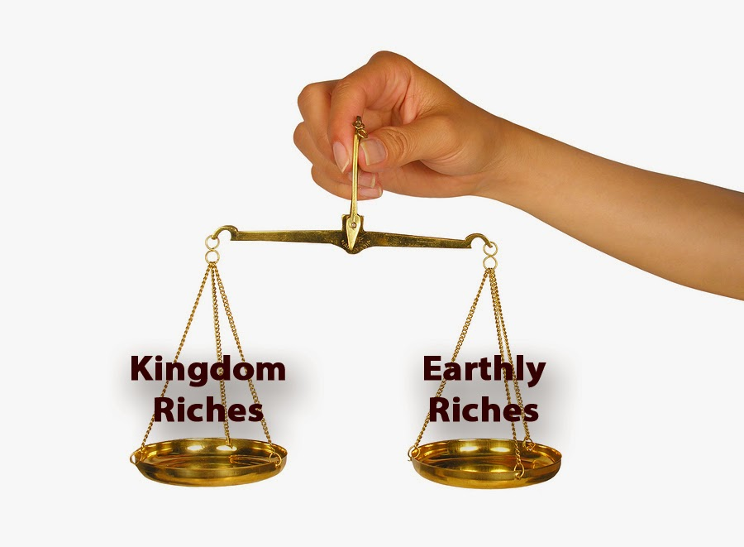
Treasures on Earth vs. Treasures in Heaven
Matt 6:19-20 – “¹⁹Do not store up for yourselves treasures on earth, where moth and rust destroy, and where thieves break in and steal. ²⁰But store up for yourselves treasures in heaven, where neither moth nor rust destroys, and where thieves do not break in or steal.”
Notes:
Matt 6:19-20 – The import of this passage is that nothing lasts. Buildings in Atlanta and in downtown Birmingham from 100 years ago that were once the pick of the litter now have leaking roofs, plumbing that doesn’t work, floors that are caving in due to rot, plaster falling from the ceiling, etc. The time will come when the building becomes less valuable than the land they are sitting on and they’ll bulldoze it, put something new up there, and then not a hint of the former building will remain. This is the nature of the material and therefore nothing on earth will truly secure us.
Eccl 1:3-11 – That’s kind of depressing isn’t it? For thousands of years the Earth has been doing the same thing over and over again. There is nothing from an earthly standpoint that has changed. It just keeps repeating and going around in circles. And the reason he is making this point is that while the world continues doing this, a generation is born only to pass away again and make room for another one. Before I was born, the earth has done what it does now. And when I die 30, 40, 50 years from now, the earth will continue to do what it has always done. And all the money, all the assets, all the property, all the material things we worked so hard for in this life is going to be passed on to someone else who didn’t even work for it, and eventually it will just decay.
Illustration: my first keep wrangler. Then someone broke into it and stole my tennis racket and all my CDs!
So then why would we consume our lives w/the accusation material things?

Slide 3
Treasures on Earth vs. Treasures in Heaven
Matt 6:19-20 – “¹⁹Do not store up for yourselves treasures on earth, where moth and rust destroy, and where thieves break in and steal. ²⁰But store up for yourselves treasures in heaven, where neither moth nor rust destroys, and where thieves do not break in or steal.”
Issue Not:
Savings & IRAs – Prov 6:6-8; 21:20
Enjoying the fruit of our labor – Eccl 5:18; 8:15; Deut 12:5-7
Notes:
Now let’s understand what Jesus is not saying here. First, He is not saying that we cannot save money. The Proverb writer makes this clear – Prov 6:6-8; 21:20 – In other words, saving is the action of a wise man and as much of a pest as the ant can be, it is an example to be looked to. Life can throw us a monkey rich, like we experienced w/Covid, and a person who is wise enough not to spend all their money but rather to have some savings to cover times of financial drought, this is a person who can sleep a little better at night.
Also, Jesus is not saying that we cannot enjoy the fruit of our labor – Eccl 5:18; 8:15 – So even though he recognizes the vanities of material pursuits, Solomon makes it clear that it is a good thing to enjoy the fruit of your labor. In fact, when God was about to bring Israel into the promise land, He gave similar commands in Deut 12:5-7 – The key to this kind of rejoicing in the fruit of our labor is that it leads to greater thankfulness toward God for all the things He has given us. And anything that produces more gratitude toward the Giver is a good thing.

Slide 4
Treasures on Earth vs. Treasures in Heaven
Matt 6:19-20 – “¹⁹Do not store up for yourselves treasures on earth, where moth and rust destroy, and where thieves break in and steal. ²⁰But store up for yourselves treasures in heaven, where neither moth nor rust destroys, and where thieves do not break in or steal.”
Issue Not:
Savings & IRAs – Prov 6:6-8; 21:20
Enjoying the fruit of our labor – Eccl 5:18; 8:15; Deut 12:5-7
Issue Is:
Attitude toward wealth – Luke 12:16-21
Defining yourself by your wealth – Matt 19:22
Notes:
So, then what is Jesus condemning in this passage? Remember in the first 18 verses, when talking about worship, that we made the point that Jesus wasn’t condemning a particular posture when praying, or when someone sees you giving to someone, or even the act of fasting in and of itself. What was He condemning? A prideful attitude. In the same way, Jesus is not condemning the acquisition of wealth, rather a particular attitude toward it – Luke 12:16-21. He was a big saver, too. But what is the difference between him and the man enjoying the fruits of his labor from Ecclesiastes? The difference is this man didn’t use what God had given Him for good (vs. 19). The rich man’s attitude toward his wealth was to keep it for himself and to find satisfaction for his soul by what he could accumulate. And as vs. 21 says, he may have been rich in treasure, but wasn’t rich toward God.
What about the rich young ruler. What was his attitude toward wealth? – Matt 19:16-22 – This guy seemed to have a lot going for him spiritually. So, then what was his issue? Well, despite all his good qualities, he could not part w/his riches if kingdom work depended on it. Money, in and of itself, is not evil. It’s just paper. But when we define ourselves by it, if seek to find our sole security and self-worth through it, we’re going to kick against the goads because it is vanity. And Jesus would have us to learn that less as early in life as possible.

Slide 5
Treasures on Earth vs. Treasures in Heaven
Matt 6:21 – “For where your treasure is, there your heart will be also.”
God wants all of our heart – Matt 22:37
Notes:
What is the heart of the issue? – Matt 6:21 – What’s the heart of the issue? The heart of the issue. The vanity and futility of storing up treasures on earth is one thing. But the main issue is that when we allow it to take over our lives, we’re inevitably not going to be able to serve God faithfully. There will come a point where one of the other will have to give, and history has shown that the one that gives more often than not is our love toward God. Remember the parable of the sower? What happened to the seed sewn among the thorns? – Matt 13:22 – “And the one on whom seed was sown among the thorns, this is the man who hears the word, and the worry of the world and the deceitfulness of wealth choke the word, and it becomes unfruitful.” Practically speaking, how does this happen? Because a person’s whose sole time and energy going toward material things will take away the time he needs to be expending toward spiritual things. Their growth is stunted, and in may cases it is halted. And if we’re not growing, we’re dying.
Before I got married, I once dated a girl for several months and her ex started getting back in the picture. She loved us both. And so I said, “Decide now; do you want to be w/this guy or, or me’? You can’t love 2 men, or you’re not loving either enough.” She went w/the other guy.
We cannot fully devote yourself to 2 things. It’s either God or nothing, and God wants all of our heart, and what’s more, He deserves all of our heart, soul, mind, and strength.

Slide 6
Treasures on Earth vs. Treasures in Heaven
Matt 6:21 – “For where your treasure is, there your heart will be also.”
God wants all of our heart – Matt 22:37
Once God has all of our heart, we will use material possessions for His purpose – 1 Kings 3:5-14; Col 3:23;
Notes:
Once God has all of our heart, we will then use our money and material possessions for His purposes. Solomon is a great example of this – 1 Kings 3:5-14 – Why would God give him riches when all he really wanted, all he asked for, was the wisdom and discernment to judge between good and evil for the sake of God’s people? Because once His heart was incline wholly toward God, God knew Solomon could use his wealth for noble purposes.
Once God has all of our heart, no one is going to have to command us to be benevolent or generous toward others and toward the church. We’ll use our homes, our vehicles, everything we have to serve Him whole-heartedly. When God has our entire heart, we realize that nothing we have truly belongs to us, but that we are merely stewards. And maybe this is the thing that keeps God from blessing a lot of people? Maybe He’s not seeing the kind of heart in others that Solomon displayed here – Jas 4:3 – “You ask and do not receive, because you ask with wrong motives, so that you may spend it on your pleasures.”

Slide 7
Treasures on Earth vs. Treasures in Heaven
Matt 6:21 – “For where your treasure is, there your heart will be also.”
God wants all of our heart – Matt 22:37
Once God has all of our heart, we will use material possessions for His purpose – 1 Kings 3:5-14; Col 3:23
Because we are created in God’s image, it is impossible for us to be ultimately satisfied with wealth. It will corrupt us if we let it – Eccl 3:11; 1 Tim 6:10
Notes:
Also, since we are created in God’s image and have the spirit of God within us, we are not even created to ultimately be satisfied with material things. – Eccl 3:11 – Our spirit will always crave that which is eternal, and so any life that is wholly devoted to material pursuits will be a meaningless life of vanity and utter futility. Our ability to achieve spiritual planes will be choked and polluted by any lust for the material that is within us – 1 Tim 6:10.
If we do not learn to see wealth in its proper scope, it will corrupt us and condemn us as it has many men since the beginning of time.

Slide 8
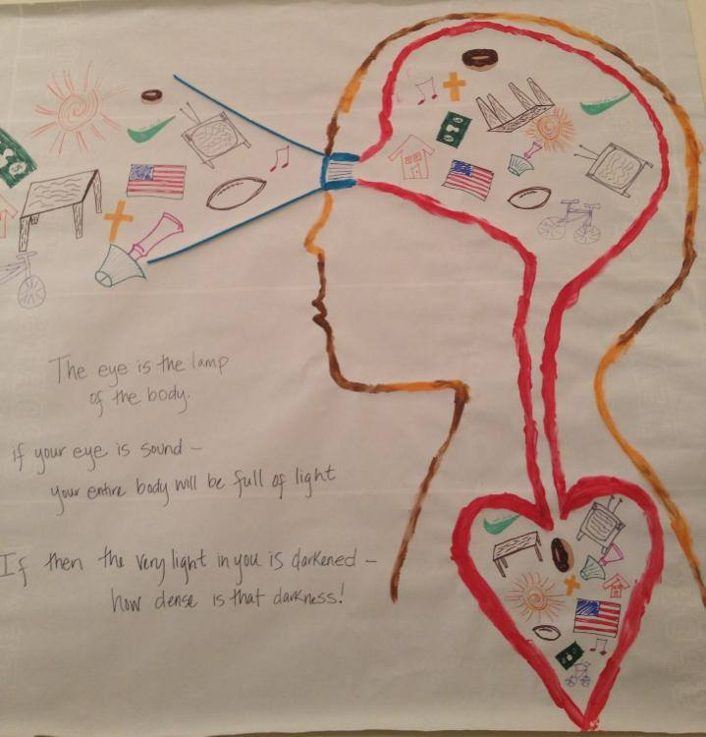
The Eye Is The Lamp Of The Body
Matt 6:22-23 – “²²The eye is the lamp of the body; so then if your eye is clear, your whole body will be full of light. ²³But if your eye is bad, your whole body will be full of darkness. If then the light that is in you is darkness, how great is the darkness!”
Keep our spiritual vision clear of any distractions that could hinder us from seeing spiritual imports – Col 3:2
Guard against any temporal distractions that choke, contaminate, or cloud our vision – Matt 13:22
Notes:
Matt 6:22-23 – What Jesus is urging us to do is clear our spiritual vision of any and al distractions that could hinder us from seeing things the way God would have us to see them. If we train ourselves to see things clearly, then we’ll learn to look past daily distractions that hinder eternal realities. The key is as Col 3:2 says – meaning, we need to learn to see material things through heavenly lenses and not as things that will ultimately supply us and sustain us with what we need.
Again, in Matt 13:22, Jesus said that excessive concern for the material will choke our spirituality, it will cloud our vision, and corrupt our nature. The material demands just too much time and energy and so the body gets filled with darkness. And so, the challenge is to learn to look beyond the temporal and recognize that this life and everything in it is just a speck compared to the entire scope of eternity.

Slide 9
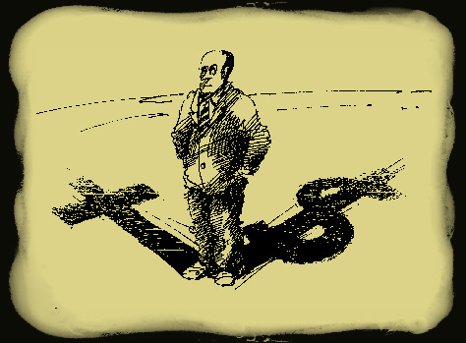
No One Can Serve Two Masters
Matt 6:24 – “No one can serve two masters; for either he will hate the one and love the other, or he will be devoted to one and despise the other. You cannot serve God and wealth.”
Conclusion: We must make a choice: God or wealth?
God has done everything to show us the right choice – Rom 2:4
We must guard against the deception that says we can juggle both effectively – Gal 6:7
Notes:
Matt 6:24 – So here’s the conclusion regarding material wealth: everybody will have to make a choice. Will we choose worldly wealth or will we choose eternal and spiritual riches? Either way, we will make a choice even if we are not realizing it at the time. By not committing to a choice, we’ve making a choice.
But God has done His part in showing us the right choice – Rom 2:4. His kindness has reached from everlasting to everlasting. He causes the rain to fall on the just and unjust. For this reason and more, He is the best and only choice we should make.
However, Satan is actively working in our hearts to not just convince us we don’t need God; he is actively working to convince us we can fully dedicate ourselves to both causes – Gal 6:7. Do not be deceived. It cannot be done. Men have unfortunately learned this fact too late, but we must believe God’s word and make our choice on the basis of faith.

Slide 10
Practical Questions
When we make decisions in this life, is our decision based on material elements or spiritual elements?
How much time do I spend on material pursuits vs. spiritual pursuits?
What would I be left with if I lost everything I owned?
Notes:
Some practical questions to consider:
When we make our decisions in this life, is our decision based on material elements or spiritual elements? For example, when we accept a job, do we consider the demands this job will make of us that will take us away from the spiritual duties that we have? Is excessive overtime causing us to miss assembling or bible studies or day to day spiritual requirements such as praying, giving, evangelism, etc?
How much time do I spend on material pursuits compared to spiritual pursuits? Don’t just assume you aren’t materialistic, but ask the question in view of our current expenditures. Do I have so much “stuff” that maintaining it and looking after it are taking me away from what is most important? Or have I budgeted the appropriate time needed to maintain spiritual things?
What would I be left with if I lost everything I owned? If a tornado came and swept everything we owned away including the banks that house our money and we are left with absolutely nothing of material substance, where would we stand? For most, this would be the ultimate test of our faith and would test our true loyalties. But the truth is, this will one day happen. The Lord will eventually return and everything on Earth will be burned up and we’ll be left to account for the heavenly treasure we laid up or the lack therefore. Where will we stand?

