Slide 1
Notes:
To be a citizen in the kingdom of heaven, whose king stands above all kings of this world, we must also stand above this world in quality of character. And this quality of character is taught in the beatitudes and realized in how we preserve the world with our salt and shine as lights. This is when we make a difference as Christians.
And this is why we have been saved – to make a difference. But that only happens when we are different. One of the reasons for so much skepticism toward Christians is that there are many who call themselves Christian who act the furthest thing from it. Hypocrisy and self-righteousness have kept many out of the Lord’s body for centuries. And even in the 1st century Jesus, is having to contend with a sect of hypocritical and self-righteous Jews who watched His every step. They had a negative influence on people. They could have been lights, too, but they chose to be self-serving. And so, as Jesus came on the scene teaching God’s word, attempting to preserve the spirit and intent of the Law, the things He said appeared contrary to the teaching of religious elite, and so they accused him of not teaching or keeping the Law. And it was in response to this accusation about Jesus that He says what He does in Matt 5:17-19.
Now, to understand why He had to make this defense, the gospel of Luke provides some clues (Luke 5). One thing that Luke’s gospel teaches us that Matthew’s doesn’t is that the Sermon on the Mount was taught in the 2nd year of Jesus’ ministry. And so, Jesus had already been spending a year or more teaching and performing miracles and upsetting the Jewish elite before this sermon. And before we begin looking at Matt 5:17-19, I want to begin by examining some of these occurrences in Luke 5 & 6 that caused the Pharisees, in their blindness, to look at Jesus with suspicion.

Slide 2
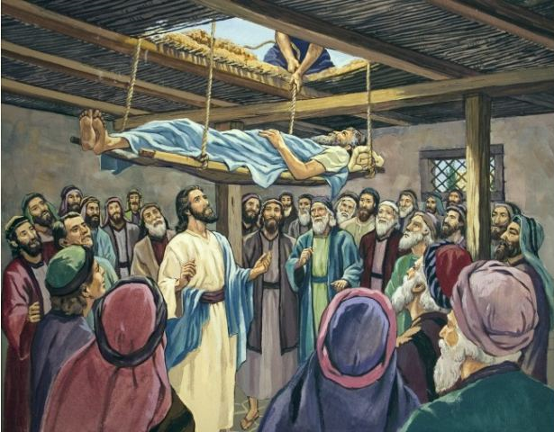
Forgave & Healed Paralytic Man
Luke 5:17-25 – “¹⁷One day He was teaching; and there were some Pharisees and teachers of the law sitting there, who had come from every village of Galilee and Judea and from Jerusalem; and the power of the Lord was present for Him to perform healing. ¹⁸And some men were carrying on a bed a man who was paralyzed; and they were trying to bring him in and to set him down in front of Him. ¹⁹But not finding any way to bring him in because of the crowd, they went up on the roof and let him down through the tiles with his stretcher, into the middle of the crowd, in front of Jesus. ²⁰Seeing their faith, He said, ‘Friend, your sins are forgiven you.’ ²¹The scribes and the Pharisees began to reason, saying, ‘Who is this man who speaks blasphemies? Who can forgive sins, but God alone?’ ²²But Jesus, aware of their reasonings, answered and said to them, ‘Why are you reasoning in your hearts? ²³Which is easier, to say, “Your sins have been forgiven you,” or to say, “Get up and walk”? ²⁴But, so that you may know that the Son of Man has authority on earth to forgive sins,’ - He said to the paralytic – ‘I say to you, get up, and pick up your stretcher and go home.’ ²⁵Immediately he got up before them, and picked up what he had been lying on, and went home glorifying God.”
Notes:
Luke 5:17-25.
When Jesus said, “Friend, your sins are forgiven”, I bet those Pharisees blew a gasket. They knew just like we do that only God can forgive sins. And so, any person making such a claim regarding sin other than God Himself would have been considered blasphemous and subject to the full penalty of the Law.
But Jesus gave a response to this, and it is very sound logic. It is easier to say “Your sins are forgiven” because nobody will know after the fact whether your sins had truly been forgiven. But if telling a paralyzed man to “get up and walk” could be verified, and only God could do such a thing, and if Jesus was to perform that miracle after stating this man’s sins were forgiven, not only was it affirmation that God testified with Him, it was affirmation that He is God.
But the Pharisees are so blind that they cannot make the appropriate application. All they could do was scoff and plot and hate, and so they’re always watching and trying to catch Him in some trap.

Slide 3
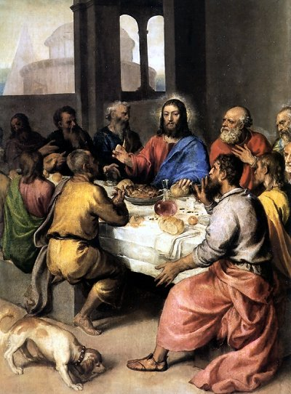
Dined With Publicans
Luke 5:27-32 – “²⁷After that He went out and noticed a tax collector named Levi sitting in the tax booth, and He said to him, ‘Follow Me.’ ²⁸And he left everything behind, and got up and began to follow Him. ²⁹And Levi gave a big reception for Him in his house; and there was a great crowd of tax collectors and other people who were reclining at the table with them. ³⁰The Pharisees and their scribes began grumbling at His disciples, saying, ‘Why do you eat and drink with the tax collectors and sinners?’ ³¹And Jesus answered and said to them, ‘It is not those who are well who need a physician, but those who are sick. ³²I have not come to call the righteous but sinners to repentance.’”
Notes:
In this passage, Jesus is at Matthews house with a bunch of his tax collector buddies – these were some of the most despised men in Judea, and by Jesus associating w/them, it would have appeared on the surface that He commended their nefarious lifestyles – Luke 5:27-32
The Pharisees are present, yet again, watching and trying to catch Him in some transgression. And this time, they disapprove of the fact that He spent His time with the least reputable people in town. The Pharisees would never associate with people such as this because they were too wrapped up in themselves.
Jesus’ response to them? A real physician goes to where the sick are, not the righteous. His goal was to save the least reputable, to bring hope to the lost, and to lift the burden of sin from the shoulders of those who suffered under its immense weight.

Slide 4
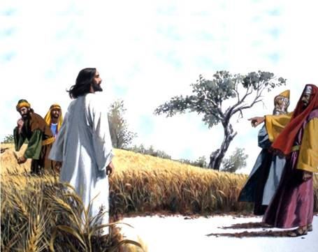
Picked Grain On The Sabbath
Luke 6:1-5 – “¹Now it happened that He was passing through some grainfields on a Sabbath; and His disciples were picking the heads of grain, rubbing them in their hands, and eating the grain. ²But some of the Pharisees said, ‘Why do you do what is not lawful on the Sabbath?’ ³And Jesus answering them said, ‘Have you not even read what David did when he was hungry, he and those who were with him, ⁴how he entered the house of God, and took and ate the consecrated bread which is not lawful for any to eat except the priests alone, and gave it to his companions?’ ⁵And He was saying to them, ‘The Son of Man is Lord of the Sabbath.’”
Notes:
In Luke 6, Jesus and His disciples are walking through the grain fields and the Pharisees are there watching again, hoping to catch Jesus in some transgression. They have their opportunity to accuse when they see Jesus and His disciples picking grain on the Sabbath – Luke 6:1-5.
To pick the heads of grain, rub it between their fingers, and then eat the grain means that they were must have been really hungry. We don’t know what this kind of hunger is like. It was not snack time, but a necessary means of replenishing themselves.
When the secret police accuses them of violating the Sabbath, they did so with their twisted, preconceived belief of what actions violated the Sabbath. Jesus compares the occasion to David’s hunger that caused Him to eat the showbread. Jesus, being the Lord of the Sabbath, knew what violated and did not violate the Sabbath.

Slide 5
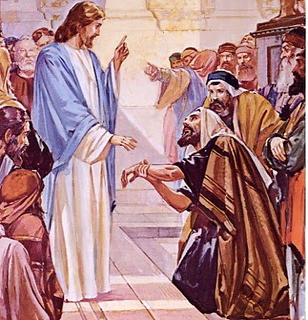
Healed Man’s Hand On Sabbath
Luke 6:6-11 – “⁶On another Sabbath He entered the synagogue and was teaching; and there was a man there whose right hand was withered. ⁷The scribes and the Pharisees were watching Him closely to see if He healed on the Sabbath, so that they might find reason to accuse Him. ⁸But He knew what they were thinking, and He said to the man with the withered hand, ‘Get up and come forward!’ And he got up and came forward. ⁹And Jesus said to them, ‘I ask you, is it lawful to do good or to do harm on the Sabbath, to save a life or to destroy it?’ ¹⁰After looking around at them all, He said to him, ‘Stretch out your hand!’ And he did so; and his hand was restored. ¹¹But they themselves were filled with rage, and discussed together what they might do to Jesus.”
Notes:
Luke 6:6-11 – In this section, the Pharisees were there again watching Jesus as He taught in the synagogue. This time, though, he leaves it up to them to tell Him what should be done for a man on the Sabbath with a withered hand. They would not answer Him one word, though, because either a “yes” or “no” would have condemned them. Mark’s version of this occasion in 3:5 tells us that He looked at them with anger.
What all these occasions show us is that Jesus already had a reputation among the scribes and Pharisees that warranted the statement He made back in Matt 5:17. Because the Pharisees were viewed as the elite sect of the Jews in the people’s eyes, and to go against them meant to go against God. That is why when Jesus came on the scene doing what He did and teaching what He taught that He was looked at by the ignorant elite as one who was trying to tear down God’s law. It was the opposite, in fact…

Slide 6
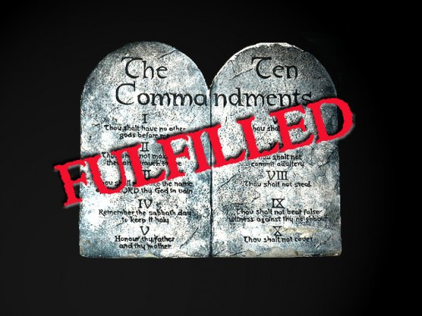
The Law & The Prophets
Matt 5:17 – “Do not think that I came to abolish the Law or the Prophets; I did not come to abolish but to fulfill.”
What Jesus didn’t mean:
Law would never be removed – Jer 31:31-32
Law was profitless – Matt 4:4, 7, 11
Law was not authoritative – Matt 22:29
What Jesus means:
The law will not fail in accomplishing the purpose for which it was given
He Himself will fulfill the Law and its eternal purpose
Notes:
Unless we misunderstand what Jesus meant in Matt 5:17, lets talk about what He did not mean.
First, He did not mean the law would never be removed. Jer 31:31 was an explicate prophecy regarding the temporal nature of the Law of Moses and the eventual coming of a new and better law.
Second, He did not mean that the Law was profitless. The law was profitable enough to ward off the very temptations of Satan in the wilderness. Jesus constantly used the OT in Hs ministry to rebuff challenges, to correct misunderstandings, and to give clarity to the ignorant.
Third, He did not mean the Law was not authoritative. It was because the Sadducees did not take the Law seriously enough that they missed one of the most fundamental teachings of a very well-known passage about the resurrection. The Law had authoritative power over even the strongest of preconceived beliefs.
Jesus’ point is that the Law will remain until it has accomplished the very purpose for which God intended it. And perhaps the boldest claim Jesus makes is that He Himself would fulfill its eternal purpose.

Slide 7
The Law & The Prophets
Matt 5:18 – “For truly I say to you, until heaven and earth pass away, not the smallest letter or stroke shall pass from the Law until all is accomplished.”
Jot – smallest letter of the Aramaic alphabet
Tittle – mark distinguishing Hebrew letters
Matt 5:19 – “Whoever then annuls one of the least of these commandments, and teaches others to do the same, shall be called least in the kingdom of heaven; but whoever keeps and teaches them, he shall be called great in the kingdom of heaven.”
There were certain OT laws that were strange
Our attitude towards the least of God’s commands is our attitude toward God
If this was Jesus’ view of the OT, how much more so to the NT which is superior?
Notes:
To what degree must the law be fulfilled? Matt 5:18 – Not one jot or tittle will pass from the Law until it is complete fulfilled and accomplished. The jot was the smallest letter in the Aramaic alphabet, and the tittle was the little mark that served to distinguish between the Hebrew letters. In our terms, He is saying every “i” will be dotted and every “t” will be crossed, even every lower case “j” will be dotted.
Matt 5:19 – There were some strange laws. In Ex 23:19; 34:16; Deut 12:21-22, the Jews were not allowed to boil a baby goat in its mother’s milk. In Ex 21:6, the Jews were required to pin the ear of a slave through a door to symbolize his willingness to stay on with his master. Deut 22:6-7, the Jews were allowed to take the baby birds from its mother’s nest, but not the mother herself. As strange as some of these laws seemed, the Jews were not allowed to pick and choose which laws they thought were important and disregard the others.
Point: a person’s attitude towards one of the least of God’s commandments is his attitude toward God. And if that was Jesus’ view about the OT, how would He feel about the NT which is superior in so many ways to its predecessor?

Slide 8
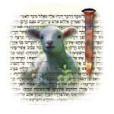
How Was The OT Fulfilled?
Fulfilled Through Jesus
Luke 24:44-48 – “⁴⁴Now He said to them, ‘These are My words which I spoke to you while I was still with you, that all things which are written about Me in the Law of Moses and the Prophets and the Psalms must be fulfilled.’ ⁴⁵Then He opened their minds to understand the Scriptures, ⁴⁶and He said to them, ‘Thus it is written, that the Christ would suffer and rise again from the dead the third day, ⁴⁷and that repentance for forgiveness of sins would be proclaimed in His name to all the nations, beginning from Jerusalem. ⁴⁸You are witnesses of these things.’”
OT centered around Jesus across the entire canon
Helped them to understand so they could teach others using the OT
Notes:
How was the OT fulfilled in Jesus? Luke 24:44-48.
First, the entire OT centered around Jesus. The OT canon was divided up into three sections: the law, the prophets , and the psalms (writings). Every section centered on Jesus and prophesied of Him. In His life and death, He would fulfill its ultimate purpose and then it would be ready to be replaced with a new law.
The apostles needed the understanding to take this evidence to people across the world and therefore Jesus opens their mind to understand what they had been missing.

Slide 9
How Was The OT Fulfilled?
Shadows & Types
Heb 10:1 – “For the Law, since it has only a shadow of the good things to come and not the very form of things, can never, by the same sacrifices which they offer continually year by year, make perfect those who draw near.”
Examples:
Tabernacle - Heb 9:8-9
Sacrifices - Heb 10:2-4
Moses’ serpent – John 3:14
Jonah & the fish – Matt 12:40
While the OT contained types and shadows, the NT would be a worship of spirit and truth (John 4:24)
Notes:
How was the OT fulfilled in Jesus?
Second, the OT contained types and shadows designed to point to greater things to follow in the NT. There are too many examples to name, but they include the tabernacle, the sacrifices, the priesthood, Moses’ serpent, Jonah and the fish, etc. The NT would be different than the OT in that it would contain worship in spirit and in truth – the substance of all God wants in us.

Slide 10
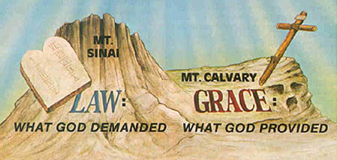
How Was The OT Fulfilled?
Taught righteousness
Rom 8:2-4 – “²For the law of the Spirit of life in Christ Jesus has set you free from the law of sin and of death. ³For what the Law could not do, weak as it was through the flesh, God did: sending His own Son in the likeness of sinful flesh and as an offering for sin, He condemned sin in the flesh, ⁴so that the requirement of the Law might be fulfilled in us, who do not walk according to the flesh but according to the Spirit.”
Law teaches justice and righteousness, but it could not be kept perfectly
The Law wasn’t weak, our flesh was weak and therefore made it sufficient as a permanent fixture
Notes:
How was the OT fulfilled in Jesus?
Third, the purpose of the law was to guide men to the righteous ways of God. God stated continuously throughout the OT that He wanted the Jews to be a people who loved and practiced righteousness and were merciful – to imitate God’s values. But the weakness of the flesh made the law insufficient to bring men to righteousness because it required perfect obedience. Therefore, in it all men sinned and needed Christ to come and do it for us.

Slide 11
How Was The OT Fulfilled?
Tutor that leads to Christ
Gal 3:24 – “Therefore the Law has become our tutor to lead us to Christ, so that we may be justified by faith.”
Children need schooling to learn basic principles and to learn how to make in the world
The OT taught fundamental principles holiness, righteousness, and virtue every Jew needed to know to be right with God
When Christ came, they were no longer under a tutor
Notes:
How was the OT fulfilled in Jesus?
Fourth, the OT was intended to be a tutor to lead others to Christ so they could be justified by faith (Gal 3:24). Since children don’t have enough sense to make it on their own, they need schooling to learn fundamentals to make it in life. The Jews, as children, needed to learn fundamentals of righteousness to be close to God. Once Jesus, came however, we are no longer under a tutor.

