Slide 1
Notes:
Heb 4:15 – What this means is that the challenges Jesus has been bringing to light in this sermon are challenges He understands. But having conquered the temptations inherit in the challenges of this sermon, He is teaching us how to overcome them as He did. He is challenging us to a higher plain of Christianity because He knows it is within our grasp to do so by faith. As radical of a faith that this sermon is calling us to achieve, it is absolutely within our grasp if we truly desire to serve God above all else.
Now part of developing that faith that immerses ourselves in the kingdom living He’s talking about here is by following the example of Jesus – Heb 5:8. So what is your weakness? Is it being self-righteously judgmental as we talked about last week? Is it anxiety, materialism, pride? Is it loving your enemies and praying for them? Whatever your weakness, what do you have to do to overcome those weaknesses? You have to suffer. Fighting temptation is hard, there is suffering involved in self-denial. So don’t just read Heb 5:8 as Jesus suffering physically in order to learn obedience. Much of His suffering involved the same ruthless self-denial that we’re called on to suffer through. And so, the one who is challenging us in this sermon is calling on us to be like Him, and He is living proof in both word and deed that we can overcome it and become what He is challenging us to be. Never forget that. Jesus never once asked us to do anything, to go through anything, that He Himself didn’t go through.
The 3 topics under consideration in this study are the dogs and swine, asking/seeking/knocking, and the golden rule. On the surface, they don’t appear to be connect in anyway. They are actually very connected, and we’ll draw out that connection as we proceed.

Slide 2
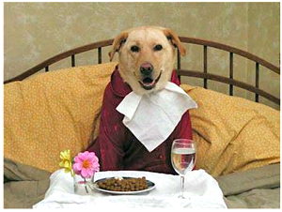
Dogs & Swine
Matt 7:6 – “Do not give what is holy to dogs, and do not throw your pearls before swine, or they will trample them under their feet, and turn and tear you to pieces.”
What Jesus is not telling us:
Judge who is worthy
Dismiss argumentative people
Dismiss those who disagree
Notes:
Matt 7:6 – What is Jesus saying here? He’s saying that there are some people who have no interest in the gospel, and that we are not to waste our time w/such people. Very bold statement. But unless we misinterpret this, lets be absolutely clear on what Jesus does not mean.
Jesus is not telling us to decide who is worthy of being taught and to teach them. And the problem w/this approach is that we’ll just end up honing in on those people who are like us and who we feel comfortable with. But we can’t do that and be consistent w/what Jesus said in the Great Commission – Mark 16:15. This is going to include a lot of people that are not like us.
Jesus is also not telling us to avoid people who are argumentative. We are going to encounter some people who are religiously biased in a particular direction, and they will contend very zealously for what they believe. And if someone like this wants to study w/you and plead his case, study with him. If he argues a point, deal w/the argument in love, humility, patience, and kindness. Don’t dismiss him just because he is attached. However, keep in mind 1 Tim 6:3-5 – In other word, do watch out for conceited people that are only interested in arguing for the sake of arguing.
Also, Jesus is not telling us not to study people who disagree w/you. Just ask them why? Do you disagree because God is saying something differently? Than please show me. Or are you disagreeing because you’re hearing a new truth and starting to count the cost? Don’t let them use the “I disagree” card as if their disagreement ends all discussion. Try to bring them back to the root of their disagreement. Show patience and kindness, but challenge them as you would want to be challenged if you are wrong.

Slide 3
Dogs & Swine
Matt 7:6 – “Do not give what is holy to dogs, and do not throw your pearls before swine, or they will trample them under their feet, and turn and tear you to pieces.”
What Jesus is not telling us:
Judge who is worthy
Dismiss argumentative people
Dismiss those who disagree
What Jesus is telling us:
Some people just don’t want
Notes:
What Jesus is telling us in vs. 6 is the same thing He told the apostles on the Limited Commission in Matt 10:11-15. What is He saying in these verses? You are going to encounter people who have no interest in spiritual things; they simply don’t want what you’re trying to show that Jesus is offering them. And many in the world have this disposition. Sometimes we have family or friends we want to convert so badly that we believe we can just beat it into them and they’ll submit. We cannot force a person into the kingdom. If they don’t want it, they don’t want it. In the Parable of the Sower, what was the explanation of the seed sown on the wayside? – Matt 13:19. Illustration – when I handed a guy at a record store a dial-a-bible card, he looked at it and burst out laughing in my face. He had zero interest. Ironically, I would have been that guy in high school and college. Time and circumstance have the potential to soften the hardest hearts. But if they’re not ready, they’re not ready. And so, what Matt 7:6 is really about is “learning to take ‘no’ for an answer”. We need to move on from this person to someone else.

Slide 4
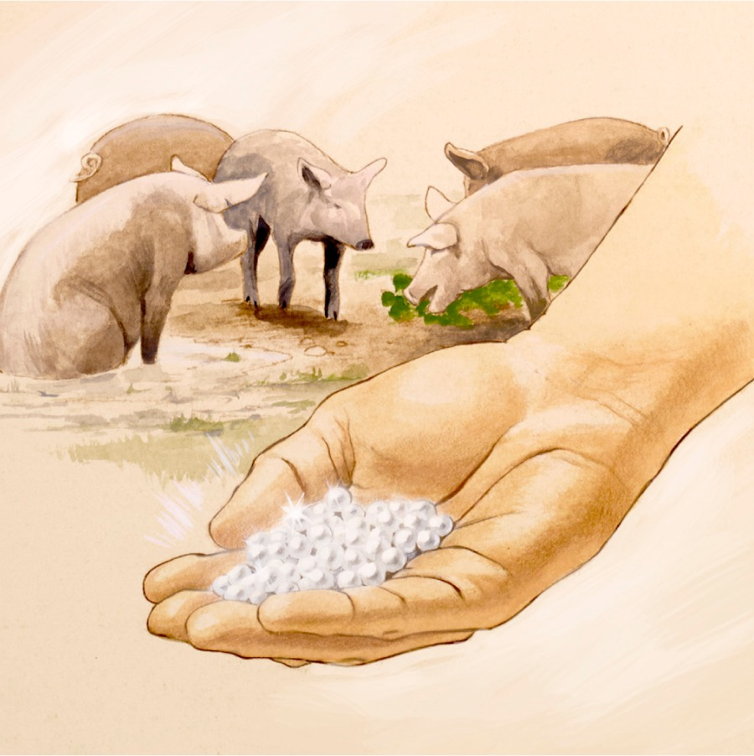
Dogs & Swine
Matt 7:6 – “Do not give what is holy to dogs, and do not throw your pearls before swine, or they will trample them under their feet, and turn and tear you to pieces.”
For many, what does not satisfy them carnally is of no interest
Many will “trample” you for what you are giving them
This does not mean they can’t change
Notes:
See, swine don’t care about much of anything unless they can eat it. And so, if you give a pig a string of valuable pearls, he’ll see if he can eat it, but when he realizes he can’t, he’ll trample all over it. Likewise, there are some who will not like what you offer them in the gospel because it won’t satisfy them from a carnal standpoint. “What can this do for me physically? Nothing? Then I don’t want it!” – they’re not interested.
And guess what will happen if you try to impress upon them the gravity of the situation? They’ll trample all over you!
Again, this does not mean that one day this person won’t become interested. Soil can change throughout life has hardships and storms are introduced. The school of hard knocks can change our perspective, something we can all relate to. But if they are not interested now, move on to someone else because there is someone else in our community who is interested now.

Slide 5
Dogs & Swine
Matt 7:6 – “Do not give what is holy to dogs, and do not throw your pearls before swine, or they will trample them under their feet, and turn and tear you to pieces.”
For many, what does not satisfy them carnally is of no interest
Many will “trample” you for what you are giving them
This does not mean they can’t change
Jesus was the ultimate Evangelist and could not convert everyone
Not a “proof text” for not teaching someone you just don’t want to teach
Notes:
Remember, Jesus was the ultimate Evangelist and He could not convert everyone. If He had, He would have never been crucified. And so, Jesus was personally acquainted with this teaching. And His apostles applied this as they went about preaching – Acts 13:45-46. Now, we’re all unworthy. But a person who has no interest, he would be especially unworthy of further study until there is a change of heart.
And so, we must be very careful that we do not use this text as a “proof-text” to avoid teaching people that can be difficult. I was a difficult prospect 20 years ago, but that wasn’t because I didn’t want to study, but because of the implications of having to personally repent of my sins. And I’m thankful for the evangelist that didn’t give up on me, but pushed me to seek things above and not things on the earth. If someone wants to study, study with them. Just don’t spin your wheels on someone who has no interest.

Slide 6
Ask, Seek, & Knock
Matt 7:7-8 – “⁷Ask, and it will be given to you; seek, and you will find; knock, and it will be opened to you. ⁸For everyone who asks receives, and he who seeks finds, and to him who knocks it will be opened.”
Main thrust is our attitude toward God and His righteousness – Matt 6:33; Luke 11:13
Notes:
Matt 7:7-8 – Just like “judge not lest ye be judged”, these are more verses that are often taken out of context and so we must be careful in how we apply them. Many in our day and time use these verses as the centra thrust behind the “health and wealth” gospel. Is that consistent w/what Jesus has already said in the previous chapter about wealth? What did He tell us not to store up? Treasures on earth. And He said so because it takes away our devotion toward God. But then He’s going to come back and tell us that if we want wealth bad enough, He’ll give it to us anyway? That’s not consistent at all.
If we’re staying within context, then these verses apply to our attitude toward God and His righteousness – Matt 6:33. We seek His kingdom and righteousness first because it is the most important thing we could ever do – nothing in this world should compete w/it. When we ask, seek, and knock, we’re beseeching God to be as righteous and as holy as He is. There is a parallel passage to what Matthew is saying here in Luke 11:13. And so what are we to be asking, seeking, and knocking for? The Holy Spirit, or more specifically fruit of the Spirit.

Slide 7
Ask, Seek, & Knock
Matt 7:7-8 – “⁷Ask, and it will be given to you; seek, and you will find; knock, and it will be opened to you. ⁸For everyone who asks receives, and he who seeks finds, and to him who knocks it will be opened.”
Main thrust is our attitude toward God and His righteousness – Matt 6:33; Luke 11:13
If we seriously want this, God will not refuse it –Deut 4:29; Jer 29:12-13; Jas 4:2-3; Heb 11:6
Notes:
These verses are teaching that if we want it bad enough, God will not deny us. If we want to have His righteousness, we can have it. He will not refuse this for us. This is a truth taught across both testaments – Deut 4:29; Jer 29:12-13; Jas 4:2-3. This is not talking about getting things from God to spend on our pleasures. It’s asking God to for the pleasure of truly being right Him, and being willingly to diligently seek it – Heb 11:6. And so, we need to approach the Lord in prayer for this standard and have full confidence He’ll make good on His word when we do.

Slide 8
Ask, Seek, & Knock
Matt 7:9-11 – “⁹Or what man is there among you who, when his son asks for a loaf, will give him a stone? ¹⁰Or if he asks for a fish, he will not give him a snake, will he? ¹¹If you then, being evil, know how to give good gifts to your children, how much more will your Father who is in heaven give what is good to those who ask Him!”
If we would never deny our child, why would God deny His children?
Notes:
What reason do we have for believing God is credible in this? – Matt 7:9-11 – We would never think of denying one of our children what they need, right? But it happens sometimes doesn’t it? There are parents who abandon their children, and abortion is an example of that. But how does God’s love compare to earthly parents? – Isa 49:14 – Now this is Zion’s charge against God, that He had forgotten them. Now check out God’s response – Isa 49:15ab – This is profound, isn’t it? A nursing mother cannot forget her child. She will remember regularly throughout the day that she has a child because she’ll need to nurse that child as much as the child will have a need to be nursed. But I suppose it isn’t too far-fetched to assume that a nursing mother could get so wrapped up w/the business of a day that she momentarily forgets where her children are, but that moment won’t last. A nursing mother will be drawn back to her child physically and instinctively. It’s unfathomable to think that would happen. So, here’s the point – Isa 49:15c – He’s not saying that there are a bunch of mothers out there who forget their children and don’t show their children any compassion. He’s saying that before God forgets us, we will forget our children. And if a mother forgetting her children seems like an impossibility, know that it is an even greater impossibility that God forgets us. This is a large church. And I dare say the majority of us here don’t know everyone’s name. In fact, those we have known the names of, isn’t it frustrating when we forget their name and how we’ll be talking to that person and it’s on the tip of our tongue? But God doesn’t forget our name. In fact, He doesn’t just know the names of those in this assembly, but in assemblies all around the world, and in all generations – “Even these may forget, but I will not forget you”. How do we know? What evidence has He given us? Isa 49:16 – In what very graphical way did God inscribe us on His hands? The crucifixion.

Slide 9
Ask, Seek, & Knock
Matt 7:9-11 – “⁹Or what man is there among you who, when his son asks for a loaf, will give him a stone? ¹⁰Or if he asks for a fish, he will not give him a snake, will he? ¹¹If you then, being evil, know how to give good gifts to your children, how much more will your Father who is in heaven give what is good to those who ask Him!”
If we would never deny our child, why would God deny His children?
However, He cannot and will not give us what we do not really want
Notes:
Brethren, we are plagued with all sorts of evil and temptations to hurt and harm ourselves and others. Therefore, what should the cross say about His real, genuine desire not just to forgive us, but to inspire us toward His righteous character? And why, if we seek it, would He go through all that pain and suffering and the years of planning and not willing to give us what we need? Why would God deny us what He has explicitly said He wants to give us? He loves us with incompressible love, why would He ruin our lives?
Now, understand this, He cannot and will not give us that righteousness if we do not seek it with all of our heart. What He is offering us involves our will and our hearts, our spiritual side. And until we desire to give up our hearts to God, we’re never going to ask for it. And even if we do ask for it but the desire is not there, God still cannot give it to us. There’s a reason these verses follow up Matt 7:6 because just as we cannot force the gospel on someone who has no interest, God cannot force us to be godly if we have no interest. It must be a conscious choice on our part, and there must be the diligence to seek it w/all our heart, mind, soul, and strength. See how the greatest commandment is really in play here?

Slide 10
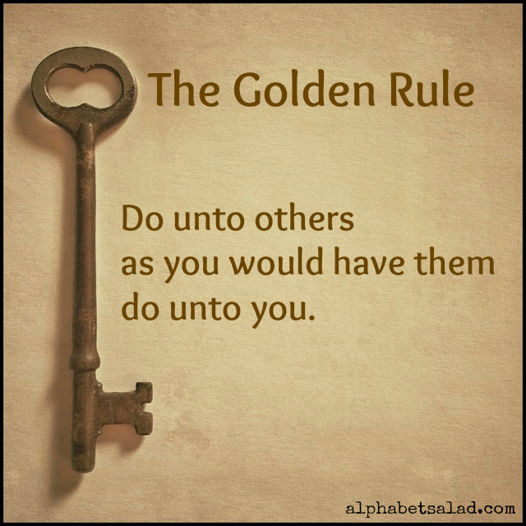
The Golden Rule
Matt 7:12 – “In everything, therefore, treat people the same way you want them to treat you, for this is the Law and the Prophets.”
God wants us to see how He treats His children so that we will treat one another the same way
It is the law and the prophets because it encompasses the 2nd greatest commandment
Notes:
Matt 7:12 – Now if “judge not lest ye be judged” is one of the most misinterpreted verses, this could very well be one of the most well-known verses, beloved by Christians and non-Christian alike, though seldom practiced by most.
Why is this verse here when it feels like it shouldn’t be? The “therefore” is here because God is wanting us to see how He treats His children, that He always wants to give us what is best for us. And if we have the attitude of God as our Father, we’re always going to give our fellow man whatever it is they need – this is the golden rule.
The golden rule is simply a restatement of the second greatest commandment – “You shall love your neighbor as yourself.” And the key to applying is that word “yourself”. It starts w/retrospection. We’re not to treat others as we think they deserve to be treated. We’re to put ourselves in their shoes and ask, “How would I need to be treated if I was in their position?”

Slide 11
The Golden Rule
Matt 7:12 – “In everything, therefore, treat people the same way you want them to treat you, for this is the Law and the Prophets.”
God wants us to see how He treats His children so that we will treat one another the same way
It is the law and the prophets because it encompasses the 2nd greatest commandment
We love because God first loved us – 1 John 4:19
Notes:
So then if this verse is known and loved by all, why is it not practiced by those who so admire it? Selfishness and self-centeredness, the kind of which will never cease until we first come to love God w/all our heart, soul, mind and strength – the first greatest commandment. We only learn to loves others by learning how God loving God because of how much He has loved us – 1 John 4:19. Only when God’s love for us has penetrated our hearts will it drive out that love of self that then frees us to love others as we love ourselves, to treat others as we would want to be treated. This is the reason behind the “therefore”. The foundation for our treatment of other people, the 2nd greatest commandment, is by understanding how God has treated us – not giving us what we deserve, but what we need. This brings us right back to the beginning, the Beatitudes, in that disciples worthy of the kingdom will be those who show mercy because God showed us mercy. Since He gave us what we needed and not what we deserved, we are better off. Imagine how we could bless and help others if we took on this example in our lives?

