Slide 1
Psalms
Book 1 – Psalms 1 - 41

Slide 2
Arrangement of the Psalms
The Psalms were originally collected into 5 “books” according to the material found in them
Book I (Psalm 1 & 2, 3 – 41) – finish first half today
Book II (Psalm 42 – 72)
Book III (Psalm 73 – 89)
Book IV (Psalm 90 – 106)
Book V (Psalm 107 – 150)

Slide 3
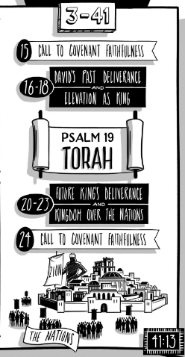

Slide 4
Psalms Book 1 Summary
Psalm 4:4 “Be angry, and do not sin;
ponder in your own hearts on your beds, and be silent.”
Psalm 5:7b “I will bow down toward your holy temple in the fear of you”
Psalm 6:6a “I am weary with my moaning”
Psalm 7:8b-9a “judge me, O Lord, according to my righteousness and according to the integrity that is in me. Oh, let the evil of the wicked come to an end; and may you establish the righteous…”
Psalm 8:5-6a “Yet you have made him a little lower than the heavenly beings and crowned him with glory and honor. You have given him dominion over the works of your hands”
Psalm 9:11b “Tell among the people His deeds!”

Slide 5
Psalms Book 1 Summary
Psalm 10:9b-10a “he seizes the poor when he draws them into his net. The helpless are crushed”
Psalm 11:4b “the Lord’s throne is in heaven”
Psalm 12:5b “I will now arise, says the Lord”
Psalm 13:1 “How long, O Lord? Will you forget me forever?
How long will you hide your face from me?”
Psalm 14:4a “Have they no knowledge, all the evildoers”
Psalm 16:6b “indeed, I have a beautiful inheritance”
Psalm 17:8 “Keep me as the apple of your eye;
hide me in the shadow of your wings”
Psalm 18:25 “With the merciful you show yourself merciful;
with the blameless you show yourself blameless”

Slide 6
Psalm 15
Book has a “mostly” simple format
Question(s) asked (vs 1)
Answer(s) given (vs 2 – 5b)
Personal character (vs 2)
Relationship to neighbors (vs 3)
Relationship to the evil\Godly man (vs 4)
Relationship to all (vs 4c – 5b)
Conclusion (vs 5c)
He who does these things shall never be moved.”
He will dwell in the Lord’s tent (question 1)
He will dwell on the Lord’s holy hill (question 2)

Slide 7
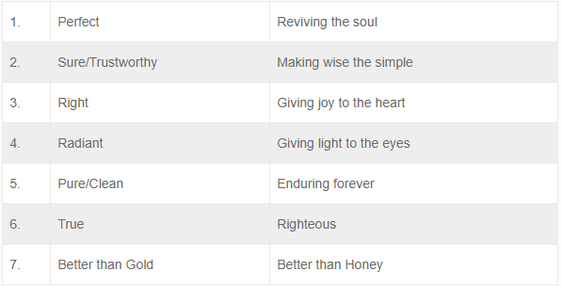
Psalm 19
The number 7 (perfection) is found throughout
Perfection is God’s creation \ nature
Perfection in God’s Law
Concluding prayer (vs 11-14)

Slide 8
Psalm 18
II Samuel 22 this Psalm is seen here (with slight differences)
Psalm of David, when delivered from Saul
A shift on our view of “The Nations”
Difficult to summarize
God is a mighty warrior
God saves us from drowning
God is just
God makes us great
God wins
God is to be praised

