Slide 1
Psalms
Book 2 – Psalms 73 - 89

Slide 2
Arrangement of the Psalms
The Psalms were originally collected into 5 “books” according to the material found in them
Book I (Psalm 1 & 2, 3 – 41)
Book II (Psalm 42 – 72)
Book III (Psalm 73 – 89)
Book IV (Psalm 90 – 106)
Book V (Psalm 107 – 150)

Slide 3
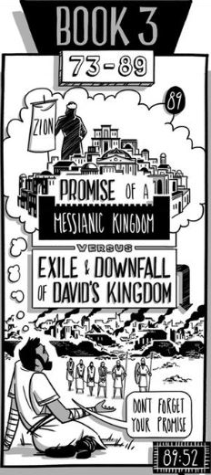
Book III includes 11 songs by Asaph, poems by the Sons of Korah and one by David. This is the darkest of the books making a clear parallel to the book of Lamentations.

Slide 4
Psalms Summaries
Psalm 73:16-17 “But when I thought how to understand this,
it seemed to me a wearisome task,
until I went into the sanctuary of God; then I discerned their end.”
Psalm 74:1a “O God, why do you cast us off forever?”
Psalm 75:10 “All the horns of the wicked I will cut off,
but the horns of the righteous shall be lifted up.”
Psalm 76:7 “Buy You, You are to be feared!
Who can stand before You when once your anger is roused?”
Psalm 77:7a\11a “Will the Lord spurn forever…
I will remember the deeds of the Lord”
Psalm 78:32 “In spite of this, they still sinned;
despite His wonders, they did not believe.”
Psalm 79:4 “We have become a taunt to our neighbors,
mocked and derided by those around us.”
Psalm 80:7 “Restore us, O God of hosts; let your face shine,
that we may be saved!”

Slide 5
Psalms Summaries
Psalm 81:8 “Hear, O my people, while I admonish you! O Israel,
if you would but listen to Me!”
Psalm 82:4 “Rescue the weak and the needy;
deliver them from the hand of the wicked.”
Psalm 83:16 “Fill their faces with shame, that they may seek Your name, O Lord”
Psalm 84:1 “How lovely is your dwelling place, O Lord of hosts!”
Psalm 85:4 “Restore us again, O God of our salvation,
and put away your indignation toward us!
Psalm 86:7 “In the day of my trouble I call upon You, for You answer me.”
Psalm 87:3 “Glorious things of You are spoken, O city of God”
Psalm 88:9 “my eye grows dim through sorrow.
Every day I call upon You, O Lord; I spread out my hands to You.”
Psalm 89:38 “But now you have cast off and rejected;
you are full of wrath against your anointed.”

Slide 6
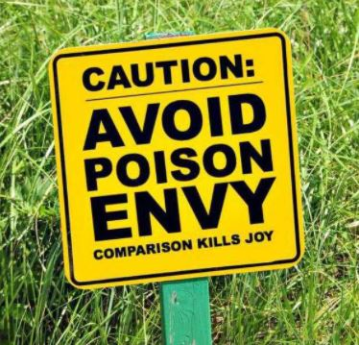
Psalm 73
The contradiction between God’s goodness and the prosperity of the wicked (1-3)
The good life of the wicked (4-9)
The godly have doubts (10–14)
A New Perspective (15-17)
The wicked are not so safe (18-20)
I was foolish, you guide me (21-24)
Heavenly Hope (25-28)

Slide 7
Psalm 73

Slide 8
Psalm 79
The devastation of Jerusalem (1-4)
Prayer for God’s Anger to turn (5-7)
Plea for Rescue (8-10)
Hear the Prayers\Plight of the Suffering (11-12)
Vow to Give Thanks…Hope (13)

Slide 9
Psalm 84
Longing for the House of God (1-2)
Satisfaction in God’s House (3-4)
Finding strength in God (5-7)
Hear our Prayer (8-9)
The Greatness of God and His House (10-12)

