Slide 1
Psalms
Book 2 – Psalms 42 - 72

Slide 2
Arrangement of the Psalms
The Psalms were originally collected into 5 “books” according to the material found in them
Book I (Psalm 1 & 2, 3 – 41)
Book II (Psalm 42 – 72) 42-56
Book III (Psalm 73 – 89)
Book IV (Psalm 90 – 106)
Book V (Psalm 107 – 150)

Slide 3
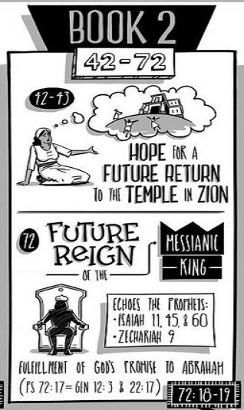
Book II is Psalms 42-72 and includes poems written by the Sons of Korah, David, Asaph and Solomon. These psalms continue the cry for help and many of the poems are written when David was in exile running from King Saul paralleling the book of Exodus.

Slide 4
Psalms Book 1 Summary
Psalm 42:8 “By day the Lord commands his steadfast love,
and at night His song is with me, a prayer to the God of my life.”
Psalm 43:5c “Hope in God; for I shall again praise Him”
Psalm 44:13 “You have made us the taunt of our neighbors,
the derision and scorn of those around us.”
Psalm 45:9 “daughters of kings are among your ladies of honor;
at your right hand stands the queen in gold of Ophir.”
Psalm 46:7 “The Lord of hosts is with us; the God of Jacob is our fortress.”
Psalm 47:6a “Sing praises to God, sing praises!”
Psalm 48:8 “As we have heard, so we have seen in the city of the Lord of hosts, in the city of our God, which God will establish forever.
Psalm 49:1 “Hear this, all peoples! Give ear, all inhabitants of the world”

Slide 5
Psalms Book 1 Summary
Psalm 50:7 “Hear, O my people, and I will speak; O Israel,
I will testify against you. I am God, your God.”
Psalm 51:10 “Create in me a clean heart, O God,
and renew a right spirit within me.
Psalm 52:6 “The righteous shall see and fear, and shall laugh at him”
Psalm 53:4 “Have those who work evil no knowledge,
who eat up my people as they eat bread, and do not call upon God?”
Psalm 54:4 “Behold, God is my helper; the Lord is the upholder of my life.”
Psalm 55:15 “Let death steal over them; let them go down to Sheol alive;
for evil is in their dwelling place and in their heart.”
Psalm 56:4 “In God, whose word I praise, in God I trust;
I shall not be afraid. What can flesh do to me?

Slide 6
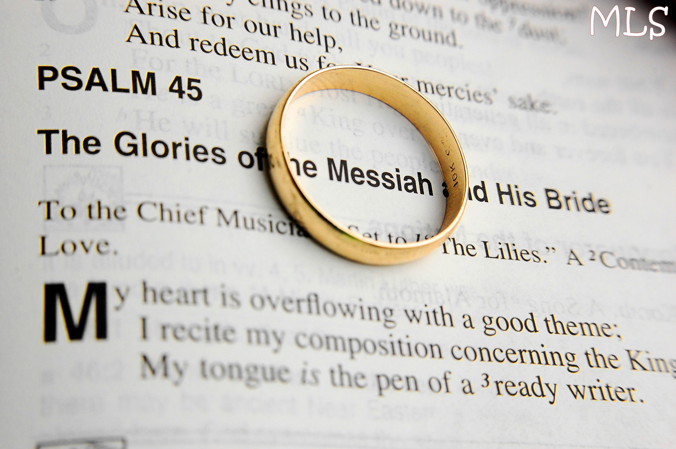
Psalm 45
A Love song, written for a King of Israel

Slide 7
Psalm 45

Slide 8
Psalm 45

Slide 9
Psalm 51
Wash be thoroughly, cleanse me from my sin (vs 2)
I know my sin (vs 3)
Against You have I sinned (vs 4)
Purge me, wash me (vs 7)
Create in me a clean heart, renew my spirit (vs 10)
A promise, to show others (vs 13)
Remorseful heart (vs 17)

Slide 10
Psalm 52
A Maskil of David, when Doeg, the Edmonite, came and told Saul “David has come to the house of Amhimelech.”
I Sam 21-22 events happen
7 Attributes of an evil person (vs 2-4)
7 impacts from God’s judgment on them (vs 5-6)
David’s response is Trust in God
His Justice
His Love

Slide 11
Psalm 56
“In God, whose word I praise,
In God I trust; I shall not be afraid.
What can flesh do to me?” – vs 4
“In God, whose word I praise,
in the Lord, whose word I praise, - vs 10
In God I trust; I shall not be afraid.
What can man do to me? – vs 11
Begin with Praise
Overcome fear with faith
Recognize that God is in control of our life
Ps 56:3

