Slide 1
“The fear of the Lord is the beginning of knowledge”
(Prov 1:7a)
“The knowledge of the Holy One is understanding”
(Prov 9:10b)
“For if you cry for discernment, lift your voice for understanding”
(Prov 2:3)
“The fear of the Lord is the beginning of wisdom” (Prov 9:10a)
“The fear of the Lord is the instruction for wisdom” (Prov 15:33a)
Understanding
Formerly spelled “rightwiseness”
Fear
Instruction
Knowledge
Discernment
Righteousness
Trust
“The mouth of the righteous flows with wisdom”
(Prov 10:31a)
“Trust in the Lord with all your heart and do not lean on your own understanding.”
(Prov 3:5)
Wisdom
…has built her house, she has hewn out her seven pillars. (Prov 9:1)

Slide 2
FACTUAL KNOWLEDGE
SITUATIONAL INSIGHT
NECESSARY RESOLVE
Righteous goal
2 Tim 2:15 – “Be diligent to present yourself approved to God as a workman who does not need to be ashamed, accurately handling the word of truth.”
John 7:24 – “Do not judge according to appearance, but judge with righteous judgment.”
Notes:
The definition of wisdom that we’ve been evaluating is this – “Wisdom is the combination of factual knowledge, situational insight, and necessary resolve, which, when practiced, has the greatest likelihood of achieving an intended righteous goal”. The subject of this lesson will be “situational insight” which the bible calls “discernment”.
Discernment is an ability that we gain, based on our knowledge, our understanding, and the trust we have in that knowledge, which equips us with the ability to accurately decide between things. It is the quality of being able to grasp and comprehend what is obscure; a power to perceive what is not evident to the average mind and to appropriately measure their weights – 2 Tim 2:15 – Some of your translations say “rightly dividing the word of truth” which indicates that even the things in God’s word have not been given equal weight, in a manner of speaking.
Many times, the things in which we have to discern between look so similar, which makes decision making difficult. This is why discernment is sometimes referred to as a sixth sense. But its not a sixth sense in the case of being a super power gifted to only a select few. The bible commands us to have this situational insight which means God has given us everything we need to obtain it because not everything can be judged based on how it looks on the surface – John 7:24

Slide 3
Hos 14:9a – “Whoever is wise, let him understand these things; whoever is discerning, let him know them.”
Psa 119:99 – “I have more insight than all my teachers, for Your testimonies are my meditation.”
Discernment
Prov 10:13a – “On the lips of the discerning, wisdom is found”
Prov 2:3 – “For if you cry for discernment, lift your voice for understanding”
Psa 119:66 – “Teach me good discernment and knowledge, for I believe in Your commandments.”
Notes:
There is a relationship between wisdom and discernment, and sometimes these two concepts are referred to synonymously in scripture – Hos 14:9a - But the bible also refers to discernment as the application of wisdom based on other qualities that one has gained in his/her discipleship.
First, discernment is the application of knowledge – Psa 119:99 – In other words, here is the guy who takes in God’s testimonies, knowledge, and he meditates and meditates on it. And because its no longer abstract knowledge, but knowledge with meaning, he develops discernment.
Second, discernment is the application of understanding – Prov 2:3 – No discernment can be obtained without an understanding of the knowledge we receive, the implications, having the knowledge and “getting it”.
But third, notice how discernment is also the application of trust – Psa 119:66 – “Teach me good discernment and knowledge, for I believe in Your commandments.”
All three of these combined, knowledge, understanding, and trust gives us that sixth sense we so desperately need to avoid the many pains that this life can bring – Prov 10:13a

Slide 4
“Anakrino”: “judging w/a view toward heaven in mind”
1 Cor 2:14-15 – “But a natural man does not accept the things of the Spirit of God, for they are foolishness to him; and he cannot understand them, because they are spiritually appraised. But he who is spiritual appraises all things, yet he himself is appraised by no one.”
Acts 17:11 – “Now these were more noble-minded than those in Thessalonica, for they received the word with great eagerness, examining the Scriptures daily to see whether these things were so.”
“Diakrino”: “judge back-and-forth, separate, examine”
1 Cor 11:29 – “For he who eats and drinks, eats and drinks judgment to himself if he does not judge the body rightly.”
Acts 15:9 – “and He made no distinction between us and them, cleansing their hearts by faith.”
Notes:
When the word “discern” is used in scripture, or just the concept, there are two different Greek words used. The first is “anakrino” and the second is “diakrino”. Both are compound words and “krino” is the common word between them both, which simply means “to judge”.
“Ana” means “up” which suggests it is a heavenly judgment, not from God so much as the perspective from which the judgment is made. It is judgment made between things on the basis that a Christian would naturally seek things above and not below (Col 3:1). So we’re making judgments between two or more seemingly opposing concepts with a view toward heaven – 1 Cor 2:14-15; Acts 17:11
“Dia”, however, means “thoroughly back and forth”, which when combined with “krino”, “to judge”, further qualifies and intensifies it as if to mean “judging back and forth between things”. You’re separating things out and examining and comparing them to one another – 1 Cor 11:29; Acts 15:9
In Christianity, there are different things we have to learn to discern between:
Right vs. wrong
Good vs. better
Better vs. best
Primary vs. secondary
Essential vs. indifferent
Permanent vs. transient

Slide 5
Discerning Between…
Right Vs. Wrong
1 Kings 3:9 – “So give Your servant an understanding heart to judge Your people to discern between good and evil. For who is able to judge this great people of Yours?”
2 Cor 11:14-15 – “No wonder, for even Satan disguises himself as an angel of light. Therefore it is not surprising if his servants also disguise themselves as servants of righteousness, whose end will be according to their deeds.”
1 John 4:1 – “Beloved, do not believe every spirit, but test the spirits to see whether they are from God, because many false prophets have gone out into the world.”
1 Thes 5:21 – “But examine everything carefully; hold fast to that which is good”
Notes:
Discernment is recognizing the difference between right vs. wrong.
Solomon’s own wisdom was conditional upon his ability to discern and he knew this would be pivotal from a right and wrong perspective – 1 Kings 3:9 – Solomon knew that his success as a king would depend on how ably he was to relinquish justice for those under his authority. There is right and there is wrong, and he knew that sometimes what is wrong can look so right and what initially looks right can be so wrong. He is praying to God for this sixth sense to see through to the truth.
If there is one thing we know about Satan from scripture, it is that he does not come at us with blunt face lies – 2 Cor 11:14-15 – That would be too easy to detect. No, he typically puts some truth in the temptation, but just enough lie to trip you up and get you sinning, or get you hurting yourself.
I love how Charles Spurgeon put it – “Discernment is not knowing the difference between right and wrong. It is knowing the difference between right and almost right.” And there is some truth to that. What Satan told Eve was almost right in some ways. But it was just wrong enough to cause her to sin and set off the chain of events from which we are all affected. Satan even used scripture against Jesus in the wilderness in an effort to get Him to sin, but Jesus had the discernment to see through Satan’s misinterpretation of Psalm 91 and to fend him off with the whole truth. This is what we have to develop, not just the ability to see right from wrong, but right fro almost right – 1 John 4:1; 1 Thes 5:21

Slide 6
Discerning Between…
Right Vs. Wrong
Good Vs. Better
1 Cor 7:25 – “Now concerning virgins I have no command of the Lord, but I give an opinion as one who by the mercy of the Lord is trustworthy.”
1 Cor 7:26 – “I think then that this is good in view of the present distress, that it is good for a man to remain as he is.”
1 Cor 7:28 – “But if you marry, you have not sinned; and if a virgin marries, she has not sinned. Yet such will have trouble in this life, and I am trying to spare you.”
1 Cor 7:38 – “So then both he who gives his own virgin daughter in marriage does well, and he who does not give her in marriage will do better.”
Notes:
Second, discernment is recognizing the difference between good vs. better.
In 1 Cor 7, Paul is giving them advice on whether, at that time, those who are unmarried should seek to be married. Its not a command, just advice, which we know from – 1 Cor 7:25 – What’s the advice? – 1 Cor 7:26 – Whatever this distress is, which we suspect was great persecution of the saints, Paul was trying to help them avoid as much trouble as he could. In fact, he tells them if they’ve just got to be married, go ahead and do it – 1 Cor 7:28 – So is marriage a good thing? Yes, its divinely given to us by God, though it is not commanded. Are there certain times, certain events in world history, that would make being responsible for a wife and children more difficult than others? Absolutely. So this is not a right verses wrong, this is a good vs. better – 1 Cor 7:38 – Marriage is good, but for the present distress, stating unmarried would be better, and would allow them to keep focused on serving Christ during times when it was going to be really hard to do so.
And so sometimes we need discernment just for things like this. Meaning, its not a matter of right vs. wrong, good vs. evil; its just a matter of whether I need to go the good path or the better path. And choosing the better path is the better path.

Slide 7
Discerning Between…
Right Vs. Wrong
Good Vs. Better
Better Vs. Best
1 Cor 7:8-9 – “But I say to the unmarried and to widows that it is good for them if they remain even as I. But if they do not have self-control, let them marry; for it is better to marry than to burn with passion.”
Rom 8:18 – “For I consider that the sufferings of this present time are not worthy to be compared with the glory that is to be revealed to us.”
Notes:
However, discernment is also recognizing the difference between better vs. best.
Let’s assume the same scenario, but introduce another variable into the picture – 1 Cor 7:8-9 – Now you have the situation where a person may be subject to stronger sexual temptation than another person. And that may override the whole “better to be single” choice. Now it may be best to go ahead and marry despite the trouble it will cause you in the present distress. Because now I’ve got two troubles I have to discern between. There is trouble that comes as a married person in a time of distress, and trouble that comes as an unmarried person due to a potential struggle w/lust regardless whether it is a time or distress or not. Now you have to weigh the two. Which is worse, the physical and mental turmoil of being married in a time of distress or the spiritual trouble you would give into by not being in a relationship where you can fulfill those desires in a lawful way? It would be best to marry in this situation. – Rom 8:18 – See ho we’re rightly dividing the word?

Slide 8
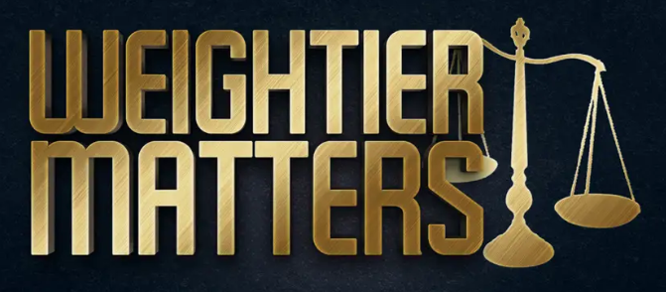
Discerning Between…
Right Vs. Wrong
Good Vs. Better
Better Vs. Best
Primary Vs. Secondary
1 Cor 15:3-4 – “For I delivered to you as of first importance what I also received, that Christ died for our sins according to the Scriptures, and that He was buried, and that He was raised on the third day according to the Scriptures”
Matt 23:23 – “Woe to you, scribes and Pharisees, hypocrites! For you tithe mint and dill and cummin, and have neglected the weightier provisions of the law: justice and mercy and faithfulness; but these are the things you should have done without neglecting the others.”
Notes:
Fourth, discernment is recognizing the difference between primary vs. secondary.
Have you ever tried to talk with your friends, coworkers, or neighbors about the gospel, and they always want to talk about more complicated subjects? They want to talk about social drinking, why we don’t use musical instruments in our worship, what those doily things are on the women’s head, etc. These are worthy subjects to discuss, make no mistake. But they are not the most important thing for a nonChristian? Many times these are distractions created to keep us from discussing what is of first importance – 1 Cor 15:3-4 – There are secondary matters and primary matters. Both are important, but one is more important. Don’t let someone distract you discussing secondary matters while the primary matter isn’t being discussed. Its not going to matter what someone’s opinion on musical instruments in worship is if they haven’t even obeyed the gospel.
Sometimes we can put the cart before the horse by putting more precedence on certain doctrines than others. Jesus made it clear that some matters are weightier – Matt 23:23 – Does this mean they didn’t need to tithe mint, dill, and cummin? Of course not. Jesus’ point was, “What good will those things be if you are without mercy, without justice, and unfaithful? Perhaps the lesson for us is will we be saved simply because we’re a church that doesn’t use instrumental music in worship, baptizes for the forgiveness of sins, takes the Lord’s Supper every week, and doesn’t have a fellowship hall? We know the answer. Does that mean those other things don’t matter? No, they matter. But there are weightier matters. If we’re going to be defined in any way as a Christian, let it be that people see Christ in each one of us. Once that is in place, the secondary matters will take care of themselves.

Slide 9
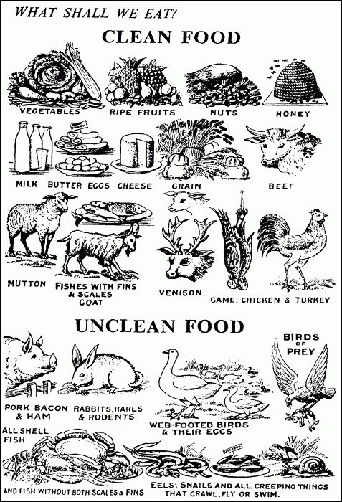
Discerning Between…
Right Vs. Wrong
Good Vs. Better
Better Vs. Best
Primary Vs. Secondary
Essential Vs. Indifferent
Rom 14:5-6 – “One person regards one day above another, another regards every day alike. Each person must be fully convinced in his own mind. He who observes the day, observes it for the Lord, and he who eats, does so for the Lord, for he gives thanks to God; and he who eats not, for the Lord he does not eat, and gives thanks to God.”
Rom 14:13 – “Therefore let us not judge one another anymore, but rather determine this—not to put an obstacle or a stumbling block in a brother’s way.”
Notes:
Discernment is recognizing the difference between essential vs. indifferent.
In Rom 14, Paul gives instruction to the church on how to work through disagreements they were having amongst one another, disagreement relative to their differing cultures – Jew and Gentile – Rom 14:5-6 – What’s happening is that the Gentiles ate whatever they wanted; there were no dietary laws for them. But the Jewish Christians had spent the majority of their life not eating things like pork. Those dietary laws were removed in the NT, see Acts 10, and were no longer a requirement by God for his people. The Jews also observed certain feast days, which were likewise removed in the NT. The Gentiles weren’t required to keep any feasts. These were now matters of indifference. But what was essential? Rom 14:13 – In other words, if you’re a Gentile and you like pork, don’t you invite a Jewish Christian to your house and put a nice juicy pork chop on his dinner plate just to get him to eat it if it makes him uncomfortable, regardless of whether it is a matter of indifference to God. Because you’re causing him to violate his conscious. He knows he technically can, but he just doesn’t feel comfortable doing it and you’re rubbing it in his face. That kind of disregard for another’s conscious is not a matter of indifference to God.
We may not be living in a Jew/Gentile culture today, but things like this still come up where there are liberties that are indifferent to God, that is until it causes someone weaker to stumble. And it takes a lot of discernment to work these things out, but work them out we must because it has the potential to really hurt another person spiritually.

Slide 10
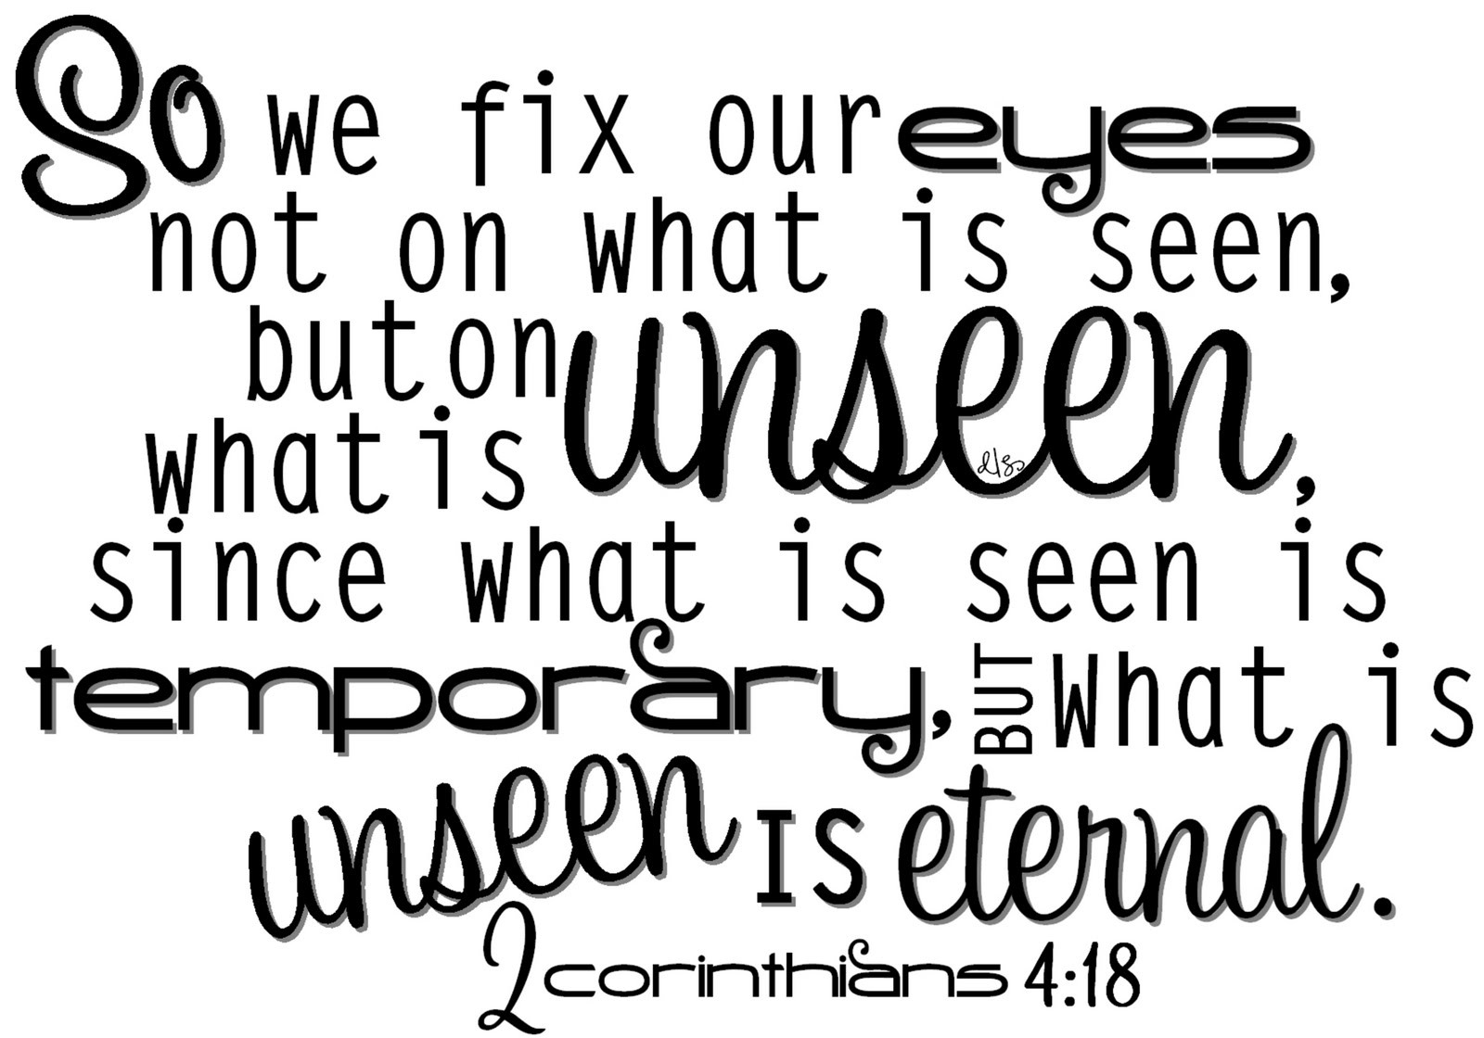
Discerning Between…
Right Vs. Wrong
Good Vs. Better
Better Vs. Best
Primary Vs. Secondary
Essential Vs. Indifferent
Permanent Vs. Transient
Rom 15:4 – “For whatever was written in earlier times was written for our instruction, so that through perseverance and the encouragement of the Scriptures we might have hope.”
Gal 3:24-25 – “Therefore the Law has become our tutor to lead us to Christ, so that we may be justified by faith. But now that faith has come, we are no longer under a tutor.”
Psa 39:4 – “Lord, make me to know my end and what is the extent of my days; let me know how transient I am.”
Notes:
And then sixth, discernment is recognizing the difference between what is permanent vs. transient.
This would include a lot of things. It might include knowing the difference between when to apply the OT and when not to apply it – Rom 15:4 – So that verse makes it sound like we need to be studying thee OT because there are things we need to learn and apply from it. Gal 3:24-25 – That makes it sound like we’re not under the OT. If we’re not under it, why should we listen to it? And the answer, of course, is that while we’re not under it as a law, it still contains principles, stories, and precedencies that can help us in our faith today. But it requires some discernment to know when to apply something and when not to apply it.
But maybe another way to look at this is that everything in life needs to be decided between whether or not there are eternal implications associated with it or not – 2 Cor 4:18 – Do put more emphasis on earthly treasures or heavenly treasures? One is going to burn up, the other is not. Do I put more emphasis on physical beauty, or spiritual beauty? One is decaying, one is being renewed day by day. Do I care more about relationships with worldly, unspiritual people, or with Christians? We’re only going to spend eternity with one of those groups of people, and its our choice which one it is. See, so many decision in life surround just these three things: wealth, beauty, and relationships. Do we use spiritual discernment when it comes to these things?
Psa 39:4 – “Lord, make me to know my end and what is the extent of my days; let me know how transient I am.”

Slide 11
Keys To Discernment
In Depth Knowledge Of God’s Word
2 Tim 2:15 – “Be diligent to present yourself approved to God as a workman who does not need to be ashamed, accurately handling the word of truth”
Notes:
So let’s talk about keys to developing discernment.
1. Knowledge of God’s word. And I want to press this hard, that we have to know what is authentic so well, that we can recognize what is false almost immediately. Bank tellers are trained vigorously to recognize the difference between genuine and fake currency. In their training classes, they are put through hours of counting cash over and over again. The reason is so that they know how those bills feel. They know how much they weight, their texture, their thickness, their smell, every little detail, every little picture, all the text. Why? Because if they’re given a counterfeit bill, they’ll know. But counterfeit bills are designed to be as close to the real thing without being the real thing. But those tellers know, because they’ve spent hours, days, weeks sifting through those bills.
Only by knowing God’s word in detail will we be able to rightly divide it – 2 Tim 2:15

Slide 12
Keys To Discernment
In Depth Knowledge Of God’s Word
Don’t Keep Bad Company
1 Cor 15:33 – “Do not be deceived: ‘Bad company corrupts good morals.’
Prov 7:7 – “And I saw among the naive, and discerned among the youths a young man lacking sense”
Prov 14:7 – “Leave the presence of a fool, or you will not discern words of knowledge.”
Notes:
2. Not keeping bad company – 1 Cor 15:33 – A professor at FC told me years ago about an observation he made concerning the bad crop of students they get every year. He said they were drawn to each other like gravity and it was a very mysterious thing. After being in Auburn a few years, I made the same observation. Eventually I began to realize that those who are rebellious, even wicked, use discernment to seek out those w/o discernment – Prov 7:7
Keeping bad company has a way of clouding our judgment and hindering discernment – Prov 14:7 – Being surrounded by bad influences will suck the spiritual discernment right out of you. “Well I’m glad I’m at this church with all these Christians because this is a safe environment.” No, you have to be even more careful here. This is an environment where you can easily let your guard down; and as I’ve stressed in these lessons, not everyone that is at this church is living right. In many ways, it is easier for your to get carried away into sin than being out there in the world where you expect it.
Discernment therefore allows us to take obey Rom 12:9, to “hate what is evil; cling to what is good”

Slide 13
Keys To Discernment
In Depth Knowledge Of God’s Word
Don’t Keep Bad Company
Practice
Heb 5:14 – “But solid food is for the mature, who because of practice have their senses trained to discern good and evil.”
Notes:
3. Practice
Being trained through the word is one thing, but putting into practice is another – Heb 5:14 – “But solid food is for the mature, who because of practice have their senses trained to discern good and evil.” Practice makes perfect. Sometimes the school of hard knocks is the only way we’ll learn. And sometimes we’ll buy into wisdom more when we actually start applying it.

Slide 14
Keys To Discernment
In Depth Knowledge Of God’s Word
Don’t Keep Bad Company
Practice
Learn From Failure
Jer 8:4 – “You shall say to them, ‘Thus says the Lord, “Do men fall and not get up again? Does one turn away and not repent?”’”
Psa 119:71 – “It is good for me that I was afflicted, that I may learn Your statutes.”
Notes:
4. Learn From Failure
Ultimately, applying knowledge will lead to disappointment and failure. Unless we accept this, we’ll never act upon knowledge in such a way that it cultivates wisdom. Failure is a time to reflect on our knowledge – Jer 8:4; Psa 119:71
Don’t fear failure, it enhances our knowledge!

