Slide 1
“The fear of the Lord is the beginning of knowledge”
(Prov 1:7a)
“The knowledge of the Holy One is understanding”
(Prov 9:10b)
“For if you cry for discernment, lift your voice for understanding”
(Prov 2:3)
“The fear of the Lord is the beginning of wisdom” (Prov 9:10a)
“The fear of the Lord is the instruction for wisdom” (Prov 15:33a)
Understanding
Formerly spelled “rightwiseness”
Fear
Instruction
Knowledge
Discernment
Righteousness
Trust
“The mouth of the righteous flows with wisdom”
(Prov 10:31a)
“Trust in the Lord with all your heart and do not lean on your own understanding.”
(Prov 3:5)
Wisdom
…has built her house, she has hewn out her seven pillars. (Prov 9:1)

Slide 2
Prov 9:10 - “The fear of the Lord is the beginning of wisdom, and the knowledge of the Holy One is understanding.”
Prov 14:6 - “A scoffer seeks wisdom and finds none, but knowledge is easy to one who has understanding.”
Knowledge
Understanding
Col 2:2 - “that their hearts may be encouraged, having been knit together in love, and attaining to all the wealth that comes from the full assurance of understanding, resulting in a true knowledge of God's mystery, that is, Christ Himself”
Notes:
There is a relationship between knowledge and understanding that is quite interesting – Prov 9:10 – So, true knowledge is having an understanding of the Holy One, an understanding of God. This takes the idea of knowledge further than mere abstract knowledge in that in order to have true knowledge, as God sees true knowledge, we come to an understanding of Him. Therefore knowledge leads to understanding.
But now consider Prov 14:6 – In other words, when one has understanding, that leads to an even greater knowledge. What we find, as we consider these two ideas, is that both knowledge and understanding feed one other. Knowledge leads to understanding. And understanding leads to even greater knowledge. There is a symbiotic relationship between the two. When we begin to develop an understanding regarding the knowledge that we have, it leads to more knowledge because we’re buying into what we’re learning and its creating more of that necessary resolve to learn even more so as to understand more.
Consider what happens when we take on the love of Christ – Col 2:2 – Having an understanding of Jesus Christ is considered true knowledge.

Slide 3
Jer 10:12 – “It is He who made the earth by His power, Who established the world by His wisdom; and by His understanding He has stretched out the heavens.”
Prov 3:13 – “How blessed is the man who finds wisdom and the man who gains understanding.”
Prov 14:33a – “Wisdom rests in the heart of one who has understanding…”
Prov 24:3 – “By wisdom a house is built, and by understanding it is established”
Notes:
The concept of “understanding” is imperative when we’re aspiring for wisdom because scripture actually uses the two synonymously. Remember, synonymous parallelism, which is so common in Hebrew poetry, is designed to compare two concepts that are not exactly alike but related, in order to shed light on the relationship or the deeper meaning between the two.
Jer 10:12 – So obviously there was divine wisdom involved in the Creation. But that involved an understanding in how every aspect of Creation fit together and acted and reacted with one another. Its almost as if Jeremiah is telling us that understanding is the aspect of wisdom that what makes this world such a wonderful place to live and dwell.
Prov 4:7 – So as we gain more and more wisdom, we begin to understand more and more the wisdom we are acquiring.
Prov 14:33a – In other words, a person who has understanding is wise. He goes beyond mere knowledge. This is the person who “gets it”
Prov 24:3 – Wisdom builds the house, furnishes and supplies it with the necessities and conveniences, and the family can live there and enjoy the blessing of God. But understanding secures it further and goes beyond the methods of evil men who likewise build houses and families but don’t see the underlying blessing of it.
So obviously there is a relationship between wisdom and understanding, but they’re not the same thing. Rather, understanding is just another pillar that we need to develop in order to be wise people.

Slide 4
What Is Understanding?
Prov 18:2 – “A fool does not delight in understanding, but only in revealing his own mind.
Notes:
What is understanding? Psa 119:130 is a good definition. The difference between knowledge and understanding is that understanding involves extracting meaning out of the information so that we don’t just have knowledge, we understand the significance of that knowledge. This is sometimes called “intellection” because understanding involves conceptualization and association. It’s an awareness of the connection between pieces of information that have been presented. So this is much deeper than just “knowing”. In fact, without “understanding”, we won’t be likely to put knowledge to good use.
When you “know” something, you are able to identify, label, list, name, and recall data. Many of us “know” the books of the bible. Many of us “know” the five steps of salvation or the five acts of worship. But when you “understand”, you are able to distinguish, explain, interpret, and summarize knowledge. Both are important for our spiritual growth because they determine how we view and react to our environment and the people we associate with. But spiritual understanding takes us to a far deeper level because we’re “getting it”. And when we “get it”, that builds our trust in God, which is the subject of our next class.
And so understanding allows us to “see through” the abstract knowledge to the dynamics of it, the what, the how, and the why. It is a lens which brings the facts into crisp focus and produces godly principles – Prov 18:2 – Only by gleaning understanding from scripture will we transform from foolish to wise.

Slide 5
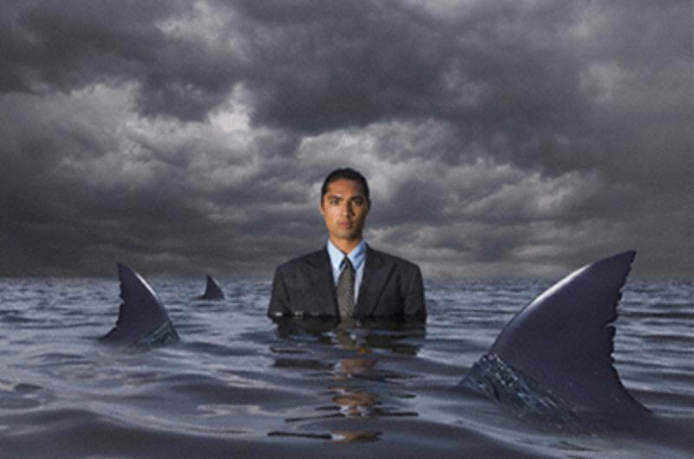
Example
Prov 17:27 – “He who restrains his words has knowledge, and he who has a cool spirit is a man of understanding.”
Psa 119:34 - “Give me understanding, that I may observe Your law and keep it with all my heart.”
Notes:
Prov 17:27 – Knowledge of God will lead us to the conclusion that restraining our words is wise. But we may only do it over lawful compulsion. “God said to do it, so I will...but I don’t like it. What I’d really like to do is give this guy a piece of my mind...put him in his place. But God said not to.” Now if you obey, you’ve done well. God’s knowledge prevented you from sinning. But that doesn’t mean you’re doing so with a cool spirit. You may be eaten up inside. You may be thinking of all the ways you could retaliate and cut that person down.
But understanding is when we “get it”. We understand why in situations where we may want to open our mouth, it’s better to say nothing. And so not only do we restrain our words, but our spirit is at peace with it. We calmly and confidently remain silent because we understand the implications of remaining silent, we confidently see it as the better way, and therefore we WANT to remain silent.
Psa 119:34 – So one is better, but the other is best.

Slide 6
Example
Deut 8:3 – “He humbled you and let you be hungry, and fed you with manna which you did not know, nor did your fathers know, that He might make you understand that man does not live by bread alone, but man lives by everything that proceeds out of the mouth of the Lord.”
Matt 4:3-4 – “And the tempter came and said to Him, ‘If You are the Son of God, command that these stones become bread.’ ⁴But He answered and said, ‘It is written, “Man shall not live on bread alone, but on every word that proceeds out of the mouth of God.”’”
Notes:
Deut 8:3 – When they didn’t have food, they “knew” the Lord was taking care of them. They had that knowledge. But further meditation on that knowledge would have led to the “understanding” that if man will just learn to live in God’s word, He’ll take care of the rest - Matt 6:33.
When Jesus used this verse to combat Satan, did He merely have knowledge of what God was doing with the manna, or did He have understanding?

Slide 7
Example
Luke 23:33-34a – “When they came to the place called The Skull, there they crucified Him and the criminals, one on the right and the other on the left. But Jesus was saying, ‘Father, forgive them; for they do not know what they are doing.’”
Acts 3:17 – “And now, brethren, I know that you acted in ignorance, just as your rulers did also.”
John 16:3 – “These things they will do because they have not known the Father or Me.”
John 17:3 – “This is eternal life, that they may know You, the only true God, and Jesus Christ whom You have sent.”
Notes:
Luke 23:33-34a – Pop quiz. When they crucified Jesus, did they know what they were doing? Yes. Let’s take it a step further. Did they really know what they were doing? Meaning, did they understand the implications of murdering this particular man? No, they did not. They knew they were torturing a man to death. Many, including Pilate, even knew they were torturing an innocent man to death. The Jewish Sanhedrin even knew that his death was really out of necessity so that the whole nation wouldn’t perish. But few if anyone knew the true implications of crucifying Jesus of Nazareth.
This is Peter’s conclusion in his recorded sermon in Acts – Acts 3:17 – They killed a man, but they were ignorant regarding a lot of things, that it was according to the foreknowledge of God, that it was according to prophecy, that Jesus willingly went to His death and that He was doing so to ultimately possibly save everyone including those who were crucifying Him. Had they known all this, do you think their reaction to what they were doing would have been different? Would they even have crucified Him had they understood the implications? What a paradox to consider!
John 16:3; 17:3 – Here, Jesus gets to the root of the problem. They thought they knew God, but they didn’t really know Him. There was no deeper knowledge, no understanding of God’s ways, God’s word, God’s plan. But part of Jesus’ crucifixion was to instill a greater understanding within us all.
In fact, the crucifixion is in many ways designed to be the foundation from which we take whatever knowledge we think we have of God and cultivate a greater knowledge which leads to “understanding”. Because this understanding will inevitably lead us to trusting God when we’re encountered with things we do not understand.

Slide 8
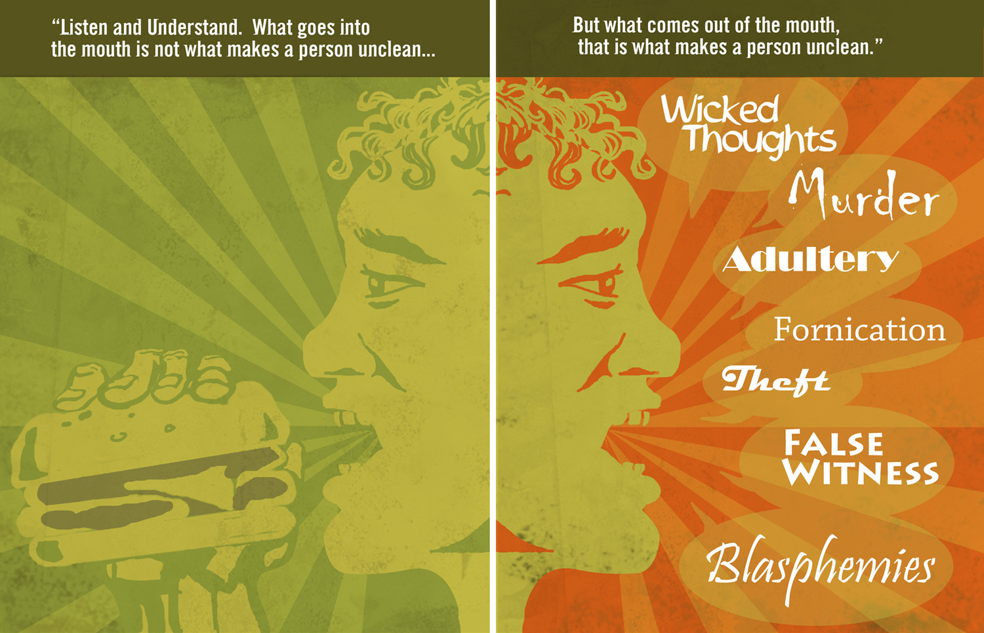
Jesus Demands It
Matt 15:15-20 – “¹⁵Peter said to Him, ‘Explain the parable to us.’ ¹⁶Jesus said, ‘Are you still lacking in understanding also? ¹⁷Do you not understand that everything that goes into the mouth passes into the stomach, and is eliminated? ¹⁸But the things that proceed out of the mouth come from the heart, and those defile the man. ¹⁹For out of the heart come evil thoughts, murders, adulteries, fornications, thefts, false witness, slanders. ²⁰These are the things which defile the man; but to eat with unwashed hands does not defile the man.”
Notes:
Jesus often rebuked those who did not have understanding. In Matt 15, after the Pharisees accused Jesus and His disciples of not washing their hands when they ate bread, Jesus accuses them of holding this tradition above God’s command. The Pharisees were designating all their belongings as “Corbin”, belonging to God, which in their minds released them from obligations to use their belongs to take care of their parents, which violated the ten commandments. He then said in Matt 15:11 – “It is not what enters into the mouth that defiles the man, but what proceeds out of the mouth, this defiles the man.” The disciples were confused by this – Matt 15:16-20 – The disciples weren’t thinking deep enough. And because of this they couldn’t understand what Jesus meant in verse 11 and needed additional explanation.
Could there be a reason why God speaks in this way? Could it be that understanding only belongs to those who seek after it diligently, think hard about what they reason, or ask questions?

Slide 9
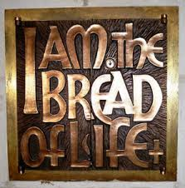
Jesus Demands It
John 6:54 – “He who eats My flesh and drinks My blood has eternal life, and I will raise him up on the last day.”
John 6:60 – “Therefore many of His disciples, when they heard this said, ‘This is a difficult statement; who can listen to it?’”
John 6:66-68 – “⁶⁶As a result of this many of His disciples withdrew and were not walking with Him anymore. ⁶⁷So Jesus said to the twelve, ‘You do not want to go away also, do you?’ ⁶⁸Simon Peter answered Him, ‘Lord, to whom shall we go? You have words of eternal life.’”
Notes:
Consider the situation in John 6. Jesus, in His discourse to the crowd, purposely worded His teaching in this way – John 6:54 – A lot of the Jews there didn’t like that teaching. It was hard to swallow, and some couldn’t stomach it, pun intended. Notice their response – John 6:60 – Several of your versions say, “Who can understand it?” So when they didn’t understand what He was saying, how did they respond? John 6:66 – They left Him. But you know who was able to understand Him? Those who did not leave and asked Jesus to explain it – John 6:67-68
Could it be that God’s word has only been designed to draw people who will diligently seek after it even when they don’t initially understand it?

Slide 10
Jesus Demands It
Matt 22:23-28 – “²³On that day some Sadducees (who say there is no resurrection) came to Jesus and questioned Him, ²⁴asking, ‘Teacher, Moses said, ‘If a man dies having no children, his brother as next of kin shall marry his wife, and raise up children for his brother.’ ²⁵Now there were seven brothers with us; and the first married and died, and having no children left his wife to his brother; ²⁶so also the second, and the third, down to the seventh. ²⁷Last of all, the woman died. ²⁸In the resurrection, therefore, whose wife of the seven will she be? For they all had married her.
Matt 22:29 – “ But Jesus answered and said to them, ‘You are mistaken, not understanding the Scriptures nor the power of God.”
Notes:
In Matt 22, the Sadducees thought they had Jesus. They had concocted this religious hypothetical based on their incorrect belief that there is no resurrection – Matt 22:23-28 – Now notice Jesus’ response in Matt 22:29 – This was a punch to the gut. The Sadducees were teachers of the people. The people looked up to them and their example and Jesus says, “You don’t know what you’re talking about.” That no doubt bruised their ego. But it was the truth. All those years reading and memorizing scripture and they had missed the truth of the resurrection in the story of Moses at the burning bush – “I am the God of Abraham, the God of Isaac, and the God of Jacob” God is not the God of the dead, but of the living. They never thought deeply enough in what they read otherwise the use of the verb tenses would have clued them into this reality.
Does this not show us that there is more to studying the bible than a mere surface reading? And what treasures are there to mine if we would seek after it with this intensity?
Both of these examples, and others we could look at, suggests that Jesus expects all of his followers to go beyond a cursory understanding of God’s word. We must dig deep. Only then can we go beyond mere knowledge to an actual understanding that produces wisdom.

Slide 11
What Hinders Us?
Untaught
2 Pet 3:16 – “as also in all his letters, speaking in them of these things, in which are some things hard to understand, which the untaught and unstable distort, as they do also the rest of the Scriptures, to their own destruction.”
Unstable
2 Pet 3:16 – “as also in all his letters, speaking in them of these things, in which are some things hard to understand, which the untaught and unstable distort, as they do also the rest of the Scriptures, to their own destruction.”
Fleshly
1 Cor 2:14 – “But a natural man does not accept the things of the Spirit of God, for they are foolishness to him; and he cannot understand them, because they are spiritually appraised.”
Know-it-all
Prov 18:2 – “A fool does not delight in understanding, but only in revealing his own mind.”
Notes:
What prevents someone from understanding?
1. Untaught - 2 Pet 3:16 – Obviously, in order to understand, there has to be knowledge. There are things we must learn that require maturity and if we do not develop the fundamental knowledge from which to build on more deeper principles, certain things that are taught will sound ridicules. How can someone without a knowledge of arithmetic ever understand calculus? Yet the principles of calculus are what makes our cars go and our airplanes fly. If I cannot understand some spiritual truth that is being taught, perhaps I have not learned fundamental principles beforehand.
2. Unstable - 2 Pet 3:16 – However not everyone who does not understand is due to being untaught. Sometimes it is because we are unstable. This word comes from the Greek word that means “does not have a staff to lean on.” This could be a person w/o a true faith in Jesus because of too much faith in man or a person not grounded in God’s authority. They are building their faith on sand, not rock.
3. Fleshly - 1 Cor 2:14 – This could be someone who reasons with their heart and not their mind. It could be a person who puts his passions before his principles. If I cannot step out of myself and look at spiritual truths objectively because I’m feeling my way through life, even those things which are true will seem untrue. No one living by the flesh will ever understand or appreciate deep spiritual truths. He is unable to. He or she will hardly admit it though. They’ll hate the messenger who teaches because they’re letting their passions instruct them.
4. Know-it-all - Prov 18:2 - Ever been around the “actually” guy? You’re talking about something, and this guy always has to give his two cents. He knows more than you and always assumes his views should be considered above another. I will never develop understanding until I learn to listen, think, meditate, and be slow to speak.

Slide 12
What Hinders Us?
Prejudice
Acts 10:34 – “I most certainly understand now that God is not one to show partiality”6
Dishonest heart
Matt 13:19 – “When anyone hears the word of the kingdom and does not understand it, the evil one comes and snatches away what has been sown in his heart. This is the one on whom seed was sown beside the road.”
Matt 13:23 – “And the one on whom seed was sown on the good soil, this is the man who hears the word and understands it; who indeed bears fruit and brings forth, some a hundredfold, some sixty, and some thirty.”
Bad company
Prov 13:20 – “He who walks with wise men will be wise, but the companion of fools will suffer harm.”
A limited perspective
Job 42:3 – “‘Who is this that hides counsel without knowledge?’ Therefore I have declared that which I did not understand, things too wonderful for me, which I did not know.”
Notes:
5. Prejudice - Acts 10:34 – Jesus had already told the Apostles to go into all the world and preach the gospel to every creature. But it took an intervention by the Holy Spirit to finally get Peter to do what he should have figured out on his own. Sometimes we bring prejudices and biases into our faith and it will hinder us from seeing people, teachings, and other realities through heavenly lenses.
6. Dishonest heart - Consider the difference between these two soils – Matt 13:19 vs. Matt 13:23 – What this shows is where my heart is inclined will be a make a huge difference in my understanding of spiritual things. If I have a dishonest heart, that wants to do what I want to do and be what I want to be regardless of what God has to say on the matter, how can I ever understand spiritual principles?
7. Bad company - Prov 13:20 – I cannot press this point strong enough with college students. I am on my seventh year preaching at this church and I have watched incoming freshmen who were strong in the faith destroy themselves spiritually by who they chose to befriend here in Auburn. And not just of those out there, but of those “Christians” here. See, not every Christian here is faithful. Some show up just to make an appearance, just to appease mom and dad. But they have no desire to be Christ-like. There are negative, toxic people who constantly complain about the leadership, the preaching, as if they know everything. Jude 10 – “But these men revile the things which they do not understand…” And strong Christians who have chosen to be around these groups (which we have every year here) have had the spiritual life drained out of them. Be careful about the company you keep.
8. A limited perspective - Job 42:3 – Like Job, there are some things we’ll never understand. What do we need them? Trust. That’s all we can do. God has not chosen to reveal everything about everything on this side of eternity. If we could understand everything, there would be no room left for faith. But if we get too bogged down on what we can’t understand w/o being content, that’s where we can get in trouble.

Slide 13
Gaining Understanding
Meditate On What We Read
Psa 119:104 – “From Your precepts I get understanding; therefore I hate every false way.”
Psa 1:2 – “But his delight is in the law of the Lord, and in His law he meditates day and night.”
Eph 3:4 – “By referring to this, when you read you can understand my insight into the mystery of Christ”
Acquire Counsel
Acts 8:30-31 – “Philip ran up and heard him reading Isaiah the prophet, and said, “Do you understand what you are reading?” ³¹ And he said, “Well, how could I, unless someone guides me?” And he invited Philip to come up and sit with him.”
Pray
1 Kings 3:9a – “So give Your servant an understanding heart to judge Your people to discern between good and evil…”
Obey Regardless
Psa 111:10 – “The fear of the Lord is the beginning of wisdom; a good understanding have all those who do His commandments; His praise endures forever.”
Live a Little
Job 12:12 – “Wisdom is with aged men, with long life is understanding.”
Notes:
Do then how do we gain understanding?
Meditate On What We Read – Psa 119:104 – So it starts from reading. But don’t just read, study, and then think hard about what you just read, how that particular truth impacts my life, personally, relationally, in my work, my hobbies, my worship. I make it about me. And then it begins to guide me in my decision making. It begins to give me clarity. Daily bible readings are great, but what’s better is daily bible meditation, think long and hard about what you’re reading – Psa 1:2 – If you don’t understand, seek to understand. Eph 3:4 tells us that one of Paul’s purposes in writing was that we might understand.
Acquire Counsel – Meaning, find someone you can ask questions of – Acts 8:30 - Try to figure it out on your own first, because if you do, you own it and it will stick. But if you’re hung up, ask someone older/wiser. (I used to bother Todd, my counselor, at work w/questions about things I was studying). But even then, studying w/people who are older, wiser, been studying longer, will open our eyes to truths we did not know, building our understanding.
Pray – 1 Kings 3:9 – Solomon prayed and he got all the wisdom and understanding he needed to guide the people he was leading. If we want divine, spiritual understanding, who better to as than the source Himself?
Obey even if you don’t understand...it’ll come - Psa 111:10 – There are some things we won’t come to understand until we begin to obey on faith. Over time, the lens becomes clearer by virtue of our actions. “It is more blessed to give than to receive”. This makes no sense to the selfish man. But those who have tried this out can attest to the wisdom behind it. They understand.
Live a little - Job 12:12 - This means young people can’t expect to have it yet. This is a hard thing for many young people to grasp because w/youth often comes confidence and a sense of invincibility, but no experience. Don’t be afraid to fail. Every now and then when you go for it, you’ll hit a homerun. But most of the time, at this stage of your life, you’ll swing and miss. But the more you live, the more understanding you’ll develop.

