Slide 1
“The fear of the Lord is the beginning of knowledge”
(Prov 1:7a)
“The knowledge of the Holy One is understanding”
(Prov 9:10b)
“For if you cry for discernment, lift your voice for understanding”
(Prov 2:3)
“The fear of the Lord is the beginning of wisdom” (Prov 9:10a)
“The fear of the Lord is the instruction for wisdom” (Prov 15:33a)
Understanding
Formerly spelled “rightwiseness”
Fear
Instruction
Knowledge
Discernment
Righteousness
Trust
“The mouth of the righteous flows with wisdom”
(Prov 10:31a)
“Trust in the Lord with all your heart and do not lean on your own understanding.”
(Prov 3:5)
Wisdom
…has built her house, she has hewn out her seven pillars. (Prov 9:1)
Notes:
Overview of chart.
Being wise is a commandment given by God to all Christians – Eph 5:15 – “Therefore be careful how you walk, not as unwise men but as wise”. Wisdom takes the Christian discipline beyond simply asking the question “Is this sinful?” That’s obviously the first question we ask when confronted with any situation. We have to go further and ask, “Is this wise?” This takes our decision-making out of the realm of “Can I do this” and places in the realm of “Should I do this?” and that is the question that mature Christians ask.
“Its not a sin to take just one sip of alcohol” – maybe it is, maybe it isn’t, but that’s not the point. “Ryan are you saying I’m going to hell if I got to this frat party but I don’t engage in what they’re doing?” Why are we basing our faith simply around avoiding the things that keep us out of hell? Shouldn’t we be aiming toward purity and holiness and wisdom? If you try to go through life as a Christian nick-picking legal technicalities, you’re missing the whole point…and I can assure you that Satan will wipe the floor with you.
Wisdom is about pursuing the things that gives us the greatest chance of spiritual success. That’s the essence of the book of Proverbs isn’t it? When you think about proverbs, think about “probabilities”. In this book, God is giving us “truisms” that will give us the greatest likelihood of being righteous. It’s not that they’re guarantees. Prov 22:6 – “Train up a child in the way he should go, even when he is old he will not depart from it.” Is that always true? No, there are children who grow up after much spiritual training and decide later on to follow the devil. But which is more likely to guarantee a child’s success, training him in the way he should go, or leaving he/she to his/her own choices at a very young age? We know the answer.
Proverbs is probabilities and wisdom is seeking after the paths that lead us to the greatest likelihood of success regardless whether or not we can prove using legal technicalities whether something is 100% right or wrong.

Slide 2
John 1:1 – “In the beginning was the Word…”
Rom 10:17 – “So faith comes from hearing, and hearing by the word of Christ.”
1 John 4:19 – “We love, because He first loved us”
Psa 9:10a – “The fear of the Lord is the beginning of wisdom”
Psa 111:10a – “The fear of the Lord is the beginning of wisdom”
Job 28:28a – “Behold, the fear of the Lord, that is wisdom”
Notes:
Every journey begins with the first step. For example – John 1:1 – Without God, there would be nothing. God was the very beginning of everything that we know as existence itself. Even faith has a beginning – Rom 10:17 – True faith’s beginning is hearing God’s word, the instruction He gives us which we choose to believe or not believe is the basis of all genuine faith. Even love has a beginning – 1 John 4:19 – We wouldn’t understand love nor could we even apply love correctly if it weren’t for the example we have of God’s love as it is expressed toward us. So truly some of the most significant Christian principles in the bible all have a source, a beginning.
Wisdom also has a beginning – Psa 9:10a; Psa 111:10; Job 28:28 – There will be no wisdom to be had by any of us without a healthy sense of fear toward the Lord. Without the fear of the Lord, not only will we not become wise, but we will inevitably become fools.

Slide 3
FACTUAL KNOWLEDGE
SITUATIONAL INSIGHT
NECESSARY RESOLVE
Righteous goal
Notes:
So the first pillar of wisdom is the fear of the Lord. Every other aspect of wisdom depends on this one virtue being in place. We defined wisdom last week as this: “Wisdom is the combination of factual knowledge, situational insight, a strong, necessary resolve, that when practiced, has the greatest likelihood of achieving an intended righteous goal”.
The fear of the Lord is that necessary resolve. Fear is that motivation to see a path through to its righteous end. Just as a car cannot start without gas, fear is the fuel that ignites within us just the right resolve and incentive to begin thinking about life through the lens of wisdom.

Slide 4
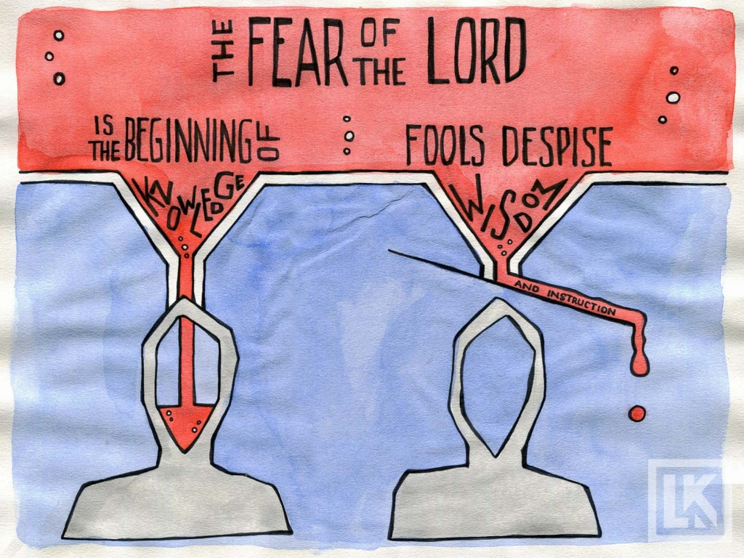
Prov 15:33 – “The fear of the Lord is the instruction for wisdom…”
Prov 1:7 – “The fear of the Lord is the beginning of knowledge; fools despise wisdom and instruction.”
Notes:
Because if don’t learn to fear the Lord, we will never be a people that readily receive instruction – Prov 15:33 – Wisdom demands accepting instruction so that we can have the factual we need to make the right decisions. Fools, however, despise wisdom and instruction. Why? Because they have no fear – Prov 1:7
It is not uncommon for someone to be instructing another from God’s word, especially in a public setting where a lot of people are present, for there to be people present who completing tune out the instruction. Preachers experience this all the time as do most bible class teachers. For some, instruction goes through one ear and out the other. They’re playing on their phones, whispering in the ears of the person sitting next to them, making fun of the speaker said something wrong, misquoted a verse, honing in on their personally quarks, and more. If we’re doing that, there is no awareness of Jesus being among us, no respect for occasions such as this that call for instruction so we might gain knowledge. To sum it up, there’s no fear of God.

Slide 5
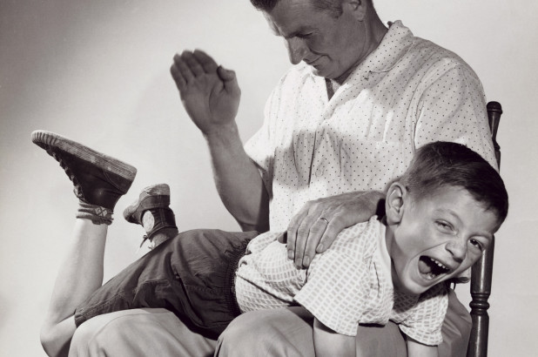
Prov 22:15 – “Foolishness is bound in the heart of a child; but the rod of correction shall drive it far from him.”
Eph 4:14 – “As a result, we are no longer to be children, tossed here and there by waves and carried about by every wind of doctrine, by the trickery of men, by craftiness in deceitful scheming.”
Notes:
Think about it this way. How do children begin learning to obey the instruction of their parents? What do they need when they’re young to learn the fundamentals of life so that when they’re grown up and the real challenges come, they’ll have the knowledge, insight, and resolve to handle them appropriately? They need discipline. They need the fear put in them – Prov 22:15 – Right? As much as we love young children, they struggle very early on with selfishness. Concepts like “sharing” can become extremely challenging. Even simple instructions like “do not eat that cookie until after dinner” can be really hard to obey. That is, until you know what’s coming to you if you disobey.
The point is this: even as adults, we have a similar “foolishness” that is bound up in our hearts that culminates into sin – Eph 4:14 – What this means is that there are people in the world that want to use us, abuse us, manipulate us, take advantage of us, threaten us, all for their own selfish gain. And they’ll use every trick in the book they can muster to do so – Paul calls it craftiness and deceitful scheming. How do we prevent being taken advantage of in this way? The next verse tells us – we’re to “grow up”. We’re to grow in into Him in all things. And children of God will never grow up until they learn the fear of the Lord.

Slide 6
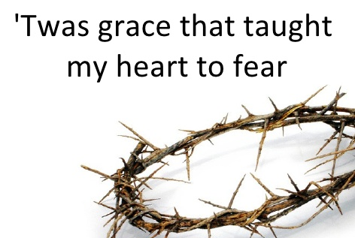
Abraham – “…for now I know that you fear God…” – Gen 22:12
Hebrew Midwives – “…the midwives feared God…” – Ex 1:17, 22
Moses’ Judges – “…select out of all the people able men who fear God” – Ex 18:21
Job – “…fearing God and turning away from evil…” – Job 1:1,8
Virtuous Woman – “…a woman who fears the Lord, she shall be praised…” – Prov 31:30
Thief On The Cross – “Do you not even fear God…” – Luke 23:40
Cornelius – “…a righteous and God-fearing man…” – Acts 10:22
Apostles – “…knowing the fear of the Lord, we persuade men…” – 2 Cor 5:11
1 John 4:18 – “There is no fear in love; but perfect love casts out fear, because fear involves punishment, and the one who fears is not perfected in love.”
Notes:
Question: why do some in mainstream Christendom, and even some in the church, balk at the subject of fearing God? Why is that a subject that many Christians don’t want to think about?
“But I don’t want my relationship with God to be defined by fear” – Funny, since those we admire most in the bible all had a healthy fear of the Lord.
When Abraham was about to obey God and sacrifice his son as a burnt offering, God stopped Him and said, “for now I know you fear the Lord.” – Gen 22:12
When the Hebrew midwives refused to kill the Israelite baby boys, we’re told that the reason was they “feared God” – Ex 1:17,22
When Moses father-in-law was giving him advice on how to delegate his duties, he advised him to select judges among the people who “fear God” – Ex 18:21
Job is described by God as one “fearing God and turning away from evil” – Job 1:1,8
Regarding the virtuous woman of Prov 31, we learn that “a woman who fears the Lord shall be praised” – Prov 31:30
When the thief on the cross rebuked his fellow thief for mocking Jesus, he said, “Do you not even fear God?”, which implies that he did – Luke 23:40
Cornelius was described as “a righteous and God-fearing man…” – Acts 10:22
And the Apostles…what made them such great evangelists? “Knowing the fear of the Lord, we persuade men…” – 2 Cor 5:11
These are some of the most honored, well-respected men and women of the bible and they all had one thing in common – they feared the Lord.
“But I’m saved by grace!” – Yes, we are. “Amazing grace, how sweet the sound, that saved a wretch like me. But what’s the second verse? – “Was grace that taught my heart to fear…”. And when that fear becomes rooted in us and we grow in faith, what we actually find out is that a lot of the motive for why we do things as mature Christians is not driven by fear as much as it is driven by love – “And grace my fears relieved…” – 1 John 4:18

Slide 7
Fear Of God: Two Extremes
Terror
Foreboding
Hopelessness
Paranoia
Dread
Apathetic
Cavalier
“Buddy God”
Flippant
Casual
Notes:
Now, there are two extremes we can take regarding the fear of God, both as equally unhealthy as the other. One extreme is to be so frightened of God, that the very thought of Him fills us with terror and dread. It’s the idea that He is some kind of cosmic grouch just waiting for us to commit the slightest infraction so He can strike us down with hell, fire, and brimstone. And many who view God this way live lives of hopelessness and paranoia and misery. And if you try to introduce this faulty concept of our Creator to a lost world, it will come across as incredibly distasteful because no one would ever try to draw near or close to the Lord for a personal, intimate relationship if they think that the moment they step out of line, God will crush them. This is not the fear of God the bible teaches that the faithful must have.
The other extreme, though, is to have no fear whatsoever. This is when we act flippant and cavalier toward God, and treat it like some casual relationship. We treat Him like He is some permissive “buddy god” who is our pal and winks at sin and whatever is cool with us is cool with Him. All this does is place God down at our level and robs us of the ability to have toward Him the healthy respect, awe, and majesty that He deserves by virtue of His might and awesomeness.
I will say this: if you are not a Christian, you have every reason for experiencing terror and dread because hell is what awaits for those who do not obey the gospel. But if you are a Christian, saved by the grace of God, we must develop what is a healthy, biblical fear toward God. So what is that exactly?

Slide 8
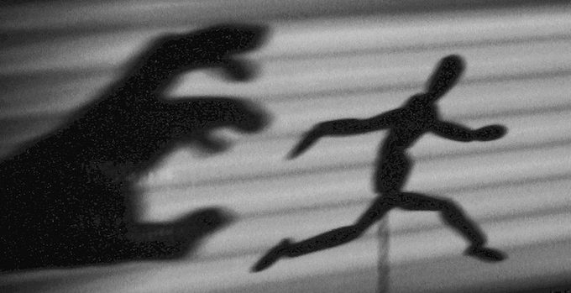
Frightening Feeling
Deut 2:25 – “This day I will begin to put the dread and fear of you upon the peoples everywhere under the heavens, who, when they hear the report of you, will tremble and be in anguish because of you.”
Josh 2:9-11 – “⁹I know that the Lord has given you the land, and that the terror of you has fallen on us, and that all the inhabitants of the land have melted away before you. ¹⁰For we have heard how the Lord dried up the water of the Red Sea before you when you came out of Egypt, and what you did to the two kings of the Amorites who were beyond the Jordan, to Sihon and Og, whom you utterly destroyed. ¹¹When we heard it, our hearts melted and no courage remained in any man any longer because of you; for the Lord your God, He is God in heaven above and on earth beneath.”
Notes:
Now, the bible does use the fear of God in the sense of a frightening feeling. And that sounds counterintuitive to what we just discussed. But we need to have the knowledge that God is not only able but in certain circumstances even willing to scare us beyond belief if He so chooses. However, in doing so, scripture always seems to indicate that this is a means to an end.
For example – Deut 2:25 – Did God want to put this fear in the Canaanites because He’s mean and just revels in people shaking in their boots? No. But He understood that the people of Canaan were so far gone in iniquity, if there was any potential for repentance left in them, it was going to take this kind of dread and fear to get it out of them.
And God was vindicated in applying this fear. Can you think of any Canaanites who responded appropriately to this fear? – Josh 2:9-11 – Notice how the terror of the Lord fell on all of them. They all had that in common. But only Rahab would let this fear of God usurp all else. And she was saved because of it. Some people suggest that you can catch more people with honey/sugar than with fire/brimstone. This saying may be true for some, but it is not true for everyone. There are some people who simply will not respond until the fear of the Lord is instilled in them.

Slide 9
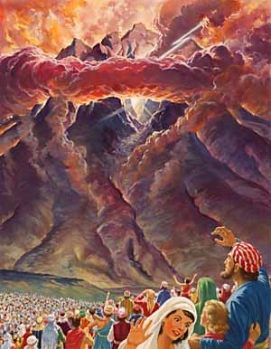
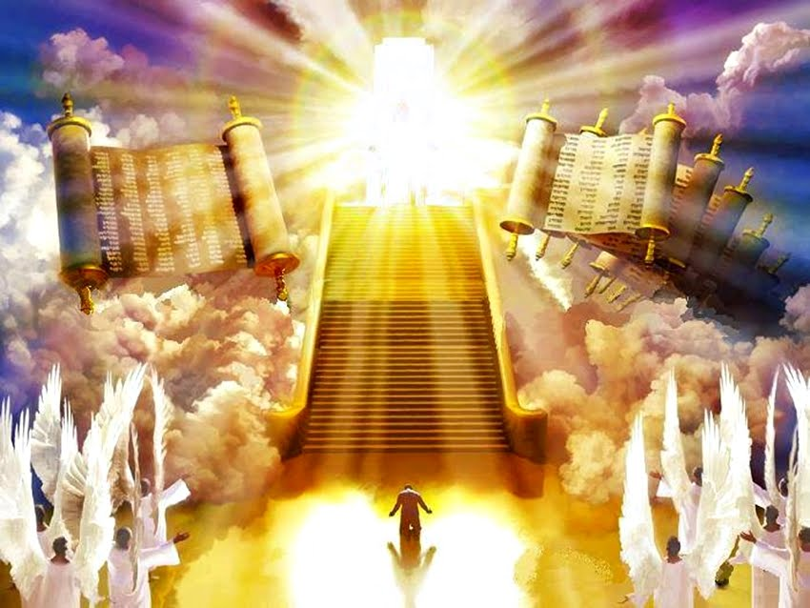
Awe-Inspired Reverence
Ex 20:20 – “Moses said to the people, ‘Do not be afraid; for God has come in order to test you, and in order that the fear of Him may remain with you, so that you may not sin.’”
Isa 6:5 – “Then I said, ‘Woe is me, for I am ruined! Because I am a man of unclean lips, and I live among a people of unclean lips; for my eyes have seen the King, the Lord of hosts.’”
Notes:
But the fear of the Lord also means having an awe-inspired reverence toward God. Consider the example of God’s appearance to Israel at Mt. Sinai. Ex 19 describes the mountain as being covered in smoke like the smoke of a furnace and there was fire. The whole mountain quaked. There was the sound of a trumpet which grew louder and louder and God spoke to Moses in thunder. Then God spoke the Ten Commandments. And after doing so, the people were so scared they begged Moses to beseech the Lord to stop speaking but that Moses would instead relay the messages and that they would obey. Now notice what Moses reply to this is – Ex 20:20
Did you catch that? Don’t be afraid, God is simply putting the fear in you. He’s talking about two different types of fear isn’t He? He doesn’t want them to feel dread and terror, like He was about to put in the Canaanites. God had went to a lot of trouble to bring them our of Egypt and up to this point But He does want to instill within them a healthy reverence and respect of His majesty because that is what helps us to think twice about even getting close to sin.
Notice Isaiah’s reaction while in the presence of God, after seeing the Lord sitting on His throne, lofty and exalted, and His train filling the temple with the angels surrounding Him singing, “Holy, holy, holy…” – Isa 6:5 – This is the reaction we need to have toward God. We are to be overwhelmed by who God is. His glorify confounds us, makes us weak in the knees. Because when we’re this captivated by God, He then becomes front and center of our lives, constantly on our mind, and every decision we make is compelled by the very knowledge of His glory. This is the fear of the Lord that is the beginning of wisdom, a healthy awe-inspired reverence toward God. By respecting God in this way, He is preeminent, He is everything. There is no room for anything/anyone else.

Slide 10
His Presence
Psa 139:2 – “You know when I sit down and when I rise up; You understand my thought from afar.”
Jer 12:3a – “But You know me, O Lord; You see me; and You examine my heart’s attitude toward You.”
Rom 1:21-22 – “²¹For even though they knew God, they did not honor Him as God or give thanks, but they became futile in their speculations, and their foolish heart was darkened. ²²Professing to be wise, they became fools.”
Notes:
Now, there are implications to having an appropriate, healthy fear of the Lord. It causes us to have a proper assessment of our own life. First of which is a constant awareness of His presence.
Psa 139:2; Jer 12:3a – God is watching and evaluating everything that we do, everything that we say, everything that we think. Isn’t that a scary thought? Someone once asked me if I could choose any super power, what would it be? There may be several I would choose, but I can tell you what I absolutely would NOT choose. I don’t want to read minds. If words hurt, can you imagine what thoughts would do? We can think some pretty terrible things in which we manage to bite our tongues. Yet God knows them all, everyone of our thoughts. Many sin in secret so they won’t get caught by others. But when we sin, its not a matter of whether we are caught because every time we sin, we are caught. God sees it all, hears it all, evaluating everything that we say and do. Shouldn’t this knowledge about God and how disgusted He is with evil profoundly affect the way we live? We have an instinctive concern over what other people think of us, but how much more should we feel concerned with how God thinks about us since we will one day stand in judgment before Him?
Rom 1:21-22 – See, what this verse tells us is that its possible to know about God, know that He exists, and yet not focus enough on the implications of that knowledge. So though the Gentiles knew Him, they did not respect Him, honor Him, revere Him. This blinded them from seeing His true presence which kept them from a healthy fear. That’s how they became fools, the opposite of wisdom, because there was no fear of the Lord from which wisdom could launch. This is why its important that we empty ourselves before we can obtain true wisdom.

Slide 11
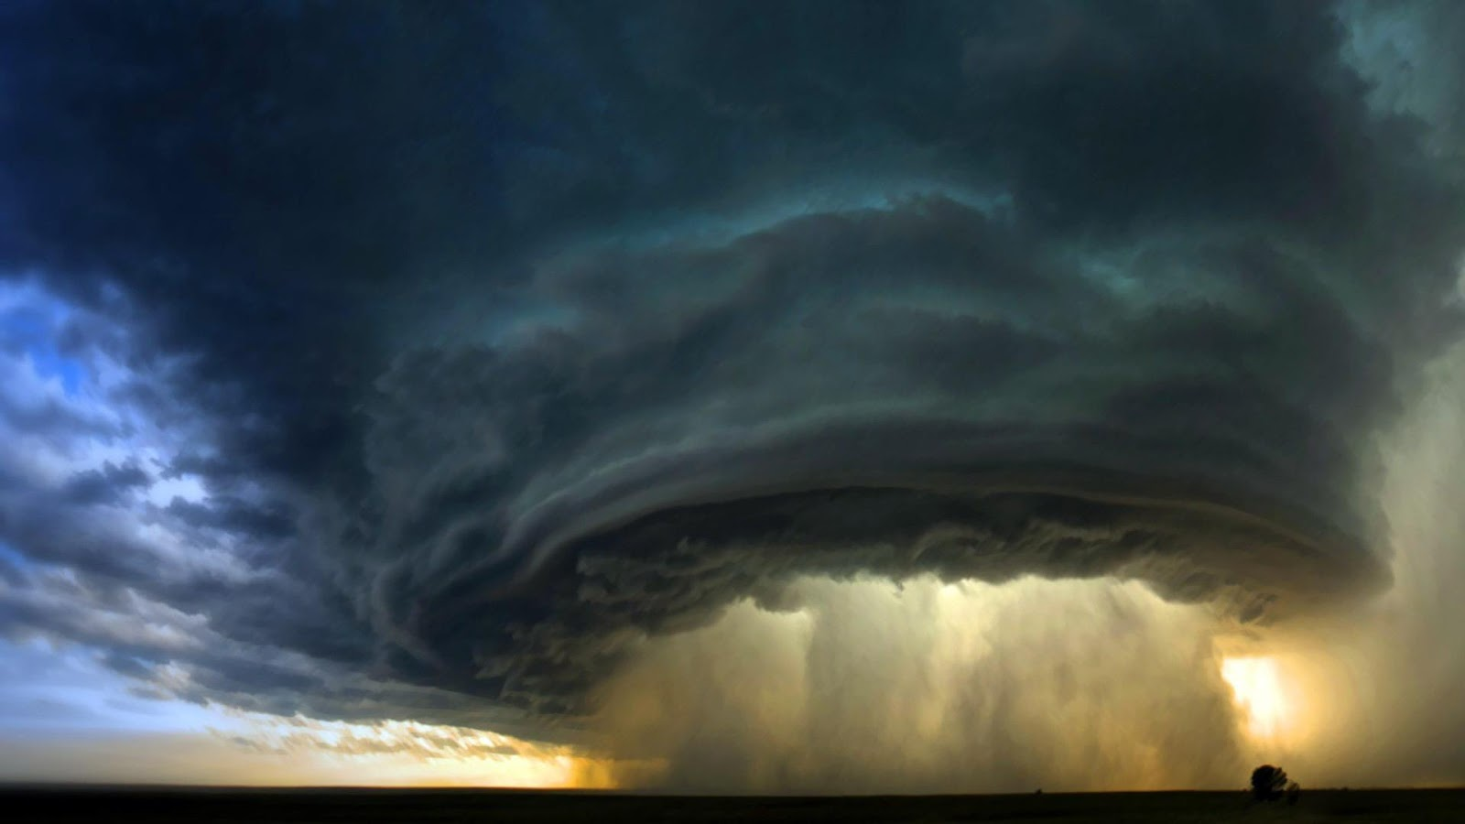
His Character
Job 42:2-3 – “²I know that You can do all things, and that no purpose of Yours can be thwarted. ³‘Who is this that hides counsel without knowledge?’ Therefore I have declared that which I did not understand, things too wonderful for me, which I did not know.”
Notes:
Fear gives us a proper assessment of His character. Job is a perfect example of this. Job had a misconception about God. He believed himself undeserving of such suffering and so He began to question whether God could truly be just. And he just knew that if He could state his case personally that he would be exonerated. But when God did appear to him, in a whirlwind no less, Job found out just how unprepared he was to defend himself. And without going through those last couple chapters in detail, the point of it all is this: don’t assume you know why God does what He does until you know what God knows. And Job got the lesson – Job 42:1-2
Job’s misconception stemmed from a lack of hindsight of God’s purpose for Job’s suffering. And what I’m suggesting, is that when we’re truly in awe of who and what God really is, we’re going to readily acknowledge that He is beyond our comprehension to grasp. As Isa 55:8-9 says, his thoughts and His ways are so much higher and better than our own. The fear of the Lord gives us a proper assessment of His character wherein we won’t be tempted to tame Him or lower Him into our image as some kind of nonthreatening entity, a permissive “buddy” who simply exists to give us what we want. God is infinitely greater than that!

Slide 12
Other People
Fear Over Faith
Israel Feared The Egyptians – Ex 14:13
King Saul Feared The People – 1 Sam 15:24
Elijah Feared Jezebel – 1 Kings 19:2-3a
Pharisees Feared The People – Luke 22:3
The People Feared The Pharisees – John 12:42
Faith Over Fear
Noah “Revered” God – Heb 11:7
Moses Parents Didn’t Fear The King’s Edict– Heb 11:23
Moses Didn’t Fear Pharaoh’s Wrath – Heb 11:27
Israel Encircled Jericho – Heb 11:30
Rahab Welcomed The Spies – Heb 11:31
Notes:
Third, fear gives us a proper assessment of other people. If we do not develop a healthy fear toward God, we will always be vulnerable to assessing ourselves and our actions by the opinions of other people. This happened all over the bible with many, many people:
Israel toward Egypt (Ex 14:13)
King Saul toward the people (1 Sam 15:24)
Elijah scared to death of Jezebel (1 Kings 19:2-3a)
Pharisees fearing the people (Luke 22:3) and the people fearing the Pharisees (John 12:42). How about that dreaded symbiotic circle? The people feared the Pharisees but the Pharisees feared the people. Maybe that circle could have been broken if one of the parties had the guts to start fearing God! We don’t look at these people in these insistences with any admiration whatsoever. We think, “What a bunch of dufuses. They were more scared of what people thought of them, or of what people would do to them, than the Cosmic Creator of this universe.”
Contrast this with Hebrews 11 and what people did by faith in the very face of fear, when the opposition of man was against them:
Noah (Heb 11:7)
Moses’ Parents (Heb 11:23)
Moses (Heb 11:27)
Israel (Heb 11:30)
Rahab (Heb 11:31), etc.
They didn’t fear the mocking, they didn’t fear death, they didn’t fear the wrath of the king, the armies of nations, or accusations of treason. They had faith.

Slide 13
Other People
Prov 29:25 – “The fear of man brings a snare, but he who trusts in the Lord will be exalted.”
Isa 57:11 – “Of whom were you worried and fearful when you lied, and did not remember Me nor give me a thought? Was I not silent even for a long time so you do not fear Me?”
Prov 23:17 – “Do not let your heart envy sinners, but live in the fear of the Lord always.”
Notes:
Contrast this with what we allow man to influence us to do. “If you really love me, you’ll have sex with me.” “If you’re cool, you’ll have a drink. Everyone does it.” “If you want guys to notice you, you need to expose more skin, more leg, more cleavage, and its important not to just do it in public but its GOT to go on social media, because the only way you’re going to be able to boost your self esteem is by tallying up those likes.
Folks, many of the sins we commit will come about simply because we let what man thinks override what God thinks and that is evidence that we do not have a healthy fear of the Lord – Prov 29:25 – If you make your decisions based on what other people think, you’re becoming their prisoner. And Jesus went to the cross to free us from those chains. Don’t willingly put them back on!
Isa 57:11 – In other words, what possible power and sway does man hold over you that you purposely sin just to avoid their wrath when in doing so you are going to incur God’s? It’s ludicrous to even consider! – Prov 23:17 – In other words, stop caring about what they’re doing. It’s not as fun as you think.
Caring what other people think over what God thinks will suck the wisdom right out of us.

Slide 14
Ourselves
Notes:
Finally, fear of the Lord gives us a proper assessment of ourselves. This can be summed up in Solomon’s conclusion of the whole duty of man – Eccl 12:13-14 – Fearing God means understanding our life’s purpose is not to acquire every vanity under heaven, rather it is about living for Jesus Christ – Gal 2:20

