Slide 1
Notes:
1 Kings 3:16-22 – What a mess. How in the world do you figure something like this out? There are no witnesses. There’s no DNA testing or blood testing available at this time. And since they’re harlots, there’s no father to help out. So this has the makings of being the trial of the century, a classic “She said, she said” that would have most judges scratching their head on what to do about it. How is Solomon to sort out all this baby mama drama?
1 Kings 3:24-27 – Every time I read this story, it just blows me away. This was an incredible display of brilliance for such a young king. Think about all the deductions he had to make to sort this thing out.
He had to have the best poker face in the world. Because He’s ordered his servant to slice this baby in half. I couldn’t have done it with a straight face.
He would have had to deduce some things about the countenance of each woman, their claims and their counter claims. A typical mother wouldn’t lay on her child and crush him in her sleep. So Solomon must have had the insight to know that any woman who could do such a thing would lack typical maternal instincts. Because any normal women, having accidentally done such a thing, would cry and cry and cry all night.
But whichever mother was lying actually had the gall to sneak over to the other one’s bed and exchange babies. I mean the psychological numbness required to pull this off must have clued Solomon in to the fact that the imposter would be satisfied with a “lose-lose” judgment.
Because apparently Solomon knew the ins and outs of “envy”, that rather than rejoicing with those who rejoice and weeping with those who weep, envy rejoices with those who weep and weeps toward those who rejoice.
And then Solomon must have also understood that any true mother would rather relinquish her parental rights than to see her innocent child be put to death.
So with all this insight and understanding, he is then able to draw up a play wherein the imposter could be revealed by her heartless cruelty and the true mother would be revealed by her willingness to do anything to spare the life of her son. Solomon is simply brilliant.
So the question is, how did Solomon take what to us looks like a judicial calculus equation, and draw out the truth with such logical and reasonable certainty? What is this sixth sense that he possessed that allowed him to know what looks like on the surface is an unknowable situation?

Slide 2
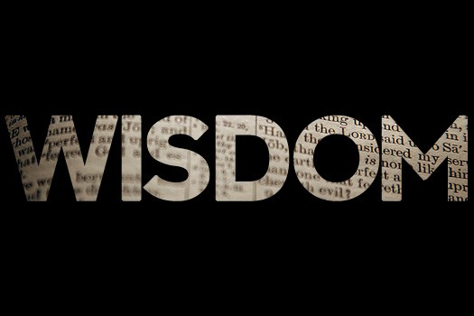
Notes:
The answer is in 1 Kings 3:28 – That’s the answer to the question. Solomon had wisdom.
The subject of wisdom is an underestimated, underappreciated, and understudied biblical concept. But it is crucial to our growth as Christians. I believe we have neglected a thorough study on wisdom in the church and in so doing we have trained Christians to only look at scripture through surface lenses, those things which can only be explicitly proven, which stymies our growth, because God didn’t deliver His word as a manual of “thou shalls” and “thou shall nots”. There is no scripture that explicitly teaches us dos and don’ts of social media interaction. That didn’t exist at in biblical days. But are there enough verses in scripture that deal with some of its “dos and don’ts” in principle? Absolutely. How do you know an how do you apply? Wisdom.
This subject is important for college students. You guys bring a lot of energy, and we need it here. You bring a lot of confidence, zeal, determination. Those are good qualities. But what the majority of young people lack is wisdom. And confidence without wisdom easily turns into pride. Zeal without wisdom makes you an unguided missile. It’s not necessarily your fault if you don’t have it; you’re young! It’s almost expected. But you have to seek after it.
Guys, when you’re young, you don’t know what you don’t know. You know a lot. Many of you are taking some killer classes in college. Calculus, Organic Chemistry, Electrical Circuits, and you pass that class and you think you know something. But you don’t know what you don’t know. And often you don’t know that you don’t know. Sometimes I go back and look at sermons I preached 20 years ago and I’m shocked. “Ryan, did you really say that? That was stupid. How were you not fired? Oh, I bet I made some brethren incensed and if I would have just said this and not that, I could have made the same point.” Now I’ve got a little bit more wisdom. But what do you think when Ryan 20 years from now is going to think about sermons he is writing this year? Probably the same thing.
Guys, we don’t know what we don’t know. We need wisdom. A that’s going to be the subject of this quarter.

Slide 3
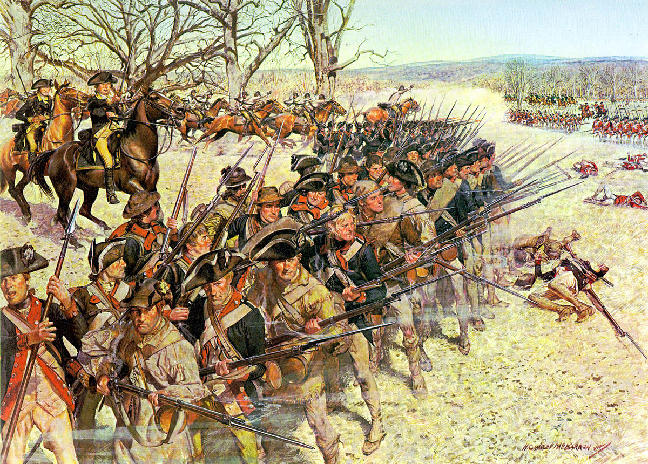
What is wisdom?
FACTUAL KNOWLEDGE
SITUATIONAL INSIGHT
NECESSARY RESOLVE
Righteous goal
Notes:
What exactly is wisdom? No dictionary definition does it justice, but here is as meaningful of a definition as I can muster – “Wisdom is the combination of factual knowledge, situational insight, that when combined with a strong, necessary resolve, and when practiced, has the greatest likelihood of achieving an intended righteous goal”.
So imagine you are wanting to lead an army on a battlefield with the intended goal being victory. A wise general will have the factual knowledge he needs such as the terrain, the weather, the strengths and weaknesses of the opposing army, where they are located, how they fight, what kinds of weapons they use, how skilled his own troops are, how weary his troops are from previous battles, and much more.
But in additional to those facts, a wise general must also have the situational understanding, discernment, and insight so that at the critical moment when the enemy reacts one way, he responds appropriately in order to achieve the greatest chance of success.
But in addition to this knowledge and insight, he must have the proper resolve to act knowing that everything hangs on this.
Now take this military, battlefield example and make it a spiritual battlefield where Satan is the enemy who is trying to destroy us, and can you see how wisdom is so imperative for the Christian’s walk? Can you see how important it is to know Satan’s tactics, how he works, how he fights, what his weapons are, the kinds of troops he uses, and then developing the insight and resolve to know how to respond to his temptations to have the greatest chance for spiritual success?

Slide 4
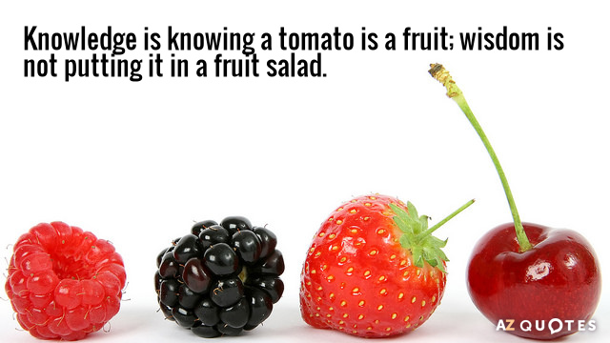
Prov 26:4 – “Do not answer a fool according to his folly, or you will also be like him.”
Mark 9:40 – “For he who is not against us is for us.”
“He who hesitates is lost.”
Prov 26:5 – “Answer a fool as his folly deserves, that he not be wise in his own eyes.”
Matt 12:30a – “He who is not with Me is against Me.”
“Haste makes waste”
Notes:
See wisdom goes beyond factual knowledge; it expands to application. Because wisdom understands that not every situation demands the same response, and the bible’s been telling us this for centuries. Here are a couple of examples:
Prov 26:4 – “Do not answer a fool according to his folly, or you will also be like him.” That’s easy enough to understand. The idea is that by arguing with a fool, as Mark Twain even once said, “he will drag you down to his level and beat you with experience.” But then notice the very next verse in Prov 26:5 – “Answer a fool as his folly deserves, that he not be wise in his own eyes.” Now on the surface this sounds like a contradiction. God just told us not to argue with a fool but then the very next verse he tells us we need to do so. Well, we understand this isn’t a contradiction, rather some fools need to be put in their place and others need to just be ignored. How do you when to do one and when to do another? Situational insight. The factual knowledge is not enough. There are other factors involved. What’s the battleground, who are the players involved, what’s the subject, what’s the motive, what’s the influence factor, and the list goes on and on.
Here’s another one – Mark 9:40 – “For he who is not against us is for us.” – Matt 12:30a – “He who is not with Me is against Me…”. They’re not contradictory. The man in Mark 9:40 was casting out demons in Jesus’ name, so he was obviously one of the 70 that Jesus commissioned in Luke 10 to do miracles and cast out demons. So just because this man wasn’t with Jesus physically doesn’t mean He was against Jesus. But Matt 12:30 seems to be referring to those who are clearly opposed to Jesus, as the Pharisees and scribes most certainly were. So again, it’s not a question of contradiction, rather, what are the circumstances? What’s the situation so we can understand which applies and which does not? What’s the context? That’s where wisdom comes in.
And there are tons of examples like this. “He who hesitates is lost”. But what about the saying, “haste makes waste”? They’re both truisms right? But it depends on the circumstance. “Knowledge is knowing a tomato is a fruit. Wisdom is not putting it in a fruit salad. Philosophy is wondering if that means ketchup is a smoothie”. Wisdom goes beyond the factual knowledge; it involves situational insight combined with resolve to have the greatest likelihood of producing an intended righteous result.

Slide 5
Is It Sinful?
Is It Wise?
Eph 5:15-16 – “Therefore be careful how you walk, not as unwise men but as wise, making the most of your time, because the days are evil.”
Notes:
Now, this tells us something that is imperative for our day-to-day decision making. What it tells us is that not every situation should be approached by simply asking the question, “Is this sinful?” Obviously that’s the first question we should ask. But stopping at that question is like graduating from the first grade. That’s just the ABC’s of Christianity as we’re first being instructed and gaining the factual knowledge we need. And if all we ever aspire to do is play nerf ball Christianity, that’s the only question we’ll ever ask. But on the spiritual battlefield, Satan will wipe the floor with us. Because only asking “Is it sinful?” is for those with little experience in spiritual discernment.
True discipleship goes beyond asking, “Is it sinful?” True discipleship asks, “Is this wise?” That question is the mark of Christian maturity and growth on the part of a person who understands the facts, the circumstances, the situation, and the times. The person who asks this question attempts to make his decisions through the lens of wisdom. Because there are a lot things around today that were not around in biblical times, a lot of situations we’re confronted with that didn’t exist in antiquity. So as Paul encourages us in Eph 5:15-16

Slide 6
Prov 4:7a – “The beginning of wisdom is: acquire wisdom”
Ask God
Jas 1:5 – “But if any of you lacks wisdom, let him ask of God, who gives to all generously and without reproach, and it will be given to him.”
1 Kings 3:9-10 – “So give Your servant an understanding heart to judge Your people to discern between good and evil. For who is able to judge this great people of Yours? It was pleasing in the sight of the Lord that Solomon had asked this thing.”
1 Kings 3:12 – “behold, I have done according to your words. Behold, I have given you a wise and discerning heart, so that there has been no one like you before You, nor shall one like you arise after you.”
Notes:
Well Prov 4:7a – “The beginning of wisdom is: Acquire wisdom”. That sounds self-defeating, that the beginning of wisdom is the acquisition of wisdom. But there is some profundity to what Solomon is saying here. We’re never going to get wisdom unless you have that “go get it” attitude. But how do we get it? How do we become like Solomon where we’re able to navigate the calculus equations of life that get thrown at us, so that we have the best chance of spiritual success?
First, when we’re considering spiritual wisdom, we’re not talking about something that is of ourselves. Wisdom comes from God. Jas 3:17 calls its “wisdom from above”. And so what that means is, if we want it, we need to ask God for it – Jas 1:5 – “But if any of you lacks wisdom, let him ask of God, who gives to all generously and without reproach, and it will be given to him.” And that’s what King Solomon had done. Before he ever displayed that judicial genius in 1 Kings 3, He had asked God for wisdom. 1 Kings 3:9 – “…give Your servant an understanding heart to judge Your people to discern between good and evil”. And what does verse 10 say? – 1 Kings 3:10 – “It was pleasing in the sight of the Lord that Solomon had asked this thing.” 1 Kings 3:12 – “Behold, I have done according to your words. Behold, I have given you a wise and discerning heart, so that there has been no one like you before you, nor shall one like you arise after you.” See, God wants us to ask. Then when we do ask, He’s really pleased by that, and so He pours it out upon us beyond what we could possibly imagine.
It really is that simple. Just ask God to give it to you and trust that the one who is asking us to ask is of course going to be generous in His giving.

Slide 7
Prov 4:7a – “The beginning of wisdom is: acquire wisdom”
Ask God
DESIRE
1 Kings 3:8-9 – “Your servant is in the midst of Your people which You have chosen, a great people who are too many to be numbered or counted. So give Your servant an understanding heart to judge Your people to discern between good and evil. For who is able to judge this great people of Yours?”
Prov 3:13-15 – “How blessed is the man who finds wisdom and the man who gains understanding. For her profit is better than the profit of silver and her gain better than fine gold. She is more precious than jewels; and nothing you desire compares with her.”
Prov 8:11 – “For wisdom is better than jewels; and all desirable things cannot compare with her.”
Prov 16:16 – “How much better it is to get wisdom than gold! And to get understanding is to be chosen above silver.”
1 Kings 3:11-13 – “God said to him, ‘Because you have asked this thing and have not asked for yourself long life, nor have asked riches for yourself, nor have you asked for the life of your enemies, but have asked for yourself discernment to understand justice, behold, I have done according to your words. Behold, I have given you a wise and discerning heart, so that there has been no one like you before you, nor shall one like you arise after you. I have also given you what you have not asked, both riches and honor, so that there will not be any among the kings like you all your days.”
Notes:
However, wisdom is only something we should ask for if we really want it. There must be a desire to acquire wisdom, above everything else. Again, Solomon is the perfect example of this. God is the one who approaches Solomon in verse 5 and says to him, “Ask what you wish Me to give you.” Can you imagine God saying that to you? We’ll sometimes play this game in round about ways. We talk about what we’d do if a Jeannie offered us three wishes or what we’d do if we had a billion dollars. And all the things we talk about are typically material things because, to us, those are typically the things of the greatest value to us personally. But I’ve never met anyone who would waste one of their three wishes asking for wisdom, have you? But here is God telling Solomon, “You just name it and its yours.” And of all the things Solomon could have asked God for, here is what he prays – 1 Kings 3:8-9 – “Your servant is in the midst of Your people which You have chosen, a great people who are too many to be numbered or counted. So give Your servant an understanding heart to judge Your people to discern between good and evil. For who is able to judge this great people of Yours?” I mean of all things the mind could fathom, Solomon wanted wisdom. Why? Because he understood that wisdom is more valuable than anything
Maybe that’s the idea behind Prov 4:7 which says that the beginning of wisdom is to acquire wisdom. It almost takes a certain degree of wisdom to see just how valuable wisdom is:
Prov 3:13-15 – “How blessed is the man who finds wisdom and the man who gains understanding. For her profit is better than the profit of silver and her gain better than fine gold. She is more precious than jewels; and nothing you desire compares with her.”
Prov 8:11 – “For wisdom is better than jewels; and all desirable things cannot compare with her.”
Prov 16:16 – “How much better it is to get wisdom than gold! And to get understanding is to be chosen above silver.”
Now, you can easily prove that wisdom is far more valuable than wealth like this: think about all the people who have won the lottery – most of them go from rags to riches just like that. Do you know how many of them eventually go broke? It’s a lot, 70% was the last statistic I saw. Many of them have gone on record regretting the day they ever won it. How ironic. The thing so many of us dream of, financial independence for the rest of our lives, is what some former lottery winners have written books on stating their regret ever buying a lottery ticket. Why? Because of all the long lost cousins that come knocking on their door looking to swindle them, shady businessmen looking for an investor, having to choose the right financial advisor to trust with your money, which bank to trust, where to spend and how much to spend when what once cost so much now costs so little, how to manage being a janitor of all your possessions, all of the sudden having a giant target on your head for scans, lawsuits, or robbery. Go read the testimonies of these lottery winners, and it’s a nightmare for the majority because they’ve had these circumstances and situations arising that they’ve never had to deal with before and they don’t have the wisdom to navigate through them.
But on the other hand, when Solomon prayed for wisdom, notice what else he got? – 1 Kings 3:11-13 – “God said to him, ‘Because you have asked this thing and have not asked for yourself long life, nor have asked riches for yourself, nor have you asked for the life of your enemies, but have asked for yourself discernment to understand justice, behold, I have done according to your words. Behold, I have given you a wise and discerning heart, so that there has been no one like you before you, nor shall one like you arise after you. I have also given you what you have not asked, both riches and honor, so that there will not be any among the kings like you all your days.”
I’m speculating here, but could it be that the reason God gave him the material things was because not only did Solomon understand how valuable wisdom was compared to wealth, but that he also would know how to better deal with the responsibilities and the burdens that material wealth brings? Do you see how wisdom is so indispensable and vital to any success? Only when we recognize its value will we truly want it. And it’s only when we desire wisdom above anything else that we’ll be able to be good stewards of the blessings God can give us.

Slide 8
Prov 4:7a – “The beginning of wisdom is: acquire wisdom”
Ask God
DESIRE
Humility
1 Cor 3:18 – “Let no man deceive himself. If any man among you thinks that he is wise in this age, he must become foolish, so that he may become wise.”
Prov 11:2 – “When pride comes, then comes dishonor, but with the humble is wisdom.”
1 Kings 3:7-9 – “Now, O Lord my God, You have made Your servant king in place of my father David, yet I am but a little child; I do not know how to go out or come in. Your servant is in the midst of Your people which You have chosen, a great people who are too many to be numbered or counted. So give Your servant an understanding heart to judge Your people to discern between good and evil. For who is able to judge this great people of Yours?”
Notes:
So we need to ask for it, we’ve got to want it more than anything before we actually ask, but we’ll never want it until we see its value which means before we can become wise we must become fools. That’s the terminology Paul uses anyway – 1 Cor 3:18 – “Let no man deceive himself. If any man among you thinks that he is wise in this age, he must become foolish, so that he may become wise.” He’s not talking about walking around wearing a cone hat, in self-pity, forlorn, and misery. He’s talking about being unashamed, joyful, hope-filled fools for Christ. And that means recognizing that all our intellect, all our talent, all our material possessions, all our college degrees and everything else that man sees of value is nothing in comparison to the wisdom of Jesus Christ. In other words, we’re called to feast on a big ole slice of humble pie. Humility is what we need if we’re ever to gain wisdom – Prov 11:2 – “When pride comes, then comes dishonor, but with the humble is wisdom.”
Again, was this not the attitude of Solomon? – 1 Kings 3:7-9 – “Now, O Lord my God, You have made Your servant king in place of my father David, yet I am but a little child; I do not know how to go out or come in. Your servant is in the midst of Your people which You have chosen, a great people who are too many to be numbered or counted. So give Your servant an understanding heart to judge Your people to discern between good and evil. For who is able to judge this great people of Yours?”
Humility is the key. Only when we realize how little we know, how deficient and bankrupt we are, will we truly want what only God can provide, from which then we make our petition

Slide 9
“The fear of the Lord is the beginning of knowledge”
(Prov 1:7a)
“The knowledge of the Holy One is understanding”
(Prov 9:10b)
“For if you cry for discernment, lift your voice for understanding”
(Prov 2:3)
“The fear of the Lord is the beginning of wisdom” (Prov 9:10a)
“The fear of the Lord is the instruction for wisdom” (Prov 15:33a)
Understanding
Formerly spelled “rightwiseness”
Fear
Instruction
Knowledge
Discernment
Righteousness
Trust
“The mouth of the righteous flows with wisdom”
(Prov 10:31a)
“Trust in the Lord with all your heart and do not lean on your own understanding.”
(Prov 3:5)
Wisdom
…has built her house, she has hewn out her seven pillars. (Prov 9:1)
Notes:
Well like all worthwhile journeys, wisdom can be divided into certain stages. The Prover writer said it this way – Prov 9:1 – “Wisdom has built her house, she has hewn out her seven pillars”. And while I don’t know whether or not Solomon intended for us to take the number 7 literally in this text, let me suggest to you 7 things that are incumbent of wisdom:
Prov 9:10a – “The fear of the Lord is the beginning of wisdom”. Why? Because Prov 22:15 says that foolishness is bound up in the heart of a child and that’s what we all are, spiritually speaking, without divine wisdom. Like Paul said in Eph 4, we’re children tossed here and there, by every whim, desire, and prejudice with no motivation whatsoever to put godly principle before our passions. And so wisdom, as we defined it earlier, is only going to take effect when there is the necessary resolve to see a path through to its intended righteous end. Fear is that motivation. Just as a car cannot start without gas, fear is the fuel that ignites with us just the right resolve and incentive to begin thinking about life through the lens of wisdom.
Prov 15:33a – “The fear of the Lord is the instruction for wisdom”. And truly nothing will test our resolve for doing what is right than our ability to receive instruction, whether that instruction is from God, from others who speak as the oracles of God, or simply learning from life’s experience. Without fear, instruction will go through one ear and out the other. But when coupled with fear, instruction is observed and sustained and stored away rather than just going through one ear and out he other. Ever wondered why Jesus spoke in parables and metaphors? One of the reasons is that He wanted to know who had the motivation and resolve to seek out the deeper meaning. And in the same way God has designed the proverbs, in its metaphors, paradoxes, and personifications, not just as short witty statements to be memorized and grabbed at a moment’s notice, but filled with deeper meaning that will only be understood by those with the determination to seek their many truths.
Because the purpose of instruction is to gain the factual knowledge that we need – Prov 1:7 – “The fear of the Lord is the beginning of knowledge…”. And this shouldn’t surprise us because Christianity is a religion of instruction. Jesus said in John 8:31-32 – “…If you continue in My word, then you are truly disciples of Mine; and you will know the truth, and the truth will make you free.” But it’s not just any knowledge because we’re interested in the knowledge of God. The Apostle Paul says in Col 2:3 that in Him is “hidden all the treasures of wisdom and knowledge.” In other words, be weary of the knowledge of man. I heard a woman commenting on a once faithful Christian who became an atheist how he “studied himself out of the bible.” Paul described people like this in 2 Tim 3:7 saying they are “always learning and never able to come to the knowledge of the truth.”
We’re interested in the knowledge of God because therein is where we find understanding – Prov 9:10b – “...the knowledge of the Holy One is understanding.” Now the difference between understanding and mere knowledge is that understanding is the point we come to where we’ve extracted meaning from the knowledge. Understanding is a lens which brings knowledge into better focus, so that we begin to not only see but to appreciate what we’ve learned. A good example is Prov 17:27 – “He who restrains his words has knowledge, and he who has a cool spirit is a man of understanding.” In other words, you can restrain your words because you know that’s what God wants you to do, but in doing so, there may still be an atomic bomb inside of you waiting to explode at a person. But understanding takes this knowledge to another level, because in addition to obeying, we actually see the benefit of this knowledge, the good that comes from obeying it and the bad that comes in disobeying it. And so a man of understanding not only restrains his word, but keeps a level head about it. He’s composed and calm because he gets it
So then understanding is taking abstract knowledge that we have from God, and learning to trust it – Prov 3:5-6 – “Trust in the Lord with all your heart and do not lean on your own understanding. In all your ways acknowledge Him, And He will make your paths straight.” Trust not only feeds our knowledge and our understanding, but it’s a byproduct of them as well – Prov 22:19 – “So that your trust may be in the Lord, I have taught you today, even you.” In other words, God so designed His word that when we immerse ourselves in it, and begin to meditate on it and apply it, we start to “get it”; we start to trust. And this is in turn will increase our appetite for learning more and more and increasing in understanding which in turn helps us trust even more and on and one it goes
And this is when we start to develop the tools to apply our knowledge correctly. This is where we begin to develop discernment – Prov 2:3 – “For if you cry for discernment, lift your voice for understanding”. Again, how do you know when to argue with a fool and when to ignore him? It’s simple, through practice – Heb 5:14 – “But solid food is for the mature, who because of practice have their senses trained to discern good and evil.” See, wisdom isn’t gained simply from this book, but by taking what we learn and through knowledge understanding, and trust, putting it to practice. And along the way, we’ll make good decisions and bad decisions. We’ll find success in some situations and in others we’ll find failure. But we’ll use those failures, not as lightning rods for bitterness or self-pity, but as stepping stones for reflecting upon our choices so that when a similar situation arises again, we’ll have even better discernment.
All these pillars of wisdom have in mind one objective, an intended righteous end. Prov 10:31a – “The mouth of the righteous flows with wisdom”. We’re not trying to be wise just so we can bask in pride or so others can look at us and say, “Oh, he is so wise”. We want wisdom because it causes us to be righteous. That makes wisdom non-optional, doesn’t it? You can’t take a topic like wisdom and brush it off as something only suited for elders, deacons, preachers, or any other kingdom role we may wrongly exalt in our minds. Wisdom is a requirement if we want to be righteous, and righteousness is a requirement for heaven. Paul said in Acts 24:15 that come judgment day there will be a resurrection of the righteous and the wicked. I don’t know about you, but I want to be found amongst the righteous. How do we attain righteousness? Through wisdom. You know how else I know this? Because Vine’s Greek dictionary tells us that the word “righteousness” used to be called “rightwiseness”. A righteous person is a person who practices the right wisdom, “rightwiseness.”

