Slide 1
Notes:
The name “Micah” means, “Who is like…?”. It’s an incomplete sentence, but by the time we finish this last chapter, we’ll know for sure that the object implied is God – “Who is like God?” And in order not to belabor this point in the introduction, I’ll summarize it this way – God is so above us in His thoughts and in His ways, that He can fully satisfy justice by judging sin and aiding the afflicted while at the same time fully satisfying His promises by saving His people despite their best efforts to destroy themselves. We worship a God who is truly like no other, incomparable, so transcendent, that to be asked by anyone to describe God could only be answered w/the question, “Who is like God?”
Keep in mind that chapter 6 ended w/Judah being presently compared to the house of Ahab in her sinfulness, and so judgment would be coming. And this is going to lead to unfathomable social conditions that in chapter 7 prompts another lamentation by Micah.

Slide 2
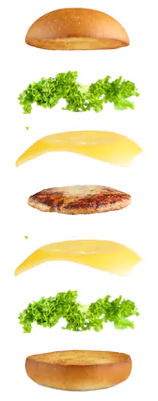
A. Who is like…? (1:1)
B. God’s demolition project (1:2-7)
C. Lamentation (judgment) (1:8-16)
D. Iniquity (coveting) (2:1-6)
E. Misrepresenting God (2:7-11)
F. God will lead them (2:12-13)
G. God strips away (3:1-12)
H. Nations among remnant (4:1-8)
I. Agony in labor (4:9-13)
X. Humiliation & Victory (5:1-2)
I’. Rejoicing in birth (5:3-6)
H’. Remnant among nations (5:7-9)
G’. God strips away (5:10-15)
F’. God led them (6:1-5)
E’. Misrepresenting God (6:6-8)
D’. Iniquity (Omri’s statutes) (6:9-16)
C’. Lamentation (immorality) (7:1-8)
B’. God’s rehabilitation project (7:9-17)
A’. Who is like God? (7:18-20)
Notes:
Keep in mind that Micah is one giant chiasm (palistrophe), and as we walked it up to the central theme of the birth of Christ in chapter 5, each theme has been walking back, matching the themes from the prior verses. This is a wonderful way to memorize the structure of the book.
PRAYER

Slide 3
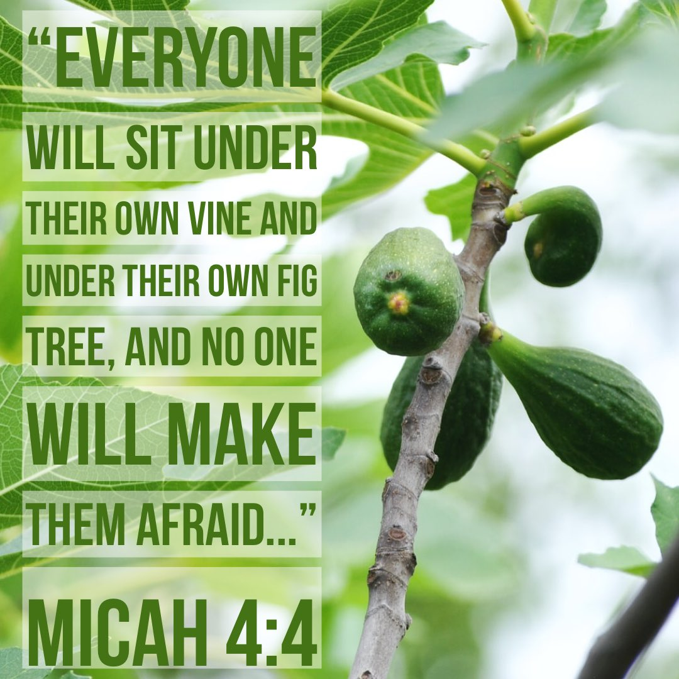
Lamentation
Mic 7:1-3 – “¹Woe is me! For I am like the fruit pickers, like the grape gatherers. There is not a cluster of grapes to eat, or a first-ripe fig which I crave. ²The godly person has perished from the land, and there is no upright person among men. All of them lie in wait for bloodshed; each of them hunts the other with a net. ³Concerning evil, both hands do it well. The prince asks, also the judge, for a bribe, and a great man speaks the desire of his soul; so they weave it together.”
Notes:
Right off the heels of being accused of observing the “statutes of Omri”, Micah, knowing what’s coming, begins another lamentation (CLICK) – Mic 7:1 – (CLICK) This is the opposite of what we read in 4:4, which reveal latter days in which, ”Each of them will sit under his vine and under his fig tree, with no one to make them afraid…”.
In reaping season, the Law of Moses forbade harvesters from going back through a 2nd time to gather up what they missed the first time, but to leave the gleanings for the poor. But Micah speaks of a vineyard that has been picked over so thoroughly, nothing good is left for anybody.

Slide 4
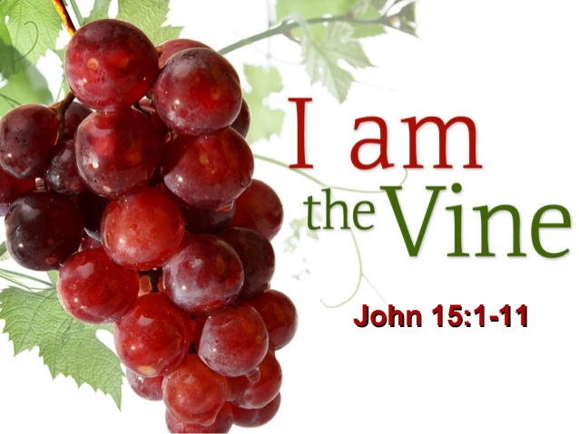
Lamentation
Mic 7:1-3 – “¹Woe is me! For I am like the fruit pickers, like the grape gatherers. There is not a cluster of grapes to eat, or a first-ripe fig which I crave. ²The godly person has perished from the land, and there is no upright person among men. All of them lie in wait for bloodshed; each of them hunts the other with a net. ³Concerning evil, both hands do it well. The prince asks, also the judge, for a bribe, and a great man speaks the desire of his soul; so they weave it together.”
Notes:
What does the metaphor mean? (CLICK) – Mic 7:2 – It’s not physical fruit Micah is referring to, rather he can’t find anyone who has high moral standards, who are honest, and who deal fairly w/their neighbor. Instead, they’re engaged in sinister, covert practices that go to any length to best their neighbor. And not just greedy, but He depicts them as hunters who prey upon people, like some ancient parody of the Hunger Games.
(CLICK) Mic 7:3 – So it’s not that they didn’t have any good in them, right? They’re really good at evil. In fact, they’re ambidextrous at it. The leaders work closely together to see their evil schemes through to the end, and that word “weave” really brings this out, because it gives the picture of an evil person so adept at knitting together conspiracies in order to plunder their subjects, no one escapes the plans they hatch. They’re that good at evil. (CLICK) This is why the coming of Jesus Christ, who is described in John 15:1 as the true vine, is so satisfying.
And so, try to appreciate the metaphor – the poor and afflicted amongst the people were looking for gleanings in the form of people who would stand up for them, who would stand up for righteousness, and there were no gleanings left. Yet, from chapter 6, we know they were in denial of having done anything wrong, even accusing God of being unreasonable in His expectations. But when Abraham tried to intercede for Sodom and Gomorrah on Lot’s behalf, and God said He’d spare it if just ten righteous souls were found there, Micah couldn’t even find that in Judah.

Slide 5
Lamentation
Mic 7:4 – “⁴The best of them is like a briar, the most upright like a thorn hedge. The day when you post your watchmen, your punishment will come. Then their confusion will occur.”
Notes:
“Surely that’s an overstatement. It couldn’t have been that bad” (CLICK) – Mic 7:4a – Briars and hedges are obstructions to those wanting access to the vineyard. The idea is that even amongst those who are not actively engaged in wickedness, (CLICK) they at the very least obstruct justice. This is how abysmally low is the level of moral responsibility, that if an innocent person appeals to them for relief from an oppressor, he only finds apathy and indifference, pricking and hurting where they should be helping and loving.
And in a tangential statement of judgment, (CLICK) Micah says in Mic 7:4b – watchmen were lookouts posted on city walls to warn of approaching danger, likely alluding to the coming siege by Sennacherib. But rather than it being enough of a heads up for them to do something about it, it’ll just throw the city into further panic and confusion because outside of God’s personal intervention, they won’t be able to do anything about it.

Slide 6
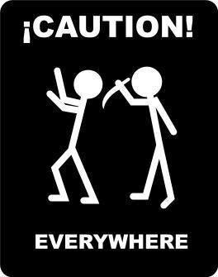
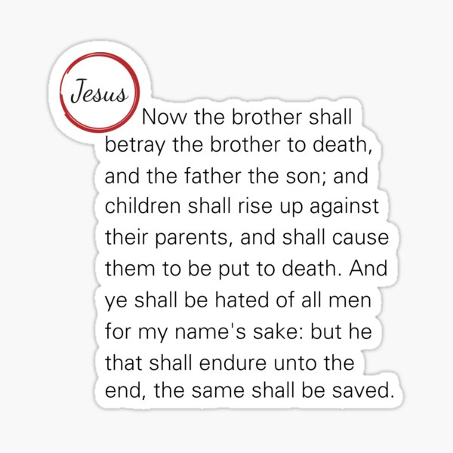
Lamentation
Mic 7:5-6 – “⁵Do not trust in a neighbor; do not have confidence in a friend. From her who lies in your bosom guard your lips. ⁶For son treats father contemptuously, daughter rises up against her mother, daughter-in-law against her mother-in-law; a man’s enemies are the men of his own household.”
Notes:
So, this would be a time to keep your neighbors and your friends close, right? You’d think – but here is how bad times would be – Mic 7:5 – The confusion brought on by God’s judgment will result in social anarchy in which a person won’t even be able confide in his closest companions. Notice how it increases in intimacy – first neighbor, then friend, all the way to the one who lies in your bosom (wife). The point is that due to the strain of what was to come, even the strongest ties of social solidarity would snap, because one’s closest confidants would abuse that trust just to ensure their own survival.
And so, when that happens, you’re only going to be able to trust in your family, right? – Mic 7:6 – A fitting sentence against a nation that preyed upon its brothers – those even related by blood and marriage will rise up as enemies against one another to save their own hides. (CLICK) Jesus quoted in Matt 10:35-39; Luke 12:53 to describe what His arrival would produce in Israel, and we see a taste of it in John 9 in the story of the blind man when even the parents wouldn’t stand up for their own healed son over fear of being cast out from the synagogue. These descriptions picture a community unraveling at its tightest seams. This is a natural consequence when justice and righteousness allude society.

Slide 7
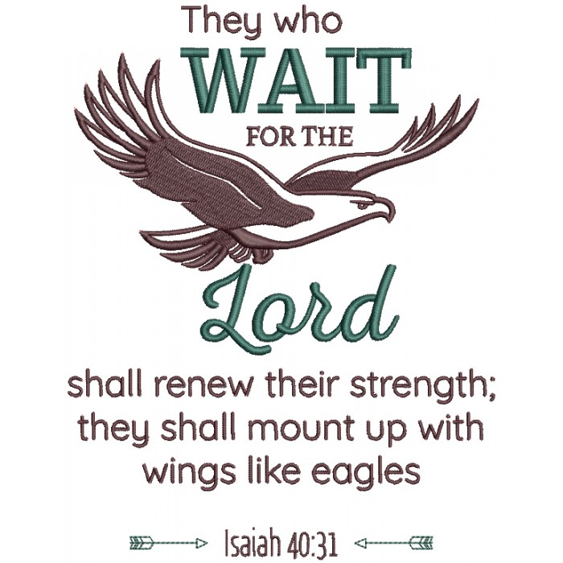
Lamentation
Mic 7:7 – “⁷But as for me, I will watch expectantly for the Lord; I will wait for the God of my salvation. My God will hear me.”
Notes:
But Micah now turns from pessimism to optimism, typical to find even in the psalms of lamentation (CLICK) – Mic 7:7 – So, while Zion watches for judgment, Micah watched for salvation. His pessimism didn’t drive him into despair, but further into the arms of God. Why? Because of God’s promise to Abraham – no matter how bad things get, God will always have the last word. And while it seems like the conditions described in the previous verses would make it difficult to trust, I’d suggest it is easier to trust when everything one places their hopes on in this fallen world fails them. It’s the vacuum in leadership created by those earthly leaders and judges who were turning a blind eye to the case of the innocent that causes people to reason that God will hear them. And so, even in his lamenting, He has hope – he waits.
COMMENTS

Slide 8
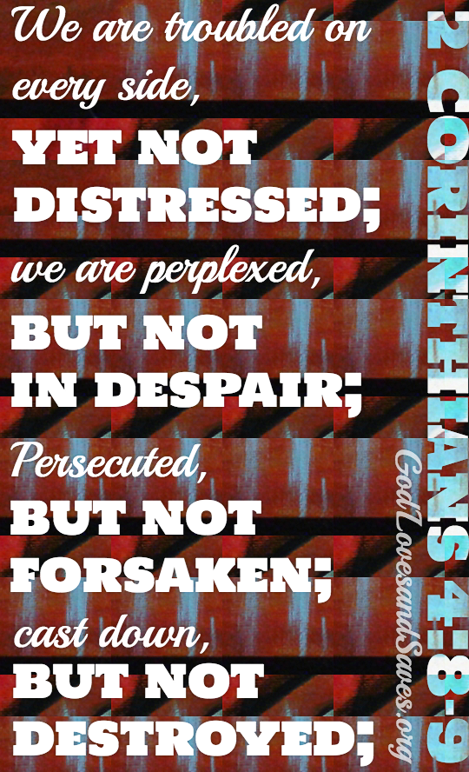
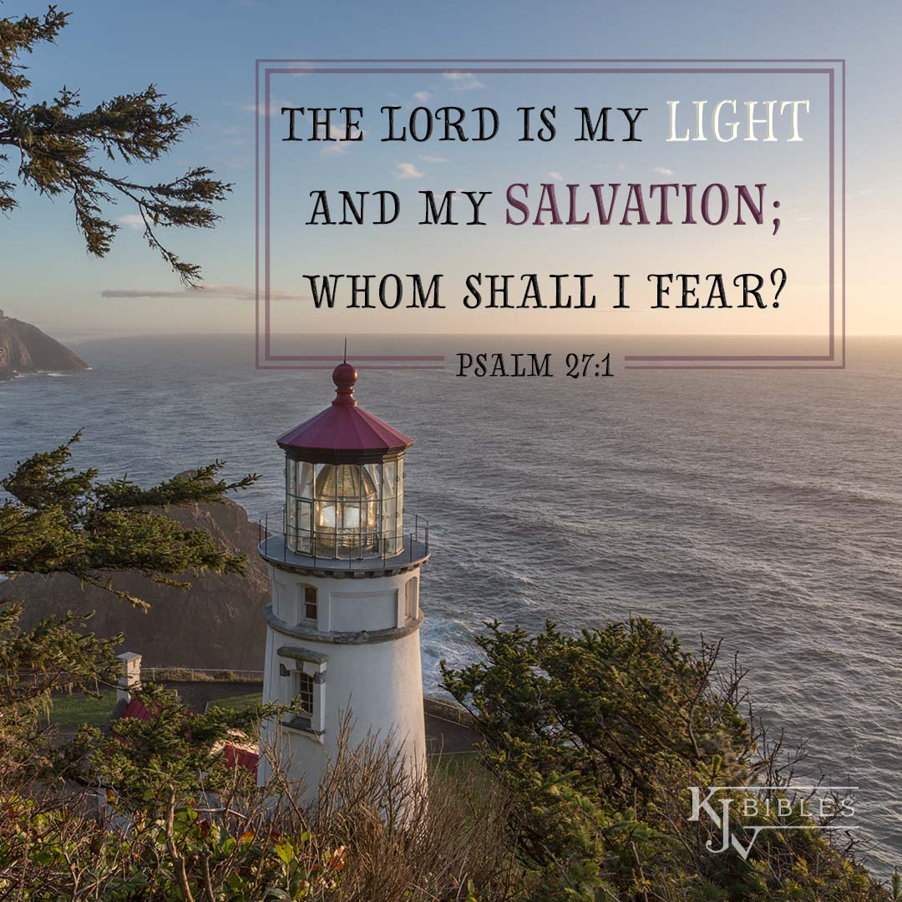
Zion’s Confidence
Mic 7:8 – “⁸Do not rejoice over me, O my enemy. Though I fall I will rise; though I dwell in darkness, the Lord is a light for me.”
Notes:
Now, the last 13 verses of the book form a hymn that seeks to recall major themes of the book. Despite a harsh situation ahead of them, these last 13 verses look to better times ahead w/assurance (CLICK) – Mic 7:8 – At first glance, it seems Micah is talking about himself. But down in vs. 10, which is a continuation of the conversation, the phrase “your God” is feminine. It’s when you take all the verses together that you realize this is not an individual person saying this – the “me” in this verse is a collective. This Daughter Zion being personified, and the book of Lamentations does something similar. The phrase “my enemy” is also feminine, likely referring to whatever city happens to be the enemy of Daughter Zion at the time – Assyria at present, but then later Babylon, then Persia, then Greece, then Rome.
(CLICK) Daughter Zion is saying something similar to Paul in 2 Cor 4:9, that though “persecuted, not forsaken; struck down, but not destroyed”. She’s currently pictured as in the dark tunnel of despair, (CLICK) but she can see a light at the end of the tunnel. Because though Zion knew the greatness of her sin, she also knew the greatness of God’s redemption.
Who is like God? Though our sin leads us to fall, God is always there w/His hand extended to lift us up – even in our darkest moments, He is our light and our salvation.

Slide 9
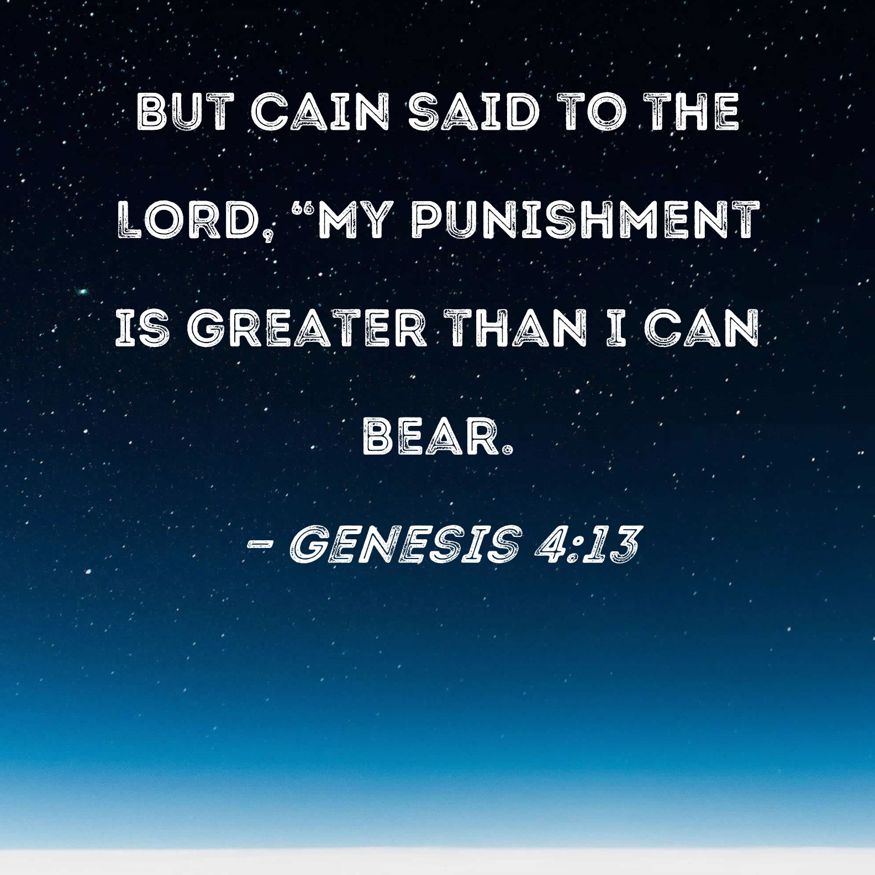
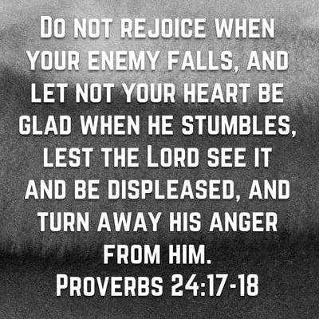
Zion’s Confidence
Mic 7:9-10 – “⁹I will bear the indignation of the Lord because I have sinned against Him, until He pleads my case and executes justice for me. He will bring me out to the light, and I will see His righteousness. ¹⁰Then my enemy will see, and shame will cover her who said to me, ‘Where is the Lord your God?’ My eyes will look on her; at that time she will be trampled down like mire of the streets.”
Notes:
Mic 7:9 – (CLICK) Cain said, “My punishment is too great to bear!” But Zion accepts that her fall wasn’t by chance, but that her sinful past against God had caught up to her. But she knows it’s remedial, because if God is judging her sin, how much more those enemies who abuse her? Sometimes it’s hard to appreciate the fact that God’s judgment for Israel was both a warning and a comfort. Right now, they were serving time, but He would ultimately free them from their prison of darkness, granting them release, and judge those who mistreated them.
(CLICK) Mic 7:10a – (CLICK) It’s one thing to kick God’s people when they’re down, it’s another thing to include God in their taunts. That was Goliath’s undoing, it was the Rabshakeh’s undoing, etc. Anytime it’s God’s honor at stake, we can go ahead and start planning the victory party. Who is like God? He is a God who can be trusted not just to vindicate His people, but His glory and His might.
(CLICK) Mic 7:10b – You’ll recall from the last chapter that phrase “the statues of Omri, the works of the house of Ahab”. There was arguably no great enemy to God’s people than the Baal worshipper “Jezebel”. She persecuted and harassed God’s people to no end. But what was her fate? 2 Kings 9 records for us that at Jehu’s urging, some of her officials “threw her down, and some of her blood was sprinkled on the wall and on the horses, and he trampled her under foot.” Just another interesting allusion to the house of Ahab. Who is like God? He will bring those who abuse His people as low as they can possibly be.

Slide 10
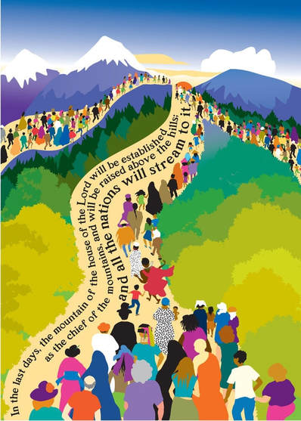
Oracle of Salvation
Mic 7:11-13 – “¹¹It will be a day for building your walls. On that day will your boundary be extended. ¹²It will be a day when they will come to you from Assyria and the cities of Egypt, from Egypt even to the Euphrates, even from sea to sea and mountain to mountain. ¹³And the earth will become desolate because of her inhabitants, on account of the fruit of their deeds.”
Notes:
And w/their enemies gone, the Lord delivers a message of hope (CLICK) – Mic 7:11a – “Walls” is typically referred to in the prophets as the enclosure of a vineyard. (CLICK) Zechariah alluded to this in his book, that God is the ultimate firewall for Israel, preventing all viruses and hackers from piercing through its shield.
Not only that (CLICK) – Mic 7:11b – Meaning, her enclosure will be so large, any who want to find refuge within its walls will find ample space. This is a wonderful promise for a present community living in cramped conditions as a result of Sennacherib’s invasion.
And in a surprising twist, look who will come (CLICK) – Mic 7:12 – I would take this to mean both Jewish exiles returning to their native land as well as those from pagan nations, just as we saw in chapter 4. This is a geographical merism, Egypt being in the south, Assyria in the north. Egypt afflicted them at her birth, Assyria toward her end, and so not only do they picture the entirety of the world, but both represent the salvation of all who formerly threatened her very existence.
And this would be important because (CLICK) – Mic 7:13 – In other words, those outside these boundaries from vs. 12, who ultimately do not choose to stream up to the mountain of the house of the Lord, they’re done. They’ll reap what they’d sown. So, while prior verses considered Zion, these verses expand to the whole Earth who decide to dwell within Zion’s borders. Peoples of all nations will be saved within the walls of Jerusalem. Everyone outside those walls will be destroyed.
Who is like God? His compassion is not limited to Israel, but extends to the whole earth, even those who were once His enemies.
COMMENTS

Slide 11
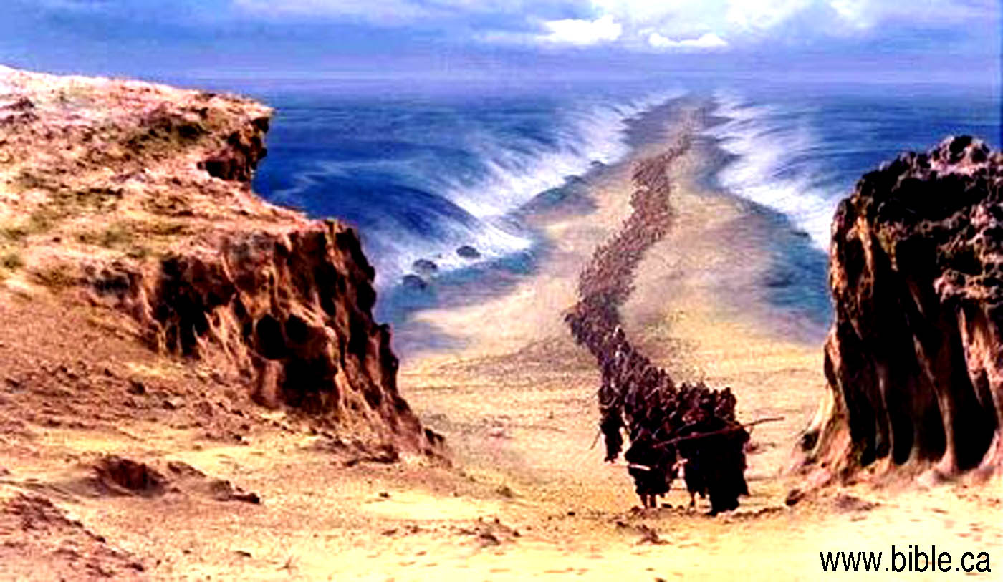
Supplication
Mic 7:14-15 – “¹⁴Shepherd Your people with Your scepter, the flock of Your possession which dwells by itself in the woodland, in the midst of a fruitful field. Let them feed in Bashan and Gilead as in the days of old. ¹⁵‘As in the days when you came out from the land of Egypt, I will show you miracles.’”
Notes:
We next see a prayer of supplication for God’s provision, expressing how ardent is the desire that the prior oracle should come true (CLICK) – Mic 7:14 – (CLICK) “shepherd” was a common figure in the ancient east of the ideal king, and was even commonly depicted by the scepter in Egyptian sarcophaguses. It depicted an inward spiritual relationship of love and trust between king and people, outward protection, and we’ve seen this imagery in all 3 “hope” sections in the book. We’ve seen the promise previously, but now Zion is yearning for God to keep His promise. The “scepter/rod” symbolizes security against their enemies, the “woodland” symbolizes the richest provisions, Carmel, Bashan, and Gilead being some of the finest land in Israel. I think the idea is that they could see greener grass beyond their present affliction. God gave them these lands before, so Zion is praying He’ll do so again.
And as if interrupting the petition, God speaks in the first person (CLICK) – Mic 7:15 – (CLICK) meaning, God looks back even further than their occupation of Bashan and Gilead, promising a similar miraculous fete in the future. The OT prophets use the Exodus from Egypt as a prototype of what God will do in the future over and over again. Israel’s true remnant, which would include Jewish and Gentile Christians, experience an Exodus from sin and judgment and a wilderness wandering toward heaven, and it involves far greater “wonders” than what we see in Exodus.

Slide 12
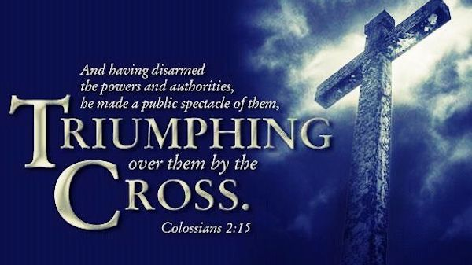
Supplication
Mic 7:16-17 – “¹⁶Nations will see and be ashamed of all their might. They will put their hand on their mouth, their ears will be deaf. ¹⁷They will lick the dust like a serpent, like reptiles of the earth. They will come trembling out of their fortresses; to the Lord our God they will come in dread and they will be afraid before You.”
Notes:
(CLICK) Mic 7:16 – this prayer strikes a similar not to v. 10 and 13, concerning the humiliation of the nations that presently threatened them, but it widens it beyond Assyria. History confirms that what God did to nations like Assyria and Babylon put other nations on notice. (CLICK) And we saw a similar reaction by the Canaanites in Josh 5:1 when God’s wonders were on full display then. I believe this is one of the reasons why we see so many God-fearers in the NT from other nations (amongst other reasons). When foreign nations are confronted w/God’s power, they will see just how puny their own power is, not only zipping those lips that once taunted Him and His people, but in turn bowing the knee.
(CLICK) Mic 7:17a – sound familiar? According to Matt 25:41, who is hell reserved for? The devil and his angels. Then why would God send people there? Because they choose to serve him over God and therefore deserve his punishment. “You want to be like the devil, you’ll share his curse”.
(CLICK) Mic 7:17b – (CLICK) This verse goes so well w/Col 2:15 – “When He had disarmed the rulers and authorities, He made a public display of them, having triumphed over them through Him.”
So, who is like God? His power is so imposing, it causes people to move out of their former strongholds to worship Him.
COMMENTS

Slide 13
Confidence
Mic 7:18-20 – “¹⁸Who is a God like You, who pardons iniquity and passes over the rebellious act of the remnant of Him possession? He does not retain His anger forever, because He delights in unchanging love. ¹⁹He will again have compassion on us; He will tread our iniquities under foot. Yes, You will cast all their sins into the depths of the sea. ²⁰You will give truth to Jacob and unchanging love to Abraham, which You swore to our forefathers from the days of old.”
Notes:
A young boy was sitting in his classroom drawing a picture. The teacher walked up behind him, saw the picture, and asked him, “What are you drawing?” He answered, “I’m drawing a picture of God.” The teacher replied that no one had ever really seen God and that we don’t really know what He looks like. The young boy didn’t miss a beat. He replied, “They will when I’m finished.” The book of Micah ends how it began, Micah’s very name taken up and woven into a final poem of praise to God.
(CLICK) Mic 7:18a – “Where is your God” in vs. 10 is answered by Micah w/the question “Who is like God?”. The question began in vs. 1 w/Him coming in judgment, but it ends here w/Him coming in salvation. Final stanza concluding w/7 descriptions of God that provided a final answer of the book to any and every question about who God is.

Slide 14
Confidence
Mic 7:18-20 – “¹⁸Who is a God like You, who pardons iniquity and passes over the rebellious act of the remnant of Him possession? He does not retain His anger forever, because He delights in unchanging love. ¹⁹He will again have compassion on us; He will tread our iniquities under foot. Yes, You will cast all their sins into the depths of the sea. ²⁰You will give truth to Jacob and unchanging love to Abraham, which You swore to our forefathers from the days of old.”
“Who is like God?”
Pardons iniquity
Passes over rebellion
Doesn’t retain anger
Delights in unchanging love
Notes:
And the first incomparable quality? – Mic 7:18b – Not His military prowess, but His willingness to completely forgive. “Pardon” is a word that means “suffering love”, suggesting the lifting up of sin from one person and the bearing of it by another (Isa 53). What “god” has ever displayed this quality?
Mic 7:18c – Meaning He is someone who overlooks faults. The ultimate Passover that is only extended toward the remnant of His possession, not unrepentant sinners. And this is an attribute of God that evokes love and admiration more than a warrior.
Mic 7:18d – This asserts the same truth as the former statement, just expressing it in the negative. Psa 130:3-4 – “If You, Lord, should mark iniquities, O Lord, who could stand? But there is forgiveness with you, that You may be feared.”
Mic 7:18e – Here’s the word “hesed” again, mercy and clemency. See, God never asks something of us that He doesn’t do Himself. But He doesn’t just practice it, He delights in it.
Much of the vocabulary used in vs. 18 is used of Jesus in Isa 53, words like “bear”, “iniquity”, “transgression”, “pleasure”. Put together, God isn’t incomparable because He winks at sin, but in perfect justice allows Himself to be sacrificed in order to make His forgiveness possible.
Point: Who is like God? No other “god” would ever die in the place of his sinful creation to save them from his wrath – God then “lives on” through our praises.

Slide 15
Confidence
Mic 7:18-20 – “¹⁸Who is a God like You, who pardons iniquity and passes over the rebellious act of the remnant of Him possession? He does not retain His anger forever, because He delights in unchanging love. ¹⁹He will again have compassion on us; He will tread our iniquities under foot. Yes, You will cast all their sins into the depths of the sea. ²⁰You will give truth to Jacob and unchanging love to Abraham, which You swore to our forefathers from the days of old.”
“Who is like God?”
Pardons iniquity
Passes over rebellion
Doesn’t retain anger
Delights in unchanging love
Will have compassion
Abolish sin
Keep His promise
Notes:
Mic 7:19a – This verb is always used of a superior to an inferior, parents to children, victors to defeated, advantaged to disadvantaged.
Mic 7:19bcd – Sound familiar to a promise in the garden? – Gen 3:15 – “And I will put enmity between you and the woman, and between your seed and her seed; He shall bruise you on the head, and you shall bruise him on the heel.” Or Rom 16:20a – “The God of peace will soon crush Satan under your feet.” In what way? By reminding us of what happened to Egypt – God began Israel on her journey by hurling the Egyptians into the sea, and now He will restore them on their pilgrimage by hurling their sins into the depths of the sea. No longer would Israel be held captive by sin. As decisively and effectively as God removed Pharaoh and His troops, He will rid them of their sin.
And to conclude the book, he goes further back than even the Exodus – Mic 7:20 – The idea is, “I will do for you what I did for Abraham, Isaac, and Jacob”. Micah sees all this future work by God as simply a continuation of His past work w/the fathers.
This shows that despite the graphic depicting of sin and judgment throughout the book, the last word is grace. Though this grace is not cheap.

