Slide 1
Notes:
There is a play called “The Black Angel”, written by Michael Christopher, that is based on a true story about a former WW2 German general named Engel. Engel was sentenced by the Nuremburg court to 30 years in prison for atrocities committed by his army. He survived this experience and the play picks up after his release with Engel attempting to make a new life for himself in a small French village. He builds a small cabin in the woods, hoping that he and his wife can live the remainder of their days incognito and in peace.
Also in the play, however, is a French Journalist names Morrieu, and he tracked Engel upon his release. Morrieu had been strongly impacted by Engel in that his entire family had been massacred by Engel’s army in WW2. When the Nuremburg court sentences Engel to 30 years in prison rather than give him the death sentence, Morrieu condemned Engel in his own heart and for 30 years kept that hot hatred alive, waiting for the opportunity to plot his revenge and now it had arrived. Morrieu tracked Engel to the French village where he lived and incited the villagers in the town, and that very evening these villagers were going to march to Engel’s cabin, burn it down, and kill Engel and his wife. Morrieu, though, being a journalist, wanted to get to Engel beforehand because there were some gaps in his story that bothered him and he wanted to get it from Engel before he was killed. So Morrieu arrives early and introduces himself to Engel and proceeds to grill him about the massacre, trying to ascertain motive and such.
But while Morrieu expected to find some kind of monster in this cabin, he instead found a former general who was older than he remembered and visibly shaken. Engel had rediscovered humanity and was full of guilt and regret. And so Morrieu’s desire for vengeance began to be blurred, and his seething hatred contaminated, and no longer did he desire for the general to die. And so as the sun was about to set and the villagers would soon be there, Morrieu decided he wanted to save the general and therefore told him what was about to happen to him and his wife. Morrieu offers to smuggle Engel and his wife to safety, wishing to save their lives rather than forfeit them to the angry villagers.
It was then that Engel said to Morrieu, “I’ll agree to go with you on one condition.” And Morrieu couldn’t believe it. Engel is giving conditions for Morrieu to save his life? What possible condition could he require? So perplexed by this, Morrieu responded, “What condition?” and Engel responded, “I’m just asking that you forgive me for what I have done.” Morrieu had not thought about that, because in his mind, since his own family had been killed, he had exterminated Engel a hundred thousand different ways. His hatred and resentment had seethed toward this man for 30 years. He had agreed to save Engel’s physical life, but forgive him? Never. And so that night, the enraged villagers came to that cabin with sacks over their heads and burned it to the ground and they shot Engel and his wife dead
Why was forgiving Engel harder than saving his life? Because he had given into his resentment, his inward anger, for so long, those past offenses were engraved in stone upon his heart so deep, it had become a part of who he was. Morrieu simply didn’t know how to be anyone else. He had come to be synonymously associated with the resentment he felt toward this man so that when the time came to actually forgive him, it meant cutting out the part of his life that had consumed his whole life. His resentment had come to be such a part of him, that for him to be able to forgive that man, would be like consigning himself to death, destroying any reason he had left for living. Because Morrieu had come to live for one thought and one thought only – to hate that man. Talk about the price of resentment.

Slide 2
What Is “Take Into Account”?
“take into account” = “logizetai”
“to reckon, compute, count, impute, calculate”
Other Verses Where Used
Rom 4:8 – “Blessed is the man whose sin the Lord will not take into account.
2 Cor 5:19 – “namely, that God was in Christ reconciling the world to Himself, not counting their trespasses against them, and He has committed to us the word of reconciliation”
Phil 4:8 – “Finally, brethren, whatever is true, whatever is honorable, whatever is right, whatever is pure, whatever is lovely, whatever is of good repute, if there is any excellence and if anything worthy of praise, dwell on these things.”
Notes:
1 Cor 13:5d – “[Love] does not take into account a wrong suffered.”
The phrase “take into account”, or some of your translations say, “keeps no record” or “resentful” or “thinks no evil” is one Greek word – “logizetai”, which means “to reckon, compute, count, impute, calculate”. It is actually a book keeping term, and it means to calculate or to reckon when you are figuring an entry into a ledger. The reason we might make an entry into a ledger is to make it a permanent record so that we might go back later and consult that record. And in the area of bookkeeping and accounting, this is a very necessary practice. But in our personal relationships, not only is it unnecessary, it is harmful. It will destroy us spiritually. And to quote this section of 1 Cor 13:5 literally, love does not keep a record of the wrong done to it so that it can refer to it later.
This term is used in a couple other passages in the NT. Rom 4:8 – “Blessed is the man whose sin the Lord will not take into account.” There is the word “logizetai”. In other words, blessed is the one whose sin the Lord does not keep track of or enter into His records. And all of us should say “amen” to that. We have hope because through the shed blood of Jesus Christ, God has determined not to make an entry into His ledger so that He can consult it when we’re standing before Him on Judgment Day.
2 Cor 5:19 – “namely, that God was in Christ reconciling the world to Himself, not counting their trespasses against them, and He has committed to us the word of reconciliation”. So this is saying that God was in Christ reconciling the world to Himself, not tallying up their trespasses against them.
(Phil 4) Here, we find the word being used in a very positive way – Phil 4:8 – “Finally, brethren, whatever is true, whatever is honorable, whatever is right, whatever is pure, whatever is lovely, whatever is of good repute, if there is any excellence and if anything worthy of praise, dwell on these things.” “Dwell” on those things: meditate on them, calculate them, keep track of them, record the entry so you can refer back to these things later. That is what Paul is saying love does not do. Love does not take into account a wrong suffered

Slide 3
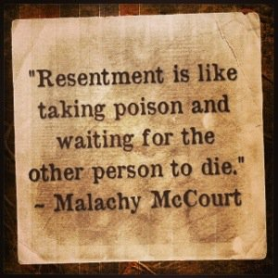
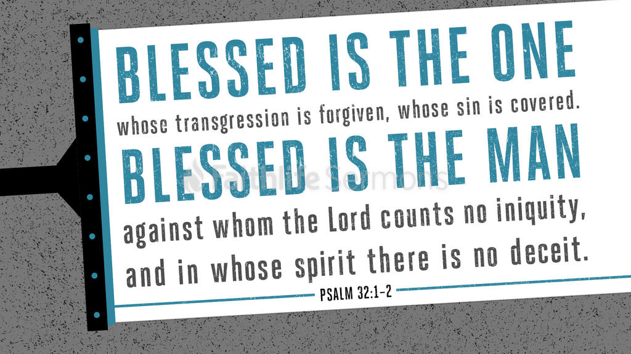
What Is “Take Into Account”?
Notes:
This is what resentment is, right? Resentment is the documenting, the logging into the book of memory, the calculating up of all the wrong done against us so we might consult that log at some point in the future. That is the basis and purpose of resentment; resentment is the ultimate accountant. Resentment is careful at keeping the books. With resentment, every “t” is crossed and every “i” is dotted so that it can be read and reread hoping for a chance to one day share it with the offender. But love doesn’t keep any books.
Resentment is different than ordinary anger. Ordinary anger or wrath is an explosion. But resentment is the accumulation of unexpressed anger. It’s like a radioactive explosion underground that not only rocks your foundations, but poisons and infects the soul. And because resentment is kept out of view, it can be difficult to detect in its full scope until at last it just spills over into the wellsprings of our life, poisoning us, and shuts the door to our heart. Anger that isn’t dealt with builds up and clogs up so that every good thing that comes down our pipes just gets caught in its web
But if God erases the record against us, if He no longer tallies up those trespasses, what then should we do about the much lesser offenses committed against us? Love doesn’t keep track of all the wrong done against us. Love forgives and love dismisses and love moves on to more important, lovelier things

Slide 4
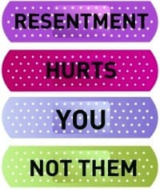
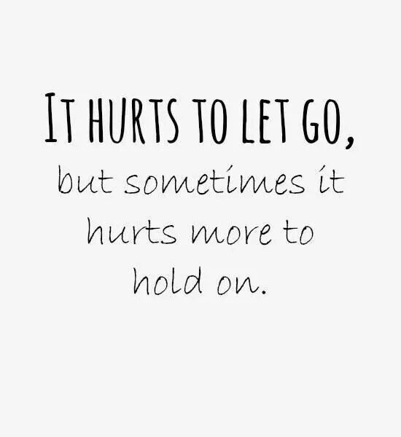
Price of Resentment
Hurts Me Physically
Prov 17:22 – “A joyful heart is good medicine, but a broken spirit dries up the bones.”
Notes:
What price does a person pay to harbor resentment in their heart? A writer once visited Yellowstone National Park and noticed that there was a grizzly bear who only consented to share his food with a skunk. It wasn’t that the grizzly wanted to share his food. Instead, he chose to share his food. That bear could have crushed that skunk with one swing of his powerful paw. So why did he allow the skunk to eat with him? Because he knew the high cost of getting even, that’s why. Harbored resentment comes with a terrible price.
First of all, it will hurt us physically. It will set us up for emotional breakdowns, and it will set us up for breakdowns in our physical health. Some doctors have honed in on unresolved resentment as the #1 emotional problem that leads to physical health problems. Prov 17:22 – “A joyful heart is good medicine, but a broken spirit dries up the bones.”

Slide 5
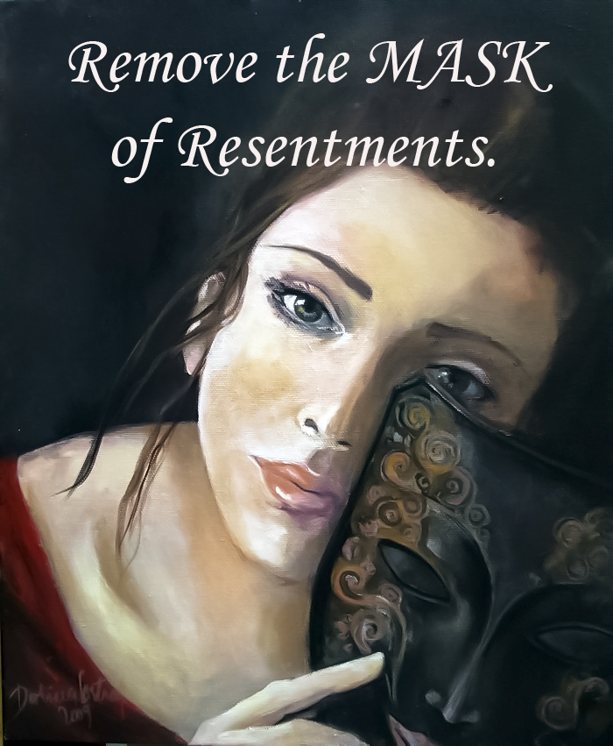
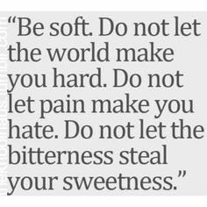
Price of Resentment
Hurts Me Physically
Deceives Me
1 Sam 18:10-11 – “¹⁰Now it came about on the next day that an evil spirit from God came mightily upon Saul, and he raved in the midst of the house, while David was playing the harp with his hand, as usual; and a spear was in Saul’s hand. ¹¹Saul hurled the spear for he thought, ‘I will pin David to the wall.’ But David escaped from his presence twice.”
Notes:
Resentment will deceive us. Have you ever been in the presence of someone who you thought was a loving, patient, kind person who, without any apparent provocation, explodes in such a way that is so out of context that you just don’t know how to understand it? Is that an accident? Is this some person who is a freak of nature regarding basic interpersonal skills? No, there is more to it. What you likely saw was a volcano that finally burst to the surface in pent up resentment, offenses of bygone days in books that have been kept up to date. It’s like when David was playing the harp for Saul, trying to soothe him and out of nowhere Saul tries to pin him to the wall with a spear as all that resentment towards David came seeping out.

Slide 6
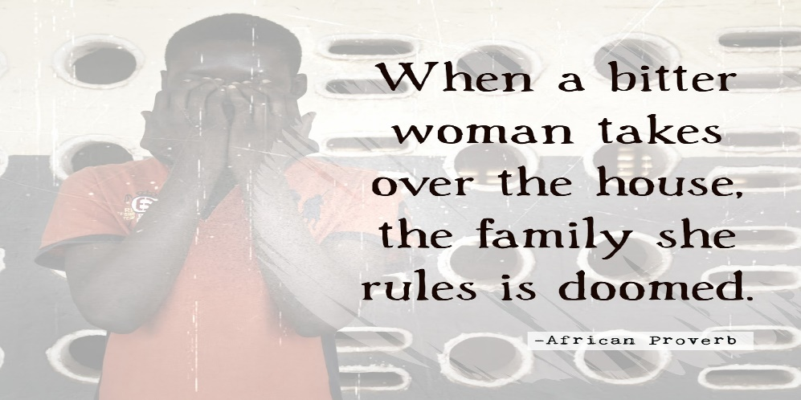
Price of Resentment
Hurts Me Physically
Deceives Me
Destroys My Family
Col 3:19 – “Husbands, love your wives and do not be embittered against them.”
Col 3:21 – “ Fathers, do not exasperate your children, so that they will not lose heart.”
Notes:
It will destroy our family. The consequences of resentment are not contained to the resenter, it bubbles to the surface. And it affects our spouse and our children. It brings collateral damage upon the most precious souls in my life as the only outlet I can seem to find to deal with it is take it out on them. This happens when infractions in the home are blown out proportion, where there needs to be mercy and patience expressed, but wrath instead follows. It destroys self confidence in children, makes husbands and wives feel undervalued and underappreciated, and unforgiven. Col 3:19 – “Husbands, love your wives and do not be embittered against them.” Col 3:21 – “ Fathers, do not exasperate your children, so that they will not lose heart.” All throughout the bible, we see the sin of one person affecting another and this is no different with the sin of resentment. Resentment will infect those we love in our family.

Slide 7
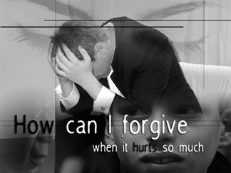
Price of Resentment
Hurts Me Physically
Deceives Me
Destroys My Family
Destroys My Ability To Forgive
Psa 73:21-22 – “When my heart was embittered and I was pierced within, then I was senseless and ignorant; I was like a beast before You.”
Notes:
But fourth, it destroys our capacity to forgive another person. We all know someone whose whole life is built around one basic truth, and that is their resentment toward someone else. Maybe it’s someone here whose mother/father abused them. And try as you may to forgive them, you can’t do it. Maybe it was a spouse who left you. Maybe it was someone in the church who did or said something to you, and now your whole life has been defined by your resentment toward that brother/sister. So day after day after day you refer to that ledger; you replay the tapes of that resentment in your mind and it’s become an acid that is eating away at your soul to the point where it’s impossible for you to function normally
Psa 73:21-22 – “When my heart was embittered and I was pierced within, then I was senseless and ignorant; I was like a beast before You.”
Resentment is hatred gone underground, being stored up beneath the surface, because forgiveness and reconciliation has not taken place. Because your resentment will not allow it to take place. And it robs us of our senses, preventing us from exercising some of the most basic graces toward another. Because if you go to the person that has wronged you, and you let them have it, going over every single infraction they have committed against you, how will you respond if they do the incredible? What will you do if they humbly repent, tearfully, regretfully, and want to make amends? Now you’re backed in a corner. Because now, all these years of holding on to that resentment and making draws on it to justify who you have allowed yourself to become, you’re going to be challenged to exercise a grace toward that person you may not have anymore. You’re going to have to forgive that person, let it go, and treat that person as if it never even happened because that’s exactly what Jesus does for us. But if you’re a person whose heart has been buried in the black depths of bitterness to the point where you’ve allowed it to consume you, that’s a heavy burden to lay at the cross.
Corrie ten Boom is famous for helping Jews escape the Holocaust during WW2 until she was caught and imprisoned in a Nazi concentration camp. A few days after the Allies conquered Germany, she was released, but it took her a lot longer to release herself from the resentment she had stored up in her heart because of the things that had happened to her while she was behind bars. But by an act of will, she set out on a European journey of extending forgiveness to whoever she met. So in Europe she went about teaching forgiveness, in Holland, in France, and even in Germany. One day while she was in Munich, she proclaimed forgiveness to all those Germans so eager to be forgiven, and when she was finished, something happened she was not prepared for. A man who had heard her speech approached her outside and reached out his hand to her expecting she would take it. He said to her, “Frauline ten Boom, I am so glad Jesus forgives us all our sins just as you say.” Corrie ten Boom recognized this man. She knew him. She remembered him from the concentration camp because she was forced to take a shower with all the other women prisoners while this beast watched, leering and mocking, guarding helpless naked women. She remembered him. So when this same man stretched out his hand, her own hand froze at her side. She couldn’t lift it because she couldn’t forgive him. She had been proclaiming forgiveness all throughout Europe, but now that she was confronted with it personally, she could not bring herself to do it. And she wrote that she was stunned and terrified by her own weakness. She was so sure that she had overcome the deep hurt, so what could she do now that she was confronted by a man she could not forgive? So she prayed. “Lord, I cannot bring myself to forgive this man. Please forgive me for not forgiving him.” And all at once, in some unexplained way she could not later describe, she felt forgiven, forgiven for not forgiving. And at that moment, her hand was able to go up and embrace the hand of her enemy and released him of his debt against her. And in doing so, she likewise freed herself.
It takes faith. You have to really go from the ordinary to the extraordinary to be willing to let something like this go that has become so engrained. Because this only happens with people that others write stories about, people that become sermon illustrations for preachers. It takes guts.

Slide 8
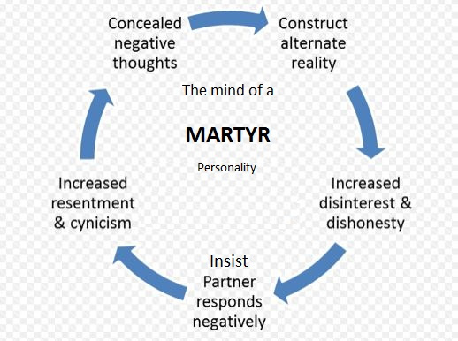
Why Do We Do It?
We Feel Superior To The One We Resent
Notes:
So why do we do it? Have you ever really thought about that? Why is it so much easier to harbor anger and resentment towards another person rather than seek forgiveness and reconciliation? Why, with all the damage that resentment brings to our spiritual life, would we rather let it fester and eat away at us than seek to set ourselves free? There are reasons that have come out of the studies that have been done on it.
First of all, resentment causes us to feel superior to the one we resent. It’s the “martyr complex”. We enjoy the noble feeling of being the decent person who was wrongfully treated. And the more we think with a martyr mentality, the more it elevates us above the one that we resent. It really does produce a feeling of superiority and that’s exactly why so many do it

Slide 9
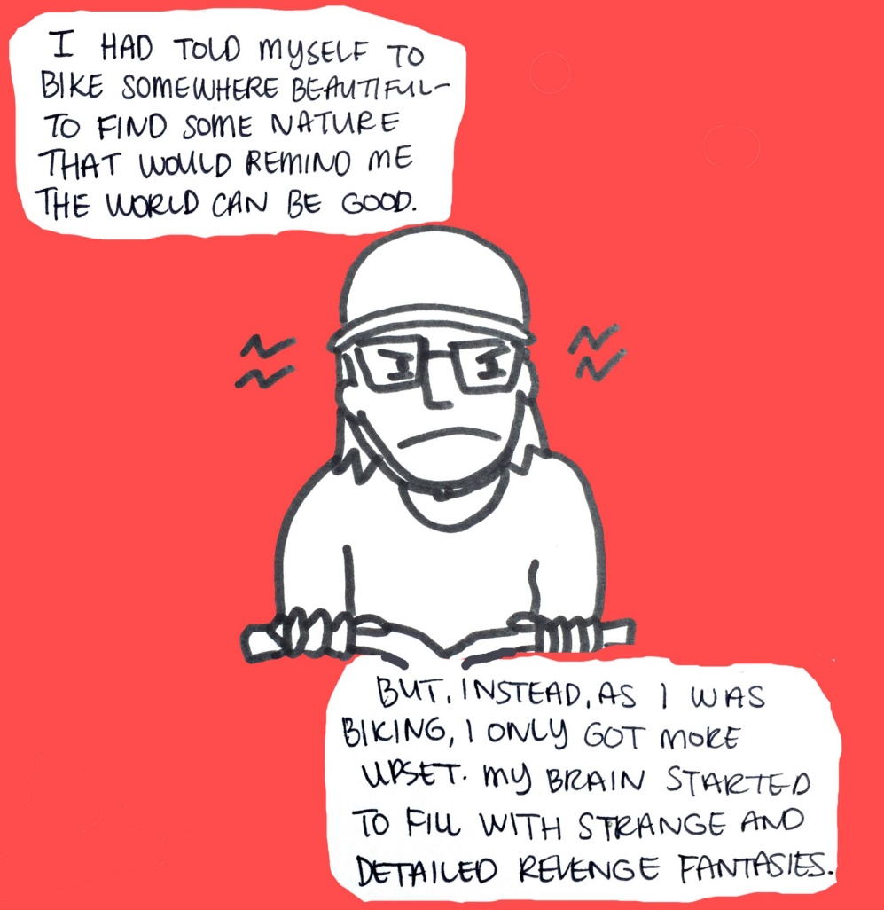
Why Do We Do It?
We Feel Superior To The One We Resent
To Indulge In It’s Rehearsal
Notes:
Second, harboring resentment allows us to indulge our minds in exquisite plots of revenge. You know what I’m talking about, don’t you? You’re in a conflict, and once you’ve walked away from said conflict, you get in the car and drive home, and on the home, it hits you – and out loud in the car, you start rehearsing what you should have said to that person. I mean, that turkey on the other side of the conflict is way back there where you just left him, and no one is in the car with you, but people pulled up next to you are looking at you like you should be in the nut house because you’re chewing out this guy in your car who isn’t even in your car. You’re rehearsing your resentment towards that man! And if you do it once or twice and get it out of your system, fine. But if you keep rehearsing it over and over and over again, planning intricate, exotic plots to get even, that’s where we get in trouble. There really is a sadistic pleasure we get out of it, right? It’s one thing to do it and get it out of your system. But to play it over and over again like a worn out tape

Slide 10
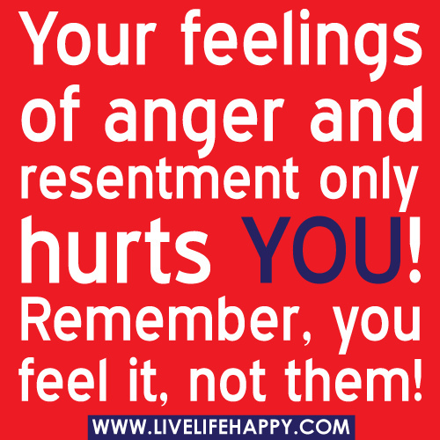
Why Do We Do It?
We Feel Superior To The One We Resent
To Indulge In It’s Rehearsal
Self-mutilation
Notes:
Third, and this one is so odd, but we harbor past wounds so we can hurt ourselves. Resentment is a sort of neurotic desire on the part of the resenter to inflict pain upon himself, a strange way to learn to enjoy your resentment. And so we lay in bed and replay the circumstance over and over again, because we get some kind of sorted pleasure out of hurting ourselves. When something unjust happens to us, what is generally our first reaction? We tell everyone we’re close to what happened, don’t we? Then we go to work and we tell it to our coworkers. We catch them by the coffee pot and we say, “You’re never going to believe what this joker did to me over the weekend” and then we rehearse it. What are we doing? Every time we tell someone what someone else did to us that is unjust, we’re driving our resentment deeper and deeper into our souls and we’re making that log book of infractions more difficult to erase until that resentment is so deep that only a miracle of God’s grace can deal with it. There really is a pattern of self-destruction we place ourselves in by continuing to rehash old wounds to others. We need to tell it to the Lord one time and that’s it. Because all harboring resentment gives us is neurotic pleasure and religious pride all wrapped up in a nice little sin package.

Slide 11
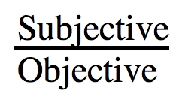
What Do We Do About It?
Write It Down
Notes:
Let me give you a suggestion that sounds rudimentary, but it actually serves a more profound purpose. Write it down. If you have a problem with resentment and you know why you are resentful, go home and get out a blank sheet of paper and write at the top, “This is why I am filled with resentment”. And then list the reasons. And when you’re done writing it down, look at it full in the face and read it over. Don’t try to make a better case than you should. Don’t try to make the person you’re angry with more evil than he already is, just put the facts down as they are, read it over, and what you’ll first of all will find out is that you feel better having written it down. But then the next thing you’ll experience is a discrepancy. You’ll notice a difference between what your honesty let you write down on the paper and what your mind has been letting you believe as you play it over and over again each day. Then take a couple days, and get that sheet out again and read it again and see if it’s the truth.

Slide 12
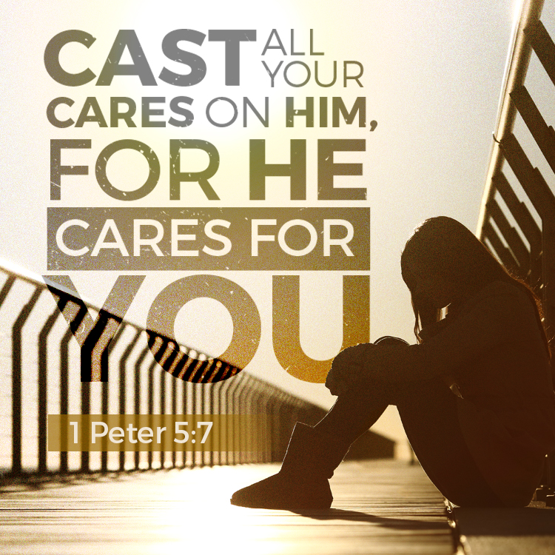
What Do We Do About It?
Write It Down
Work It Out
1 Pet 5:6-7 – “Therefore humble yourselves under the mighty hand of God, that He may exalt you at the proper time, casting all your anxiety on Him, because He cares for you.”
Notes:
Second, work it out. There are much better ways to work through resentment than to ventilate it toward another person. Exercise is one of them. Sometimes when I’m struggling with something like, I find it’s much easier to take it out on a tennis ball with my racket than it is to on someone else. But even better than this is to work it out with God
1 Pet 5:6-7 – “Therefore humble yourselves under the mighty hand of God, that He may exalt you at the proper time, casting all your anxiety on Him, because He cares for you.”

Slide 13
What Do We Do About It?
Write It Down
Work It Out
Talk It Out
Eph 4:26 – “Be angry, and yet do not sin; do not let the sun go down on your anger”
Notes:
Third, talk it over with a true friend. What I mean by a true friend is the one you can depend on not simply to confirm your feelings, but who is faithful enough that he/she will tell you, “Ryan, don’t you think you’re overreacting? I understand how you’re feeling, but take a deep breath and think this through because it doesn’t sound as bad to me as it does to you.” We all need friends like that. And that is how we are supposed to be with our mate too isn’t it? Because the idea is not to let our anger get to the point where it becomes settled and turns to resentment.
Eph 4:26 – “Be angry, and yet do not sin; do not let the sun go down on your anger”

Slide 14
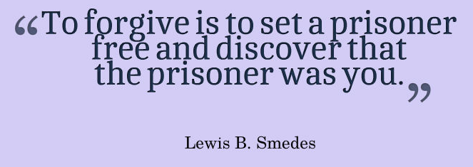
What Do We Do About It?
Write It Down
Work It Out
Talk It Out
Give It Up
Notes:
Fourth, and finally, and most important, give it up. There is something about the game of basketball that can bring out the worst in people, right? Even Christians. Elbows are flying, hands are in faces, and if you’re competitive its makes it worse. I’ve been on both the giving and receiving end of some sharp talk in games of basketballs in bygone days. But somehow we all managed to come back together and play a day or two later and we had forgotten all about it. I’ve been around construction crews, and I’ve. seen subcontractors just go at it and all matter of filth spilling from their mouths. And you’d think the way they were talking to each other that day that there would be no way they could work together again. And then the next day their working right alongside of each other hammering away as if the conflict never even happened. Why is it that people in the world seem to do a much better job of letting it go than Christians? Why can’t we be better forgetters? There are probably several reasons. But maybe, just maybe, it’s because the devil works harder on us, because he knows the kind of damage we can to his diabolical cause should we all be united in love at this church. Clara Barton, who was the founder of the Red Cross, had a friend who once reminded her of a very cruel thing someone had done to her years prior. And Clara Barton couldn’t remember what it was. And so her friend said, “Don’t you remember?” And Clara Barton said, “No I distinctly remember forgetting it.” That’s the key, right? Just give it up, forget it, turn it loose
Eph 4:31 – “Let all bitterness and wrath and anger and clamor and slander be put away from you, along with all malice.”

