Slide 1
Notes:
In 1 Cor 7, Paul begins answering some questions posed to him concerning marriage. Verses 1 – 24 pertain to those who are married and verses 25 – 40 pertain to those who are single. Much of the instruction given by Paul is in light of a “present distress” occurring, which we deem to be a persecution that was specific to that time that may have been a hindrance to Christians to such a degree that Paul makes the point to them that it would be better in whatever state they find themselves to remain as they are. And much of what he says he even admit is his own personal judgment rather than a commandment from the Lord. So a lot of what is said in this chapter 7 is not so much a matter of right vs. wrong as it good vs better.
In verses 25-38, he speaks to virgins, those who had never been married. Isn’t it remarkable that in biblical times if you were unmarried, it was assumed you were a virgin? But what he says to them, in light of the present distress, is that its better if you just remain as you are and not complicate an already complicated life by introducing added trouble that often comes with marriage. But then he says this in 1 Cor 7:36 – “ But if any man thinks that he is acting unbecomingly toward his virgin daughter, if she is past her youth, and if it must be so, let him do what he wishes, he does not sin; let her marry.” Paul, in essence, seems to be saying to fathers, “If you think its too hard on your daughter that you’re preventing her to marry, if its creating too much stress or too much difficulty, and by choosing to allow her to marry will remove obstacles that otherwise will be there by insisting she remain a virgin, go ahead and let her marry. “if any man thinks that he is acting unbecomingly toward his virgin daughter”. Paul would not want such a judgment call on the fathers part, when it was really just matter of good vs. better than right or wrong, to infringe on the relationship between the father and daughter. That word “unbecomingly”, which some of your translations say is “honorably”, “not behaving properly”, “uncomely”, or “improperly” is is only used one other time in the NT and its in 1 Cor 13:5 – “[Love] does not act unbecomingly”.

Slide 2
What Is “Unbecomingly”?
“unbecomingly” = “aschémoneó”
“shapeless, unfitting, deformed, unpresentable, uncomely, lacking respect, indecent”
Notes:
This word “unbecomingly”, to me at least, is one of the most difficult of all the qualities mentioned in 1 Cor 13 to accurately define, which is evident by how many different ways translators choose to translate it. The NIV says “[love] does not dishonor others”, the ESV says, “[love] is not rude”, the KJV says “[love] does not act unseemly”, and the NKJV uses the word “rudely”. So you can see, that even the translators of some of the reputable or at least more popular bible translations struggle to agree on what English word to use to fully bring out the meaning.
The Greek word used here is “aschémoneó”, and if you look closely you’ll see the word “schema” right there in the middle. Schema means a shape or figure or proper, and in the Greek language, the way you express the opposite of something is to put an “a” in front of it. So the root word from where “aschémoneó” comes from means “shapeless, unpresentable, deformed, or unfitting”. And Paul says love is not like that. Love does not act that way.
The idea seems to be that when you love someone, you behave properly and honorably toward and around that person. Wherever a relationship exists, there is a proper order of things, and love doesn’t resists that proper order. That is what a rebellious generation does. Rather, love conforms to certain orders and certain protocols that are reasonably expected by the person I am trying to love. In my interaction with people, I’m choosing appropriate actions and responses that would help them. Love is not a square peg trying to fit into a round hole, but it adapts to cultural norms and honorable habits, respectable appearances, proper words in order to love people. We have a very simple word for this concept: manners.
On the flip side, though, we’re finding that rudeness is becoming more and more acceptable in today’s culture. There are behaviors and words commonplace today that would have been unthinkable a generation ago. One person said that we are living in a “renaissance of rudeness” that creates more and more friction between people, which we see displayed in politics, the media, and especially social media. But manners are meant to reduce that friction in human interaction, right? We’re courteous and respectable because we want to be considerate towards others. But the ill-mannered person is communicating a selfishness that will rob them of the ability to truly love another. Love rejects rudeness because its impolite and disrespectful reserved only for the insensitive and insecure.

Slide 3
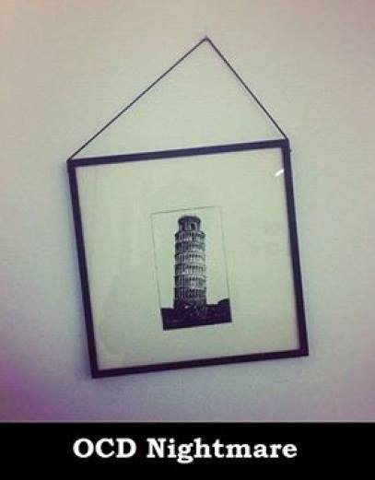
Illustration
Notes:
Now to illustrate this, I want to walk you through a demonstration, and I do this with great hesitation because what I’m about to show you is really going to rub some of you the wrong way. I promise someone’s day is going to be ruined with what I’m about to show you. Some of you are going to approach the elders after this bible class and demand my resignation. Are you ready?
Here’s a crooked picture of the Leaning Tower of Pisa. Or is it? If you were hanging this in your house, how would you do it? Here’s another picture of how not to eat a piece of pizza. Can you imagine going out to eat with someone and the moment you start to dig in, they do this? Here are more examples. Now for some people, this is just funny. To others, its an OCD nightmare. I actually posted the Leaning Tower of Pisa picture on Facebook a few years back because I thought it was funny and someone actually told me later how unsettling it was to them because of their OCD.
Now, the point of “love does not act unbecomingly” is not that love is OCD, I hope you understand that. The point is that there are social norms and manners expected in loving relationships and there is something upsetting about stepping outside of those norms, even if we can rightly say that technically something is not sinful. When eating pizza, is it sinful to take a slice out of the middle? Technically, no. But it’s rude and inconsiderate, because there’s just a culturally accepted way of doing it and when you do it this way, there’s really no good reason for it any other way.

Slide 4
Where Does It Come From?
Low Self-Esteem
Matt 4:3,5 – “If You are the Son of God…”
Notes:
Where does this rudeness, this unbecoming behavior come from? If I’m this way and it is causing me not to be able to love the way God would have me to love, what is going on inside of me? Well, psychologists have said a lot about the subject but we’ll try to provide some scriptural insight as well.
Low Self-Esteem. If you carefully observe a rude individual, you’ll often fine that you are dealing with a deeply insecure individual with low self-confidence. And if that person constantly regards himself in a negative and critical light, his attitude about himself is going to affect the way he regard others. Then what happens? He tends to mask his own insecurities by overcompensating wherein he’ll be rude and boorish and use course language like its nothing just so he can try to convince himself he is strong because, “Look at me, without airs and without boundaries!” And the more I can shock someone or the more I can take the sensationalist position on something, the better off I’ll be because a generation of people lacking self-esteem will inevitably pride itself on being individualistic. This is how Satan challenges us – he challenges our sense of self-worth – Matt 4:3 – “If you are the Son of God…”. The temptation is the same for us today. Do you doubt yourself? Prove yourself. And too often, it comes out in unbecoming, rude behavior.

Slide 5
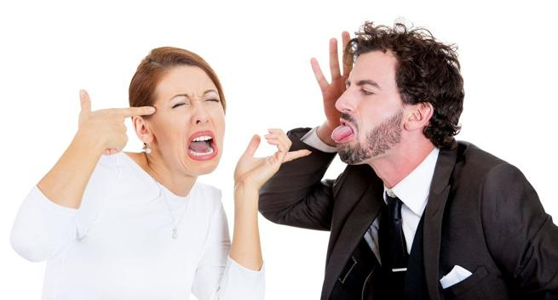
Where Does It Come From?
Low Self-Esteem
Matt 4:3,5 – “If You are the Son of God…”
Emotional Immaturity
Prov 10:23 – “To do evil is like sport to a fool, but a man of understanding has wisdom.”
Notes:
2) Emotional Immaturity. Some people, for whatever reason, haven’t yet matured in the emotional sense. Perhaps they never will. And so they act in a way that hurts others because they lack the awareness to consider the impact of their behavior. Since they cannot comprehend their behavior as hurtful, they see no reason not to engage in it. They have no mental checks in place to stop them from acting in such ways. The bible unfortunately categorizes this sort of behavior as that of the fool. Prov 10:23 – “To do evil is like sport to a fool, but a man of understanding has wisdom.” This might amount to being a personality disorder in some individuals in which socially acceptable boundaries for human interaction were never learned during those impressionable years of their youth.

Slide 6
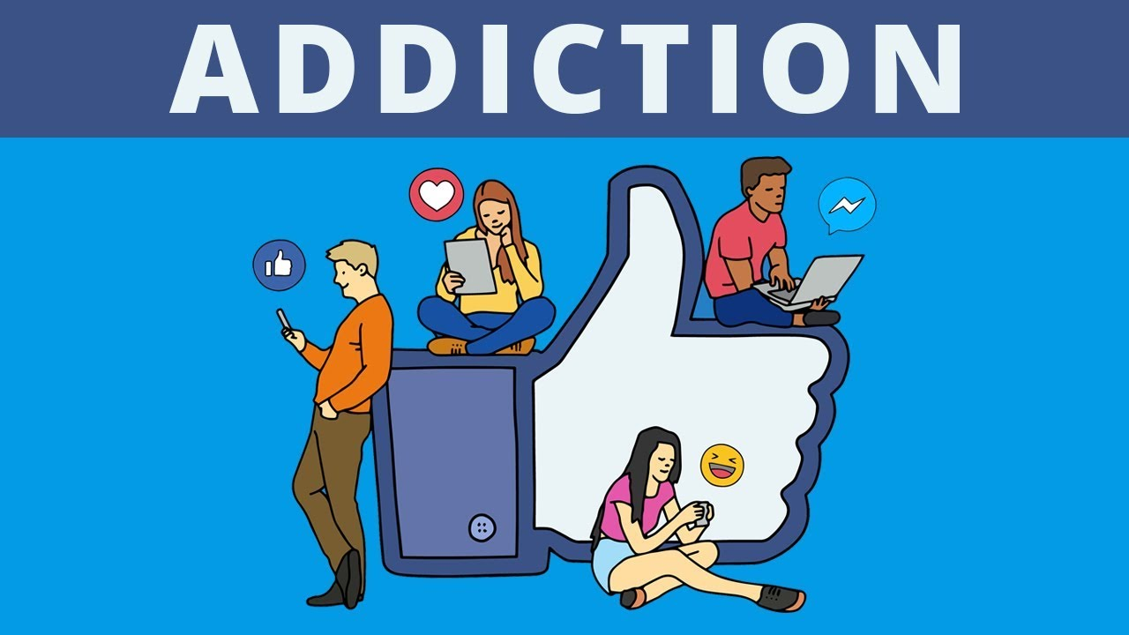
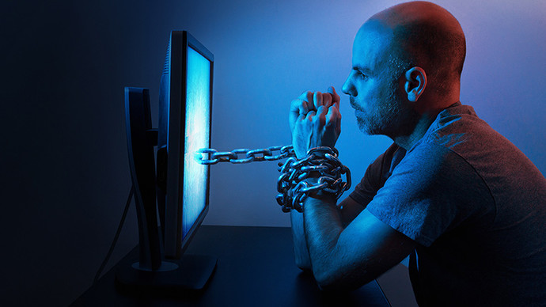
Where Does It Come From?
Low Self-Esteem
Matt 4:3,5 – “If You are the Son of God…”
Emotional Immaturity
Prov 10:23 – “To do evil is like sport to a fool, but a man of understanding has wisdom.”
Social Media
Prov 18:1 – “A man who isolates himself seeks his own desire; he rages against all wise judgment.”
Notes:
3) Social Media. This is a surprising culprit. Or maybe it isn’t surprising. When you think about it, the rapid rise of technology has led to an exponential increase in the pace of life. The insistent and oh-so-hard-to-ignore demands of social media, and the online information explosion leaves most of us bombarded with constant demands on our attention that didn’t even exist as little as 15 years ago. This relentless obsession with social media leads to anxiety and stress, and, in turn, to aggravation and aggressive behavior. People are overloaded and overwhelmed and as result, manners and politeness have been sacrificed on the altar of technology. One of the biggest reason we are experiencing a renaissance of rudeness is because of what can we held in the palm of our hands. Now combine this with a person who is emotionally immature and/or has low-esteem, and it creates an isolated individual who finds no other comfort than being immersed into his online persona. And so he never develops. And sound wisdom walks right out the door. Prov 18:1 – “A man who isolates himself seeks his own desire; he rages against all wise judgment”. Ever been around someone addicted to social media? They’re volatile, socially discrete, irreverent, sarcastic, and all you want to do is shun their presence. These aren’t just people who can’t love, they’re hard to love in return. Even the most accepting and forgiving of Christians will find themselves growing weary of such people.

Slide 7
Application
There are cultural norms to consider
1 Cor 10:23 – “All things are lawful, but not all things are profitable. All things are lawful, but not all things edify.”
There are personal scruples to consider
1 Cor 10:33 – “just as I also please all men in all things, not seeking my own profit but the profit of the many, so that they may be saved.”
There is wisdom to consider
1 Pet 3:15 – “but sanctify Christ as Lord in your hearts, always being ready to make a defense to everyone who asks you to give an account for the hope that is in you, yet with gentleness and reverence”
Notes:
Let’s look at some applications
There are cultural norms relative to the society we live in, things that are expected of decent people to be respectable, considerate, and honorable.
Examples: Being on time for church. Looking one another in the eye and shaking each others’ hand. Yes ma’am. Please. Thank you.
But there are also things we should consider when in other cultures. People here tell me they always know when I’m going to preach because I have a jacket on. Why do I that? I’ve found that some brethren believe that a preacher should wear a suit and tie when he preaches. Not every thinks that, but some do. But to love others who otherwise would be distracted by not doing that, I wear a jacket and tie and that’s no big deal. However, in Africa where I’ve preached several times, I would not wear a jacket. I don’t even wear a tie. Can anyone guess why? Much poorer culture. I would actually come across in that culture as rich and perhaps haughty and rather being a help to them wearing a full suit would be a distraction of them. Love does not act unbecomingly. It’s not a matter of right vs. wrong so much as being considerate to cultural norms so as to win as many as I can because so many people will be put off by things that they consider to be impolite or without manners.
Paul said it this way – 1 Cor 10:23 – “All things are lawful, but not all things are profitable. All things are lawful, but not all things edify.”
2) Do we consider personal scruples? Sometimes its not a matter of what culture expects, but sometimes there are individuals who have certain tendencies, hang ups, or scruples that need to be taken into consideration lest I come across as rude and disrespectful. In Rom 14, Paul deals with some of the scruples that existed between Jews and Gentiles. Gentiles would eat pretty much any meat they wanted, but Jews, as a culture, even after God eliminated the dietary restrictions, could not in good conscious eat certain meats. So if a Gentile invited a Jew over to his house to eat, would it be right, as he is sitting at the dinner table, to slap a freshly cooked pork chop on his plate, daring him to eat it? The Gentile might be thinking, “This is silly, those OT laws don’t apply anymore” and he’d be right. But a Jew who had been raised under those restrictions and was having trouble expanding his food pyramid, would have a hurt conscious. It would be rude and unseemly for the Gentile to do this to a Jew and Paul makes the point in Rom 14:20 not to destroy the work of God over something like food. Love your brother so much that you take into account his scruples.
Paul says it this way in 1 Cor 10:33 – “just as I also please all men in all things, not seeking my own profit but the profit of the many, so that they may be saved.”
Example: my big hair; guy who didn’t like it when I didn’t shave
3) Do we consider wisdom? Not everything is about answering the question, “Is this sinful?” We must also ask, “Is this wise?” For example, Peter says this in 1 Pet 3:15 – “but sanctify Christ as Lord in your hearts, always being ready to make a defense to everyone who asks you to give an account for the hope that is in you, yet with gentleness and reverence”. It’s one thing to win an argument. When you know the bible well, you should be able to do that. That’s elementary, basic stuff. Mature Christianity is not just about winning an argument, its about winning a soul. And so there is more to evangelism than trying to one-up someone. There’s a proper attitude: gentleness and respect. There are some brethren who seem to pride themselves on putting lost souls in their place. They’ll talk to people in other religious organizations who are teaching wrong things not with love, but with a haughty spirit. What good does it prove your belief is right and theirs is wrong if what you’ve done in the process is ostracize them? There is an attitude becoming of Christians when we’re talking to a lost world and there is an attitude that is not.

