Slide 1
Notes:
Jas 4:6b – “God is opposed to the proud, but gives grace to the humble.”
In Dan 4, Nebuchadnezzar is the great ruler of the world, the ruler of Babylon, the greatest kingdom and most ornate city the world had ever known – Dan 4:29 – “…he was walking on the roof of the royal palace of Babylon.” What would he have seen from his vantage point?
Golden palace and the huge walls which surround the city. These walls were 387ft high and 85 feet wide; they were so wide that 4 chariots could be driven side by side on top of them, all around the city walls
The city itself was a perfect square, 15 miles on each side, the most powerful city of antiquity
It boasted wide streets and tons of buildings, populating 1.2 million inhabitants.
It was protected by a deep, wide moat filled with water by the mighty Euphrates River which flowed into one side of the city and out the other side. And so the city was well water, filled with gardens and farmland and palm groves and orchards, that, according to historians, provided enough food to feed the entire city for 20 years in case they were besieged.
In the city were gigantic shrines to the deities, beauty eclipsed only by the marvelous air conditioned hanging gardens which the king had built to give his wife for a birthday present.
As Nebuchadnezzar looks out upon this magnificent city, he is so puffed up with pride that his heart explodes into the following words – Dan 4:30 – “Is this not Babylon the great, which I myself have built as a royal residence by the might of my power and for the glory of my majesty?”
God had enough of that, and so He resisted Nebuchadnezzar. And the next thing we see is that he’s crawling around the grass outside the palace, fingernails as long as they could be, hair matted, because God is humbling him. Why? Because God resists the proud but gives grace to the humble
In 1 Cor 13, we read about what love does, those things that naturally come about as an expression of one individual’s love toward another. And then we also read things that love does not do under any circumstance, and one of the things it does not do is expressed to us in 2 separate statements – 1 Cor 13:4d – “Love does not brag and is not arrogant”.

Slide 2
How Pride Is Expressed
Puffed Up
Boasting
Notes:
If there was ever a weed that could grow in this local vineyard of God’s people that would constrict and suffocate our ability to love one another, it is that dreaded weed called “pride”.
1 Cor 13:5 contains 2 statements about pride that reveal how it is expressed. The second statement is the inward pride, and translations will more accurately portray this with the phrase “puffed up” – love is not “puffed up”. But the first statement is the outward expression of being inwardly puffed up, the boasting and bragging that accompanies ego.
Someone once commented on this verse, saying, “Love is neither anxious to impress nor does it cherish inflated ideas of its own importance”. And that is exactly right.

Slide 3
How Pride Is Expressed
C. S. Lewis – “There is one vice of which no man in the world is free; which everyone in the world loathes when he sees it in someone else; and of which hardly any people, except Christians, ever imagine that they are guilty themselves. I have heard people admit that they are bad-tempered, or that they cannot keep their heads about girls or drink, or even that they are cowards. I do not think I have ever heard anyone who was not a Christian accuse himself of this vice. And at the same time I have very seldom met anyone, who was not a Christian, who showed the slightest mercy to it in others. There is no fault which makes a man more unpopular, and no fault which we are more unconscious of in ourselves. And the more we have it ourselves, the more we dislike it in others.”
Notes:
C. S. Lewis made this profound observation about pride:
“There is one vice of which no man in the world is free; which everyone in the world loathes when he sees it in someone else; and of which hardly any people, except Christians, ever imagine that they are guilty themselves. I have heard people admit that they are bad-tempered, or that they cannot keep their heads about girls or drink, or even that they are cowards. I do not think I have ever heard anyone who was not a Christian accuse himself of this vice. And at the same time I have very seldom met anyone, who was not a Christian, who showed the slightest mercy to it in others. There is no fault which makes a man more unpopular, and no fault which we are more unconscious of in ourselves. And the more we have it ourselves, the more we dislike it in others.”
The bible absolutely echoes this sentiment.

Slide 4
How Pride Is Expressed
Prov 6:16-19 – “There are six things which the Lord gates, yes, seven which are an abomination to Him: Haughty eyes, a lying tongue, and hands that shed innocent blood, a heart that devises wicked plans, feet that run rapidly to evil, a false witness who utters lies, and one who spreads strife among brothers.”
Mark 7:21-22 – “For from within, out of the heart of men, proceed the evil thoughts, fornications, thefts, murders, adulteries, deeds of coveting and wickedness, as well as deceit, sensuality, envy, slander, pride and foolishness.”
Rom 1:29-30 – “being filled with all unrighteousness, wickedness, greed, evil; full of envy, murder, strife, deceit, malice; they are gossips, slanderers, haters of God, insolent, arrogant, boastful…”
Notes:
When you read those “catalogues” of sins we find scattered throughout scripture, those things that will keep you out of heaven, pride always seems to make the majority of these lists. Prov 6 is one of those catalogues – God’s hate list, a list of 7 things that God absolutely hates. And notice what makes the very top of this list:
Prov 6:16-17a – “There are six things which the Lord hates, yes, seven which are an abomination to Him: haughty eyes…” Some of your translation say, “A proud look”.
It’s one of those sins that arises from an evil heart. Another catalogue of sins is in Mark 7:21-22 – “For from within, out of the heart of men, proceed the evil thoughts, fornications, thefts, murders, adulteries, deeds of coveting and wickedness, as well as deceit, sensuality, envy, slander, pride and foolishness.”
Rom 1:29-30 – “being filled with all unrighteousness, wickedness, greed, evil; full of envy, murder, strife, deceit, malice; they are gossips, slanderers, haters of God, insolent, arrogant, boastful…”.
Pride is a self-evaluation that is exaggerated and dishonest, a pretense in which we would have people to accept us. It is an ego-motivated maneuver that seeks value and honor and importance and reputation and significance that it does not deserve. Because what we’re doing with pride is that we’re seeking to hide from ourselves the truth about ourselves
And so pride is avoiding character changes that are absolutely necessary, because we’re expecting others to fit their ideas and feelings around mine. And if we can learn to see pride in this scope, we could easily see why it sucks the love right out of a church. Because love, agape love, always seeks the best interest of the other guy. But pride is so consumed with one’s own personal interest; it has no time and no room to look with love at another. Pride is the enemy of love

Slide 5
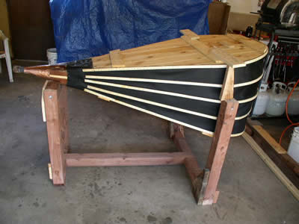
What Is Pride?
“pride” = “phusioó”
“to puff, to blow up, swelled, to bear oneself lofty”
1 Cor 5:1-2 – “¹It is actually reported that there is immorality among you, and immorality of such a kind as does not exist even among the Gentiles, that someone has his father’s wife. ²You have become arrogant and have not mourned instead, so that the one who had done this deed would be removed from your midst.”
1 Cor 8:1 – “Now concerning things sacrificed to idols, we know that we all have knowledge. Knowledge makes arrogant, but love edifies.”
Col 2:18 – “Let no one keep defrauding you of your prize by delighting in self-abasement and the worship of the angels, taking his stand on visions he has seen, inflated without cause by his fleshly mind.”
Notes:
The word translated “pride”, as used in 1 Cor 13, is mostly found in 1 Cor alone. It’s in a few other places too, but nowhere near as often as in this specific letter. It is the Greek word “phusioó”, which means, “to puff, to blow up swelled to bear oneself lofty.” It comes from the root word, though, that means “a blacksmith’s bellow that is filled up with air”. That’s quite descriptive isn’t it? In our day and age, you might think of it as a balloon that is so full of air, that it’s about ready to burst. Because the word means to inflate by blowing, swelled up, like an egotistical person spewing out arrogant thoughts.
It is used in 1 Cor 5, a chapter that deals with sexual immorality that is occurring amongst the brethren in this church
And the main emphasis of this chapter is not to point our finger at the guilty fornicator so much as it is to point the finger at the church for tolerating this sin among them. And Paul tells us that at the center of this toleration of such blatant immorality amongst those Christians was pride – 1 Cor 5:1-2 – “It is actually reported that there is immorality among you, and immorality of such a kind as does not exist even among the Gentiles, that someone has his father’s wife. You have become arrogant and have not mourned instead, so that the one who had done this deed would be removed from your midst.” It was bad enough that the sin happened, but Paul says, “You are so proud and so lifted up on your own pedestals that you cannot see this sin for how heinous it is”
1 Cor 8:1 – “Now concerning things sacrificed to idols, we know that we all have knowledge. Knowledge makes arrogant, but love edifies.” Now here is a play on words that often gets lost in translation. The word “edify” means “to build up”, right? So Paul is saying, “You have a choice. You can either puff up or you can build up.” Knowledge “puffs up” but love “builds up”. And what a great verse for us to keep in our hearts in this educational melee in which we live
Knowledge without love is simply an opportunity to build a pride mechanism within our own spirit by which we can put ourselves first. But when we have love, whatever education we receive from God’s word will focus on the other guy and not ourselves
Outside of 1 Cor, we see this word used in Col 2. Pride is certainly a sin of the spirit, but as we saw in the previous verse, it is often associated with the intellect. Col 2:18 – “Let no one keep defrauding you of your prize by delighting in self-abasement and the worship of the angels, taking his stand on visions he has seen, inflated without cause by his fleshly mind”. Have you ever been around a person who is inflated and puffed up? Sometimes it takes all your energy not to stick a pin in them just so they will deflate. Ever driven on the interstate and heard the loud noises that come from those big semis? It’s the empty ones that make the most noise. It’s like the fly in one of Aesop’s fables who is sitting on the axil of a chariot exclaiming “What dust do I raise”. It’s typically the people who don’t have anything to say that are puffed up with pride. They’re the ones making all the racket, all the noise, and Paul says that these type of people can’t love the way Christ has called Christians to love.

Slide 6
Understanding Pride
An Assault On God’s Sovereignty
Question #1
1 Cor 4:7a – “For who regards you as superior?”
Question #2
1 Cor 4:7b – “What do you have that you did not receive?”
Question #3
1 Cor 4:7b – “And if you did receive it, why do you boast as if you had not received it?”
Notes:
A few things we need to understand about pride:
First, whenever this exists among Christians, it is an assault on God’s sovereignty. If I am a Christian who has surrendered to the shackles of pride in my life, 1 Cor 4:7 poses 3 very penetrating questions for me:
Question #1 – 1 Cor 4:7a – “For who regards you as superior?” That’s a good question. What exactly makes you so superior to another individual and what makes them so inferior to you? Who is the one ultimately responsible for making all of us different, individual, and unique? God. He is the one who makes us different, He is the one responsible for our uniqueness. But when we give into pride, we have begun a process of ignoring God’s sovereignty in our lives through an overly inflated view about ourselves.
Question #2 – 1 Cor 4:7b – “What do you have that you did not receive?” This really begs the question. What endowment do you have that didn’t come to you from God? What is it that you now possess that you brought into the world with your own accord? If you are physically beautiful, so what? Where did it come from? If you are a good athlete, who was it that gave you the propensity for such success? If you are intelligent, what is the reason for your intelligence other than the fact that God has endowed you with the equipment to be who you are? And so there is no reason to be proud because ultimately everything comes from God – John 3:27 – “A man can receive nothing unless it has been given him from heaven.” Jas 1:17 – “Every good thing given and every perfect gift is from above, coming down from the Father of lights, with whom there is no variation or shifting shadow.” There’s your looks, your intelligence, your wealth, your talent, your abilities, your health, all of it – it comes from God. What do you have that you did not receive?
Question #3 – And this is where Paul really drives it homes. He’s asked, “Who regards you as superior? What do you have that you did not receive?” And now, recognizing that the answers to those question should be obvious, he says this: 1 Cor 4:7c – “And if you did receive it, why do you boast as if you had not received it?” This is the most difficult question of the 3, and yet it should be the simplest and most obvious because he’s pointing out the incongruity of boasting about something that is merely a gift from God. From the standards of the world, the Corinthians may well indeed have had something to boast about but Christians do not live by the standards of the world. How can I love the way I’m supposed to love God if in an ungrateful spirit I ignore God’s provisions for me, in the gifts He has given me? How will I learn to love you as a person if rather than having a grateful spirit for what God has given me, I laud it and showcase it and do not give credit to God? Pride is an assault on God’s sovereignty.

Slide 7
Understanding Pride
An Assault On God’s Sovereignty
Invites God’s Judgment
Prov 8:13 – “The fear of the Lord is to hate evil; pride and arrogance and the evil way and the perverted mouth, I hate.”
Prov 11:2 – “When pride comes, then comes dishonor, but with the humble is wisdom.”
Prov 16:5 – “Everyone who is proud in heart is an abomination to the Lord; assuredly, he will not be unpunished.”
Prov 16:18 – “Pride goes before destruction, and a haughty spirit before stumbling.”
Prov 29:23 – “A man’s pride will bring him low, but a humble spirit will obtain honor.”
Jas 4:6 – “But He gives a greater grace. Therefore it says, ‘God is opposed to the proud, but gives grace to the humble.’”
Notes:
Now that is bad enough. But we need to understand secondly that pride invites God’s judgment upon us. How many times does God have to tell us something before its true? Once, right? But what if we find something in the bible that is said over and over and over and over again? That would be something we would really need to attend to, right?
Prov 8:13 – “The fear of the Lord is to hate evil; pride and arrogance and the evil way and the perverted mouth, I hate.”
Prov 11:2 – “When pride comes, then comes dishonor, but with the humble is wisdom.”
Prov 16:5 – “Everyone who is proud in heart is an abomination to the Lord; assuredly, he will not be unpunished.”
Prov 16:18 – “Pride goes before destruction, and a haughty spirit before stumbling.”
Prov 29:23 – “A man’s pride will bring him low, but a humble spirit will obtain honor.”
Another question: if you knew that there was something you could do that would cause God to want stay as far away from you as possible, would you take that seriously? If there was one thing we knew for sure that would drive God’s heart to retreat from us, to want to be away from us, wouldn’t you avoid that action at all costs? Jas 4:6 – “But He gives a greater grace. Therefore it says, ‘God is opposed to the proud, but gives grace to the humble.’” If you look at all these verses together, and there are more, you’d have to come to conclude that not much else turns God away from a person quite like a proud heart. And I pray to God that we would be kept from this wicked iniquity, that we’d also pray for one . another because like many sins, this can be a hard one to identify ourselves with – it’s hard to admit. But if we can’t shake it, God tells us in no uncertain terms that we will be judged, and woe to the one who meets that judgment.

Slide 8
Understanding Pride
An Assault On God’s Sovereignty
Invites God’s Judgment
Acts 12:21-23 – “On an appointed day Herod, having put on his royal apparel, took his seat on the rostrum and began delivering an address to them. The people kept crying out, ‘The voice of a god and not of a man!’ And immediately an angel of the Lord struck him because he did not give God the glory, and he was eaten by worms and died.”
C. S. Lewis – “In God you come up against something which is in every respect immeasurably superior to yourself. Unless you know God as that—and, therefore, know yourself as nothing in comparison—you do not know God at all. As long as you are proud you cannot know God. A proud man is always looking down on things and people: and, of course, as long as you are looking down, you cannot see something that is above you.”
Notes:
King Herod found this out too late, didn’t he? Acts 12:21-23 – “On an appointed day Herod, having put on his royal apparel, took his seat on the rostrum and began delivering an address to them. The people kept crying out, ‘The voice of a god and not of a man!’ And immediately an angel of the Lord struck him because he did not give God the glory, and he was eaten by worms and died.” – God resists the proud, but gives grace to the humble.
C. S. Lewis – “In God you come up against something which is in every respect immeasurably superior to yourself. Unless you know God as that—and, therefore, know yourself as nothing in comparison—you do not know God at all. As long as you are proud you cannot know God. A proud man is always looking down on things and people: and, of course, as long as you are looking down, you cannot see something that is above you.”
Could this be happening in our life? Is my marriage in shambles? Maybe it’s a proud heart that’s keeping God from getting close to us, and working in our marriage to strengthen it. Do we find ourselves without friends? Maybe it’s because people have a hard time being around me because of my ego. Could it be that when difficulties come into our lives that maybe those difficulties are God’s messengers to keep our feet on the ground so we don’t float away because of a puffed up heart? May we seize on every opportunity that comes our way to honor God, to humble ourselves, lest He resist us and turn away from us and we face the ripple effects in our life of such a separation

Slide 9
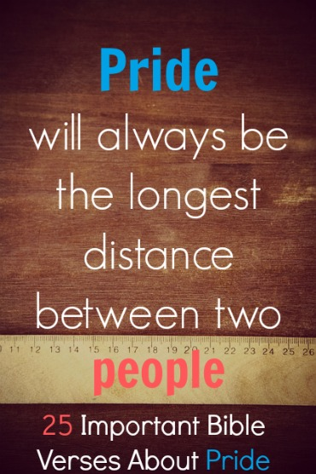
Understanding Pride
An Assault On God’s Sovereignty
Invites God’s Judgment
Interrupts Peace & Love
Notes:
The 3rd thing about pride that is so devastating is that it interrupts peace and love. And the reason this happens is because pride, by its very nature, is competitive. 2 Cor 13:5a – “Test yourselves to see if you are in the faith; examine yourselves!” – And I want us to do that this evening. Here are some questions we should ask ourselves that will hone in on whether we have a pride problem. How do I react when someone refuses to take notice of me, when someone snubs me? How much do I dislike it when someone shows off around me or patronizes me or dismisses me and my ideas about things?
See, the problem with pride is that it is always in competition with everyone else’s pride. It’s because I want to be the center of attention at the party that is one of the reasons many don’t like those being the center of attention at the party
Pride is competitive by its very nature, and that separates it from most other sins because pride gets no pleasure in simply having something, which is the difference between pride and envy. Pride only gets something out of having more of it than everyone else. We say people are proud of being rich, proud of being good looking, and proud of being talented. But that’s not really true. They’re proud of being richer, proud of being better looking, and proud of being more talented than everyone else. If everyone else became equally rich, equally good looking, and equally talented, there would be nothing to be proud about because it’s only the comparison that makes us proud, the pleasure of being above everybody else. Once the element of competition is gone, pride is gone with it. And this is what separates pride from so many other sins; it is competitive and robs us of our peace and love toward one another. For those of us that are married, can you see how pride makes it absolutely impossible for us to truly love one another when our hearts are filled with pride and competition? Can you see how pride, because of its competitive nature, will leave a local church in shambles, because brethren are trying to outdo one another? A proud man never gets enough. And when he has what he wants, it will only ever be as good as he is able to evaluate it in context with other people.
Think about that relief pitcher who is making $1.1 million a year, and he only throws that little round ball maybe one or 2 innings every other game. He’s doing great, right? That is until he reads on the internet that a relief picture on another team is making $1.1 million a year. Now he’s willing to strike, to report late to practice, and he wants his contract renegotiated. Why? Is it because he doesn’t have enough money to live on? Man if he doesn’t, what about the rest of us? It’s not the money and it’s not whether he has enough to live on. It’s pride. It’s pride because pride is competitive and it only finds its sense of self-worth on having more than the other guy. Pride always has to win. Pride always has to be on top. And for that reason, pride will drive relationships apart because pride does not allow us to love the way Christ has commanded us Christians to love, looking out for the other person’s best interest

Slide 10
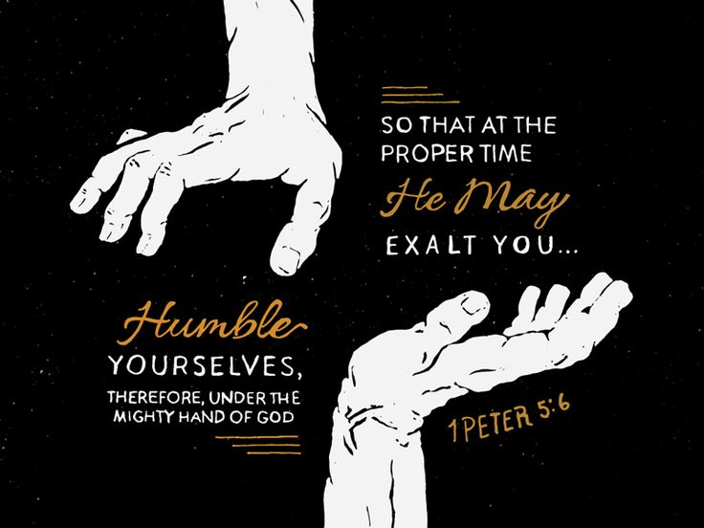
What Can We Do?
Humble Yourself Before God
Notes:
What should we do about pride in our life? We need to humble ourselves before God. “Tell me something I didn’t know” – No, listen again: we need to humble ourselves before God; because if we don’t, the bible teaches that God will do it.
Nebuchadnezzar had a shot to humble himself before God had to humble him. It’s not like he didn’t have chances to recognize God’s sovereignty. In Dan 2, when his dream is interpreted by Daniel, Nebuchadnezzar at the end of the chapter gives glory to the God of Daniel. He even admits that He is the Lord of lords and King of kings. In Dan 3, when God saves Shadrach, Meshach, and Abed-nego from the fiery furnace, He again recognizes and proclaims God’s sovereignty, forbidding anyone from speaking offensively against the God of heaven. Nebuchadnezzar had been given chances. But he had not seized upon them, and therefore he was not able to sustain his humility. He was not willing to humble himself. And so God humbled him. And the bible teaches that if we will humble ourselves before God, He will be the one to exalt us when it is the proper time.

Slide 11
What Can We Do?
Humble Yourself Before God
Get To Know God
Notes:
Second, God isn’t forbidding pride on our part because He’s worried about maintaining His dignity. The point of forbidding pride is because He wants us to know Him and give ourselves to Him so that we can understand Him. Do you want to know God? It is only through humility that we can truly come to know the One who created us and saved us. John 5:44 – “How can you believe, when you receive glory from one another and you do not seek the glory that is from the one and only God?” That strutting about that we do, the boasting and bragging, being puffed up and trying to impress others, it literally blinds us from knowing and seeing God for who He really is. And it will keep us from loving God, because loving ourselves leaves no room for us in His life – He wants all of us

Slide 12
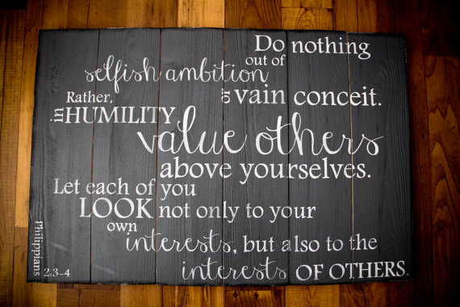
What Can We Do?
Humble Yourself Before God
Get To Know God
Love One Another
Notes:
Third and finally, God is also forbidding pride because He knows the effect it has toward loving one another the way the bible commands. Phil 2:3-4 – “Do nothing from selfishness or empty conceit, but with humility of mind regard one another as more important than yourselves; do not merely look out for your own personal interests, but also for the interests of others.” A familiar verse, but hard to apply isn’t it? Could it be that the reason it is so hard to apply is because of how proud we allow ourselves to become. But imagine, as a church, if we would trust God and humble ourselves as He has ordained, how much easier it would get? Pride is a cancer, that eats away at the relationship God wants us to have with one another because we cannot regard one another selflessly when we’re proud people
1 Cor 13:4d – “Love does not brag and is not arrogant”.
1 Pet 5:6 – “…humble yourselves under the mighty hand of God, that He may exalt you at the proper time”

