Slide 1
Notes:
1 Cor 13:6 – “[Love] does not rejoice in unrighteousness, but rejoices with the truth”

Slide 2
Notes:
There is an interesting word in the German language that we don’t have in the English language, though the concept is the same in all languages. Schadenfreude is the German word which describes our malicious enjoyment of the mishaps or misfortunes of others. Schadenfreude is part of our culture. Everyone of us experiences schadenfreude.
It is intrinsic to every sport. We love it when our golfing buddies hit their balls in the bunkers or miss their putts. We inwardly applaud when our tennis opponent double-faults or hits into the net. We cheer when the opposing quarterback in football fumbles the ball. We thrill to see cars crash in the Daytona 500. Much of the fun in sports comes from schadenfreude: malicious enjoyment of the mishaps or misfortunes of others. It is central to the slapstick comedy of the Three Stooges, and many cartoon series such as Tom and Jerry or the Roadrunner.
News organizations love schadenfreude. Nothing excites the public more than breaking news about the latest scandal amongst celebrities or politicians. We secretly rejoice to see self-righteous leaders fall from grace. We gloat when prominent and powerful politicians on the opposition party are caught in crimes and misdemeanors. We love scandals because they give us something to be disgusted about, and to make us feel so morally superior (Luke 18:9-15). Other people's sins make us look virtuous. Other people's misfortunes make our lot easier to bear. They put our problems into perspective. We are delighted when our enemies suffer. Nothing gives us greater joy than seeing our opponents get their comeuppance. When we are engaged in a battle we are relieved when the enemy is killed or destroyed in some way, shape or form. We feel justified when people whom we loathe, because they have hurt us or our loved ones, drop dead. But love cannot delight in evil. Though we may have to go to war, though many people may be killed, and families lose loved ones, we cannot delight in it. It is the sadist who enjoys seeing pain inflicted on others. No matter how much the punishment fits the crime we can take no joy in executions or incarcerations. While we may support the free market and the risks associated with investment, we do not delight in downturns, personnel reductions, and bankruptcies.

Slide 3
A Look At The Greek
The 1st “rejoice” = “chairó”
Definition – “to be glad or euphoric over something that has happened, a sense of satisfaction”
Phil 1:18 – “What then? Only that in every way, whether in pretense or in truth, Christ is proclaimed; and in this I rejoice.”

Slide 4
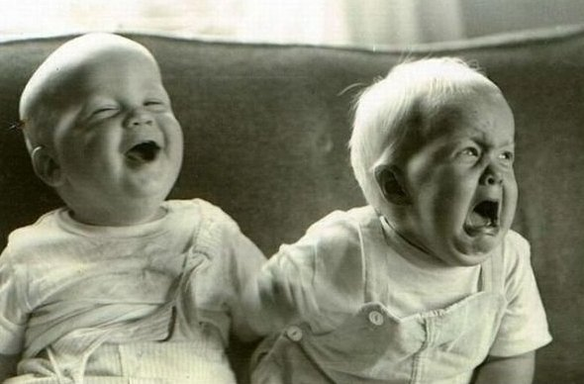
Love Does Not Rejoice In Unrighteousness
Gloating
Isa 63:9a – “In all their affliction He was afflicted,”
Job 31:29 – “Have I rejoiced at the extinction of my enemy, or exulted when evil befell him?”
Prov 24:17 – “Do not rejoice when your enemy falls, and do not let your heart be glad when he stumbles;”
Notes:
Where does it come from?
1) Gloating
Further, to “not delight in evil” carries the idea of not gloating over someone else’s guilt. It is common for people to rejoice when an enemy is found guilty of a crime or caught in a sin. This is not love. Love rejoices in the virtue of others, not in their vices. Sin is an occasion for sorrow, not for joy.
Upon hearing of that person’s difficulty or hardship, perhaps you were tempted to think, Serves him right! He deserves what he’s getting! After what he did to me and to so many others, he deserves a little punishment! If this describes you, let me tell you — this is not the way God’s love reacts to such situations!
If we are not careful we can become culpable of finding pleasure when our partner is guilty of some sort of wrongdoing. We see their negative conduct as verification of our preconceptions and we feel vindicated. Or, we view it as something that can be leveraged and manipulated to get what we want. We keep score of each other’s missteps intending to cash in later. We rejoice in their iniquity. In the most egregious of cases, some have even wished for their spouse to fall into a serious reproach so that they can feel justified in walking away from the marriage. God help us!
How can we pray about someone’s misfortunes when we’re glad about it?
When we see someone make a mistake we often find personal satisfaction in telling them, “I told you so”. We do this because we enjoy proving that we are right, even at other people’s expense. God, however, has no need to prove himself right; only the insecure attempt to prove their rightness. Sometimes we think of God as getting some kind of perverse pleasure from being able to hold our mistakes over us, reminding us of how bad we have been, but God does not use our poor choices as an opportunity to “rub it in”, He takes no joy in our mistakes and never says “I told you so!”

Slide 5
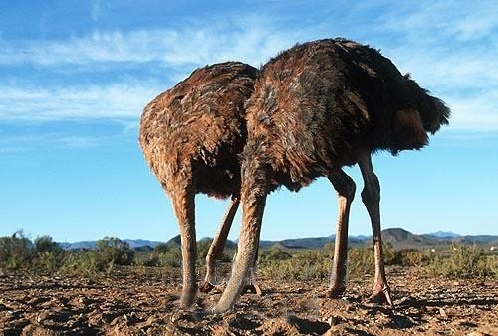
Love Does Not Rejoice In Unrighteousness
Gloating
Toleration
1 Cor 5:2 – “You have become arrogant and have not mourned instead, so that the one who had done this deed would be removed from your midst.”
Rev 2:20 – “But I have this against you, that you tolerate the woman Jezebel, who calls herself a prophetess, and she teaches and leads My bond-servants astray so that they commit acts of immorality and eat things sacrificed to idols.”
Rom 1:32 – “and although they know the ordinance of God, that those who practice such things are worthy of death, they not only do the same, but also give hearty approval to those who practice them.”
Notes:
2) Toleration
Anything that covers up sin or seeks to justify wrongdoing is the polar opposite of godly love. Love does not sweep sin under the rug. Love does not try to find ways to get away with bad behavior, and it does not put up with injustice. Instead, it treasures truth, celebrates good behavior, and promotes virtue. True love has nothing to hide.
“O my son Absalom! My son, my son Absalom! If only I had died instead of you - O Absalom, my son, my son!" (2 Samuel 18:33) David was only too well aware of the truth - that he had aided and abetted the rebellion by turning a blind eye to Absalom's ambitions over the years. He was also aware of his own sins that had contributed to the moral decay in the court. His mourning for his son was also a mourning for the culture that he had allowed to flourish, where abuse, anger, adultery, incest, and murder had been tolerated in his own household, and by himself. He came face to face with his own culpability, and the cost in human lives that resulted. He could not delight in the destruction of Absalom's army because he knew the truth of his own negligence as a father and a ruler.

Slide 6
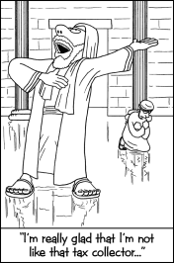
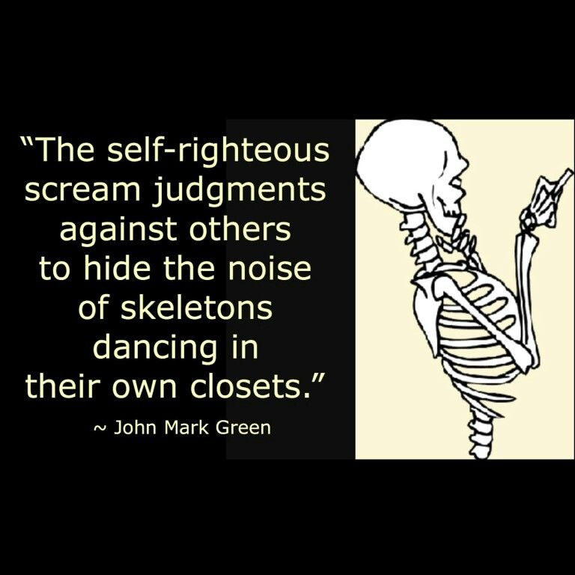
Love Does Not Rejoice In Unrighteousness
Gloating
Toleration
Spiritual Pride
Luke 18:10-14 – “Two men went up into the temple to pray, one a Pharisee and the other a tax collector. The Pharisee stood and was praying this to himself: ‘God, I thank You that I am not like other people: swindlers, unjust, adulterers, or even like this tax collector. I fast twice a week; I pay tithes of all that I get.’ But the tax collector, standing some distance away, was even unwilling to lift up his eyes to heaven, but was beating his breast, saying, ‘God, be merciful to me, the sinner!’ I tell you, this man went to his house justified rather than the other; for everyone who exalts himself will be humbled, but he who humbles himself will be exalted.’”

Slide 7
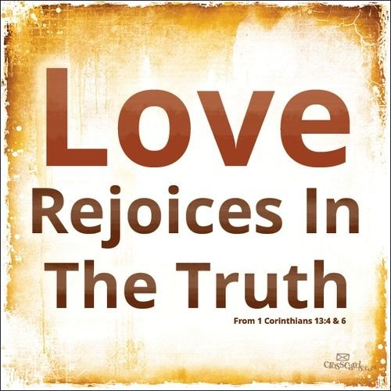
A Look At The Greek
The 2nd “rejoice” = “sugchairó”
“sug” = “together with, to identify with”
1 Cor 12:26 – “And if one member suffers, all the members suffer with it; if one member is honored, all the members rejoice with it.”
Gal 2:20a – “I have been crucified with Christ; and it is no longer I who live, but Christ lives in me”
Rom 6:4 – “Therefore we have been buried with Him through baptism into death, so that as Christ was raised from the dead through the glory of the Father, so we too might walk in newness of life.”
Eph 2:6 – “and raised us up with Him, and seated us with Him in the heavenly places in Christ Jesus”
Notes:
Back in 1 Cor 13, when Paul uses the word “rejoice” again, in that love “rejoices” in the truth, it’s the Greek “sugchairó”, a slightly different word because there is a prefix at the beginning of it. That prefix “sug” means “together with” or “to identify with” an what that suggests is that love doesn’t simply rejoice in truth in the sense of being happy or satisfied with the truth, it suggests an intimate connection with truth. Paul uses this word in 1 Cor 12:26 to talk about how members of the body “rejoice with” members that are honored. This is a intimate rejoicing in which we’re identifying with those members we rejoice with.
In fact, words in the NT in which that prefix appears before a Greek always has this connotation. Gal 2:20a – “I have been crucified with Christ; and it is no longer I who live, but Christ lives in me”. Rom 6:4 – “Therefore we have been buried with Him through baptism into death, so that as Christ was raised from the dead through the glory of the Father, so we too might walk in newness of life.” Different verbs, but the same prefix is used in these two verses as we see used in the second “rejoice” in 1 Cor 13:6 because love doesn’t simply rejoice in truth, but it rejoice because it is intimately associated with truth.
A great indicator of whether or not we are walking in love is to examine what gives us pleasure. The Three Stooges and Tom & Jerry, in my estimation at least, are innocent in nature and designed solely for laughs. But talk shows like Jerry Springer that investigate every type of immorality known to the devil should not be the type of things that Christians should derive pleasure and entertainment from. Movies, magazines, or books that glorify relationships that are contrary to God’s blueprint or that exalt values other than God’s values should not be entertainment for believers. These things should bring us no joy at all.

Slide 8
Love Rejoices In Truth
A True Transformation
Eph 4:22-24 – “that, in reference to your former manner of life, you lay aside the old self, which is being corrupted in accordance with the lusts of deceit, and that you be renewed in the spirit of your mind, and put on the new self, which in the likeness of God has been created in righteousness and holiness of the truth.”
Rom 13:12 – “The night is almost gone, and the day is near. Therefore let us lay aside the deeds of darkness and put on the armor of light.”
Col 3:9-10 – “Do not lie to one another, since you laid aside the old self with its evil practices, and have put on the new self who is being renewed to a true knowledge according to the image of the One who created him”
Notes:
Where does it come from?
A true transformation
The bible is pretty straightforward in stating that a proper view of good and evil begins when we are regenerated. Condemning what needs to be condemned and approving of what needs to be approved is evidence of a true transformation wherein we become fully immersed in God’s cause. Because we’re born again, which means we’re doing away with one way of thinking and putting on a new way of thinking. Paul says it this way:
Eph 4:22-24 – “in reference to your former manner of life, you lay aside the old self, which is being corrupted in accordance with the lusts of deceit, and that you be renewed in the spirit of your mind, and put on the new self, which in the likeness of God has been created in righteousness and holiness of the truth.”
Now this isn’t something magical that happens and we understand that. And those of us that have been transformed likely have seen in our lives that the transformation is ongoing. It begins when we obey the gospel, but it continues as we grow in faith. We learn about God, who He is, what He has done for us, what He approves of, what He disapproves of, which gives us the knowledge that we need to know the difference between right and wrong. But in this growth we also start to “get it”. Meaning, learning God’s ways won’t always make sense to us when we’re young in faith. But the more we put it into practice and see its fruit, the wiser we become through trial and through time, the more we add understanding to our knowledge and when it comes to good and evil, its no longer of loving or hating it because God told s to love or hate it, but because we get it. We can see through things for what they are, what they lead to, and we don’t want to be apart of it because we know that not only do unrighteous things suck the spiritual life right out of us, but the truth is exactly what we understand needs to be approved.
Rom 13:12 – “The night is almost gone, and the day is near. Therefore let us lay aside the deeds of darkness and put on the armor of light. ”
Col 3:9-10 – “Do not lie to one another, since you laid aside the old self with its evil practices, and have put on the new self who is being renewed to a true knowledge according to the image of the One who created him”
Again, if you want to do a survey of your own life in how far you have arrived in your spiritual maturity, your love toward God and toward others, take a survey regarding the things you approve of and the things you don’t approve of. That will tell us exactly where we are at. And if at the end of that self-examination, you find yourself falling well short of where you should be at this moment in your life, perhaps it is time to start taking notice of the people we spend most of our time with, the TV/movies we find ourselves watching, and any other medium that may be desensitizing us to evil and sharpening our approval of those things that are good.

Slide 9
Love Rejoices In Truth
A True Transformation
We See Others As God Sees Them
Luke 6:42 – “Or how can you say to your brother, ‘Brother, let me take out the speck that is in your eye,’ when you yourself do not see the log that is in your own eye? You hypocrite, first take the log out of your own eye, and then you will see clearly to take out the speck that is in your brother’s eye.”
Notes:
2) God’s perspective become our perspective
Because this transformation will ultimately cause us not to just see “things” as God sees things, but it will help us to see people as God sees people. Brethren, if we are going to love other people, we have to have God’s perspective on sin and righteousness. This how we can truly help people, it’s how we can truly love them. Because when I rejoice in this truth, that people are God’s creation, and I reject those fleshly indulgences in my heart that keeps people at bay such as pride, envy, and self-righteousness and make connections. I see a person’s sin and I say, “I want to try to help them, be a positive influence in their life.” Or we may see a person’s righteousness and we think, “I want to tap into this person and be edified by them.” Rejoicing in truth helps us to see others as God sees them so we can love them as God loves them.
Luke 6:42 – “Or how can you say to your brother, ‘Brother, let me take out the speck that is in your eye,’ when you yourself do not see the log that is in your own eye? You hypocrite, first take the log out of your own eye, and then you will see clearly to take out the speck that is in your brother’s eye.” Brethren, sometimes that speck in our eye is our inability to distinguish between the truth and error of things. If I see people as obstacles that get in my way, I’m blinded to their true need. If I look at people as inconveniences to achieving my own personal goals rather than people made in God’s own image, I’ll never shine my light around them and love them as God loves them. If that is the speck in our eye, we need to take the ointment of God’s love to it so that we can clearly see others as God sees them and love them wholly as God loves them.

Slide 10
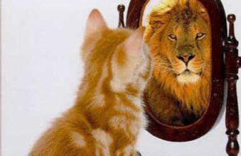
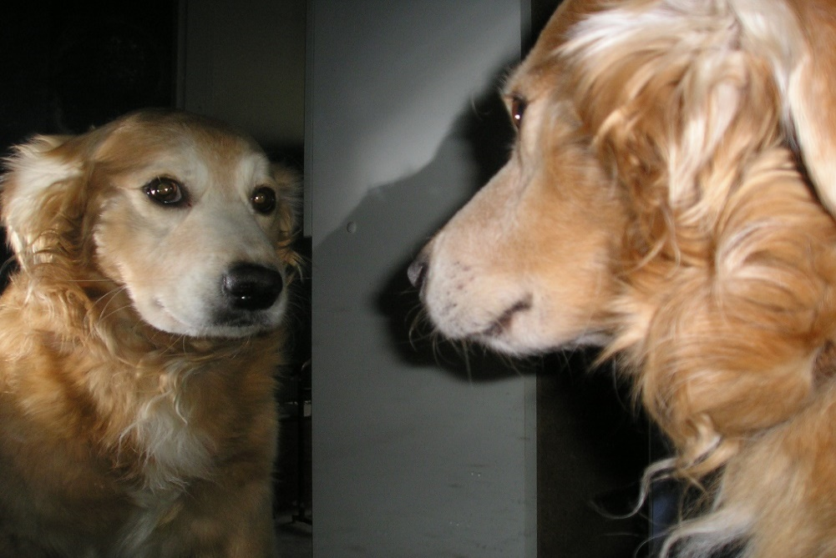
Love Rejoices In Truth
A True Transformation
We See Others As God Sees Them
We See Ourselves As God Sees Us
Heb 4:12-13 – “For the word of God is living and active and sharper than any two-edged sword, and piercing as far as the division of soul and spirit, of both joints and marrow, and able to judge the thoughts and intentions of the heart. And there is no creature hidden from His sight, but all things are open and laid bare to the eyes of Him with whom we have to do.”
Notes:
3) God’s perspective become our perspective
This is most important. Are we truthful of who we really are? When we attend worship, do we feel pressured to put on a persona about ourselves that isn’t truthful? Or are we genuine people? If we give into the temptation to present ourselves with all the pros and none of the cons, we’re not rejoicing in truth because we’re rejecting what God has already revealed about us; we’re sinners.
Heb 4:12-13 – “For the word of God is living and active and sharper than any two-edged sword, and piercing as far as the division of soul and spirit, of both joints and marrow, and able to judge the thoughts and intentions of the heart. And there is no creature hidden from His sight, but all things are open and laid bare to the eyes of Him with whom we have to do.”
Truth doesn’t just open us up to be truly known, but by being truly known by others, it enables us to be truly loved. And in that we can rejoice. Because it’s a lot harder for someone to love us when we’re being less than upfront with who we are. And it’s hard for us to love others when we’re overexerting our energies in whitewashing ourselves. We have to love hypocrites to, I understand that. But it’s a lot harder isn’t it? But we rejoice in that individual who doesn’t feel the need to put on a front but is as real as they come because we appreciate genuineness and honesty. I’m saying that we need to be that person because that person is so much easier to love and we can rejoice in that.

