Slide 1
Notes:
Lev 4:14 (whole congregation) – “when the sin which they have committed becomes known, then the assembly shall offer a bull of the herd for a sin offering and bring it before the tent of meeting.”
Lev 4:23 (leader) – “if his sin which he has committed is made known to him, he shall bring for his offering a goat, a male without defect.”
Lev 4:28 (common) – “if his sin which he has committed is made known to him, then he shall bring for his offering a goat, a female without defect, for his sin which he has committed.”
So here’s the question: what if a sin is not made known? What if days, weeks, even months go by, or what if it is never known? Then sin remains in the camp. What does God have to do? Does he wink at it? He can’t. He’s holy. There has to be something else in place to atone for sins that are not expiated at the altar.
Hence, the Day of Atonement. This is the climax of Leviticus, the center if you will. It shows that even the sacrifices were not enough to remove sin from the camp. Something more must be done.

Slide 2
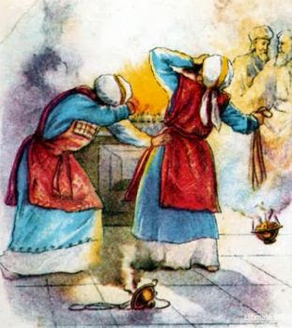
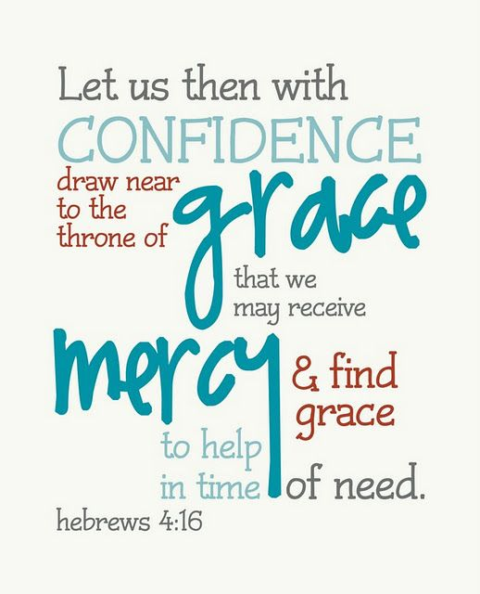
Reminder Of Nadab & Abihu
Lev 16:1-2 – “¹Now the Lord spoke to Moses after the death of the two sons of Aaron, when they had approached the presence of the Lord and died. ²The Lord said to Moses: ‘Tell your brother Aaron that he shall not enter at any time into the holy place inside the veil, before the mercy seat which is on the ark, or he will die; for I will appear in the cloud over the mercy seat.’”
Notes:
The chapter begins with a reminder of the events surrounding Nadab and Abihu’s death – Lev 16:1-2 – This may give us additional clues that Lev 10 did not, that in addition to offering strange fire, they did so entering the most holy place. The most holy place was off limits to all priests because within it dwelled the very presence of God.
However, sin that remained in the camp because it wasn’t atoned for at the altar would have profaned the holy objects in the tabernacle, including that which is in the Most Holy Place. So the Day of Atonement required a purifying of the objects with the most holy place in order for the children of Israel to remain in fellowship with God. The instructions that follow in Lev 16 allows for the High Priest to enter behind the veil on this one day of the year without being subject to the wrath of God, as long as he did so in the prescribed way. Jewish tradition tells us that this occurrence was so feared that the high priest would enter with a rope tied around his waste leading out so that in case he erred/sinned, they could drag his body out of the most holy place without entering in themselves and incurring God’s wrath. There was simply no confidence on the part of any priest over this occasion.
Thankfully, for Christians, this prohibition no longer exists. When Christ was crucified, the veil was torn in two from top to bottom, signifying access to God’s presence through Jesus Christ – Heb 4:16

Slide 3
The High Priest
Lev 16:3a – “Aaron shall enter the holy place…”
Rev 1:6a – “and He has made us to be a kingdom, priests to His God and Father”
Heb 9:11-12 – “But when Christ appeared as a high priest of the good things to come, He entered through the greater and more perfect tabernacle, not made with hands, that is to say, not of this creation; and not through the blood of goats and calves, but through His own blood, He entered the holy place once for all, having obtained eternal redemption.”
Notes:
While it is the Day of Atonement and therefore atonement is the purpose, the high priest takes a big role in this chapter and therefore deserves our attention.
The high priest was not typically involved in the sacrifices that were offered perpetually throughout the year. This was the job of the priests who served under him in both the offerings as well as attending to the work inside the holy place. But on this Day of Atonement, the high priest did the work – Lev 16:3a –This was his job and his job alone.
In the same way, we are priests of God – Rev 1:6a – But though we are priests, we are inferior priests and we cannot offer the sacrifices necessary for the Day of Atonement. Only our high priest can do this – Heb 9:11-12 – Only Jesus can offer atonement. Only His blood can truly save us. Even as we Christians continue to offer living sacrifices, we’re acknowledging they would be for not without the great work that our High Priest Jesus did on the Day that He atoned for our sins.

Slide 4
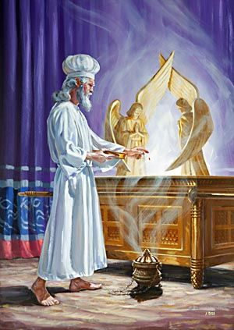
The High Priest
Lev 16:17 – “When he goes in to make atonement in the holy place, no one shall be in the tent of meeting until he comes out, that he may make atonement for himself and for his household and for all the assembly of Israel.”
Isa 63:3a – “I have trodden the wine trough alone, and from the peoples there was no man with Me.”
Notes:
In fact, no other person was present while the high priest performed these functions. Lev 16:17
Interestingly, no disciple died with Christ. All of them fled. In a way, that might have been a good thing because then no one could say that Jesus was assisted in any way as He is making atonement for the sins of the people – Isa 63:3a

Slide 5
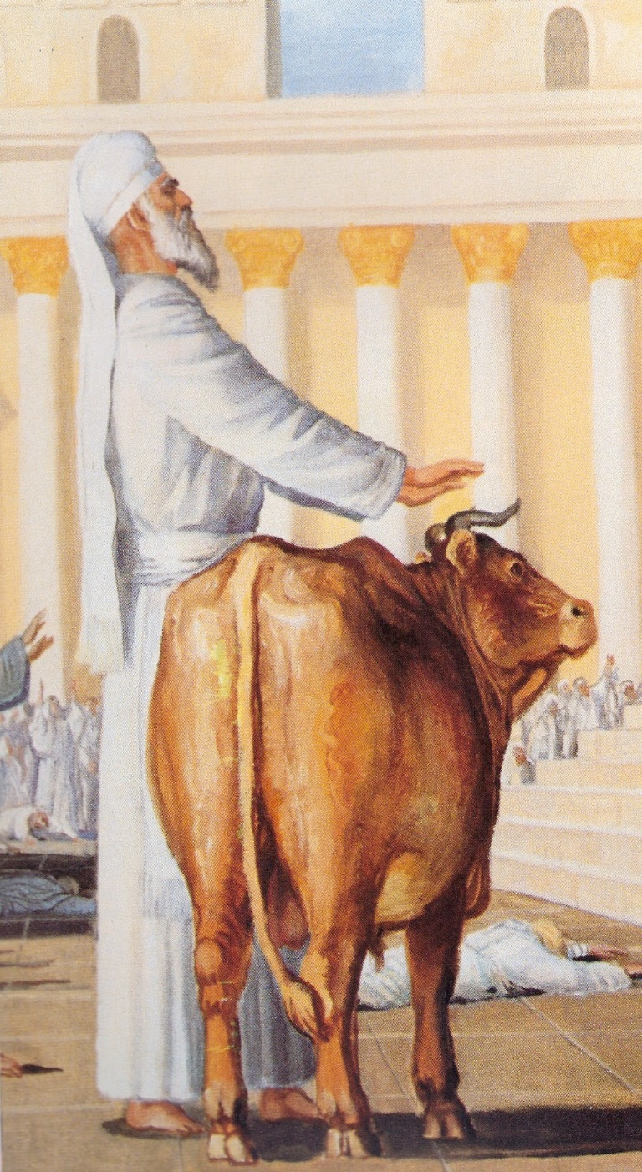
The High Priest
Lev 16:3 – “Aaron shall enter the holy place with this: with a bull for a sin offering and a ram for a burnt offering.”
Lev 16:6 – “Then Aaron shall offer the bull for the sin offering which is for himself, that he may make atonement for himself and for his household.”
Lev 16:11-14 – “¹¹Then Aaron shall offer the bull of the sin offering which is for himself and make atonement for himself and for his household, and he shall slaughter the bull of the sin offering which is for himself. ¹²He shall take a firepan full of coals of fire from upon the altar before the Lord and two handfuls of finely ground sweet incense, and bring it inside the veil. ¹³He shall put the incense on the fire before the Lord, that the cloud of incense may cover the mercy seat that is on the ark of the testimony, otherwise he will die. ¹⁴Moreover, he shall take some of the blood of the bull and sprinkle it with his finger on the mercy seat on the east side; also in front of the mercy seat he shall sprinkle some of the blood with his finger seven times.”
Notes:
Now, ideally, if someone is going to mediate between you and God to provide atonement, you’d want that man to be perfectly sinless, lest God refuse atonement on the basis of his sin. This was a problem with the Levitical priesthood because every high priest from Aaron down the line was a sinner. So think about the implications of one sinner mediating on behalf of other sinners. This was not the ideal situation. And so, before the high priest could offer atonement for the people, he must first make atonement for himself. Lev 16:3
Then Aaron killed it, because this is for his sins. Even his sons defiled the tent of meeting and so they needed to be consecrated with blood – Lev 16:6, 11-14

Slide 6
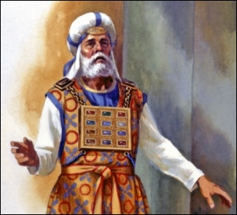
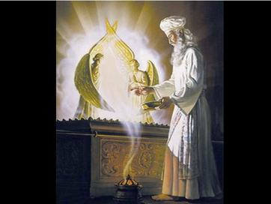
The High Priest
Ex 28:2 – “You shall make holy garments for Aaron your brother, for glory and for beauty.”
Lev 16:4 – “He shall put on the holy linen tunic, and the linen undergarments shall be next to his body, and he shall be girded with the linen sash and attired with the linen turban (these are holy garments). Then he shall bathe his body in water and put them on.”
Phil 2:6-8 – “⁶who, although He existed in the form of God, did not regard equality with God a thing to be grasped, ⁷but emptied Himself, taking the form of a bond-servant, and being made in the likeness of men. ⁸Being found in appearance as a man, He humbled Himself by becoming obedient to the point of death, even death on a cross.”
Notes:
Did you notice anything different about the attire of the high priest in the prior pictures? Normally, the high priests would be dressed in beautiful colored materials, intricate embroidery, gold and jewelry, etc. It would have made him look very ornate and beautiful, and that was the purpose. Ex 28:2 – So among his fellow men, his dignity as the great mediator between man and God is unsurpassed, and his splendid clothes drew attention to the glory of his office.
But on this day, this Day of Atonement, the high priest is entering into the very presence of God Himself and he must therefore dress as befits the occasion. Lev 16:4 – In other words, he is stripped of his honor, becoming simply a servant of the King of kings, a status portrayed through this more humble attire. He’s humbling himself just as the people were to humble themselves. Just as the angels in Isa 6 covered their faces with two of their wings while in the presence of God.
I can’t help but think about Jesus’ attire in John 13, where he exchanged his garments for that of a slave as he washed their feet. But even more symbolic is the cross. When Jesus made atonement for us, there was no diadem on His head except for a crown of thorns. There was no purple robe save the one the soldiers dressed Him in to mock Him. Then when they crucified Him, they didn’t even allow Him the dignity of clothes that ordinary high priests had. In other words, Jesus didn’t make atonement arrayed in glory. Far from it! – Phil 2:6-8

Slide 7
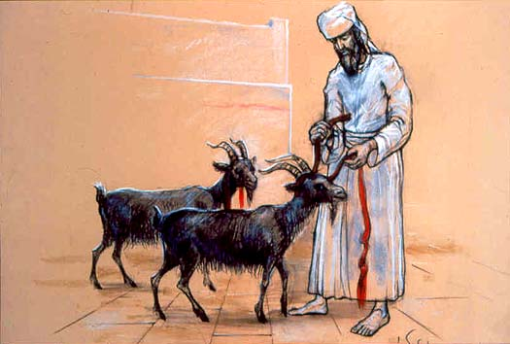
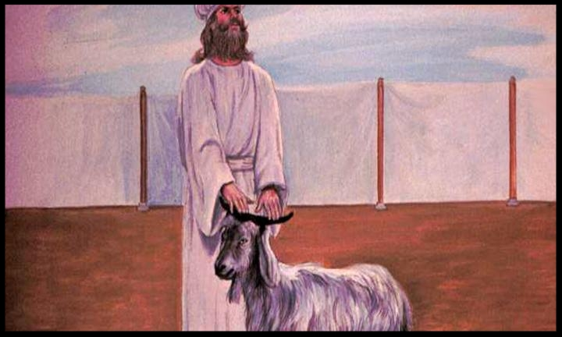
The Offering
Lev 16:5 – “He shall take from the congregation of the sons of Israel two male goats for a sin offering and one ram for a burnt offering.”
Lev 16:7-9 – “⁷He shall take the two goats and present them before the Lord at the doorway of the tent of meeting. ⁸Aaron shall cast lots for the two goats, one lot for the Lord and the other lot for the scapegoat. ⁹Then Aaron shall offer the goat on which the lot for the Lord fell, and make it a sin offering.”
Lev 16:15-16 – “¹⁵Then he shall slaughter the goat of the sin offering which is for the people, and bring its blood inside the veil and do with its blood as he did with the blood of the bull, and sprinkle it on the mercy seat and in front of the mercy seat. ¹⁶He shall make atonement for the holy place, because of the impurities of the sons of Israel and because of their transgressions in regard to all their sins; and thus he shall do for the tent of meeting which abides with them in the midst of their impurities.”
Notes:
Once the high priest made atonement for himself, he was then tasked to make atonement for the people. This was done through two male goats as a sin offering and one male ram for a burnt offering. Once lots were cast between the two male goats, one was offered as a sin offering, an obvious type of Christ and the atonement He rendered for all mankind, and one became the scapegoat.
The goat that was sacrificed met all the same requirements a sin offering must meet – a perfect, unblemished, male goat of the first year, meaning it was in its prime of life, just like our Lord. It was taken from the congregation, as verse 5 says, just like our Lord who “came from His own” though they did not receive Him. However, this goat was an unwilling participant. He had no idea when he was snatched from his pen that that was it for him. He was likely eating, sleeping, playing with other goats and then he is snatched to face a possible death. I say “possible” because there were two that were taken and lots were cast to determine which would reach this demise, just as our Lord stood with Barabbas as the people decided which one would die and which one would be released.
The sin offering was slain for the people just as the bull offering was for the priest. Because the people’s sin violated the sanctuary, Aaron was to do with the blood as he did for his offering. It was brought into in the most holy place where it was applied to the mercy seat. It was then applied to the horns of the altar of incense and sprinkled seven times before the veil. Verse 16 explicitly says this is because of the impurities and the transgressions of the people. Sin infects everything around us, including those things which are deemed holy to the Lord, and only through blood can they be cleansed.

Slide 8
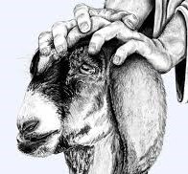
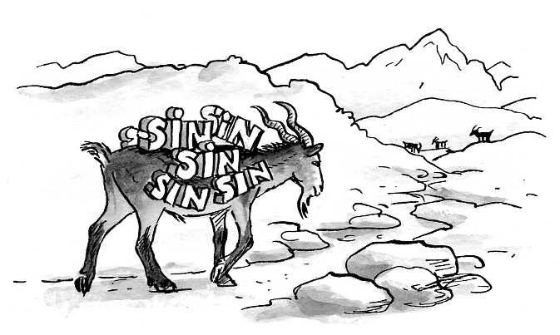
The Offering
Lev 16:20-22 – “²⁰When he finishes atoning for the holy place and the tent of meeting and the altar, he shall offer the live goat. ²¹Then Aaron shall lay both of his hands on the head of the live goat, and confess over it all the iniquities of the sons of Israel and all their transgressions in regard to all their sins; and he shall lay them on the head of the goat and send it away into the wilderness by the hand of a man who stands in readiness.²²The goat shall bear on itself all their iniquities to a solitary land; and he shall release the goat in the wilderness.”
Luke 4:28-29 – “And all the people in the synagogue were filled with rage as they heard these things; ²⁹ and they got up and drove Him out of the city, and led Him to the brow of the hill on which their city had been built, in order to throw Him down the cliff.”
Notes:
The other goat, however, is a different story. This is referred to as the “scape goat”. And it was only after atonement was made for the sanctuary that this goat was dealt with – Lev 16:20-22 – Now on the surface, it sounds like this goat got off a lot easier than the one which as sacrificed. However, Jewish tradition tells us that the Jews were so worried that this goat might find its way back to camp, with all that sin figuratively applied to it, that in an effort to ensure it wouldn’t, the man who led it into the wilderness caused it to fall down a rocky cliff to its death to ensure it wouldn’t come back. In fact, the word scapegoat in Hebrew is “Azazel” and a lot has been suggested about this word. The Rabbis suggested that it came from two words, “azaz” which means “rugged” and “el” which means “strong” referring to the rugged cliff that the goat was cast down so it is possible that though this action is never explicitly called out by the text that the Jews understood what was to occur to this goat from the word itself. This is speculative.
What is not speculative, though, is that when Jesus came to Galilee and quoted from Isa 61 claiming those things were being fulfilled in their hearing, notice their reaction in Luke 4:28-29 – It is very possible this is not a coincidence.

Slide 9
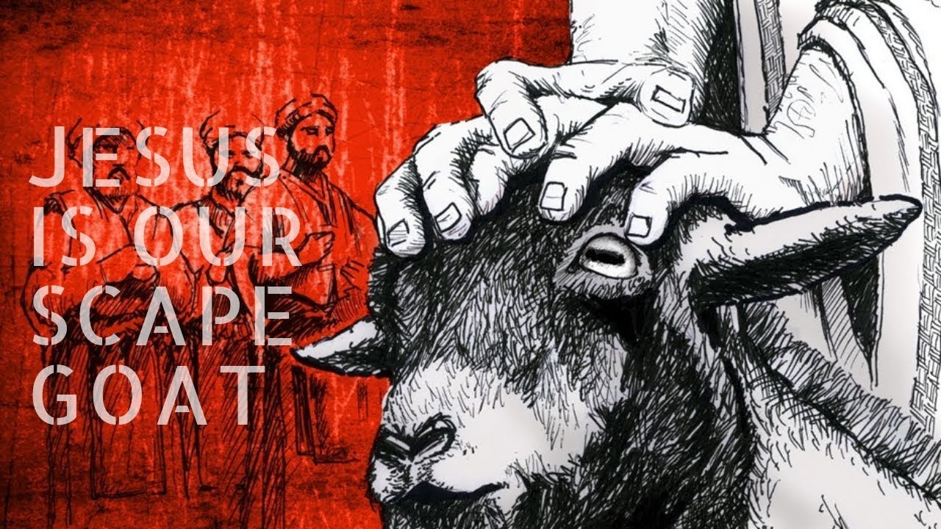
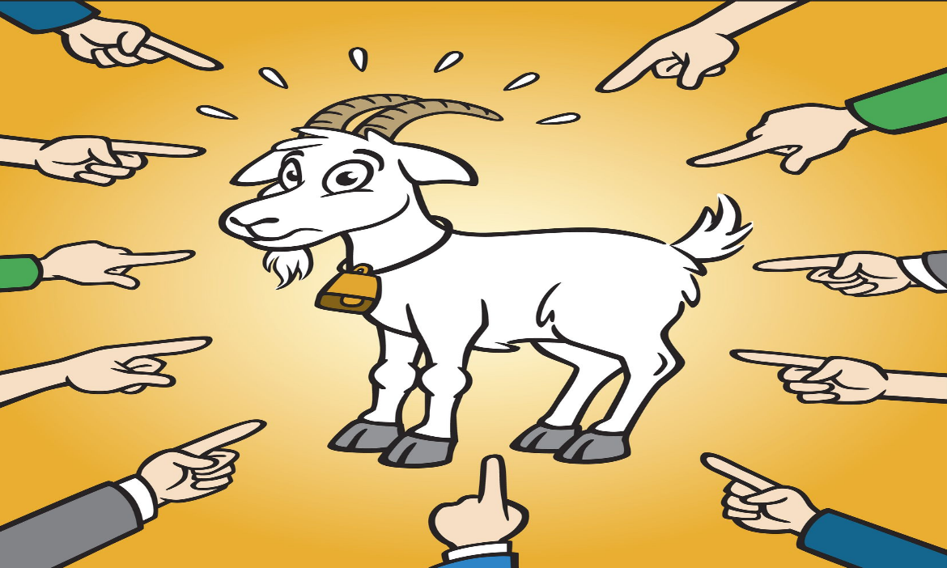
The Offering
Matt 26:37-38 – “He took with Him Peter and the two sons of Zebedee, and began to be grieved and distressed. Then He said to them, ‘My soul is deeply grieved, to the point of death…”
Matt 27:46 – “About the ninth hour Jesus cried out with a loud voice, saying, ‘Eli, Eli, lama sabachthani?” that is, “My God, My God, why have You forsaken Me?’”
Isa 53:10a – “But the Lord was pleased crush Him, putting Him to grief; if He would render Himself as a guilt offering”
Notes:
To show further the horror of being the scapegoat, consider how much Jesus was affected by the looming separation from His Father while He bore mankind’s sin on the cross – Matt 26:37-38. Now let me ask this: when Jesus claimed that His soul was deeply grieved to the point of death, was He embellishing? We do that sometimes. We say things like, “I’m scared to death” or “I’m dead tired”. And while our hunger or exhaustion during these times may be greater than normal, we’re hardly on death’s doorstep. Is this what Jesus was doing when He said that His soul was grieved even to the point of death? I’d suggest He wasn’t exaggerating or overstating His condition. This is the same man who said that our yes should be “yes” and our no” should be “no”. In other words, say what you mean and mean what you say and don’t give in to the urge to reinforce your statements with inflating words. Jesus is grieved to the point of death because He is about to have to bear the sins of mankind and thereby take upon God’s wrath by being tortured in the most heinous of ways. And His disciples, who were supposed to be there in support through prayer and keeping watch, couldn’t resist their flesh by staying awake for even one hour. The grief and the sorrow Jesus experienced was excessive and His physical, human body could barely contain the grief.
Consider Matt 27:46 – Just as the scapegoat was driven away from the sanctuary and from the congregation, bearing mankind’s sins, during Jesus’ time on the cross for forsaken by the Father. Don’t misunderstand me. The Father never left the Son, but He did forsake Him to this degree. This is one of the great paradoxes of the cross. It fits what we read in Isa 53:10a – Nothing hurt Jesus quite like being the scapegoat for man’s sins, driven away for a time, bearing the sins of the congregation.

Slide 10
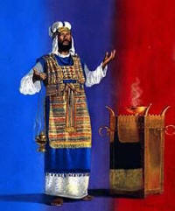
Aaron’s Change Of Clothes
Lev 16:23-28 – “²³Then Aaron shall come into the tent of meeting and take off the linen garments which he put on when he went into the holy place, and shall leave them there. ²⁴He shall bathe his body with water in a holy place and put on his clothes, and come forth and offer his burnt offering and the burnt offering of the people and make atonement for himself and for the people. ²⁵Then he shall offer up in smoke the fat of the sin offering on the altar. ²⁶The one who released the goat as the scapegoat shall wash his clothes and bathe his body with water; then afterward he shall come into the camp. ²⁷But the bull of the sin offering and the goat of the sin offering, whose blood was brought in to make atonement in the holy place, shall be taken outside the camp, and they shall burn their hides, their flesh, and their refuse in the fire. ²⁸Then the one who burns them shall wash his clothes and bathe his body with water, then afterward he shall come into the camp.”
Notes:
Notice what happens next – Lev 16:23-28 – So after atonement was made in the sanctuary, Aaron was allowed to change back into his normal attire, after washing. Now he is arrayed once more in beauty and holiness. He was once humbled and alone, but once atonement was made, like Christ’s atoning death, he emerged victorious, arrayed once more in glory and in splendor. Think about the description John gives us of Jesus in heaven in Rev 1. Is he arrayed in humility or in glory? He’s arrayed in glory.
Then he shall offer up the burnt offering on top of the fat of the sin offering so that the cleansing could be made complete. Imagine the joy of the people as the waited in anticipation for this ceremony to be complete only to see the high priest emerge triumphant.
But so holy was the scape goat as well as the remains of the offering, even the man who carried off the scapegoat and carried off the ashes were required to wash.

Slide 11
Application
Psa 19:12 – “Who can discern is errors? Acquit me of hidden faults.”
Psa 139:23-24 – “²³Search me, O God, and know my heart; try me and know my anxious thoughts; ²⁴and see if there be any hurtful way in me, and lead me in the everlasting way.”
Psa 90:8 – “You have placed our iniquities before You, our secret sins in the light of Your presence.”
Prov 14:12 – “There is a way which seems right to a man, but its end is the way of death.”
Prov 12:15 – “The way of a fool is right in his own eyes, but a wise man is he who listens to counsel.”
Prov 16:2 – “All the ways of a man are clean in his own sight, but the Lord weighs the motives.”
Notes:
The Day of Atonement was a time for dealing with unknown sins. The text does not explicitly state this, but it strongly infers that there were so many sins which might go unnoticed, neglected throughout the year, and would have produced intolerable contamination. It was not those sins for which atonement had already been made that the Day of Atonement was given for, but for those which had not been recognized, and for which a sacrifice had not been offered. The Day of Atonement, then, is based on the assumption that some sins never come to the attention of the sinner.
David was concerned by sins of this nature – Psa 19:12; 139:23-24 – Moses, who penned Leviticus, was also the author of Psa 90:8
We commit a lot of unknown, hidden sins, which we are either unable or unwilling to acknowledge. Several proverbs speak to this – Prov 14:12; 12:15; 16:2
All these texts tell us that fallible man is not capable of seeing many of his own sins. We need help. We need other godly people to bring it to our attention, we need counsel and advice, constant meditation on scripture, and even after all of this we need the grace of God and that is exactly what the Day of Atonement was for Israel and its what Christ’s atonement is for us.

Slide 12
Application
Lev 16:29-31 – “²⁹This shall be a permanent statute for you: in the seventh month, on the tenth day of the month, you shall humble your souls and not do any work, whether the native, or the alien who sojourns among you; ³⁰for it is on this day that atonement shall be made for you to cleanse you; you will be clean from all your sins before the Lord. ³¹It is to be a sabbath of solemn rest for you, that you may humble your souls; it is a permanent statute.”
Notes:
The Day of Atonement required a humbling in attitude. It was the only time in scripture that fasting was explicitly commanded – Lev 16:29-31 – You’ll remember that in Lev 23, that we discussed a few weeks back, so serious was this attitude of humility that God commanded that anyone who doesn’t do be destroyed. God wanted them to afflict themselves, so they could identify with the sacrifice for sin. Afflicting the soul brought the Israelite into sympathy with the afflicted sacrificial victim, even as the believer identifies with Jesus Christ on the cross.

