Slide 1
Moral Purity
Notes:
The laws for moral purity are given to us in Lev 17 – 20. The purpose was this: Israel was called to live differently than the Canaanite nations they would be replacing. But they were to be just any nation, but a holy nation because they serve a holy God. There were things that the Canaanites were doing that were perverse and immoral and that partially led to their downfall. And so these chapters are to call attention to that fact as well as instruct Israel what they are to do and not do in order to not be influenced by the Canaanite’s corrupt practices as well as to be holy themselves. These were not arbitrary laws, but laws that were consistent with God’s holy nature. So as learn these laws, we’re learning more about the nature of God and His holiness.

Slide 2
Leviticus 17 - 20
Lev 17 – Sacrifices & Blood
Lev 18 – Sexual Morality
Lev 19 – God & Man
Lev 20 – Penalty
Notes:
The following is an outline of these chapters
Chapter 17 is going to teach us about the holiness of the sacrifices and the meaning behind blood as the atoning element.
Chapter 18 teaches holiness as it pertains to sexuality. In designing sexuality for man and woman’s good, God is prohibiting certain of these man/woman unions.
Chapter 19 teaches holiness and moral purity in regards to Israel’s relationship with both God and man. These are multiple laws, and we’ll show some NT significance to these things.
Chapter 20 enumerates through the penalties for those who violate these laws of holiness.

Slide 3
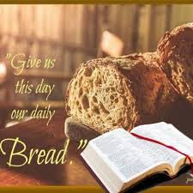
Proper Sacrifice
Lev 17:3-4 – “Any man from the house of Israel who slaughters an ox or a lamb or a goat in the camp, or who slaughters it outside the camp, and has not brought it to the doorway of the tent of meeting to present it as an offering to the Lord before the tabernacle of the Lord, bloodguiltiness is to be reckoned to that man. He has shed blood and that man shall be cut off from among his people.”
Lev 17:5 – “The reason is so that the sons of Israel may bring their sacrifices which they were sacrificing in the open field, that they may bring them in to the Lord, at the doorway of the tent of meeting to the priest, and sacrifice them as sacrifices of peace offerings to the Lord.”
Notes:
Back in Lev 12, we learned which animals Israel could and could not eat. When we get to the beginning of Lev 17, we receive additional information regarding these animals. Specifically, when an animal was slaughtered that was not only clean but could be offered as a sacrifice, we see the following instruction – Lev 17:3-4 – This is not a ceremonial instruction; it is a moral one – Lev 17:5 – The main reason was to prevent them from offering these sacrifices in open fields which God knew would incline them to offer these animals to idols or in places not sanctioned. Animals that could be offered as peace offerings needed to be offered as peace offerings so that the one whom the animal belongs to may share in fellowship with both the priesthood and God.
Application today? When we are about to eat, we give thanks to God, just as Jesus did when He broke bread. This is done in order to be in constant reminder of the true source of our blessings. This is not to suggest that we cannot also give thanks to the “hands that prepared it” or for the host of the house in which we are feasting. But if all we gave thanks for were those people, or if we gave no thanks at all because we’re contributing our meals to our own strength, is it any different than idolatry? Matt 6:11 – “Give us this day our daily bread.” Our regular thanksgiving at our meals is designed to work just as the peace offerings were, a recognition of the fellowship we enjoy with God and with one another.
Lest we think this was a cumbersome thing to do once they settled in the land, it does appear that the law was modified for when they settled in Canaan – Deut 12:15-16, 20-24.

Slide 4
Meaning Of The Blood
Lev 17:11 – “For the life of the flesh is in the blood, and I have given it to you on the altar to make atonement for your souls; for it is the blood by reason of the life that makes atonement.”
Blood
Life
Atonement
Heb 9:13-14 – “For if the blood of goats and bulls and the ashes of a heifer sprinkling those who have been defiled sanctify for the cleansing of the flesh, how much more will the blood of Christ, who through the eternal Spirit offered Himself without blemish to God, cleanse your conscience from dead works to serve the living God?”
Heb 10:19 – “Therefore, brethren, since we have confidence to enter the holy place by the blood of Jesus”
Heb 10:29 – “How much severer punishment do you think he will deserve who has trampled under foot the Son of God, and has regarded as unclean the blood of the covenant by which he was sanctified, and has insulted the Spirit of grace?”
Notes:
Now there were a lot of clean animals that could not be offered as sacrifices, yet they were still permitted to eat them. However, the blood must not be consumed. God gives two reasons why this is the case - Lev 17:11
Reason #1 is that life is in the blood. Scientifically speaking, blood carries oxygen, which is why we need it to live. They didn’t have to understand that as long as they trusted what God told them. Hopefully in doing this, it would instill in Israel a profound respect for the sanctity of life.
Reason #2 is that this symbolic association is the reason why God allows blood to make atonement. And so blood is sacred. Therefore any blood not used for the sanctuary should not only not be consumed, but is to be poured out on the ground so as to symbolically return it to God. Some may think this would profane the blood, as Uzzah no doubt believed when he tried to prevent the ark from falling to the ground. But the ground is not more profane than we are. Though not explicitly stated, returning the blood to the ground would have been hygienic, preventing others who come across it from infection due to communicable diseases that so easily passes through blood.
If the blood of animals, by reason of the life it represented, was to be so respected, what of the blood of Christ that atones us of our sins? – Heb 9:13-14; Heb 10:19; Heb 10:29

Slide 5
Sexual Morality
Prohibited
Lev 18:1-3 – “Then the Lord spoke to Moses, saying, ‘Speak to the sons of Israel and say to them, ‘I am the Lord your God. You shall not do what is done in the land of Egypt where you lived, nor are you to do what is done in the land of Canaan where I am bringing you; you shall not walk in their statutes’”’
Incest
Adultery
Homosexuality
Bestiality
Lev 18:24-25 – “Do not defile yourselves by any of these things; for by all these the nations which I am casting out before you have become defiled. For the land has become defiled, therefore I have brought its punishment upon it, so the land has spewed out its inhabitants.”
Notes:
Lev 18 deals with inappropriate sexual relationships such as incest, adultery, homosexuality, and bestiality. One would think that such prohibitions would not need to be taught. However, God explains why these prohibitions need to be reminded – Lev 18:1-3
In other words, “Just because they do it doesn’t mean you do it.” They belong to God and therefore are to think and act differently than the world around them. And in our day and age where sexual integrity is becoming a thing of the past, even the most obvious of lessons needed to be reminded over and over again. This is what the Canaanite nations were doing – Lev 18:24-25
And this has been stated before, but archeologists have been able to determine from the DNA Canaanite remains that they suffered from a variety of diseases related to perverse sexual practices and that God is trying to help Israel not to repeat their same mistakes.

Slide 6
Sexual Morality
“Uncover The Nakedness”
Lev 18:7a – “You shall not uncover the nakedness of your father…”
Ham & Noah (Gen 9:22); Lot & his daughters (Gen 19:30-38)
Lev 18:8 – “You shall not uncover the nakedness of your father’s wife; it is your father’s nakedness.”
Reuben & Bilhah (Gen 35:22)
Lev 18:9 – “The nakedness of your sister, either your father’s daughter or your mother’s daughter, whether born at home or born outside, their nakedness you shall not uncover.”
Abraham and Sarah (Gen 20:12)
Lev 18:15 – “You shall not uncover the nakedness of your daughter-in-law; she is your son’s wife, you shall not uncover her nakedness.”
Judah & Tamar (Gen 38)
Notes:
The phrase used over and over again in this chapter regarding these relationships is “uncover the nakedness”. This is a euphemism for sexual sin, but not necessarily limited to the act of sex itself. It traces its meaning back to Genesis 3 when Adam and Eve realized they were naked and attempted to hide themselves from the garden. The sexual relationship is reserved between a man and his wife and Lev 18 is further limiting which man and wife. This was important because as you consider the Genesis narrative, much of what is prohibited in Lev 18 was practiced during that time:
Lev 18:7 is seen in Gen 9:22 with Ham and Noah and again in Gen 19:30-38 with Lot and his daughters
Lev 18:8 is seen in Gen 35:22 when Reuben sleeps with Jacob’s concubine
Lev 18:9 is seen in Gen 20:12 with Abraham marrying his half-sister Sarah
Lev 18:15 is seen in Gen 38 when Judah had a child by his daughter-in-law Tamar

Slide 7
Sexual Morality
“Uncover The Nakedness”
Lev 18:18 – “You shall not marry a woman in addition to her sister as a rival while she is alive, to uncover her nakedness.”
Jacob, Rachel, & Leah (Gen 29:21-30)
Lev 18:19 – “Also you shall not approach a woman to uncover her nakedness during her menstrual impurity.”
Rachel (Gen 29:34-35)
Lev 18:20 – “You shall not have intercourse with your neighbor’s wife, to be defiled with her.”
Potiphar’s wife attempts to seduce Joseph (Gen 39)
Lev 18:21 – “You shall not give any of your offspring to offer them to Molech, nor shall you profane the name of your God; I am the Lord.”
Abraham & Isaac (Gen 22)
Lev 18:22 – “You shall not lie with a male as one lies with a female; it is an abomination.”
Sodom & Gomorrah (Gen 19:4-5)
Notes:
Lev 18:18 is seen in Gen 29:21-30
Lev 18:19 is seen, somewhat, in Gen 29:34-35
Lev 18:20 is seen, somewhat, in Gen 39 w/Potiphar’s wife’s attempt to seduce Joseph
Lev 18:21 is seen, somewhat, in Gen 22
Lev 18:22 is seen in Gen 19:4-5
Point: just because they did it doesn’t mean you do it. Just because it happened in the past doesn’t mean God wanted them to do it now. There very well may have a temptation for these Israelites to want to justify certain things merely because it was tradition, family heritage, etc. By going into great detail regarding which relationships limit man and woman being joined together, it would prevent Israel from defiling themselves over what they otherwise might have pointed to as biblical precedence.

Slide 8
Holiness Toward God & Man
Be Holy (1-2)
Love
Your Neighbor As Yourself
(18b)
Don’t Mix Cattle, Seed, Garments (19)
Honor Parents (3)”
Don’t Lie w/Another’s Slave (20-22)
Don’t Turn To Idols (4)
Eat Fruit Trees Starting Year 5 (23-25)
Peace Offerings (5-8)
No Eating Blood (26a)
Consider Poor (9-10)
No Divination Or Soothsaying (26b)
Don’t Steal (11a)
No Altering Beard Or Hair (27)
Don’t Lie To Each Other (11b)
No Cuts Or Tattoos (28)
Don’t Swear Falsely (12)
No Making Daughter A Harlot (29)
Don’t Oppress, Deny Wages (13)
Keep The Sabbath (30a)
Don’t Make Fun Of Neighbor (14)
Revere The Sanctuary (30b)
No Partiality (15)
Don’t Use Mediums & Spiritists (31)
No Slander (16a)
Honor & Rise Up For Elderly (32)
Act When A Life On Line (16b)
Love Strangers w/You (33-34)
No Holding Grudges (17-18a)
Use Just Weights & Balances (35-36)
Notes:
Leviticus 19 is a summary of various laws designed to be adhered to in order to become holy as God is holy. In fact, all these laws find unity in the phrase repeated 15 times – “I am the Lord.” It follows the pattern of the ten commandments as well as the pattern of the two great commandments – loving God and loving others. However it expounds upon these general commands to some specific applications.
A person learns to fear God by first learning to fear his parents. This is the essential building block for the stability and health of all society. If the younger generation is constantly at war with the older generation, the foundation of society will come tumbling down.
Once we are older, our devotion to God will be in competition to other devotions. God prohibits putting idols, in whatever form they may come in, before Him. Though Israel struggled with molten images up to the Babylonian captivity, it turned more insidious after. They began idolizing their nation, their temple and its ceremonies, tradition, etc.
The mention of peace offerings is no coincidence as peace with God can only be maintained when proper reverence is given to Him. And the meat must be consumed by the third day or else burned. God’s desire was a true fellowship, not a stale one.
Beginning in verse 9, the text shifts to our obligations to man. There must be habitual consideration for the poor. The land they harvested from was not there’s. It was given to them by God therefore God expected Israel to leave gleanings for the poor. Closely related to depriving the poor is taking what doesn’t belong to us, through theft, lies, false swearing, and denying wages earned. In order to be holy, they were to deal honestly with their neighbor as God had dealt honestly with them.
God also would have us show concern for the helpless by not taking advantage of someone with a handicap, not showing partiality toward the mighty, no slandering a person who won’t be able to defend the accusations, not standing idol when your testimony could save a person’s life, and not holding a grudge against a neighbor. Each of these shows malice towards a person who cannot defend himself and needs someone to stand up for him.
The center of the book is the second greatest command, loving our neighbor as yourself. Curious that it should be found in a book so heavily avoided for its strict detail to Levitical law. This doesn’t mean that we must love ourselves before we can love anyone else; it means that in the same way we take care of ourselves and are concerned about our own interests, we should take care and have concern for the interests of others. We love ourselves just fine: ”For no one ever hated his own flesh, nourishes and cherishes it” (Eph 5:29). Paul warned that in the last days, ”men will be lovers of themselves” (2 Tim 3:2) – and not in a positive sense! In fact, our misery when things are going bad shows we love ourselves; we rejoice in the misery of those we hate! Our challenge is to show others the same love we show ourselves.
Israel was not to mix different kinds of cattle, seed, or garment together. The meaning is unclear, but its possible it’s purpose is to instill a reverence in God’s natural order of things.
If a bondwoman is betrothed to another man and you lie with her, a penalty must be paid, that of a guilt offering.
A newly planted fruit tree could not be eaten from for three years. On the fourth year, the fruit belonged to God. Only on the fifth year could it be consumed by the Israelite. The idea is that the first and best always belongs to God, but the fruit from a tree hasn’t reached its best until at the fourth year.
The next six commands can be grouped together as they were common practices amongst the heathens, that of eating animals with the blood not drained, divination, soothsaying, altering the edges of the head and the beard to mark one as belong to a certain idol, cutting oneself, as the Baal worshippers did in Mt. Carmel, and tattoos that would bear signs of the gods, or prostituting your daughter as was also common amongst pagan religions. Removing these pagan customs were designed to keep Israel unique, holy, and separated.
The Sabbaths were to be honored and kept and the sanctuary revered, which would follow that any mediums and spiritists should be rejected rather than sought out since the High Priest with the urim and thummim mediated between God and man. Reverence for the aged is to be practiced which closely ties with honoring God. Strangers who reside with them are to be loved and accurate measures are to be made.

Slide 9
Holiness Toward God & Man
Lev 19
James
Regard For The Poor – Lev 19:9-10
Regard For The Poor – Jas 2:1-7
Honesty In All Things – Lev 19:11-12
Honesty In All Things – Jas 5:12
Don’t Deny Wages – Lev 19:13
Don’t Deny Wages – Jas 5:4
No Partiality – Lev 19:15
No Partiality – Jas 2:9
Don’t Slander – Lev 19:16
Don’t Slander – Jas 4:11
Rebuke Your Neighbor – Lev 19:17b
Rebuke Your Neighbor – Jas 5:20
Don’t Hold Grudges – Lev 19:18a
Don’t Hold Grudges – Jas 5:9
Love Your Neighbor – Lev 19:18b
Love Your Neighbor – Jas 2:8
Notes:
These laws may seem to be thorough, dry, cumbersome to remember, and appear to be “out of date”. This couldn’t be further from the truth. Why did James draw upon so many of them? Much of what James teaches can be found in Lev 19 which would lead us to believe that these things are not as out of doubt as we’re prone to think. They are in fact applicable even for this day.
This is further evidence that Leviticus is not a dead letter to collect dust and to be skipped over, but reveals righteousness and holiness in its most fundamental and needed level.

Slide 10
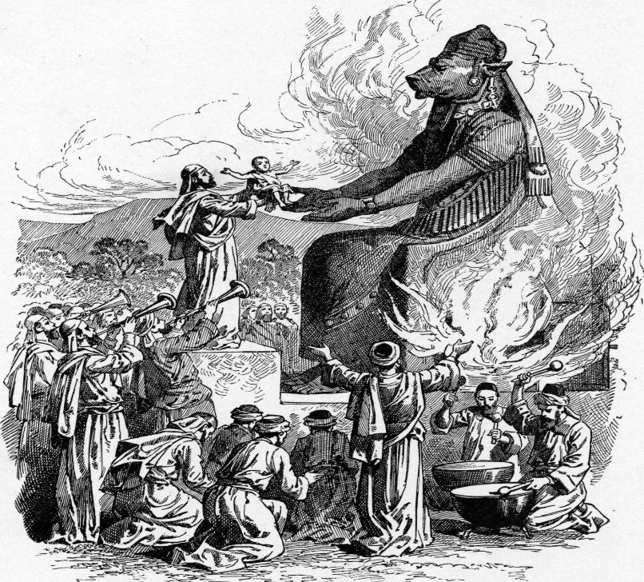
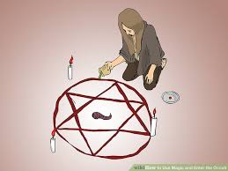
Penalties For Disobedience
Capital Offenses
Molech Worship
Involvement w/The Occult
Cursing Your Parents
Adultery
Incest
Homosexuality
Marrying a woman & her mother
Bestiality
Notes:
No nation under law has ever sufficiently kept those laws. But since the goal in mind is for Israel to be a morally pure nation, God now spends Lev 20 enumerating through the various penalties for not adhering to the laws for moral purity. It cannot be stressed enough that moral purity cannot be attained unless those in leadership positions see to it that the things taught from God are adhered to. The law will fall on deaf ears and in order to preserve the holiness of the nation, leaders must enforce the penalties. The first set of penalties are capital offenses:
Molech worship involved the burning alive of babies. This was so heinous in God’s eyes, the death penalty must be imposed on the perpetrator by the nation. If the people should disregard capital judgment against this person, God assures them He would act against the perpetrator and his family as well as any and all who are influenced by him. Those involved with the occult, such as mediums and spiritists, would likewise face this capital punishment.
Cursing of the parents demanded the death penalty. This is not the outburst of small child still learning his way, but the adult child. Deut 21:18-21 indicates that they were to be brought to the elders of the city where the men of that city would stone the child to death. This indicates that parents do not have absolute authority over the life of their child – God does. This was to keep the nation holy and the unraveling of the family order is the first step to the unraveling of society.
The exceedingly great consequences of adultery demanded a capital punishment. So did incest, homosexual acts, marrying a woman in addition to her mother, and bestiality. All partied involved in such acts were to be killed so as to keep the nation holy and separate.

Slide 11
Penalties For Disobedience
Lesser Offenses
Cut Off From
Among Your
People
Lesser Incest
Lying w/a Woman During Cycle
Lev 20:22-24 – “²²You are therefore to keep all My statutes and all My ordinances and do them, so that the land to which I am bringing you to live will not spew you out.²³Moreover, you shall not follow the customs of the nation which I will drive out before you, for they did all these things, and therefore I have abhorred them.²⁴Hence I have said to you, “You are to possess their land, and I Myself will give it to you to possess it, a land flowing with milk and honey.” I am the Lord your God, who has separated you from the peoples.”
Notes:
There were, however, lesser offenses that merely required a cutting off of the offender from the rest of the people. This cutting off may be due to the requirements of separation for being clean again or because a sin offering must be provided before fellowship could once again be granted.
These sins were “lesser” incest offense such as toward a sister, or an aunt as well as lying with a woman during her cycle. A stronger penalty was enacted toward a man who takes his brother’s wife in that he would be childless.
The reason – Lev 20:22-24 – Each of these penalties were to be enacted because God is spewing out the current tenants of Canaan’s land for these same practices. Since God is giving them the land He is spewing them out of, they are to enact these penalties in order to instill fear in the masses so that God would not have to spew them out one day.

