Slide 1
Ritual Purity
Notes:
In this lesson, we’ll focus on chapters 11 – 15 which deals with the laws of ritual purity. Since God is set apart, the Israelites also needed to be set apart when they entered into His presence. Scripture refers to this state as being “clean” or “pure”. Anyone not in a “pure” or “clean” state was off limits from approaching God. Now there were multiple ways that Israel could become impure or unclean: contact with reproductive body fluids, having a skin disease, touching mold or fungus, touching a dead body, or eating certain animals. Most of these, though not all, were associated with mortality, the loss of life, and this commonality actually gets us to the core symbol behind these laws. Israel became contaminated when they touched death and this is the opposite of God whose essence is life.
However, simply being impure was not sinful because being exposed to these things was a natural part of every day life. Impurity was a temporary state that lasted a day, a week, or two weeks, and then its over. So there was nothing wrong, in and of itself, with being unclean. What was wrong was waltzing into God’s presence while carrying these symbols of death and corruption on your body. God’s point in these laws was to remind Israel that His holiness extended to every area of their life.

Slide 2
Clean & Unclean Animals
Notes:
Chapter 11 are the instructions concerning clean and unclean animals. This distinction is not new to Leviticus; it goes all the way back to the days of Noah who was commanded to take 2 of every kind of unclean animal but to take 7 of every clean animal. This presupposes that Noah knew the difference. So the distinction already existed, but its legislated further in Leviticus. Here’s the breakdown:
Land animals: to be clean, it had to split the hoof and chew the cud. A cow has a split hoof and it chews the cud so you could eat beef. But they could not eat a camel because though it chews the cud, it has a single hoof.
Water animals: it had to have fins and scales. Salmon, tuna, flounder, would be considered clean because they have both. But catfish would be out because though it has fins, it doesn’t have scales. Lobster has neither so it was out.
Flying animals & insects: no meat eaters, which means you couldn’t eat spiders. Bats weren’t allowed. And no walking, winged insects. So that would eliminate the cockroach. Locusts were allowed, however, and you’ll remember that John the Baptist ate these while preaching in the wilderness.
All dead animals are unclean and if you touched one, you were unclean which would require you to go through a ceremony by which you could become clean again.
Animals that swarm: some versions say “creeping things”, would be animals such as snakes, moles, mice, etc. All creeping/swarming things were forbidden.

Slide 3
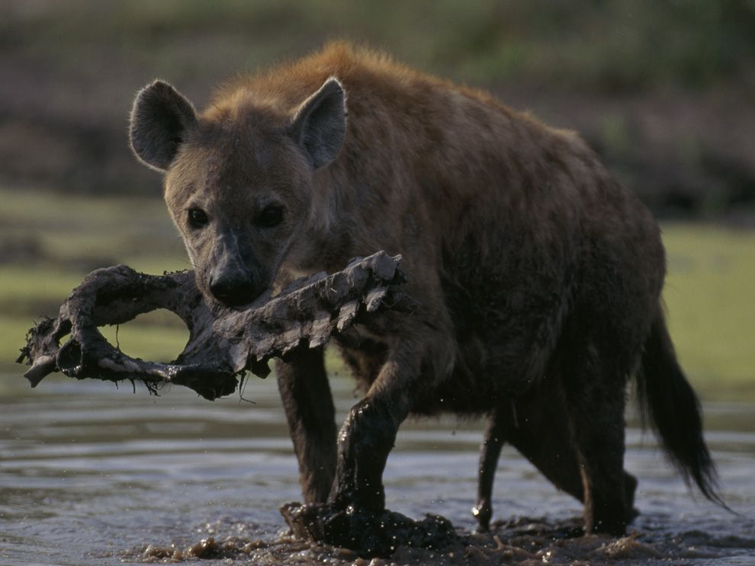
Clean & Unclean Animals
Lev 11:44-45 – “For I am the Lord your God. You shall therefore consecrate yourselves, and you shall be holy; for I am holy. Neither shall you defile yourselves with any creeping thing that creeps on the earth. For I am the Lord who brings you up out of the land of Egypt, to be your God. You shall therefore be holy, for I am holy.”
Notes:
Now, there are a variety of reasons that have been suggested for why God considered some animals clean and some unclean.
Some have suggested it was for health reasons. There have actually been books written by doctors who suggest that if you follow these kosher guidelines, it will be healthier for you and since God was greatly concerned about eliminating disease from his people, and since that made you unclean, there could be some validity to this.
Some have suggested symbolic reasons. For example, animals that eat other animals would obviously be considered unclean because it would require that animal to touch something dead.
Some have suggested it was merely to keep the Jews separate from the Canaanites because there were cultural taboos associated with certain animals that pagans ate and that God wanted to keep them as distinct as He possibly could.
And then some have suggested it merely boiled down to God’s sovereign choice. God has a right to say “do this” and “don’t do this” and He doesn’t have to have a reason. Since He is God, He is sovereign and makes the rules.
There is merit to each of these, but I would suggest that the main point is He wanted them to be different – Lev 11:44-45

Slide 4
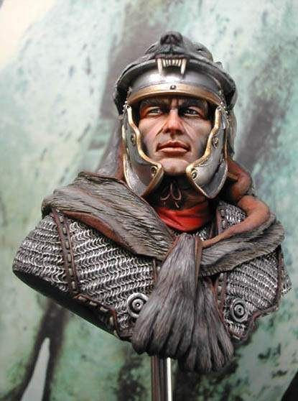
Clean & Unclean Animals
Acts 10:14-15 – “But Peter said, ‘By no means, Lord, for I have never eaten anything unholy and unclean.’ Again a voice came to him a second time, ‘What God has cleansed, no longer consider unholy.’”
Acts 10:28 – “And he said to them, ‘You yourselves know how unlawful it is for a man who is a Jew to associate with a foreigner or to visit him; and yet God has shown me that I should not call any man unholy or unclean.”
Acts 10:34 – “I most certainly understand now that God is not one to show partiality, but in every nation the man who fears Him and does what is right is welcome to Him.”
Rom 14:3 – “The one who eats is not to regard with contempt the one who does not eat, and the one who does not eat is not to judge the one who eats, for God has accepted him.”
Notes:
One thing that may help us is to consider the NT story where God removed these dietary restrictions. In Acts 10, Peter receives a vision from God in which a great sheet filled with all sorts of animals, clean and unclean, is lowered down from heaven. He is told in this vision to take, kill, and eat and Peter is opposed to this – Acts 10:14 – And here is God’s response – Acts 10:15 – What this is teaching us is that it isn’t so much about food as it is people. God had in mind for Peter to go to Cornelius’ house and baptize him and Peter eventually figures that out – Acts 10:28,34
So what conclusion might we draw from this? Remember the main point of Rom 9 – 11, that God made a sovereign choice in whom the promised seed would come from. He chose Abraham above any others, Isaac over Ishmael, Jacob over Esau, etc. Eventually the Israelites came about as a result of this sovereign choice and God separated them from other people to fulfill His promise to Abraham. But there was nothing inherently more righteous about Israel or the people they came that led to this choice. Israel was an idolatrous people from the time they left Egypt and they would continue to struggle with it until they eventually became worse than the Canaanites who had previously inhabited the land. The point is, God’s selection of Israel simply boiled down to His sovereign choice based on a promise He made.
In the same way, God has the sovereign right to choose what is to be considered clean and unclean, pure and impure. He has a right to choose who may come into His presence and who may not come into His presence. Whereas in the OT He could choose these standards, the standard He has chosen for the NT is that those who have faith in Christ may come into His presence by virtue of His shed blood – Rom 14:3

Slide 5
Leprosy
Lev 14:2-6 – “This shall be the law of the leper in the day of his cleansing. Now he shall be brought to the priest, and the priest shall go out to the outside of the camp. Thus the priest shall look, and if the infection of leprosy has been healed in the leper, then the priest shall give orders to take two live clean birds and cedar wood and a scarlet string and hyssop for the one who is to be cleansed. The priest shall also give orders to slay the one bird in an earthenware vessel over running water. As for the live bird, he shall take it together with the cedar wood and the scarlet string and the hyssop, and shall dip them and the live bird in the blood of the bird that was slain over the running water.”
Notes:
We’ll skip Lev 12 for now and deal with it when we discuss Lev 15 because there is some overlap between the two. Lev 13 deals with tests for leprosy and chapter 14 deals with the law of the leper.
Here is one man’s graphic detail of leprosy – “His hands were swollen stumps, fingerless stumps pink, sick meat marked by cracks and ulcerations from which a yellow exudation oozed through the medication. They hung on this, hooped arms like awkward sticks. And even though his kegs were covered by his hospital pajamas, they looked liked gnarled wood. Half of one foot was gone, gnawed away, and in the place of the other was nothing but an unhealable wound. His dull, cataractal eyes sat in his face as if they were the center of an eruption. The skin of his cheeks was as white-pink as an albino’s; it bulged and poured away from his eyes in waves, runnulets, as if it had been heated to the melting points…
Sounds disgusting right? That was leprosy. It involved a deadening of the nerves; there wasn’t a great deal of pain. And that was the problem. You begin to lose feeling and then when you have to scratch yourself, you end up almost scratching your arm off. Leprosy begins on the inside and works its way out. It is corrosive and cancerous which is why in Lev 13 and 14, the law not only concerned the person who was infected but also the clothes he wore and the house he lived in. It was also exceptionally contagious and ultimately fatal.
Now, biblical leprosy was somewhat different from today’s leprosy which is known as Hansen’s Disease. Today, it can be cured but in biblical days it could not. Can you remember an event in the OT in which someone was cured of leprosy? Only Naaman in 2 Kings 5 and that was through God’s grace. That being the case, how strange is the following verse – Lev 14:2-6
Given that this basically never happened, I imagine the priests sort of rolling this part of their scroll up and putting it on their shelf and basically forgetting about it.

Slide 6
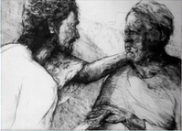
Leprosy
Mark 1:40-42 – “And a leper came to Jesus, beseeching Him and falling on his knees before Him, and saying, ‘If You are willing, You can make me clean.’ Moved with compassion, Jesus stretched out His hand and touched him, and said to him, ‘I am willing; be cleansed.’ Immediately the leprosy left him and he was cleansed.”
Mark 1:43-44 – “And He sternly warned him and immediately sent him away, and He said to him, ‘See that you say nothing to anyone; but go, show yourself to the priest and offer for your cleansing what Moses commanded, as a testimony to them.’”
Notes:
But then, when you get to the NT, it did – Mark 1:40-42 – No one touched leprosy because that’s how you contracted it. But Jesus touched it. What’s that about? Have you ever heard the Chuck Norris joke that says, “When Chuck Norris jumps in a pool, Chuck Norris doesn’t hit the water, the water hits Chuck Norris.”? When Jesus touched a leper, He didn’t get leprosy; the leper got Jesus – he was healed – Mark 1:43-44.
The main point is this. Leprosy was the most dreaded of all diseases, just like sin. But if Jesus is willing to touch a leper and heal him of this dreaded disease so that he could once again be clean and able to approach God, imagine what He is willing to do for our sin? When we are in Christ, buried with Him, clothed with Him, all that uncleanness that keeps us from approaching God is removed by virtue of who He is.

Slide 7
Blood & Discharges
Lev 12
Male Birth – 12:1-4
Female Birth – 12:5
Purification Offering – 12:6-7
Purification Offering For Poor – 12:8
Lev 15
Introduction – 15:1-2a
Abnormal Discharges (Male) – 15:2b-15
Normal Discharges (Male) – 15:16-17
Marital Intercourse (Male & Female) – 15:18
Normal Discharges (Female) – 15:19-24
Abnormal Discharges (Female) – 15:25-30
Summary – 15:31-33
Notes:
We’ll discuss Lev 12 and 15 together because both are related to the same issue, that of the unclean state resulting from the discharging of internal bodily fluids, whether blood or reproductive. Lev 12 explains the uncleanness that results from giving birth: the birth of a male child, the birth of a female child, the purification offering required, and then the one required if you were poor. There is nothing inherently sinful about a woman giving birth. But because of the internal fluids that would be released, blood or otherwise, it would put her in a state of ceremonial uncleanness for a set number of days. If she gave birth to a boy, it was 41 total days (33 days longer after the circumcision), twice the amount for a girl, 66 days. Why the difference? Some suggest the penalty was longer for girls because of the same reasons Paul gave in 1 Tim 2 for why a woman must remain silent in the assembly. Man is made in God’s image but woman is made in man’s image; woman was deceived by the serpent, not man. Others suggest that its not uncommon for a female baby to have discharges of uterine blood as a result of the hormone withdrawal at birth from her mother’s pregnant state. If this is the case, it could explain why the longer period. We’re not told in the text, so we’re left to nothing but speculation. Regardless of the baby’s gender, a purification offering was required, a one year old lamb for a burnt offering and a young pigeon or turtle dove for a sin offering. If the family was poor, they could replace the lamb with another pigeon or turtle dove.
The interesting thing about this law is that it is the only time the burnt offering came before the sin offering. What could this suggest? It may be a reminder that child bearing is not a sin, but a declaration of devotion of this child to God. We are, after all, stewards of the children God gives us and responsible for bringing them up in the nurture and admonition of the Lord. However, even as we devote them to the Lord, we must acknowledge that we are still bringing a human being into the world that will one day sin (Rom 3:23) and it may be that God demands we accept an ounce of responsibility for that. Or it could be that her time shut in kept her from the normal devotion and worship to God that would be standard for that time and that atonement would need to be made. We’re simply not told.
Lev 15 deals with normal and abnormal discharges as well as that which would occur in marital relations. There are normal male seminal discharges and normal female menstrual discharges that occur. But the abnormal ones required a sin offering followed by a burnt offering. But all discharges, normal or abnormal, put them in a state of uncleanness that lasted for a period of time (7 days, until evening, 7 days, or counting off 7 days after the end of the flow). Anything that touched this person in their uncleanness such as clothes, the bed, the place they sit, a person who touches them, a saddle you may ride, a vessel you touch, or even a person who was spit on by an unclean person….all those become unclean as well by virtue of coming in contact with the person who initiated the uncleanness. Those things must be washed and rinsed in water.

Slide 8
Blood & Discharges
Reasons?
Symbolic
Distinct between sex and worship
Consequence of woman’s sin
Fallen world demands quarantine from spread of disease
Ex 15:26 – “And He said, ‘If you will give earnest heed to the voice of the Lord your God, and do what is right in His sight, and give ear to His commandments, and keep all His statutes, I will put none of the diseases on you which I have put on the Egyptians; for I, the Lord, am your healer.’”
Notes:
If bodily discharges are a normal part of life, what about them would make a person unclean? Several theories have been suggested:
1) One suggestion is symbolic, that blood represents life and reproductive fluid represents seed and so they’re precious in God’s sight to such a degree that the flow of either one would demand an atonement of some kind.
2) Another suggestion is that God is making an obvious separation between sex and the worship of God. To the modern world this seems unusual, but in the ancient world it was commonplace to worship idols by having ritual fornication with temple prostitutes. Its possible God did not want this association in worship toward Him.
3) Another suggestion is that Lev 12 is meant as a consequent of the pain multiplied in child birth as a result of woman’s sin and that in giving birth, it is a reminder of the curse given to woman.
4) The likely reason is this: we live in a fallen world. While discharges are natural, so is disease. What is known to be an easy carrier of disease? Blood and reproductive emissions. Its probable that these laws were designed to keep the spread of disease at bay, much like the laws pertaining to leprosy, so that the people would be distinct in their pureness and holiness. Canaanite culture wasn’t simply corrupt and murderous; they were perverted as a result of devious, sexual practices. Archeologists who have studied the skeletal remains have seen signs of all matter of STDs that they carried a result of these practices and they passed these diseases on to their children. Its very probable God was simply quarantining them to prevent them from the same end – Ex 15:26
Illustration – Bubonic Plague, dying mothers, etc.

Slide 9
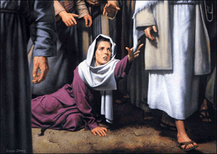
Blood & Discharges
Mark 5:24-27 – “And He went off with him; and a large crowd was following Him and pressing in on Him. A woman who had had a hemorrhage for twelve years, and had endured much at the hands of many physicians, and had spent all that she had and was not helped at all, but rather had grown worse—after hearing about Jesus, she came up in the crowd behind Him and touched His cloak.
Mark 5:28-29 – “For she thought, ‘If I just touch His garments, I will get well.’ Immediately the flow of her blood was dried up; and she felt in her body that she was healed of her affliction.”
Mark 5:30-34 – “Immediately Jesus, perceiving in Himself that the power proceeding from Him had gone forth, turned around in the crowd and said, ‘Who touched My garments?’ And His disciples said to Him, ‘You see the crowd pressing in on You, and You say, “Who touched Me?”’ And He looked around to see the woman who had done this. But the woman fearing and trembling, aware of what had happened to her, came and fell down before Him and told Him the whole truth. And He said to her, ‘Daughter, your faith has made you well; go in peace and be healed of your affliction.’”
Notes:
However when we get to the NT, we read an interesting story – Mark 5:24-27 – It was not uncommon for Jesus to attract a lot of attention, but it could be a deterrent for someone who wants to get close to Him in order to be healed. Here, we’re introduced to a woman who has been hemorrhaging blood for 12 years, so she would fit in the mold of an abnormal female discharge that is discussed in Lev 15:25-30. She should have been at home, quarantined so as not to make others unclean or spread disease. But she was desperate. She had spent all she had trying to get cured and it was only getting worse. So when she heard Jesus was near, she leaves her home and pushes her way through the crowd. And think about all the other people she would be making unclean, doing so to every single person she touched. But then she reaches Jesus and very covertly touches Him. So not only is she ceremonially unclean, she’s making others ceremonially unclean and making Jesus ceremonially unclean. So why’d she do it? Mark 5:28 – And then what happened? Mark 5:29 – Again, she didn’t make Jesus unclean. He made her clean.
But Jesus knows what happened – Mark 5:30-34 – Jesus heals uncleanness when it is accompanied with faith. What was her faith?
There was a crowd so it took a lot for her to get to Jesus just so she could touch Him
She had to get to Jesus in a very weakened condition
She needed to go unnoticed because she was both a woman as well as unclean…but it wouldn’t last (vs. 47)
She had to admit it was she who did so, something that might have brought her scorn or embarrassment
Why press the issue of who touched Him?
He would not allow her to have a second-class healing. If she truly thought she was unworthy enough to approach Him secretly, He would not allow her thinking to stand
Everyone with faith belong at the feet of Jesus, and He did not want her to misunderstand what was the real reason for her healing
He did not want her feeling guilty for having been healed. It was grace
He did not want her faith to remain anonymous. All must confess with their mouth that Jesus is Lord because faith is not intended to be a private matter (i.e. “my faith is a very personal thing”). That won’t cut it

