Slide 1
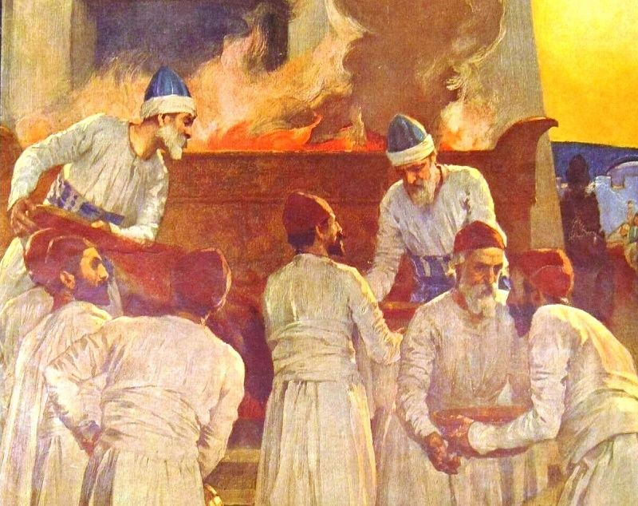
Priesthood:
Consecration &
Qualification
Notes:
The priesthood was an essential part of the sacrificial system. It wasn’t just the sacrifices that made the way for atonement because the sanctification process involved more than just the sinner. The priests filled the role of teacher and mediator. They were teachers in that they were responsible for knowing the Levitical law so thoroughly as to ensure the proper procedures were followed. And they were mediators in that they prepared the way by which repentance could be granted and man could become acceptable to God. And since the priest served in this role, he was required to be consecrated in a special way, holy before the Lord, to know the difference between that which was holy and profane, and to abide by stricter guidelines them the ordinary Israelite so that they could protect themselves and also to teach the people.
This class will focus on how they were originally consecrated to perform this task, additional qualifications they had to meet to serve in this role, and then we’ll look at an unfortunate story demonstrating an event that occurred to two of the priests who did not abide by these guidelines.

Slide 2
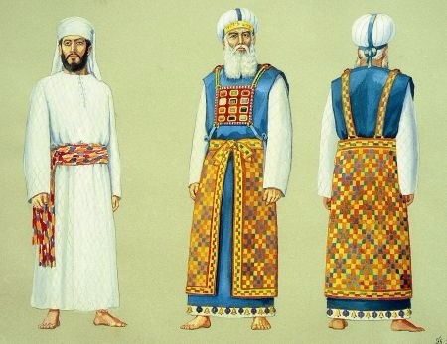
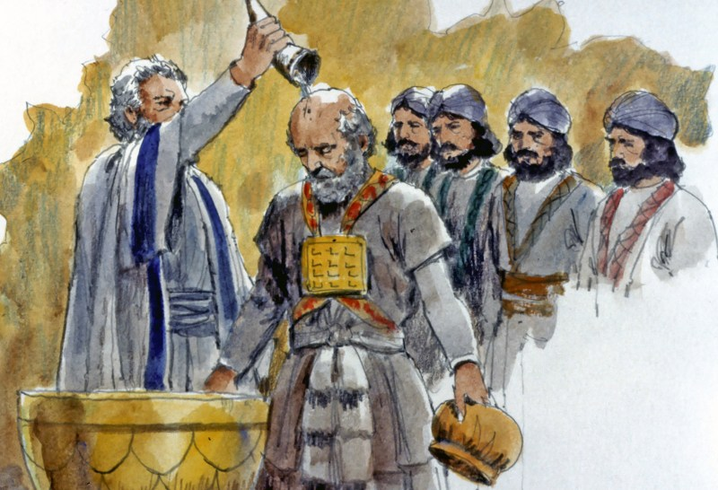
Consecration
Lev 8:1-5 – Command is given
1 Pet 2:9 – “But you are a chosen race, a royal priesthood, a holy nation, a people for God’s own possession, so that you may proclaim the excellencies of Him who has called you out of darkness into His marvelous light”
Lev 8:6-9 – Priests are washed and clothed
Tit 3:5 – “He saved us, not on the basis of deeds which we have done in righteousness, but according to His mercy, by the washing of regeneration and renewing by the Holy Spirit”
Ex 28:2 – “You shall make holy garments for Aaron your brother, for glory and for beauty.”
Gal 3:27 – “For all of you who were baptized into Christ have clothed yourselves with Christ”
Lev 8:10-13 – High Priest is anointed
Acts 10:38 – “You know of Jesus of Nazareth, how God anointed Him with the Holy Spirit and with power”
Notes:
Verses 1-5: The command is given – This is the process of setting the priests apart for the work of the tabernacle. All the congregation was gathered to witness this event and so it was not done in secret. After this consecration, every Israelite would know who was ordained to serve as priests before the congregation. Remember, we Christians serve this role now – 1 Pet 2:9 – Since we are a holy priesthood, God has likewise set us apart. Verdes 6 - 9: The priests are washed and clothed. Remember, the congregation was gathered to witness this. How much of this washing they were able to see, we don’t know, but it was likely still a very humbling experience. As Christians, we are likewise washed are we not? Washing in baptism – Tit 3:5. The garments were to show the glory and beauty of the priesthood – Ex 28:2. And like these ancient priests, every believer is clothed in Jesus Christ and in his righteousness – Gal 3:27. These are clothes that are given freely by Jesus but received and “worn” by faith. Verses 10 - 13: The High Priest is anointed. Interestingly, the articles of the tabernacle were only sprinkled; but upon the heads of the priests it was poured. If something is consecrated, it is set apart for God’s service from that day forward. Once sprinkled with oil, the tabernacle was no longer just a tent; the altar was no longer just a fire-pit; and Aaron was no longer just a man. Jesus, our high priest, was likewise anointed – Acts 10:38

Slide 3
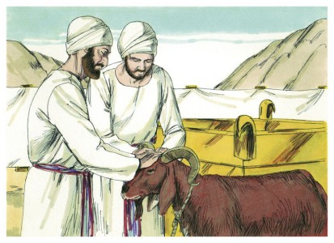
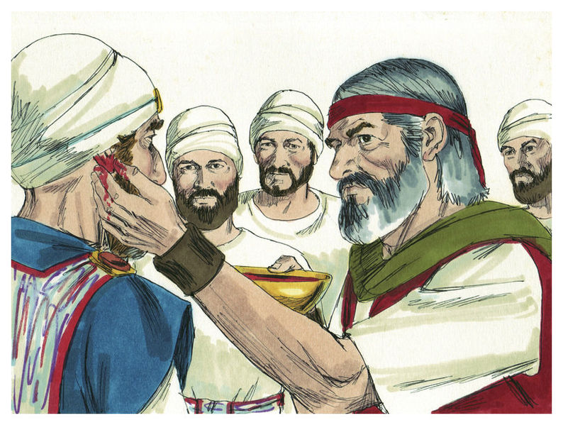
Consecration
Lev 8:14-17 – The sin offering: a bull
Lev 4:10-11 – “¹¹But the hide of the bull and all its flesh with its head and its legs and its entrails and its refuse, ¹²that is, all the rest of the bull, he is to bring out to a clean place outside the camp where the ashes are poured out, and burn it on wood with fire; where the ashes are poured out it shall be burned.”
Lev 8:18-21 – The burnt offering: a ram
Lev 1:13c – “it is a burnt offering, an offering by fire of a soothing aroma to the Lord”
Lev 8:22-29 – The ordination offering, a 2nd ram
Heb 9:22b – “all things are cleansed with blood”
Notes:
Verses 14 - 17: The sin offering, a bull. Remember, the sin offering always came first. Since the high priesthood was not yet set up, Moses officiated over this one. When a sin offering was for the priest, no part of it was eaten. The blood was then applied to all the appropriate places by Moses for cleansing. This was to cover the sins of the priests that their sin might be removed when they minister before God. Verses 18 - 21: Then a burnt offering, a ram. This follows the proper order. Now that their sin has been atoned for, they are fully devoting themselves to God, promising to love God with all their heart, mind, soul, and strength. This complete act of dedication was a soothing aroma to the Lord. Verses 22 - 27: The ordination offering, a second ram. Since their duties went beyond simple atonement and dedication and extended to a special service of consecration, we have a special offering called the ordination offering, though it was treated like the peace offering. However, the consecrated priests were to be stained with the blood of sacrifice. The blood was applied to their right ear lobe, their right thumbs, and their right big toes, probably meaning that they were to dedicate all their faculties and powers to the service of God. In other words, they are consecrated to more readily hear the divine word of God. They are consecrated to perform with the hand the sacred duties. They are consecrated to walk the way of holiness. The right side was considered superior, with more strength and skill because most people were right-handed. God wanted their best to be dedicated to Him. Cakes from the basket were offered on top of the fat of the consecration offering. Aaron’s portion were then waved before the Lord then burned. Moses’ portion, the breast, was waved and he kept it.

Slide 4
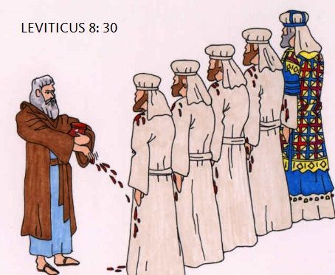
Consecration
Lev 8:30 – Blood & oil sprinkled on priest
1 Pet 1:2 – “according to the foreknowledge of God the Father, by the sanctifying work of the Spirit, to obey Jesus Christ and be sprinkled with His blood: May grace and peace be yours in the fullest measure.”
Lev 8:31-32 – Meal
John 6:51 – “I am the living bread that came down out of heaven; if anyone eats of this bread, he will live forever; and the bread also which I will give for the life of the world is My flesh.”
Lev 8:33-36 – Seven days of consecration
Psa 84:1-2 – “¹How lovely are Your dwelling places, O Lord of hosts! ²My soul longed and even yearned for the courts of the Lord; my heart and my flesh sing for joy to the living God.”
Notes:
Verse 30: Blood and oil sprinkled on priests’ garments. The blood came from the altar and was mixed w/anointing oil and then sprinkled on his garments. This may have been done in order to serve as a long reminder of their consecration. But interesting, Peter talks about Christians of that era sanctified by the work of the Spirit and sprinkled w/Jesus’ blood – 1 Pet 1:2
Verse 31 - 32: Meal. The remaining meat portions of the ram of the ordination offering were given to Aaron and the other priests, after those portions were presented to God as a wave offering. It was then cooked and eaten by the priests during the days of their consecration ceremony. The eating speaks of the continuing relationship of the priest with God, as the peace offering also symbolized. Remember, Jesus mentioned “consuming” Him in order to have everlasting life, and He is speaking in types, likely pointing back to the consumption of the sacrifices as involved here. Verse 33 - 36: Seven Days of Consecration. Verse 35 indicates that on each of the next seven days Moses was to offer the same sacrifices on behalf of Aaron and his sons (Ex 29:35-36). In others words, the consecration ceremony wasn’t quick and easy. It took time, reflection, and a constant awareness of sacrifice and atonement. If approached with the right heart, their consecration demonstrates the heart of the Psalmist in Psa 84:1-2 – For Christians, it takes time and training after our “consecration” to be ready for the work.

Slide 5
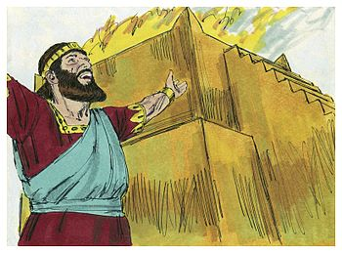
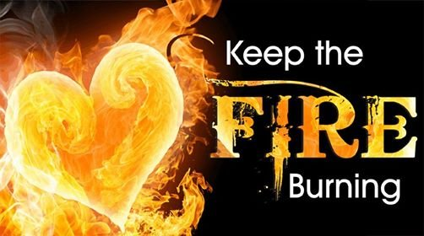
Consecration
Lev 9:1-2 – Priests offer another sacrifice
Heb 11:11 – “Every priest stands daily ministering and offering time after time the same sacrifices, which can never take away sins”
Lev 9:3-21 – Preparation for the Lord’s appearance
Hab 1:13a – “Your eyes are too pure to approve evil, and You can not look on wickedness with favor.”
Isa 59:2 – “But your iniquities have made a separation between you and your God, and your sins have hidden His face from you so that He does not hear.”
Lev 9:22-24 – God displays His glory
Lev 6:13 – “Fire shall be kept burning continually on the altar; it is not to go out.”
Notes:
Verse 1 - 2: Aaron and his sons summoned after 7 day consecration to offer another sacrifice. This was not a quick and easy process. But during this seven day consecration, it is likely they had sinned. This was a public offering for himself before the people, which would identify him with the people, declaring “I am a sinner and am in need of atonement too.” And it also means the consecration ceremony wasn’t perfect and as useful as animal sacrifices were, they could not put an end to sin. Only Jesus’ sacrifice could do so. Even their dedication, by means of burnt offering, had apparently expired and needed to be offered again – Heb 11:11
Verse 3 – 21: Preparation For The Lord’s Appearance. After atoning for His own sin, Aaron is to offer a sin offering, burnt offering, grain offering, and peace offering on behalf of the people, all according to the rules we have discussed in prior lessons. This is to prepare them for the Lord’s appearance. The glory of the Lord is going to appear to the people and a holy God cannot be around sin – Hab 1:13; Isa 59:2
Verse 22 – 24: God displays His glory. Once the sacrifices are complete, Aaron blesses the people, then Moses blessed the people, and then fire came from heaven and consumed the offerings, causing the people to fall on their faces. This is God’s proof that He was with Aaron, the people, and this entire system through this visible display of His glory. According to Lev 6:13, it was to never go out. And so the fact that it began with God would have been an additional reminder to Israel of God’s atoning power and that as long as this fire burned, the covenant would continue and atonement would be available for the people. God, though He is a consuming fire, is making the path for their redemption perpetually available.

Slide 6
Qualifications
Lev 21:1-5 – Forbidden from touching dead bodies
Lev 21:6-9 – Marriage practices
Lev 21:10-15 – High Priest responsibilities
Lev 21:16-24 – Free from defect
Notes:
Now, because of the priests special responsibility to represent God before the people, they had a special call to holiness that was above and beyond the common Israelite. The following is a summary:
Verse 1 – 5: Priests were forbidden from touching dead bodies. Death is associated with corruption and holiness and corruption are incompatible. The only exception allowed by God was for the priest’s immediate family. The prohibitions in verse 5 may be because these were the mourning habits of the pagan nations and God wanted them to separate from that. The issue wasn’t that it was inherently sinful in and of itself to do what they did, but it would identify them with those pagans. God wants his priests to remain a radically separate people.
Verse 6 - 9: Priests marriage practices. Priests were only allowed to take virgin wives. A priest was only to set their affections on that which is pure. So pure is the priesthood that if a daughter of the priest profaned herself, it would the same as profaning her father by virtue of the relationship. Everything associated with a holy person shares in that holiness and vice versa – Acts 5:14-15
Verse 10 – 15: Responsibilities of High Priest. These were even more radical than that of an ordinary priest. Outward signs of mourning or defiling oneself even for your dead father or dead mother was forbidden for the high priest. In selecting a wife, no widow, divorced woman, defiled woman, or harlot was allowed – only a virgin of his own people. It was important that even his offspring from his marriage be pure.
Verse 16 – 24: Priests must be free from defect. Nothing sinful about carrying a defect in this fallen world. But since the priesthood demanded the utmost standards of purity and holiness, no one who had a defect could serve as a priest. They could eat of the sacred food, however. Barring one from the priesthood was not barring him from being in fellowship with God, only from this special role.
Point: not everything we should stay away from is sinful in and of itself. Sometimes the things we should stay away from give off the wrong impression or wrong connotation. Sometimes its things the world does that, though not sinful in and of itself, may come across that way – 1 Thes 5:22. Sometimes a past sin may prevent us from serving in a specific role in his church, i.e. preacher who committed adultery though he repented, elders, etc. This has nothing to do with condemning the person or removing his fellowship from God or the church or being useful in his service to God. It only means certain roles may not be conducive for my present or past situation – 2 Cor 6:17

Slide 7
Qualifications
Lev 22:1-3 – Need for ceremonial purity
Lev 22:4:9 – Things that defile priests
Lev 22:10-16 – Those who can eat the offerings
Lev 22:17-30 – Unacceptable sacrifices
Lev 22:31-33 – Summary
Notes:
Verse 1 – 3: Need for ceremonial purity. The holy things were consecrated and the tabernacle housed God’s presence. Therefore no one who was not properly consecrated could draw near or touch these things. These things represented heavenly realities and though God doesn’t really dwell in tents made with hands, His presence was there all the same and they needed to bear a ceremonial cleanness and purity indicative of holiness and separation from the world that made they themselves heavenly.
Verse 4 – 9: Things that defile the priests. Any of these things would make one unclean: leprosy, discharges, touching dead things, reproductive fluid emissions, etc. This would not disqualify the man from being a priest, it simply would make him ceremonially unclean until evening. Once ceremonially clean again, they could perform their duties. Sundown was significant because this is when the Jews started their new day. Lam 3:22-23 – “The Lord’s loving kindnesses indeed never cease, for His compassions never fail. They are new every morning; great is Your faithfulness.” In other words, no matter how we may have failed the Lord, we can begin each new day clean and ready to approach the Lord.
Verse 10 – 16: Those who can eat the offerings. Anyone who was a permanent part of the priests’ household could eat of the holy food that was the priests portion: grain offerings, sin offerings, peace offerings, etc. Since the priest was sanctified, anyone that was a part of his household was sanctified. Unintentionally eat of the holy things meant you had to restore it plus 20%.
Verse 17 – 30: Unacceptable sacrifices. God reminds Israel that certain blemishes and defects in their sacrifices were unacceptable. He specifically says in verse 25 “for their corruption is in them, they have a defect”. In other words, it wasn’t just that they had to bring God their best, but defects such as this was a symbol of corruption of the fallen world in which we live. God is holy and anything offered to him cannot have visible evidence of this corruption.
Verse 31 – 33: Summary. The reason for all of this can be summarized in the last three verses of the chapter. This is God that we’re talking about. He is holy and is to be honored, especially because of what He is doing in providing Israel with a means to sanctification. He did not have to do this, but He is doing it. He deserves the utmost honor and respect.

Slide 8
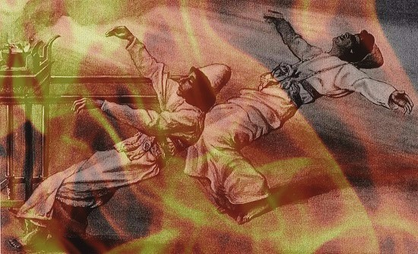
Consequences
Lev 10:1-3 – “¹Now Nadab and Abihu, the sons of Aaron, took their respective firepans, and after putting fire in them, placed incense on it and offered strange fire before the Lord, which He had not commanded them. ²And fire came out from the presence of the Lord and consumed them, and they died before the Lord.”
Notes:
Now, Lev 10 gives a graphic example of why this consecration and qualifications were so important – Lev 10:1-3 – One of the things that makes this so shocking is what Nadab and Abihu had experienced so far. They saw all the miracles God performed to bring them out of Egypt. They were there at Mt. Sinai when God appeared and spoke the 10 commandments. In fact, they were with Moses, Aaron, and the seventy elders who went up Mt. Sinai to see God, and they ate and drank together in His presence. They saw God shoot fire from heaven to light the offerings in the previous chapter. Yet the legacies of these great spiritual experiences weren’t enough to keep them right with God. Only a relationship grounded in truth can do that.
The issue was they offered incense lit with strange fire before the Lord, which I interpret to be that they lit the incense with fire that did not come from the brazen altar. It is possible the phrase “before the Lord” indicates they also went into the most holy place, and the beginning of chapter 16 as the instructions for the Day of Atonement are given seem to infer that. The fact God killed them on the spot shows not only how serious God is regarding His commands, but how dangerous it is to profane that which is holy. One cannot come into God’s presence without meeting His standards of holiness. Its not enough to limit God’s character to His goodness and His love. He is holy, He is a consuming fire, and His will must be respected. Only God should be glorified in His meeting with man. It’s not about us, our cleverness, our insight, or our ingenuity. Those who fail to glorify God in their meeting with Him will not be rewarded.

Slide 9
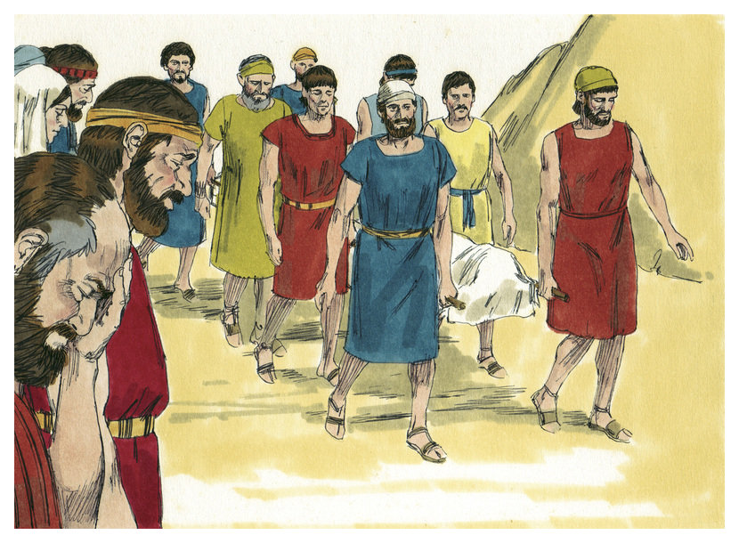
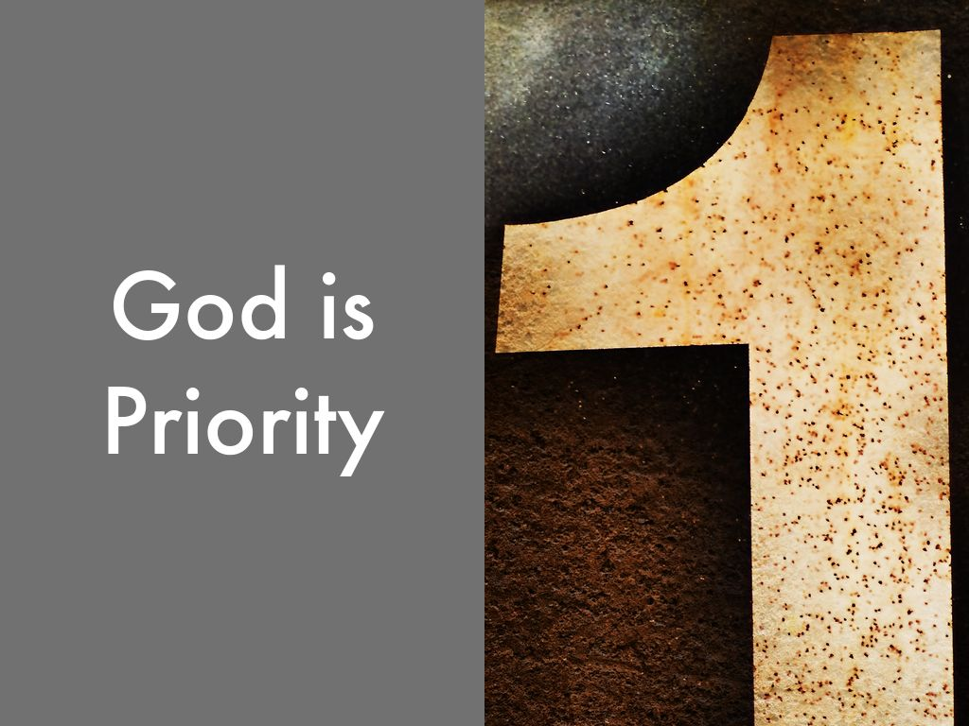
No Mourning
Lev 10:3-7 – “³Then Moses said to Aaron, ‘It is what the Lord spoke, saying, “By those who come near Me I will be treated as holy, and before all the people I will be honored.”’ So Aaron, therefore, kept silent. ⁴Moses called also to Mishael and Elzaphan, the sons of Aaron’s uncle Uzziel, and said to them, ‘Come forward, carry your relatives away from the front of the sanctuary to the outside of the camp.’ ⁵So they came forward and carried them still in their tunics to the outside of the camp, as Moses had said. ⁶ Then Moses said to Aaron and to his sons Eleazar and Ithamar, ‘Do not uncover your heads nor tear your clothes, so that you will not die and that He will not become wrathful against all the congregation. But your kinsmen, the whole house of Israel, shall bewail the burning which the Lord has brought about. ⁷ You shall not even go out from the doorway of the tent of meeting, or you will die; for the Lord’s anointing oil is upon you.’ So they did according to the word of Moses.”
Notes:
What Nadab and Abihu did was such a dishonor to God’s holiness, for Aaron and his sons to even mourn over their deaths would have been a dishonor to God’s holy judgment upon them. It did not matter that Aaron was their father or that Eleazar and Ithamar were their brothers. They were priests and lived by a holier standard than those who were not. Therefore, no outward signs of mourning could be shone as they might have implied, even in the slightest way, that God was wrong in His judgment and priests could not communicate this about God. They were held to a higher standard of accountability because the “anointing oil is upon you”.
Sometimes church discipline must be applied to a member of the church and those who are related or close to the individual cry foul. They resent the discipline, scoff at the leadership, and refuse to follow through on the withdrawal. We need to remember that we priests. Our obligation is to follow God’s law usurps family loyalty. When our mourning over those who sin usurp the damage done to God and His cause, what will become of us?
Two relatives were allowed to remove the bodies from the sanctuary. No consecrated priest could touch a dead body, so the work of the removal and burial must be done by these relatives instead.

Slide 10
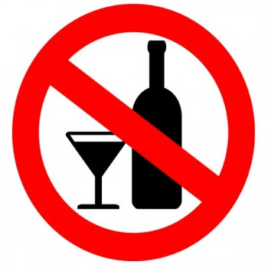
Wine Prohibited
Lev 10:8-11 – “⁸The Lord then spoke to Aaron, saying, ‘⁹Do not drink wine or strong drink, neither you nor your sons with you, when you come into the tent of meeting, so that you will not die—it is a perpetual statute throughout your generations— ¹⁰and so as to make a distinction between the holy and the profane, and between the unclean and the clean, ¹¹and so as to teach the sons of Israel all the statutes which the Lord has spoken to them through Moses.”
Notes:
The fact that this prohibition of wine came right after this event is probably not a coincidence. It is very likely, even if not inconclusive, that they were inebriated and this is what led them to do what they did. Alcohol is a depressant that clouds the mind and heart from being fully devoted to God and it takes away the ability of a person to completely give himself to God. Notice the three applications from God:
To make a distinction between the holy and profane. Given the delicate nature of God and His holiness, and the rigorous rules that had to be remembered, God knew that imbibing a substance that robs the faculties would endanger the priest’s life. And it is a life and death issue – “so that you will not die.”
To make a distinction between the clean and unclean. Being unclean was not a sin in and of itself but approaching God while in this state was. And just as the rules for sanctification and holiness were vast, so were the rules regarding cleanliness. All the unclean things were typically associated with mortality and the loss of life. The idea is that death contaminates one from being holy preventing them from being able to come in God’s presence.
To teach the sons of Israel. This was a verbal teaching and a teaching by way of influence. The Israelites needed to be able to look up to the priests and to respect them because they brought God’s law. Partaking of a substance that ruined this influence would impede their ability to instill sober mindedness amongst the Israelites.
I regards to our own NT priesthood….should we not abstain for the same reasons?

Slide 11
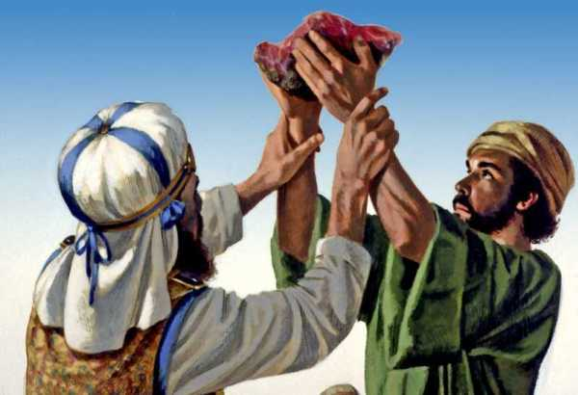
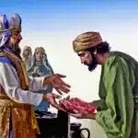
Aftermath
Lev 10:16-20 – “¹⁶But Moses searched carefully for the goat of the sin offering, and behold, it had been burned up! So he was angry with Aaron’s surviving sons Eleazar and Ithamar, saying, ‘¹⁷Why did you not eat the sin offering at the holy place? For it is most holy, and He gave it to you to bear away the guilt of the congregation, to make atonement for them before the Lord. ¹⁸Behold, since its blood had not been brought inside, into the sanctuary, you should certainly have eaten it in the sanctuary, just as I commanded.’ ¹⁹But Aaron spoke to Moses, ‘Behold, this very day they presented their sin offering and their burnt offering before the Lord. When things like these happened to me, if I had eaten a sin offering today, would it have been good in the sight of the Lord?’ ²⁰When Moses heard that, it seemed good in his sight.”
Notes:
The chapter concludes with Moses reminding Aaron regarding the priests’ portion, the grain offering, the breast of the wave offering and the thigh of the heave offering, etc. Moses is upset because the priests had burned the portion of the sin offering that was there’s to eat. However, Aaron defends his decision by claiming the circumstances of the day prevented them from doing so. But it has to be remembered that while the portions of the sin offering was theirs to eat, anything left over by a certain number of days was to be burned. The priests’ refusal to eat it could be for a couple reasons.
Aaron might have believed that though no outward signs of mourning could be applied, fasting before the Lord was a right that he believed superseded the eating of the offering.
Since the eating of the sin offering was an expression of “bearing away the guilt of the congregation”. Aaron may have understood that it was inappropriate to do so since the sin offering had been remembered void by the actions of Nadab and Abihu. In other words he may have seen it as a moot point.
Whatever the reason, Moses apparently saw wisdom in Aaron’s explanation and was satisfied, having not understood the reasoning at first.

