Slide 1
Outline
Chap
1-7
Chap
8-10
Chap
11-15
Chap
16
Chap
17-20
Chap
20-22
Chap
23-25
Day of
Atonement
Ritual
Purity
Moral
Ordained
Priesthood
Qualifications
Sacrifices
Rituals
Feasts
Chap 26-27: Consequences of Obedience & Disobedience
Notes:
You’ll recall this outline from last week which will be the framework for out studies. We’re going to focus on the ritual sacrifices for 3 classes.

Slide 2
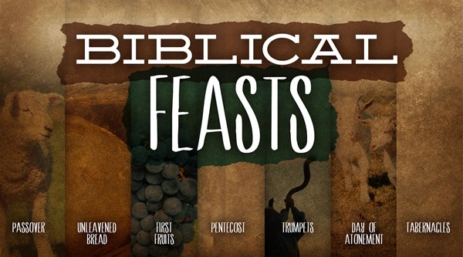
Notes:
In addition to the ritual sacrifices, Israel was required to observe certain religious days/feasts. Each of these events retold a different part of Israel’s story: how God redeemed them from captivity, how He brought them safely through the wilderness, how He then brought them into the promised land. So by celebrating these feasts regularly, Israel would remember who they were, who God is, and what God had done for them.
There were seven ritual feasts: Passover, Unleavened Bread, First Fruits, Weeks/Pentecost, Trumpets, Day of Atonement, and Tabernacles. In addition to these, we’ll discuss the Sabbath Year as well as the Year of Jubilee, time permitting. As we observe these feasts, not only will we see the significance of them for Israel, but also how each one pointed to a greater spiritual truth realized in the latter days of the OT dispensation, as Col 2:18 affirms, they are a “shadow of things to come”. There are some other incidentals discussed in these chapters, but for time’s sake, we’ll stick to the feasts and special days primarily found in chapters 23 and 25.
The feasts are divided up into two groups: the four spring feasts followed by a large gap of time then the 3 fall feasts.

Slide 3
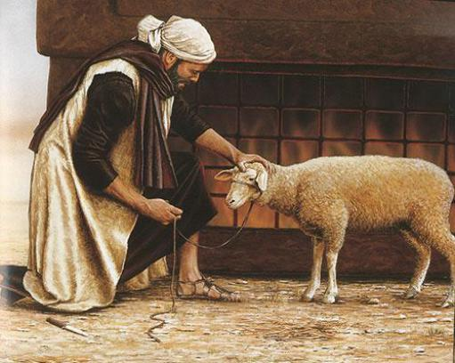
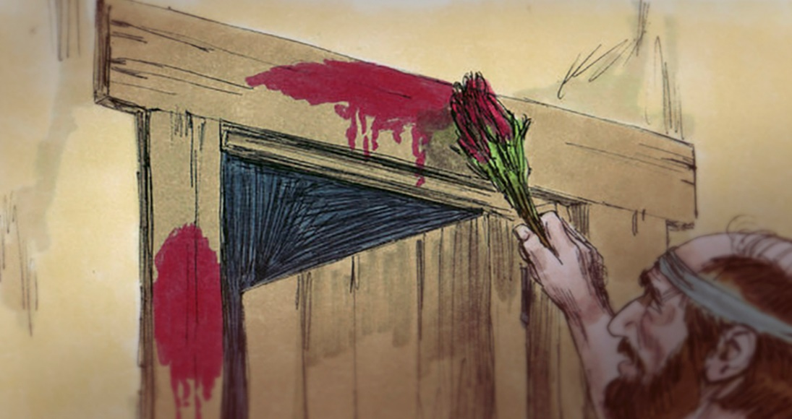
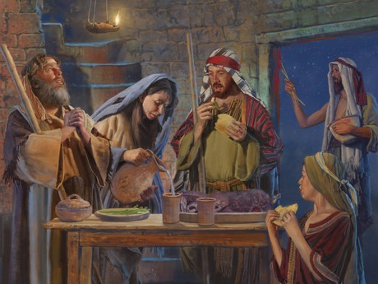
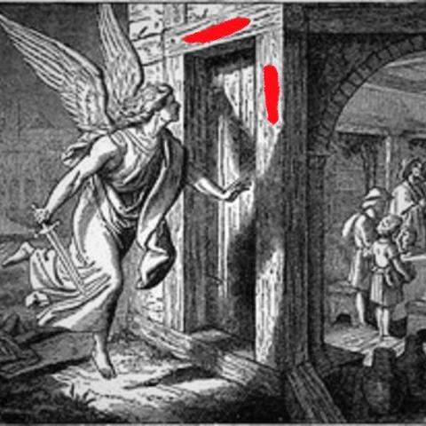
Passover
Lev 23:5 – “In the first month, on the fourteenth day of the month at twilight is the Lord’s Passover.”
Notes:
Passover was the first feast celebrated in the Jewish religious calendar. On the 10th day of the first month, each family would select a lamb to be separated from rest of their flock. It would be kept until the 14th day of the month. On that day, at twilight, it would be slain. It was to then be roasted with fire and eaten with unleavened bread, representing the haste in which they were to partake, and bitter herbs, perhaps representing the bitterness of their prior slavery and suffering. This commemorated the exodus of Egypt in which the Israelites were required to take the blood of the lamb and place it on the two doorposts and lintel of the house so that when God sent the angel of the destruction in the 10th plague to kill the firstborn sons of Egypt, he would pass over the Israelite houses when he saw the blood. The Israelites were commanded to eat the meal in haste, with their loins girded, sandals on their feet, and staff in hand. This would be the final plague that would finally convince Pharaoh to let His people go. This was one of the most celebrated feasts in all of Israel because it marked a triumphant occasion of Israel’s rescue from bondage. By taking of this feast, the Israelites would remember where they came from, where they are, and the One who got them there.

Slide 4
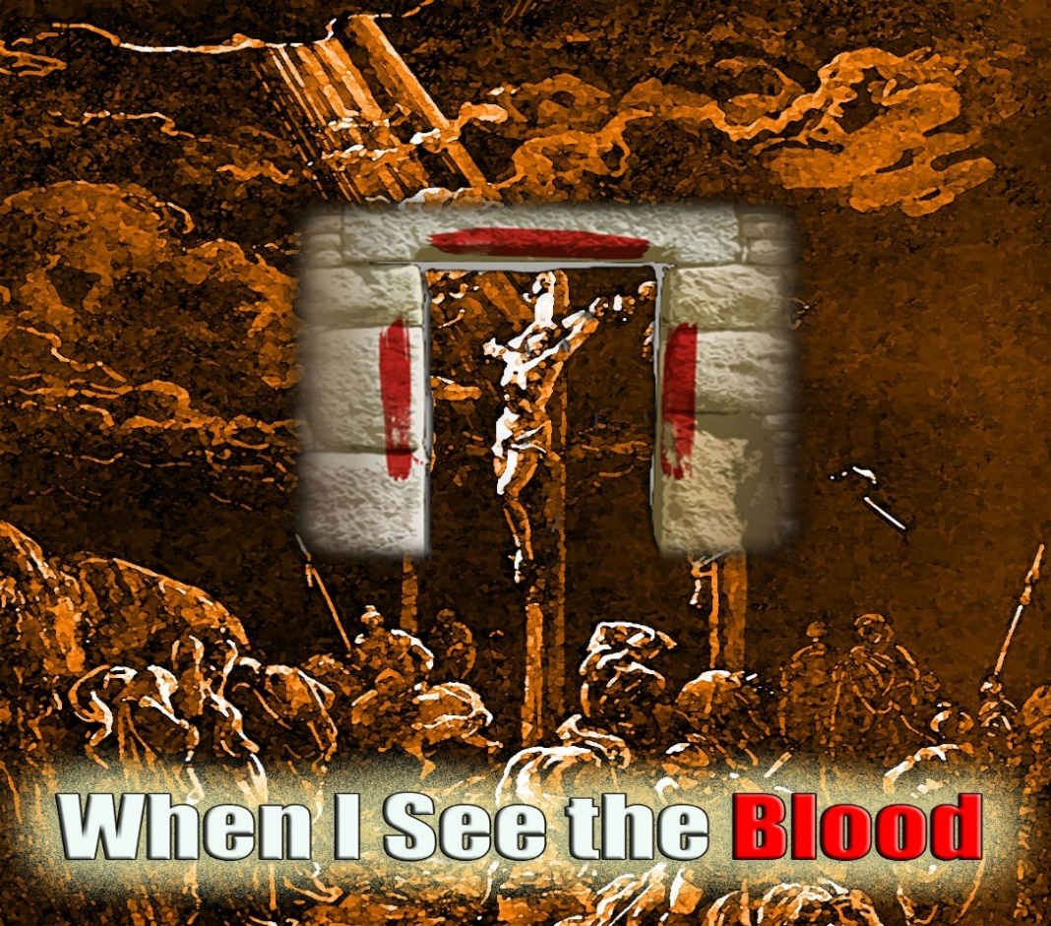
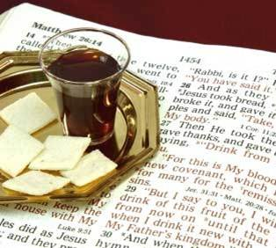
Passover
1 Cor 5:7 – “Clean out the old leaven so that you may be a new lump, just as you are in fact unleavened. For Christ our Passover also has been sacrificed.”
Luke 22:14-16 – “¹⁴When the hour had come, He reclined at the table, and the apostles with Him. ¹⁵And He said to them, ‘I have earnestly desired to eat this Passover with you before I suffer; ¹⁶for I say to you, I shall never again eat it until it is fulfilled in the kingdom of God.’”
Notes:
Now NT is very clear on the spiritual significance that Passover has for Christians – 1 Cor 5:7 – When we are saved by the blood of Christ, we are washed in the blood of the lamb so that when judgment day comes, God passes over us. The unleavened bread represents the haste in which we should come to Christ not know whether today could be our last on this earth. The bitter herbs represent the bitterness of sin and that while we rejoice over his sacrifice, we recognize that it was wholly our fault that He was killed. And truly no celebrated event in the history of man is as “bittersweet” as that of the cross.
Jesus understood the implications of this feast when He partook of the last Passover with His disciples and instituted a new feast – Luke 22:14-16 – This would be the last legitimate Passover Feast ever celebrated because when Jesus died, He fulfilled what the Passover pointed to: the redemption of God’s people unto Him.

Slide 5
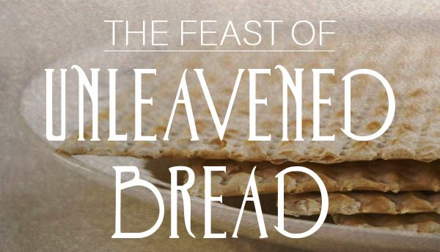
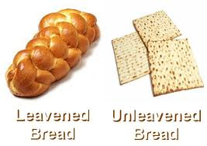
Unleavened Bread
Lev 23:6-8 – “⁶Then on the fifteenth day of the same month there is the Feast of Unleavened Bread to the Lord; for seven days you shall eat unleavened bread. ⁷On the first day you shall have a holy convocation; you shall not do any laborious work. ⁸But for seven days you shall present an offering by fire to the Lord. On the seventh day is a holy convocation; you shall not do any laborious work.”
Ex 12:39b – “..For it had not become leavened, since they were driven out of Egypt and could not delay…”
Notes:
Closely connected to Passover was the Feast of Unleavened Bread. This feast began on the 15th day of the first month, which meant that it began the day after Passover, and it lasted for seven days. The Israelites were to have a Sabbath rest on the first and last day of this feast. The origin behind this feast stressed two points to the Israelites, one which is explicitly stated and the other heavily implied. First, Ex 12:39 states they baked their dough without leaven because they were driven out of Egypt. Yeast is a leavening agent that causes bread dough to rise. And the leavening process takes time. The Israelites had no time to spare when they left Egypt, so they baked and ate flat bread. Therefore the first point associated with this feast is that it represents the haste in which they were to leave their slavery.
However, implicit to the lack of leaven is that since they were called of slavery/bondage by a the holy God of heaven, they were to live lives free from corruption in response to the grace God had bestowed upon them. Since leaven is highly symbolic of corruption, sin, hypocrisy, and the like (which we learned in our study about the Grain Offering), their partaking of unleavened bread was to denote the change of life they were being called to.

Slide 6
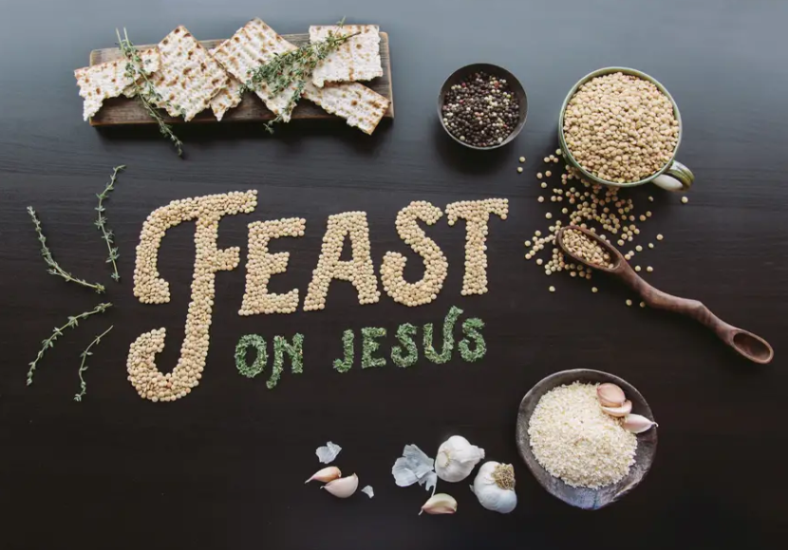
Unleavened Bread
1 Cor 5:7-8 – “⁷Clean out the old leaven so that you may be a new lump, just as you are in fact unleavened. For Christ our Passover also has been sacrificed. ⁸Therefore let us celebrate the feast, not with old leaven, nor with the leaven of malice and wickedness, but with the unleavened bread of sincerity and truth.”
John 6:27 – “Do not work for the food which perishes, but for the food which endures to eternal life, which the Son of Man will give to you, for on Him the Father, God, has set His seal.”
Notes:
So if the Passover typifies redemption, the death of Jesus, the Feast of Unleavened Bread typifies our corresponding sanctification. And we are sanctified when we are buried with Christ in baptism, which Peter described in 1 Pet 3:21 as the appeal to God for a god conscious through His resurrection. We resolved to partake of the Feast Of Unleavened Bread the moment we put on Christ and that is exactly what Paul alludes to in 1 Cor 5:7-8. In other words, we’ve resolved to put away all leaven from our life and live genuinely by God’s commandments. We must replace our human weaknesses and sinful tendencies with something better found in Christ.
Now in order to make this work, we can’t simply remove wickedness and expect to prosper. We must fill the void with the unleavened bread of Jesus Christ – John 6:27 – This means we accept Him as the final authority in our lives. It means we hunger for Him as we hunger for physical food. It means we desire to learn about Him so we can become like Him in every aspect of our lives. It means we study His teachings and example so we can better follow Him as a disciple. It means we make His priorities our priorities. It means taking in and living by the whole of God’s Word so that we can develop godly character.

Slide 7
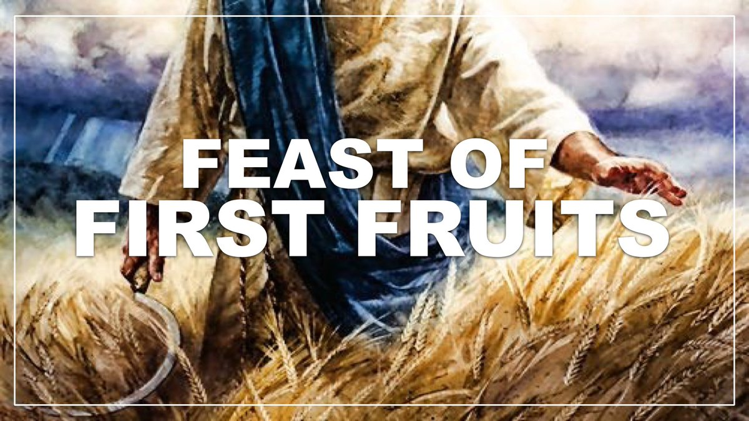
First Fruits
Lev 23:9-14 – “⁹Then the Lord spoke to Moses, saying, ‘¹⁰Speak to the sons of Israel and say to them, “When you enter the land which I am going to give to you and reap its harvest, then you shall bring in the sheaf of the first fruits of your harvest to the priest. ¹¹He shall wave the sheaf before the Lord for you to be accepted; on the day after the sabbath the priest shall wave it. ¹²Now on the day when you wave the sheaf, you shall offer a male lamb one year old without defect for a burnt offering to the Lord. ¹³Its grain offering shall then be two-tenths of an ephah of fine flour mixed with oil, an offering by fire to the Lord for a soothing aroma, with its drink offering, a fourth of a hin of wine. ¹⁴Until this same day, until you have brought in the offering of your God, you shall eat neither bread nor roasted grain nor new growth. It is to be a perpetual statute throughout your generations in all your dwelling places.”’”
Prov 3:9 – “Honor the Lord from your wealth and from the first of all your produce”
Notes:
The third feast was called First Fruits. The law does not specify what “fruit” it was, but barley is what ripened first during this time of year. This feast occurred the day after the first holy convocation of the Feast of Unleavened Bread which means it occurred on the 16th day of the first month, which is the 2nd day of the Feast of Unleavened Bread, and the 3rd day after Passover. A sheaf of grain was offered before the Lord as a wave offering, a male one year old lamb as a burnt offering, and 2/10 of an ephah of flower was presented as a grain offering which was twice the normal amount. Then a drink offering of ¼ a hin was offered. No grain was to be eaten until this offering to God was made.
The significance of this feast for Israel is that it was harvest time. This is when the hard work the farmers had poured into their crops all year began to pay off. They were literally reaping what they sowed. And so by giving to God the very first fruit of the harvest, they were demonstrating that all things ultimately belong to Him, demonstrating they trusted God, and it would remind them that God was the one that provided what they were reaping. They gave to God first even before giving to their family! – Prov 3:9

Slide 8
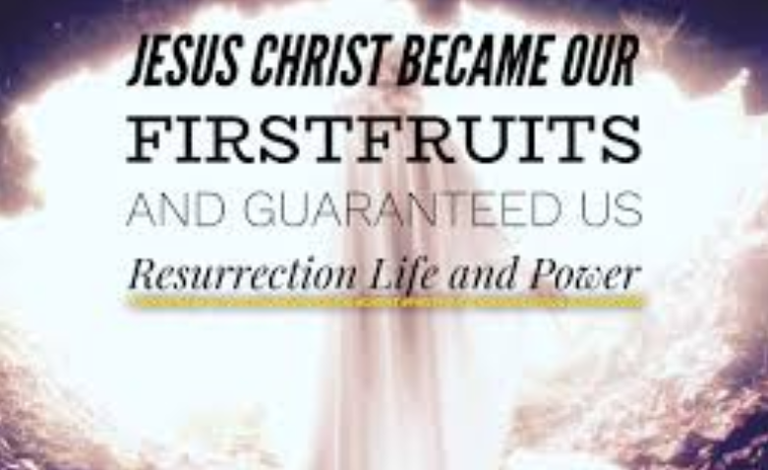
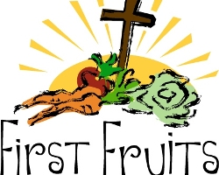
First Fruits
1 Cor 15:20-25 – “²⁰But now Christ has been raised from the dead, the first fruits of those who are asleep. ²¹For since by a man came death, by a man also came the resurrection of the dead. ²²For as in Adam all die, so also in Christ all will be made alive. ²³But each in his own order: Christ the first fruits, after that those who are Christ’s at His coming, ²⁴then comes the end, when He hands over the kingdom to the God and Father, when He has abolished all rule and all authority and power. ²⁵For He must reign until He has put all His enemies under His feet.”
1 Cor 10:26 – “for the earth is the Lord’s, and all it contains.”
Notes:
Here’s a pop quiz: a couple thousand years later, what great event occurred 3 days after the last legitimate Passover? The resurrection of Jesus Christ, and that is exactly what is signified by the First Fruits feast – 1 Cor 15:20-25 – Remember, the wave offering meant you “gave” it to God, but only as a type because it was given back to you. Jesus was given to God but then given right back to us. The one year lamb offered was the same as the Passover lamb. The grain offering was twice the amount which may signify that just as he was “ground” going to the cross, it is as if He came back twice the bread of life from which he left.

Slide 9
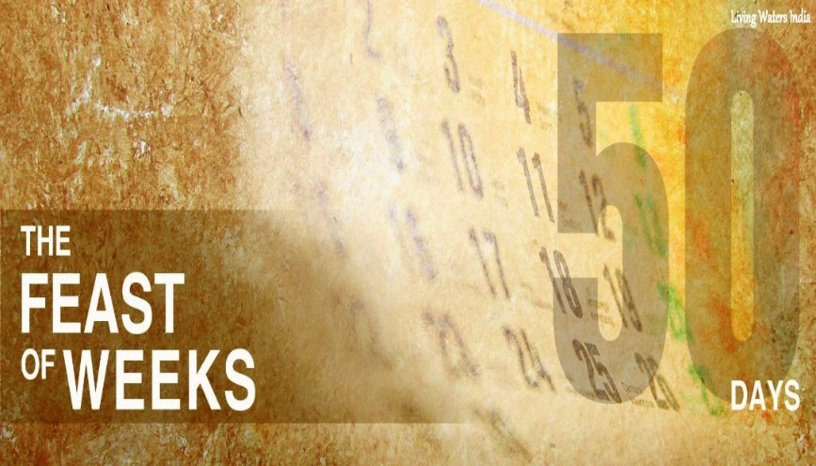
Weeks/Pentecost
Lev 23:15-21 – “¹⁵You shall also count for yourselves from the day after the sabbath, from the day when you brought in the sheaf of the wave offering; there shall be seven complete sabbaths. ¹⁶You shall count fifty days to the day after the seventh sabbath; then you shall present a new grain offering to the Lord. ¹⁷You shall bring in from your dwelling places two loaves of bread for a wave offering, made of two-tenths of an ephah; they shall be of a fine flour, baked with leaven as first fruits to the Lord. ¹⁸Along with the bread you shall present seven one year old male lambs without defect, and a bull of the herd and two rams; they are to be a burnt offering to the Lord, with their grain offering and their drink offerings, an offering by fire of a soothing aroma to the Lord. ¹⁹You shall also offer one male goat for a sin offering and two male lambs one year old for a sacrifice of peace offerings. ²⁰The priest shall then wave them with the bread of the first fruits for a wave offering with two lambs before the Lord; they are to be holy to the Lord for the priest. ²¹On this same day you shall make a proclamation as well; you are to have a holy convocation. You shall do no laborious work. It is to be a perpetual statute in all your dwelling places throughout your generations.”
Deut 16:11-12 – “¹¹and you shall rejoice before the Lord your God, you and your son and your daughter and your male and female servants and the Levite who is in your town, and the stranger and the orphan and the widow who are in your midst, in the place where the Lord your God chooses to establish His name. ¹²You shall remember that you were a slave in Egypt, and you shall be careful to observe these statutes.”
Notes:
The final spring feast goes by many names: “Feast of Weeks”, “Feast of Harvest”, “Day of the First Fruits”, Josephus called it “Feast of the Fifty Days” in his writings. But we know it as “Pentecost”. The date of this feast was determined by counting 7 Sabbaths from the day in which the sheaf offering was waved at the Feast of First Fruits. Pentecost was the next day after that seventh Sabbath, on a Sunday, hence where the number 50 comes from. It was a one day feast, a holy assembly, in which no work was to be done, and every male was required to assemble before the sanctuary. A whole bunch of burnt offerings, grain offerings, sin offerings, and peace offerings were offered.
What was the purpose of this feast? Deut 16:11-12 – In other words, it was a time of rejoicing and thanksgiving before the Lord in which they were to remember that they were once slaves but now are free, a memorial feast that should motivate them to be careful to observe all of God’s decrees.

Slide 10
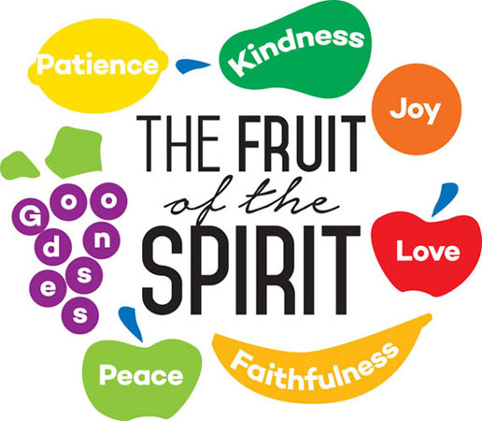
Weeks/Pentecost
Acts 2:41-42 – “⁴¹So then, those who had received his word were baptized; and that day there were added about three thousand souls. ⁴²They were continually devoting themselves to the apostles’ teaching and to fellowship, to the breaking of bread and to prayer.”
Notes:
One thing to keep in mind is that it was 50 days from the time Israel departed Egypt to the time Moses ascended Mt. Sinai to receive the law. The church of Jesus Christ was established on Pentecost in Acts 2. It began when the Apostles received the Holy Spirit and preached the first gospel sermon in which the first 3000 souls were added to the church. Just as 50 days after their release from captivity, Moses ascended Mt. Sinai to receive the law, it was 50 days after Christ’s death, burial, and resurrection that the first century Christians began devoting themselves to the Apostles doctrine. Therefore Pentecost represents the birth of the NT church.
However, Pentecost doesn’t just represent the birth of the church and the giving of God’s law, but also through the great miracle that was the outpouring of the Holy Spirit, it shows us how we can persist in living by the spiritual intent of God’s law. Academic knowledge of God’s law is not what enables us to think and act like God. By receiving the gift of the Holy Spirit, we receive in the law purpose, intent, and motivation for keeping the law that replaces the corruptibleness of our heart with a devotion not realized by OT saints.

Slide 11
Lev 23:22 – “When you reap the harvest of your land, moreover, you shall not reap to the very corners of your field nor gather the gleaning of your harvest; you are to leave them for the needy and the alien. I am the Lord your God.’”
Notes:
Typological summary: Passover represents the death of Christ, Unleavened Bread His burial, First Fruits His resurrection, and Pentecost the church. These four feasts all occurred the spring months and concluded the series of 7 feasts for a period of about 3 months.
Now a very interesting thing happens in Lev 23 after Pentecost is discussed and before the 5th feast is described – Lev 23:22 – This verse appears out of nowhere, seemingly having nothing to do with any particular feast. Its almost as if God is telling them that during these 3 months of long summer, they’re not to be stingy with what God has given you. Don’t be partial, the needy and the alien among you needs food too. Does this not signify the early church age? During this time, Christians planted the seed liberally to everyone they came across, including the poor and the Gentile, waiting to see the fruit rendered from this harvest. The literal meaning of Lev 23:22 is clear, that the poor and strangers be provided for and that those with fields not horde their fruit. But I would also suggest that this signifies the inclusion of all types of people in the church. The gift of the Holy Spirit, the fruit of the Holy Spirit is not limited to Jews. It includes Gentiles, the poor, the stranger, etc. We are to sow the seed to everyone, not just those like us. While we’re in this long summer harvest, God would have us to learn that the gospel is for all.

Slide 12
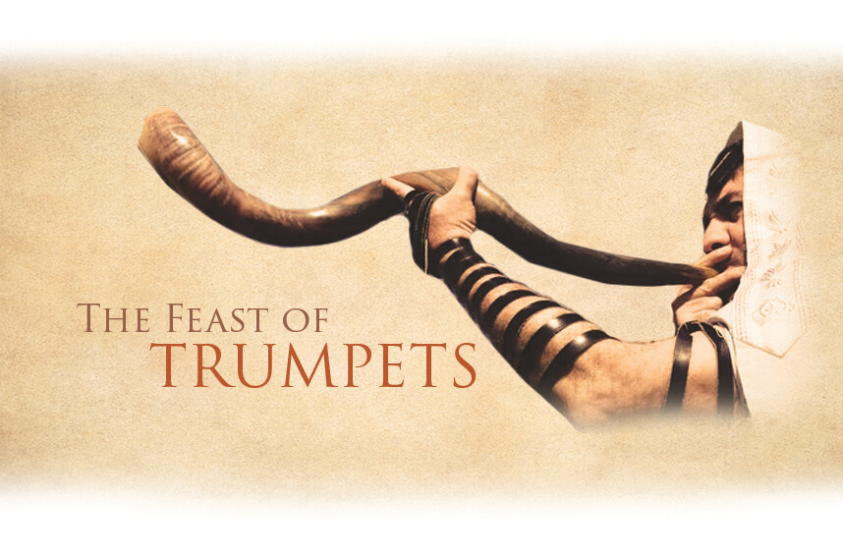
Trumpets
Lev 23:23-25 – “Again the Lord spoke to Moses, saying, ‘²⁴Speak to the sons of Israel, saying, “In the seventh month on the first of the month you shall have a rest, a reminder by blowing of trumpets, a holy convocation. ²⁵You shall not do any laborious work, but you shall present an offering by fire to the Lord.”’”
Num 29:1-6 – “¹Now in the seventh month, on the first day of the month, you shall also have a holy convocation; you shall do no laborious work. It will be to you a day for blowing trumpets. ²You shall offer a burnt offering as a soothing aroma to the Lord: one bull, one ram, and seven male lambs one year old without defect; ³also their grain offering, fine flour mixed with oil: three-tenths of an ephah for the bull, two-tenths for the ram, ⁴and one-tenth for each of the seven lambs. ⁵Offer one male goat for a sin offering, to make atonement for you, ⁶besides the burnt offering of the new moon and its grain offering, and the continual burnt offering and its grain offering, and their drink offerings, according to their ordinance, for a soothing aroma, an offering by fire to the Lord.”
Notes:
Following this 3 months of summer harvest was the seventh month, and this was a big month for Jews. All three of the final seven feasts occur in this month beginning with the Feast of Trumpets which was celebrated on the first day of the seventh month. On this day, they were to observe a Sabbath rest and make an offering by fire to the Lord. According to Num 10:2-10, trumpets were blown at the beginning of every month to commemorate the new moon feast. So we assume since the new moon of the seventh month was extra special that the trumpet was blown in a unique way separate from the other times. Num 29:1-6 lists all the sacrifices that were to be made and 10 specific animals are mentioned along with their grain and drink offerings.
What might this have meant for the Jews? It likely heralded the arrival of this sacred month which was the beginning of their civil calendar, something like a New Year celebration. At this time of year where the work of the harvest would have been more hectic than usual, it was all the more important that the people stop for some reflection. The key word in Lev 23:24 is “reminder” or “memorial” What might it reminded them of? God’s impending arrival before the people eat Mt. Sinai is the most probable – Ex 19:13b – “When the ram’s horn sounds a long blast, they shall come up to the mountain.” Given that the Day of Atonement was upon them, this likely could have been a reminder that God made a covenant with them, they promised to do everything He said. Yet because something like the day of Atonement was necessary, it was evident they had not one so. Therefore the Jews termed the 10 days between the Feast of Trumpets and the Day of Atonement as the “Days of Awe” because this was a time for the penitent to humble themselves for the pending Day of Atonement, to instill in them a righteous fear and dread just like in that moment when God spoke the Ten Commandments from the blazing mountain.

Slide 13
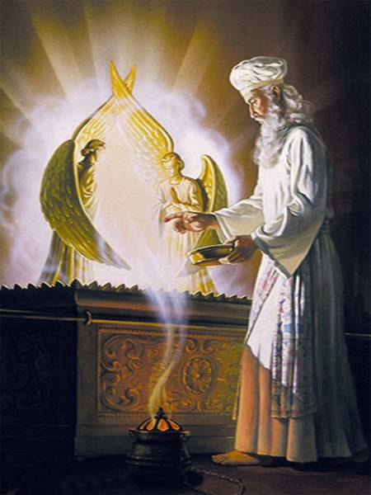
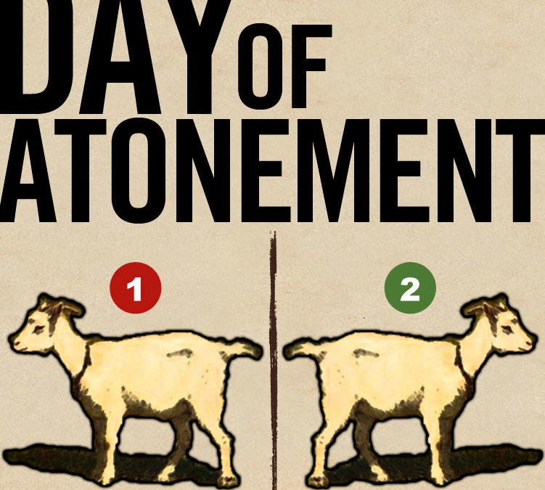
Day of Atonement
Lev 23:26-32 – “The Lord spoke to Moses, saying, ²⁷On exactly the tenth day of this seventh month is the day of atonement; it shall be a holy convocation for you, and you shall humble your souls and present an offering by fire to the Lord. ²⁸You shall not do any work on this same day, for it is a day of atonement, to make atonement on your behalf before the Lord your God. ²⁹If there is any person who will not humble himself on this same day, he shall be cut off from his people. ³⁰As for any person who does any work on this same day, that person I will destroy from among his people. ³¹You shall do no work at all. It is to be a perpetual statute throughout your generations in all your dwelling places. ³²It is to be a sabbath of complete rest to you, and you shall humble your souls; on the ninth of the month at evening, from evening until evening you shall keep your sabbath.””
Notes:
When those 10 “Days of Awe” were complete, the Day of Atonement came on the 10th day of that 7th month. We will go into detail about this feast in an upcoming class so it will only be summarized for now.
This day was not a feast, it was a fast. In fact, it is the only fast that is ever commanded in scripture. Atonement was made for the high priest and for the most holy place, which required the high priest to enter behind the veil, the only time of the year he could do this. Atonement was also made for the holy place and for the brazen altar, all because the sacred objects had been defiled by the sins of the people. Atonement was finally made for the people all the sins that had not been covered by the ritual sacrifices. One of the things we remember most about the day of Atonement are the two goats. One goat was sacrificed as a sin offering, but the other was kept alive. The priest would confess over the goat all the sins of the people and then it was led outside the camp where it was to be released, symbolically removing the sin from the camp.

Slide 14
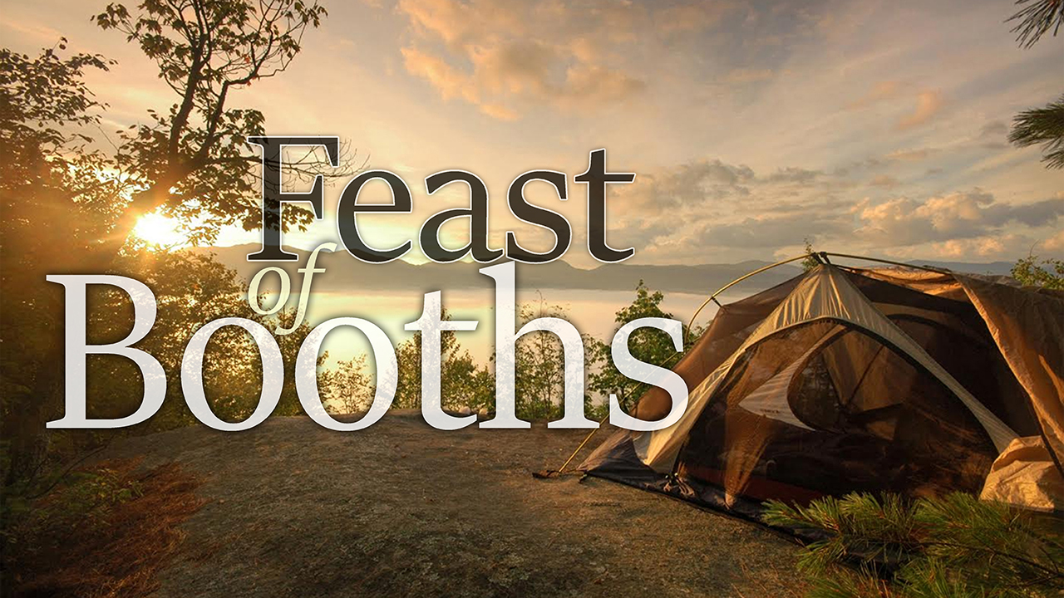
Tabernacles
Lev 23:34-36 – “³⁴Speak to the sons of Israel, saying, ‘On the fifteenth of this seventh month is the Feast of Booths for seven days to the Lord. ³⁵On the first day is a holy convocation; you shall do no laborious work of any kind. ³⁶ For seven days you shall present an offering by fire to the Lord. On the eighth day you shall have a holy convocation and present an offering by fire to the Lord; it is an assembly. You shall do no laborious work.
Lev 23:39-43 – “On exactly the fifteenth day of the seventh month, when you have gathered in the crops of the land, you shall celebrate the feast of the Lord for seven days, with a rest on the first day and a rest on the eighth day. ⁴⁰Now on the first day you shall take for yourselves the foliage of beautiful trees, palm branches and boughs of leafy trees and willows of the brook, and you shall rejoice before the Lord your God for seven days. ⁴¹You shall thus celebrate it as a feast to the Lord for seven days in the year. It shall be a perpetual statute throughout your generations; you shall celebrate it in the seventh month. ⁴²You shall live in booths for seven days; all the native-born in Israel shall live in booths, ⁴³so that your generations may know that I had the sons of Israel live in booths when I brought them out from the land of Egypt. I am the Lord your God.’”
Notes:
5 days after the Day of Atonement came the last of the fall festivals and it was held at the end of the agricultural year when the grapes and olives were harvested in Israel. Jewish sources tell us this was the biggest one of the year and that the Jews looked forward to this feast more than any other. It was similar to our thanksgiving where they camped out for seven days in a hut attached to the side of your house. It is specifically stated that this feast is for rejoicing. It is a “feast to the Lord”. This was a time to thank God for all of the preceding year’s provisions and to pray for a good rainy season, which lasted from October through March. It was also a feast to remember that the Lord brought them out of Egypt and provided for them. Their shoes didn’t wear out, their clothes didn’t wear out, they dwelt in booths and God provided day after day. The number of sacrifices offered was staggering. 159 total animals were offered over a seven day period.

Slide 15
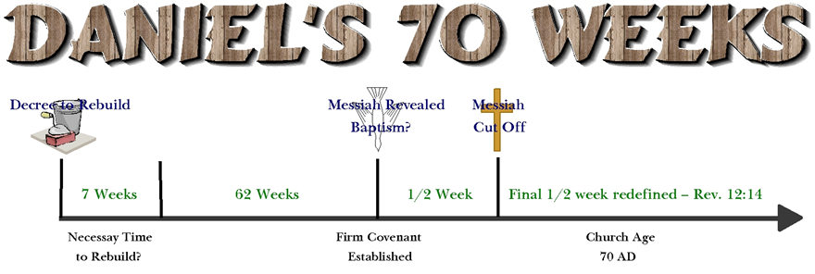
Fall Feasts Meaning
Matt 24 Warnings:
False Messiahs – vs. 5
Wars – vs. 6
Famines & earthquakes – vs. 7
Persecution – vs. 9
Christians fall away – vs. 10
False prophecies- vs. 11
Lawlessness increases
Love grows cold – vs. 12
Abomination of Desolation – vs. 15
Matt 24:15-16 – “¹⁵Therefore when you see the Abomination Of Desolation which was spoken of through Daniel the prophet, standing in the holy place (let the reader understand), ¹⁶then those who are in Judea must flee to the mountains...”
Notes:
Now, coming to terms with the NT significance of the Fall feasts is trickier than with the summer feasts. The following is speculative, but it is the best I can make of the significance. I suspect that these three feasts represent the end of the Jewish age, Daniel’s last week of the seventy weeks ending with the destruction of the temple in AD 70 and implications of that event.
First, trumpets are very symbolic in scripture of warning and alarm. When you consider what Jesus said in Matt 24, he mentioned many occurrences that would be a forewarning of the events of AD 70. There would be false Messiahs, numerous military encounters, famines, earthquakes, persecution, the falling away of some, false prophecies, increase in lawless, decrease in love. And then Jesus specifically hones in on the Abomination of Desolation spoken of in Daniel – Matt 24:15-16 – And then he says down in vs. 21 that “then there will be tribulation”. Then in vs. 25 He reminds them He is telling them in advance about these things. He’s giving them warnings about the coming destruction of Jerusalem, sounding the alarm so to speak to Christians of that era that time was near and they would need to flee.

Slide 16
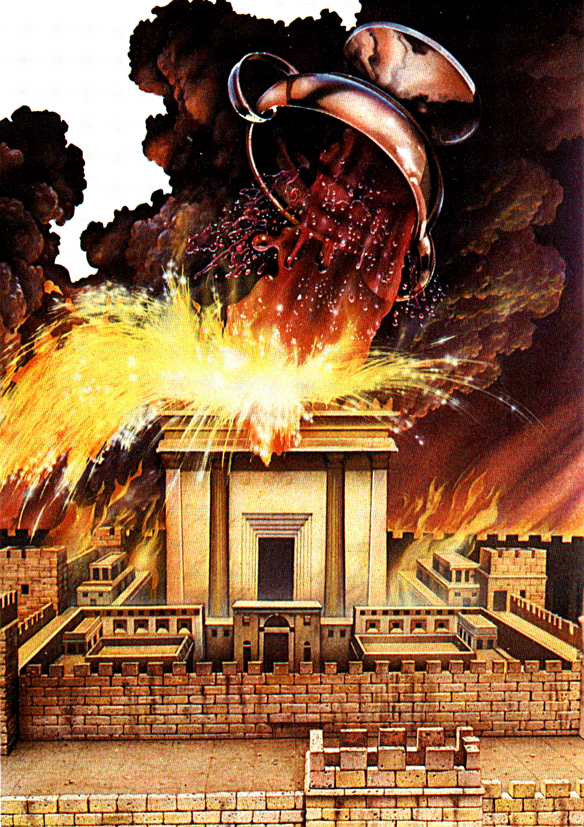
Fall Feasts Meaning
Luke 21:21-22 – “²¹Then those who are in Judea must flee to the mountains, and those who are in the midst of the city must leave, and those who are in the country must not enter the city; ²²because these are days of vengeance, so that all things which are written will be fulfilled.”
Dan 9:24-27 – “²⁴Seventy weeks have been decreed for your people and your holy city, to finish the transgression, to make an end of sin, to make atonement for iniquity, to bring in everlasting righteousness, to seal up vision and prophecy and to anoint the most holy place. ²⁵So you are to know and discern that from the issuing of a decree to restore and rebuild Jerusalem until Messiah the Prince there will be seven weeks and sixty-two weeks; it will be built again, with plaza and moat, even in times of distress. ²⁶Then after the sixty-two weeks the Messiah will be cut off and have nothing, and the people of the prince who is to come will destroy the city and the sanctuary. And its end will come with a flood; even to the end there will be war; desolations are determined. And he will make a firm covenant with the many for one week, but in the middle of the week he will put a stop to sacrifice and grain offering; and on the wing of abominations will come one who makes desolate, even until a complete destruction, one that is decreed, is poured out on the one who makes desolate.”
Notes:
Where does the Day of Atonement come into play? Well, there can be no question that Christ’s redemptive work is present in the Day of Atonement, since Heb 9 makes mention of Him not needing to go in to the Most Holy Place year by year because He lives there. However, I would suggest there is some negative typology occurring in AD 70 with regards to the Day of Atonement. Similar to how Christ compared to Adam in Rom 5, whereas through Adam sinned entered the world, through Christ came grace. I believe the Day of Atonement and the destruction of Jerusalem may play a similar comparison.
Keep in mind that the word “atonement” means “covering”. On that day, your sins were being covered in order to protect you. Without that protection, only death and destruction could follow, God’s wrath/judgment. So whereas the Day of Atonement was a day in which Israel humbled itself in order for their sins to be atoned for, when AD 70 occurs, those Jews had had a probationary period of 40 years by which to humble themselves before this great day in AD 70, which Jesus calls in Luke 21:22, “Days of Vengeance”. Its as if the time for atonement, though fulfilled on the cross, is officially over for the Jews as a nation. It’s still available for the Jews as a people, if they survived this day, but not as a nation. So rather than the priests cleansing the most holy place with blood, God cleanses it with the blood of His wrath, with purifying fire, for the Jews unrepentant sins, ending what was really only a model to the heavenly reality where Christ now dwells. One goat died in the camp, another was led into the wilderness. On the day of vengeance, Jesus warned them to flee if they wanted to stay alive. Those who remained in Jerusalem would die. So while the Day of Atonement was God visiting His people to offer forgiveness, the Days of Vengeance is God’s judgment upon a city that refused to receive the forgiveness He offered through Christ; therefore would no longer be covered – Dan 9:24-27

Slide 17
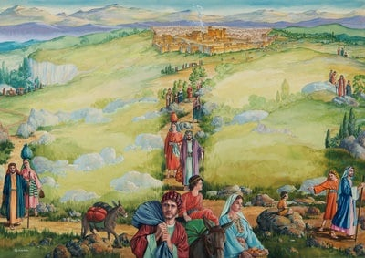
Fall Feasts Meaning
Matt 24:14 – “This gospel of the kingdom shall be preached in the whole world as a testimony to all the nations, and then the end will come.”
John 4:21,23 – “Jesus said to her, ‘Woman, believe Me, an hour is coming when neither in this mountain nor in Jerusalem will you worship the Father…But an hour is coming, and now is, when the true worshipers will worship the Father in spirit and truth; for such people the Father seeks to be His worshipers.’”
Zech 14:16-18 – “Then it will come about that any who are left of all the nations that went against Jerusalem will go up from year to year to worship the King, the Lord of hosts, and to celebrate the Feast of Booths. And it will be that whichever of the families of the earth does not go up to Jerusalem to worship the King, the Lord of host, there will be no rain on them. If the family of Egypt does not go up or enter, then no rain will fall on them; it will be the plague with which the Lord smites the nations who do not go up to celebrate the Feast of Booths.”
Notes:
Regarding the Feast of Booths, remember it was held to celebrate the harvest that had come in – Matt 24:14 – Therefore it is likely that the destruction of Jerusalem was the sign that God’s word and had been sowed throughout the entire world and the harvest reaped. However, with the destruction of the temple and no more physical Jerusalem to cling to, they would be required to trust God again as they wandered the Earth, as strangers and aliens, preaching and living the gospel. Jesus referred to this time in John 4:21-23.
Zechariah 14 prophecies about a time when the enemies of God would attack God’s people, but then He would bring destruction upon those enemies. And then he mentions the Feast of Booths in a symbolic way – Zech 14:16-18 – There is some debate over whether this is referring to the remnant that remained after the destruction of Jerusalem or some other disaster, but regardless, the Feast of Booths is talked about as something celebrated, and it is not literal, but symbolic. We currently do this, as we sometimes sing – “Here we are but straying pilgrims…” and other songs.

Slide 18
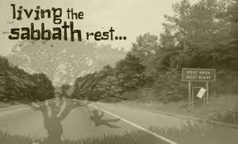
Sabbath Year
Lev 25:1-7 – “¹The Lord then spoke to Moses at Mount Sinai, saying, “²Speak to the son of Israel and say to them, ‘When you come into the land which I shall give you, then the land shall have a sabbath to the Lord. ³Six years you shall sow your field, and six years you shall prune your vineyard and gather in its crop, ⁴but during the seventh year the land shall have a sabbath rest, a sabbath to the Lord; you shall not sow your field nor prune your vineyard. ⁵Your harvest’s after growth you shall not reap, and your grapes of untrimmed vines you shall not gather; the land shall have a sabbatical year. ⁶All of you shall have the sabbath products of the land for food; yourself, and your male and female slaves, and your hired man and your foreign resident, those who live as aliens with you. ⁷Even your cattle and the animals that are in your land shall have all its crops to eat.”
Notes:
Think about all the sevens we’ve seen so far. The Sabbath Day occurs on the seventh day of every week. Many of the feasts last seven days. The Fall Feasts occur in the seventh month. Then as we get to Lev 25, we learn that every seventh year, the land is to enjoy a Sabbath rest in which nothing was to be reaped that entire year. In fact, there were agricultural advantages in leaving a field fallow once every seven years because it alleviates the exhaustion of the soil.
However, there was faith and corresponding blessing that occurred from this. It required faith because not only would Israel be required to abstain from reaping their fields for that entire year, but they would have to trust in God to provide for them during that time. Then when the seventh year was complete, they would have to plow, sow the seed, and then wait for the harvest. This Sabbath year rest required them to trust in God to provide for them when they were required not to provide for themselves. It led to blessing because they were able to take a whole year off from plowing, sowing, and reaping just to let the Lord take care of them. In some ways, it would be have been like taking a year vacation just to sit back and let the Lord provide simply because He promised that He would.

Slide 19
Sabbath Year
Lev 26:34-35 – “Then the land will enjoy its sabbaths all the days of the desolation, while you are in your enemies’ land; then the land will rest and enjoy its sabbaths. All the days of its desolation it will observe the rest which it did not observe on your sabbaths, while you were living on it.”
2 Chron 36:20-21 – “Those who had escaped from the sword he carried away to Babylon; and they were servants to him and to his sons until the rule of the kingdom of Persia, to fulfill the word of the Lord by the mouth of Jeremiah, until the land had enjoyed its sabbaths. All the days of its desolation it kept sabbath until seventy years were complete.”
Jer 50:33-34 – “Thus says the Lord of hosts, ‘The sons of Israel are oppressed, and the sons of Judah as well; and all who took them captive have held them fast, they have refused to let them go. Their Redeemer is strong, the Lord of hosts is His name; He will vigorously plead their case so that He may bring rest to the earth, but turmoil to the inhabitants of Babylon.”
Notes:
Is the Sabbath Year a shadow of any NT reality? A few things to consider:
Whereas the Sabbath Day was a rest for the individual people of God, so that they will rest, the Sabbath Year was a rest for the land, corporately. It is a Sabbath of sabbaths. Reaping and gathering for storage and selling were not permitted in the Sabbath year, but harvesting for daily needs was permitted. The purpose of these laws seems to promote social equality in Israel wherein anyone was permitted to use anything that grew, wherever it grew. Even the wild beasts of the field are mentioned, to emphasize that God would provide for every creature. And during this time, Deut 31:10 tells us that rather than this year being spent in idleness, it was to be used for the teaching/training regarding the law of God.
Because we are an affluent society, this actually decreases our leisure time, our family time, and certainly our devotional times. More people not only choose to work to fulfill what they want to be, but we feel compelled to work in order to afford what society says we should have. Consumerism has always necessitated “producerism” to keep both supply and demand high. And our overwork leads to exhaustion, which we attempt to fix with chemicals.
Well, what did God warn He would do if they didn’t voluntarily do this? When the Jews refused to carry out God’s command to let the land rest every seventh year, God prophesied that Israel and Judah would go into captivity. Lev 26:34-35 – And this happened. Notice 2 Chron 36:20-21. However, it seems when Israel’s time of captivity was over, Babylon would be judged with a Sabbath rest for the land – Jer 50:33-34.
Point? In the hustle and bustle of life God wants us to stop and see to it that the “land” (people) are taken care of. If we don’t, He will force this Sabbath Year upon us as He has done so many times in history. (I’m still working through all the implications of this typology).

Slide 20
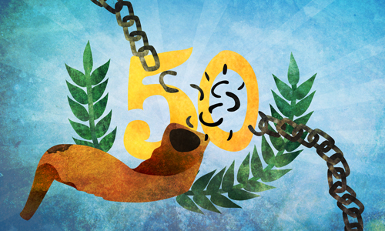
Year of Jubilee
Lev 25:8-12 – “⁸You are also to count off seven sabbaths of years for yourself, seven times seven years, so that you have the time of the seven sabbaths of years, namely, forty-nine years. ⁹You shall then sound a ram’s horn abroad on the tenth day of the seventh month; on the day of atonement you shall sound a horn all through your land. ¹⁰You shall thus consecrate the fiftieth year and proclaim a release through the land to all its inhabitants. It shall be a jubilee for you, and each of you shall return to his own property, and each of you shall return to his family. ¹¹You shall have the fiftieth year as a jubilee; you shall not sow, nor reap its after growth, nor gather in from its untrimmed vines. ¹²For it is a jubilee; it shall be holy to you. You shall eat its crops out of the field.”
Redemption
Slaves Freed
Families Reunited
Inheritance Restored
Notes:
Then there is the Jubilee. The word Jubilee is transliterated from the Hebrew word pronounced in English as “yobel”, which means a “trumpet sound”. They were to count off seven sets of seven years, and then on the following year, which would be the fiftieth year, the land was to enjoy an additional Sabbath rest. So if the Sabbath Year was a Sabbath of sabbaths, the Jubilee was a Sabbath of Sabbaths of sabbaths.
They were to blow a ram’s horn on the Day of Atonement to announce this day. So think about it…this means that there were two years of Sabbath rest, the seventh sabbath year followed by the Jubilee. What if they worried about what to eat? God said He would provide 3 years worth of food so that when it was time to flow and sow again, they’d still be eating old produce.
But the biggest reward in Jubilee was redemption. The word “redeemed” is used 14 time in this chapter. Everyone who had lost their original property could return to it. Everyone who had sold themselves as slaves to pay a debt were free. Verse 23 tells us why: God owns everything. They were simply aliens and sojourners on God’s property. Anyone who had lost his inheritance as a result of loans, debt, liens, etc. would have their inheritance restored. In other words, at the Jubilee, everything was restored to God’s people that was originally given. This feast had huge economic, social, and family implications. It eliminated all oppression brought on by the people even if it was brought on by themselves. No wonder it began on the Day of Atonement.

Slide 21
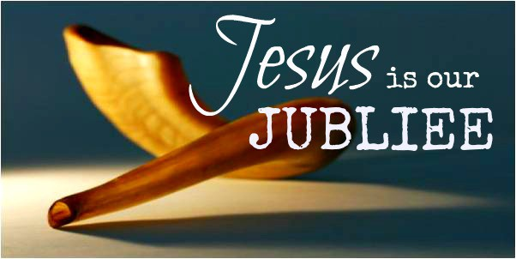
Year of Jubilee
Isa 61:1-3 – “¹The Spirit of the Lord God is upon me, because the Lord has anointed me to bring good news to the afflicted; He has sent me to bind up the brokenhearted, to proclaim liberty to captives and freedom to prisoners; to ²proclaim the favorable year of the Lord and the day of vengeance of our God; to comfort all who mourn, ³to grant those who mourn in Zion, giving them a garland instead of ashes, the oil of gladness instead of mourning, the mantle of praise instead of a spirit of fainting. So they will be called oaks of righteousness, the planting of the Lord, that He may be glorified.”
Heb 2:6b – “For in subjecting all things to him, He left nothing that is not subject to him. But now we do not yet see all things subjected to him.”
Notes:
Jesus quoted Isa 61 in His hometown of Nazareth as being fulfilled through Him – Isa 61:1-3 – What happened on the cross began the fulfillment of our Year of Jubilee. Jesus took God’s own and returned them to their rightful, created place. He restored and delivered us from our captivity to sin. But this will not be fully realized until He returns.
Psalm 8 tells us that it was always God’s intention to give man dominion. But Heb 2:6, after quoting this very psalm, reminds us, “But now we do not yet see all things subjected to him.” But when Christ came, he freed us from our slavery in which we sold ourselves to the devil, and gave us back what God determined for us to have.
Rom 6:6-7 – “knowing this, that our old self was crucified with Him, in order that our body of sin might be done away with, so that we would no longer be slaves to sin; for he who has died is freed from sin.”
Rom 8:11 – “But if the Spirit of Him who raised Jesus from the dead dwells in you, He who raised Christ Jesus from the dead will also give life to your mortal bodies through His Spirit who dwells in you.”
Rom 8:51 – “For you have not received a spirit of slavery leading to fear again, but you have received a spirit of adoption as sons by which we cry out, “Abba! Father!””

