Slide 1
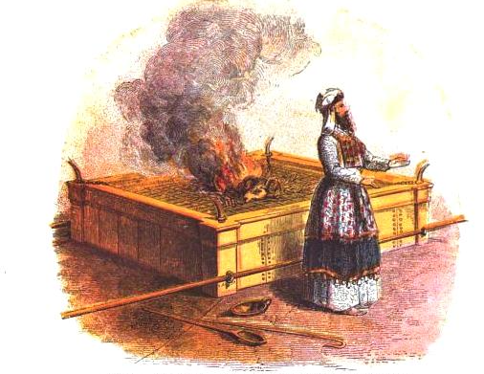
Ritual Sacrifices

Slide 2
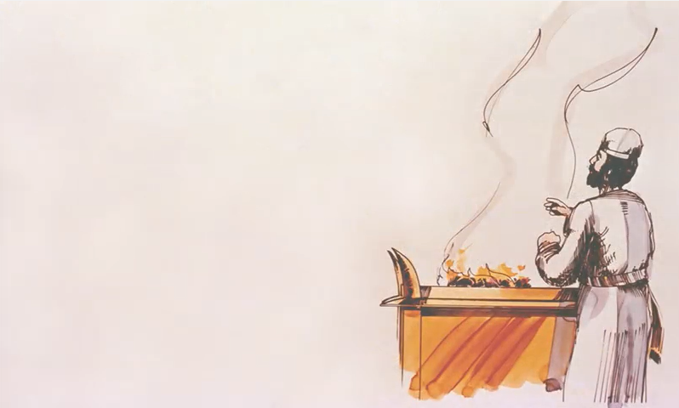
Voluntary Offerings
The Burnt Offering
The Grain Offering
The Peace Offering
Obligatory Offerings
The Sin Offering
The Guilt Offering
Notes:
The Bible provides two different orders for the ritual sacrifices. The teaching order begins in Leviticus 1 where it seems that God first wants us to learn about devotion to Him and our fellow man, which we see portrayed by the burnt offering, the grain offering, and the peace offering. Following that, the instruction proceeds on to the sin and guilt offering which we’ll be discussing in this class. However, the order is different when they were actually being performed at the altar. The sin offering almost always happened first and the reason is that we cannot approach God in dedication and devotion while sin remains with us. When we have sin, any devotion we offer is flawed. The only way we can approach God is to have the way cleared before us through a sin offering made on our behalf, which in turn prepares the way for us to make devotional offerings.
This order also makes sense when you consider what a person who is completely ignorant of God’s scheme of redemption actually first learns about God. The first thing that typically happens as a lost person makes the transition to being saved is that they become aware of their sin before God and their need to be made right with Him. Then we learn that only through the shedding of blood can this forgiveness be attained. So we obey the gospel, but as we progress in our discipleship, that is when we begin to grow and learn the value of perfect devotion to God and to man and to see the value in mimicking this devotion by which we too can become types of burnt and grain and peace offerings. This is the thrust behind the statement in 1 Cor 11:29 that we are not to judge the body of Christ lightly. A deeply appreciative and perceptive understanding of Christ's sacrifice is possible only in those who have strived to emulate Him by being living sacrifices.

Slide 3
The Sin Offering
Notes:
The sin offering of Lev 4 & 5 appears to simply focus on the spiritually destructive state that sin puts us in, as Paul alludes to in Rom 6:23 – “The wages of sin is death.” In most cases, the sin offering is made as an atonement for the sin committed by a person or group of people. Here is how it worked:
God loves us and wants to be in a relationship with us. But He is holy and we are sinners. A holy God cannot be in fellowship with sin. In fact, because He is a God of justice, He demands a punishment for sin. And the only punishment that fits the crime that is “sin” is death. But because He is also a God who loves us, He doesn’t want us to have to pay this price ourselves. This is where the sin offering comes in. By the grace of God, a sinner was allowed to take an animal which God specified depending on sinner(s) involved, which we’ll discuss in a moment, and he would take this animal to the tabernacle. The offender would then place his hands on the head of this animal to figuratively transfer his sin to the animal. An animal is innocent. It cannot sin. So for that era, it was a fitting substitute and type of who God would eventually send in Christ. After placing his head on the animal, he would slit its throat. Various things were done with the blood and the carcass, again depending on who it was that actually sinned, but the ultimate result was that the sinner became sanctified and God was able to practice both His justice as well as His love toward man.

Slide 4
The Sin Offering
Lev 4:2 – “Speak to the sons of Israel, saying, ‘If a person sins unintentionally in any of the things which the Lord has commanded not to be done, and commits any of them…’” (also vs. 13, 22, 27)
Rom 7:15-17 – “¹⁵For what I am doing, I do not understand; for I am not practicing what I would like to do, but I am doing the very thing I hate. ¹⁶But if I do the very thing I do not want to do, I agree with the Law, confessing that the Law is good. ¹⁷So now, no longer am I the one doing it, but sin which dwells in me.”
Notes:
Now Leviticus is very specific in stating that the kinds of sins this offering atoned for were unintentional sins, which might be sins of omission, sins people committed in ignorance of the Mosaic code, sins committed when they forgot the laws they had learned, or sins committed out of weakness and succumbing to the flesh. Sins committed with a “high hand” were not covered. A high-handed sin is a sin that a professing believer commits boldly and defiantly, not caring about the consequences and they feel no guilt about it once committed. It is a sin people commit fearlessly as they shake their fists, literally or figuratively, at the Lord. A sin committed with a high hand is not always the same thing as an intentional sin — all high-handed sins are intentional but not all intentional sins are high-handed. The truly converted will not commit high-handed sins, though they may commit sins of intention due to an ongoing struggle against the flesh. Paul seems to allude to this contrast in Rom. 7:7–25.

Slide 5
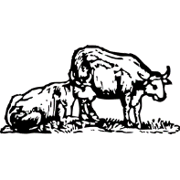
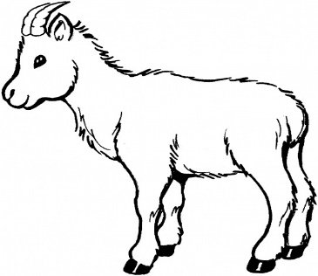
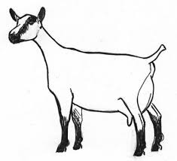
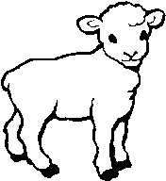
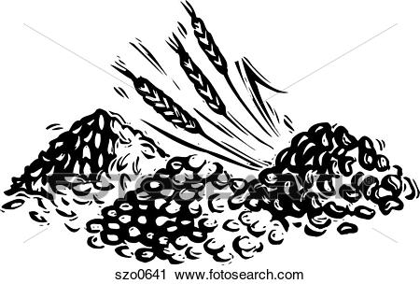
The Sin Offering
Priest & Congregation: Bull (Lev 4:3-21)
Carcass burned outside camp
Blood applied in holy place
Leader: Male goat (Lev 4:22-26)
Meat eaten by priest and male family members
Blood applied to brazen altar
Commoner: Female goat/lamb (Lev 4:27-35)
Meat eaten by priest and male family members
Blood applied to brazen altar
Poor: Turtle Doves (Lev 5:7-10)
Blood applied to brazen altar
Very Poor: 1/10 ephah of flour (Lev 5:11-13)
No incense or oil allowed
Priest allowed to eat memorial portion
Notes:
The sin offering was performed differently relative to the social status and the economic status of the person or persons who is involved. There is actually more diversity in this offering than any other.
Priest or whole congregation sinned: a bull. The blood was applied in the holy place, the fat and kidneys were removed and burned on the altar, and then the remainder of the carcass was burned outside the camp.
Leader: a male goat. In this situation, part of the animal could be eaten by the officiating priest and the male members of his family and in this instance the blood was only applied to the brazen altar.
Commoner: a female goat or a female lamb. In both of these cases, part of the animal could be eaten by the officiating priest and the male members of his family and the blood was only applied to the brazen altar.
Poor commoner: two turtle doves. The blood was only applied to the brazen altar. And if he was so poor that he couldn’t afford that, he could bring 1/10 of an ephah of flower, but incense and oil are explicitly forbidden, because their significance was irrelevant when it was a sin offering being made. The priest would eat the memorial portion as he would for the grain offering.

Slide 6
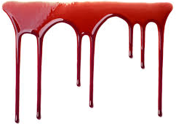
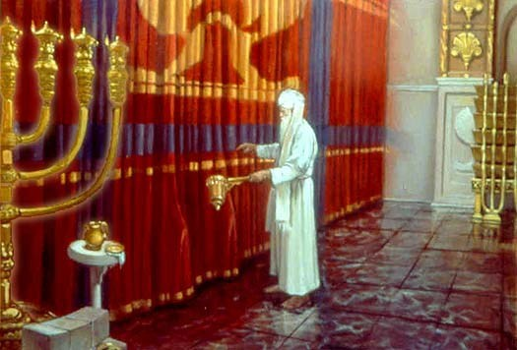
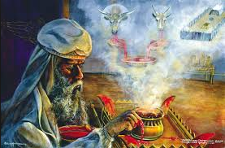
The Sin Offering
Heb 9:22a – “And according to the Law, one may almost say, all things are cleansed with blood…”
Priest & Congregation
Lev 4:5-7 – “⁵Then the anointed priest is to take some of the blood of the bull and bring it to the tent of meeting, ⁶and the priest shall dip his finger in the blood and sprinkle some of the blood seven times before the Lord, in front of the veil of the sanctuary. ⁷The priest shall also put some of the blood on the horns of the altar of fragrant incense which is before the Lord in the tent of meeting; and all the blood of the bull he shall pour out at the base of the altar of burnt offering which is at the doorway of the tent of meeting.”
Jas 3:1 – “Let not many of you become teachers, my brethren, knowing that as such we will incur a stricter judgment.”
Heb 7:25 – “Therefore He is able also to save forever those who draw near to God through Him, since He always lives to make intercession for them.”
Notes:
First, there was a distinction which of the holy articles needed to be cleansed by the blood of the offering. Remember what the Hebrew writer says about blood? – Heb 9:22
Lev 4:5-7 says that if a sin offering for the priest or for the whole congregation required that that some of the blood be brought into the holy place where it would be sprinkled seven times toward the veil. Why? Well Lev 4:3 says, his sin brought guilt upon the people. The consequences of sin are more severe for those in positions of influence. Also consider Jas 3:1. The high priest, though he was an individual, was more critical to God's means of communicating with His people. When he sinned, the consequences were far more serious.
The blood was then dabbed on the four horns of the altar of incense. Why? Because incense represents prayer. On each day, the priest would take coals from the brazen altar into the holy place and place incense on it at the alter of incense to be burned the horns of that altar signify power. But the sin of the priest or of the whole congregation had such adverse consequences on this daily “prayer” that in order for that power to be restored, it had to be cleansed with blood. So in dabbing it on the horns of the altar of incense, it signifies God would once again hear their prayers. Remember, Jesus makes intercession for us and the reason our prayers have the power to reach Him in order to do so is because of His blood – Heb 7:25

Slide 7
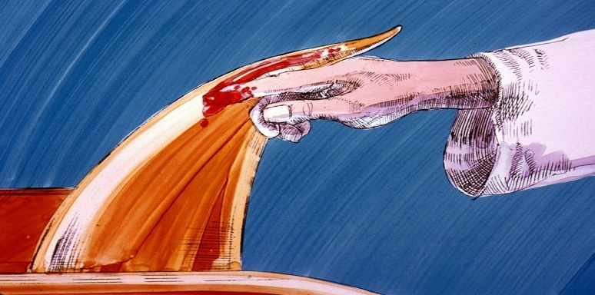
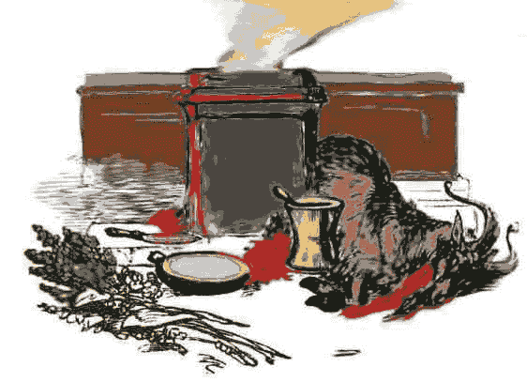
The Sin Offering
Heb 9:22a – “And according to the Law, one may almost say, all things are cleansed with blood…”
Leader, Commoner, Poor
Psa 89:17 – “For You are the glory of their strength, and by Your favor our horn is exalted.”
Ex 27:2 – “You shall make its horns on its four corners; its horns shall be of one piece with it, and you shall overlay it with bronze.”
Ex 21:14 – “If, however, a man acts presumptuously toward his neighbor, so as to kill him craftily, you are to take him even from My altar, that he may die.”
Rev 6:9 – “When the Lamb broke the fifth seal, I saw underneath the altar the souls of those who had been slain because of the word of God, and because of the testimony which they had maintained”
Notes:
However, if the offerer was a leader or commoner, poor or otherwise, the blood was not required to be take into the holy place. Instead, it was to be put on the horns of the brazen altar. Again, horns are symbols of power – Psa 89:17. Also the horn made as one piece with the altar itself – Ex 27:2. The idea then seems to be that God’s person and His power are inseparably connected and when the atoning blood is applied to the horns, the sinner’s life, by reason of the animal substitute would be one with God again. There was now union between the altar, the horns, and the sinner.
We also see God’s mercy in connection to the horns. It was a place of refuge that many would flee to and grab hold of in order to be protected, if he were indeed innocent. Ex 21:14 – In fact, you’ll remember that Adonijah did so in 1 Kings 1:50 and Solomon spared his life. But when Joab fled to the altar and grabbed its horns in 1 Kings 2:28, he was not spared because he was not innocent.
Regardless of the offerer, after the blood was applied, the rest was then poured out at the foot of the brazen altar. Over time, the altar would have been encrimsoned with it and the soil around was saturated with it. The blood of Christ is the foundation upon which all our sacrifices are based. No doubt the ground at the foot of the cross was saturated with the blood of Christ. Remember Rev 6:9.

Slide 8
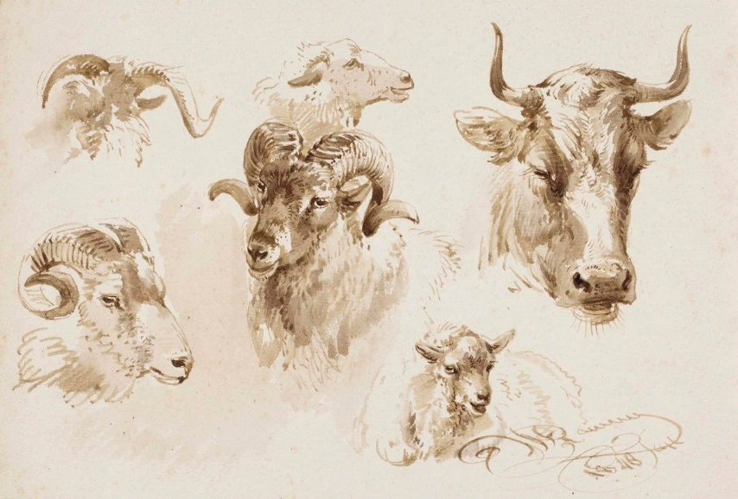
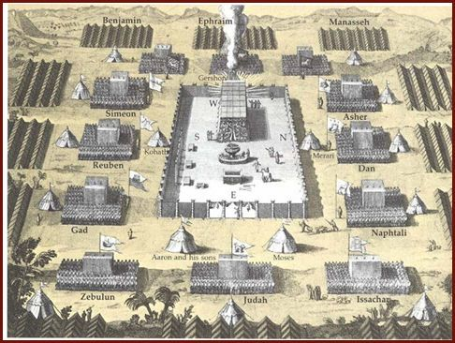
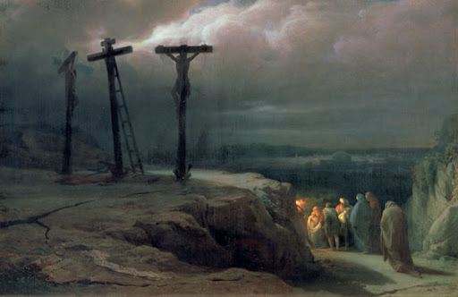
The Sin Offering
Priest & Congregation
Heb 13:12-14 – “Therefore Jesus also, that He might sanctify the people through His own blood, suffered outside the gate. So, let us go out to Him outside the camp, bearing His reproach. For here we do not have a lasting city, but we are seeking the city which is to come.”
Notes:
Not only was the application of the blood different depending on the offerer, but so was how the remains of the animal was treated.
The offering for the priest or for the whole congregation required that after burning all the fat and the kidneys on the altar (same symbolism as discussed with the peace offering) that the rest of the bull be taken outside the camp and burned in a ceremonially clean place. None of the meat of this bull could be eaten, probably because of the severity of it being a sin of the priest or the whole congregation. When a priest sins, it affects everyone as communication is shut off. When the whole congregation sins, the leavening affect is serious. Therefore this required a greater sacrifice and was not a fragrant aroma. In contrast, the burning outside the camp suggested God’s disgust and aversion to sin and at the same time signaled the separation it produces.
Remember, the Hebrew writer referred to Jesus as suffering “outside the camp” and we’re encouraged to go to Him there, bearing His reproach because the of greater reward waiting for us. Heb 13:12-14

Slide 9
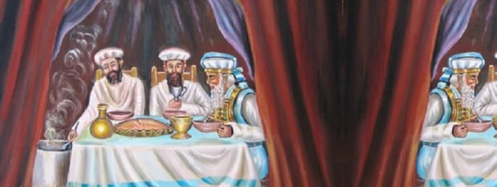
The Sin Offering
Leader & Commoner
1 Cor 9:13 – “Do you not know that those who perform sacred services eat the food of the temple, and those who attend regularly to the altar have their share from the altar?”
Num 18:31b – “it is your compensation in return for your service in the tent of meeting”
Deut 18:1 – “The Levitical priests, the whole tribe of Levi, shall have no portion or inheritance with Israel; they shall eat the Lord’s offerings by fire and His portion.”
Notes:
However, if the offerer is a leader or commoner, the priest would be allowed to eat the flesh of the animal after its fat had been offered by fire. Why? 1 Cor 9:13; Num 18:31b; Deut 18:1
God designed the priesthood so that it wouldn’t have to worry about money or food or how to take care of their family. He wanted them solely focused on the work they needed to do without the distractions that secular work can bring. The Levites job was to teach the people concerning sin and righteousness and if in his duties he leads a person from sin to righteousness through officiating the sacrifice, God would have that he be taken care of. And so in addition to the grain offering and peace offering, the flesh of the sin offering was also provided. By virtue of its holiness, it was to be eaten by a holy person (Lev 6:24-30).

Slide 10
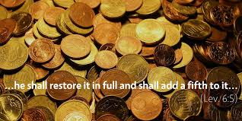
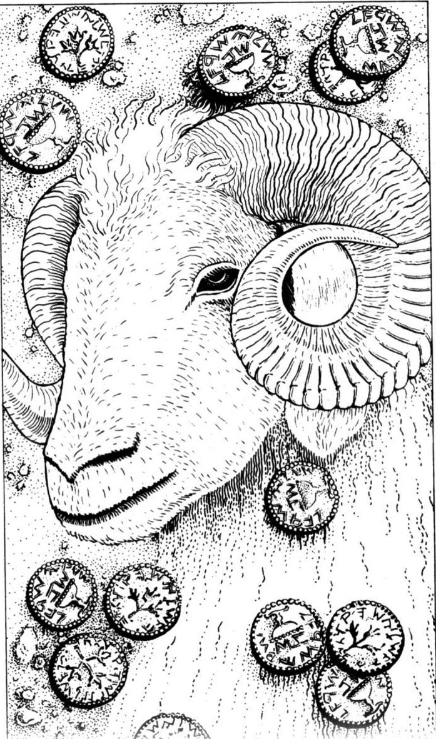
The Guilt Offering
Sin Offering | Guilt Offering
Sin Itself | Fruit/Effect
Against God | Against Things/Man
Wrong Done | Right Undone
Lev 5:15a – “If a person acts unfaithfully and sins unintentionally against the Lord’s holy things, then he shall bring his guilt offering to the Lord: a ram without defect from the flock, according to your valuation in silver by shekels, in terms of the shekel of the sanctuary, for a guilt offering.”
20% Added
Against Holy Things? To the priest
Against Individual? To the offended
Notes:
The guilt offering, sometimes called the trespass offering, is closely related to the sin offering. However, when studied closely, there appears to be some subtle differences between the two. First, the sin offering seems to be for sin itself whereas the guilt offering seems to be because of the effect that sin had on others, sin’s fruit. The sin offering appears to be because of sin committed against God whereas the guilt offering appears to be toward things/man. And whereas the sin offering appears to be for a wrong that is done, many of the specifics surrounding the guilt offering are for rights undone. So the guilt offering is a sin offering, but because of these differences, God seems to demand its own sacrifice.
Lev 5:15a – Only one offering was accepted, a ram, which was to be sacrificed just like the peace offering. All the fat, kidneys, and liver lobes were offered to God, for the same symbolic reasons as the peace offering, but the offering was holy, which meant the remaining meat could be eaten by the priest just as the sin offering for the commoner. It is to be a ram of a certain value fixed by the priest, relative to the seriousness of the sin, meaning it was to be grown to such a degree that its value must at least be two shekels.
Also, the offerer was to add 20% to the value imposed by the priest. If the sin, unintentional or accidental, was against the holy things, the 20% went to the priest. If it were against an individual, a value of restitution was imposed by the priest relative to the sin and this was given to the individual sinned against plus 20%.

Slide 11
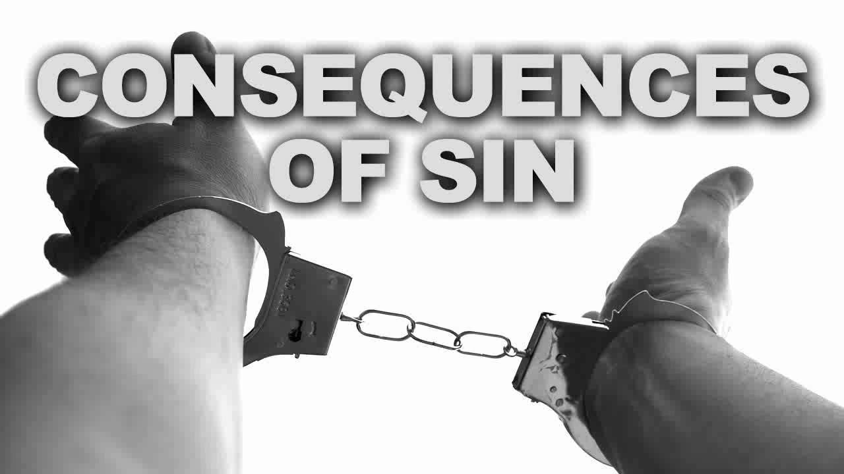
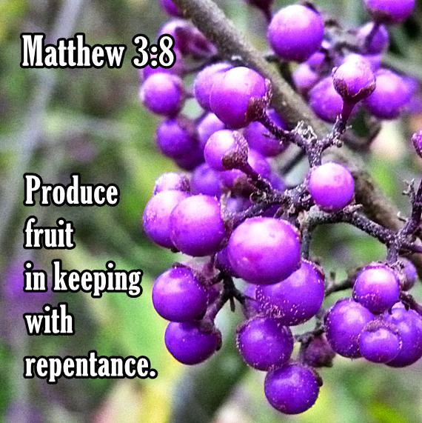
The Guilt Offering
Lev 5:1-4 – “¹Now if a person sins after he hears a public adjuration to testify when he is a witness, whether he has seen or otherwise known, if he does not tell it, then he will bear his guilt. ²Or if a person touches any unclean thing, whether a carcass of an unclean beast or the carcass of unclean cattle or a carcass of unclean swarming things, though it is hidden from him and he is unclean, then he will be guilty. ³Or if he touches human uncleanness, of whatever sort his uncleanness may be with which he becomes unclean, and it is hidden from him, and then he comes to know it, he will be guilty. ⁴Or if a person swears thoughtlessly with his lips to do evil or to do good, in whatever matter a man may speak thoughtlessly with an oath, and it is hidden from him, and then he comes to know it, he will be guilty in one of these.”
Lev 6:2-3 – “When a person sins and acts unfaithfully against the Lord, and deceives his companion in regard to a deposit or a security entrusted to him, or through robbery, or if he has extorted from his companion, ³ or has found what was lost and lied about it and sworn falsely, so that he sins in regard to any one of the things a man may do”
Notes:
What is the significance of the guilt offering? Again, the sin offering appears to cover the “fact” that we sinned and therefore needed atonement, but the guilt offering atones for the fruit of the sin committed, the acts that were actually performed in the sin. And so this offering didn’t look so much on man’s separation from God, but rather at the consequences of the sin, suggesting that a wrong committed against an injured party must be compensated plus interest. So, because there are consequences to sin, the significance of this offering was to make restoration. Just look at the list of things in Lev 5:1-4; 6:2-3 – God required offerings whenever a person deceived another in regards to a pledge, deposit, if he committed robbery or fraud, lied about personal property, or swore falsely about something. These would be sins committed in the context of commerce and other interpersonal transactions wherein rights, goods, or property that had been unjustly disturbed or violated were restored to the injured party. Therefore what we see in this offering is the seed of the doctrine of repentance, much like John the Baptist warned people concerning in Matt 3:8.

Slide 12
The Guilt Offering
Apologizing Wasn’t Enough
2 Cor 7:9 – “I now rejoice, not that you were made sorrowful, but that you were made sorrowful to the point of repentance; for you were made sorrowful according to the will of God, so that you might not suffer loss in anything through us.”
Full Restoration Wasn’t Enough
2 Cor 7:11b – “In everything you demonstrated yourselves to be innocent in the matter.”
Benefited The Offender
2 Cor 7:10a – “For the sorrow that is according to the will of God produces a repentance without regret…””
2 Cor 2:6 – “Sufficient for such a one is this punishment which was inflicted by the majority”
Benefited The Offended
2 Cor 2:10 – “But one whom you forgive anything, I forgive also; for indeed what I have forgiven, if I have forgiven anything, I did it for your sakes in the presence of Christ.”
Notes:
So consider the practical teaching of this offering:
Apologizing wasn’t enough. Apologizing would be the obvious first step because you’re admitting the guilt, that you committed wrong. But saying “I’m sorry” is to lead us to repentance, because that’s what godly sorrow does – 2 Cor 7:9.
But even full restoration wasn’t enough. Something similar to today’s punitive damages were added wherein the offender willingly took on a share of the harm themselves and thereby shared in the distress they caused the victim. This was to ensure that the offender go above and beyond for the victim, because in most instances the consequences of sin outweigh what was gained by the offender. So the idea is that I repentance, you go so above and beyond, no one would be able to come back and say you didn’t make this right – 2 Cor 7:11b.
This sacrifice was good for the offender because it helped ease his conscience. Now that he has been made aware of his crime and its damaging effects, it allows him to deal with it and bring the matter to a close so he can move on unimpeded in his devotion to God and his devotion to his fellow man – 2 Cor 7:10a; 2:6
This sacrifice was also good for the offended as it neutralizes the pain caused him and extinguishes the need for him to take the matter into his own hands – 2 Cor 2:10
Therefore the guilt offering appears to be a very potent reminder that God does not exercise his right of forgiveness at the expense of people harmed by our misdeeds. He does not offer us psychological release from our guilt as a cheap substitute for making right the damage and hurt we have caused. Is there a more needed lesson in the church today?

Slide 13
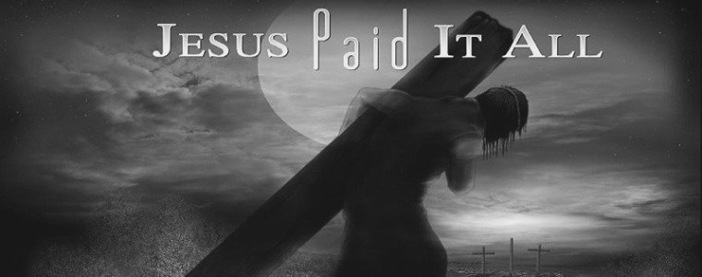
The Guilt Offering
Isa 53:10 – “But the Lord was pleased to crush Him, putting Him to grief; if He would render Himself as a guilt offering, He will see His offspring, He will prolong His days, and the good pleasure of the Lord will prosper in His hand.”
Rom 8:17 – “and if children, heirs also, heirs of God and fellow heirs with Christ, if indeed we suffer with Him so that we may also be glorified with Him.”
Eph 3:6 – “to be specific, that the Gentiles are fellow heirs and fellow members of the body, and fellow partakers of the promise in Christ Jesus through the gospel”
Notes:
Christ is our guilt offering! – Isa 53:10 – This means Christ satisfied payment for our debt and more. It’s like when we said, “I pay my bills and then some.” Jesus paid our debt and then some.
But he also did more. He made man a joint heir with Him. Rom 8:17 – Imagine you are 6 months behind on your mortgage payment, and the bank is going to foreclose any day. Any day from now, you and your family are going to be kicked out of your home onto the street. But then one day, the owner of the bank comes to your house and says, “I’ve paid your debt”. You’d be ecstatic. But then he adds, “I also paid off your house so you won’t have any further debt going forward. Can you imagine how excited you’d be? But then it gets better. He also says, “And by the way, I’ve now made you co-owner of the bank and so you’ll share in the perks and privileges of ownership in this great company. That’s what Christ did for us. He made restitution for our debt, and he went well beyond a 20% restitution in that he gave us, the offender, a partnership in being heirs in the kingdom of God – Eph 3:6
Despite the fact we sinned, everything we devote and suffer for His name will be made up for in Christ. When the love of Christ compels us, we devote ourselves above and beyond to God and our fellow man. This is not because we believe we can pay Him back. It’s not works to earn salvation. It’s works motivated by love that goes above and beyond in our service to God and man by virtue of Christ going above and beyond for us on the cross.

