Slide 1
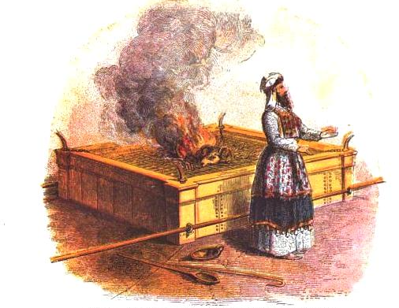
Ritual Sacrifices
Notes:
Anyone who truly loves another will sacrifice anything for that person. A husband will die for his wife. Even when you’re dating, you’ll forgo things like sleep or food just to be in one another’s presence. A football player will leave it “all on the field.” Sacrificial action will always speak louder than words because sacrifice reveals where our passions truly lie. And so it shouldn’t surprise us to see sacrifice as the biblical means by which the true devotion of our heart is given a voice. It is the most profound way we could ever approach God in true devotion. And sometimes this truth gets lost when we try to limit the Levitical sacrifices to simply providing atonement. Obviously there is a redemptive element to the Levitical offerings in which the offerer approached God with an attitude of “please forgive me.” But there were other Levitical sacrifices in which the offerer would approach God as if to say, “I devote myself to you” or “thank you” and these are attitudes which one might expect would flow from being forgiven – the forgiven person should always respond with joyful gratitude.
And so it is certainly worthwhile to note that these sacrifices typify the Lord Jesus Christ. But as we talked about in the last lesson, the Levitical sacrifices were ideally designed to typify the devotion God sought from the offerer himself. Whichever offering is under discussion, God’s desire was that this offering be a type/figure of the heart of the man making the offering. However, because man either could not or would not embody these types perfectly, Christ came and exemplified perfectly what God was hoping to achieve in man by the offering of these sacrifices because He became the offering Himself.
And so, as we study these sacrifices, we will certainly note how each one prefigures Jesus Christ. But we will also note what it is that God wanted the Israelites to embody in their own character as they offered these individual sacrifices.

Slide 2
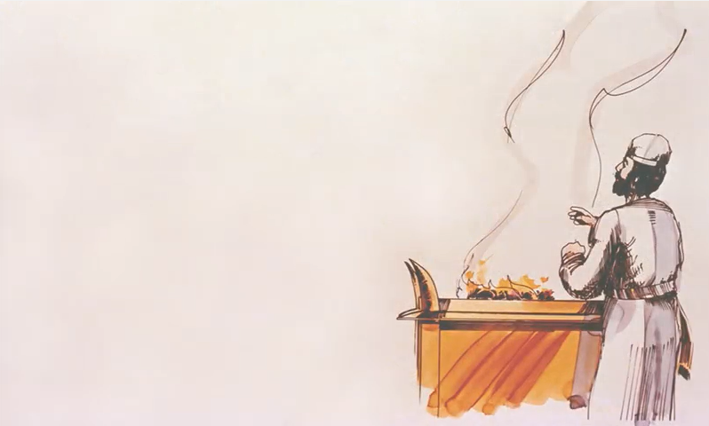
Voluntary Offerings
The Burnt Offering
The Grain Offering
The Peace Offering
Obligatory Offerings
The Sin Offering
The Guilt Offering
Notes:
Leviticus chapters 1 – 7 discusses 5 distinct sacrifices which can be divided up into 2 categories.
Chapters 1 – 3 deal exclusively with the voluntary offerings: the burnt offering, the grain offering, and the peace offering. Now, certain events would call for these sacrifices and so there were times where these voluntary offerings became obligatory. However, the language of the first 3 chapters, in summarizing these offerings, seems to suggest that individuals would offer these on a voluntary basis. These were devotional offerings toward God. And though they could not be offered before the obligatory offerings, they are mentioned first and so we will discuss them first.
Chapters 4 – 7 deal mostly with the obligatory offerings: the sin offering and the guilt offering. There is some information pertaining to the voluntary offerings given, but the majority deal with sacrifices that must be offered when sin was committed if that individual was to receive atonement for that sin.

Slide 3
The Burnt Offering
“The Ascent” or “To Go Up In Smoke”
קָרְבַּן עוֹלָה
=> “korban olah”
Mark 7:9-13 – “He was also saying to them, ‘You are experts at setting aside the commandment of God in order to keep your tradition. For Moses said, “Honor your father and your mother’; and, ‘He who speaks evil of father or mother, is to be put to death”; but you say, “If a man says to his father or his mother, whatever I have that would help you is Corban (that is to say, given to God),” you no longer permit him to do anything for his father or his mother; thus invalidating the word of God by your tradition which you have handed down; and you do many things such as that.’”
Notes:
The burnt offering is the first discussed and Leviticus 1 provides the details. The word literally means “the ascent” or “to go up in smoke”. For most of the sacrifices, the priest or offerer would receive a part of the offering. This was never the case with the burnt offering. In the burnt offering, the entire animal was consumed on the altar – nothing was held back but the skin, which went to the priest officiating over the offering.
The Hebrew phrase for the burnt offering is pronounced “korban olah”. If that sounds familiar, its because it is where the word “corban” comes from. This was the concept of giving it all to God. You’ll remember that by Jesus’ day, the Pharisees attempted to earmark everything they owned as “corban”, belonging to God, which prevented them from honoring their mother and father, and Jesus rebukes them for placing their traditions at a higher level than God’s word. But the term is the same and so the Israelites understood the meaning behind the burnt offering. With this offering, you leave it “all out on the field.”

Slide 4
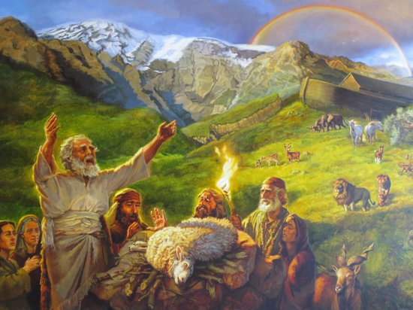
The Burnt Offering
Gen 8:20-21 – “Then Noah built an altar to the Lord, and took of every clean animal and of every clean bird and offered burnt offerings on the altar. The Lord smelled the soothing aroma; and the Lord said to Himself, ‘I will never again curse the ground on account of man, for the intent of man’s heart is evil from his youth; and I will never again destroy every living thing, as I have done.’”
Other Passages
Gen 22:2,13; Ex 10:25-26; Ex 20:24; 24:5; 32:6
Notes:
The burnt offering does not originate with Leviticus. The first mention of it is actually in Gen 8 when Noah offered it upon exiting the ark. Gen 8:20-21
There are other passages as well that show this offering was made long before Leviticus came along. But notice in Gen 8 God’s reaction to this offering – this offering was the basis for God’s promise that He would never again destroy every living thing by a flood. “The intent of man’s heart is evil from his youth”. This is very similar to what God said in Ex 32 when the people started worshipping the golden calf – “I have seen this people, and behold, they are an obstinate people”. God realizes that man just can’t help himself, we’re just going to keep messing up time and again. But even though He recognizes this propensity for evil in man, Noah recognizes it as well and so he offered burnt offerings. And when God “smelled” the offering, He also sees the propensity of man, by virtue of the character of Noah, to overcome evil and to actually serve Him. This is a key to understanding the purpose behind this offering.

Slide 5
The Burnt Offering
Regularly Scheduled
Morning/evening (Ex 29:38-42)
Sabbath (Num 28:9-10)
Beginning of month (Num 28:11)
Passover (Num 28:16)
Feast of Weeks (Num 28:27)
Feast of Trumpets (Num 29:2)
New Moon (Num 29:6)
Feast of Booths (Num 29:12)
Cleansing
After giving birth (Lev 12:6-8)
Cleansing Leper (Lev 14:19-20)
Man w/a discharge (Lev 15:14-15)
Woman w/discharge (Lev 15:30)
Nazarite defiled (Num 6:11,14)
Purify nation (Num 15:22-26)
Aaron’s Consecration (Lev 16:3-5)
Consecration of Levites (Num 8:12)
Other Sacrifices
Guilt Offering (Lev 5:7, 10, 17-18)
Sin Offering (Lev 5:7; 6:25)
Freewill Offering (Lev 22:18)
Sheaf Offering (Lev 23:12)
New Grain Offering (Lev 23:15-22)
Notes:
And it also has to do with the regularity by which this sacrifice needed to be offered when it became obligatory. Leviticus 1 does come from the standpoint of it being a voluntary offering, but the burnt offering could also become corporate as well as obligatory during certain times, certain situation, and certain feasts. They were regularly scheduled, offered when someone needed cleansing, and also offered alongside other sacrifices and offerings. The burnt offering was the most common of all the offerings and God believed it to be something that needed to be offered regularly by the people. Again, keep this in mind as we get closer to determining the meaning behind it.

Slide 6
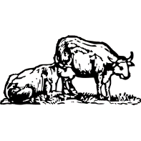
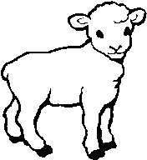
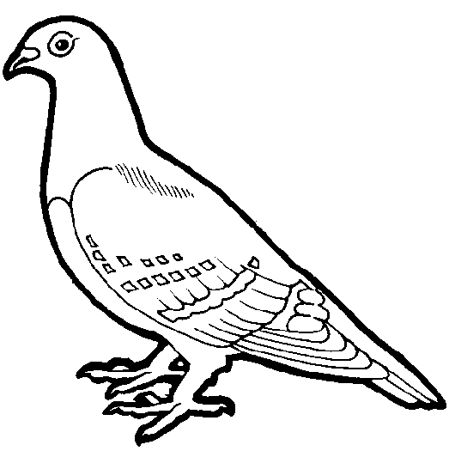
The Burnt Offering
Animals
Bull
Sheep or goat
Turtle dove or pigeon
Lev 1:5-9 – “⁵He shall slay the young bull before the Lord; and Aaron’s sons the priests shall offer up the blood and sprinkle the blood around on the altar that is at the doorway of the tent of meeting. ⁶He shall then skin the burnt offering and cut it into its pieces. ⁷The sons of Aaron the priest shall put fire on the altar and arrange wood on the fire. ⁸Then Aaron’s sons the priests shall arrange the pieces, the head and the suet over the wood which is on the fire that is on the altar. ⁹Its entrails, however, and its legs he shall wash with water. And the priest shall offer up in smoke all of it on the altar for a burnt offering, an offering by fire of a soothing aroma to the Lord.”
Lev 7:8 – “Also the priest who presents any man’s burnt offering, that priest shall have for himself the skin of the burnt offering which he has presented.”
Notes:
Lev 1 divides it up into three different categories of animals that were allowed for the burnt offering, each category divided up into socio-economic groups, which seems to imply that God desired for anyone in Israel, regardless of class, to be able to offer a burnt offering. The upper class were required to offer a bull, the middle class a sheep or goat, and the lower class a turtle dove or pigeon. Again, this was a real sacrifice in the truest sense of the word because it was an animal without defect from your herd or flock, meaning it was the product of your labor, and it was a true sacrifice because meat was a rare luxury in that day. It would have been costly to burn an entire animal on the altar without giving any part of it to anyone but the Lord.
Here’s a summary of Lev 1: the offerer would bring the animal to the doorway of the tent of meeting in which he would then lay his hand on the head of the animal. The offerer would then slay the animal and the officiating priest would take over from there. Lev 1:5-9 then contains the rest of the instruction. The only time the priest would deviate from this is if the offering was a bird. The animal was then divided up into parts, certain parts were washed, and then the entire thing was burned. Lev 7:8 tell us that the priest kept the skin of the animal and it was the only portion he kept.
When this is completed, it is referred to as a smoothing aroma to the Lord. In other words, the Lord sees the offering much like he did Noah’s. Though he recognizes man’s sinful inclinations, he is satisfied through the offering and blesses man. It was very similar to when Abraham was willing to offer his only son as a burnt offering, the Lord swore by Himself that He would fulfill His promise to Abraham. So satisfied was God with this offering that Lev 6 says the ashes were to be discarded the following morning in a clean place, signifying that even the perishable part that remained was considered holy.

Slide 7
The Burnt Offering
Luke 10:27a – “You shall love the Lord your God with all your heart, and with all your soul, and with all your strength, and with all your mind…”
Psa 51:10 – “Create in me a clean heart, O God, and renew a steadfast spirit within me.”
John 13:10 –"He who has bathed needs only to wash his feet, but is completely clean; and you are clean, but not all of you“
Notes:
Now, the purpose given for this offering is “atonement” for the offerer, but not for a specific sin so much as an admission of the general state of the sinfulness of man, an admitting about oneself the very thing that God told Noah in Gen 8, that man is inclined toward sin time and time again. And so while the burnt offering offered atonement, the atonement appears to merely be a means to an end and this can be seen in the dividing of the animal and what it appears to represent. As we just read, the priest took the carcass and cut it into pieces consisting of the head, legs, inwards, and the fat. The inwards and the legs were washed with water after which the priest arranged all the pieces on the altar and burned them. This is not an arbitrary thing to be skipped over – there is significance. It’s likely that each part of the animal’s body was a symbol of various aspects of the offerer’s life. The head is symbolic of the thoughts (man’s mind), the legs is symbolic of the walk (man’s strength), the inwards are symbolic of the feelings and affections (man’s heart); the fat is the general energy, health, and vigor of the body as a whole (man’s soul). So the burnt offering is symbolic of a person’s desire to surrender and devote himself wholly to the Lord. To put it biblically – Luke 10:27a – “You shall love the Lord your God with all your heart, and with all your soul, and with all your strength, and with all your mind”. This makes the sacrifice a sweet savor that is satisfying to the Lord.
Now, all four of these parts of the carcass was burned, but interestingly God required that the inwards and legs first be washed before being burned. I would suggest this symbolizes the desire to be spiritually pure both in our inward desires as well as in the things those desires lead us to do, our walk. Consider what David said in Psa 51:10 – “Create in me a clean heart, O God, and renew a steadfast spirit within me.” And also consider what Jesus said in John 13:10 –"He who has bathed needs only to wash his feet, but is completely clean; and you are clean, but not all of you“. The Apostles had been cleansed; their whole moral life had been changed, but they were liable to the corruption of everyday life through which they walked, and needed to be cleansed from the pollution of it. The washing of the legs seems to indicate the need to cleanse our course in life which we wrongly walk as a result of the evil inclinations of our heart.
And so the burnt offering is a recognition by man of his sinful inclinations, his need for regular atonement for this fact (hence the regularity of the offering), and is indicative of his voluntary, willing spirit to wholly devote Himself to God – the greatest commandment. And through the animal sacrifice, God is pleased and it activates God’s blessing upon him.

Slide 8
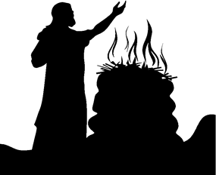
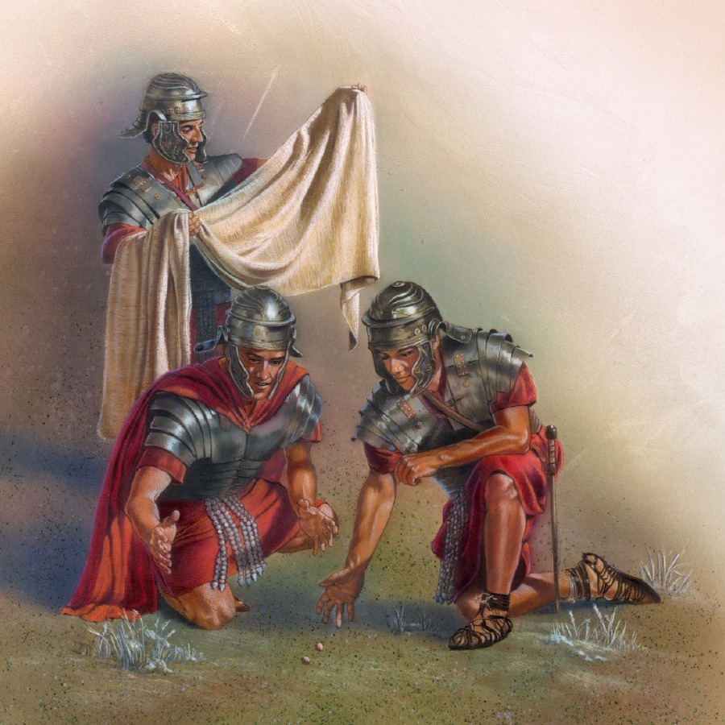
The Burnt Offering
Eph 5:2 – “walk in love, just as Christ also loved you and gave Himself up for us, an offering and a sacrifice to God as a fragrant aroma.”
Matt 27:35 – “And when they had crucified Him, they divided up His garments among themselves by casting lots”
Notes:
Now, man could not and still cannot offer Himself wholly to God. And so Jesus fulfilled the burnt offering by wholly and perfectly devoting His life to God. Every verse that indicates He “gave Himself” is represented by the burnt offering. Eph 5:2 – “walk in love, just as Christ also loved you and gave Himself up for us, and offering and a sacrifice to God as a fragrant aroma.” See the connection? To love someone is to give one self up utterly and completely for a cause outside of themselves. Jesus did this and when He did, He sacrificed Himself up to His Father in heaven as a fragrant aroma, the same language as used concerning the burnt offering. The sin offering never has the language “a fragrant aroma” attached. But the burnt offering did. And so His burnt offering is to be the impetus for our own, which is why He said “walk in love”. Christ, as our perfect burnt offering, is the incentive.
What allusion might this verse have to the burnt offering? – Matt 27:35 – “And when they had crucified Him, they divided up His garments among themselves by casting lots”. Well, in the burnt offering, everything was offered but the skin, which was left to the ones officiating over the offering to do as they pleased. The ones officiating over Jesus’ sacrifice, the Roman soldiers, divided up His outer garments which is likely an allusion to this very idea.

Slide 9
The Burnt Offering
Rom 12:1 – “Therefore I urge you, brethren, by the mercies of God, to present your bodies a living and holy sacrifice, acceptable to God, which is your spiritual service of worship”
Heb 13:15-16 – “Through Him then, let us continually offer up a sacrifice of praise to God, that is, the fruit of lips that give thanks to His name. And do not neglect doing good and sharing, for with such sacrifices God is pleased.”
Mark 12:44 – “they all put in out of their surplus, but she, out of her poverty, put in all she owned, all she had to live on.”
Mark 14:8 – “She has done what she could; she has anointed My body beforehand for the burial.”
Notes:
But the burnt offering’s purpose was not solely for Israel, nor was it solely to prefigure Christ. Christ’s purpose in becoming our burnt offering was to teach us the extent by which we should sacrifice ourselves as well as to be our motivation, because we know full well that it was because of His sacrifice that our sacrifices could even be acceptable. Christians are called to surrender ourselves wholly to God, to put it all on the altar, holding nothing back.
Rom 12:1 – In other words, these sacrifices are acceptable through Jesus Christ, because of what He has done for us. Heb 13:15-16
Think about the individuals that Jesus used as examples to follow. In Mark 12:41-44, it wasn’t the rich people who put large sums of money in the treasury that caught Jesus’ attention. They were simply giving from their surplus. It was the widow that caught His attention. She only gave two mites, but it was all she had. She gave everything she owned. She left it all on the field.
In Mark 14:3-9, Jesus lifted up the woman who anointed him with costly perfume as a model for the faithful. This was a woman who counted the cost of discipleship and she gladly paid it, holding nothing back.
Remember the 3rd verse from “Trust and Obey”? “But we never can prove the delights of His love, until all on the altar we lay; for the favor He shows, and the joy He bestows, are for them who will trust and obey.” With the burnt offering, nothing gets off the altar; it all belongs to God. We love God with all our heart, mind, soul, and strength.

Slide 10
The Burnt Offering
Luke 9:23 – “If anyone wishes to come after Me, he must deny himself, and take up his cross daily and follow Me”
2 Cor 8:5 – “and this, not as we had expected, but they first gave themselves to the Lord and to us by the will of God.”
Hos 6:6 – “For I delight in loyalty rather than sacrifice, and in the knowledge of God rather than burnt offerings”
Psa 51:16-17 – “For you will not delight in sacrifice, or I would give it; you will not be pleased with a burnt offering. The sacrifices of God are a broken spirit; a broken and contrite heart, O God, you will not despise.”
1 Sam 15:22 – “Has the Lord as much delight in burnt offerings and sacrifices as in obeying the voice of the Lord? Behold, to obey is better than sacrifice, and to heed than the fat of rams.”
Notes:
Just as the burnt offering was offered daily, every morning and evening, Jesus calls us to devote ourselves daily – Luke 9:23
Why was the burnt offering the first of the voluntary offerings to be given? Because when you give yourself wholly to the Lord, you’ll hold nothing else back. That’s why Paul said this of the Macedonians in 2 Cor 8:5
A living sacrifice is much more precious to God than any burnt offering, and the OT testifies to this fact: Hos 6:6; Psa 51:16-17; 1 Sam 15:22
The burnt offering is the visual representation of the greatest commandment, loving the Lord our God with everything we are.

Slide 11
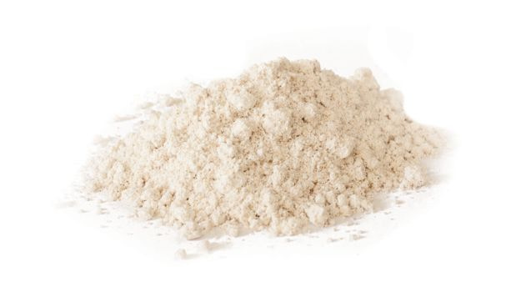
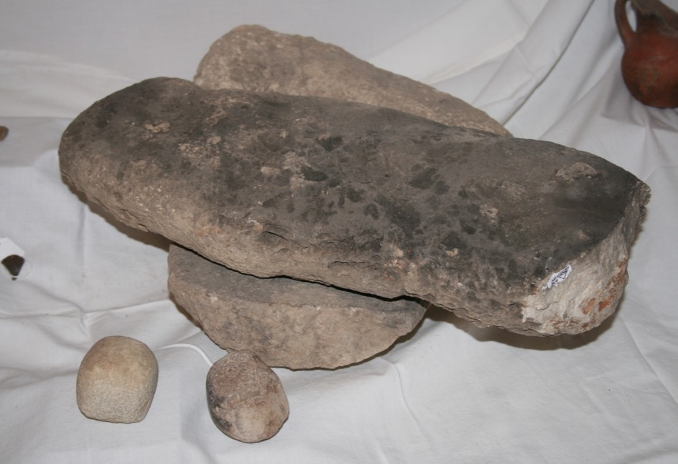
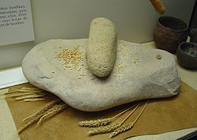
The Grain Offering
1 Kings 4:22 – “Solomon’s provision for one day was thirty kors of fine flour and sixty kors of meal.”
Notes:
The Grain Offering – Lev 2. The KJV calls it the “meat” offering, which, in the seventeenth century indicated food in general. But that word’s usage has evolved over the years – “meat” now means "flesh." Regardless, what is under consideration is finely ground flour (unless it is was an offering of first fruits) and this is actually the only offering that was totally bloodless. Such flour was only fit for a king – 1 Kings 4:22
In biblical days, fine flour was not something you could buy in a store. Neither did the one who grew the grain simply run it through an electrically powered mechanical grinder as such did not exist. The flour would have been ground on a primitive grinding stone, a process which at best usually produces only a coarse flour. This was an elongated basalt stone that was moved back and forth on a base—often called a quern. This quern was normally slightly elevated from the floor so that the woman grinding grain could kneel behind it and work with the quern sloping away from her. The picture on the top right is one that was uncovered at excavations on Tell Halif, though they were no longer in the original position (bottom right)
Point: to produce fine grain required a great deal of extra effort on the part of the Israelite. It was a sacrifice.

Slide 12
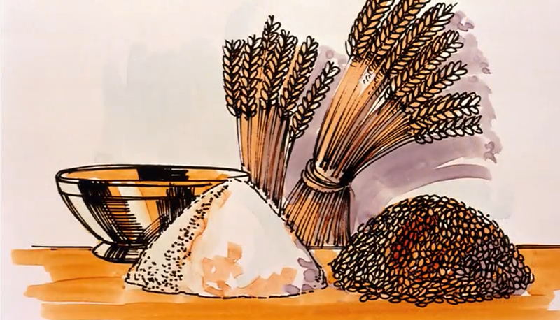
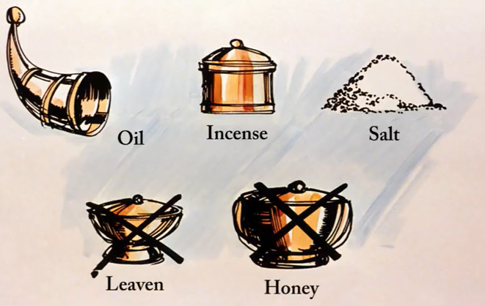
The Grain Offering
Memorial Portion
Lev 2:2 – “He shall then bring it to Aaron’s sons the priests; and shall take from it his handful of its fine flour and of its oil with all of its frankincense. And the priest shall offer it up in smoke as its memorial portion on the altar, an offering by fire of a soothing aroma to the Lord.”
A Thing Most Holy
Lev 2:3 – “The remainder of the grain offering belongs to Aaron and his sons: a thing most holy, of the offerings to the Lord by fire.”
Notes:
Lev 2 informs us that the fine flour could be given directly or it could be baked into loaves prepared in an oven or on a flat iron plate. Only if the grain offering was incumbent of the first fruits could the fresh heads be offered without it being finely ground. In this case, the form was in groats and the fresh ears would be roasted by fire or the dried grains coarsely rubbed or crushed.
But when it was offered, it was divided into two separate portions. The first portion is called the “memorial” portion which is when the priest would take a handful of the grain and offer by fire to the Lord. So in one sense, the offering was a gift to God in which the offerer is giving over the fruit of his labor. But the vast majority of it was given to the priest, which was to be consumed, and this means this offering was primarily intended for man. Yet despite this, Lev 2:1 still says the entire offering was “to the Lord.” Keep this point in mind for when we start dissecting the meaning of this particular offering. God considered this provision for the priests as “a thing most holy”. And because of this, that portion for the priesthood had to be eaten in the inner court, a holy place, to prevent it from getting defiled.
Lev 2 mentions three things to be added to the grain and two things expressly forbidden. The things to be added were oil, salt, and frankincense, which signify things we’ll discuss later. And if God had simply left it at oil, salt, and frankincense, it would be true that there would no authority to add anything else. But the Lord explicitly forbids leaven and honey. The fact he specifically forbids these things seems to suggest that He expected the Jews to grasp the spiritual significance of this offering.

Slide 13
The Grain Offering
Lev 17:14a – “For as for the life of all flesh, its blood is identified with its life…”
Belongs To
Man
Belongs To
God
Gen 1:29 – “Behold, I have given you every plant yielding seed that is on the surface of all the earth, and every tree which has fruit yielding seed; it shall be food for you”
Notes:
Now, what is the significance of this offering? Consider what Lev 17:14 says about blood – Lev 17:14a – “For as for the life of all flesh, its blood is identified with its life…”. When you combine this with God’s command not to eat blood in Gen 9, it is heavily implied that blood belongs to God because all life belongs to God. Contrast this with what God has given to man – Gen 1:29 – “Then God said, ‘Behold, I have given you every plant yielding seed that is on the surface of all the earth, and every tree which has fruit yielding seed; it shall be food for you’”. So blood symbolizes what we owe God, but the grain, oil, frankincense, salt, all this is the fruit of the earth and symbolizes what we owe man. Both are duties of man, but one is a surrender to God, and another one is a fulfillment of our duty toward man. So if the burnt offering is loving the Lord with all our heart, mind, soul, and strength, what might the grain offering represent?

Slide 14
The Grain Offering
Matt 22:37-40– “³⁷And He said to him, ‘You shall love the Lord your God with all your heart, and with all your soul, and with all your mind. ³⁸This is the great and foremost commandment. ³⁹The second is like it, You shall love your neighbor as yourself. ⁴⁰On these two commandments depend the whole Law and the Prophets.’”
Num 29:6 – “besides the burnt offering of the new moon and its grain offering, and the continual burnt offering and its grain offering…”
1 John 4:20-21 – “²⁰If someone says, ‘I love God’, and hates his brother, he is a liar; for the one who does not love his brother whom he has seen, cannot love God whom he has not seen. ²¹And this commandment we have from Him, that the one who loves God should love his brother also.”
Notes:
The grain offering corresponds to loving our neighbor as ourselves. In the burnt offering, we’re surrendering ourselves solely to God. Just as the two greatest commands belong together, so do the burnt offering and the grain offering. But there is order to the two also isn’t there? Num 29:6a – The word “its” appears twice which means that the grain offering belongs to the burnt offering and they were were offered together. Though the burnt offering may appear to be the "greater" of the two, one is incomplete without the other, even as the two great commandments go together. In each case, one shows man doing his duty to God, the other, his duty to man. The NT also conveys this same idea in 1 John 4:20-21 – In other words, the two must go together. The burnt offering is the greater of the two, but its not complete without its grain offering and the grain offering isn’t complete without its burnt offering. No surrendering in our duty to man will matter to God unless we’ve first surrendered ourselves to God.
Could this be why God did not accept Cain’s offering but did accept Abel’s? It’s not that the offering of the ground is not acceptable in certain contexts, but it may very well be that he did not offer a burnt offering first.

Slide 15
The Grain Offering
Lev 2:13 – “Every grain offering of yours, moreover, you shall season with salt, so that the salt of the covenant of your God shall not be lacking from your grain offering; with all your offerings you shall offer salt.”
Num 18:19 – “All the heave offerings of the holy things, which the children of Israel offer to the Lord, I have given to you and your sons and daughters with you as an ordinance forever; it is a covenant of salt forever before the Lord with you and your descendants with you.”
2 Chron 13:5 – “Do you not know that the Lord God of Israel gave the rule over Israel forever to David and his sons by a covenant of salt?”
1 Cor 13:7d – “[love] endures all things”
Prov 17:17a – “A friend loves at all times.”
2 Tim 2:10a – “For this reason I endure all things for the sake of those who are chosen”
Notes:
In Lev 2:13, God says that the reason for adding salt is “so that the salt of the covenant of your God shall not be lacking from your grain offering.” This phraseology is used two other times in scripture. It is also applied directly to the Levites in Num 18:19, as a way to stress to them that though they would not receive a land inheritance as would the other tribes, God would be their inheritance and they could be sure He would see to it that they were provided for through the portions of these sacrifices. Then in 2 Chron 13:5, King Abijah uses this phrase out of nowhere when he relays to Jeroboam that God’s “covenant of salt” with David and his descendants ensured David would always have someone in his line on the throne. These two verses help us to understand why it was used in Lev 2, that what is being stressed is salt’s ability to preserve from corruption, or more specifically, endurance.
So when Jesus tells Christians in Matt 5:13 that we are the salt of the Earth, the symbolism should not be lost on us. He desires His disciples to be a preserving force in this world by which others would come to the gospel and that suggests endurance and that is the level by which our devotion toward man should be. Consider other teachings on this – 1 Cor 13:7d; Prov 17:17a; 2 Tim 2:10a – In our quest to observe the second greatest commandment, God is urging an enduring love toward man no matter how hard it might be.

Slide 16
The Grain Offering
Matt 16:6 – “Take heed and beware of the leaven of the Pharisees and the Sadducees”
1 Cor 5:6-8 – “⁶Your glorying is not good. Do you not know that a little leaven leavens the whole lump? ⁷Therefore purge out the old leaven, that you may be a new lump, since you truly are unleavened. For indeed Christ, our Passover, was sacrificed for us. ⁸Therefore let us keep the feast, not with old leaven, nor with the leaven of malice and wickedness, but with the unleavened bread of sincerity and truth.”
Rom 12:9a – “Let love be without hypocrisy.”
Eph 4:25 – “Therefore, putting away lying, ’Let each one of you speak truth with his neighbor,’ for we are members of one another.”
Col 3:8 – “But now you yourselves are to put off all these: anger, wrath, malice, blasphemy, filthy language out of your mouth”
Notes:
Leaven, on the other hand, stands in contrast to the enduring nature of salt. When you introduce leaven into a substance, it produces fermentation and corruption, and that “spoils” everything, pun intended. This is exactly how the NT uses it – Matt 16:6; 1 Cor 5:6-8 – notice what unleavened bread produces – “sincerity and truth”, meaning its real, not fake.
Deut 16:3 even calls leavened bread the “bread of affliction” and that may be a symbol of what they endured in Egypt rather than the predominant meaning. But the bible continuously signifies leaven as wickedness, malice, and hypocrisy, and those things are directly opposed to the graces of honesty, love, and sincerity – Rom 12:9a; Eph 4:25; Col 3:8
Now interestingly, the first fruit grain offerings could be baked with leaven (Lev 23:17,20) but they were waved before God rather than burned, which probably indicates the presence of sin. It is possible this signifies that most of our offerings to God are mixed with some presence of sin. But not this offering, not the grain offering.

Slide 17
The Grain Offering
Rev 5:8 – “Now when He had taken the scroll, the four living creatures and the twenty-four elders fell down before the Lamb, each having a harp, and golden bowls full of incense, which are the prayers of the saints”
Psa 141:2 – “May my prayer be counted as incense before You; the lifting up of my hands as the evening offering.”
Luke 1:10 – “And the whole multitude of the people were in prayer outside at the hour of the incense offering.”
Matt 5:44 – “But I say to you, love your enemies and pray for those who persecute you”
Luke 6:28 – “bless those who curse you, pray for those who mistreat you.”
Phil 2:14 – “Do all things without grumbling or disputing”
Notes:
They also added frankincense. Remember that the successful completion of the burnt offering is declared to be a soothing aroma, nearly 40 times, which represents God’s satisfaction when we fully surrender ourselves to Him. Frankincense contributes to this satisfaction since the grain offering always accompanies the burnt offering. The bible depicts frankincense as a symbol of prayer: Rev 5:8; Psa 141:2; Luke 1:10
How does this relate to loving our neighbor as ourselves? Frankincense does not release its greatest fragrance until heat is applied. Therefore the frankincense likely signifies the prayerful attitude of a person as he encounters the regular trials that are incumbent with fulfilling the second greatest commandment. Frankincense represents the pleasant satisfaction God experiences when His children prayerfully endure the hardships of unstinting service toward our neighbors and our brothers and sisters in Christ. Matt 5:44; Luke 6:28. We’re prayerfully enduring hardship, not grumbling complaining – Phil 2:14 – Loving is hard but this is not the response God wants!
Why did Jesus tell us that reconciliation with a brother is more important than our sacrificial offering? (Matt 5:23-26). Because it corrupts the meaning behind the offering!

Slide 18
The Grain Offering
Psa 19:10 – “They are more desirable than gold, yes, than much fine gold; sweeter also than honey and the drippings of the honeycomb.”
Psa 119:103 – “How sweet are Your words to my taste! Yes, sweeter than honey to my mouth!”
Prov 5:3 – “For the lips of an adulteress drip honey and smoother than oil is her speech”
2 Cor 7:8 – “For though I caused you sorrow by my letter, I do not regret it; though I did regret it—for I see that that letter caused you sorrow, though only for a while”
Prov 27:6 – “Faithful are the wounds of a friend, but deceitful are the kisses of an enemy.”
Prov 28:23 – “He who rebukes a man will afterward find more favor than he who flatters with the tongue.”
Notes:
Why is honey explicitly forbidden? It could be because it is a type of leaven. But there may be another reason. Honey is symbolic of sweetness, and it is used positively in scripture, even in reference to the word of God: Psa 19:10; Psa 119:103. But notice what the proverb writer says in Prov 5:3. What might be the point of this prohibition?
Honey reacts to heat in the exact opposite way that frankincense does. Frankincense releases its greatest fragrance when put to the fire, but heat corrupts, breaks down, and destroys honey. So it could be that honey is referring to man’s appetites and fancies, in regards to his relationships and “duty” to man. Our love toward our fellow man cannot be accompanied by our sinful lusts and pleasures because it causes us to be partial, flatterers, and manipulators. We then become people who withhold from someone what they need because we’re only giving them what they want – 2 Cor 7:8; Prov 27:6; Prov 28:23 – And so, our love may not always be accompanied by “sweetness” and as a result we should expect the response to this kind of love to be bitter and include reproach and afflictions and persecutions. But real love doesn’t make it about what we need, but about what the other person needs and they may be why God explicitly forbid this here.

Slide 19
The Grain Offering
Zech 4:2-6 – “²He said to me, ‘What do you see?’ And I said, ‘I see, and behold, a lampstand all of gold with its bowl on the top of it, and its seven lamps on it with seven spouts belonging to each of the lamps which are on the top of it; ³also two olive trees by it, one on the right side of the bowl and the other on its left side.’ ⁴Then I said to the angel who was speaking with me saying, ‘What are these, my lord ?’ ⁵So the angel who was speaking with me answered and said to me, ‘Do you not know what these are?’ And I said, ‘No, my lord.’ ⁶Then he said to me, ‘This is the word of the Lord to Zerubbabel saying, “Not by might nor by power, but by My Spirit”, says the Lord of hosts.’”
Gal 5:22-23 – “²²But the fruit of the Spirit is love, joy, peace, patience, kindness, goodness, faithfulness, ²³gentleness, self-control; against such things there is no law.”
Rom 5:5 – “and hope does not disappoint, because the love of God has been poured out within our hearts through the Holy Spirit who was given to us.”
Notes:
The oil signifies the Holy Spirit, which is the power, the ability, and our drive for fulfilling our duty to love our neighbor as ourselves. Zech 4:2-6 – In other words, every good thing we do for man, by virtue of our obedience to the second greatest commandment, is of the Spirit and not of ourselves. Gal 5:22-23; Rom 5:5. How does the Spirit give us this power to love in ways we wouldn’t be able to love with the Spirit? I don’t know. But He does. Without the Holy Spirit, we would not be able to tap into those characteristics of love God requires of us.
Therefore, in adding oil to this offering, we’re declaring to God that fulfilling our duty to man by loving them as God would have us does not come from ourselves, but through the Holy Spirit He has given us. We’re fully acknowledging our dependence on God to provide us with the power, ability, and incentive to fulfill this second greatest commandment.

Slide 20
The Grain Offering
John 6:48 – “I am the bread of life.”
Ground
Isa 52:14 – “Just as many were astonished at you, My people, so His appearance was marred more than any man and His form more than the sons of men.”
Oil
Luke 4:18 – “The Spirit of the Lord is upon Me, Because He anointed Me to preach the gospel to the poor. He has sent Me to proclaim release to the captives, And recovery of sight to the blind, To set free those who are oppressed”
Salt
John 13:1 – “Now before the Feast of the Passover, Jesus knowing that His hour had come that He would depart out of this world to the Father, having loved His own who were in the world, He loved them to the end.”
Frankincense
Matt 26:38-39 – “Then He said to them, ‘My soul is deeply grieved, to the point of death; remain here and keep watch with Me.’ And He went a little beyond them, and fell on His face and prayed, saying, “My Father, if it is possible, let this cup pass from Me; yet not as I will, but as You will.”
No Leaven Or Honey
1 Pet 1:19 – “but with precious blood, as of a lamb unblemished and spotless, the blood of Christ”
Matt 23:13a – “But woe to you, scribes and Pharisees, hypocrites”
Notes:
Jesus embodied the grain offering in every way. Most obvious was His declaration of being the “bread of life” in John 6:48. Bread is the physical staff of life, something we need to survive. We need Jesus to survive. We needed His love in order to live. He took this beyond the second greatest commandment, meaning He didn’t just love us as Himself; He loved us more than His own life.
Consider grain of the ancient world: it wasn’t just ground once like we can do today with modern grinding machinery. Grain of the ancient world was ground many times until it was like talcum powder in consistency. And that was what Jesus was for us, ground in body and spirit. In fact, He was bruised and ground so badly in a physical sense that He was barely recognizable as a man – Isa 52:14 – He was so sapped of strength that He could not bear His cross of crucifixion alone. Another was compelled to bear it for Him because Jesus was already figuratively ground and ready to be put on the altar.
But though ground in body and spirit in every way, he never lacked the power to do what He needed to do and be who He needed to do because He had the Holy Spirit – Luke 4:18; Acts 10:38
He was the salt in that His love was enduring, He loved them to the end – John 13:1
When the heat was on, He brought a prayerful attitude in His love for man – Matt 26:38-39
There was no corruption in His devotion to man – 1 Pet 1:19 – And He certainly wasn’t always sweet was He? He told people exactly what they needed to hear – Matt 23:13a.
Christ is our example for how to love others. He never stopped giving to His fellow man because His offerings of service were always to the Lord. They were never to glorify Himself. And in this manner, He fulfilled the second of the two great commandments perfectly.

Slide 21
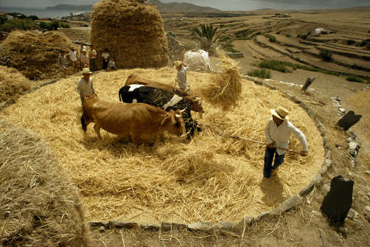
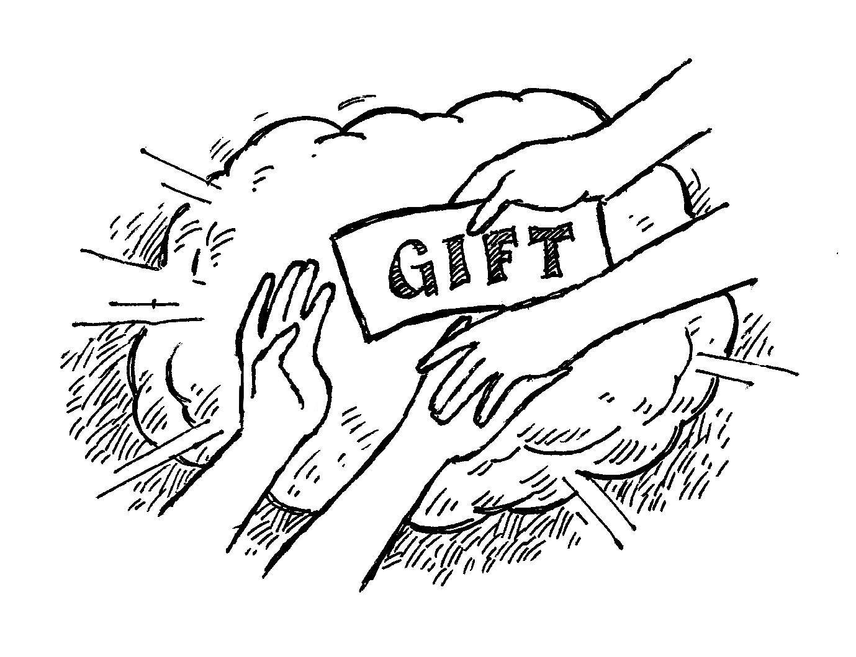
The Grain Offering
Isa 28:28 – “Grain for bread is crushed, indeed, he does not continue to thresh it forever. Because the wheel of his cart and his horses eventually damage it, He does not thresh it longer.”
Phil 4:18 – “But I have received everything in full and have an abundance; I am amply supplied, having received from Epaphroditus what you have sent, a fragrant aroma, an acceptable sacrifice, well-pleasing to God.”
Notes:
What does this mean for us today? Consider what God said to Israel regarding their coming captivity in Isa 28:28. Grain must be ground and bruised before it can be used as bread or food. But it won’t be threshed forever because that would ruin it instead of making it useful. In the same way, our service and devotion to man will be pressing, wearying, and grinding trial. But God won’t put more on us than we are capable of. This is the OT version of 1 Cor 10:13 isn’t it? God won’t allow us to be tempted beyond what we’re able. Loving our fellow man is self-surrender and self-sacrifice. And the nearer our service approaches this degree of self-sacrificing service, the more we will resemble Jesus. We, too, will find ourselves bruised.
If the one motive of our service is to get something “sweet” out of it (honey), we’ll get offended, discouraged, and ultimately quit because it doesn’t take long to realize that service to the Lord is not easy. It is sacrifice. Likewise, if our purpose is corrupting others, as false teachers do, it will be for not. We’ll be exposed. Through Christ, we can learn the correct approach. His service to man was always an offering to the Lord. How men reacted was not His major concern. The Holy Spirit provided Him with the correct perspective and power to keep grinding. Notice Paul’s allusion to the grain offering in Phil 4:18.

Slide 22
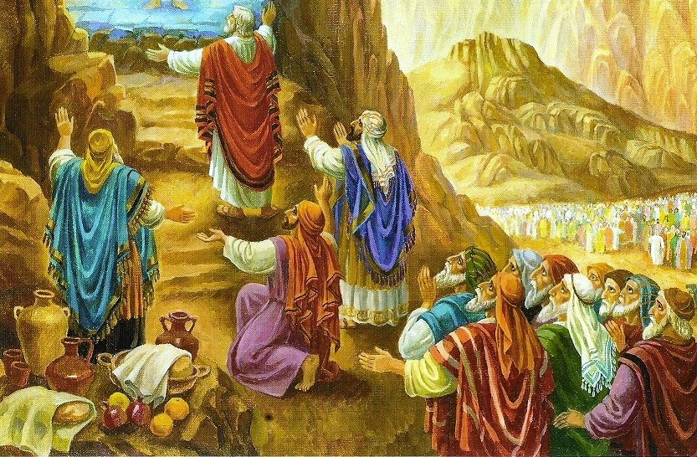
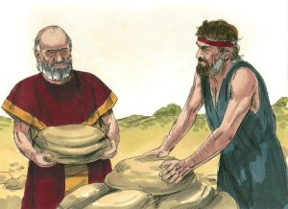
The Peace Offering
Ex 24:9-11 – “⁹Then Moses went up with Aaron, Nadab, and Abihu, and seventy of the elders of Israel, ¹⁰and they saw the God of Israel; and under His feet there appeared to be a pavement of sapphire, as clear as the sky itself. ¹¹Yet He did not stretch out His hand against the nobles of the sons of Israel; and they saw God, and they ate and drank.”
Gen 31:54 – “Then Jacob offered a sacrifice on the mountain, and called his kinsmen to the meal; and they ate the meal and spent the night on the mountain.”
Notes:
The Peace Offering is the third and last of the voluntary offerings; the only time this offering was ever obligatory was at the Feast of Weeks (Pentecost). This is considered by most to be the least understood of the offerings. It’s been given a variety of titles such as “Fellowship Offering”, “Praise Offering”, and “Thanksgiving Offering”, and all of these titles would certainly capture the idea of what the offering was intended to express.
The peace offering was known in Israel long before the Levitical regulations were written down, so the Israelites reading this would have had the whole ritual in their mind as they read about how it was to be performed here. And like the burnt offering, seeing how it was used before Leviticus provides us with keys for its understanding. For example, at the covenant ceremony at Mt. Sinai in Ex 24, it is explicitly said in verse 5 that both burnt offerings and peace offerings were part of that ceremony. Then at the end of that ceremony Moses, Aaron, Nadab and Abihu, and the seventy elders of Israel went up on to the lower reaches of the mountain and “ate and drank” as they beheld the glory of the Lord, and they ate a meal which likely would have been their portion of the peace offerings that had been made. And the result of this offering was that though they saw God, He did not destroy them. Keep this in mind. God is a consuming fire, being in His presence is dangerous for sinful men, but something about consuming this peace offering allowed them to be in the very presence of God and for Him to be in there presence also.
Now Ex 24 is the first mention of the phrase “peace offering,” but its practice likely goes further back. In Gen 31, Jacob had fled from Laban with his family. When Laban caught up with him, they made a covenant that they would not harm one another. Notice Gen 31:54 –See the similarity to Ex 24? Because of the meal, they were not to harm one another. It was a peace offering designed to take two parties who were once at odds with one another (whether God and man or man and man) and brings them together in harmony with one another.

Slide 23
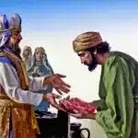
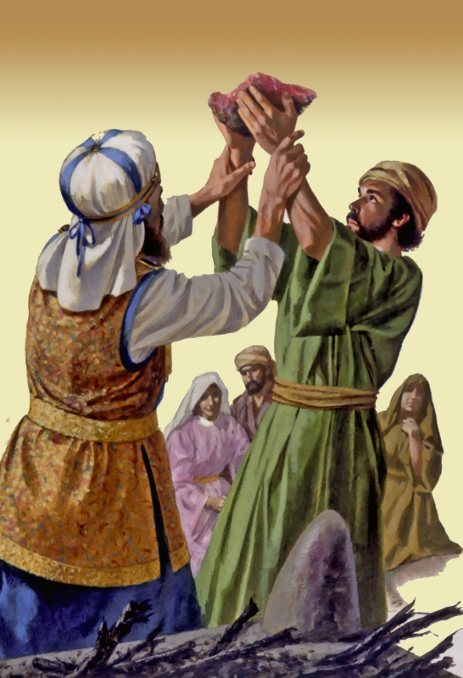
The Peace Offering
Three Circumstances
To Give Thanks (Lev 7:12-15)
Payment of a Vow (Lev 7:16-18)
Freewill Offering (Lev 7:16-18)
Three Animals
Ox/Cow (Lev 3:1-5)
Sheep (Lev 3:6-11)
Goat (Lev 3:12-17)
Notes:
Fast forwarding to Leviticus, this offering was made under three circumstances: for thanksgiving, which became a “confession” or “praise” offering that was given when someone was in dire need of deliverance. This explains why this offering was typically made prior to going to battle. Secondly, it was given as a payment for a vow or even to celebrate an answer to prayer after a person vowed to praise the Lord if He answered the worshipper’s prayer. Hannah’s lavish offering when she dedicated Samuel to the Lord is an example of a peace offering given to commemorate the payment of a vow. Third, the peace offering could be given as a freewill offering in response to God’s unexpected or unsought generosity and therefore became an expression of the worshipper’s goodwill.
The animals that were allowed in this sacrifice was a male or female ox, sheep, or goat. No birds were acceptable. As with the burnt offering, the offerer brought the animal to the north side of the altar where he killed it and then skinned it. The priest then sprinkled its blood on all four sides of the altar to cleanse it. And just like the burnt offering, it was then divided into parts:
The internal fat along with the kidneys and the fat tail of the sheep were removed and separated out into one group. The brisket, or lower chest, was separated into another group along with the right back leg. The right back leg became what is called the “heave offering” because it was lifted/heaved from the animal and it was presented to the priest for his services. The brisket/breast was presented to the Lord as a “wave offering”. This involved the priest placing the brisket in the hand of the offerer and then placing his own hands beneath his. They then moved the brisket in a horizontal motion toward the altar which was an act to symbolically transfer it to the Lord and back again, and this likely represented God’s acceptance of the offering and its transferal back to the priest. If the peace offering was a thanksgiving offering, cakes made with oil and salt and w/o leaven were also waved before the Lord and transferred to the priest which he could then prepare and eat a meal with the male members of his family in the inner court. Then the third group was the remaining portions, which was retained by the offerer who would take it home and use it for a feast in which he could invite family, friends, and the poor.
Now there was a time limit to its consumption. If it was a thanksgiving offering, it had to be eaten within one day. If it was a vow or freewill offering, it had to be eaten within two days. If any remained on the third day, it had to be burned.

Slide 24
The Peace Offering
Deut 10:12-22 – “¹²Now, Israel, what does the Lord your God require from you, but to fear the Lord your God, to walk in all His ways and love Him, and to serve the Lord your God with all your heart and with all your soul, ¹³and to keep the Lord’s commandments and His statutes which I am commanding you today for your good? ¹⁴Behold, to the Lord your God belong heaven and the highest heavens, the earth and all that is in it.¹⁵Yet on your fathers did the Lord set His affection to love them, and He chose their descendants after them, even you above all peoples, as it is this day. ¹⁶So circumcise your heart, and stiffen your neck no longer. ¹⁷For the Lord your God is the God of gods and the Lord of lords, the great, the mighty, and the awesome God who does not show partiality nor take a bribe. ¹⁸He executes justice for the orphan and the widow, and shows His love for the alien by giving him food and clothing. ¹⁹So show your love for the alien, for you were aliens in the land of Egypt. ²⁰You shall fear the Lord your God; you shall serve Him and cling to Him, and you shall swear by His name. ²¹He is your praise and He is your God, who has done these great and awesome things for you which your eyes have seen. ²²Your fathers went down to Egypt seventy persons in all, and now the Lord your God has made you as numerous as the stars of heaven.
Notes:
Significance? Consider the order in which the voluntary offerings were made. The burnt offering was offered first, then the grain offering, and then the peace offering (vs. 5). This makes sense because only our obedience to the two greatest commandments will produce peaceable fellowship with God and man. So not only is this a sacrifice in the truest sense, as maintaining peace and fellowship with God and always is, but it is also an effect of the latter two. It represents the result of a full devotion to God and a devotion to man in service of God. This places all parties in harmony with one another wherein we all enjoy peaceful satisfaction and fellowship.
Now given the complex legislation found in the Mosaic law, one might assume there’d be no room for spontaneous praise. However God has always been delighted to receive special offerings from those whose hearts have been set apart to serve Him – Deut 10:12-22 – Therefore when worshipers under the old covenant wanted to present a special offering before the Lord that was not part of those rituals for propitiation, dedication, or expiation that everyone had to offer, a peace offering was brought to the sanctuary out of the overflow of the worshiper’s heart. It was a holy covenant meal which was participated in with joy because it represented fellowship and acceptance with the Lord.

Slide 25
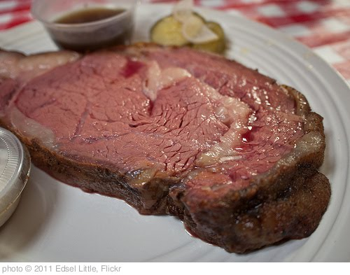
The Peace Offering
The Fat & Kidneys Belong To God
“Fat” = “The Best”
“fat of the land” – Gen 45:18
“fat of lambs” – Deut 32:14
“eat of the fat” – Neh 8:10
“Kidney” = “Desire”
Jer 17:10 – “I, the Lord, search the heart, I test the mind, even to give to each man according to his ways, according to the results of his deeds.”
Psa 26:2 – “Examine me, O Lord, and try me; test my mind and my heart”
Notes:
Why were the kidney and fat given to God?
The fat was given to God because in that time and place it was regarded as the very best part of the animal, hence the phrase “the fat of the land” in Gen 45:18 and other places. In fact, the word for fat as used in these three verses are translated in other verses as “the best” or “the finest”. Even today, any chef will tell you that the tastiest steak is the one marbled with fat. Pig farmers in America have for years worked to take the fat out of the American hog for the sake of us health-conscious consumers who have been taught to prefer lean meat; but lean pork is usually dry and much less appetizing and the market has suffered as a result. So a lot of pork farmers of today are working hard to restore the fat in pork because consumers are turning away from a meat that isn’t as tasty as it used to be. Fat matters in cooked meat! The fat goes to God because God should always get the best, the very finest.
The kidneys are used figuratively all over scripture, but to distinguish between its figurative and literal meaning it is typically translated as the word “reins” in KJV and usually the word “mind” in other translations. And when we see this word, it is apparently referring to the wisdom, emotion, and vigor of a man. – Jer 17:10; Psa 26:2
Therefore the fat and the kidney were metaphorically the seat of human emotions in the ancient world, as the heart is for us today. Perhaps the idea is that the worshipper’s best and deepest feelings were being given to God. Remember, the sacrificial animal was a substitute for the worshipper. Therefore this sacrifice stressed the necessity of men actively yielding their desires and feelings to Him. As they do so, the blood continues to cover them. The peace offering shows man accepted, fed, strengthened, and satisfied by sacrifice, teaching that sacrifice is indeed the essence, the heart and core, the essential element, of love whether to God or man. More specifically, it shows us that sacrifice plays a major role in acceptance before God, spiritual feeding and therefore spiritual strength, and spiritual satisfaction. Devoted people sacrifice for those they love. Thus, sacrifice indicates devotion to God (burnt offering) and devotion in service to man (meal offering) and the peaceful effect that comes from it as well as the sacrifices we make to sustain that peace.

Slide 26
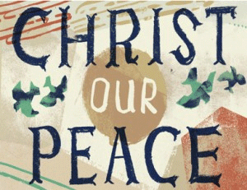
The Peace Offering
Jesus Is Our Peace Offering
Eph 2:13-19 – “¹³But now in Christ Jesus you who formerly were far off have been brought near by the blood of Christ. ¹⁴For He Himself is our peace, who made both groups into one and broke down the barrier of the dividing wall, ¹⁵by abolishing in His flesh the enmity, which is the Law of commandments contained in ordinances, so that in Himself He might make the two into one new man, thus establishing peace, ¹⁶and might reconcile them both in one body to God through the cross, by it having put to death the enmity. ¹⁷And He came and preached peace to you who were far away, and peace to those who were near; ¹⁸for through Him we both have our access in one Spirit to the Father. ¹⁹So then you are no longer strangers and aliens, but you are fellow citizens with the saints, and are of God’s household.”
Notes:
In this sacrifice Christ symbolically represents all three parts: He is the offering, sacrificing His life in service; He is the priest, serving mankind at the altar as Mediator; and He is the offerer, bringing His sacrifice to the altar. The altar, the place of meeting for all three, represents sacrificial services and devotion to God that give Him satisfaction and result in our acceptance. No scripture better presents this than Eph 2:13-19.
There were time limitations given to it. If it were a thanksgiving offering, it had to be consumed on the same day, probably because thanksgiving to God is a daily thing. But the vow and freewill offering were to be consumed by the third day, an obvious reference to Christ, whom Psa 16:10 says would not undergo decay.

Slide 27
The Peace Offering
1 John 3:16-24 – “¹⁶We know love by this, that He laid down His life for us; and we ought to lay down our lives for the brethren. ¹⁷But whoever has the world’s goods, and sees his brother in need and closes his heart against him, how does the love of God abide in him? ¹⁸Little children, let us not love with word or with tongue, but in deed and truth. ¹⁹We will know by this that we are of the truth, and will assure our heart before Him ²⁰In whatever our heart condemns us; for God is greater than our heart and knows all things. ²¹Beloved, if our heart does not condemn us, we have confidence before God; ²²and whatever we ask we receive from Him, because we keep His commandments and do the things that are pleasing in His sight. ²³This is His commandment, that we believe in the name of His Son Jesus Christ, and love one another, just as He commanded us. ²⁴The one who keeps His commandments in Him, and He in him. We know by this that He abides in us, by the Spirit whom He has given us.”
Notes:
How does this apply to us? The spontaneous expressions of gratitude portrayed in Israel’s peace offerings remind us that we should never forget or take lightly the peace we have with our Lord. Each time we think about how Christ has brought us peace with God, we should be moved to praise Him and to declare the good things He has done for us to others, because peace with God as a cause for perpetual joy!
1 John 3 teaches us this principle. In verse 16, John teaches that we can know “love” by observing the way Jesus lived His life. He sacrificed His life for us by laying it down each day, as well as in death, setting us an example to follow in our relations with the brethren. In verse 17, he provides a practical illustration of a way we can lay down our life in love. Then, in verse 18, he encourages us not merely to agree with truth but to take action to meet a brother's need. Verse 19 begins to show the effect of devoted sacrifice to this way of life. The persuasive power of knowing we are doing the right things inspires assurance, confidence, and satisfaction; we feel a positive sense that we are right with God. He then explains that, when these are not produced—but instead we feel guilt and condemnation because we know we are not doing well, and our concern for not being perfect overwhelms us—we need to go to God for forgiveness because He will forgive. Verse 21 is a subtle encouragement to repent, to turn from our self-centeredness so we can be at peace with God and within ourselves. Verse 22 discloses the positive effect of laying down our lives in sacrifice for our brethren by devotedly keeping the commandments: answered prayers. Living by faith and displaying it through a life of sacrificial love is the theme of verse 23, and finally, in verse 24, he reveals another positive effect: to know absolutely that He lives in us and we in Him. Our lives revolve around faith in this knowledge.
Therefore, “peace” as used in terms of this offering does not convey mere tranquility. But it does satisfy in ways that selfishness and self-centeredness never can. We should make this offering every day—on our knees giving thanks, praise, and blessing to God for His abundant mercy and providence.
These three offerings in Leviticus 1-3 broadly define God's way of life: doing all things within the context of His purpose in love. As we have seen, I John 5:3 defines love as keeping the commandments, and the essence of love is sacrificial giving. Today, all who really have communion with God must share that communion with His priest, Christ, and His "children," the rest of the church, the offerer's brethren. (Acts 2:41-46)

