Slide 1
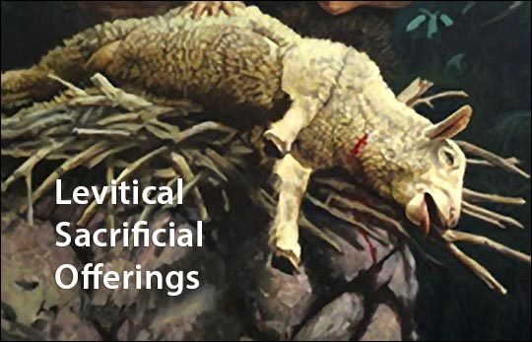
Notes:
In order for Israel to be able to exist in a holy fellowship with God, they were going to have to start doing things differently. God is holy and not just anyone can come into His presence. He dwells in “inapproachable light” (1 Tim 6:16). But Israel, up until now, has been dwelling in Egypt and picking up bad habits along the way. And those bad habits really showed out once God rescued them from Egyptian captivity through their numerous complaints culminating in Ex 32 when they fashioned a golden calf and in worshipping it broke two of the ten commandments in less than 40 days after receiving them. God wanted to kill them then, and if Moses hadn’t interceded we’d likely be calling them the “Mosites” instead of the “Israelites”. But Moses intercedes and God sets some things in place to protect them from this in the future and to instill in them the proper holiness required for Him to dwell in their presence. And that’s where Leviticus comes in:.
A big part of the Levitical law that helped to ensure holiness for an unholy people were the sacrifices and this makes up a large chunk of the book of Leviticus. There were 5 main sacrifices but there were common elements associated with each of them. So before we talk about the individual sacrifices, this class will first focus on the common elements of the sacrifices. That way, when we start looking at the five in detail, and what distinguished them from one another, we can hone in on what made them unique and significant for the Israelites of that day.

Slide 2
Outline
Chap
1-7
Chap
8-10
Chap
11-15
Chap
16
Chap
17-20
Chap
20-22
Chap
23-25
Day of
Atonement
Ritual
Purity
Moral
Ordained
Priesthood
Qualifications
Sacrifices
Rituals
Feasts
Chap 26-27: Consequences of Obedience & Disobedience
Notes:
You’ll recall this outline from last week which will be the framework for out studies. We’re going to focus on the ritual sacrifices for 3 classes.

Slide 3
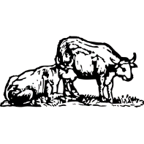
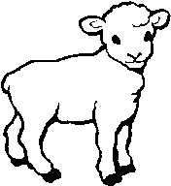
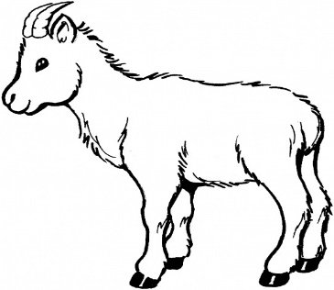
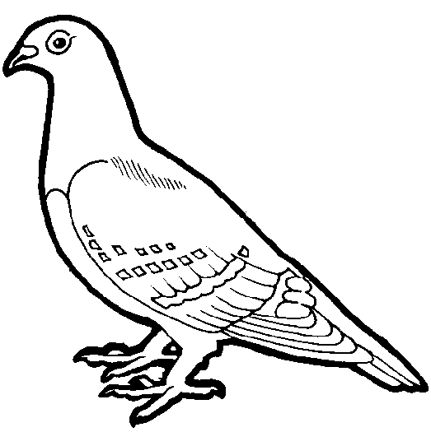
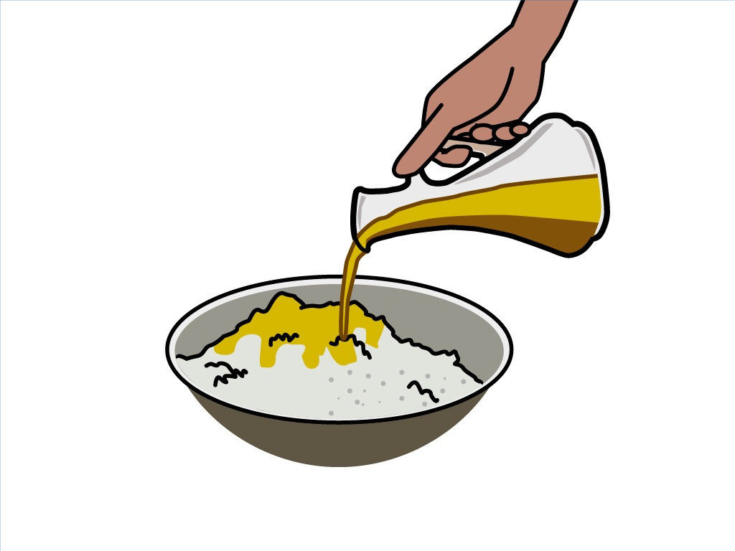
An Offering
Animals
Oxen, bulls, cows
Sheep, lamb, rams
Goats
Birds
Turtle Doves
Pigeons
Grains
Flour
Parched Wheat
Unleavened breads, cakes, wafers
Notes:
First, there were the offerings themselves, which fall into three divisions. There were animals of the flock or herd, certain birds, and then products made of grain which are sometimes called meat offerings and these were also offered with frankincense, olive oil, and salt.
All the animals God allowed for sacrifices were “clean” animals. These animals will appear again in the list from Lev 11, but you’ll remember that long before the Levitical system, there was an understanding of which animals were considered clean and unclean. Gen 7:2-3 – “You shall take with you of every clean animal by sevens, a male and his female; and of the animals that are not clean two, a male and his female; also of the birds of the sky, by sevens, male and female, to keep offspring alive on the face of all the earth.” Why seven pair of clean but only one pair of unclean? Gen 8:20 – “Then Noah built an altar to the Lord, and took of every clean animal and of every clean bird and offered burnt offerings on the altar.” We’ll make some points about what possibly made animals clean or unclean when we study chapter 11, which will further help us understand why its important here. But for now, its sufficient to say that every sacrifice except the burnt offering was consumed either by the offerer, or officiator, or both, and so if for no other reason they would had to be canonically clean because of their consumption.
Now they couldn’t just use any clean animal they wanted to. In addition to being clean, the animals had to be domesticated, which we’ll talk about in just a moment, and they had to be free from any flaws or defects. The lack of flaws or defects would represent the purity of life of the offering.
Now, for the grains, they had to either be ground into fine flour so that the priests, who took the majority of it, could make it into bread, or it had to be roasted or parched.
All this criteria was necessary so that the offering might properly symbolize the one making the offering as well as the offering itself. More on that later.

Slide 4
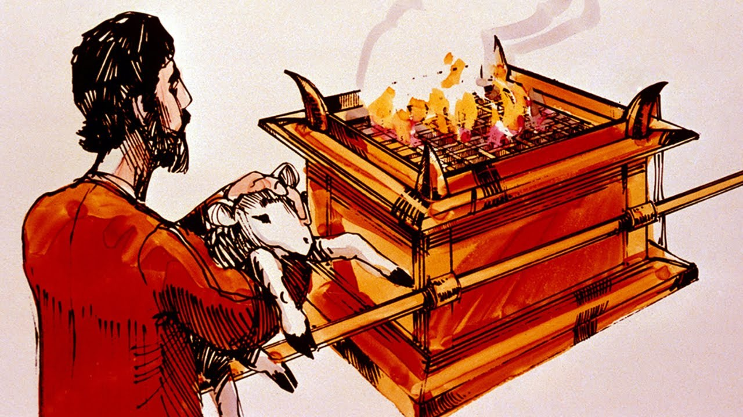
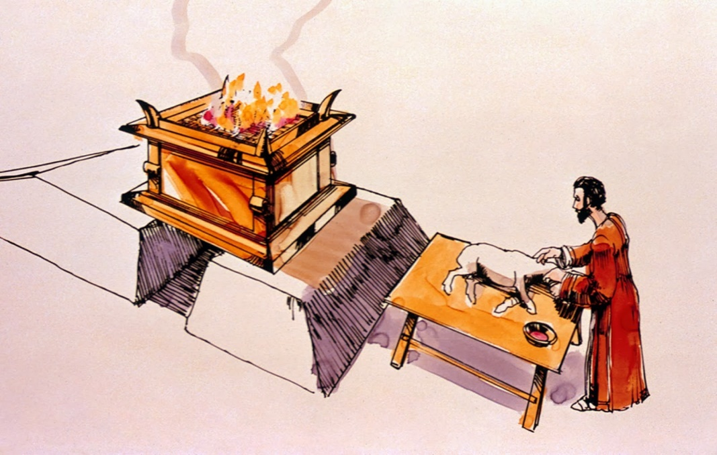
An Offerer
Psa 51:16-17 – “For You do not delight in sacrifice, otherwise I would give it; You are not pleased with burnt offering. The sacrifices of God are a broken spirit; a broken and a contrite heart, O God, You will not despise.”
Amos 5:22-24 – “Even though you offer up to Me burnt offerings and your grain offerings, I will not accept them; and I will not even look at the peace offerings of your fatlings. Take away from Me the noise of your songs; I will not even listen to the sound of your harps. But let justice roll down like waters and righteousness like an ever-flowing stream.”
Notes:
Second, there was an offerer. Now, we typically look at these sacrifices as a type of Jesus and the sacrifice He made on the cross. And that is true assessment to a large degree. But, at this point in time they were ideally designed to teach the one making the offering what kind of spirit God expected of them as they draw near to Him soliciting atonement.
So, for example, regarding the sin offering, since this is one of the ones we more easily understand, when they sinned, they had to take an animal from their flock, take it to the tabernacle, and bring it before the altar where the priest would be. Then, the offerer had to put his hand on the head of that animal, and he killed the animal, not the priest. The offerer would take a knife, cut the animal’s throat, and stand there watching the animal die. And what was supposed to be going through his mind is, “I’ve sinned. And this animal is dying for me”. The animal didn’t do anything. Whatever sin was committed by the person, priest, congregation, or ruler, the animal didn’t participate in it. The animal was out there in the field minding its own business, doing what animals do and now all of the sudden he’s being dragged into the tabernacle w/o any understanding of what’s happening and having his throat slit by the man standing there, and the man is holding this animal’s head while it undergoes a slow, agonizing death. Do you think those people should have been impacted by the image of what was going on in front of them? “This animal didn’t do it; I did. I’m guilty”
King David understood this about the Levitical offerings. Psa 51:16-17 – “For You do not delight in sacrifice, otherwise I would give it; You are not pleased with burnt offering. The sacrifices of God are a broken spirit; a broken and a contrite heart, O God, You will not despise.”
In other words, God never wanted the animals. He wanted the broken heart and broken spirit of the man offering the animal.
Amos 5:22-24 – “Even though you offer up to Me burnt offerings and your grain offerings, I will not accept them; and I will not even look at the peace offerings of your fatlings. Take away from Me the noise of your songs; I will not even listen to the sound of your harps. But let justice roll down like waters and righteousness like an ever-flowing stream.”
In other words, God didn’t merely want these people to make sacrifices; He wanted those sacrifice to change their hearts. And if you brought your sacrifice and your heart wasn’t any different, your sacrifice didn’t do any good at all. And this is where Jesus comes into the picture. He fully represented all the sacrifices in both his life and death because Israel either couldn’t ever do it (such as the case with the sin and guilt offering) or they insufficiently lived up to the standard of them (in the case of the burnt, grain, and peace offerings).

Slide 5
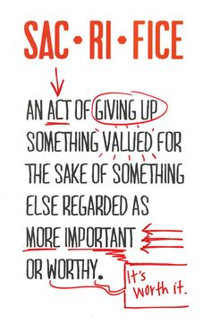
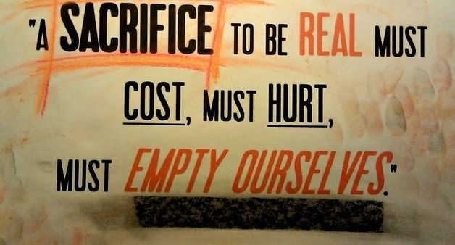
A Sacrifice
Mal 3:10 – “‘Bring the whole tithe into the storehouse, so that there may be food in My house, and test Me now in this,’ says the Lord of hosts, ‘if I will not open for you the windows of heaven and pour out for you a blessing until it overflows.”
2 Sam 24:24 – “However, the king said to Araunah, ‘No, but I will surely buy it from you for a price, for I will not offer burnt offerings to the Lord my God which cost me nothing.’ So David bought the threshing floor and the oxen for fifty shekels of silver.”
Notes:
And this is why its called a sacrifice. The idea behind sacrifice is giving up something that you want for something that you want more. If you want God, truly want Him for what He offers undeserving men, you’ll give up anything, including things of material and temporal value. And so, in this system, in order for the offering to truly be a sacrifice, it had to be a product of the offerer’s own labor. It couldn’t be a wild animal or something given to him or something that he steals. You’ll remember from Mal 1:13 that one of the reasons God was no longer accepting their offerings is because they were bringing that which had been acquired through robbery. The sacrifice had to be a product of the offerer’s labor, something that he depended on to sustain his life. Because when the offerer gives up something that came from the toil of his hands, which is indicative of his labor and time, and also gave of something that he needed to sustain his physical life, the offerer is representing and symbolizing the surrender of his soul to God and his absolute dependence on God to sustain him. This is what made it a sacrifice which then made it acceptable to God because it became something that you did by faith. And as this same individual continued to yield and serve His Creator, He would find that God could easily replace in abundance what was being offered.
Mal 3:10 – “‘Bring the whole tithe into the storehouse, so that there may be food in My house, and test Me now in this,’ says the Lord of hosts, ‘if I will not open for you the windows of heaven and pour out for you a blessing until it overflows.”
King David knew what a sacrifice truly was. In 2 Sam 24, when David took the census and sinned against God, he was commanded to build an altar at the threshing floor of Araunah where the angel of the Lord stood near. When he told Araunah that he needed to purchase the threshing floor from him, Araunah offered to just give it to him along with the oxen and the wood. Notice David’s response – 2 Sam 24:24 – “However, the king said to Araunah, ‘No, but I will surely buy it from you for a price, for I will not offer burnt offerings to the Lord my God which cost me nothing.’ So David bought the threshing floor and the oxen for fifty shekels of silver.”
Did David understand the concept of sacrifice? Absolutely he did. But this culture does not, including the Christian culture we live in. I’ve wondered if the reason why we’re losing so many young people is because it is costing some of them way too little to serve God. I’ve wondered about this of all brethren, but especially our young people. I wonder if the thinking doesn’t exist that being a Christian and going to church is just one of those things you do that doesn’t require much effort or cost us very much. Go to church just enough to keep the elders from withdrawing from you. Sin all you want as long as just before you eat or go to bed you say a prayer for forgiveness. Brethren, that is cheap grace and there is no such thing as cheap grace because of what it cost the Lord. There is no acceptable worship to God, whether it is private or public worship, that doesn’t demand real, genuine sacrifice on our part. That was the case in Leviticus and it is still the case today. It must cost us something for it to be of real value to the Lord.

Slide 6
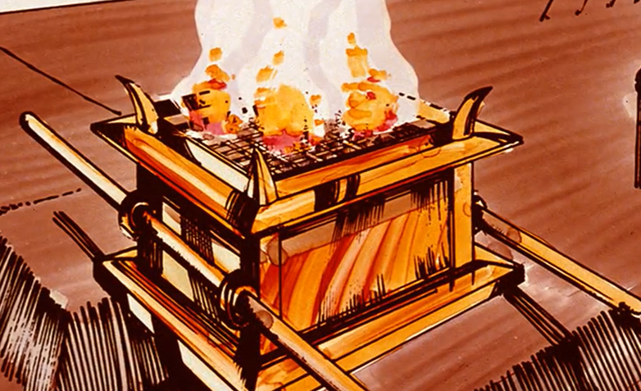
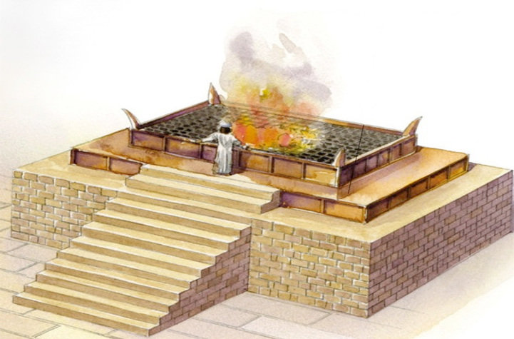
An Altar
Ex 29:42-43 – “It shall be a continual burnt offering throughout your generations at the doorway of the tent of meeting before the Lord, where I will meet with you, to speak to you there. I will meet there with the sons of Israel, and it shall be consecrated by My glory.”
Notes:
Now the general location where these sacrifices would be made were at the tabernacle/temple. Scripture does not explicitly spell this out, to my recollection, but we believe the altar was an elevated place, suggesting man’s approach to heaven, the realm of deity. In fact the Latin word for “altar” means “high”. So it would either be placed upon a mound of dirt, which is what we believe they did for the tabernacle, or built upon a structure which we know they did in Solomon’s temple.
More pertinent, though, is that this is where God designated that the sacrifices would be made – at the brazen altar right at the entrance to the courtyard. And this in Ex 29, it was at this altar that God said He would meet with Israel, speak to them, and reconcile them. Ex 29:42-43
So think about it. You’re approaching the tabernacle/temple where God’s presence dwells and boy would it be something to be there in His presence. But as soon as you entered through the courtyard gate of that tabernacle, the first thing you would see standing right before your eyes was this brazen altar with that massive fire upon it and blood is everywhere; its a perpetual reminder that you were not worthy to approach a holy God without first offering a blood sacrifice for your sins. This was to leave an impression on Israel

Slide 7
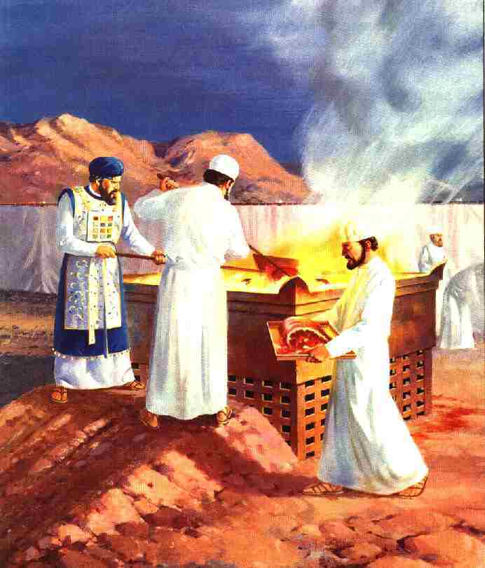
A Priest
Lev 10:10-11 – “[You are] to make a distinction between the holy and the profane, and between the unclean and the clean, and so as to teach the sons of Israel all the statutes which the Lord has spoken to them through Moses.”
Ex 28:2 – “You shall make holy garments for Aaron your brother, for glory and for beauty”
Lev 4:4-7 – “He shall bring the bull to the doorway of the tent of meeting before the Lord, and he shall lay his hand on the head of the bull and slay the bull before the Lord. Then the anointed priest is to take some of the blood of the bull and bring it to the tent of meeting, and the priest shall dip his finger in the blood and sprinkle some of the blood seven times before the Lord, in front of the veil of the sanctuary. The priest shall also put some of the blood on the horns of the altar of fragrant incense which is before the Lord in the tent of meeting; and all the blood of the bull he shall pour out at the base of the altar of burnt offering which is at the doorway of the tent of meeting.”
Notes:
Now each individual prepared the sacrifice for himself, or for his family, but he was not allowed to approach the brazen altar until expiation was made. He was considered sinful, unclean, or even common and so he was barred from access to those areas which were designated as holy. Yet an offering had to be made to get him out of this condition and so he needed a mediator, someone who could intervene and minister on his behalf before God. The person who was designated to do this was the priest. Only the priest could approach the altar and offer the sacrifice that would make the Israelite clean and acceptable. In this role, the priest as well as the high priest, was a type of Christ, the perfect Mediator between God and man. The priest prepared the way by which repentance could be granted and man could become acceptable to God.
Because the priest served in this role, he was required to be particularly consecrated and holy before the Lord, and to be able to know the difference between that which was holy and profane so that they could protect themselves and also to teach the people. Lev 10:10-11 – “[You are] to make a distinction between the holy and the profane, and between the unclean and the clean, and so as to teach the sons of Israel all the statutes which the Lord has spoken to them through Moses.”
The picture above shows the priests in their linen white garments, that God specified for them in Ex 28. Verse 2 of this chapter tells us that these garments were to be holy garments, for glory and for beauty. But what I’m going to suggest to you is that the duties they performed were not indicative of maintaining this glory and beauty – Lev 4:4-7 – “He shall bring the bull to the doorway of the tent of meeting before the Lord, and he shall lay his hand on the head of the bull and slay the bull before the Lord. Then the anointed priest is to take some of the blood of the bull and bring it to the tent of meeting, and the priest shall dip his finger in the blood and sprinkle some of the blood seven times before the Lord, in front of the veil of the sanctuary. The priest shall also put some of the blood on the horns of the altar of fragrant incense which is before the Lord in the tent of meeting; and all the blood of the bull he shall pour out at the base of the altar of burnt offering which is at the doorway of the tent of meeting.”
What do you suppose they looked like after a day of offering animals? Can you imagine coming to the tabernacle and seeing that minister of God, pure/holy/clean as God’s official, but when just you are finished with your sacrifice, the man is covered in blood? What should these people have thought about in regards to sin? They should have learned just how dirty sin makes everything. Sin takes things that are clean and makes them dirty; takes things that are pure and makes them impure; takes things that are beautiful and makes them ugly. Things in this life that are intended to be a blessing like the marriage relationship, the local church relationship, friendships, sin gets in these relationships and turns them ugly. The priests were supposed to represent a distinction between the profane and the holy, but under this system, the priests became perpetual reminders of the consequences of sin. The Israelites should have seen their sin as a heinous thing because of how much the blood required to atone for it tainted everything around them, including that which was to be distinct and holy.

Slide 8
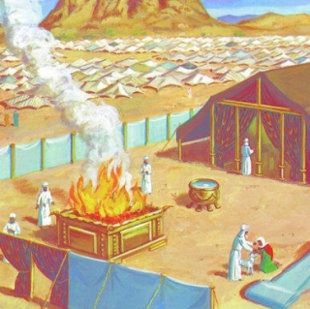
The Fire
Lev 9:24 – “Then fire came out from before the Lord and consumed the burnt offering and the portions of fat on the altar; and when all the people saw it, they shouted and fell on their faces.”
Lev 6:13 – “Fire shall be kept burning continually on the altar; it is not to go out.”
Purifies
1 Cor 3:13 – “each man’s work will become evident; for the day will show it because it is to be revealed with fire, and the fire itself will test the quality of each man’s work.”
1 Pet 1:7 – “so that the proof of your faith, being more precious than gold which is perishable, even though tested by fire, may be found to result in praise and glory and honor at the revelation of Jesus Christ”
Judgment
Lev 10:2 – “And fire came out from the presence of the Lord and consumed them, and they died before the Lord.”
Notes:
The altar also housed the fire. Lev 9:24 tells us that this fire originated from God Himself and according to Lev 6:13, it was to never go out. And so the fact that it began with God would have been an additional reminder to Israel of God’s atoning power and that as long as this fire burned, the covenant would continue and atonement would be available for the people, which made the ordinance of sacrifice efficacious. And you’ll remember that when Solomon’s temple replaced the tabernacle, 1 Chron 7:1 tells us that God once again lit the fire from the altar.
It was also a reminder of God’s presence. Prior to this, God had appeared to Moses in a burning bush (Ex 3:2), He had led the people as a cloud by day and a fire by night (Ex 13:21-22), He had appeared at the top of Mt. Sinai as a blazing fire (Ex 19:18), and He is referred to in Deut 4:24 as a consuming fire.
In the bible fire typically symbolized two things:
Purifying action – Fire destroys that which is perishable and corrupt, but it purifies that which has an imperishable portion with it. 1 Cor 3:13 – “each man’s work will become evident; for the day will show it because it is to be revealed with fire, and the fire itself will test the quality of each man’s work.” 1 Pet 1:7 – “so that the proof of your faith, being more precious than gold which is perishable, even though tested by fire, may be found to result in praise and glory and honor at the revelation of Jesus Christ”. With the sacrifices, the fire burned that which was corruptible, but the incorruptible nature of it (the innocence of the animal, etc.) was a soothing aroma to God. Even the ashes left behind were holy and to be disposed of in a holy place.
Divine displeasure – Fire also is a tool of God’s divine displeasure, employed in numerous places in scripture. Lev 10:2 – “And fire came out from the presence of the Lord and consumed them, and they died before the Lord.”
Both of these symbols appear to be employed here: judgment and purification…as well as the cross.

Slide 9
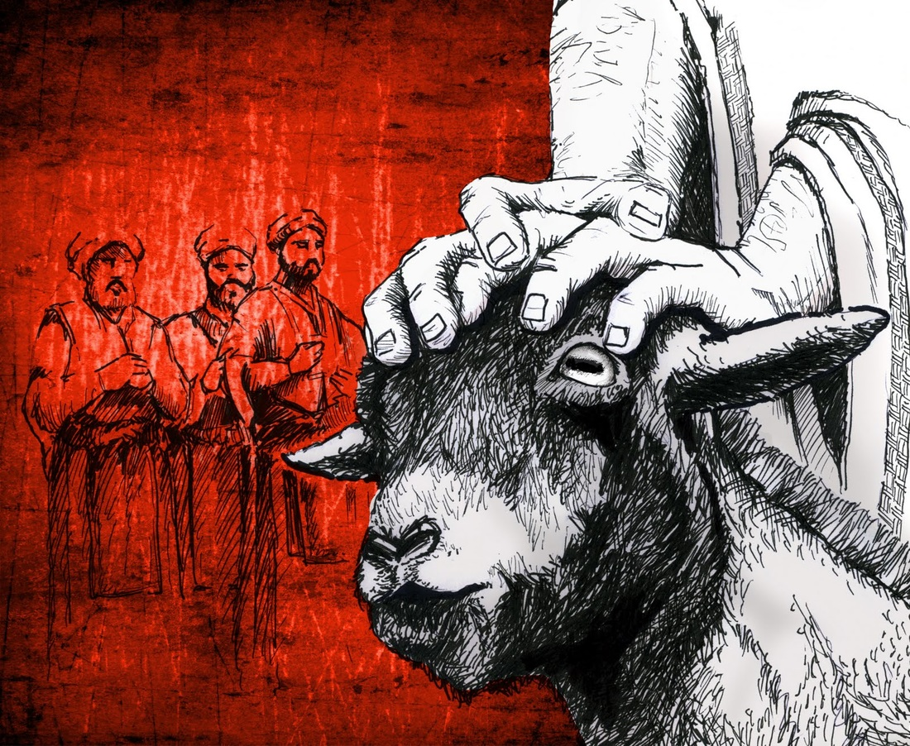
Laying On Of Hands
Lev 16:21 – “Then Aaron shall lay both of his hands on the head of the live goat, and confess over it all the iniquities of the sons of Israel and all their transgressions in regard to all their sins; and he shall lay them on the head of the goat and send it away into the wilderness by the hand of a man who stands in readiness.”
Lev 7:11-13 – “Now this is the law of the sacrifice of peace offerings which shall be presented to the Lord. If he offers it by way of thanksgiving, then along with the sacrifice of thanksgiving he shall offer unleavened cakes mixed with oil, and unleavened wafers spread with oil, and cakes of well stirred fine flour mixed with oil. With the sacrifice of his peace offerings for thanksgiving, he shall present his offering with cakes of leavened bread”
Notes:
Now before the animal was slain, the offerer would place his hands on the animal’s head. This symbolized one of two things, depending on whether it was one of the obligatory offerings or a voluntary offering.
If the offering was obligatory, the offerer placed his hands on the animal’s head w/a confession of his sins (Lev 16:21). This action symbolically imputed his sins to the animal. The animal then became a substitutionary atonement for the offerer where it was then killed by the offerer in his place because “the wages of sin is death”. And this process was designed by the Lord to stress the vicarious nature of the work through which man’s sins are forgiven. But if the offering was voluntary, meaning an individual burnt or peace offering, it made atonement, but he placed his hands on the animal’s head as more of an expression of devotion (Lev 7:11-13). This probably symbolized the transfer of the feelings of his heart that compelled him to bring this gift as if to say, “This is my property which I now devote to God.” The offerer was transferring the feelings which influenced him to perform this act of dedication to the Lord. And by doing this, the offerer demonstrated total self-surrender to the will of God. This is what made the offering a sweet savor to God. Just as the delightful smell and taste of a good meal satisfies a hungry man, the life of the offerer, willingly submissive and obedient, brings God satisfaction. We’ll dissect this point more next week. Ultimately, whichever offering, the idea was the same: the identification of the offerer with the animal being slain. This same idea was expressed in the NT through the laying on of heads. The giver of those gifts was, in a way, identifying himself with the one he was imparting his gift to. This is likely why Paul warned Timothy to take care he not lay hands on someone hastily (1 Tim 5:22) - the idea was not to be involved in their sin.

Slide 10
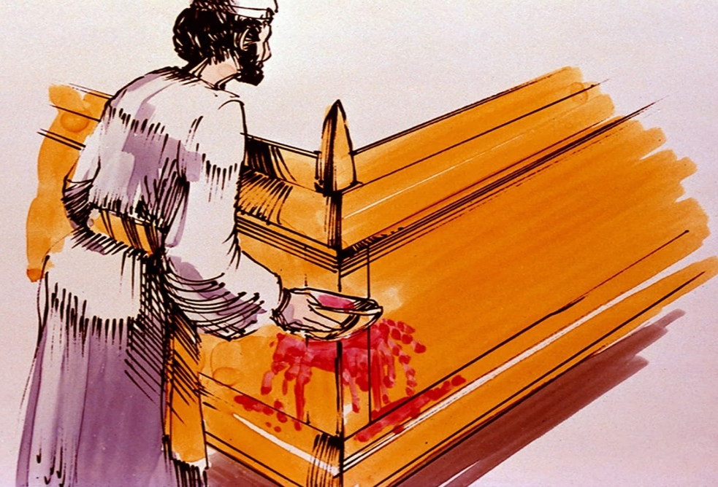
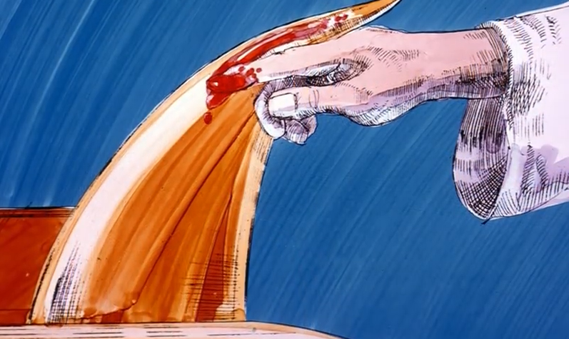
The Blood
Lev 17:11 – “For the life of the flesh is in the blood, and I have given it to you on the altar to make atonement for your souls; for it is the blood by reason of the life that makes atonement.”
Heb 9:22 – “And according to the Law, one may almost say, all things are cleansed with blood, and without shedding of blood there is no forgiveness.”
Notes:
Nothing played a more prominent role in the sacrifices than the blood of the offering, and the manner in which it was used was minutely specified by the Lord. Depending on the offering, the blood might be dabbed upon the horns that were on the four corners of the golden altar of incense, splashed/sprinkled on all four the sides of the brazen altar, or dumped out at the base of the altar, or sprinkled seven times on the veil. Why blood? Lev 17:11 – “For the life of the flesh is in the blood, and I have given it to you on the altar to make atonement for your souls; for it is the blood by reason of the life that makes atonement.”
So there were two things the blood then symbolized. First, it dramatizes the consequences of sin, and secondly, the great pains involved in the process of forgiveness and reconciliation. And so the blood symbolized both life and the shedding of blood, or the giving of one’s life. Death is the consequence of sin and so the animal was slain to show what happens when man sins. And the blood “covered” sins which is the literal meaning of the word “atonement”.
Heb 9:22 – “And according to the Law, one may almost say, all things are cleansed with blood, and without shedding of blood there is no forgiveness.”

