Slide 1
Notes:
The book of Exodus concludes with Moses outside the tent of meeting that. Ex 40:34-35 – “Then the cloud covered the tent of meeting, and the glory of the Lord filled the tabernacle. Moses was not able to enter the tent of meeting because the cloud had settled on it, and the glory of the Lord filled the tabernacle.”
Lev 1:1 – “Then the Lord called to Moses and spoke to him from the tent of meeting, saying…”
Num 1:1 – “Then the Lord spoke to Moses in the wilderness of Sinai, in the tent of meeting” .
In other words, something kept Moses out of the tent of meeting and away from God’s presence. But whatever that was seems to be solved by the time you get to the book of Numbers. The answer to this puzzle appears to be solved by the book of Leviticus because by the time the book of Numbers occurs, Moses is now meeting with God in the tent of meeting. So something happens in Leviticus of crucial importance for this to occur.
Why is it called Leviticus? Because while the instructions contained are beneficial for all of God’s people, in the OT, the tribe of Levi were the ones responsible for teaching the law to the rest of the people. You’ll remember that the tribe of Levi was the only tribe not to receive a specific inheritance of land in Canaan in which to dwell. Rather, God chose to take this tribe and to scatter them by families throughout all the tribes so that all Jews could have access to Levites who could teach them the law of God.

Slide 2
Challenges
Detailed rules and laws that no longer apply
The severity of the laws
It’s dry (on the surface)
Necessity
Foundation of the scheme of redemption
Crucial for understanding NT
Clear picture of God
Notes:
Here’s an interesting factoid. The book of Leviticus was the first book of the bible taught to children in Jewish synagogues. But for Christians, it is considered to be the most overlooked book in all of scripture. And this is despite the fact that we do recognize its authenticity and inspiration. We know this book belongs, we know it important, but we have tried to read it and glean the truths from it that God would have us to learn and we’re left frustrated and scratching our head. Most of us make it about as far as when he starts talking about leprosy and then say, “Enough of this, I’m skipping to Numbers.” Because its challenging right?
Challenges
Detailed rules and laws that no longer apply to us. Who hasn’t tried to read Leviticus only to get a mental block? We read all about these sacrifices and as we do, we think to ourselves, “Ok, I get sacrifice but do I really need to know the difference between the sin offering and the guilt offering?” Then we get to the qualifications of priests and we think to ourselves, “But these rules don’t apply anymore. We don’t need this.” The story of Nadab and Abihu is a practical story but then as soon as we get to chapter 11 we’re honestly wondering how important it really is that we know how to distinguish between those animals that chew the cud and those that don’t because the NT makes it clear that these dietary restrictions no longer apply. So we recognize that these rules were important for a particular time, but do I really want to think so deeply about all the intricacies let alone reserving mental space to memorizing them?
Others look at the extreme severity of the laws given, some of which appear on the surface to be arbitrary, and conclude that it is irreconcilable with the grace, mercy, and dignity of the God they serve. We hear, “God is love” and anything that challenges that idea is discarded. But the love of God is not the only characteristic of God nor is it the flowering, blue skies and rainbows love we wish it to be. The book of Leviticus provides a glimpse into God’s love, but we also see His holiness and His goodness. And this is a cause for praise as well as great dread. Because one side of us agrees with that goodness and the other side of us embraces selfishness which God detests. So there is severity in this book – Rom 11:22 – “Behold then the kindness and severity of God”. It’s not our job to force the bible to say what we want it to say about God. Our job, severe or not, is to learn, to accept, and to apply.
It’s dry, on the surface. I’m just being honest. Genesis and Exodus are super exciting books but Leviticus is a bit of a letdown in the excitement department. Someone once said that the Leviticus is like the liver and onions of the bible only for his friend to respond, “I like liver and onions better.” But part of the problem is that we live in culture that thinks that anything not entertaining is not worth listening to. The Magna Carta, the Declaration of Independence, and the Constitution of the United States were not written to entertain us. If we want to be entertained, we should read books that begin with, “once upon a time,” and end with “and they lived happily ever after.” And if we want to be informed about things vital to the present and to eternity, we must set aside our desire for entertainment and give this book a thorough study.
Because while this book may not be the most entertaining book in the bible, it is necessary.
Necessity
It is the foundation for the scheme of redemption. Leviticus prefigures Christ arguably more than any other book of the OT. While the Levitical priesthood and sacrifices are no more, the spiritual truth they represented continue to abide. God is just as holy today as He was when Leviticus was written. He is just as intolerant of sin. He is just as merciful to the penitent sinner who is atoned by blood. And there continues to be no citizenship in the kingdom of God apart from a High Priest with a propitiatory sacrifice for sins. Only when we understanding the nuts and bolts of God’s scheme of redemption can we truly appreciate Jesus Christ’s redemptive work.
Crucial for understanding NT. It is the 6th most quoted book in the NT (quoted 13 times). So we have 37 books in all in the OT and this one falls at #6 in quotations. The Holy Spirit is trying to tell us that this book has some important things for us to get out of it. Consider these examples: Mark 9:49-50 – “For everyone will be salted with fire. Salt is good; but if the salt becomes unsalty, with what will you make it salty again? Have salt in yourselves, and be at peace with one another.” Rom 12:1 – “Therefore I urge you, brethren, by the mercies of God, to present your bodies a living and holy sacrifice, acceptable to God, which is your spiritual service of worship.” Phil 4:18 – “But I have received everything in full and have an abundance; I am amply supplied, having received from Epaphroditus what you have sent, a fragrant aroma, an acceptable sacrifice, well-pleasing to God.” Heb 13:10-14 – “We have an altar from which those who serve the tabernacle have no right to eat. For the bodies of those animals whose blood is brought into the holy place by the high priest as an offering for sin, are burned outside the camp. Therefore Jesus also, that He might sanctify the people through His own blood, suffered outside the gate. So, let us go out to Him outside the camp, bearing His reproach. For here we do not have a lasting city, but we are seeking the city which is to come.” None of these verses even make sense unless you understand what is in Leviticus. But when we’re done with this quarter, all four of those verses we just referenced should make sense.
Gives us a clear picture of God. In fact, it is a clearer picture than what the OT saints had. 1 Pet 1:10-12 – “As to this salvation, the prophets who prophesied of the grace that would come to you made careful searches and inquiries, seeking to know what person or time the Spirit of Christ within them was indicating as He predicted the sufferings of Christ and the glories to follow. It was revealed to them that they were not serving themselves, but you, in these things which now have been announced to you through those who preached the gospel to you by the Holy Spirit sent from heaven—things into which angels long to look.”

Slide 3
Notes:
Again, Lev 1:1 – “Then the Lord called to Moses and spoke to him from the tent of meeting, saying…”. What happened of significance up to this point?
Gen 12:1-3 – “Now the Lord said to Abram, ‘Go forth from your country, and from your relatives and from your father’s house, to the land which I will show you; and I will make you a great nation, and I will bless you, and make your name great; and so you shall be a blessing; and I will bless those who bless you, and the one who curses you I will curse. And in you all the families of the earth will be blessed.’”
Within these verses are the three promises made to Abraham – land, nation, and seed. The seed promise is the only familiar one up to this point in Genesis since it references the first Messianic promise given in Gen 3:15 that the seed of woman would bruise the head of the seed of the serpent. Now we know that God not only plans for the line of Abraham to be from which the seed promise would be fulfilled, but that his plan in doing so would also involve making from Abraham a nation and giving that nation a land. Now all three of these promises were repeated to Abraham’s son Isaac in Gen 25, and again to Isaac’s son Jacob in Gen 28.

Slide 4
Notes:
Back in Gen 15, God gives Abraham a few more details in how these promises are going to go about being fulfilled – Gen 15:13-16
What event is being foretold here? The Exodus. Abraham had a great-grandson named Joseph who was sold by his own brothers into slavery in Egypt. Over the course of 13 years, he rose from slavery to prominence as Pharaoh’s right hand man. And it was through Joseph that the rest of his family eventually landed in Egypt and over the course of 400 years, 70 of the seed of Abraham exploded to ~2M people. They were so mighty in number that the current Pharaoh, who did not know the great things Joseph had done for Egypt, enslaves these Israelites.
But God hears the cries of these Israelites in their slavery, and He raises up a deliver – Moses. After God uses Moses to afflict Egypt with 10 plagues of extraordinary power and judgment, Moses successfully leads these Israelites out of Egypt, supplied with numerous possessions from the Egyptians who would have given them anything just to get them out of there, and they make their way to Mt. Sinai where they will meet with God Himself.

Slide 5
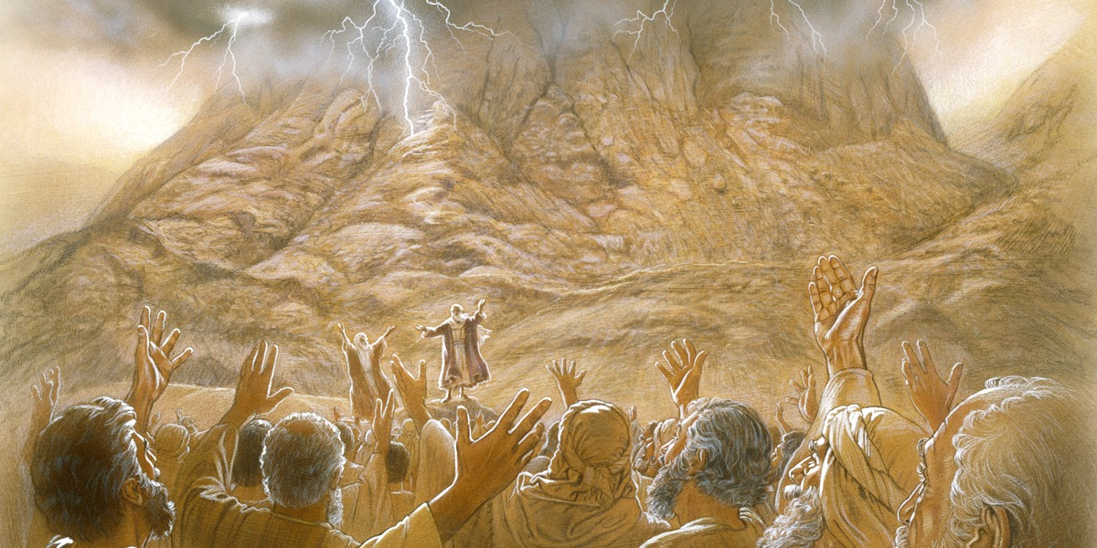
Ex 19:4-6 – “‘You yourselves have seen what I did to the Egyptians, and how I bore you on eagles’ wings, and brought you to Myself. Now then, if you will indeed obey My voice and keep My covenant, then you shall be My own possession among all the peoples, for all the earth is Mine; and you shall be to Me a kingdom of priests and a holy nation.’ These are the words that you shall speak to the sons of Israel.”
Notes:
Ex 19:4-6 – “‘You yourselves have seen what I did to the Egyptians, and how I bore you on eagles’ wings, and brought you to Myself. Now then, if you will indeed obey My voice and keep My covenant, then you shall be My own possession among all the peoples, for all the earth is Mine; and you shall be to Me a kingdom of priests and a holy nation.’ These are the words that you shall speak to the sons of Israel.”
Now this gives us some insight into the kind of nation God wants Israel to be. Not just any nation, but a holy nation. A nation that stands out amongst all the nations as God’s own kingdom of priests. It was to be a nation that was an ensign to all other nations and in whom all other nations would look up to. But in order to be that nation, God needed to provide them with a Law.

Slide 6
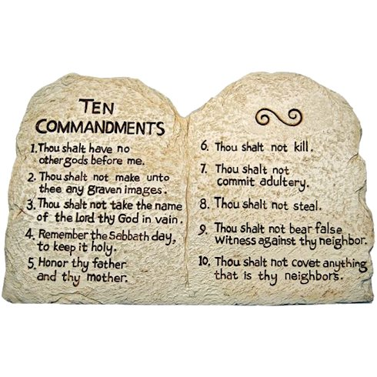
Ex 24:3b – “…all the people answered with one voice and said, ‘All the words which the Lord has spoken we will do!’”
Ex 24:7b – “…they said, ‘All that the Lord has spoken we will do, and we will be obedient!’”
Notes:
And therefore in Ex 20, God gives them the 10 commandments. And He speaks them to the Israelites from Mt. Sinai itself in order to instill fear in the Israelites so that they might follow Him. In Ex 24, God ratifies the covenant with Israel, in blood, and do you remember what the Israelites said twice in this chapter? Ex 24:3b – “…all the people answered with one voice and said, ‘All the words which the Lord has spoken we will do!’” Ex 24:7b – “…they said, ‘All that the Lord has spoken we will do, and we will be obedient!’” And so with this confession, Moses is invited up on the mountain to commune with God and receive the remainder of the law, which would take 40 days, while the people remained below and waited on them.
Now if I told you that this is a picture of the original tablets in which God Himself inscribed the 10 commandments, would you believe me? No. Because not only would time have likely taken them from us, we also know that something terrible happened to those tablets God gave Moses. The tablets were broken. Why?

Slide 7
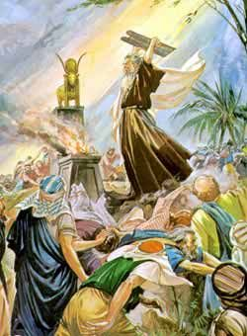
Ex 32:2-6 – “Aaron said to them, ‘Tear off the gold rings which are in the ears of your wives, your sons, and your daughters, and bring them to me.’ Then all the people tore off the gold rings which were in their ears and brought them to Aaron. He took this from their hand, and fashioned it with a graving tool and made it into a molten calf; and they said, ‘This is your god, O Israel, who brought you up from the land of Egypt.’ Now when Aaron saw this, he built an altar before it; and Aaron made a proclamation and said, ‘Tomorrow shall be a feast to the Lord.’ So the next day they rose early and offered burnt offerings, and brought peace offerings; and the people sat down to eat and to drink, and rose up to play.”
Notes:
Because in Ex 32, Moses had been up on the mountain and the people grew impatient and decided to make their own god – a golden calf. What’s worse, is they talked Moses’ brother Aaron into doing
Ex 32:2-6
And when God told Moses what was happening and he came down the mountain and saw what they were doing, he threw the tablets from his hand and shattered them. God had told Moses on the mountain, “They have quickly turned aside.” They promised they would obey God, and they’ve already violated two of His 10 commandments within a 40 day span. What God is having to work with here is a group of people who had been immersed in idolatrous practices while in Egypt and they all weren’t going to change that quickly. And so God is going to have to start putting some things in place in order to be able to have a relationship with these stubborn, rebellious, backsliding people.

Slide 8
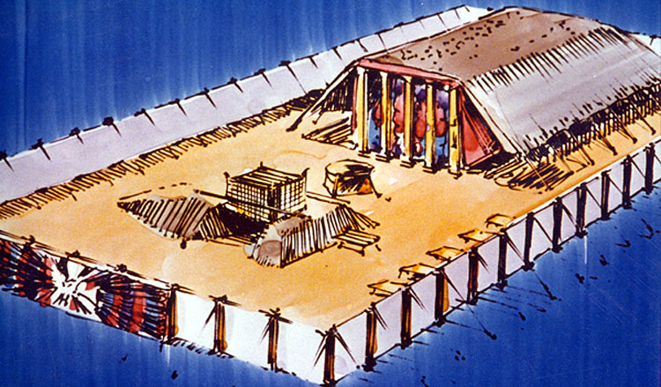
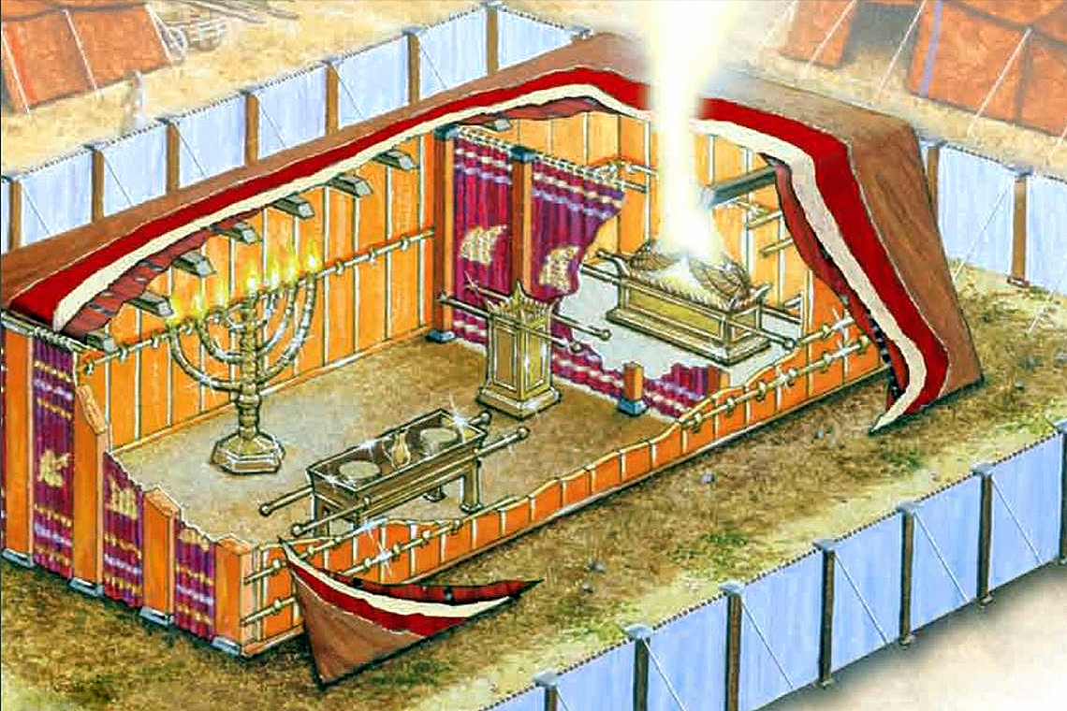
Notes:
So before we get to the beginning of Leviticus, God does two things.
First, He issues a commandment for the building of the tabernacle or “tent of meeting”. This would be a place in which God would manifest His glory and from time to time communicate His will to Israel. There were two sections: a court yard and a tent. In the courtyard, you had the brazen alter in which the sacrifices would be conducted. Then between it the tent was the bronze laver in which the priests would ceremonially wash themselves before entering the tent.
Inside the tent were two sections: the holy place and the most holy place, each separated by a veil. The holy place contained three items. On the right was the golden table of showbread in which 12 loafs laid out in two piles were kept, each one representing one of the twelve tribes of Israel, called the bread of the Presence. The priests would eat of this bread throughout the week and then it would be replenished. To the left was the golden lampstand with seven branches. It served a practical purpose of providing light for the priests to do their work, though there were also some spiritual significance to be gained. Directly in front was the golden altar of incense. This is where the priests would burn incense and the incense would permeate through the veil into the most holy place where God’s presence dwelled.
In the most holy place, in which no one could enter but once year and that was only the high priest, there stood the ark of the covenant. It contained the 10 commandments, from which Moses carved to replace the ones that were broken, a jar of manna, and Aaron’s rod that budded. God’s presence dwelled above this Ark within the mercy seat on top.

Slide 9
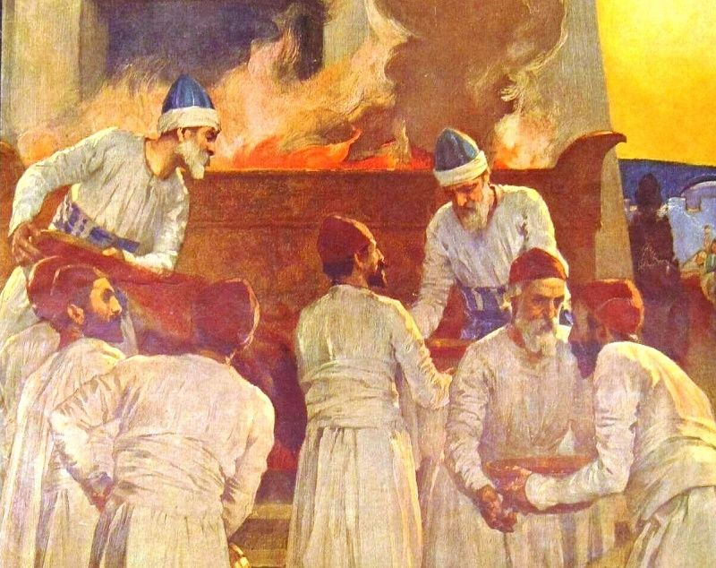
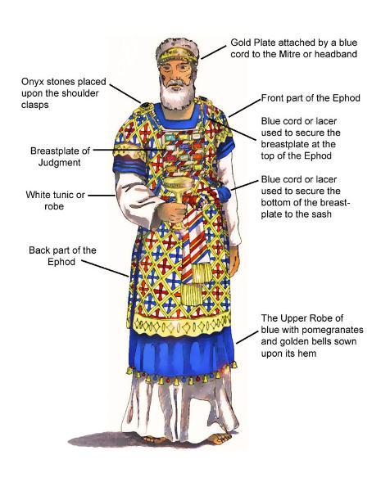
Notes:
Secondly, a priesthood was appointed to be mediators between He and the rest of the Israelites. Their garments and their duties are described. The priests main responsibility was to perform the duties demanded by God relative to the tabernacle, to teach the people His law, and to devote themselves wholly to the service God. And the people were to support the Levitical priesthood through tithes and sacrifices, many of which had parts that would be distributed to the priests.
And then there was the high priest himself, whose garments were a step up from standard priests. The high priest was the man designated to be the mediator between God and man. He was the head priest and had a massive responsibility to stay consecrated before God and the people in order to be a proper mediator.
All of this has occurred leading up to the beginning of Leviticus in which we read, “Then the Lord called to Moses and spoke to him from the tent of meeting, saying…”. So now what we’re going to find in Leviticus is a thorough explanation of the things in which these sinful Israelites are to do and not do in order to be able have fellowship with God and for God to have fellowship with them.

Slide 10
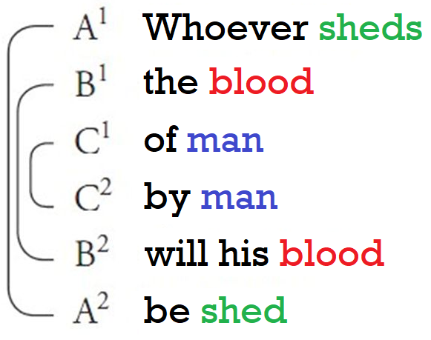
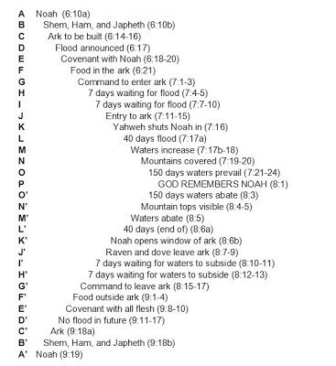
Gen 9:6
Gen 6:10-9:19
Notes:
Now, one thing that will help us immensely when we’re studying this book is to consider how it is laid out. Leviticus is laid out very symmetrically in a way that is easy to memorize. Its almost as if God anticipated how difficult this book might be for Christians and so in His divine foreknowledge He arranged for it to be laid out in such as way that we could have some help. Leviticus is arranged in a Hebrew poetic style called “Chiastic Parallelism”. Chiastic parallelism is a literary technique in which ideas are presented in a specific order and then similar ideas are repeated in reverse order. Each idea is connected to its reflection through the repeated word to give it a mirror effect in which it is reflected back. For example, “When the going gets tough, the tough gets going”. Benjamin Franklin once said, “By failing to prepare, you are preparing to fail.”
God uses chiasm in scripture many, times. Here’s a simple one: Gen 9:6 – “Whoever sheds the blood of man, by man will his blood be shed”. See how each word is repeated in reverse order? They reflect back on one another. Many verses contain this chiastic structure but its not just limited to verses. Entire sections of scripture itself are chiastic. The entire story of Noah and the flood is chiastic in nature. Most of Psalm 22 is chiastic in nature. Peter’s first epistle is chiastic, etc.

Slide 11
Outline
Chap
1-7
Chap
8-10
Chap
11-15
Chap
16
Chap
17-20
Chap
20-22
Chap
23-25
Day of
Atonement
Ritual
Purity
Moral
Ordained
Priesthood
Qualifications
Sacrifices
Rituals
Feasts
Chap 26-27: Consequences of Obedience & Disobedience
Notes:
But germane to our study is that it does seem that God also chose to use this literary style with the book of Leviticus. The majority of Leviticus can be divided into four sections: the rituals, the priesthood, laws of purity, and the day of atonement.
The rituals make up the outside chapters of the book; these were rituals that the Israelites were to practice in God’s holy presence. The first section explores the five main types of ritual sacrifices that Israel was to offer. Some of the sacrifices were offered purely out of devotion toward God, and therefore were voluntary, and others were mandatory due to sin that had been committed. But regardless of which sacrifice you were performing, the purpose of them was to be a constant reminder of what it costs to be in a relationship with God. The second set of rituals at the end of the book lay out the seven annual feasts of Israel, and each feast told a different part of the story of how God redeemed them from slavery in Egypt and brought them to the promised land. And by celebrating these feasts regularly, Israel would have ways in which to reflect on what God had done for them.
The next inner sections focus on the priests roles as mediators between God and Israel. The first section shows how Aaron and his sons are ordained to begin their work before God’s presence. And in the matching section we find the qualifications for being a priest. The priests were called to the highest level of moral integrity and ritual holiness because not only did they represent the people before God, they also represented God before the people. And we find out why these qualifications are so important in chapter 10 when two of Aaron’s son offer strange fire before the Lord, flagrantly violating the covenant, God kills them on the spot. It’s a haunting reminder of the paradox of being in God’s presence. In His presence is pure goodness, but when we bring sin into that goodness, it insults God’s holiness.
Then the next matching inner sections focuses on Israel’s purity. The first section involves Israel’s ritual purity and the matching section is Israel’s moral purity. It should be noted that being impure or unclean was not a sin in and of itself. It simply meant that while in a state of uncleanness, being in God’s presence is off limits until you are clean again. Regarding the ritual purity, all the things that made someone unclean such as contact with reproductive fluids, skin diseases, mold, or touching dead bodies, all these were associated with mortality and the loss of life. The idea is that death contaminates one from being holy and prevents them from being able to come in God’s presence. The call to moral purity basically was to teach Israel to live differently than the Canaanites. They were to care for the poor, practice sexual integrity, and to promote justice amongst one another.
Then right in the center of the book is the Day of Atonement. This is a key ritual that brings the whole book together. It was highly unlikely that all of Israel’s sins would be covered by the individual ritual sacrifices. So once a year, the high priest would take two goats. One goat would become the purification offering and atone for Israel’s sins and the other goat was the scape goat in which Israel’s sins would be confessed and symbolically placed on the goat where it would then be cast out into the wilderness. Though this is only one of Israel’s 7 annual ritual feasts, we’ll spend an entire class on just this one because of its significance.
Now the last two chapters, 26 and 27, are not part of the chiastic structure. These two chapters is where Moses encourages the people to be faithful to these laws. He first lists the blessings, peace, and abundance that would come to Israel should they obey. But if they are unfaithful to the covenant, there would be severe consequences and exile from the land.

Slide 12
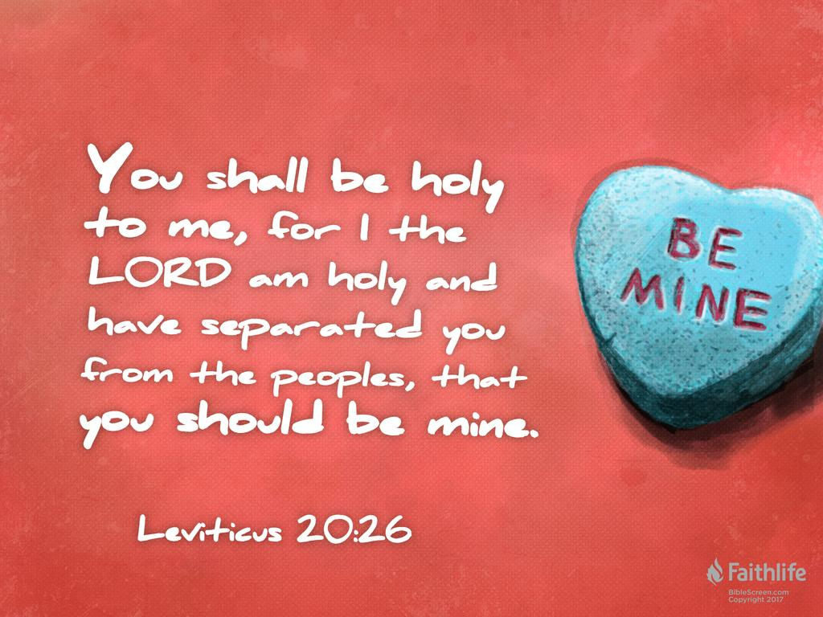
Ex 3:4-5 – “When the Lord saw that he turned aside to look, God called to him from the midst of the bush and said, ‘Moses, Moses!’ And he said, ‘Here I am’. Then He said, ‘Do not come near here; remove your sandals from your feet, for the place on which you are standing is holy ground.’”
1 Tim 6:16 – “who alone possesses immortality and dwells in unapproachable light, whom no man has seen or can see. To Him be honor and eternal dominion! Amen.”
Ex 19:6 – “and you shall be to Me a kingdom of priests and a holy nation.
Notes:
Now, no matter what section of Leviticus we are on, we need to remember that the predominate theme of this book is the holiness of God. And every single ritual and the details associated with it are designed to meet God’s holy demand. In other words, the purpose is stated in Lev 20:26 – “You shall be holy to me, for I the LORD am holy and have separated you from the peoples, that you should be mine.”
The word holy can be difficult to define. The easiest definition is that it means “set apart” but that hardly does justice to the holiness of God. One way to look at this idea is to consider the sun. The sun is pure power and goodness. And we need the sun, right? If we didn’t have it, we’d all freeze to death, we wouldn’t be able to eat because it causes things to grow, and other benefits. But however good the sun may be, if anything mortal and corruptible gets too close to it, it is destroyed by its pure power. So the sun is both extraordinarily good and extremely dangerous, right? That’s the idea behind God’s holiness. And that’s the idea behind Leviticus, teaching the Israelites what they must do in order to be in God’s presence without being destroyed.
1 Tim 6:16 – “who alone possesses immortality and dwells in unapproachable light, whom no man has seen or can see. To Him be honor and eternal dominion! Amen.”
God desired for His people to live in His presence; but to do so, they had to become more aware of His holiness, so in Leviticus, He spelled it out in fine detail. God’s people had to change if they wanted to fellowship Him. And so must we.
Ex 3:4-5 – “When the Lord saw that he turned aside to look, God called to him from the midst of the bush and said, ‘Moses, Moses!’ And he said, ‘Here I am’. Then He said, ‘Do not come near here; remove your sandals from your feet, for the place on which you are standing is holy ground.’”
Remember in Ex 19:6, God called Israel to be “a kingdom of priests and a holy nation”. And so in the book of Leviticus we see the presence of God’s glory residing among His people in the place He commanded them to construct and tend—the Tabernacle. Then He once again called them to become a holy people.

Slide 13
Why Important For Them?
A revelation God’s nature
Secure their physical, moral, and spiritual well-being
To be blessing to all nations
Separation from the heathen nations
To typify Jesus Christ
Why Important For Us?
An even clearer revelation of God’s character
To understand the fundamental conditions of Christianity
To vindicate the legislations of God
To see the embodiment of the types and prophecies
There is more to God’s character than His love
Notes:
Why was this important for them?
It was a much needed revelation of God’s nature. The Israelites had been in Egyptians captivity for 400 years, surrounded by polytheistic, pagan Egyptians. God not only reminded them that He alone is God, He also needed to make sure they understood the significance of being the one true God. His holy character needed to be a permanent fixture in their minds if they were to have any relationship at all with Him
It was to secure their physical, moral, and spiritual well-being. Unless they observed the rites of God’s holy demand, they would suffer the same fate of Egypt and the Canaanite nations, both spiritually and physically.
But this was also a means to an end. These laws were intended to make Israel a blessing to all nations they came in contact with, mediating to the Gentiles the redemption of God. And so these laws were intended to adapt, train, and prepare Israel for this special historic mission for which God had chosen them.
But in order to do this, it was crucial that they keep separate from the heathen nations. And many of the laws in Leviticus were intended to effect and maintain this separation. Ideally, by perfectly obeying these laws, Israel would have revealed to the surrounding nations the real character of God through their own character.
And then to every thoughtful Israelite, it should have suggested a redemption not yet revealed. The Levitical system, as thorough as it was, was an imperfect system from the start, which should have caused them to long for the perfect system so that when that perfect system arrived, they would be ready for it and willing to receive it. They would not have seen or known everything Levitical law was pointing to, but even thoughtful David, from things he said in the psalms, could see the futility of the system he was under. Jesus Christ was the fulfillment of every law in Leviticus.
Why is it important for us?
Leviticus gives us an even clearer picture of God’s character than even that of the Israelites. Christ has come and He fulfilled the Law, and became the Interpreter of the that Law in His own person. And God has not changed. He is still exactly as He was when He appeared to Moses in the burning bush, when He appeared to Israel at Mt Sinai, and when He led them through the wilderness as a cloud during the day and a fire at night. This is the God we serve, a holy God with a holy standard who is calling the shots, not us.
It also helps us Christians be reminded of the fundamental conditions of Christianity, that is, our redemption. The Levitical priesthood and sacrifices may be no more, but the truth they represented abide forever. Meaning, without the shedding of blood, there is no forgiveness of sins. There is no citizenship in God’s kingdom apart from a High Priest and Mediator. And Leviticus helps remind us of these fundamental facts that can be so easy for us to forget
Leviticus vindicates the legislations of God. The moral principles which underlie these laws are eternal and have vindicated God for thousands of years. In Lev 15:13, God commanded the Israelites regarding the cleansing of themselves of diseases like leprosy, discharges, and certain uncleannesses. It is specifically stated that they must bathe their flesh under running water. About a 100 yrs ago, doctors would examine seriously ill patients and in some cases dead bodies. Before moving on to deliver a baby, they would then wash their hands in a basin of still water. But they started losing about 30% of the mothers and couldn’t figure out why it was happening. Then they started experimenting with running water. The death rate dropped down to 2%. Sometimes when we study our bibles, we can look over little details and little words thinking that perhaps the writers were being redundant in what they were saying. But God wasn’t being redundant when He said to use running water. It was divine foreknowledge regarding proper sanitation that they could not have possibly gotten from anywhere else. The Bubonic Plague killed over a 1/3 of Europe during the Middle Ages. Europeans just couldn’t figure out how to keep the sickness in check. It wasn’t until the Catholic church of that age began searching the scriptures for an answer that they ran across those passages in Leviticus that spoke of sanitation. These were passages that spoke of not just washing but also of the importance separating the sick from those who were well to keep the diseases from spreading This led the Catholic Church to instituting the first known quarantine system to keep the spread of the disease in check. This in turn evolved into the first hospitals. They didn’t call this period the dark ages for nothing. But, you see, it was the bible that spoke of these sanitation procedures 1000s of years prior to this. Whether its sanitation, marriage, sexual integrity, or social justice, every law in Leviticus is perfect and worth studying and pondering for the betterment of our laws in this land.
Leviticus is wonderful in that it embodies the types and prophecies of Christ, which we now can see. This strengthens our faith in God and His plan from the beginning. Jesus wasn’t an accident. He was a deliberate means to a glorious end. I’ll speak to that more in just a moment.
And then Leviticus teaches us that there is more to God’s character than simply His love. This is not to suggest that we should ever minimize God’s love. However, the religious culture of today tends to emphasize Gods love at the expense of His holiness. We see it in such questions like, “If God is love, why is there so much suffering? Why did He kill the Canaanites? Why did He kill Uzzah when all He did was tough the Ark?” The answer is God’s holiness; and God does not take His holiness lightly so neither should we. Our Christian culture is far too flippant about God’s holiness and our own. He is utterly holy – “unapproachable light” - and we are called to walk in the Light so we can please Him. In our day and time, we need more teaching on God’s holiness – not at the expense of His love, but in order to reveal His entire nature and not just the parts we happen to like or agree with.

Slide 14
Notes:
Now, as we walk through Leviticus, we’re going to be diving heavily into some typology and I’m going to do my best to bring out the typological meaning behind everything that I can.
What is bible typology? Simply put, a “type” anticipates or foreshadows in a day to come someone or something that is greater. One person defined it this way, “A type is a shadow cast on the pages of OT history by a truth whose full embodiment or antitype (the anticipated) is found in the NT revelation”. So what we have in types are real, exalted happenings in history, divinely ordained and delivered to us, by the all-seeing, all-knowing God to be a prophetic picture of the good things which he purposed to bring to fruition in Jesus Christ. And OT types can have many representations – they can be people, they can events, they can be things, they can be places, they can be offices, they can be institutions, or they can be actions.
The NT is full of typological revelations. Marriage is compared to Christ and the church, leaven is compared to sin, Adam is compared to Jesus in a negative typology. We even sing songs that are types. “To Canaan’s Land I’m on my way…”. “As I journey here mid the toil and tears, there’s a rainbow in the cloud…”
However, this subject can be one that is abused. And because of that it has unfortunately fallen into disrepute for some as a practical means of study. I don’t think the answer to this is running to one extreme to avoid another. So while have tried to force the bible to say things its not saying, avoiding typologies is not the answer either.
Why is this important? Because Leviticus is literally filled with shadows and types whose corresponding antitypes can be easily seen. Then there are other things which I believe are reasonable conclusions we can make. And then there are other conclusions that we can make that are not so reasonable but are possible. And I’m not going to avoid telling you what I think is a reasonable conclusion to draw even if I don’t think it’s a necessary, inescapable conclusion. But I will try to do my best to distinguish between what I believe to be inescapable, reasonable, and possible conclusion to the typological meanings of what we find in this book.

