Slide 1
Notes:
As we studied this past Sunday morning, Isaiah 7 – 12 centers around a conflict called the Syro-Ephraimite War. The reason for this war is that the Assyrian empire has risen to be a great threat to the nations southwest of Mesopotamia, and the Northern Kingdom of Israel as well as the nation of Syria have formed a coalition w/one another hoping that in doing so, they can more ably defend their nations. They want the Southern Kingdom of Judah to join their coalition, but Judah’s King Ahaz refused to do so. And so, Israel and Syria decide to attack Judah, hoping to depose Ahaz and put a king on the throne that would be more favorable toward their cause. We learned from chapter 7 that God sends Isaiah to wicked Ahaz in order to offer him encouragement as well as an ultimatum. The encouragement was, “Don’t fear Israel and Syria, they’re just a couple of smoldering firebrands about to burn out”, and he takes along his son Shear-jashub, which means “a remnant will return”, to strengthen this claim. The ultimatum was, “If you won’t believe Me, that’s it for you.” And he offers to confirm this promise to Ahaz by allowing him to choose a sign for God to perform, which Ahaz in his wickedness refuses to do. And so, God is done w/Him. But because God must be w/the household of David, by virtue of the promise given to David in 2 Sam 7, God gives Him a sign anyway – the virgin birth of Immanuel, which means “God is with us.” And because this sign must be fulfilled, Judah cannot be allowed to completely fall. God must be with them. But because of Ahaz’s unbelief, God goes on to predict in vs. 17-25 how Judah would be judged in the short term. They would become a staging ground for war, humiliated through captivity, food would be scarce, and their farms and vineyards reduced to briars and thorns.
As we begin chapter 8, God is going to continue words of judgment by explaining in more detail what He will do to Syria, Israel, and Judah. And He also has personal instruction for Isaiah himself.

Slide 2
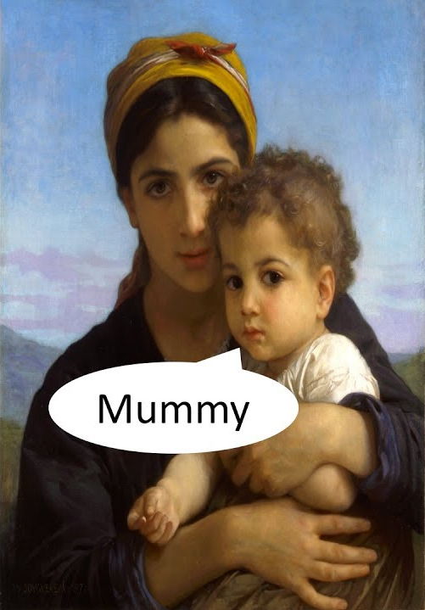
Maher-shal-hash-baz
Isa 8:1-4 – “¹Then the Lord said to me, ‘Take for yourself a large tablet and write on it in ordinary letters: Swift is the booty, speedy is the prey. ²And I will take to Myself faithful witnesses for testimony, Uriah the priest and Zechariah the son of Jeberechiah.’ ³So I approached the prophetess, and she conceived and gave birth to a son. Then the Lord said to me, ‘Name him Maher-shalal-hash-baz; ⁴for before the boy knows how to cry out “My father” or “My mother,” the wealth of Damascus and the spoil of Samaria will be carried away before the king of Assyria.’”
Notes:
Isa 8:1-4 – So right after making the great prophecy of the future arrival of Immanuel, a child who will be “God w/us”, Isaiah is to give another prophecy that is very similar. But unlike the Immanuel prophecy, this one will take place in the very near future, and so it must be available for contemporary use. He’s told to take a large tablet and write something out in simple letters that can be understood and seen by all – “swift is the booty, speedy is the prey”. Then he is to “approach” an unnamed prophetess, and this word “approach”, as used in other verses, actually denotes sexual contact, and so what he is presumably doing is taking this prophetess as a wife. She will conceive and give birth to a son whose name will be “Maher-shalal-hash-baz”. This is the longest word in the bible, hence the longest name. And it means “swift is the booty, speedy is the prey.”
What’s the point of this prophecy? Well, God already told Ahaz in chapter 7 that Israel and Syria are going down, sealing the deal w/the future coming of Immanuel. But unlike the child Immanuel, this prophecy would occur in such a short time, it will be fulfilled before Isaiah’s child is old enough to say “mama” or “dada”, suggesting a timeframe of no more than 2 – 3 years. Meaning, not only are Israel and Syria sure to go down, Assyria is going to take them down soon, and as they’re doing it, Assyria is thinking nothing of the fight, only of the spoil.

Slide 3
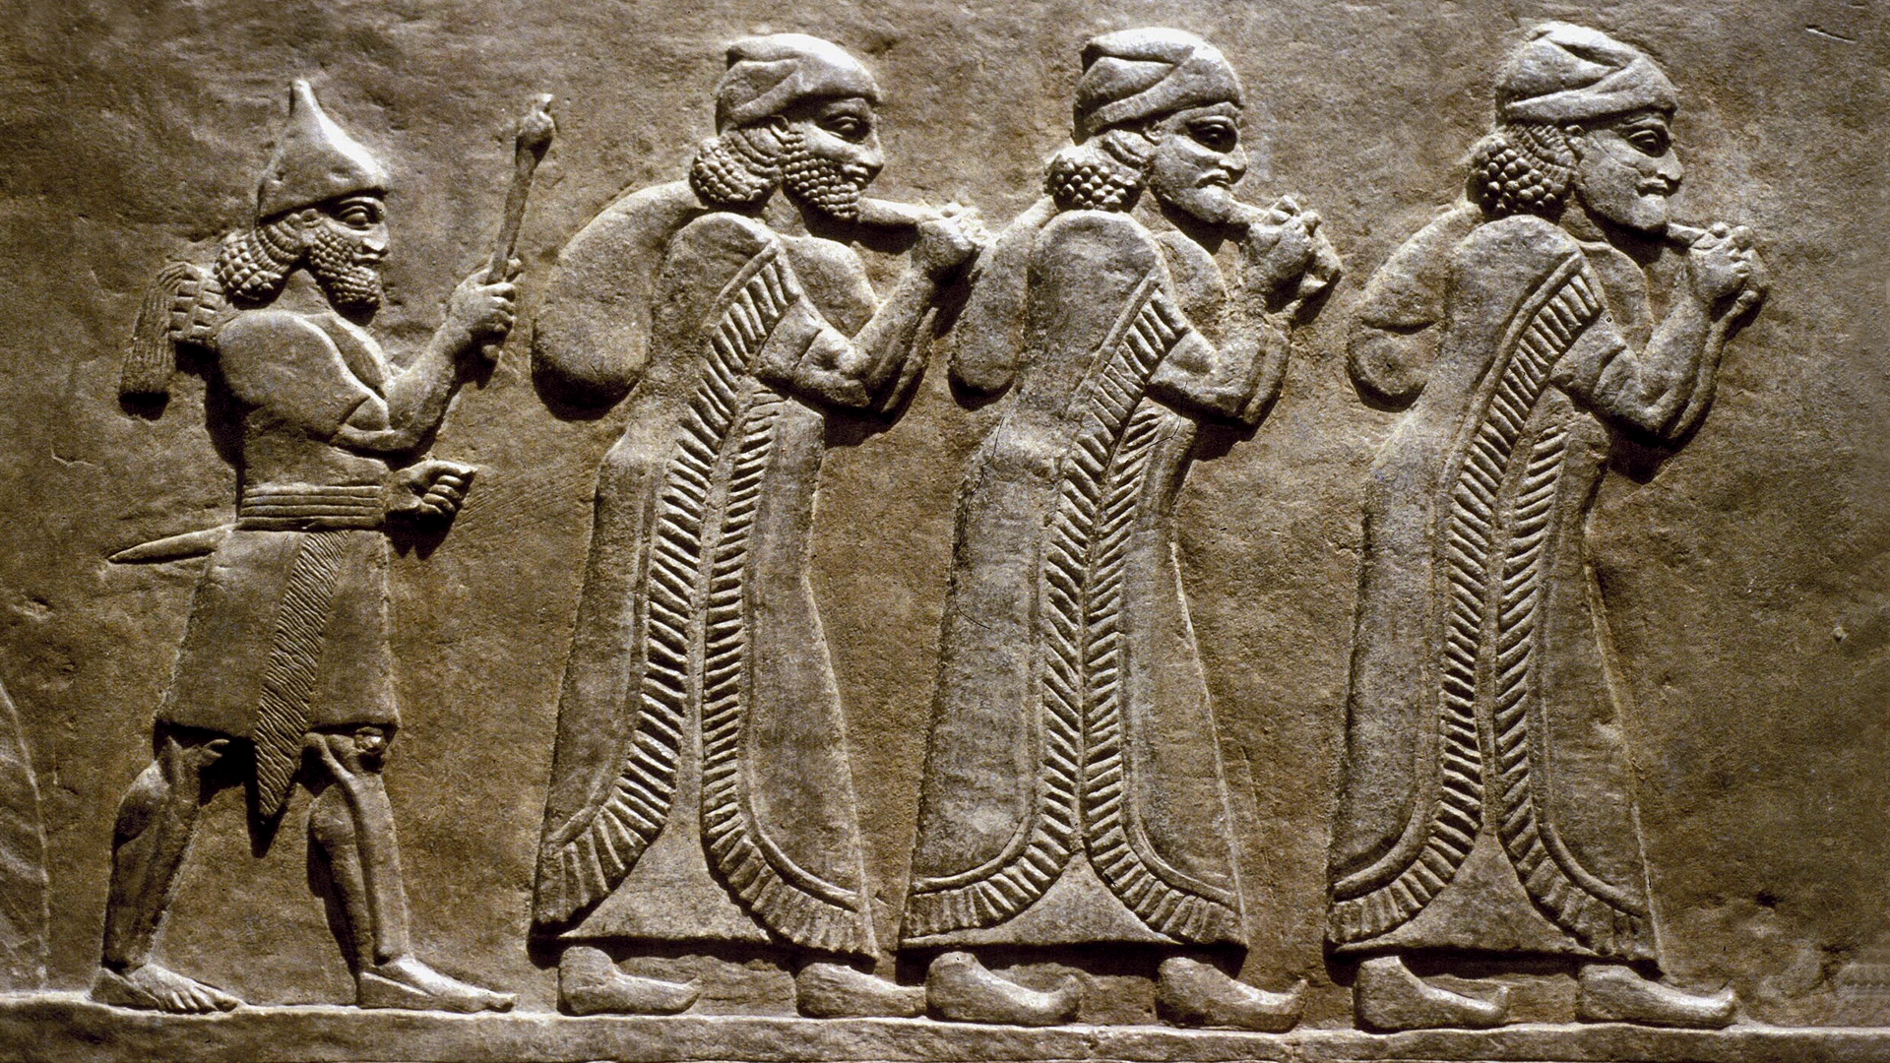
2 Kings 15:29-30 – “In the days of Pekah king of Israel, Tiglath-pileser king of Assyria came and captured Ijon and Abel-beth-maacah and Janoah and Kedesh and Hazor and Gilead and Galilee, all the land of Naphtali; and he carried them captive to Assyria. And Hoshea the son of Elah made a conspiracy against Pekah the son of Remaliah, and struck him and put him to death and became king in his place, in the twentieth year of Jotham the son of Uzziah.”
Notes:
Historically, how did this happen? Remember from Isa 7 that Ahaz refused God’s help, and we read from 2 Chron 28 that he instead hired the king of Assyria to fight Syria and Israel, paying him from money out of the temple treasury. Tiglath-pileser III was more than happy to oblige. So, in 734BC, Tiglath-pileser marched down the Israelite sea coast and defeated the Philistines, taking back the cities for Judah that Philistia had taken, and he continued his march all the way down to the Egyptian border to cut off aid from Egypt. Egypt had been a source of funding for Israel and Syria’s fight against Assyria because it was in Egypt’s best interest to keep Assyria from conquering their northern neighbors. Tiglath-Pileser knew that unless he cut off aid from them first, everything else was for naught. But having done that, the Assyrians came back up and sacked the northern part of the Northern Kingdom of Israel, taking out all the nations around the Sea of Galilee, Megiddo, most of the Trans-Jordanian tribes, and he led them away into captivity. Practically all that was left of the Northern Kingdom of Israel was the city of Samaria, and an Israelite named Hoshea then killed Pekah and Tiglath-pileser III set him up as king over Samaria under the condition that he pay regular tribute, and because of that, Samaria was actually able to last another 10 years.
This event is described in 2 Kings 15:29-30. But in addition to the biblical record, the Assyrian Annals also mention it, saying: “Israel... all its inhabitants (and) their possessions I led to Assyria. They overthrew their king Pekah and I placed Hoshea as king over them. I received from them 10 talents of gold, 1,000 talents of silver as their [tri]bute and brought them to Assyria.” Then in the following year, Assyria takes out Damascus, killing it’s king Rezin and deporting the Syrians from Damascus to Assyria. The Assyrians then turned Syria into 4 Assyrian provinces, Damascus becoming the capital city of one of the provinces.
He then came further south and took out the Levite city of Ashtaroth. The picture in the bottom right, which is on display in the British museum, shows Israelite citizens being driven out of Ashtaroth and marched to the central palace in Nimrod.

Slide 4
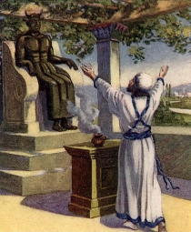
Maher-shal-hash-baz
Isa 8:1-4 – “¹Then the Lord said to me, ‘Take for yourself a large tablet and write on it in ordinary letters: Swift is the booty, speedy is the prey. ²And I will take to Myself faithful witnesses for testimony, Uriah the priest and Zechariah the son of Jeberechiah.’ ³So I approached the prophetess, and she conceived and gave birth to a son. Then the Lord said to me, ‘Name him Maher-shalal-hash-baz; ⁴for before the boy knows how to cry out “My father” or “My mother,” the wealth of Damascus and the spoil of Samaria will be carried away before the king of Assyria.’”
Notes:
Now, Ahaz was elated by this; so, what need did he have of God? And so, 2 Kings 16:10 says he went up to Damascus to pay tribute to Tiglath-pileser III – 2 Kings 16:10-18 – And 2 Chron 28 says Ahaz did this because he reasoned that the gods of Syria helped Assyria, and so he wanted to sacrifice to them so those gods would in turn help him. He refused the help of Jehovah for idolatry. There’s a reason for bringing all this up: when Isaiah wrote on that large tablet “Maher-shalal-hash-baz”, vs. 2 tells us he did so in the presence of two witnesses, a man named Zechariah and the priest Uriah. We don’t know who the man Zechariah was, but Uriah the priest is likely the same priest we just read about in 2 Kings 16 that designed Ahaz’s idol. Why would such a wicked priest be used as a witness to God’s prophecy concerning Maher-shalal-hash-baz?
I believe it is to show just how blind Judah and its leaders had become, like God told Isaiah they were in chapter 6. This prophecy was irrefutable proof that God was the one who allowed Assyria to take out Syria and Israel, not some idol, and the presence of these witnesses should have shut the mouth of any accusers who could claim “prophecy after the fact.” But despite Uriah having been present when this prophecy was made, and still alive when the prophecy came true, that he would still construct this idol for Ahaz shows just how blind the people were, and Isaiah’s preaching was truly making hard hearts even harder. This is why the purging of Judah was so necessary. How could the child Immanuel come otherwise?

Slide 5
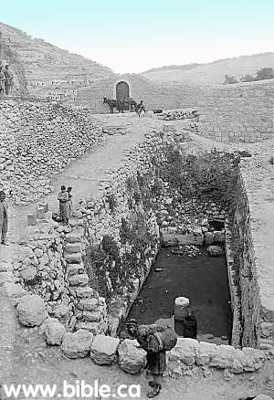
Shiloah or Euphrates?
Isa 8:5-8 – “⁵Again the Lord spoke to me further, saying, ‘⁶Inasmuch as these people have rejected the gently flowing waters of Shiloah and rejoice in Rezin and the son of Remaliah; ⁷now therefore, behold, the Lord is about to bring on them the strong and abundant waters of the Euphrates, even the king of Assyria and all his glory; and it will rise up over all its channels and go over all its banks. ⁸Then it will sweep on into Judah, it will overflow and pass through, it will reach even to the neck; and the spread of its wings will fill the breadth of your land, O Immanuel.’”
Notes:
So, what’s really happening amongst God’s people? – Isa 8:5-7 – “These people” of vs. 6 is referring to Israel. The spiritual defection of the northern tribes was their rejection of the monarchy of David. Rather than rejoicing over the Davidic king, they rejoiced over the kings of Israel and Syria.
He is comparing Judah to the “gently flowing waters of Shiloah”, which was a small, soft stream that God had given Judah for its water supply, eventually flowing into the pool of Siloam. This is a common paradox in scripture in which they are rejecting the humble yet adequate water supply by trusting in the supposed greater strength of men. And so, God will bring upon them “water” they would not like, the “strong and abundant waters of the Euphrates”, Assyria, and it would “flood” them. The purpose of the motif of these two rivers is to show a contrast between the seemingly weak and the seemingly strong. The way of faith is seemingly weak, full of hazards, but it works. But to choose the world, though seemingly strong, is to be overwhelmed by the world.
But what about Judah? They’re just as bad. Rather than Ahaz putting his trust in God, He’s relying on Assyria – it’s the same issue – but is God going to allow Assyria to knock out Judah too? – Isa 8:8 – And so the Assyrian flood will reach into Judah, but it will not engulf it. They’ll “reach even to the neck”. So, imagine a man floating in the ocean about to drown. The water has come up over his neck right to the nostrils. And just when it is about to cut off his last breath, the water subsides. The idea is that Judah will survive, though barely. But why? Judah made the same dumb decision to trust in an earthy king to save it, meriting the same fate of Israel and Syria, so why did they not share their fate? Because it’s Immanuel’s land – “God is with us”, not by virtue of their righteousness, but of God’s righteous promise; not by virtue of their merit, but God’s merit. And that Judah is Immanuel’s land makes it clear that Maher-shalal-hash-baz was not the ultimate fulfillment that God is with us. That Immanuel will one day come means for Judah that not only is God with us, He will be with us. Historically, how did this happen? Because after Ahaz hired Assyria to take out Israel and Syria, 2 Chron 28:20 tells us that Tiglath-pileser then turned around and afflicted him – 2 Chron 28:21 – “Although Ahaz took a portion out of the house of the Lord and out of the palace of the king and of the princes, and gave it to the king of Assyria, it did not help him.” – 2 Chron 28:22 – “Now in the time of his distress this same King Ahaz became yet more unfaithful to the Lord.”

Slide 6
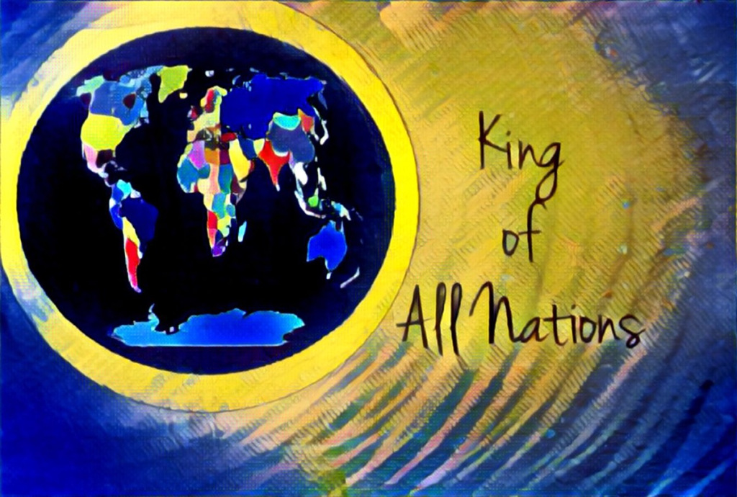
Nations called to listen
Isa 8:9-10 – “⁹Be broken, O peoples, and be shattered; and give ear, all remote places of the earth. Gird yourselves, yet be shattered; Gird yourselves, yet be shattered. ¹⁰Devise a plan, but it will be thwarted; state a proposal, but it will not stand, for God is with us.”
To all the earth
Plans won’t stand
Nations broken
Immanuel
Psa 2:1,4 – “Why are the nations in an uproar and the peoples devising a vain thing … He who in the heavens laughs, the Lord scoffs at them. ”
Psa 2:9 – “You shall break them with a rod of iron, You shall shatter them like earthenware.”
Notes:
Now, beginning in vs. 8, there is a dramatic tone shift – Isa 8:9-10. And so, the vision is no longer of Judah up to its neck in Assyria; the previous verse’s reminder that Judah is Immanuel’s land has changed its perspective.
Who is this oracle to? “All remote places of the earth.” This sounds a lot like Psalm 2 which says, “Why are the nations in an uproar and the peoples devising a vain thing…He who in the heavens laughs, the Lord scoffs at them.” I’ve mentioned before that Isaiah loves to drop hints of upcoming themes, and this statement to all the “remote places of the earth” is a tease of the next section in Isaiah, chapters 13 – 27. The idea is that the entire earth needs to pay attention to what God has done to Syria and the Northern Kingdom of Israel, because this isn’t some one-off exercise. The fate of Israel and Syria will be the fate of any nations who attempts to pick up a fight w/Judah outside of God’s sovereign will. This the theme of chapters 13 – 27, so stay tuned.
But what about their plans and proposals? Isaiah says the same thing here that he told Ahaz in 7:7 about the plans of Israel and Syria. Though Israel and Syria planned to terrorize Judah, make breaches in its walls, and set up their own king who would join their cause, Isaiah told Ahaz, “it will not stand”. They could prepare all they wanted, but it would not protect them. All their ideas and war strategies would ultimately be for naught.
All that it is left for these nations is to “be broken”, “be shattered”, and “be thwarted”. Again, this is reminiscent of Psalm 2:9 – “You shall break them with a rod of iron, You shall shatter them like earthenware.”
Why? Same reason why Judah would not suffer Israel and Syria’s fate, though they’re just as wicked – “for God is with us”. Immanuel is not a personal name in this instance; it is a declaration of victory for God’s people and defeat of His enemies. And so, as mentioned in the last study, “Immanuel” speaks to more than just God’s inevitable physical presence w/the people. For the Judeans living during this time, it speaks of the security that comes with that prophecy.

Slide 7
Stand out from the people
Isa 8:11-15 – “¹¹For thus the Lord spoke to me with mighty power and instructed me not to walk in the way of this people, saying, ‘¹²You are not to say, “It is a conspiracy!” in regard to all that this people call a conspiracy, and you are not to fear what they fear or be in dread of it. ¹³It is the Lord of hosts whom you should regard as holy. And He shall be your fear, and He shall be your dread. ¹⁴Then He shall become a sanctuary; but to both the houses of Israel, a stone to strike and a rock to stumble over, and a snare and a trap for the inhabitants of Jerusalem. ¹⁵Many will stumble over them, then they will fall and be broken; they will even be snared and caught.’”
Notes:
Now, understanding this, God has a reminder for Isaiah himself – Isa 8:11-12.
1) In other words, don’t be like the people. Some translations instead of saying “with mighty power”, says, “with a strong hand” – this implies an inspiration that was especially intense. Why would Isaiah need this from God? Probably because of what we already learned about Isaiah in 6:5. The prophet was just as liable to be negatively influenced by the people as Uzziah and as anyone, but his work is just too important for that to happen. What is the conspiracy? There are probably many answers. The main point, though, is that Isaiah is not to be swayed from the path of obedience by popular slurs of the day. Everyone is going to be tempted to give into panic from time to time, but panic leads to paranoia, which leads to fear, which leads to instability, and it was leading these people toward the occult rather than toward God. God tells Isaiah that he is to have no part in all the worldly speculations and conspiracies of man. He is to remain distinct from that mindset. He is to be so calm in the midst of the coming storm, his calmness would be conspicuous and perhaps infectious. We need this lesson today.
2) What is the key to this calm, faithful mindset in the midst of trial and uncertainty? Living in constant awareness of God – Isa 8:13 – In other words, worry about your place w/God, not your place w/your enemies. We are not to fear what the world fears; the world needs to be taught to fear the One we fear – God. Otherwise, He’ll never be regarded as “holy, holy, holy”, but as helpless, indifferent, and unimportant, causing men to resort to human explanations for their daily trials. Isaiah is calling on them to make God the most significant part of their existence.
3) Because our attitude toward God is going to determine which aspect of God’s nature we experience – Isa 8:14-15 – God does not change. But our attitude towards Him will determine how we experience Him. He will either be a sanctuary of abiding protection under the aura of His holiness, or He’ll be our downfall. This is a difficult concept for many to grasp about our God. We sing “What a friend we have in Jesus”, but for many people, they make Him their enemy. Immanuel cannot be “with us” if Immanuel is rejected. As the Apostle Peter said I 1 Pet 1:6-7, He can be a cornerstone to build upon, or rock to stumble over. It’s our choice. And if we find ourselves constantly tripping up in life, it does no good blaming God. He simply “is”; and when we attempt to live as if He is not, we’re going to find ourselves constantly kicking against a brick wall. As most of us are aware, there are several NT allusions to Jesus being a rock of stumbling, or rock to lift us up. We’ll discuss this concept further when we get to chapter 28.

Slide 8
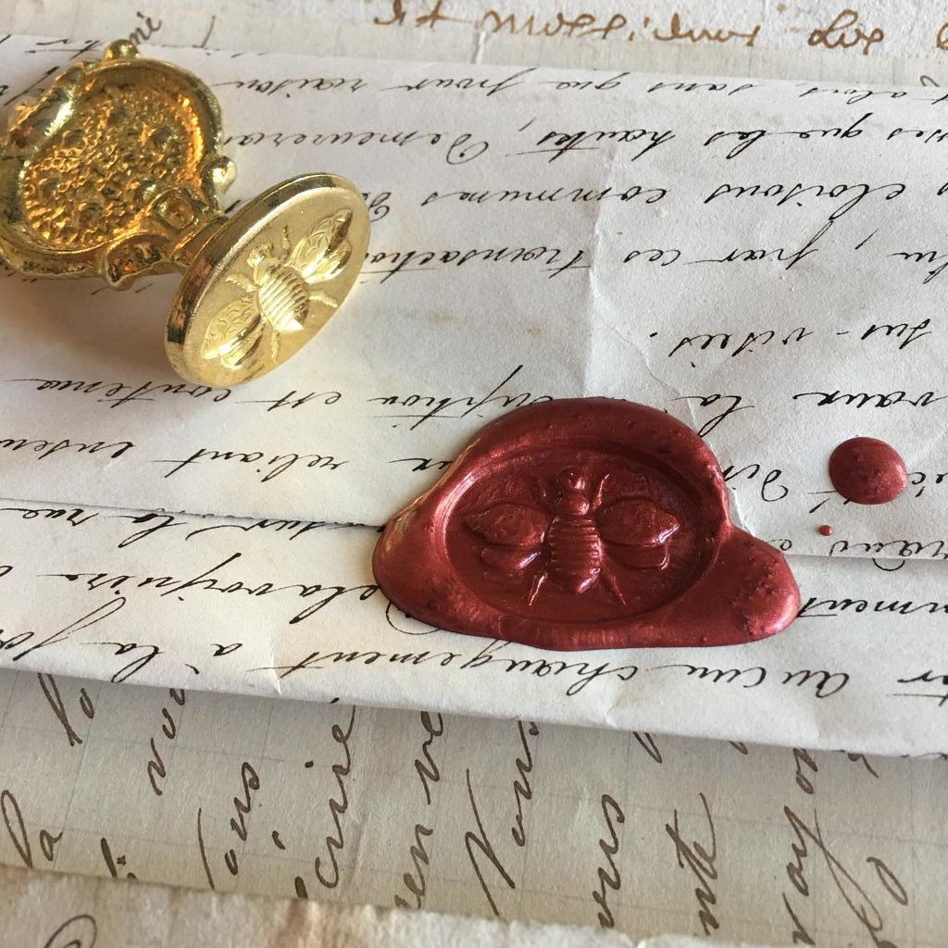
Testimony sealed
Isa 8:16-18 – “¹⁶Bind up the testimony, seal the law among my disciples. ¹⁷And I will wait for the Lord who is hiding His face from the house of Jacob; I will even look eagerly for Him. ¹⁸Behold, I and the children whom the Lord has given me are for signs and wonders in Israel from the Lord of hosts, who dwells on Mount Zion.”
Notes:
And so, given the blindness of the people, the inevitability of Israel and Syria’s destruction, the Assyrian flood that would reach to the neck of Judah, notice what God has Isaiah do – Isa 8:16-17 – So just like what we saw in vs. 2, God’s word is to have witnesses, and this time amongst Isaiah’s disciples. And they are to bind up this prophecy, most likely sealing it w/a mark and a date so when it is opened, they’ll know when it was written, and in this way God’s word will be safeguarded from accusations of tampering or addition after the fact and Isaiah’s prophecy will be vindicated. In the meantime, Isaiah, like all of God’s faithful, must wait in faith. He’s warned them as much as he can, now he waits for God to act while the people reap the fruit of their unfaithfulness. The phrase “hiding His face” expresses disfavor toward Judah, and it is the opposite of what Aaron said in his benediction in Num 6:25, “the Lord make His face to shine upon you.”
Vs. 18 then answers a question that has probably been on all of our minds since the beginning of chapter 7. What’s up w/all these churn? Isa 8:18 – Here we see that the reason for God wanting to use children repeatedly in these chapters is that they are to serve as signs. What is the point of children being used as signs? A couple ideas to consider:
1) If Shear-Jashub and Maher-shalal-hash-baz are incarnate signs of things that will shortly come to pass, and then they do come to pass, how much more faith should they put in the future coming of Immanuel? God achieved great things through two of Isaiah’s children, in the midst of very difficult and uncertain circumstances. So, if I’m a Jew living through the discouragement of Babylonian captivity or under Roman occupation in the early first century, and I have these chapters in my hands, knowing that God fulfilled prophecies through Isaiah’s children should increase my faith that He can and will do it through the coming of the ultimate Immanuel.
2) The people’s problem was putting too much trust in man and in their own power. But children by their very nature are vulnerable, fragile, and frail, unable to survive w/o trusting in a greater power. And in these children, the “word became flesh and dwelt among them”, just like what the Apostle John says of Jesus in John 1:14. As a child, Jesus was born in very humble circumstances, from a very humble town, from very humble parents, and yet God took this small child and brought about the greatness we continue to celebrate today. And so, no matter how bad things seemingly get, God can cause big things to come about from seemingly small things. Meaning, we don’t need the “Euphrates” if we have the “gentle, soft flowing stream of Shiloah”.
3) Just as Maher-shalal-hash-baz announced the fall of Israel and Syria, Matt 1:21 reveals that Immanuel will announce the fall of sin. In fact, remember all the illusions we’ve seen in this chapter to the people being broken, in vs. 9 and vs. 15? In Luke 2:34, the prophet Simeon told Mary – “Behold, this child is appointed for the fall and rise of many in Israel, and for a sign to be opposed.”
4) And also, the statement “I and the children whom the Lord has given me” is quoted in Heb 2:13 as also being stated by Jesus Himself concerning us. Jesus had to come in flesh and blood, like us, so that through Him we could be saved. And when we come to God through Christ, we become His posterity, his children in a sense, and like Isaiah’s children, we too become signs that “God is with us”.

Slide 9
Light vs. Darkness
Isa 8:19-22 – “¹⁹When they say to you, ‘Consult the mediums and the spiritists who whisper and mutter,’ should not a people consult their God? Should they consult the dead on behalf of the living? ²⁰To the law and to the testimony! If they do not speak according to this word, it is because they have no dawn. ²¹They will pass through the land hard-pressed and famished, and it will turn out that when they are hungry, they will be enraged and curse their king and their God as they face upward. ²²Then they will look to the earth, and behold, distress and darkness, the gloom of anguish; and they will be driven away into darkness.”
Notes:
And so, w/the prophecy sealed, Isaiah is waiting on the word of the Lord to come to pass. What should he do in the meantime? Isa 8:19 – If you remember back in 2:6, the people were already prone to this. Mediums were people who believed that they were arbitrators endowed w/the power to communicate with the dead, through séances and visions, and the interpreting of omens and such, and the people looked to them to inform them how they should interpret current events. The Hebrew word for “spiritist” means “to know”; these were people who “claimed” inside knowledge, especially as it pertained to future events. And the really convincing ones know how to throw their voice like ventriloquists in order to convince you they’re speaking on behalf of some spirit. But Isaiah tells us that with all their supposed knowledge, the only thing mediums and spiritists are good for is whispering and muttering. So how do people like this make a living? Preying on faithless people during times of uncertainty. Who do they need to be seeking? God. Through what “medium”?
Isa 8:20a – This is to be the watchword of the faithful. They were looking for answers from the dead, but the dead are dead. But Heb 4:12 says the word of God is “living.” The law is God’s truth. The testimony is the witness of that truth. Back in 8:2, the law was “swift is the booty, speedy is the prey”. But the verse says that Maher-shalal-hash-baz was to serve as a testimony to that law, a living witness that what God says is true. Psa 119:105 – “Your word is a lamp to my feet and a light to my path.” So, if the word of God brings light, what do contrary sources of information bring? Darkness – Isa 8:20b. And what is it like living in darkness?

Slide 10
Light vs. Darkness
Isa 8:19-22 – “¹⁹When they say to you, ‘Consult the mediums and the spiritists who whisper and mutter,’ should not a people consult their God? Should they consult the dead on behalf of the living? ²⁰To the law and to the testimony! If they do not speak according to this word, it is because they have no dawn. ²¹They will pass through the land hard-pressed and famished, and it will turn out that when they are hungry, they will be enraged and curse their king and their God as they face upward. ²²Then they will look to the earth, and behold, distress and darkness, the gloom of anguish; and they will be driven away into darkness.”
Anxious
Empty
Exasperated
Blame-game
Self-indulgent
Cast out
Notes:
Isa 8:21-22 – In chapters 1 – 5, I used the metaphor of an autopsy to describe what sins Isaiah was exposing in Judah’s society. If we were to perform an autopsy on a person living in darkness, vs. 21-22 is a perfect description.
1) Anxious – meaning, every time they sin, thinking it will give them an advantage, it just leaves them worse off than before. Sin doesn’t bring relief; it only makes things more difficult.
2) Empty – They sin because they think it will satisfy some hunger that righteousness can’t. But in the end, we’re not just hungry, but malnourished.
3) Exasperated – Not satisfied, they’re angry. We live in an angry world amongst so many angry people. Why do you think they’re angry? Because they give their bodies away to do perform so many sins, bodies made in the image of God, and when it can’t satisfy them, they don’t understand it and all they know to do is vent that frustration on others.
4) Blame-game – But rather than blame themselves, they point the finger elsewhere, usually the leader, but ultimately God. They’re the ones that have forsaken Him, but when living in darkness, He’s the one to blame all our problems on.
5) Look to the earth – And since they’re not looking to God for healing, where do they look? The earth, flesh, carnality, that which is fleeting. It’s an endless circle in which they find themselves right back where they started.
6) Driven away into darkness – loss, captivity, or maybe even hell-fire. Unwilling to make the necessary sacrifices to break the cycle of sin, they find themselves in the very personification of gloom and darkness that they reveled in. No hope from heaven (21b), from the earth (22a), or from the future (22b).

