Slide 1
Notes:
In this study from Isaiah , we’re going to take a break from Hebrew poetry to look at some narrative. Isaiah is given a very special honor which he receives by way of a vision – His call by God Himself to preach to the nations.
This chapter presents an issue of chronology. It’s hard to imagine Isaiah’s experience w/God in this chapter as anything but his inaugural calling. But who is to say he didn’t preach before this and that chapters 1 – 5 is that preaching? But as we proceed through the chapter, I am going to make the argument that theologically, it is actually where it needs to be, as a perfect conclusion to chapters 1 – 5 and a perfect introduction to the thoughts of chapters 7 – 12. In fact, chapter 6 is like a hinge, closing chapters 1 – 5 , and opening chapters 7 – 12.

Slide 2
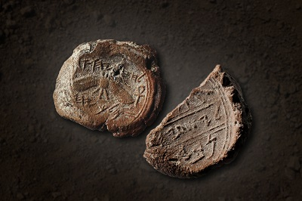
Notes:
Before we get into the text itself, it’s important to remember that before there was ever the book of Isaiah, there was the man Isaiah. And in 2015, archeologists were excavating ~10 feet from the old temple mount in Jerusalem and came across these 2 seals, called “bulla”, that were buried only 3 feet apart. The bulla in the picture on the left bears King Hezekiah’s seal, decorated by a two-winged sun disk, and w/the inscription “Belonging to Hezekiah, (son of) Ahaz, king of Judah”. And the partial bulla on the right shows most of Isaiah’s name. It literally reads “[Belonging] to Isaiah…” and then there’s a word that gets cut off due to the fact it is missing the upper left section. Remember that Hebrew is written from right to left. Archeologists believe the word missing is “prophet”, which would make this bulla say, “Belonging to Isaiah the prophet”. The archaeological layer containing these seals occur below both the Byzantine and early Roman debris, which would match the biblical time of Hezekiah. Isaiah was a real man – he really lived. And discovery was a blow to skeptics who insist that whoever wrote the book of Isaiah did so well after the Babylonian captivity, despite their poor scholarship and lack of evidence to prove it. Isaiah was a real man, and he lived and preached in a real age of uncertainty. And in chapter 6, we’re going to find that he was one of the few men in history who while still alive saw the God of heaven on His throne.

Slide 3
Isaiah Sees God
Isa 6:1-4 – “¹In the year of King Uzziah’s death I saw the Lord sitting on a throne, lofty and exalted, with the train of His robe filling the temple. ²Seraphim stood above Him, each having six wings: with two he covered his face, and with two he covered his feet, and with two he flew. ³And one called out to another and said, ‘Holy, Holy, Holy, is the Lord of hosts, the whole earth is full of His glory.’ ⁴And the foundations of the thresholds trembled at the voice of him who called out, while the temple was filling with smoke.”
God’s reign
God’s train
Notes:
Isa 6:1a – Now, why reveal Himself to Isaiah at this time? Because it’s the year when one Judah’s best kings, Uzziah, a famous and long reigning king, is dying. And though Uzziah was one of the best kings to ever reign, he messed up big time. 2 Chron 26 reveals that he got prideful and attempted to burn incense at the temple, and God struck him w/leprosy. The pride of Judah has infected one of Judah’s greatest kings. So now this once great but flawed man, who Isaiah must have looked up, is dying of leprosy. This must have been the cause of great concern for Isaiah, a bitter pill to swallow, filling him w/uncertainty. So, what does God now show Him?
Isa 6:1b – What does Isaiah see? He sees the infinitely more famous, eternally reigning, all-powerful, flawless King of kings, lofty and exalted, reigning in the temple. Those terms “lofty and exalted” had already been used by Isaiah himself in describe the pride of the people in 2:11,17; 5:15-16. And Isaiah had himself said in 2:22 that we should stop regarding and esteeming man. I wonder if one of the reasons God is showing Himself to Isaiah in this way is because maybe Isaiah had esteemed Uzziah more than he needed to, only to now be witnessing one of Judah’s best falling and dying. Yet in contrast, He sees the great “I AM” who is perfect in every way, eternally reigning, flawless in character, reigning in heaven, not in an occupied chair, but in an occupied throne. Anybody can sit in a chair, but sovereign kings w/authority sit on thrones. I would suggest this is the reason by the timing of God’s appearance to Isaiah – to strengthen his faith, revive his efforts, so that he himself will not put trust in any man, not even Uzziah – Psa 146:3-4 – “Do not trust in princes, in mortal man, in whom there is no salvation. His spirit departs, he returns to the earth; in that very day his thoughts perish.” – Psa 146:10 – “The Lord will reign forever, your God, O Zion, to all generations. Praise the Lord!” Now, according to John 12:41, who is reigning? Jesus Christ. And His appearance is dominating the scene. And what an honor for Isaiah to stand before the one who the Apostle Paul tells us “dwells in inapproachable light, whom no man has seen or can see.” (1 Tim 6:16).
Isa 6:1c – So he also sees the train of God’s robe filling the temple. In Great Britain, the length of the train of your robe is indicative of your rank; it’s called the regalia. What does it say about God’s rank that His robe is filling the temple? Also, when a bride adorns her gown, do people step on her train? No, whatever space her train fills is considered “hallow ground”. But God’s train is filling the temple, so then where is Isaiah standing? Outside the temple – there’s nowhere else for him to stand!

Slide 4
Isaiah Sees God
Isa 6:1-4 – “¹In the year of King Uzziah’s death I saw the Lord sitting on a throne, lofty and exalted, with the train of His robe filling the temple. ²Seraphim stood above Him, each having six wings: with two he covered his face, and with two he covered his feet, and with two he flew. ³And one called out to another and said, ‘Holy, Holy, Holy, is the Lord of hosts, the whole earth is full of His glory.’ ⁴And the foundations of the thresholds trembled at the voice of him who called out, while the temple was filling with smoke.”
God’s reign
God’s train
God’s attendants
God’s worshippers
Notes:
God has attendants – Isa 6:2 – “Seraphim” comes from the word “saraph” which means “burning ones”. And they are allowed to stand; but not on their feet. They have 6 wings, and 2 of them are used to fly. And what are they doing, kicking back, propping their feet up on a floating coffee table in the Lord’s temple? No. Like Isaiah, they too are impacted by the Lord’s presence. “with two [wings] he covered his face” – This could mean that even these burning ones cannot look directly at the radiance of the Lord. Rev 1:16 mentions Jesus’ face as “like the sun shining in its strength” and we’re told the same thing about Him in Matt 17 at the Mount of Transfiguration. So, while these are supernatural beings, it may be that even they have to protect their eyes from a direct apprehension of the Lord’s transcendent holiness and majestic glory. Or, they could be shielding their faces as an act of humility. Because when angels appeared to men on earth in their heavenly form, men fell on their face before them. Some even attempted to worship them; that’s how stunning was their appearance. But as glorious and magnificent as an angel from heaven would be to us humans, even they deem themselves unworthy to project that glory before the almighty God. Even the angels don’t show their faces. Could this be what Paul was alluding to in 1 Cor 11:10 when he said women should cover their hair “because of the angels”? “with two he covered his feet” – If covering the more honorable part of the body was deemed an act of humility, certainly covering the less honorable feet, typically the dirtiest part of the body, would be an act of respect. They cover their less honorable feet and more honorable faces. And this was a customary thing to do in the ancient east in the presence of dignitaries. Bottom line, God makes all His creation suitable for their habitant, whether land, sea, or air. His heavenly creation are no different. These wings are to help them be and to do the things they needs to be and do as God’s attendants.
And what do they do as they attend God? They worship Him – Isa 6:3a – I love this phrase because it suggests that singing to one another in psalms, hymns, and spiritual songs extends even past our time here on earth and into the eternity of heaven itself. And heaven will be all about praising God w/the same zeal and fervency as these seraphim are.

Slide 5
Isaiah Sees God
Isa 6:1-4 – “¹In the year of King Uzziah’s death I saw the Lord sitting on a throne, lofty and exalted, with the train of His robe filling the temple. ²Seraphim stood above Him, each having six wings: with two he covered his face, and with two he covered his feet, and with two he flew. ³And one called out to another and said, ‘Holy, Holy, Holy, is the Lord of hosts, the whole earth is full of His glory.’ ⁴And the foundations of the thresholds trembled at the voice of him who called out, while the temple was filling with smoke.”
God’s reign
God’s train
God’s attendants
God’s worshippers
God’s holiness
God’s glory
God’s anger
Notes:
What are they singing? – Isa 6:3b – In the English language, we describe this quality of God by using the positive, the comparative, and the superlative. Meaning, we would say, “Holy, holier, or holiest”, “Holy” being the positive, “Holier” being the comparative, and “Holiest” being the superlative. They didn’t have that in the Hebrew language; they used repetition to express the superlative, to show that He is the holiest. God is the superlative of holy, “Holy, holy, holy”. The difficulty of accurately defining holiness is that God is the only one who truly is. This is why making an image of Him is so wrong. Nothing material can truly represent Him, but will by necessity misdefine Him and limit Him. God’s holiness is to refer to His otherness. He is “other than” any other being in existence, in His magnitude, His worth, His transcendence, perfect purity, the ultimate goodness, the summation of all qualities that make Him divine.
Isa 6:3c – think of God’s glory as His “weightiness”, His “gravity”. And the entirety of the earth is full of it. Not just Canaan where the Jews lived. God’s glory is not for the Jews alone, it is for the whole earth. And it may be that this statement is the angels’ way of signaling to Isaiah the coming inclusion of Gentiles into the kingdom, preparing Isaiah so that he can prepare the people.
Isa 6:4 – So in the presence of such a mighty force, even the lifeless timber and stone of the temple have enough sense to shake. Shaking is the customary reaction of any physical structure that houses the divine presence. When God descended on Mt. Sinai, we’re told in Ex 19:18 – “…the whole mountain quaked violently…”. The “gravity” of God’s presence is just that strong that even the inanimate objects, which are supposed to be so firmly fixed, shiver in His presence. What is this an indication of? I would suggest His anger, because in Rev 15, just before God pours out the 7 bowls of wrath on the earth, we read in Rev 15:8 – “And the temple was filled with smoke from the glory of God and from His power; and no one was able to enter the temple until the seven plagues of the seven angels were finished.” In other words, the sins pronounced upon Judah in the first 5 chapters are serious. The people were corrupt, the infection has spread to the house of David, and few had the courage to stand against it. Something must be done, and God is going to have to do it.

Slide 6
Isaiah Sees Himself
Isa 6:5 – “Then I said ‘Woe is me, for I am ruined! Because I am a man of unclean lips, and I live among a people of unclean lips; for my eyes have seen the King, the Lord of hosts.’”
The 7th woe
Unclean lips
Dwell w/unclean
Sees the true King
Notes:
Isaiah’s response? The same as ours would be if we were standing before the holy, transcendent God of heaven w/our sins standing in stark contrast with His perfect nature – Isa 6:5. Now some have argued that this chapter belongs in the beginning of the book, and chronologically that may be the case. But I’m going to suggest that theologically, it is right where it belongs, and here is why: in chapter 5, Isaiah had pronounced 6 woes on the sinful nation in which he dwelled, but the number 6 is incomplete. And now Isaiah, who like Uzziah was probably one of the most righteous men Judah had to offer, now sees that in comparison to God, even his righteousness is like filthy garments.
So, I would suggest Isaiah now completes the woes by applying the 7th to himself, and that in doing so God is making a point. And the point is that it’s not hard to recognize sin in others, as Isaiah observed in the first 5 chapters. And when you’re a preacher, sometimes you can spend more time trying to help others come to terms with theirs that you neglect yourself. But it’s only when I can personally recognize God for who He is, and just how infinitely inferior I personally am when compared to Him, that the message of repentance I preach becomes just as real to me. We can always find someone we deem more sinful than we are, but that’s a faulty comparison that will merely exalt our ego to a place it can’t really be. The only true and righteous judgment of our character is in how we compare to the living God. And everybody, even the greatest of prophets and teachers, fall well short of that.
“I am a man of unclean lips” – Who hasn’t sinned w/his lips? Jas 3:2 says that if anyone doesn’t stumble in what he says, he’s a perfect man. But Jesus said in Luke 6:45 that out of the abundance of the heart, the mouth speaks. So, if I’m a man of unclean lips, what does that say about my heart? That it too is unclean. The tongue gives the heart its voice.
As we saw in chapter 1, sin is an epidemic and it is contagious. It had infected Uzziah, which I suspect gave Isaiah great sorrow, but now He sees how much living in a sin-filled society has affected him. Sin has truly corrupted mankind, but I am part of mankind and so I am part of the problem.
“for my eyes have see the king” – No matter how virtuous Isaiah was, even the purest of people are unclean when measured against God’s standard of holiness. He sees God as uncontested. Only by seeing his own unworthiness and sinful condition would Isaiah be able to deliver the message entrusted him. And in order for us to serve God, we too must see God as He truly is. He’s not some marvel superhero w/a tragic backstory who is just more powerful and smarter than we are. He’s not a cosmic grandpa who no matter how much trouble you are, everything is ok w/Him. That’s not what Isaiah is seeing here. He is seeing someone infinitely “other than” both Uzziah and himself, someone infinitely incomparable in His glory and majesty. Seeing God as He truly will instill in us the humility we need to truly serve Him.

Slide 7
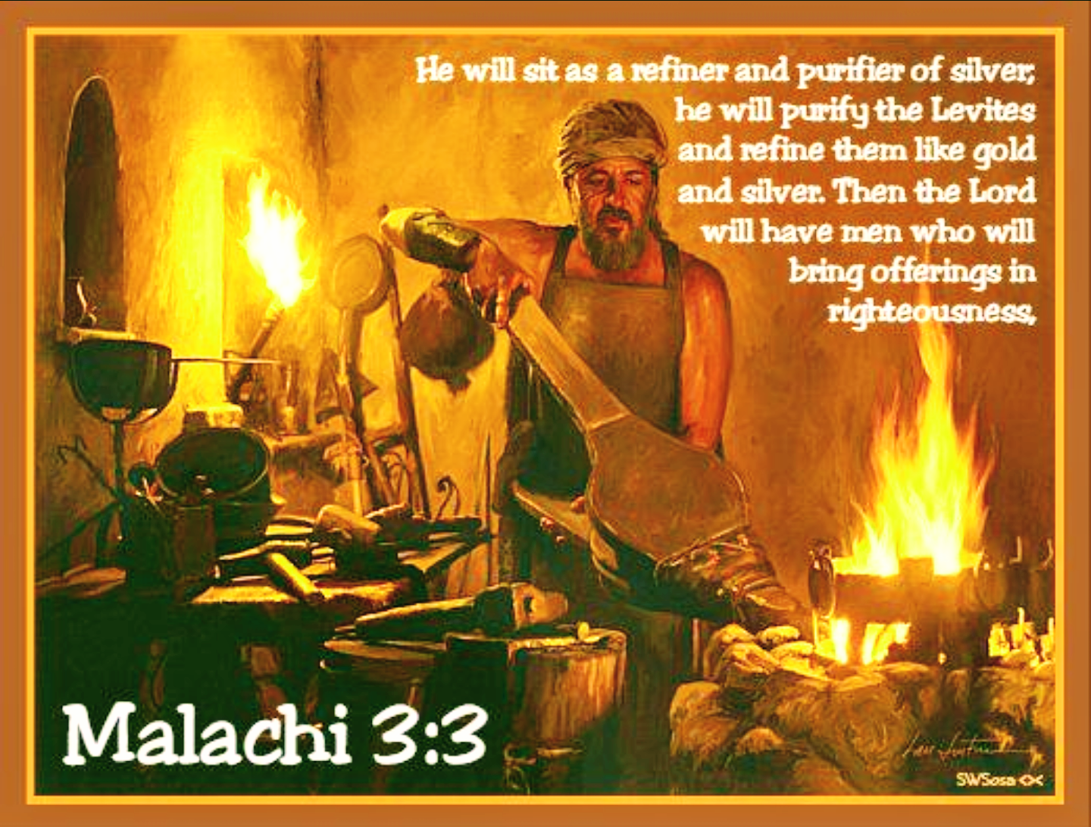
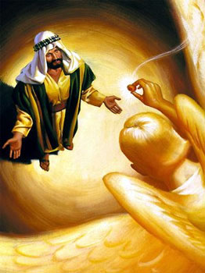
Isaiah Forgiven
Isa 6:6-7 – “Then one of the seraphim flew to me with a burning coal in his hand, which he had taken from the altar with tongs. ⁷He touched my mouth with it and said, “Behold, this has touched your lips; and your iniquity is taken away and your sin is forgiven.””
Notes:
Isa 6:6-7 – The altar where this coal was taken from would have been the heavenly equivalent to the altar of incense, which is located before the throne, and is the place where the saints’ prayers can come before God. And what does it say about the coal from this altar that one of the “burning ones” has to pick it up w/tongs? A coal that hot could have certainly been used to purge Judah of their sins. But here it is used instead to purify Isaiah of his sins. Why would the “lofty and exalted” God, who is “holy holy holy”, be willing to grant such a grace? Because He is not just “holy”, He is “The Holy One of Israel.” And Psa 138:6a – “For though the Lord is exalted, yet He regards the lowly…”. And Isaiah is humbling himself before the Lord. Nothing activates the grace of God upon sinful lives quite like a contrite heart. It was only because the Apostle Paul saw himself as the chiefest of sinners that he would become the man he was. God yearns to comfort those who mourn over their sin (Matt 5:4). Those who humble themselves in penitential shame shall be encouraged and exalted. So notice the contrast – Uzziah, thinking he’s hot stuff, enters the temple clean, but exits unclean. Isaiah enters the temple unclean, but seeing his uncleanness, exists clean. Point: the Lord desires to cleanse the sins of those who truly see who they are when compared to Him.
The seraphim touches Isaiah’ mouth w/this coal. And truly nobody is fit to proclaim God’s grace until they themselves have “tasted” that grace. Do you think this hurt his lips? Perhaps. Repentance can be a painful process; but it is so worth it. And what happens to Isaiah is actually a microcosm of what God is going to do to the nation as a whole. For Judah, there is going to be purification by judgment. And once purified, they’ll have hearts like Isaiah – Mal 3:2-4 – “But who can endure the day of His coming? And who can stand when He appears? For He is like a refiner’s fire and like fullers’ soap. He will sit as a smelter and purifier of silver, and He will purify the sons of Levi and refine them like gold and silver, so that they may present to the Lord offerings in righteousness. Then the offering of Judah and Jerusalem will be pleasing to the Lord as in the days of old and as in former years. Here’s a question: how could an OT saint be forgiven without a sacrifice? Psa 51:17 – “The sacrifices of God are a broken spirit; a broken and a contrite heart, O God, You will not despise.”

Slide 8
Isaiah’s Commission
Isa 6:8-10 – “⁸Then I heard the voice of the Lord, saying, ‘Whom shall I send, and who will go for Us?’ Then I said, ‘Here am I. Send me!’ ⁹He said, ‘Go, and tell this people: “Keep on listening, but do not perceive; keep on looking, but do not understand.” ¹⁰Render the hearts of this people insensitive, their ears dull, and their eyes dim, otherwise they might see with their eyes, hear with their ears, understand with their hearts, and return and be healed.’”
Who will go?
Isaiah volunteers
Notes:
Now God has a job for someone to do – Isa 6:8a – The point is not that God needs consultation. He’s simply looking for volunteers, because this is a dangerous mission that requires a complete emptying of self. And Isaiah has done this; and he’s been forgiven. And having been forgiven, he sees his mission clearly, he’s consumed w/purpose.
So, when God asks who there is to contend for heaven against the sinfulness of Judah, here is what Isaiah emphatically exclaims w/zero hesitation – Isa 6:8b – When God called to Moses in Ex 3:4, Moses also said, “Here am I.” But when God commissioned him, he said, “aCan you send someone else? Me no talk good.” Evangelists are not borne out of guilt, compulsion, or bred from workshops. They are raised at the foot of the cross. Those who experience the depths of God’s grace in their own personal life cannot help but proclaim Him to everyone they encounter. It will create a relentlessness that no trial or hardship will impede. And God knows he’s just the right man for the job. Typically, when you apply for a job, you want to know the job description, the starting salary, and the incentives up front. Isaiah doesn’t yet know the job description; he only knows who God is, and what God has done for him personally, and so nothing else matters. And you know what? For those truly acquainted w/grace, that’s enough. For genuinely thankful people, to know God and to know His grace is enough to inspire action. Because if we have nothing else in this world, but we have God and His forgiveness, we have everything. Nothing else matters. “Where He leads, I’ll follow.” “But I don’t know where He’s taking me” – It didn’t matter to Abraham, and it won’t matter to us, not when we’ve become fully acquainted w/His grace.

Slide 9
Isaiah’s Commission
Isa 6:8-10 – “⁸Then I heard the voice of the Lord, saying, ‘Whom shall I send, and who will go for Us?’ Then I said, ‘Here am I. Send me!’ ⁹He said, ‘Go, and tell this people: “Keep on listening, but do not perceive; keep on looking, but do not understand.” ¹⁰Render the hearts of this people insensitive, their ears dull, and their eyes dim, otherwise they might see with their eyes, hear with their ears, understand with their hearts, and return and be healed.’”
Who will go?
Isaiah volunteers
Preach to hard hearts
Harden them further
Notes:
But here’s the job description – Isa 6:9-10 – You know, a lot of employers are inclined to talk up a job like it’s going to be better than it really is, which is why secretaries are often referred to as “administrative assistants”; janitors are “custodians”. Subway trains “sandwich artists” and you don’t even have to go to Art School. I was a bagboy all through high school and my first year of college. They’re probably calling them “Baggage Engineers” now. But God doesn’t get all politically correct with what He needed. He simply tells Isaiah that his preaching is not going to save most people, because the people he is being called to preach to have hard hearts.
In fact, his preaching would actually harden the people even more, because they’re not serving God. And so, they’re no longer “My people”, as He has previously called them in the first 5 chapters. Verse 10 says they’re “this people”. They were so far gone that the only thing to do at this point was to complete the hardening process, much like what God did w/Pharaoh, so that the evil could be purged, and a remnant could be saved. You know, this is a difficult fact about our commission as Christians, but it needs to be said. While it is true that our goal is to preach people to heaven, most aren’t going to make it, according to Jesus Himself. Many people, unfortunately, are going to be preached straight to hell. Because gospel preaching contains a dual power. 2 Cor 2:15-16b – “For we are a fragrance of Christ to God among those who are being saved and among those who are perishing; to the one an aroma from death to death, to the other an aroma from life to life.” It softens honest hearts, and it further hardens rebellious ones. And the problem is not the message – “otherwise they might see with their eyes, hear with their ears, understand with their hearts, and return and be healed”. The problem is not the message; it’s the heart. Some people just don’t get it and they’ll never get it. But God tells Isaiah to preach it whether they get it or not.

Slide 10
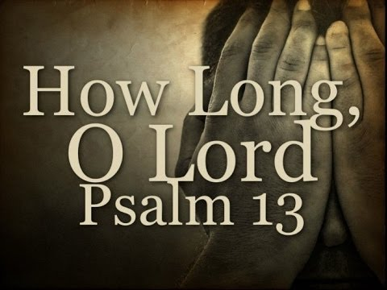
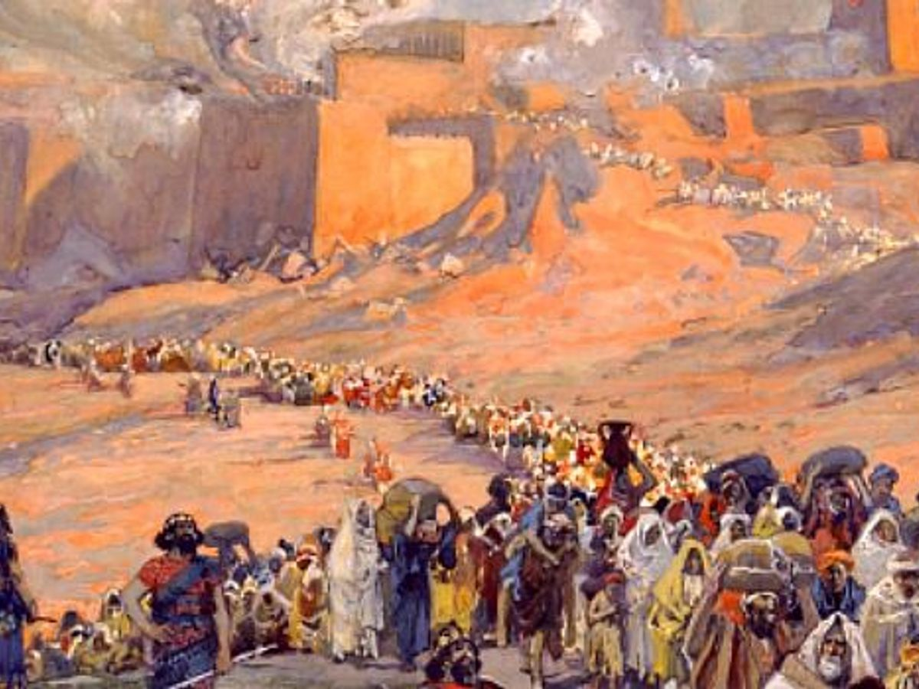
Isaiah’s Job Duration
Isa 6:11-12 – “¹¹Then I said, ‘Lord, how long?’ And He answered, ‘Until cities are devastated and without inhabitant, houses are without people and the land is utterly desolate, ¹²the Lord has removed men far away, and the forsaken places are many in the midst of the land.’”
Notes:
Isa 6:11 – When I do meetings or speak at lectures, I usually ask, “How long can I speak for?” not, “How long do I have to do this?” But given what we just read, it’s no wonder he asks this.
This phrase “Lord, how long?” is a common expression found in most psalms of lament, famous words every believer has asked God. But there’s another way to look at this – maybe as Isaiah considered how God had forgiven him his sins, maybe he’s hoping the Lord will also provide sufficient opportunity for the people in this regard too. Regardless of what Isaiah intended by this message, there will come a point when God’s patience finally ends, and Judah will be destroyed. When that happens and nobody is left, then he can stop.
Isa 6:12 – Their land will be destroyed, but exile would be their ultimate punishment. This is a fulfillment of the predictions made by Moses in Lev 26 and Deut 28 and of Isaiah himself in vs. 1:7-8 and in chapter 5 we studied last time. Sometimes temporary punishment is used to bring people back where they need to be – a humbling. Like Isaiah, we are required to continue to preach to lost souls until there are no souls left to be preached to. Dullness and blindness will come to everyone, but we are not in the position to make these judgments about people. Only God has the omniscience to know when everything that could be said and done has been said and done for individuals. Therefore, we keep preaching it until we die, or they die. “the Lord has” = prophetic perfect – it’s a done deal w/God. Once He has spoken, it’s as good as done.

Slide 11
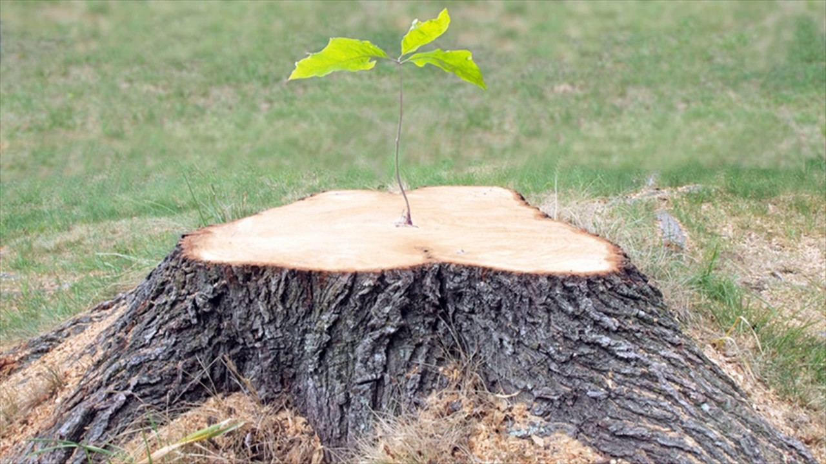
Isaiah Given Hope
Isa 6:13 – “Yet there will be a tenth portion in it, and it will again be subject to burning, like a terebinth or an oak whose stump remains when it is felled. The holy seed is its stump.”
Notes:
Yet vs. 13 indicates that a ray of sunshine will pierce through the ominous storm clouds to come – Isa 6:13a – In other words, a remnant would escape. There are always those among the world that serve God beyond all odds and negative influence and Isaiah would experience this as well - a tenth portion. We saw his word “tenth” used in 5:10 and is the same word for “tithe” found in Lev 27:32, which the text then goes on to say is “holy to the Lord”. But then what would happen to the remnant? – Isa 6:13b – This tenth that remains will also be subject to “burning”, in which all that will be left of those terebinths and oaks would be a stump.
Yet even from these stump, something wonderful would happen – Isa 6:13c – A holy seed – the Messiah. And they looked forward to this holy seed while we look backward to it. But the same lesson applies in both directions. No matter how bad our culture gets, there is always hope because of Who the seed is. Jesus still reigns today as sure as He did when Isaiah saw Him here. And w/Him reigning, a lot can be accomplished w/what seemingly looks like a little. Was Isaiah’s sin the end of him? Nope. Same here. The tree has fallen, but there will be a holy seed.
Remember Isa 1:9 – “Unless the Lord of hosts had left us a few survivors, we would be like Sodom, we would be like Gomorrah.” And I asked the question at the time, “Why should Judah, who is acting like Sodom and Gomorrah, not share their fate?” And the answer is, because God’s promise to Abraham will not be forgotten. Their desolation is a certainty, but not the end. And it is this theme that we’ll see in chapters 7 – 12.

Slide 12
Notes:
Judgment cannot be the last word for Judah, because “God is with us.” And chapter 6, in which Isaiah has his sins purged in order to go on being what God needs him to be, serves as a microcosm and foreshadow not just for what God will do for Judah in chapters 7 – 12, but for all mankind. And in chapters 7 – 12, we will study what is so affectionately referred to as “The Book of Immanuel.”

