Slide 1
Notes:
Isa 66 is a continuation of Isa 65, a chapter which concluded by introducing us to God’s promise of a new heavens and a new earth. This refers to a new “system” that would be very different than the Mosaic system. Things would be done differently; the curses would reverse to blessings. It is a brand-new way of looking at the world, a brand-new way of looking at God’s city. As Paul would say in 2 Cor 5:17b, “the old things passed away; behold, new things have come.”
Now in Isa 66, Isaiah is going to describe how the worshippers look. He first described the system, now He describes what the people will look like who truly live in His presence by faith. And what a great way to close, by describing the kind of people we must be and showing the contrast between that and the world.

Slide 2
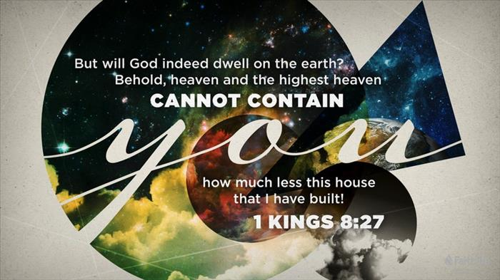
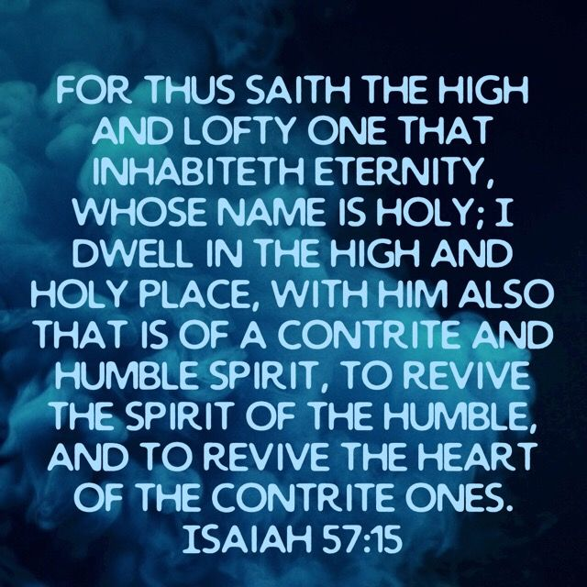
What God Sees
Blessing of true devotion
Isa 66:1-2 – “¹Thus says the Lord, ‘Heaven is My throne and the earth is My footstool. Where then is a house you could build for Me? And where is a place that I may rest? ²For My hand made all these things, thus all these things came into being,’ declares the Lord. ‘But to this one I will look, to him who is humble and contrite of spirit, and who trembles at My word.’”
Notes:
In these verses, God goes back to addressing those who depended on external conformity alone for their relationship w/God.
Isa 66:1-2a – This is reminiscent of Solomon’s dedication of the temple – 1 Kings 8:27 – “But will God indeed dwell on the earth? Behold, heaven and the highest heaven cannot contain You, how much less this house which I have built!” God is not knocking the temple. As we’ll see in vs. 6, He will bring judgment from the temple. But He doesn’t “need” the temple – heaven is His throne and the earth His footstool, meaning He’s transcendent “above all” creation. Then who needs the temple? We do, if we want a relationship w/Him. It is why God condescended Himself to dwell in that temple to live among His people, just as He would later on in Jesus Christ. Interestingly, before Stephen’s speech in Acts 7, the Jews actually accused him in Acts 6:13 of speaking against the temple, prompting him to give this long discourse of the pattern of their history. He ends this by quoting these very verses in Acts 7:49-50. The idea in Isa 66 is that by humbling Himself to dwell in the house they built, it doesn’t in any way make Him beholden to them. The physical temple simply wasn’t the sharpest thing in His field of vision. Neither are the stars, moons, or planets. What is God’s priority over any creative work, the thing that really catches His eye?
Isa 66:2b – Going back to Stephen’s speech. What does he do immediately after quoting these verses in Acts 7? He attacks their character as being stiff-necked, uncircumcised in heart and ears, and always resisting the Holy Spirit. See the parallel? Also, if you remember from 1 Kings 8, as Solomon was dedicating the temple, he asked God to help them, forgive them, and save them if wherever they were, they’d simply “look” to the temple. But the real issue is not where we look, its where God looks. And the thing that catches God’s esteeming gaze is when we are humble and contrite of heart and when we tremble at His word. The “humble” are those ready to take the lowest place at the bottom of the heap. The word “contrite” literally means “lame” and is used of those people or animals that were physically lame. But spiritually it means a sense of personal inability in spiritual matters, utter helplessness to please God. To “tremble” at His word is a sensitive longing to obey. It’s such a keen respect for God’s word, we tremble to imagine not doing it. This shows that God’s true sanctuary is the heart. He’s not ultimately interested in perishable things or in how many animals they can slaughter at the temple, but these imperishable qualities. And if the only reason they wanted a temple is because they thought they were doing Him a service, the whole thing should just be destroyed.

Slide 3
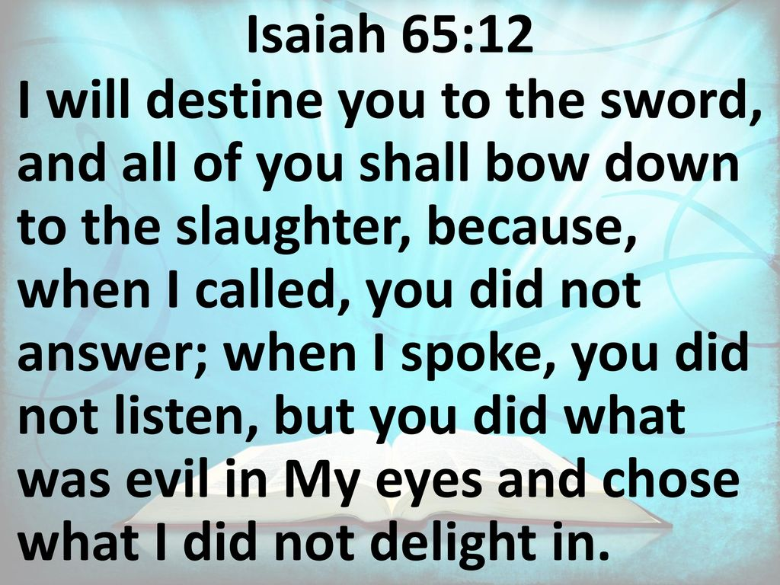
What God Sees
Judgment of false devotion
Isa 66:3-4 – “³But he who kills an ox is like one who slays a man; he who sacrifices a lamb is like the one who breaks a dog’s neck; he who offers a grain offering is like one who offers swine’s blood; He who burns incense is like the one who blesses an idol. As they have chosen their own ways, and their soul delights in their abominations, ⁴so I will choose their punishments and will bring on them what they dread. Because I called, but no one answered; I spoke, but they did not listen. And they did evil in My sight and chose that in which I did not delight.”
Notes:
And so, in vs. 3, God is going to make the point that because their worship had become so external, it became indecipherable in God’s mind w/other false practices.
Isa 66:3 – Understand that Isaiah is not condemning the sacrificial side of religion. Rather, He seems to be going for shock value by showing that anything offered from an unclean heart, no matter how much in line w/the Law, is so offensive to God that it is looked at no differently than killing a man, offering swine’s blood, etc. Remember 64:6 – “all our righteous deeds are like a filthy garment”. He’s setting these items side by side to show how they’re really no different when the outward obedience is not in tune w/the inner man. Being a just God, He cannot be “bought off” by empty ritualism. In fact, empty ritualism doesn’t take away sin like they were hoping, it adds sin. It reminds me of those passages in Matt 5 in which Jesus had to correct the Jewish notions about sin. For example, they thought that as long as they didn’t go through w/the physical act of adultery, they were ok. No, Jesus says, “but I say to you…if you even look at a woman w/lust, you’ve committing adultery.” This has always been God’s desire for us, for the outward religion to bring in tune our inward character.
But when that doesn’t happen, and repentance doesn’t come… – Isa 66:4 – One reason why they immersed themselves in ritualism is that they likely thought it would protect them from divine wrath. After all, think about all the people who weren’t doing anything at all. “At least I’m here” is a common notion amongst religious people. The reality is, because it was empty ritualism, divine justice would bring on them what they sought to avoid. What they had chosen does not reflect what God had chosen and they cannot be His servants because they do not listen when He calls. And interestingly, one of the things they dreaded must was the destruction of their temple. Could the first 2 verses of this chapter be preparing them for that future event?

Slide 4
What God Sees
Judgment of false devotion
Isa 66:5-6 – “⁵Hear the word of the Lord, you who tremble at His word: ‘Your brothers who hate you, who exclude you for My name’s sake, have said, ‘Let the Lord be glorified, that we may see your joy.’ But they will be put to shame. ⁶A voice of uproar from the city, a voice from the temple, the voice of the Lord who is rendering recompense to His enemies.”
Notes:
So now He offers encouragement to the faithful.
Isa 66:5ab – And so, no longer is good vs. evil shown side by side; now they are shown as being in stark contention, one group hating the other. The word-tremblers have a joyful expectancy, but they are mocked for it. The ones who hold God’s word reverently are hated by those who believe they are better than they. And if it were merely enemies doing it, it wouldn’t hurt as much. But the offenders are “brothers” who have empty faith, and empty faith always hates true faith. Who do these perpetrators sound like? The Pharisees, Sadducees, and scribes from Jesus’ day. We’ve seen a lot of allusions to their behavior in this last 9-chapter section. It’s almost as if while Isaiah is preparing them for the coming Messiah, He’s also comparing them to what conditions would be like when He does come.
But He offers encouragement – Isa 66:5c-6 – There will be shame for those who hate God’s faithful, but it will require waiting on God to act in the end, and the end is all that counts. Remember who God “looks to” from vs. 2 – the humble, contrite, and those who tremble at His word. But in a sense, He will also “look to” the rebellious from the temple. They will hear His voice, and it will terrify them. He will render recompense, which means making a full settlement. Vs. 1 – 6 sounds like a conclusion to the Jewish order in 70AD, doesn’t it?

Slide 5
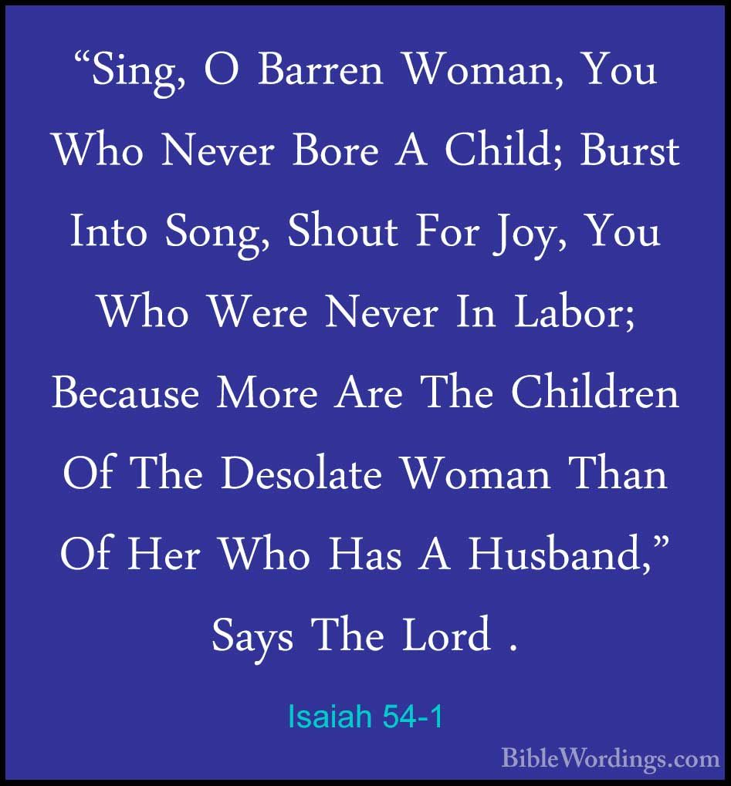
What God Sees
Blessing of New Zion
Isa 66:7-9 – “⁷‘Before she travailed, she brought forth; before her before her pain came, she gave birth to a boy. ⁸Who has heard such a thing? Who has seen such things? Can a land be born in one day? Can a nation be brought forth all at once? As soon as Zion travailed, she also brought forth her sons. ⁹Shall I bring to the point of birth and not give delivery?’ says the Lord. ‘Or shall I who gives delivery shut the womb?’ says your God.”
Notes:
As vs. 7 begins, Isaiah reverts back to symbolism he has used before in which he compared new Zion to a barren woman who will produce abundant offspring.
Isa 66:7-8 – The woman in labor is Zion, but the language suggests that before she even experiences labor, she will give birth. What could a painless birth be symbolic of? A restored Eden, in which childbirth was intended to be w/o pain, in which a child could be delivered w/no cost before sin entered the world. But now the effects of the Fall are no more. Here is the pattern it follows: in 49:1-13, a woman would give birth to the Servant (2nd Servant Song); immediately after that, this same mother is surprised at the return of her other wayward children (49:14-21). Then as we saw in 54:2-3, this return made necessary an enlarged dwelling place. This is just one more picture of how the old order giving way to a new order, the “new heavens and new earth” of 65:17, that will seemingly spring up instantaneously into being and none could have predicted it.
Isa 66:9 – Point: God does not proceed so far w/His purposes only to abandon them before fulfillment – this is God’s faithfulness; and the Lord does not begin what He does not propose to finish – this is God’s sovereignty. The pronoun “I” is emphatic in which He is stressing He is both the Author and Finisher. Another way of possibly stating this is, “Who ever heard of a new nation arising from an old nation before the old nation passes away?” And yet, the church came into being and grew to fill the earth while the physical temple still stood.

Slide 6
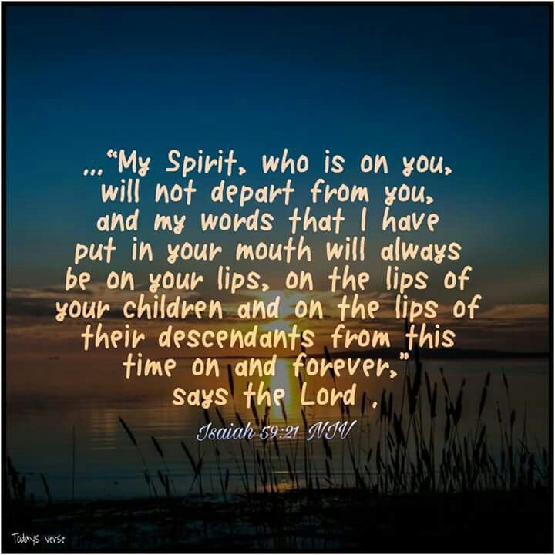
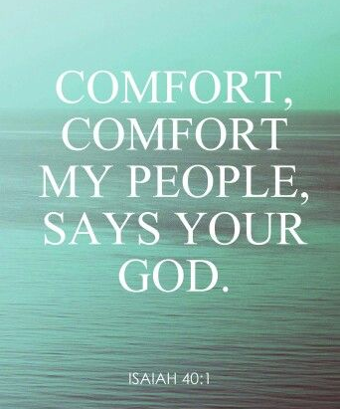
What God Sees
Blessing of New Zion
Isa 66:10-14 – “¹⁰Be joyful with Jerusalem and rejoice for her, all you who love her; be exceedingly glad with her, all you who mourn over her, ¹¹that you may nurse and be satisfied with her comforting breasts, that you may suck and be delighted with her bountiful bosom. ¹²For thus says the Lord, ‘Behold, I extend peace to her like a river, and the glory of the nations like an overflowing stream; and you will be nursed, you will be carried on the hip and fondled on the knees. ¹³As one whom his mother comforts, so I will comfort you; and you will be comforted in Jerusalem.’ ¹⁴Then you will see this, and your heart will be glad, and your bones will flourish like the new grass; and the hand of the Lord will be made known to His servants, but He will be indignant toward His enemies.”
Notes:
The next 2 verses represent the pivot point of the chapter by answering the questions of how those who are oppressed should behave.
Isa 66:10-11 – One of the consequences of siege warfare was that a nursing mothers’ breasts would dry up due to lack of nourishment. Now she will have “comforting breasts”, an allusion back to 40:1, more than enough milk, and of the kind that only a mother can offer. The idea is that the church, New Zion, will everything her children need to live strong, stable lives. And those among God’s people should identify w/Zion in rejoicing, love, gladness, and mourning over her sorrows. How do we do this? 59:21 tells us that the Spirit will give us the words to do so. This is a picture of full commitment to the church and that by identifying w/her in both her sorrows and rejoicings, we participate in her future blessings.
Why can these promises be trusted? God – Isa 66:12-13 – All that was lost is restored and peace is traced to its conclusion. Notice the words “river”, “overflowing/flooding”, “stream”; these were words we’ve seen in Isaiah that often referred to the inundation of enemy nations like Assyria that led people to captivity (8:8; 10:22; 28:2,15,17-18; 30:28). But now God’s measure of judgment is His measure of consolation. It’s as if the nations started out simply fostering Zion’s children, but now, they pass into proper parental care. It used to be that the nations seduced Zion to sin (Judges); now Zion will “seduce” the nations toward righteousness.
The result? – Isa 66:14 – This counters the mocking from vs. 5 “that we may see” w/”then you will see”. And when we see, it will lead to a restoration of the heart, which is the seat of our emotions, and the bones which having shriveled up due to sin will experience greater vigor. A clear distinction will be made between God’s servants and God’s enemies.

Slide 7
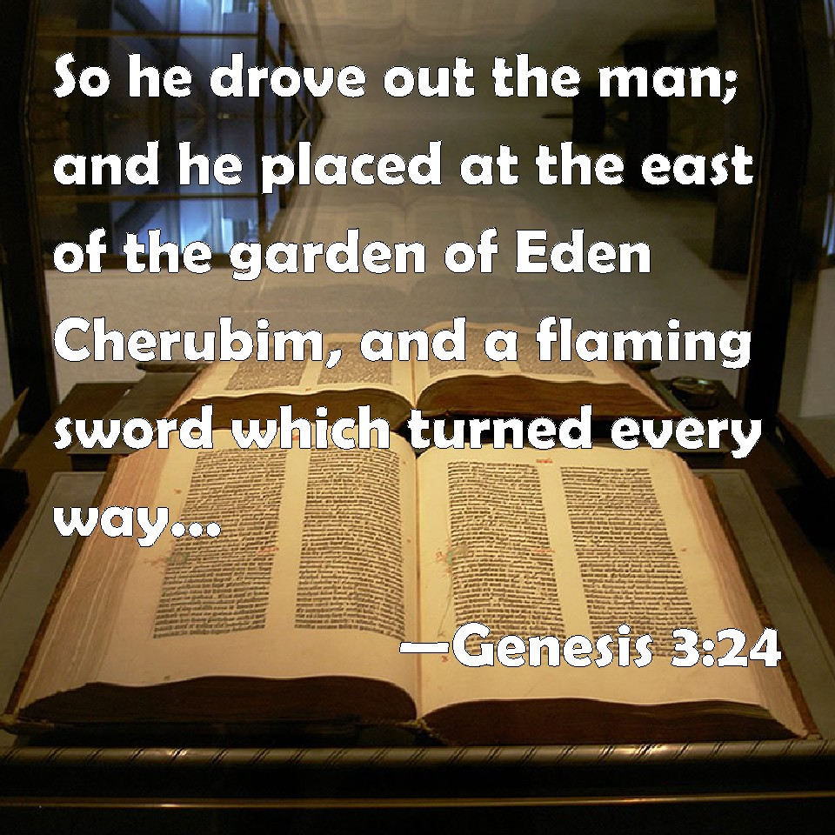
Judgment Vs. Salvation
Judgment Against Idolaters
Isa 66:15-17 – “¹⁵For behold, the Lord will come in fire and His chariots like the whirlwind, to render His anger with fury, and His rebuke with flames of fire. ¹⁶For the Lord will execute judgment by fire and by His sword on all flesh, and those slain by the Lord will be many. ¹⁷Those who sanctify and purify themselves to go to the gardens, following one in the center, who eat swine’s flesh, detestable things and mice, will come to an end altogether,’ declares the Lord.”
Notes:
So, as we conclude the book, Isaiah ends very similarly w/how he began. Just as there is glory awaiting those who tremble at His word, there is judgment coming against those who don’t.
Isa 66:15-16 – Remember one of themes we discussed from Isa 63 – just because there is hope for God’s faithful does not eliminate the inevitability of judgment. That He comes in fire and chariots seems to indicate that nothing will be left behind when He is finished w/them, similar to the effects of a tornado. This is a fitting image to what we saw from Isa 63. But rather than speaking symbolically as he did there by referencing “Edom”, vs. 16 says it will be against “all flesh”, against “many”.
Isa 66:17 – We saw some of this at the beginning of 65. These are the compromisers and apostates among God’s people who don’t tremble at His word. These aren’t Jews who don’t believe anything, but Jews who will believe anything. Further evidence why a Gentile may be a better Israelite than a physical descendant of Abraham.

Slide 8
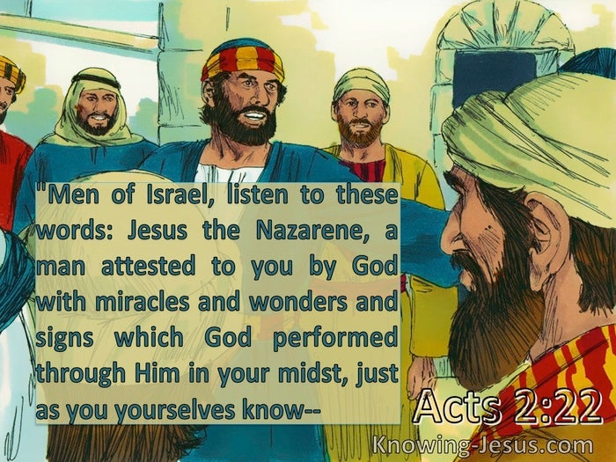
Judgment Vs. Salvation
God’s glory & man’s response
Isa 66:18-21 – “¹⁸‘For I know their works and their thoughts; the time is coming to gather all nations and tongues. And they shall come and see My glory. ¹⁹I will set a sign among them and will send survivors from them to the nations: Tarshish, Put, Lud, Meshech, Tubal and Javan, to the distant coastlands that have neither heard My fame nor seen My glory. And they will declare My glory among the nations. ²⁰Then they shall bring all your brethren from all the nations as a grain offering to the Lord, on horses, in chariots, in litters, on mules and on camels, to My holy mountain Jerusalem,’ says the Lord, ‘just as the sons of Israel bring their grain offering in a clean vessel to the house of the Lord. ²¹I will also take some of them for priests and for Levites,’ says the Lord.”
Notes:
Isa 66:18-19 – Verse 18 looks very broken, but another way of reading it is, “Inasmuch as I know their works/thoughts, the time has come to gather all the nations/tongues to see My glory.” And if you remember from prior chapters, the means by which God would gather His people would be by raising a banner, and that the Servant/Messiah will be that banner. Now, when the new Jerusalem came, where do we read of people from “all nations and tongues”? Acts 2. I don’t take these places as exclusively literal, but “types” depicting the farthest reaches of the earth. This is a reversal of Babel. What is the sign? Likely the banner Himself, Jesus Christ, as Peter Himself said in Acts 2:22, Jesus was a man “attested to you by God with miracles and wonders and signs”. And it is only through Jesus that the world finds a common cause, regardless of culture or language, that inspires outreach amongst its survivors
Isa 66:20 – By “grain offering”, the new converts are a holy gift to the Lord and the fruit of their labors. Keep in mind that the grain offering was the only “bloodless” one of the main five sacrifices in Leviticus. Jesus paid the price of blood for us. Notice the multiple transportation methods; it’s as if it is to suggest that no distance or difficulty will prevent them from answering the Lord’s call. And that some of them are military transport seems to be in line w/2:4 in which instruments of warfare would be transformed into instruments of peace. How can former vessels that brought blood be used? They will be acceptable because of who they carry.
Isa 66:21 – Remember back in 56:3-8 that those once excluded from the temple would be welcomed. This is a step up from that. Even some of the Gentiles will perform “priestly” duties. What a shocking thing this must have been to the Jews who understood that not even just any Jew under the OT could be such.

Slide 9
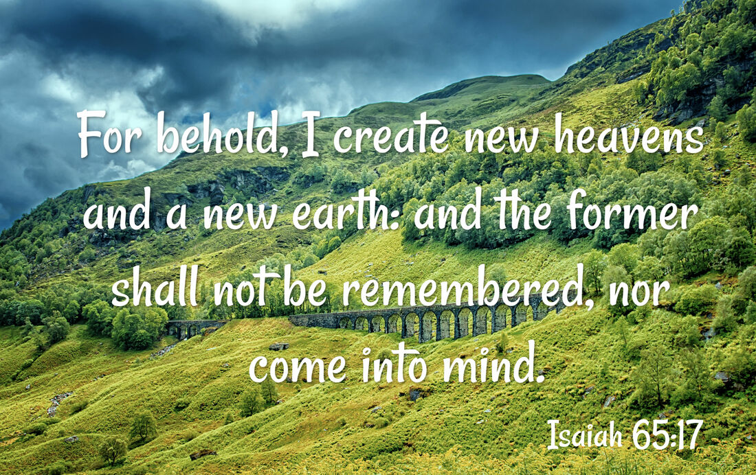
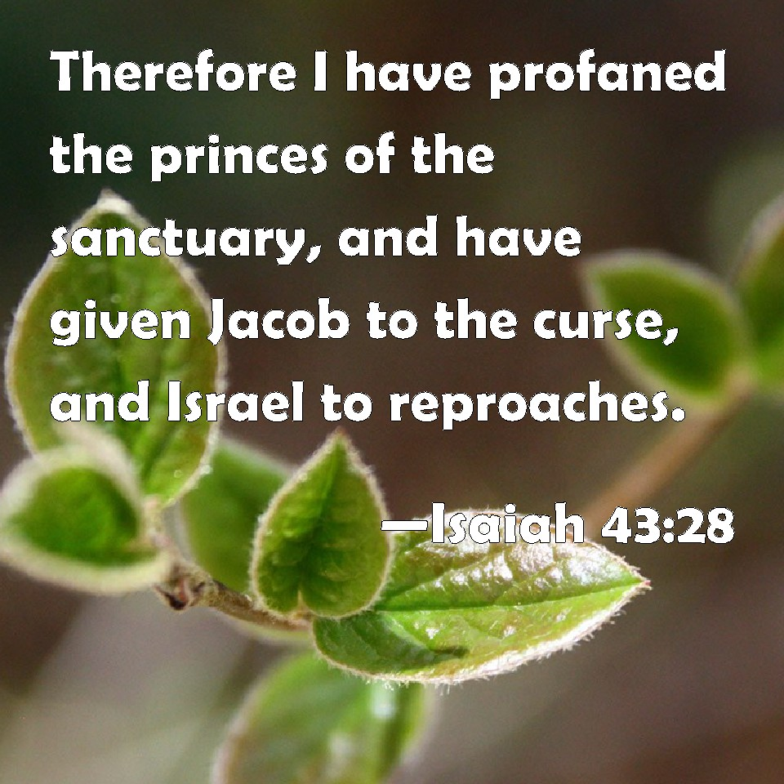
Judgment Vs. Salvation
God’s glory & man’s response
Isa 66:22-24 – “²²‘For just as the new heavens and the new earth which I make will endure before Me,’ declares the Lord, ‘So your offspring and your name will endure. ²³And it shall be from new moon to new moon and from sabbath to sabbath, all mankind will come to bow down before Me,’ says the Lord. ²⁴Then they will go forth and look on the corpses of the men who have transgressed against Me. For their worm will not die and their fire will not be quenched; and they will be an abhorrence to all mankind.’”
Notes:
And to conclude, he once again brings up the new heavens and the new earth:
Isa 66:22 – Remember in 1:2 that the old heavens/earth were called to witness against their sin. Then in 44:23 and 49:13, they were called on to sing over their redemption. Now the new heavens and the new earth stand as a testimony to God’s promises. This is a guarantee of perpetuity. Our name will endure, that which expresses and sums up the inner truth about us. And our offspring will endure, all of us that become united in the family of the Servant. This is security for our salvation.
Isa 66:23 – Does He mean literal new moon and Sabbath? Likely not. What both have in common is they symbolized regular, continual, faithful worship that comes from a true commitment from the heart. Both the New Moon and the Sabbath required one to plan one’s life around God’s timetable. Those in the New Jerusalem will assemble to worship God on every first day of the week and every other time they are called on to assemble, because that is where He is accessible.
And the final 9-chapter section closes w/an even darker description than “there is no peace for the wicked”. Rather than not having peace, there will be destruction – Isa 66:24 – We immediately recognize this verse as the vehicle Jesus used in His teaching about eternal judgment. But notice in these verses how God’s faithful will observe what’s happening. I would suggest that Isaiah is not necessarily talking about eternal judgment here as Jesus did in the OT, but rather a representation of the world we’re apart of “in between worship services”. The entire world is a “cemetery beside the church”. When not assembling, we cannot help but to gaze all around us at the fate we’ve been spared, and even be repelled. The phrase “worm will not die” alludes to ceaseless corruption and that is the state of people in the world – we see it. “fire will not be quenched” alludes to unending holy wrath of people who will not give their lives to Christ. These likely allude to the true consequence of sin and its inevitable outcome. Perhaps knowing this, Isaiah’s point is that if God’s blessings don’t win us over, maybe the terrible reward of disobedience will evoke the trembling we need.

