Slide 1
Notes:
As we walk back the chiasm from chapter 61, we learned in chapter 62 that God will not rest until Zion is transformed into the gravitating light He wants us to be. And in the 2nd half of that chapter, He appoints “watchmen on the walls” to fervently pray and wait for God w/that same restless spirit He Himself has for Zion, constantly reminding Him to fulfill the word He has promised. And as we saw in Isa 63, that persistence will one day be rewarded as the watchman catch a glimpse of a great Warrior who returns from taking vengeance on the enemies of God and His people, almost as if to remind them of some great, future event in store for Zion. But in the meantime, the watchmen are to pray, which takes up the remainder of chapter 63 – 64. And you’ll remember that this prayer can be divided into 3 parts. #1: “God, remember your gracious deeds of the past.” (63:7-14). #2: “We’re in real trouble right now; where are You?” (63:15-64:7). #3: “Please come help us” (64:8-12).
Chapter 65, we are going to see God’s response to their prayer, and that while a lot of what they prayed were good things, there were also some charges relayed toward God that are incorrect. Not only will God bluntly deny any responsibility for their sin, He’s going to remind the watchman, the faithful of Zion, of a few things they’ve forgotten, and also that they were living amongst compromisers to the faith, which is a typical scenario. But this is an important point to make because one of the things the watchmen were saying in their prayer is “we are Your people. You created us, we are called by your name, so please do something.” But that simply wasn’t true for everyone, and it’s a further reminder of why God would one day allow even foreigners, those who had previously been denied access to His house, to one day come streaming to it.

Slide 2
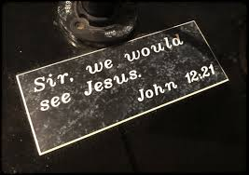
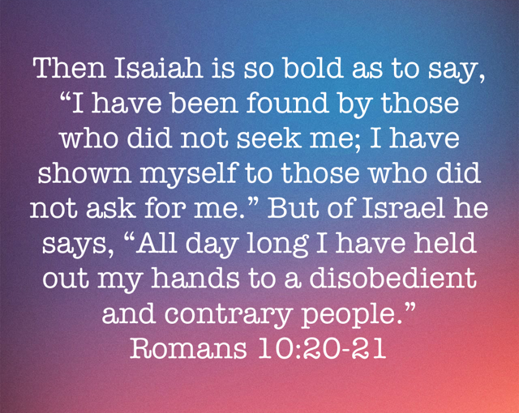
God Called, They Didn’t Listen
A rebellious people
Isa 65:1-2 – “¹I permitted Myself to be sought by those who did not ask for Me; I permitted Myself to be found by those who did not seek Me. I said, ‘Here am I, here am I,’ to a nation which did not call on My name. ²I have spread out My hands all day long to a rebellious people, who walk in the way which is not good, following their own thoughts,”
Notes:
The Lord has no intention of allowing the watchmen to rewrite history. There are 2 sides to the story and several of the charges addressed toward God were wrong. So, the Lord begins His reply by basically saying, “I’m not the one who left; you did.”
Isa 65:1 – Now, this verse is quoted by the Apostle Paul in Rom 10:20, and if you remember the context, it was to prove that it was always God’s intention to bring Gentiles into His kingdom. The idea is this – the Jews have so blatantly rejected Him, that when Jesus finally comes on the scene, that was one way of saying He is ready to receive Gentiles into the kingdom. I’m reminded of John 12:20-26 in which Greeks were seeking Jesus. And when Andrew and Phillip told Jesus, the very first thing Jesus said was – John 12:23 – “The hour has come for the Son of Man to be glorified”. In other words, “It’s time for Me to die so we can start bringing these guys in”. Isa 65:1 is God looking forward to situations like this.
That’s the Gentiles – Isa 65:2 – This verse is quoted in Rom 10:21. So they’re back-to-back in Isaiah and back-to-back in Rom 10. Who is He referring to in this verse? The Jews! It wasn’t that His hand is so short it couldn’t save. Rather, He had spread out His hands, a gesture of appeal, all day long while they were in rebellion hoping to move them to repentance, but they were stubborn in the midst of a persistent, pleading God. Remember from 64:12 that the watchman asked God, “Will you [continue to] keep silent?”. This is God’s answer to that. God was not the unresponsive one. The issue was they had a will to do wrong which caused them to follow a lifestyle rooted in their own thoughts that were not good.

Slide 3
God Called, They Didn’t Listen
A rebellious people
Isa 65:3-7 – “³‘a people who continually provoke Me to My face, offering sacrifices in gardens and burning incense on bricks; ⁴who sit among graves and spend the night in secret places; who eat swine’s flesh, and the broth of unclean meat is in their pots. ⁵Who say, ‘Keep to yourself, do not come near me, for I am holier than you!’ These are smoke in My nostrils, a fire that burns all the day. ⁶Behold, it is written before Me, I will not keep silent, but I will repay; I will even repay into their bosom, ⁷both their own iniquities and the iniquities of their fathers together,’ says the Lord. ‘Because they have burned incense on the mountains and scorned Me on the hills, therefore I will measure their former work into their bosom.’”
Notes:
And in vs. 3 – 7, he is going to go in great detail as to the kind of rebellion they were involved in, those ways from vs. 2 which he says “are not good”:
Isa 65:3-4 – Notice how brazenly and openly defiant they were – little to no effort was made to hide their rebellion. While He spread out His hands “continually”, they provoked Him “continually”. He starts w/the simplicities of religious practices, places where you’d think obedience would be easy such as the place where you worship God. But they didn’t view it as important, and so it became precedence for greater disobedience. Vs. 4 reminds me of the condition of the man w/the legion of demons in Mark 5 who sat in the tombs and then desired to go into the pigs when Jesus cast them out. But what he’s most likely alluding to is necromancy, consultation w/the dead.
Isa 65:5 – In other words, while they are acting this way, they’re treating others as 2nd class citizens, thinking they will defile their holiness. Who does this sound like from Jesus’ day? The Pharisees, scribes, and Sadducees. God is so disgusted by this, it’s like “smoke in [His] nostrils”. This could mean it’s either as off-putting as smoke getting in the nose, a constant irritant, or simply God’s anger building up. Sometimes sacrifices are called a “sweet aroma” to God. This is an irritating aroma.
Therefore, God will pay them back – Isa 65:6-7 – So certain will their judgment be, He’s figuratively written it down so as not to forget. Remember, they had previously charged Him w/being silent. The truth is, if they’d known what would come had God acquiesced, they’d have preferred He stay silent. What does He mean by punishing their iniquities and the iniquities of their fathers? Perhaps He’s alluding to generational sins that unless we break we will also be doomed to inherit (ever known anyone like this?). They would not stop worshipping on the high places, which we know even some of the greatest reformers of the kings had trouble nipping in the bud, and so He’s going to measure their works into their bosom, which is a figurative way of saying the exact wages of their sins will be paid back to them, balancing the scales of justice.

Slide 4
God Called, They Didn’t Listen
What God Will Do For His Servants
Isa 65:8-10 – “⁸Thus says the Lord, ‘As the new wine is found in the cluster, and one says, “Do not destroy it, for there is benefit in it,” so I will act on behalf of My servants in order not to destroy all of them. ⁹I will bring forth offspring from Jacob, and an heir of My mountains from Judah; even My chosen ones shall inherit it, and My servants will dwell there. ¹⁰Sharon will be a pasture land for flocks, and the valley of Achor a resting place for herds, for My people who seek Me.”
Notes:
Now, one question that would naturally arise from the horror of vs. 2 – 7 is, “Will God destroy everyone because of the sins of the majority?”. No.
Isa 65:8-9 – “New wine in the cluster” is the juice that comes from the first drippings of the grapes before it is ever pressed. These would be removed from the vine when the grape was about to burst w/juice and then pressed. There was blessing in it to be enjoyed, not to be destroyed like we saw the Warrior doing to “Edom” in 63:3. These will be guarded from destruction. Everyone merits the winepress, but a remnant will be spared it. Remember Shear-jashub, “a remnant shall return”. He will not forget the promise made to Abraham, Isaac, and Jacob, though much of that offspring will come from the nations.
Isa 65:10 – This is a coming picture we’ve seen already in Isaiah that pictures restoration and renewal. Sharon was pictured as desert wilderness in 33:9 and Achor was known for the sin of Achan in Josh 7. And so, that which was once fertile that became infertile will one more become fertile, and that which was never fertile will also become fertile, and there will be no threat left; herds will lie down in peace.

Slide 5
God Called, They Didn’t Listen
What God Will Do For His Servants
Isa 65:11-12 – “¹¹‘But you who forsake the Lord, who forget My holy mountain, who set a table for Fortune, and who fill cups with mixed wine for Destiny, ¹²I will destine you for the sword, and all of you will bow down to the slaughter. Because I called, but you did not answer; I spoke, but you did not hear. And you did evil in My sight and chose that in which I did not delight.’”
Notes:
He now contrasts those “servants” from vs. 9 w/those in rebellion :
Isa 65:11-12a – We remember from chapters 25 and 55 the great banquet awaiting God’s people on His mountain. But they’re willing to climb any mountain but God’s and have a feast on it to pagan gods. It’s not that they weren’t religious, it’s just that they were willing to climb any mountain but God’s mountain, just like Israel of old that forgot about God’s presence at Mt. Sinai and built and worshipped a golden calf right at the foot of the mountain in God’s presence no less. “Fortune” and “Destiny” were pagan gods who people thought needed to be wined and dined so that their personal fortunes and destiny would be assured. These are people who replace trust in the one true God who controls the future for controlling their own destiny. Sound like anyone you know? And so, God says, “You want destiny? Here’s some destiny for you” – the sword.
Why so harsh? – Isa 65:12b – It’s not that they didn’t know any better. Just as we saw in vs. 2, God called, they just refused to listen. And in the process, they chose the things God does not delight in.

Slide 6
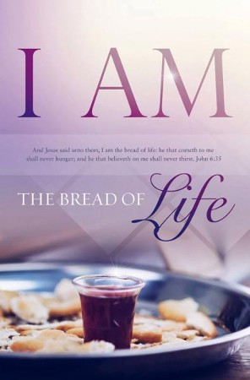
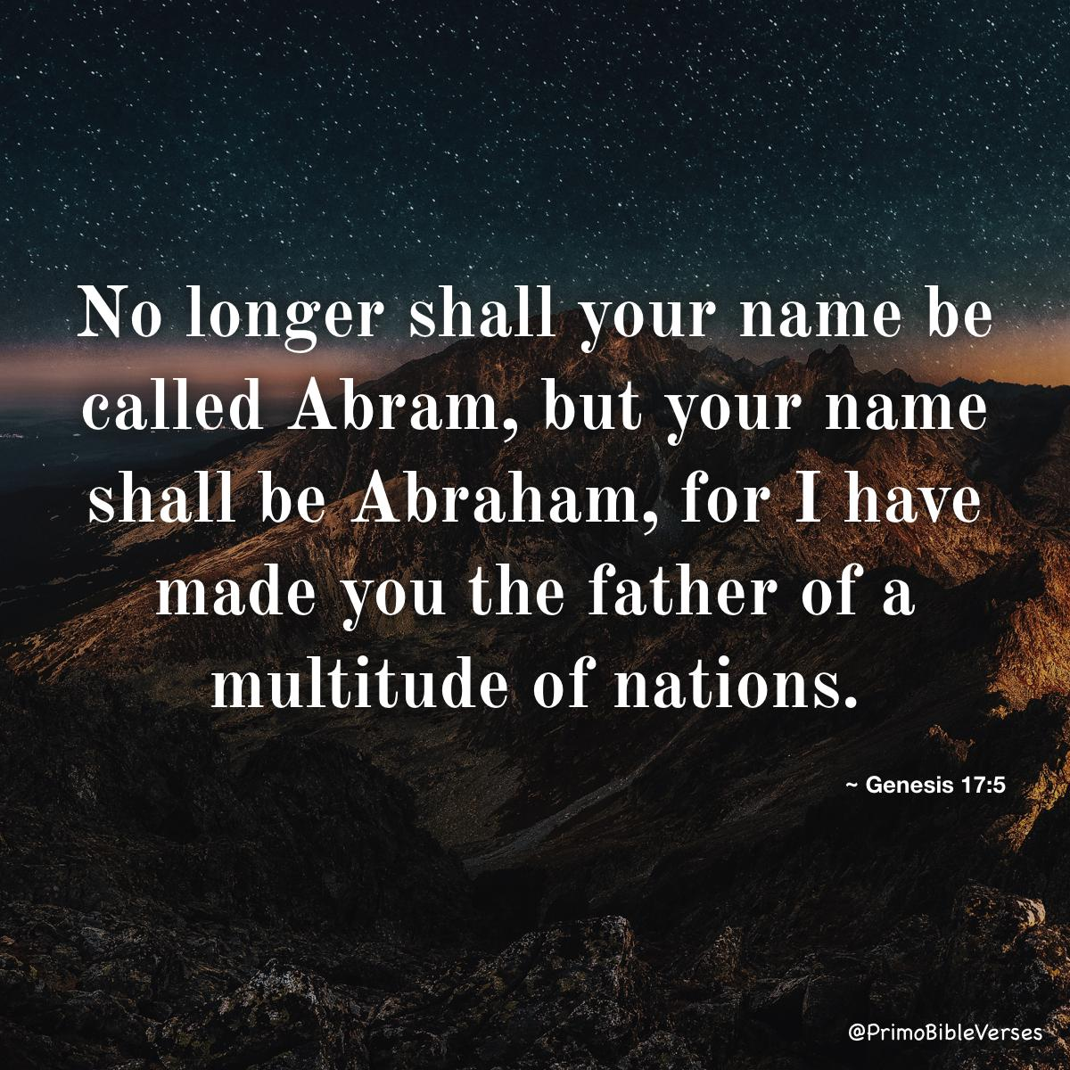
God Called, They Didn’t Listen
What God Will Do For His Servants
Isa 65:13-16 – “¹³Therefore, thus says the Lord God, ‘Behold, My servants will eat, but you will be hungry. Behold, My servants will drink, but you will be thirsty. Behold, My servants will rejoice, but you will be put to shame. ¹⁴Behold, My servants will shout joyfully with a glad heart, but you will cry out with a heavy heart, and you will wail with a broken spirit. ¹⁵You will leave your name for a curse to My chosen ones, and the Lord God will slay you. But My servants will be called by another name. ¹⁶Because he who is blessed in the earth will be blessed by the God of truth; and he who swears in the earth will swear by the God of truth; because the former troubles are forgotten, and because they are hidden from My sight!”
Notes:
And so, to finish up this section, he lays out a series of contrasts, promises and threat for the servants and rebels respectively.
Isa 65:13-14 – Sounds like 55 – “Everyone who is thirsty, come to the waters! No money? Come buy and eat without cost!” those who are lowly in heart will be blessed. All spiritual needs will be satisfied; all external needs will be satisfied which will lead to additional internal satisfaction. But those who are rebellious will continue to go totally unfulfilled, leading to a perpetually heavy heart and broken spirit.
And their names will become a curse to those who are God’s chosen – Isa 65:15-16 – Notice the contrast in names, which indicates everything that is essentially true of a person, his character and his personal traits. Also, whoever in the world that would enter into the blessing designed for him will enter into that blessing in the God of truth, which literally means “God of the amen”, the God who says “amen” to all promises and affirms their trustworthiness. So, remember from 59:2 in which we read “your sins have hidden His face from you”? The curse is reversed – now it is their sins that are hidden from His sight. Why are all these contrasts happening in the 2nd part of this 9-chapter section? Due to what the Anointed Conqueror of chapter 61 does.

Slide 7
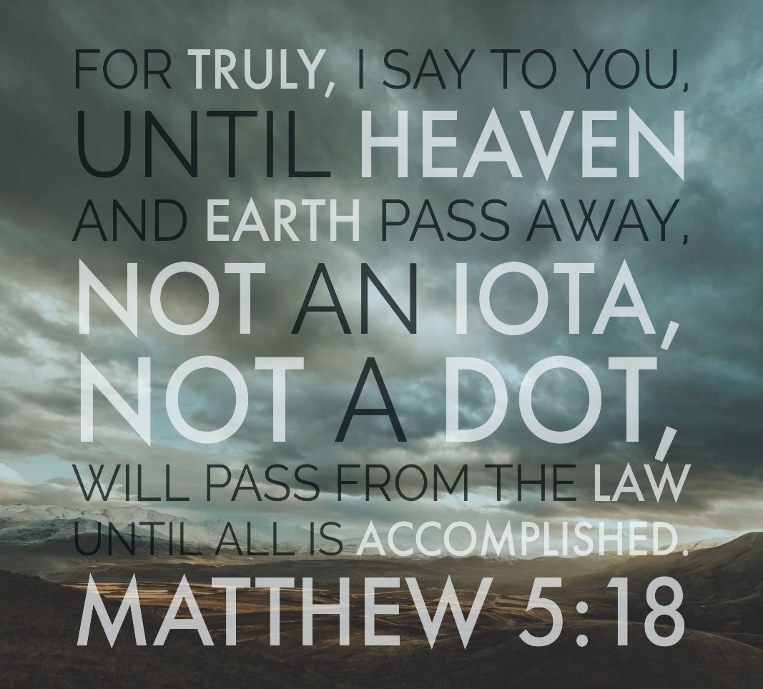
God Called, They Didn’t Listen
New Heavens & Earth
Isa 65:17-18 – “¹⁷For behold, I create new heavens and a new earth; and the former things will not be remembered or come to mind. ¹⁸But be glad and rejoice forever in what I create; for behold, I create Jerusalem for rejoicing and her people for gladness.”
Notes:
Just like chapters 1 – 5, we’re going to see a pendulum swing between judgment and hope for the remainder of the book. But just as chapters 1 – 5 begin and end w/judgment, these last set of verses will begin and end w/hope.
Isa 65:17 – Notice it begins w/“For behold”. The reason why God’s people will be blessed and the rebellious will be cursed is because God is creating a new heavens and earth. A thorough study of this idea is beyond the scope of this class, but keep in mind what we previously read in Isa 51:5-6 - “My righteousness is near, My salvation has gone forth, and My arms will judge the peoples; the coastlands will wait for Me, and for My arm they will wait expectantly. Lift up your eyes to the sky, then look to the earth beneath; for the sky will vanish like smoke, and the earth will wear out like a garment and its inhabitants will die in like manner; but My salvation will be forever, and My righteousness will not wane.” Yet there is a reversal in – Isa 51:16 – “I have put My words in your mouth and have covered you with the shadow of My hand, to establish the heavens, to found the earth, and to say to Zion, ‘You are My people.’” He is not talking about a literal heaven and earth, though that is used in places like 2 Pet 3. This is a figurative way of saying that God will usher in a new system, dispensation, environment, era, a new spiritual order, a new arrangement in Christ. It is a figure for a complete renovation and revolution of the existing course of affairs of that time, which at the time was the Mosaic Law. The idea is that just as God’s people get new names, so do the heaven and earth. Keep in mind what Jesus said in Matt 5:18 – “For truly I say to you, until heaven and earth pass away, not the smallest letter or stroke shall pass from the Law until all is accomplished.” If Jesus were talking about the physical heaven and earth, we would still be under the Law of Moses.
Isa 65:18 – Under the Mosaic Law, the old, figurative “heaven and earth”, Jerusalem was confined to a specific point on earth. But in the new heaven and earth, there is a new Jerusalem in which God’s people are scattered all over the physical earth. And rather than this city being dominated by past memories of sin, there will be joy that far outweighs any joy of the previous heaven and earth.

Slide 8
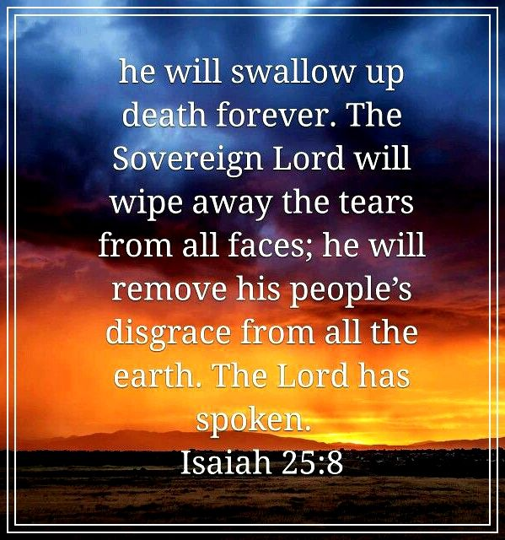
God Called, They Didn’t Listen
New Heavens & Earth
Isa 65:19-23 – “¹⁹I will also rejoice in Jerusalem and be glad in My people; and there will no longer be heard in her the voice of weeping and the sound of crying. ²⁰No longer will there be in it an infant who lives but a few days, or an old man who does not live out his days; for the youth will die at the age of one hundred and the one who does not reach the age of one hundred will be thought accursed. ²¹They will build houses and inhabit them; they will also plant vineyards and eat their fruit. ²²They will not build and another inhabit, they will not plant and another eat; for as the lifetime of a tree, so will be the days of My people, and My chosen ones will wear out the work of their hands. ²³They will not labor in vain, or bear children for calamity; for they are the offspring of those blessed by the Lord, and their descendants with them.”
Notes:
The new Jerusalem will not only be a joy in and of itself, but a joy to God.
Isa 65:19-20 – In general, He’s saying that in this new heaven and earth, specifically the new Jerusalem, things will be better than they were under the law of Moses. How? There won’t be any of the weeping and crying. But how is that the case? There are a lot of things worth weeping and crying over and we’re told to weep w/those who weep. But in context, I have to believe He is referring to weeping over their former sins, the idea being, “that’s all in the past”. Think about how different this is than the physical nation of Jerusalem! If you read vs. 20 hyper literally, you’ll be confused. I think the idea is that the power of death has been removed, something the Apostle Paul alludes to in 1 Cor 15:54-56. The sting of death is no more because the curse of sin has been removed. This is a reversal of the curses Moses mentioned in Deut 28.
Isa 65:21-22 – One of the things God caused to happen when Israel sinned was that the enemy would come in and reap the benefits of everything they’d sown. But in the new Jerusalem, you won’t build w/o enjoying the fruit of your labor as was the case in days of old.
Isa 65:23 – And so there is no cloud marring their enjoyment such as insecurity over what may happen. In the past, people labored for that which didn’t satisfy. But remember 1 Cor 15:58 – “Your labor is not in vain in the Lord”. Why? Because we are part of Gods family, the sting of death is removed, and we offspring blessed by the Lord, and offspring of the spiritual will share in that blessing.

Slide 9
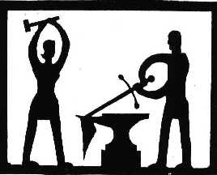
God Called, They Didn’t Listen
New Heavens & Earth
Isa 65:24-25 – “²⁴It will also come to pass that before they call, I will answer; and while they are still speaking, I will hear. ²⁵The wolf and the lamb will graze together, and the lion will eat straw like the ox; and dust will be the serpent’s food. They will do no evil or harm in all My holy mountain,” says the Lord.”
Notes:
Isa 65:24 – Back in chapter 59, their sin caused communication w/God to be hindered. But now, there will be such oneness w/Him, He’ll anticipate our needs before we even ask Him. We will be so united, so in sync, so in communion w/God, He immediately acts. This works in the real world, too – when my wife and I can go to a restaurant, she can predict from the menu what I will order and she is usually right. She can see my demeanor around the house and practically read my mind…she knows the foods I like, the ones I don’t, etc. Our marriage w/the Lamb will be similar.
Isa 65:25 – We saw this same idea back in Isa 11, and it confirms that vs. 17-25 are Messianic. Eden is restored. Old enmities are gone (wolves), fears removed (lambs), nature changed (lion…straw). All this was due to the serpent’s interference, but now he will be humbled/defeated. They will no longer do damage or destroy one another. Opposites in the old reality will in the new reality be at peace. No animosities and divisions.

