Slide 1
Notes:
In chapter 59, the Messiah put on garments for both salvation and vengeance, a helmet for salvation and garments of vengeance. Then as we saw in chapter 61, He likewise spoke in the first person His intention of bringing a year of salvation, but a day of vengeance. But when Jesus read these verses in the synagogue in Luke 4, he stopped before He got to the “day of vengeance”. Why? Because while He was on earth, it was the “year” of salvation. But one day, there will be a “day” of vengeance.
The first part of chapter 63 is going to focus on that Day of Vengeance, and this is a truth that initially cause us to recoil. But we need to remember that the reason judgment scenes like this are so difficult for us to process is because we don’t really have it in ourselves to understand what true, absolute holiness really is, and why it is so necessary for there to be a final settlement between God and all that defiles and opposes His cause. And so, we’re left attempting to swallow scenes like this “by faith”. But even as we do, we’ll try to provide enough perspective on why salvation must be accompanied by a day of vengeance.

Slide 2
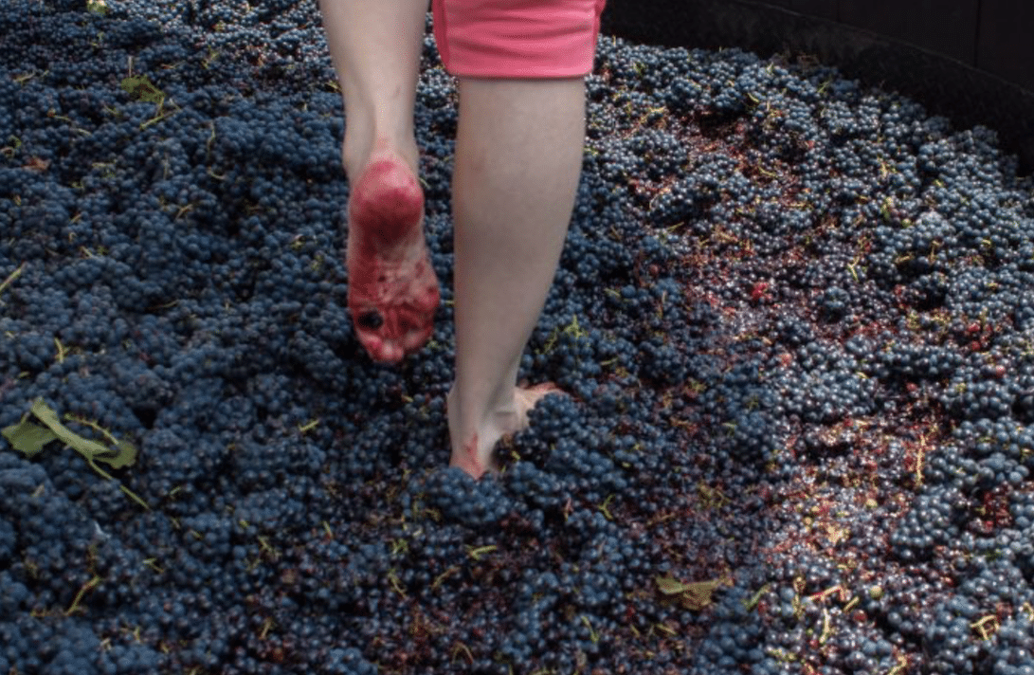
The Lord Intercedes
God’s vengeance
Isa 63:1-3 – “¹Who is this who comes from Edom, with garments of glowing colors from Bozrah, this One who is majestic in His apparel, marching in the greatness of His strength? ‘It is I who speak in righteousness, mighty to save.’ ²Why is Your apparel red, and Your garments like the one who treads in the wine press? ³‘I have trodden the wine trough alone, and from the peoples there was no man with Me. I also trod them in My anger and trampled them in My wrath; and their lifeblood is sprinkled on My garments, and I stained all My raiment.”
Notes:
We recall from 62:6 that God called on watchmen to station themselves on the wall and that their job was to be as restless in their prayers as God would be in ensuring their salvation comes. But as the watchmen are praying, they see someone approaching and they are surprised by what they see.
Isa 63:1 – You might remember from chapter 34 that Edom was singled out because they are a symbol of the enemy of God’s people. We see that same symbolism here. We’re seeing an image of the return of a great warrior from some colossal battle, and he is marching from that battle w/a confident swagger about Him. There is no weakness in Him at the end of this battle; He exudes absolute strength. And He responds to the watchmen, “It is I who speaks in righteousness, mighty to save”. And so, while His primary act was vengeance, and He was right to judge, He is also mighty to save. This shows us there is a connection between our salvation and vengeance against our enemies. More on that in a bit.
The watchmen next ask – Isa 63:2 – The symbolism is rich. All the way back in Gen 25, we read that Esau was called “Edom” because of the red stew. Also, “Bozrah”, which was a city of Edom, literally means “vintage”, a place where one would tread wine. Old coins that have been uncovered from Bozrah even have the image of a wine press stamped on them. And so, the red that this Warrior is returning w/is His clothes stained w/blood from treading over the enemy – that’s the image. Remember from chapter 59 that He was putting on garments as if He were going to war. Now He’s returning from it, having accomplished what he purposed.
And rather than being ashamed for being blood-stained, He embraces the image – Isa 63:3 – He did it all by Himself; no one helped Him. Ordinarily, this would have polluted Him and exposed Him to defilement, which He accepted. But it did not defile Him long term because vs. 1 tells us He returns in “righteousness”. This is the work of a God whose children have been abused long enough by the enemy. He is furious against all who’d deprive His people of the blessings He wishes on them. And so, as one would stomp on grapes and the juice splatter their garments, so had this man stomped on Edom and their blood splattered on Him.

Slide 3
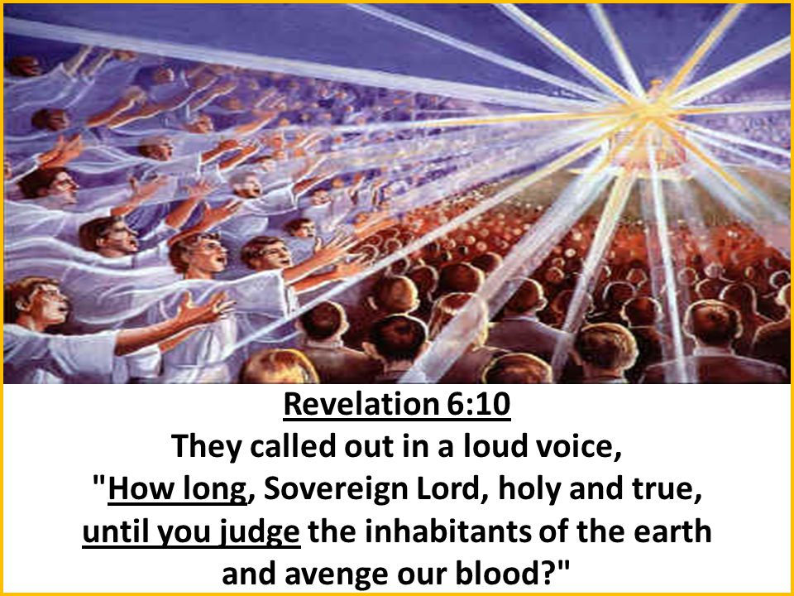
The Lord Intercedes
God’s vengeance
Isa 63:4-6 – “⁴‘For the day of vengeance was in My heart, and My year of redemption has come. ⁵I looked, and there was no one to help, and I was astonished and there was no one to uphold; so My own arm brought salvation to Me, and My wrath upheld Me. ⁶I trod down the peoples in My anger and made them drunk in My wrath, and I poured out their lifeblood on the earth.’”
Notes:
Vs. 4 explains the motive of the these first 3 verses:
Isa 63:4 – Was this blood lust, revenge, or bitterness on God’s part? No, there were offenders who aroused this vengeance, and something had to be done to them for the sake of the redeemed. Vengeance and salvation are related. Salvation cannot fully be realized w/o vengeance being poured out on the wicked ones who persecute God’s people. Remember Rev 6:10 – “How long O Lord will you not avenge our blood?” Is this a good thing or a bad thing? Well, if you’re a POW, and while in prison you hear explosions and gun fire, and all the sudden an American soldier walks around the corner soaked in blood to free you, is that a good thing or a bad thing? It’s all a matter of perspective. This is an image of Jesus liberating His people, and to do so He must conquer their oppressor.
The next verses add a personal sense of tragedy to the mess – Isa 63:5-6 – Same idea from 59:15-16 and earlier in this chapter – no one was available to help the fallen, and so God’s own arm brought salvation, and His arm upheld Him. The phrase “poured out their lifeblood on the earth” is interesting because you’ll remember from Gen 4:10 that this was what God told Cain, “The voice of your brother’s blood is crying to me from the ground.” And in Lev 17:3, when an animal was killed, his blood was to be poured out on the ground and covered w/dirt. Combine this w/53:8 in which the Servant “poured out Himself to death” and it could mean that because they did not avail themselves to His death, He’ll be glorified through theirs. What actual events do these verses point to? In the short term, it could be any time that evil on earth was judged, from the falls of the kingdoms of men forward, Jerusalem in AD 70, but will ultimately be fulfilled when Jesus returns.

Slide 4
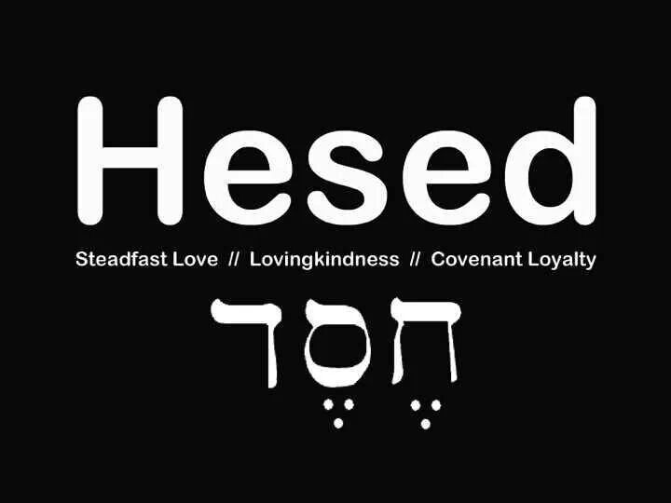
God’s Mercy Remembered
Past mercies
Isa 63:7-10 – “⁷I shall make mention of the lovingkindnesses of the Lord, the praises of the Lord, according to all that the Lord has granted us, and the great goodness toward the house of Israel, which He has granted them according to His compassion and according to the abundance of His lovingkindnesses. ⁸For He said, ‘Surely, they are My people, sons who will not deal falsely.’ So He became their Savior. ⁹In all their affliction He was afflicted, and the angel of His presence saved them; in His love and in His mercy He redeemed them, and He lifted them and carried them all the days of old.”
Notes:
Now, this is an event to wait for. But while waiting for this event, how do we, the watchmen, stay encouraged? Well, we pray, but we also trust in the steadfast love of the Lord. 63:7 through the end of chapter 64 is likely the prayer of the watchmen on the walls, and is comprised of 3 points. Point 1: “God, you were gracious to your people in the past.” (63:7-14). Point 2: “We’re in big trouble right now, so where are you?” (63:15-64:7). Point 3: “Please come help us” (64:8-12). This is one of the most emotional prayers we in the bible.
Isa 63:7 – The word “lovingkindness” is also translated “steadfast”, and that is a much better translation because it goes beyond merely stressing the love of God; rather, it stresses the “unchanging” love of God. The skeptic would take the glass half empty approach, saying about vs. 1 - 6, “That’s the God I know – angry!”. Yet the watchmen of 62:6 would take the glass half full approach, repetitively surveying the past goodness of God. They are talking to God about God. And one thing they do to recount God’s steadfast love is by recounting the “praises of the Lord”, those deeds for which He should be praised we should always keep before our mind so that while we’re down here waiting on the Lord, we’ll stick w/Him through thick and thin. Because Satan is doing the same thing to us today that he did to Adam and Eve in the garden, trying to convince us God hasn’t done enough for us. He has.
His steadfast love began by choosing Israel to be His people – Isa 63:8-9 – He didn’t choose Israel because they deserved it, but rather in order to become their Savior. And in doing so He assumed that by adopting them, it would likewise lead to their loyalty and love. And when things got rough, He shared in their affliction. There was a personal, recognizable presence. Israel’s entire life was in the Lord’s hands; they were born and carried as a mother carries her child.

Slide 5
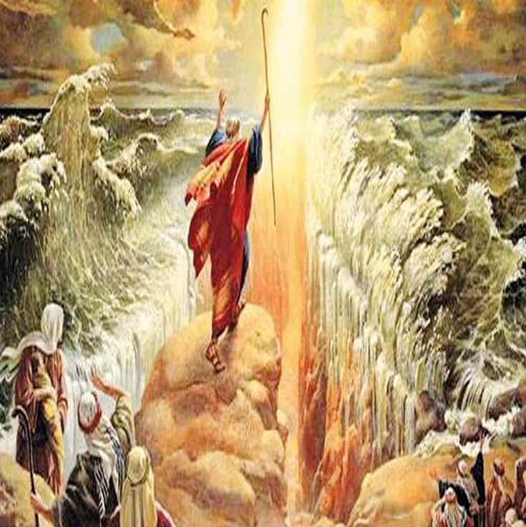
God’s Mercy Remembered
Past mercies
Isa 63:10-14 – “¹⁰But they rebelled and grieved His Holy Spirit; therefore He turned Himself to become their enemy, He fought against them.¹¹Then His people remembered the days of old, of Moses. Where is He who brought them up out of the sea with the shepherds of His flock? Where is He who put His Holy Spirit in the midst of them, ¹²Who caused His glorious arm to go at the right hand of Moses, Who divided the waters before them to make for Himself an everlasting name, ¹³Who led them through the depths? Like the horse in the wilderness, they did not stumble; ¹⁴As the cattle which go down into the valley, the Spirit of the Lord gave them rest. So You led Your people, to make for Yourself a glorious name.”
Notes:
However, vs. 10 begins w/that all important word “but”. Despite God’s divine expectation, something else happened.
Isa 63:10 – We see the idea of grieving the H.S. multiple times in scripture. And what this shows is that as powerful and as mighty as God is, we do actually hurt Him by our rebellion. He is deeply grieved emotionally. And when we rebel, He turns. See, it’s not God who changed, but the people. And when the warrior God from the beginning of the chapter is on our side, we love it. But when He turns against us, that is a terrifying thing.
Vs. 11 sets up the remainder of the chapter – Isa 63:11-13 – We’re seeing again the Exodus theme, a constant prototype in scripture for God’s salvation and deliverance. The idea is that thought He blessed them, they rebelled, then He turned, then they (or He) remembered their history. And so the watchmen on the walls are remembering God’s actions from the past and calling on Him to once again rise up to save them, and for the purpose of His “everlasting name”. Meaning, divine things were at stake as a result of Israel’s history. They would’ve drowned w/o God, but no barrier was allowed to stand in the way of His people.
Isa 63:14 – Meaning, as the flocks are brought down from the high pastures to feed in lush, grassy valleys, the Spirit gave them rest in Canaan. It’s as if the watchmen are saying to God, “Look at all you did for your people. Was it all for nothing? These are “Your” people. Will Your steadfast love cover even this situation, and will you not do so simply so that Your name will be seen in all its beauty? You did it once before, we fervently pray you will do so again.”

Slide 6
God’s Mercy Remembered
Where are You, God?
Isa 63:15-19 – “¹⁵Look down from heaven and see from Your holy and glorious habitation; where are Your zeal and Your mighty deeds? The stirrings of Your heart and Your compassion are restrained toward me. ¹⁶For You are our Father, though Abraham does not know us and Israel does not recognize us. You, O Lord, are our Father, Our Redeemer from of old is Your name. ¹⁷Why, O Lord, do You cause us to stray from Your ways and harden our heart from fearing You? Return for the sake of Your servants, the tribes of Your heritage. ¹⁸Your holy people possessed Your sanctuary for a little while, our adversaries have trodden it down. ¹⁹We have become like those over whom You have never ruled, like those who were not called by Your name.”
Notes:
Vs. 15 now begins the 2nd part of the watchmen’s prayer – “We’re in big trouble right now, so where are you?”
Isa 63:15 – This is very reminiscent of Psa 22. God “seems” far away, and one might answer that with, “Well, what did you expect?” Yetx they ask Him to take note of what He sees. They’re asking, “Where are those great qualities from the past?”
And they appeal to Him as His adopted children – Isa 63:16 – Meaning, even when the dead or alienated fathers of old can offer no help, You God, being the ultimate Father and Kinsmen of old, absolutely can. God brought them into existence, not Abraham or Jacob, and He inseparably tied His name (reputation) to them. Surely, He will take whatever steps needed to preserve His great name.
Isa 63:17 – Don’t misunderstand, God never hardened their hearts in the same way He did w/Pharaoh. Yet their rampant rebellion was causing a self-inflicted hardness. So why not help them break this pattern of sin before it gets to that point? Right now, they are suffering from their own failures, but what God desired was for them to be His heritage. It’s a conundrum, but that is the reason why the watchmen’s prayers are storming the gates of heaven.
Vs. 18-19 summarizes the appeal – Isa 63:18-19 – In other words, the physical blessings God promised were not permanent, but only for a little while. Rather than looking like a redeemed people, their rebellion caused them to be almost unrecognizable as God’s people, dispossessed, and barren. And it was their fault. So, He can either leave them in their sin, which will give the world a false impression of His holy demands, or He can remove them and then restore them, showing the world His glory. And that is exactly what God will do.

Slide 7
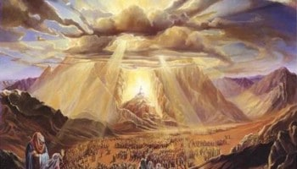
God’s Mercy Remembered
Where are You, God?
Isa 64:1-3 – “¹Oh, that You would rend the heavens and come down, that the mountains might quake at Your presence—²as fire kindles the brushwood, as fire causes water to boil—to make Your name known to Your adversaries, that the nations may tremble at Your presence! ³When You did awesome things which we did not expect, You came down, the mountains quaked at Your presence.”
Notes:
The 2nd part of the prayer continues in chapter 64, the people continuing to ask Him where He is:
Isa 64:1-3 – What they seem to be suggesting is that God had been hiding Himself from them. What does the mountain quaking at His presence remind you of? The theophany in Exodus, when He descended upon Mt. Sinai. Were they excited that He had come down? No, they were terrified and asked for Moses to instead speak on their behalf. Interestingly tidbit – in Mark 1:10 when it describes Jesus’ baptism, it mentions “the heavens opened” and the Spirit descended upon Him. This is the same expression in the LXX for “rend the heavens”. Point – God did answer the prayer and come down. And while that wasn’t exactly what they were hoping for, that specific “theophany” far exceeded expectations. “Why doesn’t He do things the way we think He should?” Because of 55:8-9. This is how we learn that there is no one like our God.

Slide 8
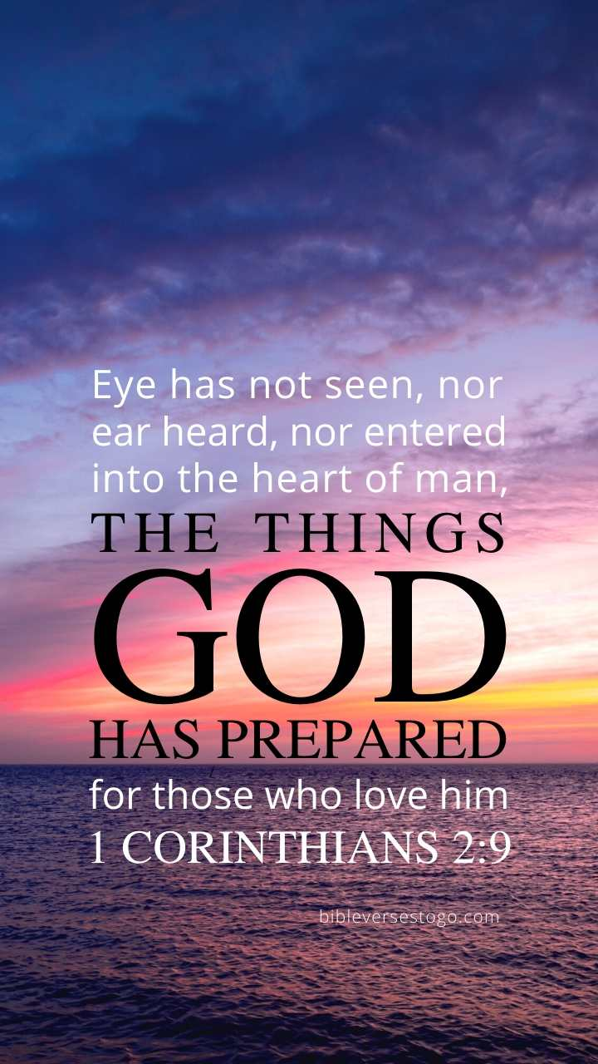
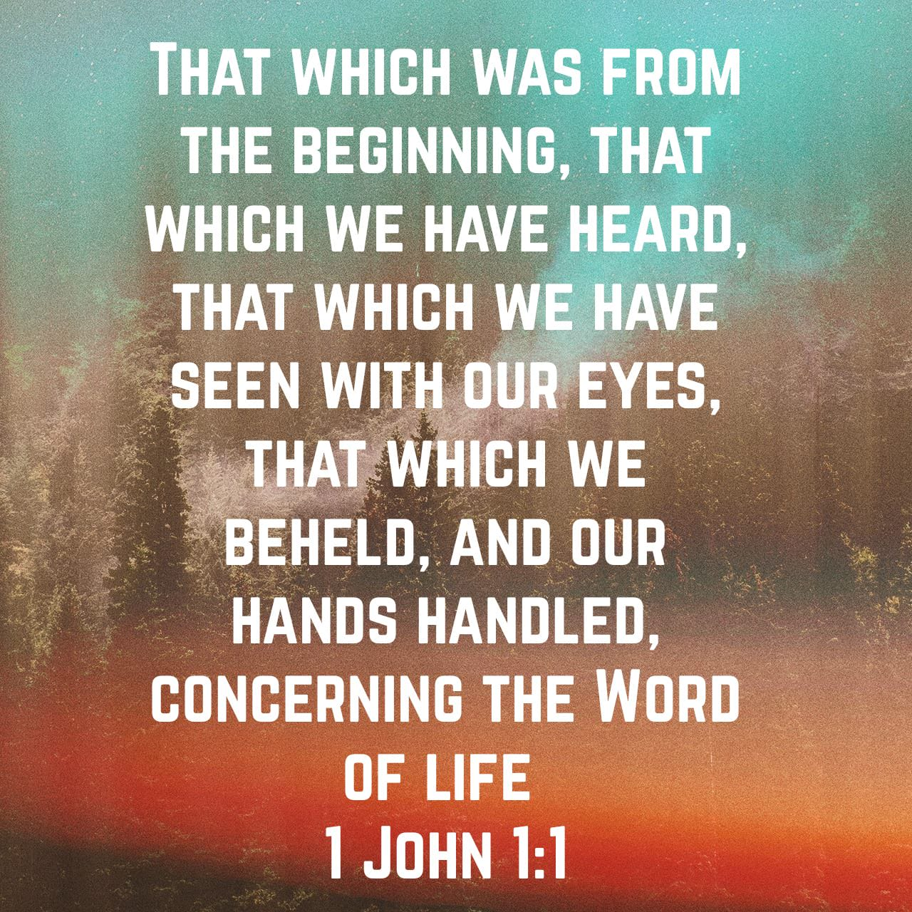
God’s Mercy Remembered
Where are You, God?
Isa 64:4-5 – “⁴For from days of old they have not heard or perceived by ear, nor has the eye seen a God besides You, Who acts in behalf of the one who waits for Him. ⁵You meet him who rejoices in doing righteousness, Who remembers You in Your ways. Behold, You were angry, for we sinned, we continued in them a long time; and shall we be saved?”
Notes:
Isa 64:4 – This same verse is cited in 1 Cor 2:9. The idea is that neither history, revelation, nor perception brought to light any other God than the one true God. This was one of the main points Isaiah was making in chapters 40 – 48 about the idols, that they could not speak or act bur rather brought nothing but shame to their devotees. But if He is the only God, and we expect Him to help, for who does He act? He acts for those who “wait” for Him, a patient, confident, expectant faith, like what those watchmen are doing on the walls. He acts for those who commit themselves for the long haul, continuing to believe even when everyone else has given up.
Isa 64:5 – In other words, He also acts for those whose joy in life is righteousness, who are in constant remembrance of His ways as opposed to theirs. But here are the hard facts: God was angry w/our sinning and we determined to go on sinning regardless of that anger. The idea is that we sinned knowing full well it would enrage Him, flying in the face of God. So, just as God has gone on forever, so has our sin, and His righteous anger must be satisfied before He can save us.

Slide 9
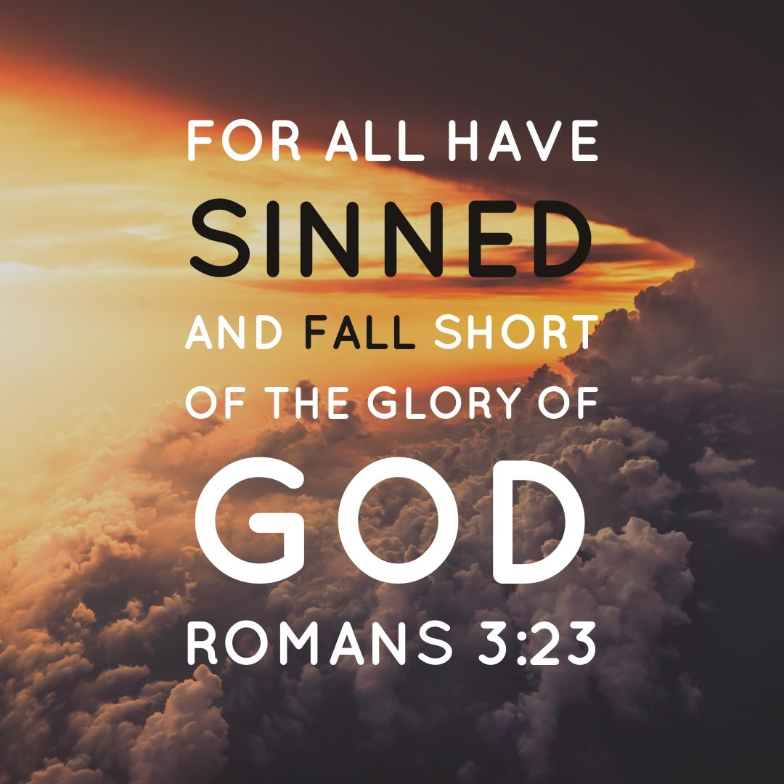
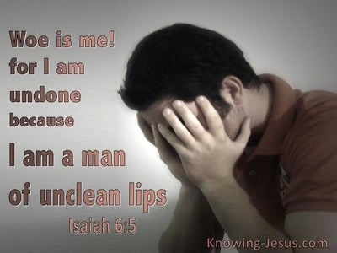
God’s Mercy Remembered
Where are you, God?
Isa 64:6-7 – “⁶For all of us have become like one who is unclean, and all our righteous deeds are like a filthy garment; and all of us wither like a leaf, and our iniquities, like the wind, take us away. ⁷There is no one who calls on Your name, Who arouses himself to take hold of You; for You have hidden Your face from us and have delivered us into the power of our iniquities.”
Notes:
Isa 64:6-7 – So here is the irony: if God showed Himself, the nations would tremble just as the mountains from Exodus 19-20, right? (vs. 1-3). But it is “we” who are withering because the Lord has hidden His face. Notice the phrase “all of us” – who is Isaiah including in this? Himself, likely remember the events of Isa 6. But this shows the scope of the problem, that all of us have sinned – Rom 3:23. So, you want God to come down in a specific way? Be careful what you ask for. We unclean, meaning unfit to for fellowship and community w/God and His people. When we’re in sin, even those righteous deeds we do commit are seen as filthy rags, which literally means (brace yourself) a garment of menstruation. Don’t ever let someone who isn’t saved tell you, “But I’m a good person, I do this and this, etc.” This is the point behind why our good works can’t save us, because of how God views good works when we’re in sin. And it’s why we need His grace. “wither like a leaf” means while in sin, we’re just decaying until there is nothing left of us, and once we’re controlled by sin, we choose out course no more than a dead leaf driven by the wind. The truth is, when in sin, we were not calling for God to come help us; He had to take the initiative Himself despite how our sins cause Him to hide His face from us. What a paradox – only on the cross could this paradox be worked out.

Slide 10
God’s Mercy Remembered
Please help us
Isa 64:8-12 – “⁸But now, O Lord, You are our Father, we are the clay, and You our potter; and all of us are the work of Your hand. ⁹Do not be angry beyond measure, O Lord, nor remember iniquity forever; behold, look now, all of us are Your people. ¹⁰Your holy cities have become a wilderness, Zion has become a wilderness, Jerusalem a desolation. ¹¹Our holy and beautiful house, where our fathers praised You, has been burned by fire; and all our precious things have become a ruin. ¹²Will You restrain Yourself at these things, O Lord? Will You keep silent and afflict us beyond measure?”
Notes:
And so, we reach the 3rd point of the prayer, and that is an urgent petition by the watchmen to “Please, come and help us.”
Isa 64:8-9 – I love how it begins w/”But now”. It’s the idea that being God’s children, they wouldn’t be there w/o the Father, just as the pot w/o the potter. They’re not blaming God, but reasserting relationship. God is responsible for their existence. So, just as it is foolish for the created thing to criticize the creator, neither cam the artist easily toss aside what He has invested so much of Himself in. In a sense, Isaiah is actually saying, “God, You’re stuck w/us.” Rather than being full partakers of His anger, they’re seeking a different attitude from God because they’re not just “any” people, but “Your” people. He’s staked His reputation in them and therefore cannot abandon them.
Isa 64:10-11 – This is where God’s presence dwelled. But the holiness of the cities and house was only attractive by virtue of He who occupied it. But they’re saying, as it is, it gives no evidence that God ever occupied it. This is despite the promise of 60 – 62 that Zion would be a reflection of His beauty, showing us He never had the physical temple in mind.
Isa 64:12 – in other words, ”Please…no more.” Since the people are repenting and the nation’s state is as it is, will the Lord not leap into action? Will He not revisit the compassion He showed in history, will He not respond to their cries for mercy, will He continue to afflict them beyond their ability to handle? It’s usually when people only have God left to seek that they pray w/such fervency and that He will answer.
Isa 64 sounds like the people have genuine complaints against God, but no matter how thin the pancake, there are always two sides. God’s side of the pancake will be chapter 65 - God’s response.

