Slide 1
Notes:
If Isa 53 represents the death, burial, and resurrection of Jesus, and Isa 54 represents the Great Commission, Isa 55 would be the message that we need to be preaching to others. It is an invitation for all to open their eyes to the richness of the gifts we’re being offered (Eph 1:3) and to grab ahold of them through faith and repentance while the offer stands. And like chapter 54, chapter 55 is full of rich imagery, sounding very similar to much of the teaching done by Jesus Himself as well as the Apostle Paul. What is the message of the church to be for a lost world? What do we say to people trapped in sin? How do we inspire people who are fooled into thinking that the message of the cross is out of date?

Slide 2
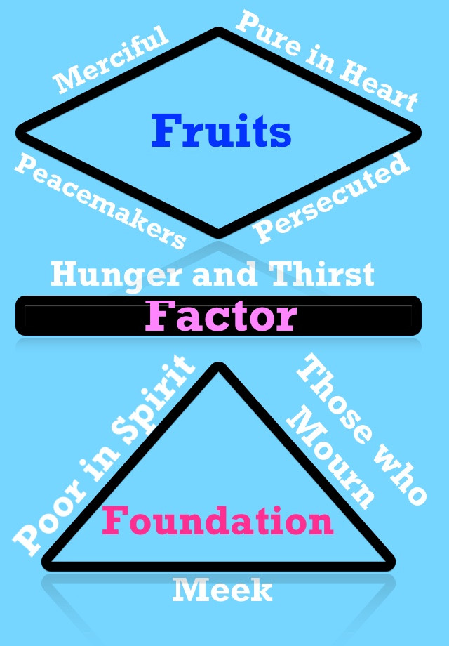
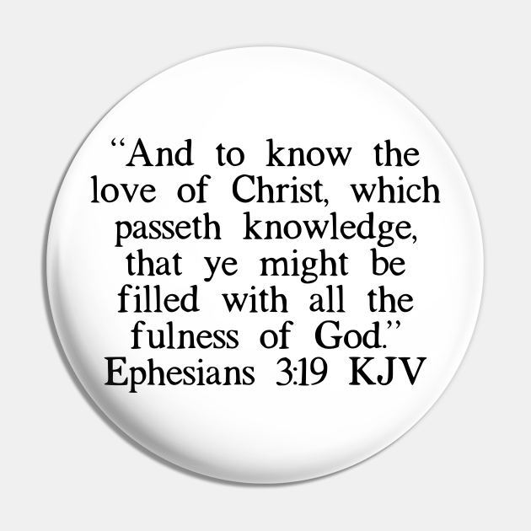
Zion’s Response to New Life
Individual Needs Met
Isa 55:1-2a – “¹Ho! Every one who thirsts, come to the waters; and you who have no money come, buy and eat. Come, buy wine and milk without money and without cost. ²Why do you spend money for what is not bread, and your wages for what does not satisfy?”
Notes:
The chapter begins by a 3-fold offer to “come” followed by a 3-fold offer to “listen”.
Isa 55:1 – Isaiah is replicating the cry of an ancient street vendors selling something valuable – “Ho!” is an urgent call for attention; God begging everyone in His Creation, Jew and Gentile, to grasp hold of the wonderful blessing He has to offer us. But it’s only going to attract 2 types of people: those who are hungry and those who are in poverty. What is this reminiscent of in the NT? Jesus’ SOTM, in which He says, “blessed are the poor in spirit…blessed are those who hunger and thirst for righteousness.” This is a spiritual hunger/thirst, a spiritual poverty, and he doesn’t want to sell us crumbs and scraps, does He? He wants to sell us rich-people food (wine and milk). However, there is an apparent contradiction to the text – the word “buy” is repeated, which implies there is a price, however at the end of vs. 1 he says it is w/o cost. How do you reconcile this? Well, there is a price, but it isn’t theirs to pay – the Servant has paid the price. They are bringing their thirst and poverty to a transaction already completed and there is enough for all. But being needy by itself will not bring us to a place of relief. What do we have to do? We have to respond, hence the 3-fold “come”. Only then can we partake of the feast that God has catered.
What is the motivation? Well, He asks a question – Isa 55:2a – This is the message of Eccl 1 & 2 is it not? If the richest man that ever lived (Solomon) could experiment in the way that he did and come to the conclusion that all is vanity and striving after wind, shouldn’t we come to the same conclusion? Back in chapter 44, in that section where God expand upon the folly of idolatry, He wonders why idolators can’t seem to understand that the very wood they made their idols from is the same wood they cook their wood over and is rendered ashes. But while gods of this world ultimately give us nothing while requiring a price we cannot pay, God wants to give us for free what will permanently satisfy our deepest yearnings. One leaves our soul completely dried up, and the other can fill us up w/all the fullness of deity itself. The invitation is for us buyers and consumers who are dissatisfied, poor, and thisty to start making wise purchases.

Slide 3
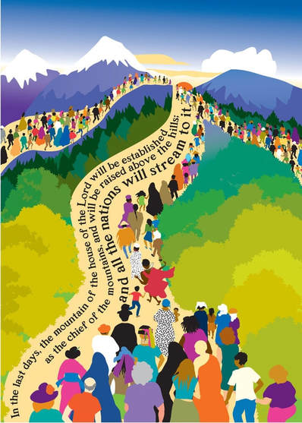
Zion’s Response to New Life
Individual Needs Met
Isa 55:2b-5 – “Listen carefully to Me, and eat what is good, and delight yourself in abundance. ³Incline your ear and come to Me. Listen, that you may live; and I will make an everlasting covenant with you, according to the faithful mercies shown to David. ⁴Behold, I have made him a witness to the peoples, a leader and commander for the peoples. ⁵Behold, you will call a nation you do not know, and a nation which knows you not will run to you, because of the Lord your God, even the Holy One of Israel; for He has glorified you.”
Notes:
What is the actual invitation? He’s not talking about eating w/our mouths, but through our ears. Notice the 3-fold “listen”:
Isa 55:2b-3a – Notice the emphasis – “Listen, listen, listen”. How does one eat and delight in spiritual richness? By listening to God’s word. This has been a constant theme through this book, that when God sent the Messiah, He would feed us through our ears. Our lives are changed based on how we respond (come) to what we have heard.
Did Jesus ever teach in these terms? “He who has ears to hear, let Him hear!” Jesus understood that eating what is good vs. eating what is bad is in a large part what we take in through the ears. And this requires discernment, it takes time, attention, and effort. It’s a deliberate choice to hear and respond. John 7:37 – “If anyone is thirsty, let him come to Me and drink.” And so, that makes the meaning clear for “Come to the waters”; what it really means is “Come to Jesus”. The Lord is not just inviting us to a feast, He is the feast.
Isa 55:3b-4 – What does this mean? 2 Sam 7:16 – “Your house and your kingdom shall endure before Me forever; your throne shall be established forever.” And in 54:8 – “But with everlasting lovingkindness I will have compassion on you.” The covenant made to David was an unconditional pledge of continuance; an enduring line. And the covenant God makes w/us is of everlasting lovingkindness and compassion. I love how Isaiah avoids the Mosaic covenant in favor of the Davidic covenant. This is because Jesus is of David’s offspring, and we are of Jesus’ offspring.
Isa 55:5 – If you’ll remember after Nathan confronts David for his sins in 2 Sam 12, that he told him in vs. 14 that he had given occasion to the Gentiles to blaspheme God’s name. But now, because of what Jesus did, the Gentile world will be drawn toward David’s descendant like a magnet, just as we saw back in 2:2. And they’re not going to walk to Him; the Lord’s attraction is going to be so strong, they’re going to run to Him.

Slide 4
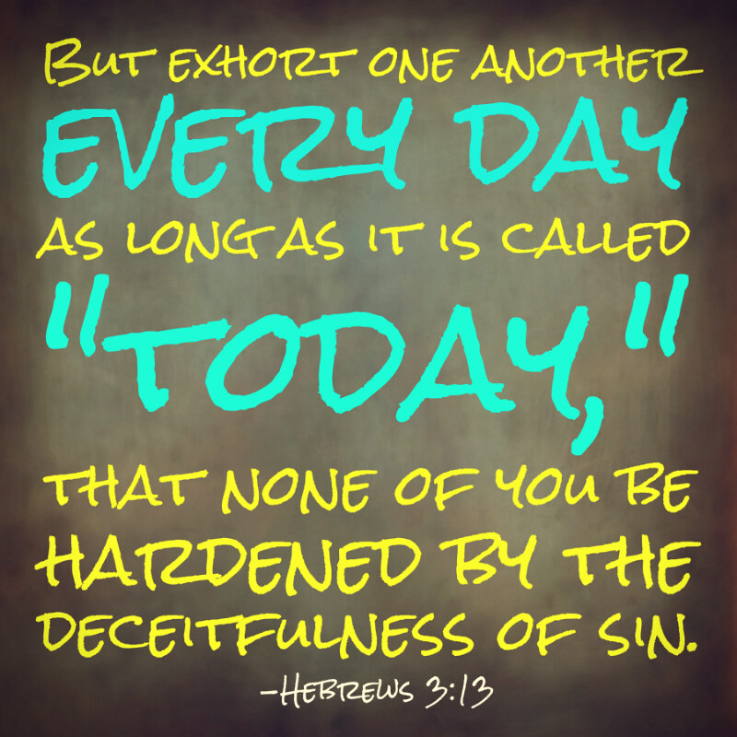
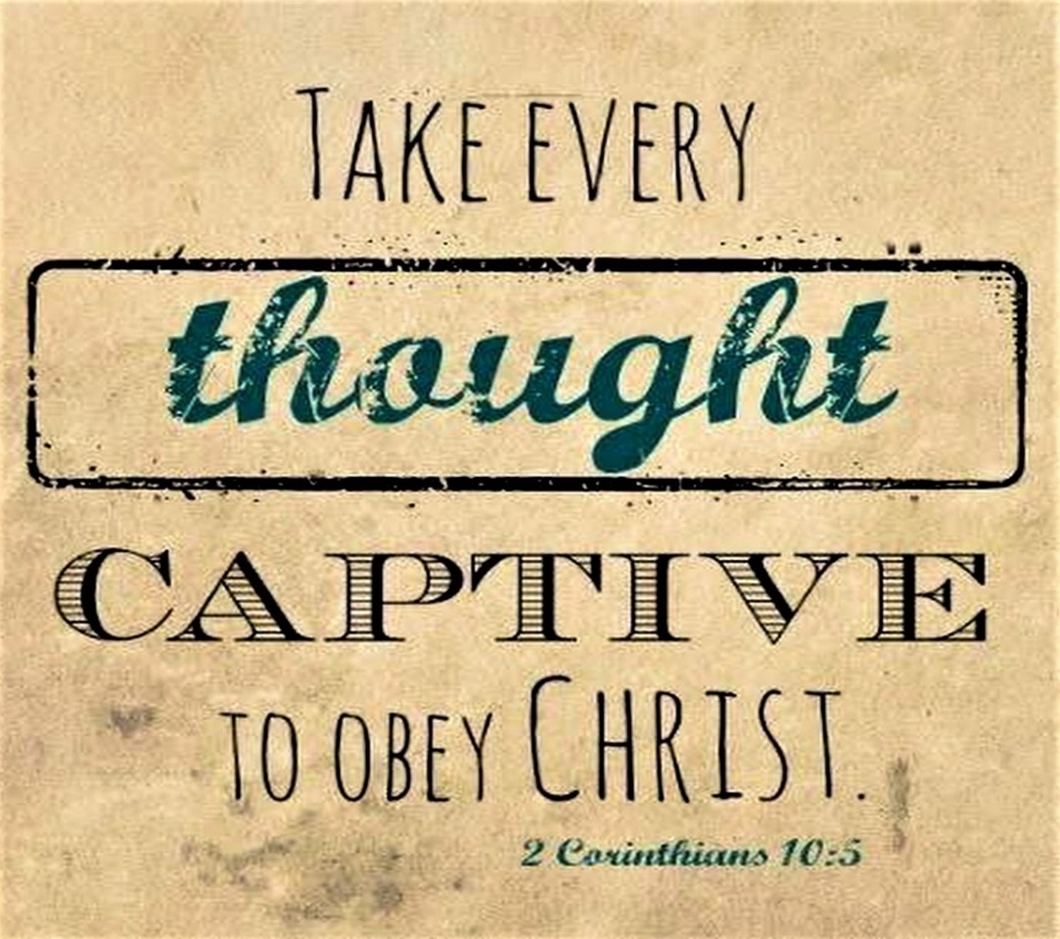
Zion’s Response to New Life
Call to Repentance
Isa 55:6-7 – “⁶Seek the Lord while He may be found; call upon Him while He is near. ⁷Let the wicked forsake his way and the unrighteous man his thoughts; and let him return to the Lord, and He will have compassion on him, and to our God, for He will abundantly pardon.”
Notes:
Isa 55:6 – Do most people think about God in this way? I would suggest most think of Him as very far away. Much of Paul’s teaching even honed in on that, such as when he preached to the Greeks on Mars Hill, encouraging to grope for Him and find Him because He isn’t far from us. That’s good news. The bad news is like many offers that sound too good to be true, but are, this one is for a limited time. It’s similar to Heb 3:13 in which we’re told to encourage one another day after day while it is still called today. We don’t know how long we will have this opportunity to come buy this wine and milk w/o cost.
Isa 55:7 – Now, it’s true we read that we can buy the wine and milk w/o cost. And it’s true that Christ paid the price for us. But that does not mean there is nothing for us to give. Look, religious people have given up things since the beginning of time – animals, money, time; idolators would even sacrifice their children if they thought it would please their god. Do you know what people are rarely prone to give up? Their thoughts and their ways, as well as the philosophies and heart behind it. It’s why we sinned in the first place. Sin begins in the thought life, but if we don’t reign it in, in time it reaches the hand, foot, and mouth, becoming “ways”. But while we can come to God, “just as I am”, we can’t stay that way. Repentance involves forsaking and returning, a turning from sin and to God.

Slide 5
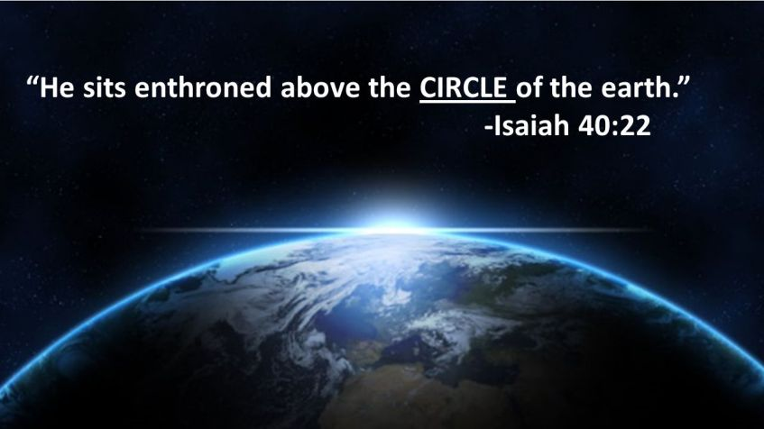
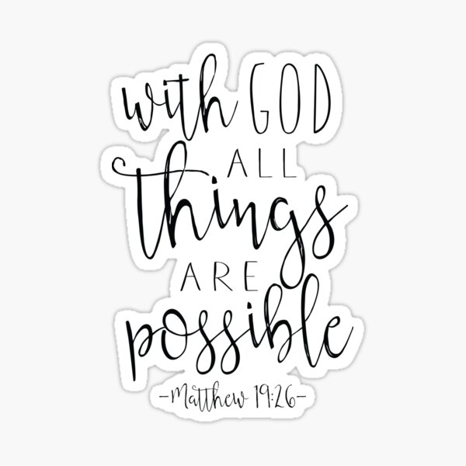
Zion’s Response to New Life
Reasons to Return
Isa 55:8-9 – “⁸‘For My thoughts are not your thoughts, nor are your ways My ways,’ declares the Lord. ⁹‘For as the heavens are higher than the earth, so are My ways higher than your ways and My thoughts than your thoughts.’”
Notes:
And turning to God means aiming for a standard that is so far above our own.
Isa 55:8-9 – This contrasts the “ways” and “thoughts” from vs. 7. The extreme highness of heaven from earth is the contrast offered between God’s and ours – immeasurably higher. And in context, the invitation seems to be that we turn from our wicked thoughts and ways because those are not God’s thoughts and ways. Gen 8:21 teaches that the intent of man’s heart is evil from his youth, and we’re never going to close that gap between us unless we repent of our wicked thoughts and ways. Some really struggle w/this – forgiveness from God, for many, seems impossible after the things they’ve done. But God’s thoughts aren’t human. The context is God is doing something for us that is way beyond how we think.

Slide 6
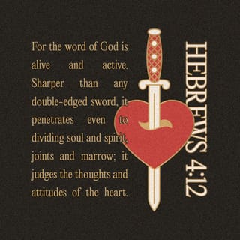
Zion’s Response to New Life
Reasons to Return
Isa 55:10-11 – “¹⁰For as the rain and the snow come down from heaven, and do not return there without watering the earth and making it bear and sprout, and furnishing seed to the sower and bread to the eater; ¹¹so will My word be which goes forth from My mouth; it will not return to Me empty, without accomplishing what I desire, and without succeeding in the matter for which I sent it.”
Notes:
But how is this gap bridged, practically speaking?
Isa 55:10-11 – The critic says, “God, you’re never going to help us! You’re never going to save us from the sinful situation we’ve reaped!” And God’s reply in these verses is, “How about you look up? Look at the rain, look at the snow, look how it waters the earth, furnishing seed that provides you w/the bread you eat. I’ve been helping you since the beginning of time and that will never stop.” The point is that just as God built into nature certain purposes that will be fulfilled (28:24-29), His word will do the same; what He promises will happen. Now, not everyone cares for the rain and the snow do they? Some people love it, some people hate it. And that’s the case w/God’s word. Some people love it, some people hate it. And this is exactly what God designed it to do. God’s word is designed to judge the thoughts and intents of the heart. For those who are hungry and thirsty and poor and dissatisfied, it results in their salvation. For everyone else, it results in their damnation. This is by design. God designed His word to draw a certain kind of people, and it will not return to Him empty. How does the feast of vs. 1 happen? Ultimately God’s word watering the seed that is in the soil of our heart. As rain spells the difference between life and death, God’s word spells the difference between salvation and damnation.

Slide 7
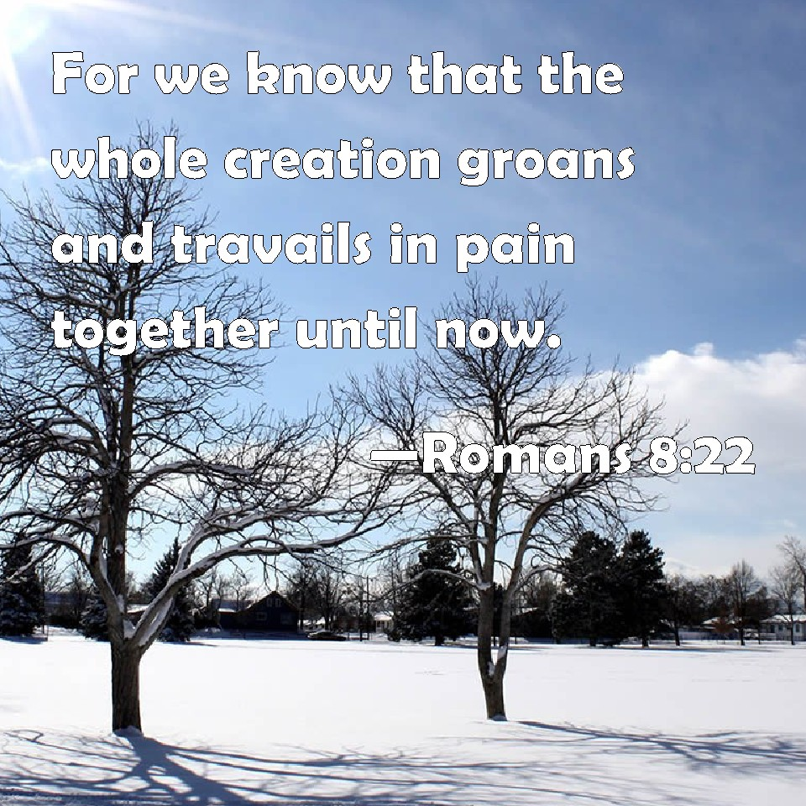
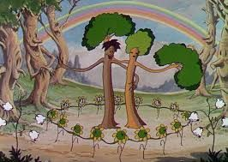
Zion’s Response to New Life
Reasons to Return
Isa 55:12-13 – “¹²For you will go out with joy and be led forth with peace; the mountains and the hills will break forth into shouts of joy before you, and all the trees of the field will clap their hands. ¹³Instead of the thorn bush the cypress will come up, and instead of the nettle the myrtle will come up, and it will be a memorial to the Lord, for an everlasting sign which will not be cut off.”
Notes:
Isa 55:12-13 – How did the chapter begin? An invitation to those who are thirsty, poor, and dissatisfied. What is the result of responding to the invitation? Joy and peace. And everybody on this planet is looking for this. The problem is, as vs. 2 says, their spending their money on things that don’t satisfy. If we would simply trade in our thoughts and our ways for God’s thoughts and ways, all that stubbornness we tend wear as a badge of honor, all the joy and peace we’ve been trying to find in life through secular pursuits will finally be realized. Why does God describe the landscape changing, that what was once a wilderness is now a forest that is cheering us on? Because mountains/hills don’t just represent nations, they also represent trial, things that it doesn’t look like we’ll ever be able to climb over to the other side. But then you fly on a plain and when you see that mountain from up high, not only can you see the other side, it looks flat. Because heaven’s perspective is always different. That’s why James said to consider it all joy when we encounter trial. Who thinks like that? Every single person that has ever traded their thoughts and ways for God’s thoughts and ways. The world looks different to people like this. All the trials that discourage us are now providing joy and applause. That’s why Paul could sit in a prison cell and talk about all the things the good things that this seemingly painful circumstance had done for the kingdom, and then say, “for this reason, I rejoice.” Paul lived his life like the curses and thorns of life had been removed, and if mountains/hills talking and trees clapping sounds strange, like some scene out of Fantasia, remember that in Eden, the animals talked. And when this kind of transformation happens, it will be an eternal memorial and witness to the world signifying the true being, power, and beneficence of the one true God.

Slide 8
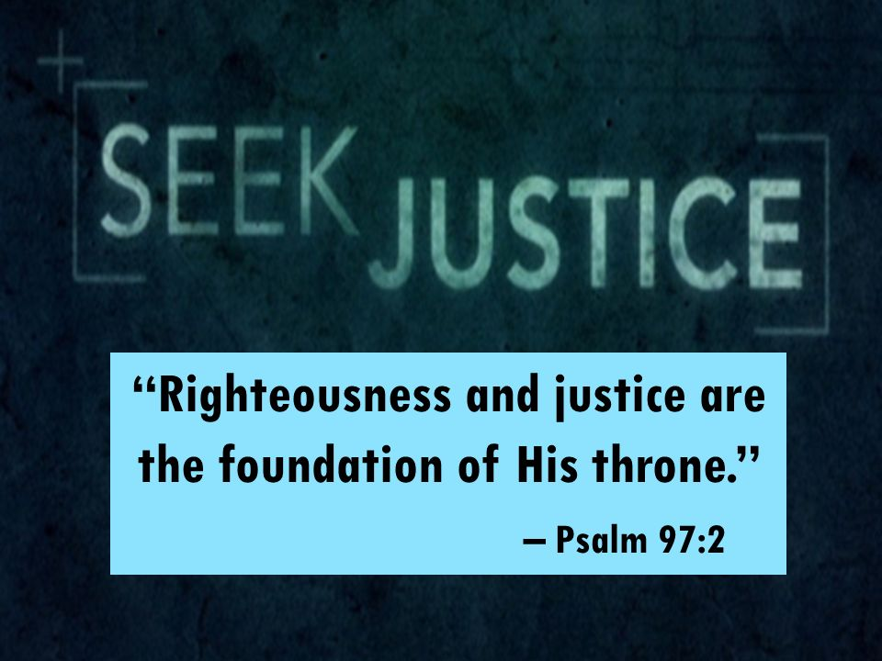
Rejected Are Remembered
Consultation for Foreigners/Eunuchs
Isa 56:1-2 – “¹Thus says the Lord, ‘Preserve justice and do righteousness, for My salvation is about to come and My righteousness to be revealed. ²How blessed is the man who does this, and the son of man who takes hold of it; who keeps from profaning the sabbath, and keeps his hand from doing any evil.’”
Notes:
What more could possibly be added to what has been said? The theme of Isa 56 – 66 is the importance of living out God’s righteousness by taking on the mark of the Servant, the inability of the people to do so, yet the promise of God to come to the aid of His struggling people. We’ve seen the ideal, now we see the actual. The grace of God is free, but His people are called to live out the implications of this grace. Does God have the power to enable His people to live out this grace?
Isa 56:1-2 – This is God’s call to righteousness based on a promise for the future. It’s an urging to those who belong to the Lord to reflect the one who will purchase them, resuming 55:6, including the fact it is for a limited time. The grace of God does carries obligations. We must live every day as if the Lord is coming today. The Sabbath emphasizes God as the Creator (Gen 2:3; Ex 20:11) and Savior (Deut 5:15), an emphasis of 40 – 55. The reference to it may suggest that by remembering who God is and what He has done, this will cause one to keep his hand from evil. He will be blessed.

Slide 9
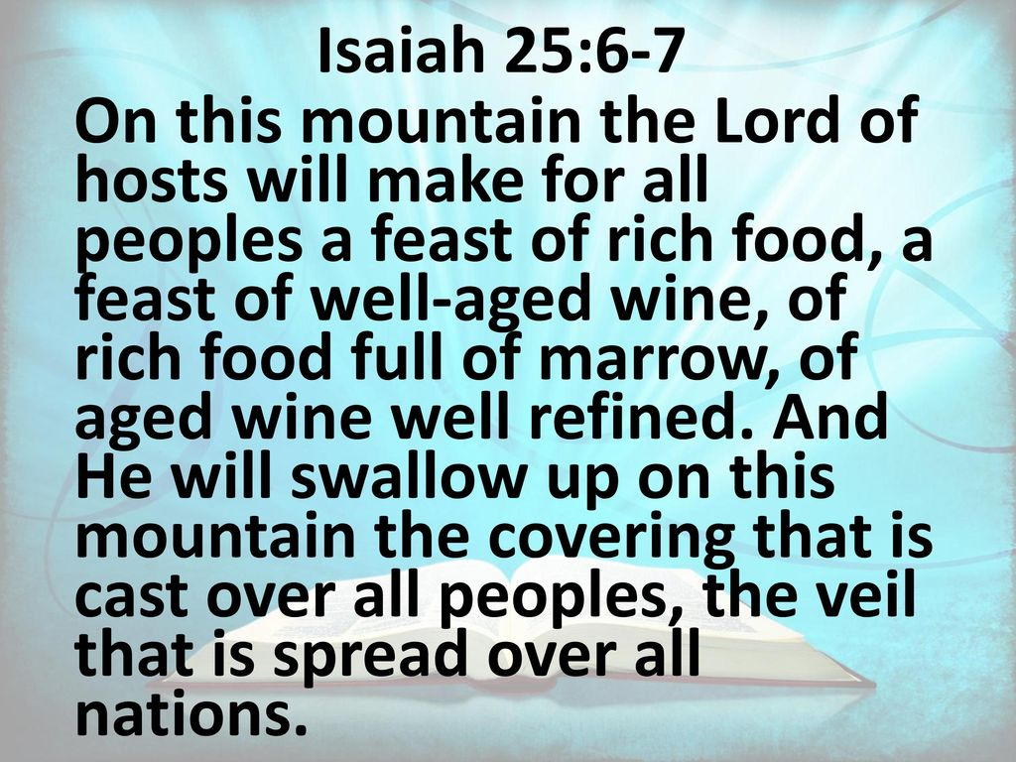
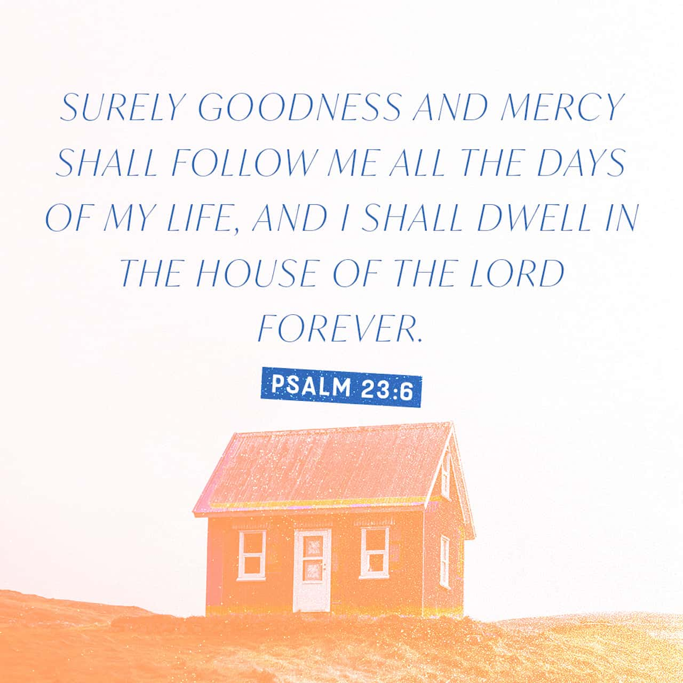
Rejected Are Remembered
Consultation for Foreigners/Eunuchs
Isa 56:3-5 – “³Let not the foreigner who has joined himself to the Lord say, ‘The Lord will surely separate me from His people.’ Nor let the eunuch say, ‘Behold, I am a dry tree.’ ⁴For thus says the Lord, ‘To the eunuchs who keep My sabbaths, and choose what pleases Me, and hold fast My covenant, ⁵to them I will give in My house and within My walls a memorial, and a name better than that of sons and daughters; I will give them an everlasting name which will not be cut off.”
Notes:
However, this must never be about performance – it’s always about relationship. And to drive this home, we see the following shocking statement:
Isa 56:3 – Why would there be this concern by the foreigner and eunuch? Because in the OT there is a connection between what is “holy” and “wholly”. Deut 23:1-3 forbade such from entering His assembly. Just as blemished animals were unfit for sacrifice, so were blemished people. Herod’s temple provided a “Courtyard of the Gentiles”, “Courtyard of the Women”, and “Courtyard of Israel”. Those who went beyond were sentenced to death. So, the foreigner and eunuch were accepted, but still separated. But a new day is coming in which these restrictions will not apply. In that day, justice and righteousness are the distinction that unites us all (Acts 10:34-35). When seeking w/sincerity (55:6) and turning from their own wicked ways/thoughts to God’s (55:7-9), even foreigners and eunuchs are included. “Let not [them] say…” is the idea that they may “feel” unworthy, but they have dignity and worth in God’s sight and should not depreciate themselves. Once in Christ, we are no longer fruitless. God’s ways/thoughts are higher than our feelings (55:8-9). The “covering/veil” is swallowed (25:6-7). If God says you belong, you belong.
Isa 56:4-5 – Given that this is a NT principle, “sabbaths” must be symbolical. Their behavior is an expression of a true relationship – they are on God’s side. God will therefore share His eternity w/that person who otherwise has no hope of posterity (54:1). When Phillip first encountered the Ethiopian Eunuch, he was reading from Isa 53. When Phillip began from this passage and “preached Jesus to him”, it’s likely he turned to this passage. Could this be another reason why he rejoiced? The Ethiopian Eunuch has been remembered because of his faith for far longer than he would have w/children and w/o faith. What we receive from God is far greater than what sons and daughters can give (Mark 10:28-31).

Slide 10
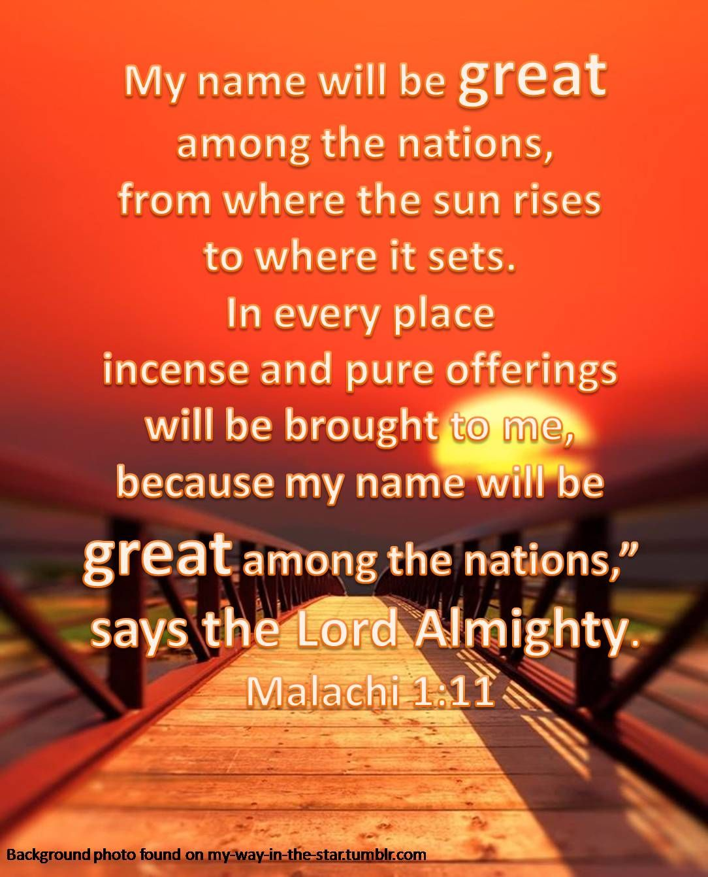
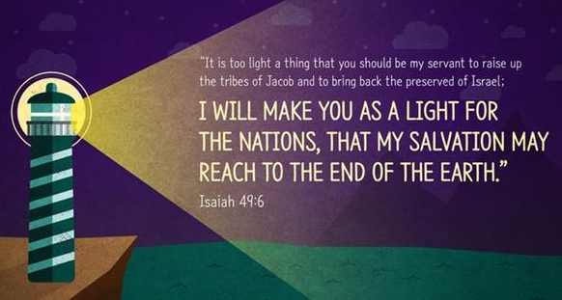
Rejected Are Remembered
Consultation for Foreigners/Eunuchs
Isa 56:6-8 – “⁶‘Also the foreigners who join themselves to the Lord, to minister to Him, and to love the name of the Lord, to be His servants, every one who keeps from profaning the sabbath and holds fast My covenant; ⁷even those I will bring to My holy mountain and make them joyful in My house of prayer. Their burnt offerings and their sacrifices will be acceptable on My altar; for My house will be called a house of prayer for all the peoples. ⁸The Lord God, who gathers the dispersed of Israel, declares, ‘Yet others I will gather to them, to those already gathered.’”
Notes:
Vs. 6 – 8 are reminiscent of Isa 2:2-4.
Isa 56:6-7 – They are not joining a “system”, but a personal devotion to the Lord resting on His character and truth. They join Him not for what they can get, but out of desire to benefit the Lord. It’s a happy servanthood. They are welcome at his place (My holy mountain), into His presence/family (house of prayer), and to fellowship (altar). This is what the Lord’s house was always intended to be. Malachi saw it as inevitable (Mal 1:11). Jesus was infuriated by Israel’s intent to exclude when He saw the outer court, which was the only place where Gentiles could come to pray, being used as a marketplace (Matt 21:13).
Isa 56:8 – “The Lord God” usually follows a declaration. That it comes first is likely for emphasis (only other place = 1:24). Israel is gathered first, then the foreigners/eunuchs (49:6). He’s making the point that not only will they not be excluded, once Israel is gathered back, He isn’t done. He’ll add more, purposefully bringing them in (John 10:16; Mark 11:17). Lest Israel become too self-focused on her own problems, God reminds them He loves the perishing world.

