Slide 1
Notes:
This 2nd 9-chapter section of Isa 40 – 66 began w/Israel’s disheartened complaint that God had forgotten and forsaken them. God had not forgotten them. In fact, Israel’s spiritual captivity is so wedded to His heart, He promises to send them a Servant who will fix their problem for good, and He promises this through 4 Servant Songs. Servant Songs 1 & 2 were followed by God’s confirmation of the Servant’s success. But Servant Songs 3 & 4 are followed by invitations to participate in what the Servant has done. He’s removed sin, established righteousness, and created a family.
Chapter 54 and 55 is the crescendo of all 4 Servant Songs, showing us the Servant’s work taking shape before our eyes, and Israel is now being called to bask in the reality of the great things it has to look forward to.

Slide 2
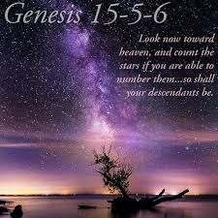
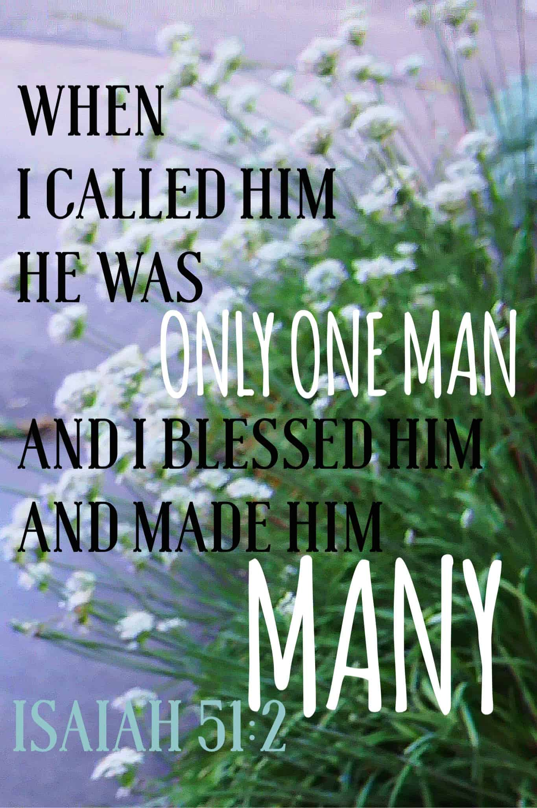
Zion’s Response to New Life
Family
Isa 54:1 – “¹‘Shout for joy, O barren one, you who have borne no child; break forth into joyful shouting and cry aloud, you who have not travailed; for the sons of the desolate one will be more numerous than the sons of the married woman,’ says the Lord.”
Notes:
Isaiah celebrates the work of the Servant by providing 2 images of Zion: a bride and a city. First image is of a bride:
Isa 54:1 – A barren woman would carry an enormous load of shame, and we remember how it affected certain women of OT, particularly as they watched other women bear children w/ease – from the weeping of Hannah, the bitterness of Rachel, Sarah’s rash decision to give Hagar to Abraham. Barrenness was not only hurtful personally, but the emotional affects created ripple affects of bitterness, favoritism, competition, pride, a whole host of sins. The barren woman of Isa 54 is Zion, who has been reduced to a remnant, a constant theme throughout Isaiah, and it brought about an emotional despondency (40:27; 49:14) that only made things worse. Add to this the fact that their situation seemed to run contrast to the promises given to Abraham that his descendants would be as numerous as the stars of heaven and the grains of sand. So how do you get from so few, to so many? Answer: the Servant. Remember from 53:11 that “My Servant will justify the many”, and in 53:12 “I will allot Him a portion w/the many (great)…He himself bore the sin of many”. The word “more” here in vs. 1 is the same word. So, here’s the point: what we’re seeing in Isaiah 54 is the Servant’s work taking shape before our very eyes. Barren Zion, who once carried enormous loads of shame, can now sing, because what the Servant does, that we just studied in Isa 53, will cause her children to far outnumber those of the OT. Zion is going to experience such growth, seemingly beyond natural odds, it will require supernatural explanation.

Slide 3
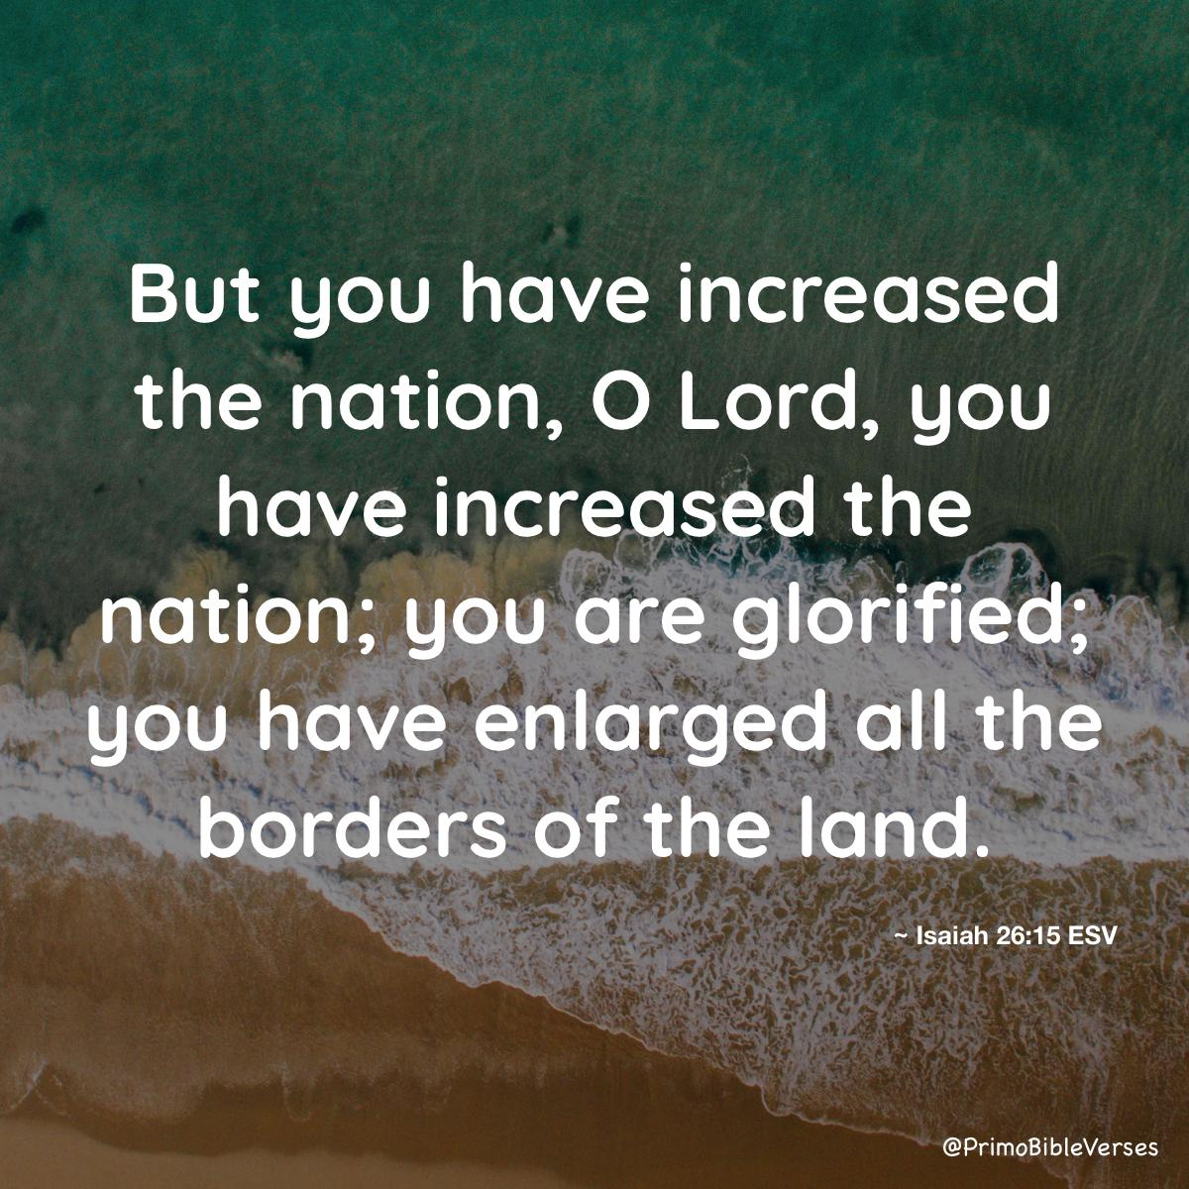
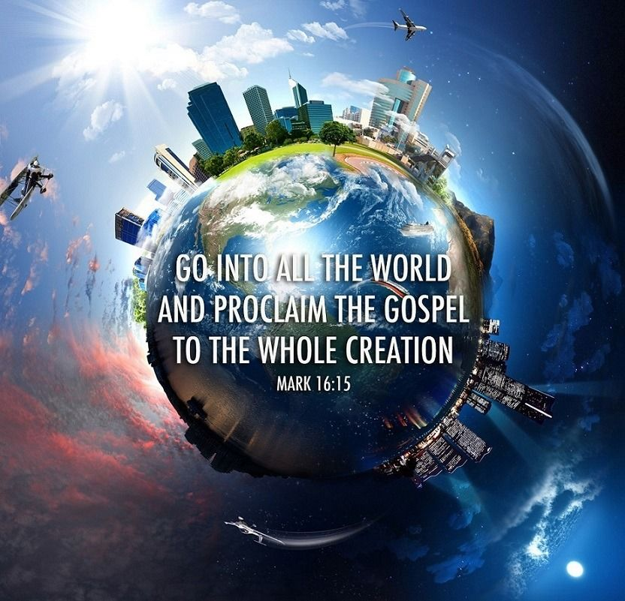
Zion’s Response to New Life
Family
Isa 54:2-3 – “²‘Enlarge the place of your tent; stretch out the curtains of your dwellings, spare not; lengthen your cords and strengthen your pegs. ³For you will spread abroad to the right and to the left. And your descendants will possess nations and will resettle the desolate cities.”
Notes:
And so, rather that wine and sulk over the past, preparation needs to be made, and so, God gives Zion a job to do:
Isa 54:2-3 – Zion’s dwelling place is pictured as a tent, reminiscent of the sojourning of the Patriarchs or perhaps Israel’s 40 years in the wilderness. This being the case, it represents the temporary dwelling of people who walk w/God. Just as Peter tells us in his first epistle, we are strangers and aliens (1 Pet 2:11-12) who after being freed from bondage are on our way home. And in the meantime, what is our job while here? To enlarge and stretch the curtains of our tents because more children are coming. 53:10 tells us that the Servant will see His offspring, but in this chapter, who is the one giving birth to that offspring? Zion. And so, we are to lengthen the cords of this tent (make room), we are to strengthen the pegs (to withstand the storms that come while we are down here), and we are to “spare not”, meaning we are to err on the side of excess rather than limitation, like that Sower who went out to sow seed, and he did so liberally amongst all the soil, did he not?
And so, just as Isa 53 points to the death, burial, and resurrection of Jesus, Isa 54 points to the Great Commission – it’s a call to evangelize. Mark 16:15 – “Go into all the world and preach the gospel to all creation.” This includes nations and desolate cities in which sin has just ravaged. And no one is more qualified to take this message to a lost world than a formerly lost people who bitterly lament the loss to ourselves and others by our prior life of sinfulness, yet who rejoice and sing because we’re experiencing God taking the wasteland of our lives and transforming it and restoring it toward new meaning. This doesn’t just produce a renewed intimacy and fellowship w/God, but His passion becomes our passion. We cannot help but preach to others God’s saving grace. No one who truly bears the scars and barrenness of the past can avoid trying to compel others who are presently victims of the same wounds that used to bind us.

Slide 4
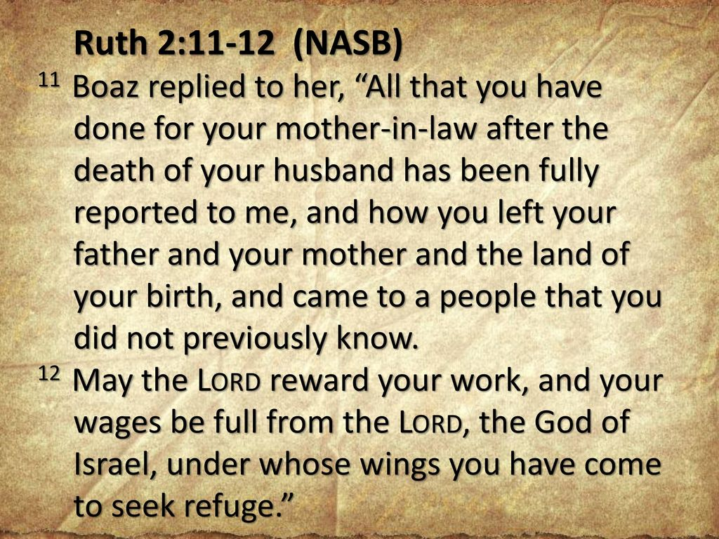
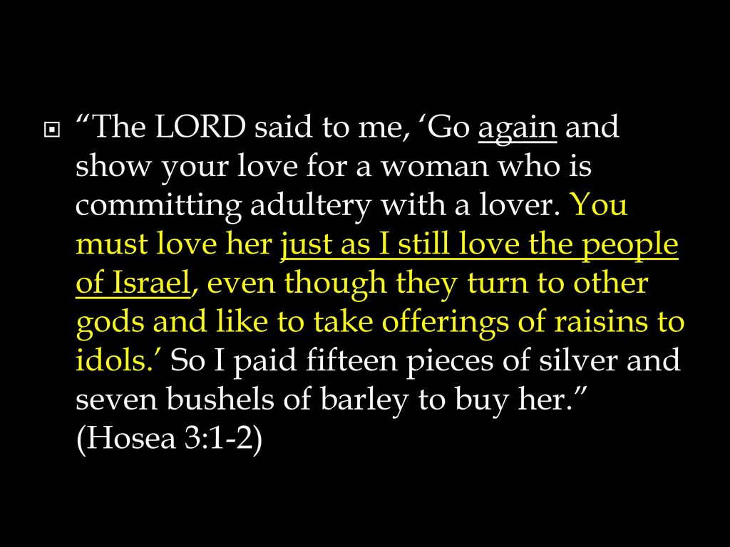
Zion’s Response to New Life
Family
Isa 54:4-6 – “⁴‘Fear not, for you will not be put to shame; and do not feel humiliated, for you will not be disgraced; but you will forget the shame of your youth, and the reproach of your widowhood you will remember no more. ⁵For your husband is your Maker, Whose name is the Lord of hosts; and your Redeemer is the Holy One of Israel, Who is called the God of all the earth. ⁶For the Lord has called you, like a wife forsaken and grieved in spirit, even like a wife of one’s youth when she is rejected,’ says your God.”
Notes:
How can Zion sing for joy and expand her tents w/such confidence? Because though childless and rejected, we are now secure in God’s loving care. He has promised that nothing will ever prevent Him from loving us. All the lonely despair, emptiness, and barrenness that we brought on ourselves will be replaced w/abundance, honor, and glory:
Isa 54:4 – Like childless women, we too once felt shame and humiliation; but those days are done. Total confidence can now be enjoyed because the past is wiped clean. We can hold our head high w/what God has blessed us with, because of who He is.
And who is God? – Isa 54:5 – Vs. 5 is powerful because it takes all the titles and roles of God and unites them together. In other words, God is not just our husband, but He made us. We’re reminded that all the hosts of heaven and earth are subject to Him, and so He can protect us. As perfectly as He is holy, He is committed to His covenant toward Israel. And He becomes our next-of-kin to redeem us. One can’t help but think about Ruth, a childless, husbandless, hopeless foreigner, but Boaz saw something really special in her, and so he stood in the place of next-of-kin. That’s what God is doing for us. And what is the bridge that allows someone so powerful and holy to be so near to His people? The Servant.
Isa 54:6 – That phrase “wife of one’s youth” implies a young, passionate married couple w/bright hopes for the future only to find bitter disappointment and broken dreams, all her fault. She was justly left. But the Lord renews His love for her just as He told Hosea to do towards Gomer (Hos 3:1-2). Hosea would have broken no law if he had left Gomer to bear her disgrace. But there is a higher law than justice that goes beyond legal allowances, and that is loving, passionate concern for another, and that’s what we see in our God toward us.

Slide 5
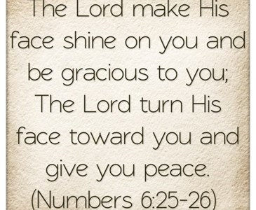
Zion’s Response to New Life
Family
Isa 54:7-8 – “⁷‘For a brief moment I forsook you, but with great compassion I will gather you. ⁸In an outburst of anger I hid My face from you for a moment, but with everlasting lovingkindness I will have compassion on you,’ says the Lord your Redeemer.”
Notes:
And it led to God acting on our behalf:
Isa 54:7-8 – All the anger and judgment we’ve seen in Isaiah? It was only asymmetrical, only for a moment. God’s wrath was never intended to be the end. His love is everlasting. And the brevity of His anger is to be seen in contrast w/the greatness of His love. Remember from Num 6:25-26, in Aaron’s benediction, that it has always been God’s desire to shine His face upon His people. How is He able to go from hiding His face toward us to shining His face on us once again? Well, remember from Isa 53:3 that the Servant became one whom men would hide their face, and despised, and rejected. And by Him going through that experience on the cross, God is able to shine His face upon us. That word “lovingkindness” means “an unfailing love loyal to its pledge, a settled disposition.” This means that out of love for us, He began His work of redemption and reconciliation before we ever sought it. This seems so shocking in light of Moses’ writings in Deut 24 about not remarrying the same woman. But remember, we learned from 50:1 that there was no certificate of divorce. God never gave up on us. We talk so much about the necessity of believing in God – and we should. But what these verses teach us is that God believes in us, and we need to see ourselves as part of God’s larger purpose.

Slide 6
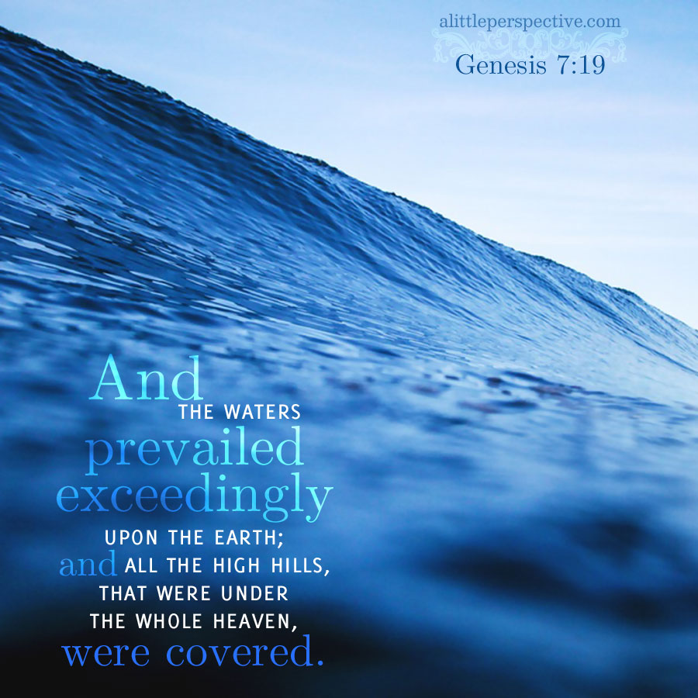
Zion’s Response to New Life
Family
Isa 54:9-10 – “⁹‘For this is like the days of Noah to Me, when I swore that the waters of Noah would not flood the earth again; so I have sworn that I will not be angry with you nor will I rebuke you. ¹⁰For the mountains may be removed and the hills may shake, but My lovingkindness will not be removed from you, and My covenant of peace will not be shaken,’ says the Lord who has compassion on you.”
Notes:
And if all of this is not enough to convince us, God reminds us of another story that is etched in all of our memories:
Isa 54:9 – Notice the parallel. The flood underlines the seriousness of divine wrath, but as God’s wrath receded, so did the water upon the earth. And once justice was satisfied, eternal love reasserted itself. And what was the first thing Noah did once he and his family left the ark? He offered burnt offerings to the Lord. A burnt offering is a sacrifice, by why would it have been a much bigger sacrifice in the case of Noah? Because his supply of animals was limited. Once they were gone, they were gone. He had to completely rely on God, and He did. And when God smelled the soothing aroma of that sacrifice, it was at this point that God made the promise He did in Gen 9:13. See, God already saw potential in Noah before the flood – it’s why He saved him in the first place. But when Noah’s first act upon leaving the ark was to offer sacrifices to God, His choice was vindicated. And when we take on Christ, His patience toward us is likewise vindicated.
Isa 54:10 – Question: were the mountains removed during the days of Noah? Yes – Gen 7:19 tells us they were all covered. Before that ever happens again, God’s lovingkindness will be removed from us. But the mountains can’t be covered again by water because God promised He wouldn’t do that again, and 4000 years later He still hasn’t. See the point? The fabric of this world is one of the most permanent things we know, isn’t it? God’s unfailing love and covenant of peace toward those who identify w/His Servant is even more permanent.

Slide 7
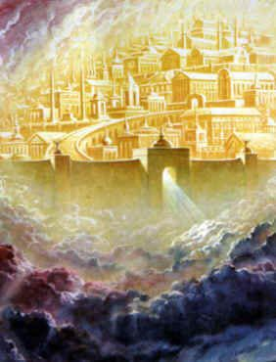
Zion’s Response to New Life
City
Isa 54:11-12 – “¹¹‘O afflicted one, storm-tossed, and not comforted, behold, I will set your stones in antimony, and your foundations I will lay in sapphires. ¹²Moreover, I will make your battlements of rubies, and your gates of crystal, and your entire wall of precious stones.’”
Notes:
Why is it important to remind Zion of this relationship? Because despite what the Servant will do, they, just like us, still live w/the consequences of sinful past actions, don’t we? But remember God’s perspective from 49:14 – “your walls are continually before Me.” Was this true literally? No, the city was still in ruins. Neh 2:17a – “Then I said to them, ‘You see the bad situation we are in, that Jerusalem is desolate and its gates burned by fire...’” So how can God say their walls are continually before Him? Because He wants them to stop living in the painful past and start living as if the promises He has made have already come to pass. And so, He expands upon the “walls” by showing how they are like a city, a rebuilt city. The city theme has been prominent in Isaiah. In chapters 24 – 27, we saw the many comparisons between a world-city that always end in destruction vs. the city of God, which is a beautiful, secure city. That same contrast continues here:
Isa 54:11a – This is a person in despair w/o any kind of stability or support. To use the language of vs. 2, their pegs are not strengthened. But God is saying here, “Your walls are continually before me…your future is bright”. Because while man is the architect of the world-city, God is the architect of the souls, and His true people will emerge from wrecked society into something infinitely better than they deserve.
Isa 54:11b – In the ancient world, antimony was used to create eye shadow. In the Greek Septuagint, the word used is where we get our word “mascara”. And what is mascara used for? To highlight or to enhance our natural features. God is saying the stones which make up His city will be set in a colored mortar or mosaics to enhance the beauty of its construction.
Isa 54:11c – This can also be translated as “lapis lazuli”, which would be a cheaper version of the same thing, but both are beautiful, blue stones highly prized for decoration, the color of heavenly beauty. Ezek 1:26 tells us God’s throne is made of lapis lazuli. I would take this to mean that the foundation of God’s city will be as permanent as God’s throne.
Isa 54:12a – “battlements” are likely towers that catch the sun’s light and being so high up and made of sparkling red rubies means that when they catch the sun’s light, it would project the city’s light.
Isa 54:12b – Where does crystal come from? Dirt/clay, and yet we prize it far more, because crystallization happens under intense pressure and intense heat. Imagine that – crystal is simply ordinary clay that undergoes an extraordinary experience. God created us from the dust, but the pressure and heat of life produces something of enormous worth. Keep that in mind next time you’re tempted to gripe and complain about some injustice or mistreatment by another, because we have a choice. We can lower ourself by taking vengeance and griping and complaining, or we can live above it by crucifying the flesh and its passions. But who here is strong having never gone through trial? We cannot enter the gates of God’s city w/o it costing us something.
Isa 54:12c – Now, according to 1 Pet 2:5, what are the stones of God’s temple? We are. And Isa 43:4 tells us we are “precious” in God’s sight. Taking all this together, we are far more than a flimsy tent – we are a beautiful, sparkling city whose character is highlighted to the world as we shine our lights, as permanent as the very throne of God, having been allowed the trials of life to beautify us. Rev 21:18-21 was inspired by this text to depict the richness, abundance, completeness, and glorious variety found in God’s kingdom.

Slide 8
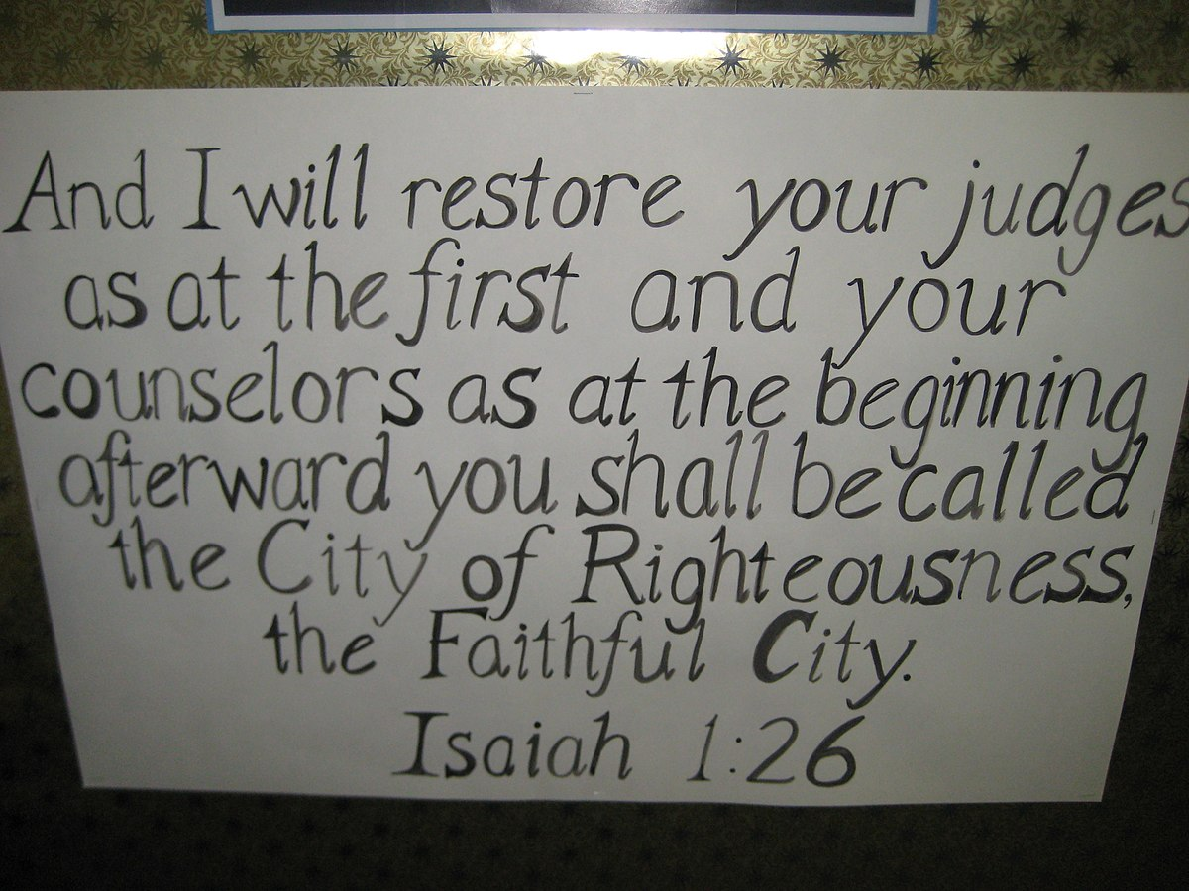
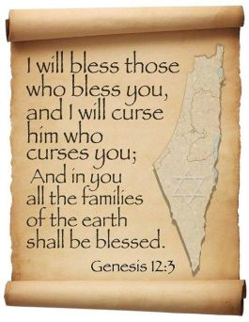
Zion’s Response to New Life
City
Isa 54:13-15 – “¹³‘All your sons will be taught of the Lord; and the well-being of your sons will be great. ¹⁴In righteousness you will be established; you will be far from oppression, for you will not fear; and from terror, for it will not come near you. ¹⁵If anyone fiercely assails you it will not be from Me. Whoever assails you will fall because of you.”
Notes:
Vs. 11-12 show the outward beauty of the new Zion, what the world sees. Vs. 13-15 show inward beauty.
Isa 54:13-14a – You’ll remember from the 3rd Servant Song in 50:4 that the Servant would awaken every morning to listen as a disciple. So, those who are apart of this city will model the Servant. This will in turn lead to our peace and well-being because, after all, God’s commandments are not burdensome, but designed to be for our good. In 1:26, we learned that one day Zion would be called the city of righteousness, and we now see how that is fulfilled in the Servant.
Having been established in righteousness, there will be no more oppression - Isa 54:14b-15 – Remember that when Hezekiah allowed the emissaries of Babylon to see his treasures, he was showing them exactly where to rob them, which they eventually did. Vs. 11-12 show a city of riches and attractiveness, and there are enemies in the world who want to rob us of this; not so they can have it, but they envy us because they have the same choice as we do but choose to pitch their tents in the darkness. And while this will lead to persecution, it ultimately won’t succeed because anyone restored to a right relationship w/God will be secure. Remember Gen 12:3 – “and I will curse him who curses you”. Therefore, no assault will ultimately succeed. God’s true people will always be strong enough to overcome. We deserve to be assailed, but the Servant took the brunt of the oppression so we wouldn’t have to. He is the cornerstone to this city, and as we learned from 28:16, “he who believes in it will not be disturbed”.

Slide 9
Zion’s Response to New Life
City
Isa 54:16-17 – “¹⁶‘Behold, I Myself have created the smith who blows the fire of coals and brings out a weapon for its work; and I have created the destroyer to ruin. ¹⁷No weapon that is formed against you will prosper; and every tongue that accuses you in judgment you will condemn. This is the heritage of the servants of the Lord, and their vindication is from Me,” declares the Lord.”
Notes:
Isa 54:16-17 – Meaning, God’s sovereignty covers the manufacturer, the product, human skill, the user’s intent, and He is pledging that no weapon nor accusation will stand because no part of God’s universe is exempt from His will. God’s incontestable judgment (45:21; 49:24) means no legal challenge can deprive them of what God has granted. We have an incontestable right to citizenship.
One important thing to keep in mind from vs. 17 is that this is the first time we see the word “servant” since chapter 53. Here, it is plural and will be plural for the remainder of the book. Why? Because, as we learned from 53:10, the Servant “will see His offspring”. The saving work of “the Servant” produces “servants”. Along w/their blessings, we share His title. And just as there was vindication for the Servant in chapter 53, there will be “vindication” for us, which is the same word for “righteousness” in 53:11. Our status could not be more complete seeing that God has affirmed it.

