Slide 1
Notes:
Do you remember the first time you saw the movie “The Sixth Sense” and its surprise twist ending? It was shocking. But then when watch it a 2nd time, you notice all the things that you missed before that, had you known the ending, would have made more sense, and so you come to appreciate the way the movie set up everything. This is Isa 53 in a nutshell, a Messianic prophecy of such specificity, one might expect Isaiah was standing beneath the cross itself recording what happened. But he wrote this 700 years before it occurred. And because we know how it all ended, we appreciate it all the more.
The Roman statesman Cicero said the following about crucifixion – “Even if death be threatened, we may die free men; but the executioner, and the veiling of the head, and the mere name of the cross, should be far removed, not only from the persons of Roman citizens—from their thoughts, and eyes, and ears. For not only the actual fact and endurance of all these things, but the bare possibility of being exposed to them,—the expectation, the mere mention of them even,—is unworthy of a Roman citizen and of a free man” – and yet, Isaiah goes into great detail about what Jesus would experience in His crucifixion.
While most Christians are familiar w/Isa 53, few are familiar w/the context leading up to it. So not only will we examine the text itself, we’re going to fill in the blanks for some of the unanswered questions leading up to it. For example, 51:17-23 talks about the wrath of God being removed. But how? 52:1-9 talks about redemption being accomplished. But how? 52:10-11 mentions a new exodus in which God would once again bare His holy arm, but as to the act itself, we’re left in suspense. How is it all possible?

Slide 2
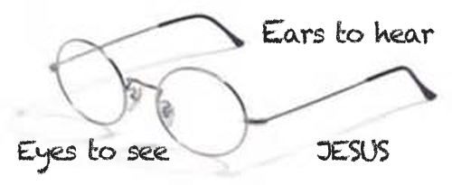
Messiah the Savior
Summary
Isa 52:13-15 – “¹³Behold, My servant will prosper, He will be high and lifted up and greatly exalted. ¹⁴Just as many were astonished at you, My people, so His appearance was marred more than any man and His form more than the sons of men. ¹⁵Thus He will sprinkle many nations, kings will shut their mouths on account of Him; for what had not been told them they will see, and what they had not heard they will understand.”
Notes:
The answer: “Behold, My servant”, the 4th and final Servant Song, which actually begins in 52:13. As a whole, it consists of 5 stanzas in 15 verses, each stanza consisting of 3 verses each. The 1st stanza introduces all the themes of the Song, but condenses them in reverse order. Meaning, chapter 53 begins w/suffering and ends w/exaltation, but in these verses, before any suffering announced, His triumph is assured – Isa 52:13-15.
In contrast to chapters 45 and 46 in which we learned every knee will bow, including Bel and Nebo, God’s Servant will be “high”, “lifted up”, and “greatly exalted”. The word “exalted” is the same word used of God in Isa 6; in fact, this word is only ascribed to God in the book of Isaiah (6:1; 33:10; 57:15), so consider what this would imply about the Servant – He is God – and so, of course He will prosper; God cannot fail.
But excitement is followed by sorrow as the stanza quickly goes from His exaltation to His suffering – this is our first plot twist, and vs. 14 says it is astonishing. Before exaltation, there would be humiliation. Something is going to happen to God’s Servant that will cause him to become so disfigured, they won’t look at Him and say, “That poor man”, they’ll say, “Is that even a man?” His disfigurement will shock people into speechlessness. His degradation would be as low as His exaltation was high, because however shocked the nations were at the destruction of Jerusalem and the defeat of God’s people, it’d be nothing compared to what happened to the Servant. And so, whatever attractiveness He had came from within because this is a Servant who prefers to lose in order to win us rather than win and lose us.
Because His disfigurement would be for us – it would “sprinkle” us, likely the priestly work of sprinkling the blood of the sacrifice onto the holy vessels to cleanse them. And this shocking and unprecedented event would reach the eyes and ears of everyone, shocking them into silence – the greatest authorities have no argument for this event. They’ll be struck dumb, something Paul alludes to in 1 Cor 1 and 2 regarding the cross.
Now, this answers a lingering question from the book. In Isa 6, God said the people couldn’t see, they couldn’t hear, and they were w/o understanding, and this is frequently repeated throughout the book. And then we saw in multiple texts how one day the blind would see, the deaf would hear, they’d come to understand, but it was never explained how this sudden transformation would occur. This Servant Song is the “how”; this is how they will “see”, “hear”, and “understand”. The crucifixion of the Servant, the Son of God, is the plot twists of all plot twists, something we would never see coming, but once it happens, we see its wisdom, and if ever anything will shake mankind out of its complacency, it is this event and no other.

Slide 3
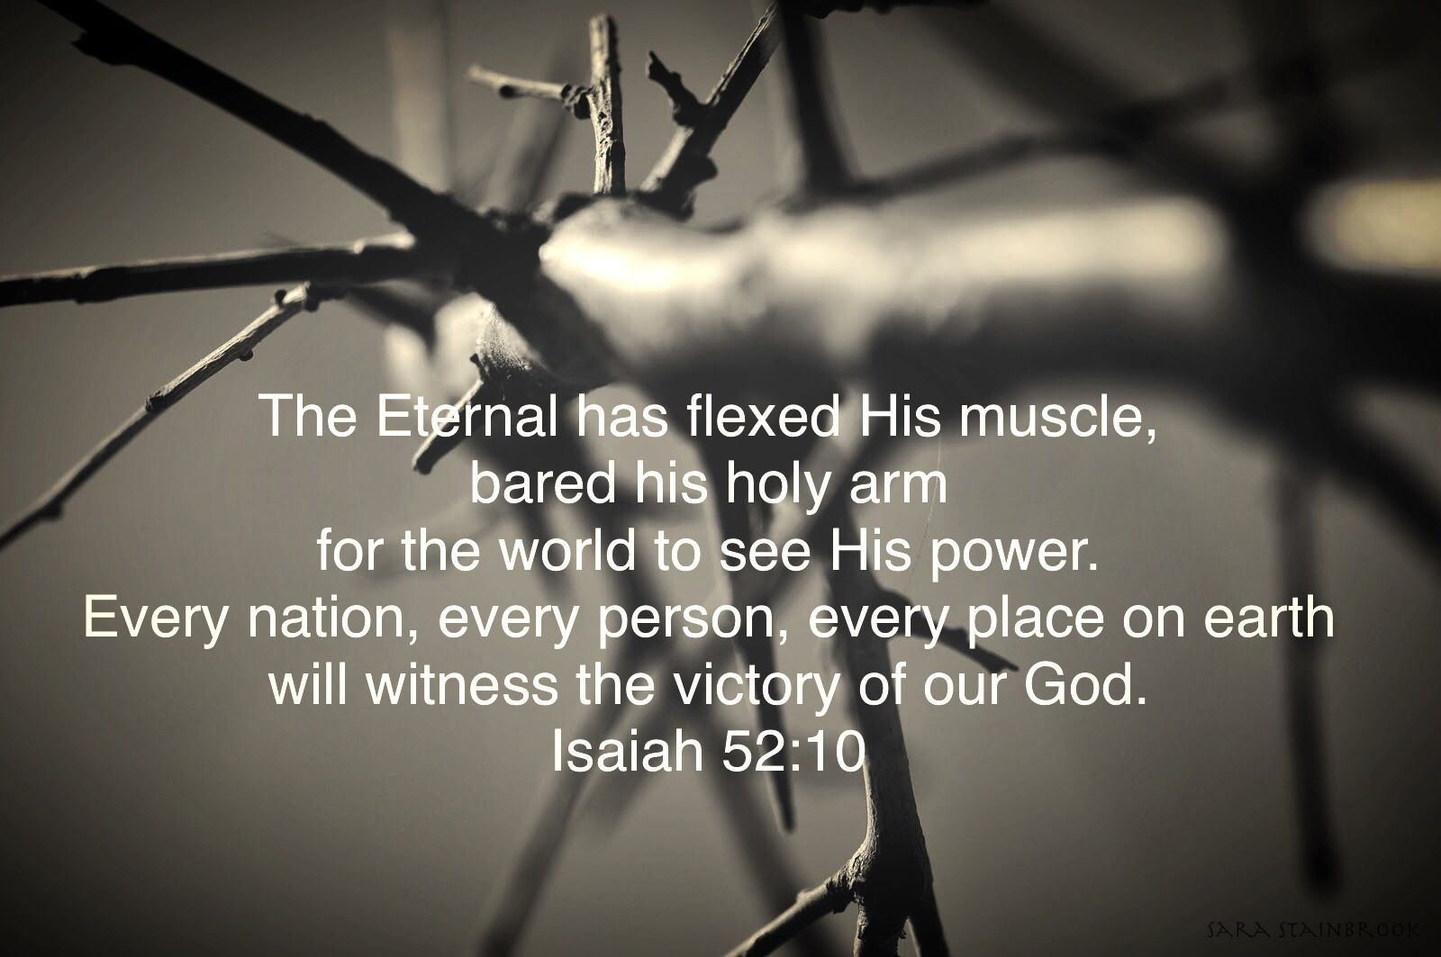
Messiah the Savior
Observed & Misunderstood
Isa 53:1 – “¹Who has believed our message? And to whom has the arm of the Lord been revealed?”
Notes:
Stanza #2 – How stunning is this event? You won’t believe it until you see it. 2 questions are posed, both rhetorical:
Isa 53:1a – The answer? No one at first. If Jesus’ closest entourage (the Apostles) didn’t get it until after the fact, neither would we. The thing that caused kings to shut their mouths was what they hadn’t heard; and what His prophets caused to be heard was ignored by the majority.
2nd question – Isa 53:1b – Who could possibly believe that the mighty arm of the Lord, which these Jews were salivating to see, would actually be the Servant Himself who’d come w/the kind of lowly birth, humble life, and cruel death as experienced by Jesus of Nazareth? This disfigured man is God’s right-hand man? Yes, because there is a far greater way to display power than even the kind of raw power we saw displayed in books like Exodus, and that is through the power of self-sacrifice. 52:10 sounds like God is rolling up His sleeves to flex His divine muscles, but some of the greatest strength God has ever displayed is His divine restraint, self-denial, and the sacrifice of His Son. And who could believe it? No one would’ve perceived this plan w/o prior revelation.

Slide 4
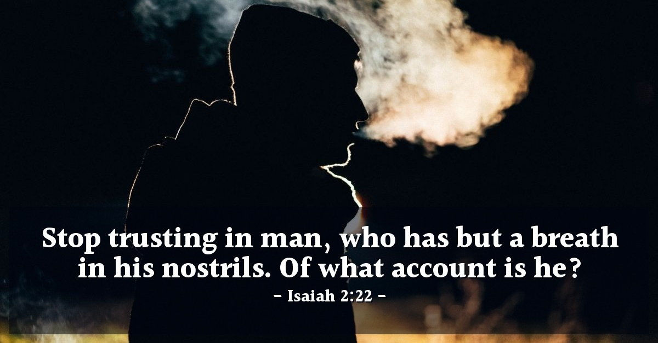
Messiah the Savior
Observed & Misunderstood
Isa 53:2-3 – “²For He grew up before Him like a tender shoot, and like a root out of parched ground; He has no stately form or majesty that we should look upon Him, nor appearance that we should be attracted to Him. ³He was despised and forsaken of men, a man of sorrows and acquainted with grief; and like one from whom men hide their face He was despised, and we did not esteem Him.”
Notes:
And to show why God’s “Arm” was met w/such shock and awe, we’re given His exceptionally humble origin and appearance.
Isa 53:2 – He had a natural birth, and it came from parched ground not suitable for growth. In what way? David’s seemingly fallen house, an Edomite ruling Judea w/Romans ruling over him, a priesthood corrupted by the religious elite bound by their hypocritical traditions, etc. That’s the “parched ground” the Father had to work with. What chance would you give someone of achieving greatness from an origin like this? There’d be low expectations. But He came as a tender shoot – the ARM OF THE LORD was nothing more than a tender shoot. And from there, He grew up w/none of the physically attractive features we look for in leaders. This doesn’t mean he was ugly, just that there was none of that magnetic attractiveness that would woo a crowd. His true splendor wasn’t on the surface, it was only for those who had “eyes to see” beyond the surface. How would we have known Him? Maybe through His poverty, by the anointing oil that came on Him through the spittle of His abusers, or maybe by the donkey that carried Him to His place of arrest and torture. But likely, we’d have only recognized Him if we valued things like righteousness, purity, holiness, gentleness, kindness, love, and grace. If we cherished those things and understood that that’s who He is, we’d have recognized Him.
But far from being recognized, He was actually shunned – Isa 53:3 – We’re now seeing why that horrible disfigurement took place. He was rejected w/extreme prejudice, an object of contempt. When you were young, did you ever make your parents so angry, they’d say, “I’m so disgusted w/u right now, I can’t even look at your face!” That’s how the common man treated Him. He was a “man of sorrows” – not the life of the party, but taking our sorrows and weaknesses upon Himself. “We did not esteem Him” means no one saw any value or beauty in Him. To view any human being in this regard reveals such a bankruptcy of emotion. How much more when it is God’s Servant? No wonder He could only be made known through revelation. He is one in which they’d “hide their face”. The world was so blinded by selfishness and power, His suffering didn’t even warrant a 2nd glance.
One of the theme verses we’ve studied is Isa 2:22, which cautions us to stop regarding man and esteeming Him. Yet, in the Servant is a man who actually merits the highest regard and esteem known to man, and we despised Him, forsook Him, hid our face from Him, and saw little value in Him or what He did.

Slide 5
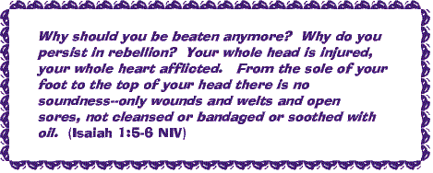
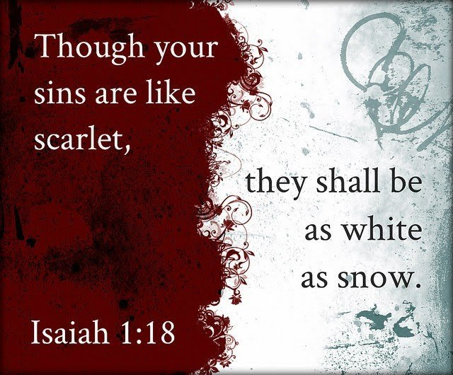
Messiah the Savior
An Atoning Sacrifice
Isa 53:4-6 – “⁴Surely our griefs He Himself bore, and our sorrows He carried; yet we ourselves esteemed Him stricken, smitten of God, and afflicted. ⁵But He was pierced through for our transgressions, He was crushed for our iniquities; the chastening for our well-being fell upon Him, and by His scourging we are healed. ⁶All of us like sheep have gone astray, each of us has turned to his own way; but the Lord has caused the iniquity of us all to fall on Him.”
Notes:
Stanza #3 – Why would this Servant, who deserves to be so highly regarded and esteemed by man, put Himself in a position to be so despised and rejected? Now we’re getting to the heart of the poem:
Isa 53:4 – In other words, as He suffers, they’d initially think God was punishing Him for His sins. But imagine the shock when they realized that the grief and sorrow they saw in Him was actually their own, and He was taking them upon Himself? They wouldn’t discern this at first, but it was actually God’s will from the beginning that He be brought low and humiliated. But why?
Because of our sins – Isa 53:5 – So this goes deeper to the actual cause of Him bearing those sorrows and griefs – our transgressions and sins. The great mystery throughout this entire book is how God was going to manage to redeem and deliver people from sin w/o some kind of atonement. We now learn that God’s Servant would become a sacrifice to secure both our well-being and our healing. What does pierced remind you of? Crucifixion. What does scourging/wounds remind you of? Jesus’ scourging at the hands of the Romans. This is no mercy killing. In order to secure our salvation, God’s Servant would be crushed because that’s how serious sin is.
This brings us back to Isa 1:5-6 in which God said to the Jews, “Where will you be stricken again?” Meaning, “how much harder do I have to beat you to get you to wake up and do right?” They were already a walking spiritual wound, head to toe. If God beat them any harder, they’d be dead.
How do they go from that to Isa 1:18 which says, “Though your sins be as scarlet, they shall be white as snow?” By God sending His only Son, the only man to ever walk this Earth who was actually worthy of our highest esteem, and allowing the people to beat Him senseless and torture Him to death in the most unimaginable way. He became the physical wound they were spiritually. There could be no other way.
It was all due to our selfishness – Isa 53:6 – Like sheep, we were single-mindedly unaware, focused only on the next clump of grass, head strong, easily frightened into running away, easily lost. This was not herd instinct – notice it is “each of us” who bears responsibility. The consistent principle across the entirety of scripture is that we individually reap what we sow. But in order for God to save us, the Servant would have to reap what we sow by bearing our iniquities. It is the ultimate paradox.

Slide 6
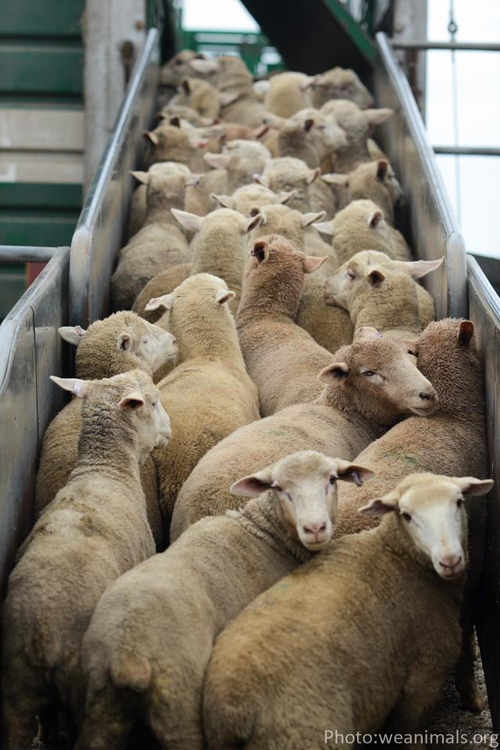
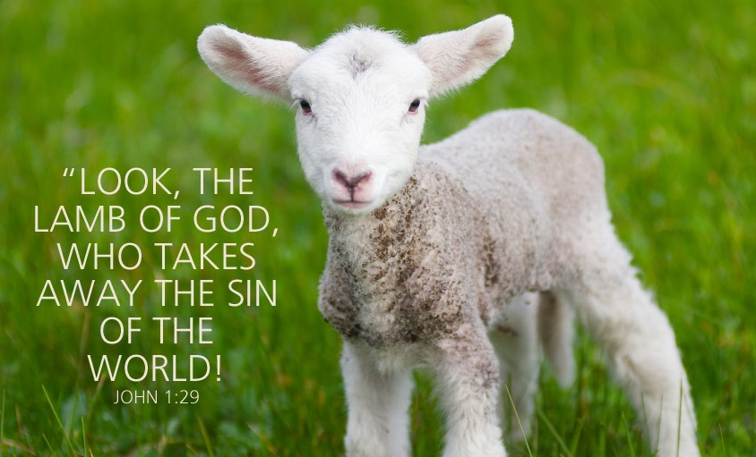
Messiah the Savior
Voluntary, Unjust, Undeserved Death
Isa 53:7 – “⁷He was oppressed and He was afflicted, yet He did not open His mouth; like a lamb that is led to slaughter, and like a sheep that is silent before its shearers, so He did not open His mouth.”
Notes:
Stanza #4 gives us an inside look into the Servant’s own consciousness as He is being led to die. How did He respond to this great injustice rendered toward Him?
Isa 53:7 – What was His disposition? Clear-headed, self-restrained, voluntary acceptance of the injustice of it all. He offered no verbal resistance.
Now, most sheep are silent before death out of ignorance. Here’s a picture of sheep being led to the slaughter, and if you were there, the silence would be deafening, because they have no idea what’s about to happen; they’re led to the slaughter in blind compliance. But the Servant knew what was about to happen to Him, which means He was silent out of submission. We merited every negative lamb comparison from vs. 6.
But He demonstrated every positive lamb comparison while suffering the negative ones. Have you ever protested your suffering? Have you ever protested it even when you deserved it, like Cain in Gen 4 who said, “My punishment is too great to bear!” No one was more innocent than Jesus, “yet He did not open His mouth”. This is one of the reasons why I’ve harped so much on Israel’s complaints from chapter 40:27 and 49:14 – “My way is hidden from the Lord…the justice due me escapes the notice of my God…the Lord has forsaken and forgotten Me.” No one had more right to protest than Jesus – yet He was silent.

Slide 7
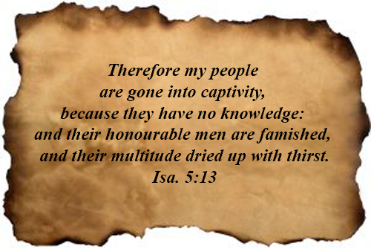
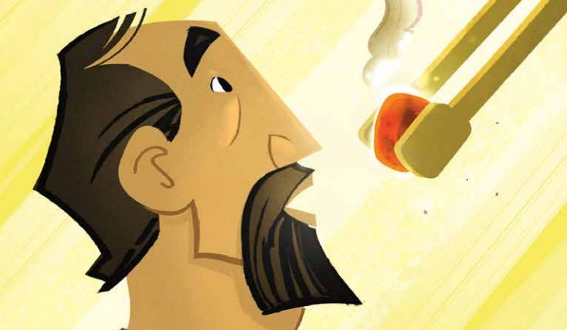
Messiah the Savior
Voluntary, Unjust, Undeserved Death
Isa 53:8-9 – “⁸By oppression and judgment He was taken away; and as for His generation, who considered that He was cut off out of the land of the living for the transgression of my people, to whom the stroke was due? ⁹His grave was assigned with wicked men, yet He was with a rich man in His death, because He had done no violence, nor was there any deceit in His mouth.”
Notes:
Isa 53:8a – “oppression” means “w/o restraint”. “judgment” means rights and due process. Yet His treatment was unjust from start to finish, restraint of justice and oppressive legal treatment. The Jews wined about being taken away to captivity. But in order to save them from their sin, Jesus was taken away to die.
Isa 53:8b – It’s the same idea as vs. 1. Among the onlookers and circle of peers, no one understood what was really happening. NLT – “Unjustly condemned, he was led away. No one cared that he died without descendants, that his life was cut short in midstream. But he was struck down for the rebellion of my people.” This is the first explicate indication in the song that He would not simply suffer, but actually die. And nobody was speaking up saying, “It’s not right for this man to be murdered in the prime of His life and w/o any children to carry on His name!” But it was all done for us. The strokes He received belonged to us.
Isa 53:9a – Typically after a crucifixion, the body was not allowed a proper burial, but was thrown in a common grave w/prior victims of crucifixion. And to add insult to injury, this is what was planned for Jesus’ body, to treat Him as just another evil-doer. But you’ll remember from the gospel accounts that Joseph of Arimathea asked permission from Pilate to take Jesus’ body. After so much unjust treatment, why would He be allowed such a proper burial in a royal grave?
Isa 53:9b – “violence” here means “planned hostility against people”. “deceit” is wickedness in the heart, ulterior motives. Jesus had none of this; He was totally guiltless to both outward and inner sin. Jas 3:2 says that the one who doesn’t stumble w/His tongue is a perfect man; even Isaiah’s mouth needed forgiveness. But Jesus didn’t do anything, say anything, or think anything that would make Him wicked. He was totally innocent, but willingly suffered in spite of it.

Slide 8
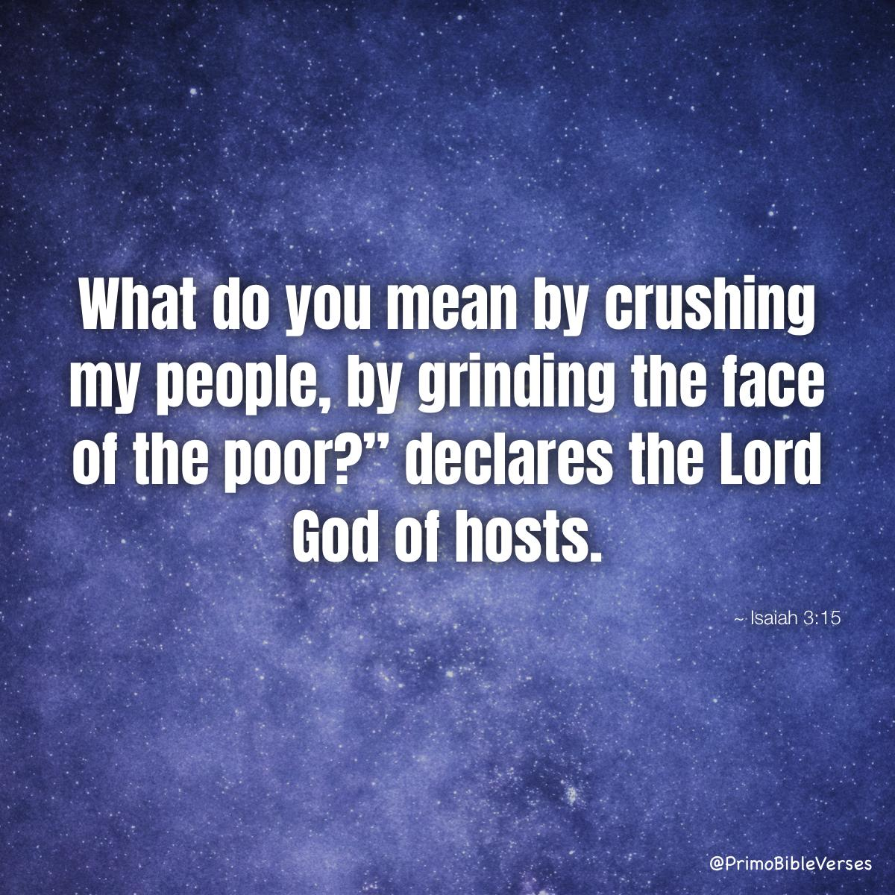
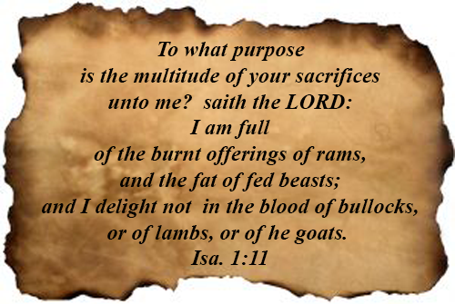
Messiah the Savior
Exaltation Through Sin Bearing
Isa 53:10 – “¹⁰But the Lord was pleased to crush Him, putting Him to grief; if He would render Himself as a guilt offering, He will see His offspring, He will prolong His days, and the good pleasure of the Lord will prosper in His hand.”
Notes:
Before we look at stanza #5, consider how each of the former stanzas contain a paradox. In stanza #1, it’s “how can suffering lead to exaltation?” In stanza #2, it’s “how can one so plainly human be the arm of the Lord?” In stanza #3, it’s “how can one so highly esteemed be esteemed stricken, smitten of God, and afflicted”? And in stanza #4, it’s “how can a condemned criminal receive a rich man’s burial?” Stanza #5 begins w/the word “but”, giving us a look at God’s perspective on the matter.
Isa 53:10a – How could the people crush God’s Servant? Because it was God’s will to crush Him. Even more, it pleased Him to do it. Now THAT’S a paradox. Why?
Because of the fruit He knew it would bear. Notice the word “if” – Isa 53:10b – We look at Matt 10:37 which says “…anyone who loves his son or daughter more than Me is not worthy of Me.” and we think “that’s too hard”. But God put us before His Son to save us. The purpose of the guilt offering was to make reparation against the Lord’s holy things or compensation for offenses against one’s neighbor; it always went further than the sin offering by demanding satisfaction of unpaid debt. But we were the ones who owed God the debt, but Christ came and paid for it, and so it pleased the Lord to crush Him.
Because by Christ doing so… – Isa 53:10c – By offspring, it means spiritual posterity. The implication from vs. 8 is how awful it was that this man, who was in the prime of His life, should die w/o descendants. No, He will see His offspring. How? Look around the room. We strayed as sheep, but we return as children. And what’s more, He will see it. How?
Isa 53:10d – This is eternal life. He died, He was buried, but He rose never to die again. He sees His offspring even now.
Isa 53:10e – Meaning, tt was a delight that His Servant could be the guilt offering. It pleased Him because He knew what it would ultimately lead to. This song started w/exaltation in 52:13, we just didn’t know the many twists and turns it would take to get there.

Slide 9
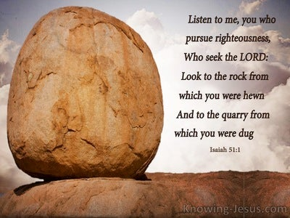
Messiah the Savior
Exaltation Through Sin Bearing
Isa 53:11 – “¹¹As a result of the anguish of His soul, He will see it and be satisfied; by His knowledge the Righteous One, My Servant, will justify the many, as He will bear their iniquities.”
Notes:
Isa 53:11a – This is the internal laboring of the Servant. Have you ever encountered an individual who is suffering internally and felt satisfied about that? The Father did, and every bit of the Servant’s suffering was worth it for what it resulted in. And Jesus thought so, too; this was part of the “joy set before Him” of Heb 12:2.
Isa 53:11b – Meaning, He knew exactly what was needed and how to do it to achieve God’s will. And part of this was living a perfect, righteous life so that He could be morally qualified to bear our iniquities. Those from Isa 51:1 who were pursuing righteousness? The Servant is the end of the quest. No longer is Abraham the rock to which we are to look, to which we are now hewn from – now it is Jesus Christ.

Slide 10
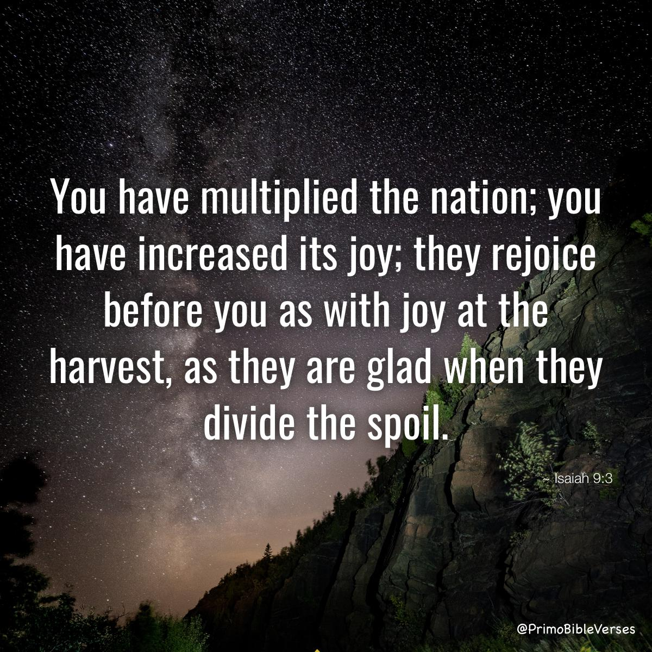
Messiah the Savior
Exaltation Through Sin Bearing
Isa 53:12 – “¹²Therefore, I will allot Him a portion with the great, and He will divide the booty with the strong; because He poured out Himself to death, and was numbered with the transgressors; yet He Himself bore the sin of many, and interceded for the transgressors.”
Notes:
Isa 53:12a – This is anticlimactical. Whose victory is this? The Servant’s. Yet when all is said and done, he takes the spoil and shares it w/the strong, the great (same word as “many”) that are in Him. The fruits of victory are shared w/the whole company of the redeemed, something we were already told in 9:3, we just weren’t told how. And the Song closes w/a 4-fold statement on the grounds for which He can take such spoil:
Isa 53:12b – Meaning, there was nothing left for Him to give. He was the agent and substance of the outpouring.
Isa 53:12c – Meaning, even though He is the Righteous One, He personally identified w/those sinners He came to save. He was content to temporarily suffer loss of reputation and life.
Isa 53:12d – We already saw this in vs. 11; He acted to lift our sins and take them away.
Isa 53:12e – Meaning, He acted as our mediator, taking our plea to God’s ear. He’s the bridge and go-between for us and God, to be presented before Him justified. This was what it was all for!

Slide 11
Notes:
Christians sometimes ask how the Jews cannot see that Isa 53 is referring to Jesus of Nazareth. It’s because most Jews don’t even know this chapter exists. It is referred to as the forbidden chapter amongst Jewish rabbis. Up until the first century, we have evidence that the Jewish rabbis agreed across the board that that Isaiah 53 was a prophecy about the Messiah. But once Jesus came and the gospel started to spread, this chapter in Isaiah began to cause problems within Judaism because of its overt resemblance to the life and work of Jesus of Nazareth. And so, whenever Isaiah is read in Jewish synagogues, once they get to 52:12, they skip right to 54:1. You can search on youtube and find Jewish Christians interviewing Jewish nonChristians and asking them if they have ever heard of Isaiah 53.

