Slide 1
Notes:
When your child misbehaves, and you send him to his room w/o supper, when is he allowed to come out? “When I say so…”. Suppose an hour then goes by, then 2, then 3. He might wonder if you’re ever going to let him out. He may even question whether you still love him. That was Israel in chapters 40 - 48, and God’s answer was, “You’re getting out.” But what about the issue that got them in trouble in the first place? And how can God fix that issue while at the same time provide the incentive to His people to be what He created them to be, so He won’t have to do the same thing or worse in the future? That is Isa 49 - 57. And as we begin Isaiah 49, which is the 2nd 9-chapter section, we’re going to continue seeing the same language of captivity and deliverance from chapters 40 - 48. And yet, neither Babylon nor Cyrus are mentioned again, because the focus now shifts from physical captivity to spiritual captivity.
Isaiah has already told us that Israel would be God’s witness that Jehovah is the only God. But how is this possible? As we saw in chapter 48, wickedness was the cause of their captivity and when they return from captivity, wickedness would continue. So, is God just going to ignore the sin that put them in captivity in the first place? Surely Cyrus can’t cure their blindness and deafness; and so, who will?
As we begin chapter 49, many questions left unanswered in Isaiah are going to start taking shape, and we’re going to start seeing a growing intensity and anticipation leading up to chapter 53 that is impossible to ignore.

Slide 2
Notes:
There are many similarities between Isa 40 and Isa 49, one of which is that each chapter contains a complaint that appears to prompt much of the text that is written before it. Isa 49:14 appears to be a response to most of what is said in the first 13 verses of this chapter – Isa 49:14 – In other words, the Babylon that held them in physical captivity seemed so strong, but God shows Himself stronger. The sin that holds them in spiritual captivity is even stronger, and God is yet to give them a solution to this w/any specificity. It’s as if they are saying, “Thanks for getting us out of Babylon and back home, but what about the issue that brought us there? Is the Lord going to help with that or has He given up on us?” The answer: God is preparing to send another deliverer. He’s already been introduced the at beginning of Isa 42, the 1st Servant Song, in which He’d be given a worldwide task. But now His uniqueness will be even more fully distinguished from the nation and its remnant, and He’ll be given a double task of deliverance. And by delivering the people, He will reveal His mighty arm, but in a very unexpected way.

Slide 3
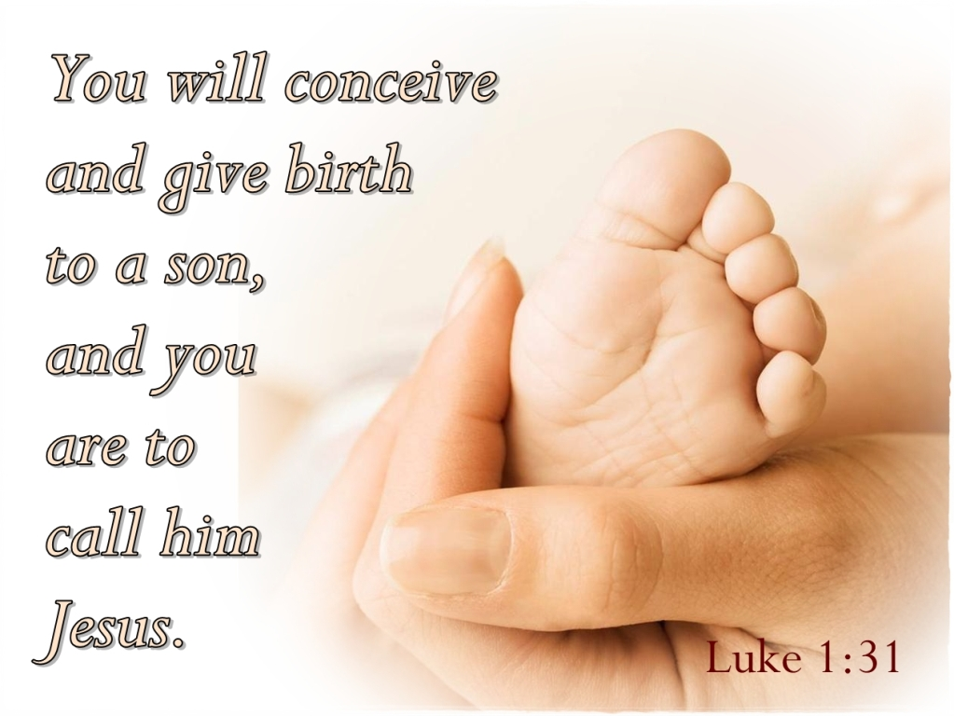
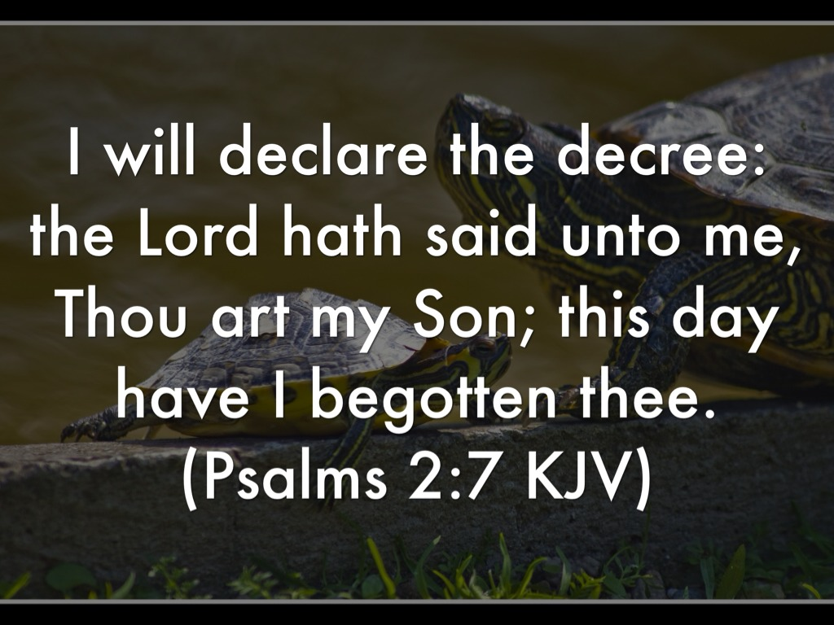
Deliverance of the Disheartened
Servant Song #2
Isa 49:1-3 – “¹Listen to Me, O islands, and pay attention, you peoples from afar. The Lord called Me from the womb; from the body of My mother He named Me. ²He has made My mouth like a sharp sword, in the shadow of His hand He has concealed Me; and He has also made Me a select arrow, He has hidden Me in His quiver. ³He said to Me, ‘You are My Servant, Israel, in Whom I will show My glory.’”
Notes:
The 2nd of 4 Servant Songs begins in Isa 49:1-3. Notice what we learn about this next Deliverer:
First of all, He will help everyone, even Gentiles. More on that in a bit.
How far in advance has He been prepared for this? From the womb, which could mean the mother who bore Him but is more likely figurative of the spiritual remnant returning from Babylon.
Cyrus would bring physical warfare through a physical sword, but this Deliverer will bring a warfare of the Word. And like an arrow, He hits His mark. Consider the contrast between a sword and an arrow. A sword is used against those near (Jews), the arrow is used on those afar (Gentiles).
We saw this Servant step out of the shadows and speak at the end of 48:16. He’s always been there, but also hidden. Out of sight, but present in the shadow. This denotes personal preparation and care rather than haphazard work.
And what does vs. 3 remind us of? It is similar to Psa 2:7, but also similar to words spoken by the Father to Jesus Christ, at His baptism in Matt 3, at His transfiguration in Matt 17:5, and also when those 2 Gentiles visited Him in John 12:28. And this Deliverer is identified as God’s Servant “Israel”. This isn’t the nation Israel, this is a person – He is God’s ideal Israel, everything He wished the nation of Israel could have been but fell so short of the mark that this “arrow” will now hit. This Servant “Israel” will be for all the world what Israel never could be.

Slide 4
Deliverance of the Disheartened
Servant Song #2
Isa 49:4-6 – “⁴But I said, ‘I have toiled in vain, I have spent My strength for nothing and vanity; yet surely the justice due to Me is with the Lord, and My reward with My God.’ ⁵And now says the Lord, who formed Me from the womb to be His Servant, to bring Jacob back to Him, so that Israel might be gathered to Him (For I am honored in the sight of the Lord, and My God is My strength), ⁶He says, ‘It is too small a thing that You should be My Servant to raise up the tribes of Jacob and to restore the preserved ones of Israel; I will also make You a light of the nations so that My salvation may reach to the end of the earth.’”
Notes:
But when He comes, notice how fully His humanity will be on display.
Isa 49:4 – Do you see that “striving w/God” that is so indicative of “Israel”? This Servant would come to deliver, but He’d know frustration and failure. And His first thought would be the same as ours: despondency, not seeing any fruit from the toil of His labor. Yet His 2nd thought shows the rewards of striving, that He reaches His ultimate conclusion by faith and not by sight. What this means is that true trust is not the absence of frustration. It’s based on the ultimate conclusion that we reach. True reward is not found in how people down here respond to our spiritual labors. True reward is found w/God. This Servant would be tested, bearing our same burdens/frustrations, yet will prove to be the true Author and Perfector of our faith.
Notice what helped Him to overcome this initial frustration – Isa 49:5 – How did He overcome discouragement? By remembering He was fashioned for this very purpose. And so, nothing can hinder Him from accomplishing it. He has God’s strength and so He ultimately can’t fail. He may fail to deliver everyone, but He won’t fail w/the remnant. All that matters in the end is to be honored in God’s sight.
And what is this new bit of information the Lord has for His Servant? – Isa 49:6 – It is not a large enough task for the Servant to just save the Jews; God has a broad mission in mind. The Servant’s very nature, preparation, and calling demands a larger scope of work: saving everyone. And He won’t just bring salvation; He will be their salvation. Paul quotes this verse about Jesus in Acts 13:47, and we know from several texts in the gospel that Jesus self-identified Himself as the Light of the world. Now, did you catch how vs. 5-6 says He is going to bring Israel back to God, yet vs. 3 identifies Him as “Israel”? How can He “be” Israel and “save” Israel? Because, in His person, He will embody everything that Israel should be.

Slide 5
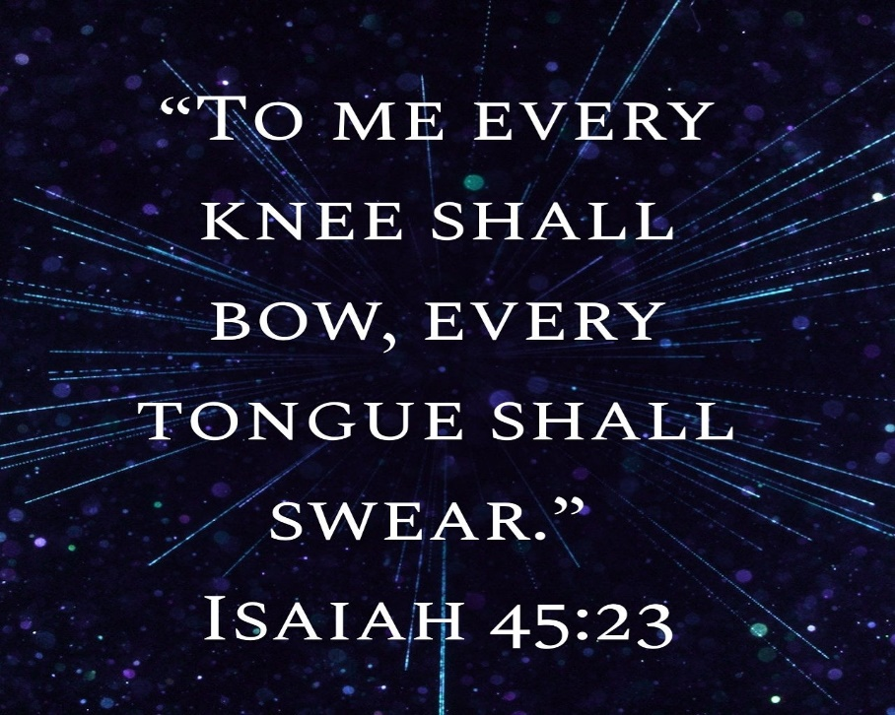
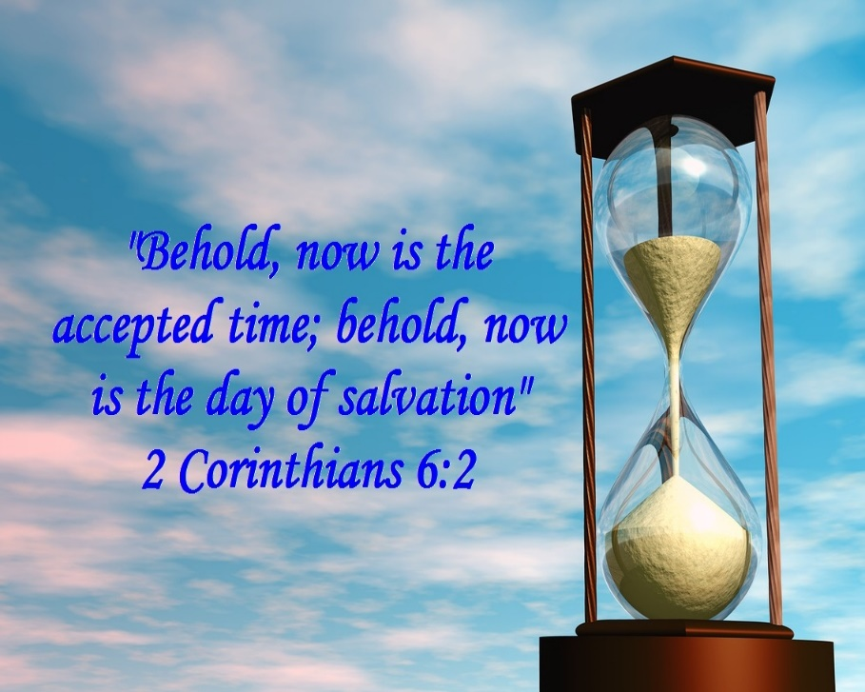
Deliverance of the Disheartened
Servant Song #2
Isa 49:7-9a – “⁷Thus says the Lord, the Redeemer of Israel and its Holy One, to the despised One, to the One abhorred by the nation, to the Servant of rulers, ‘Kings will see and arise, princes will also bow down, because of the Lord who is faithful, the Holy One of Israel who has chosen You.’ ⁸Thus says the Lord, ‘In a favorable time I have answered You, and in a day of salvation I have helped You; and I will keep You and give You for a covenant of the people, to restore the land, to make them inherit the desolate heritages; ⁹saying to those who are bound, ‘Go forth,’ to those who are in darkness, ‘Show yourselves.’”
Notes:
But in a surprising twist, notice the outcome of the Servant’s mission:
Isa 49:7 – So, initially, He will not be well received; people will show contempt toward Him. Nations will see themselves as more significant and powerful than Him, and so He will suffer at their hands. What they didn’t know but would learn later was that His rejection by the majority was to be His lot. And once they figure this out, He will go from being despised to acknowledged, and the world will be amazed at the kind of absolute reliability He had in the Father. One thing to keep in mind as you study the Servant Songs is the increasing level of opposition: Isa 42:4 – "He will not be disheartened or crushed until He has established justice in the earth; And the coastlands will wait expectantly for His law“ to Isa 49:4a – But I said, "I have toiled in vain, I have spent My strength for nothing and vanity”. And now we read He would be despised and abhorred. The language of hostility will continue to increase across the Songs.
Isa 49:8-9a – This shows the Servant would be a man of prayer, and those prayers would be answered, but only in a “favorable time”. The Father guarded Jesus’ life from danger until an appointed time, and when salvation came, the Father would help the Servant. This is the language of the Jubilee in which captives were freed and inheritances restored, and Paul quotes this in 2 Cor 6:2 as being Messianic. Jesus will be the embodiment of our covenant, in that only through personal fellowship w/Him can covenant blessings be found.

Slide 6
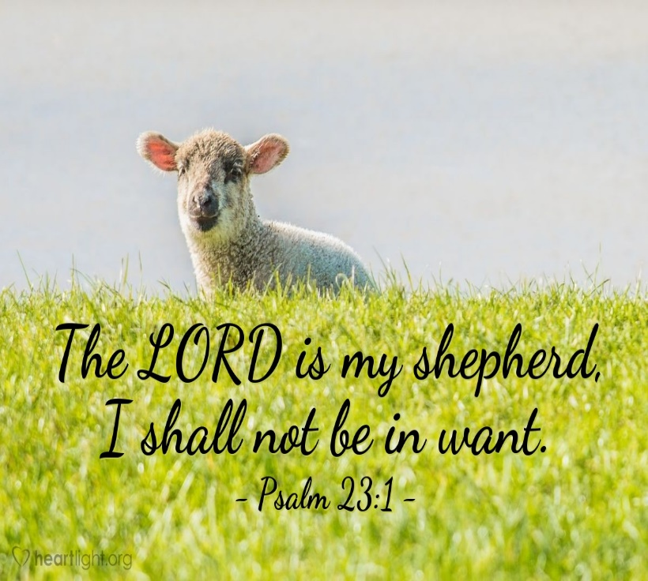
Deliverance of the Disheartened
Servant Song #2
Isa 49:9b-13 – “⁹Along the roads they will feed, and their pasture will be on all bare heights. ¹⁰They will not hunger or thirst, nor will the scorching heat or sun strike them down; for He who has compassion on them will lead them and will guide them to springs of water. ¹¹I will make all My mountains a road, and My highways will be raised up. ¹²Behold, these will come from afar; and lo, these will come from the north and from the west, and these from the land of Sinim. ¹³Shout for joy, O heavens! And rejoice, O earth! Break forth into joyful shouting, O mountains! For the Lord has comforted His people and will have compassion on His afflicted.”
Notes:
And as Servant Song #2 concludes, notice how Isaiah uses the same captivity language from chapters 40 – 48, but how it is now incorporated toward their rescue from spiritual captivity:
Isa 49:9b-10 – This Exodus imagery is combined w/the highway imagery and sheep imagery constantly found in this book. It reveals that the Servant’s ministry is not just designed to free us from spiritual bondage, but to lead us safely home. And no matter how seemingly bare our circumstances in life, the Lord will provide. Pastures in which to feed will be found in the most unlikely of places. Total protection from every inward threats of hunger and thirst and every outward threat of heat and sun will be found, as we also read in the famous Psalm 23. And we will be led w/the paternal compassion one would expect of a Shepherd, not to small streams, but springs of water.
Isa 49:11-12 – Not physical obstacles, but spiritual obstacles. God manages everything according to His sovereign power. Consider the pronouns. Mountains seemingly insurmountable can be overcome w/confidence because they are “My” mountains. It is “My” highway and will therefore be raised up, easily seen. Neither distance (from afar) nor location (north, west) will prevent this pilgrimage. The name Sinim is an unidentified location. Some say it is in the east since that location not mentioned. Others say it is somewhere in China or Egypt. Or it could be that Isaiah was being purposefully obscure to apply it to people coming from even remote, unknown places.
And vs. 13 is the conclusion to the stanza, and another thing to keep in mind about the Servant Songs is that each one is always followed by a statement of praise to celebrate the news – Isa 49:13 – Singing is the appropriate response of joy over what the Lord has accomplished from the prior verses, heaven and earth representing totality, and mountains o often being where good news is heralded.

Slide 7
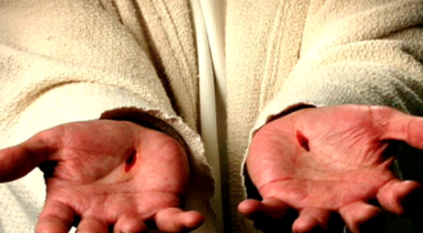
Zion Not Forgotten
God Won’t Forget Zion
Isa 49:14-16 – “¹⁴But Zion said, ‘The Lord has forsaken me, and the Lord has forgotten me.’ ¹⁵Can a woman forget her nursing child and have no compassion on the son of her womb? Even these may forget, but I will not forget you. ¹⁶Behold, I have inscribed you on the palms of My hands; Your walls are continually before Me.”
Notes:
So, let’s revisit Israel’s complaint:
Isa 49:14 – When sin gets its grips in you, do you ever feel like that? We’re held captive to a world ruined by sin every day. And more than that, mankind is in personal, spiritual bondage to sin, having become our own worst enemy, hurting ourselves and others in our quest for significance. But God’s point when they uttered this complaint in chapter 40:27 is the same here. In God’s greatness, He is not too great to care. Rather, He is too great to fail us. And through the sending of this new Deliverer/Servant, He will demonstrate this very thing. Notice His argument:
Isa 49:15a – A nursing mother cannot forget her child. She’ll regularly remember throughout the day that she has a child because she’ll need to nurse that child as much as the child will have a need to be nursed. I suppose it isn’t too far-fetched to assume that a nursing mother could get so wrapped up with the business of a day that she momentarily forgets where her children are, but that moment won’t last. A nursing mother will be drawn back to her child physically and instinctively. And just as a mother will not forget her child, can she cease to show her child compassion? It’s unfathomable.
So, here’s the point – Isa 49:15b – He’s not saying that there are a bunch of mothers out there who forget their children and don’t show their children any compassion. He’s saying that before God forgets us, we will forget our children. And if a mother forgetting her children seems like an impossibility, know that it is an even greater impossibility that God forgets us.
Isa 49:16 – There was an ancient custom that helped the Jews to remember things of spiritual significance. The Jews would have some impression made on a block of wood of the temple and they would take powder or charcoal and imprint that figure onto the palm or the arm. They called these representations “ensigns of Jerusalem”. But some would seek a more permanent representation by puncturing their skin w/needles and ink. This was the Jews way of keeping Jerusalem in their remembrance and always in the forefront of their mind. I think it’s possible that this verse is borrowing from the imagery of that ancient custom. But now God is saying about His people, “I have inscribed you on the palms of My hands”. But doesn’t use powder and ink does He?
Rather, this is the very term used in the NT for the placement of the nails in the hands of Jesus. In other words, this is Him saying, “I have chiseled you into My hands.” Some of your translations will say graven or carved. And by beginning vs. 16 w/the word “Behold”, it’s as if He’s spreading out His hands to display the self-inflicted wounds of Zion’s name. What is the significance of the “walls”? This would normally be symbolic of Zion’s strength, prosperity, and security. But an easier way to think of it is by way of contrast. Their “ruins” are not continually before Him; not their past failures, not their sin, but their walls. We’ll get more into the “walls” later.

Slide 8
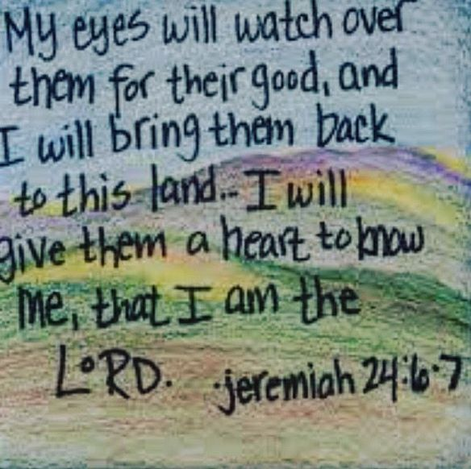
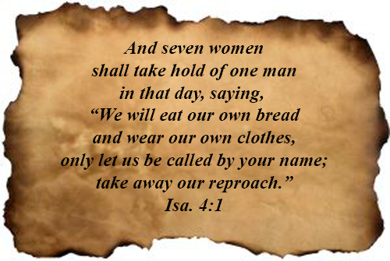
Zion Not Forgotten
God Won’t Forget Zion
Isa 49:17-21 – “‘¹⁷Your builders hurry; your destroyers and devastators will depart from you. ¹⁸Lift up your eyes and look around; all of them gather together, they come to you. As I live,’ declares the Lord, ‘You will surely put on all of them as jewels and bind them on as a bride. ¹⁹For your waste and desolate places and your destroyed land—surely now you will be too cramped for the inhabitants, and those who swallowed you will be far away. ²⁰The children of whom you were bereaved will yet say in your ears, “The place is too cramped for me; make room for me that I may live here.” ²¹Then you will say in your heart, “Who has begotten these for me, since I have been bereaved of my children and am barren, an exile and a wanderer? And who has reared these? Behold, I was left alone; from where did these come?’””
Notes:
Not only will He not forget Zion, He’ll bless them abundantly:
Isa 49:17-18 – Some of your translations say “sons” instead of “builders” – would suggest that both fit well in the contrast. Because while God’s city lay in ruins, they’d be built quickly, those who destroyed it would retreat, and then all of Zion’s children will return. Some of you mothers have a necklace w/birthstones of all your children and you wear it like an ornament. In the same way, Zion would bind her sons as jewelry. And there is a mixing of metaphors – the mother of sons now becomes the bride dressing for her wedding, wearing all the returned sons/builders as ornaments.
Isa 49:19 – Whatever he planned to say about the waste and desolate places, he gets caught right back up in a restored Zion too small for its inhabitants, an overflowing population free from the opposition it was so accustomed to.
Isa 49:20-21 – Though Zion seemed to have lost almost everything, a new generation will explode w/life. The city is being pictured as a mother listening as her children jostle about for more room, and there is amazement over the incomprehensible turn of events, and this large influx of children is likely the result of Gentile inclusion (2:2-3).

Slide 9
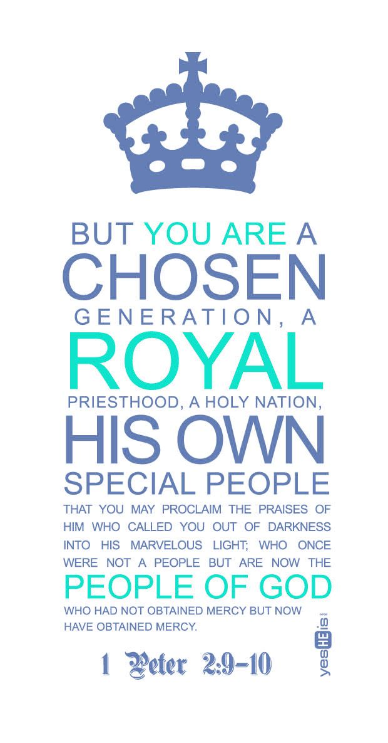
Zion Not Forgotten
God Conquers
Isa 49:22-23 – “²²Thus says the Lord God, ‘Behold, I will lift up My hand to the nations and set up My standard to the peoples; and they will bring your sons in their bosom, and your daughters will be carried on their shoulders. ²³Kings will be your guardians, and their princesses your nurses. They will bow down to you with their faces to the earth and lick the dust of your feet; and you will know that I am the Lord; those who hopefully wait for Me will not be put to shame.”
Notes:
Isa 49:22 – Remember from the 2nd Servant Song how sword is in combat against those in close proximity, and the arrow for those far away, to suggest He is aiming to conquer both Jew and Gentile? In the same way, the “hand” can be seen for those nearby, and the “standard” those far away. That word “standard” is a favorite word of Isaiah’s, often used to call nations to plunder. But rather than destroy as they once did, they will come w/Zion’s children, tenderly in their arms and on their shoulders, ready to repent, to care, and to serve. God only has to signal, and the nations fall in line.
Notice more reversal of circumstances – Isa 49:23 – Zion once bowed before Earth’s mighty and served her children. Now the mighty will grovel at Zion’s feet noting that the royalty of Zion is of superior quality. This is likely alluding to the spiritual indebtedness of those who’d become children of God. And for those of us who perhaps became Christians later, you’ve likely felt this indebtedness toward those who initially taught and encouraged you. And those who experience the other side of this come to realize how rewarding of an experience “waiting” can be.

Slide 10
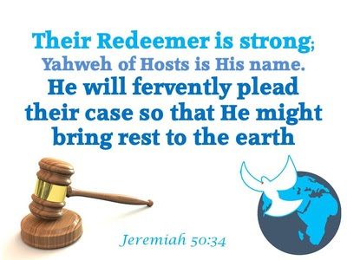
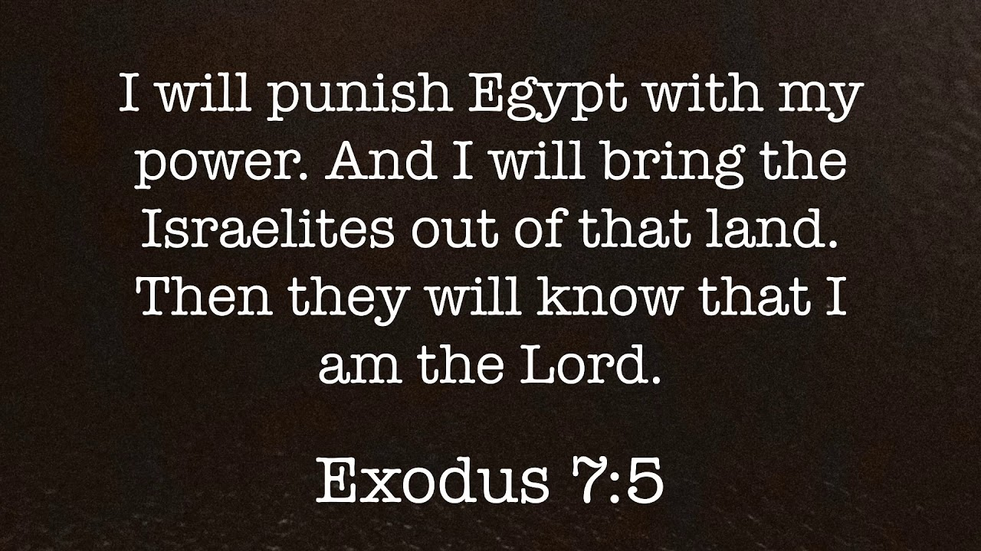
Zion Not Forgotten
God Conquers
Isa 49:24-26 – “‘²⁴Can the prey be taken from the mighty man, or the captives of a tyrant be rescued?’ ²⁵Surely, thus says the Lord, ‘Even the captives of the mighty man will be taken away, and the prey of the tyrant will be rescued; for I will contend with the one who contends with you, and I will save your sons. ²⁶I will feed your oppressors with their own flesh, and they will become drunk with their own blood as with sweet wine; and all flesh will know that I, the Lord, am your Savior and your Redeemer, the Mighty One of Jacob.”
Notes:
“But surely this isn’t possible”. It is w/God.
Isa 49:24-25 – For God to bring us home, the power of sin must be broken. Now, in the normal course of affairs, its power is not broken. But God is not subject to the normal course of affairs and acts outside of them when he chooses. The 2nd part of vs. 25, though. has forensic connotations, suggesting they were captive by right. What’s the solution? That there is a force even mightier and fiercer than sin, and the Lord will contend w/the legal side of the matter. By themselves, Israel could do nothing against the demands of sin. But when God inserts Himself into the equation, anything can happen. Just as Babylon was defeated, so will sin.
Isa 49:26 – So, the thrust of these verses has been getting Zion home. But even then, there will always be those who resist it and oppose His people. This leads to their own self-destruction, a recurring theme in God’s judgments. As w/Pharaoh, this will cause them to know who God is.

