Slide 1
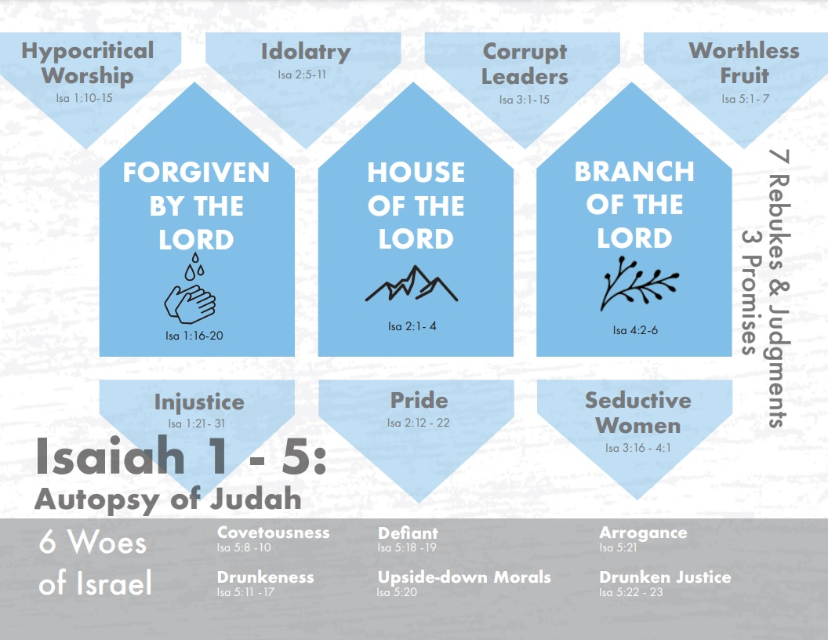
Notes:
We’re in the first part of Isaiah, chapters 1 – 5, in which Isaiah is performing an autopsy on the spiritually dead body that is the nation of Judah, and as he is taking the knife to them, he’s uncovering what has just killed them as a nation of God’s people. So far, he has found hypocritical worship, injustice, idolatry, pride, and corruption in their leadership. But as he’s examining them, he’s also noticing a recurring issue – they’re putting too much trust in man and not enough trust in God – Isa 2:22 – “Stop regarding man, whose breath of life is in his nostrils; for why should he be esteemed?” This same theme has popped up in each rebuke.
In what ways? We learned in chapter 1 that one of the reasons they were worshipping was to “appear” before Him suggesting their desire to be seen by man. Regarding their injustice, the cause is that they loved bribes and chasing after reward from men. Regarding their idolatry, they put too much emphasis in the accumulation of man’s goods and the construction of their hands. In their pride, they placed too much trust in themselves, and regarding their leadership, we mentioned the irony of fallen man putting so much faith in fallen man. See the common theme? Trust in man. What’s Isaiah ultimately trying to teach us? To trust in God.
And while the rebukes have this common theme of placing too much trust in man, the judgments all have a common theme as well – God will remove these things from them. There will be a purging. He will remove their leaders and replace w/capricious children. He’ll remove the things they pride themselves over, He’ll remove the idols. For their injustice, He will remove all their allow and smelt them away as dross. But the biggest thing He will remove is in His judgment against their hypocritical worship, and that is He will remove Himself, saying in 1:15 that when they worship and pray to Him, He will hide His eyes. It’s one thing to lose things, to lose people, but it’s an entirely different thing to lose access to God.
But judgment will not be the final word. He is ready to offer forgiveness to those who repent, and He has promised a new Jerusalem that will surpass the old in every way. In this study, we will consider rebukes #6 and #7 as well as the 3rd of the 3 promises.

Slide 2
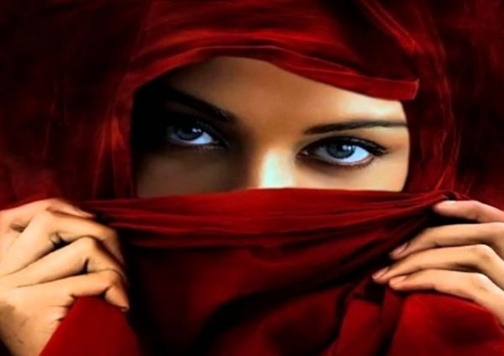
Rebuke & Judgment 6
Seductive Women
Isa 3:16 – “Moreover, the Lord said, ‘Because the daughters of Zion are proud and walk with heads held high and seductive eyes, and go along with mincing steps and tinkle the bangles on their feet.”
Too Good For You
Ensnare Men
“Prized Jewels”
Attract Glances
Notes:
While rebuke #5 focused on men and their corrupt leadership, rebuke #6 centers on the women, daughters of Zion, who in their pride adorned themselves in ways that put their beauty on display – Isa 3:16 – Now in the book of Judges, when men started failing in leadership, there were some women who stepped up, right? We think about Deborah, Jael, and the unnamed woman who threw the millstone on Abimelech's head. But things seem to be worse in Isaiah’s day as not only are there no women stepping up to fill the void, they’re contributing to its downfall, too.
“heads held high” – I take this to mean they acted as if they were too good for anyone.
“seductive eyes” – They are deliberately trying to seduce and ensnare men w/their beauty, though by the way they walked they also put out the signal that you didn’t have a chance.
“mincing steps” – this means they are walking in a deliberate way so as to attract attention (runway model), as if they are the prized jewels of Judah.
“tinkle the bells on their feet” – and for those who weren’t looking in their direction already, but who had ears, they put bells on their shoes to attract glances.
Now, in 1 Tim 2:10, Paul teaches that a women should adorn themselves w/proper clothing, modestly and discreetly, for making what claim? Godliness. Modesty clothing is a way that godly women shine their light so as to bring God glory, and not glory to themselves.

Slide 3
Rebuke & Judgment 6
Judgment
Isa 3:17-24 – “¹⁷Therefore the Lord will afflict the scalp of the daughters of Zion with scabs, and the Lord will make their foreheads bare.¹⁸In that day the Lord will take away the beauty of their anklets, headbands, crescent ornaments, ¹⁹dangling earrings, bracelets, veils, ²⁰headdresses, ankle chains, sashes, perfume boxes, amulets, ²¹finger rings, nose rings, ²²festal robes, outer tunics, cloaks, money purses, ²³hand mirrors, undergarments, turbans and veils. ²⁴Now it will come about that instead of sweet perfume there will be putrefaction; instead of a belt, a rope; instead of well-set hair, a plucked-out scalp; instead of fine clothes, a donning of sackcloth; and branding instead of beauty.”
Disease
Lose hair
Luxuries taken
Disgrace
Notes:
But because they were more interested in putting their glory and beauty on display rather than God’s glory and beauty, here is how God says He will judge them – Isa 3:17-3:24.
God will afflict them w/disease in the form of scabs. Interestingly, the word “scab” is the same word used in Lev 13:2 for “leprous tissue”. It was not uncommon for God to punish pride w/disease. Remember Uzziah?
But when scabs begin to form on their head, it would cause them to lose hair. I don’t have to tell you women how humiliating this is – 1 Cor 11:15 says that a woman’s long hair is her glory. And we know it is one of the most attractive features of a woman, hence why so much money is spent by you gals to maintain it and beautify it and color it and layer it and highlight it. I read an article that estimated women who are around the age of 25 will end up spending, in their lifetime, about $200k on clothing, $300k on their makeup, and $55,000 on their hair. And this was before Biden’s inflation.
Vs. 18 – 23 then lists 21 ornaments that were prized by women of that day for enhancing their beauty and attractiveness. And they had changes of clothes for seemingly every occasion, but they will be taken away. Taken away how? Probably by the ones who would kill their men and take them captive. It’s not that any of those things were wrong in and of themselves, but when horded in abundance and used to bring glory to self at the expense of godly character, it was wrong.
And then in vs. 24, he informs them that those trophy bodies they carried around would become a burden – smelly, bald, branded, and donning sackcloth for lack of clothes. This is a situation of disgrace for these women. But it fits the theme of every other rebuke and judgment we’ve seen thus far, that in order for people to learn to trust God, He has to take away those things in which we seem to find false security.

Slide 4
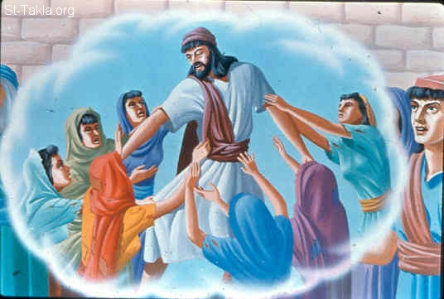
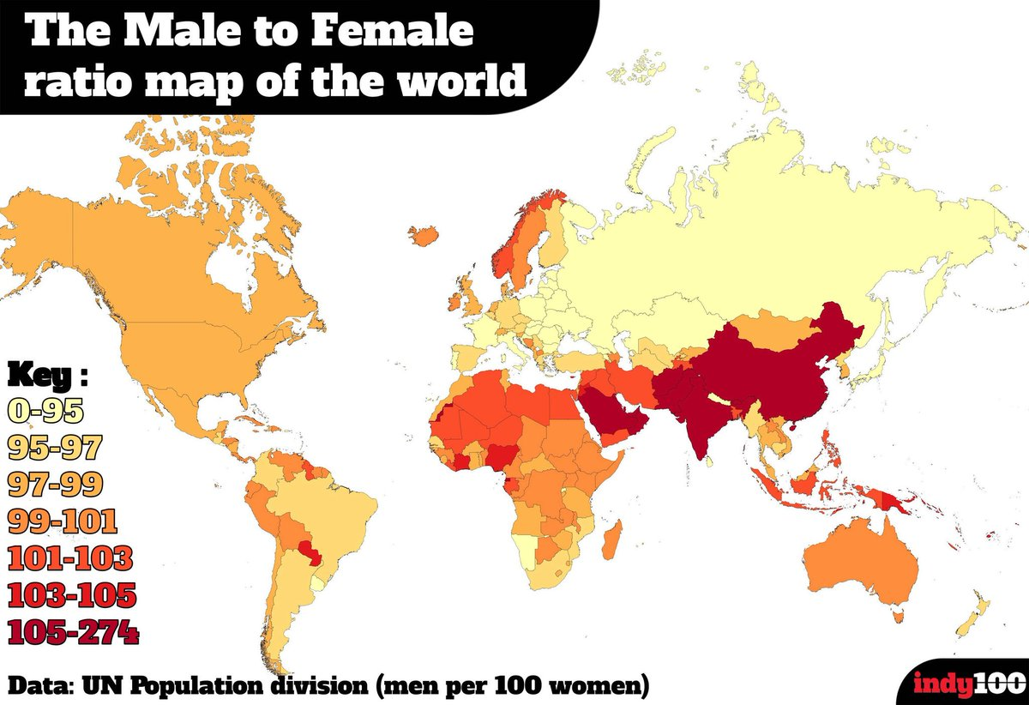
Rebuke & Judgment 6
Judgment
Isa 3:25-4:1 – “²⁵Your men will fall by the sword and your mighty ones in battle. ²⁶And her gates will lament and mourn, and deserted she will sit on the ground. ¹For seven women will take hold of one man in that day, saying, ‘We will eat our own bread and wear our own clothes, only let us be called by your name; take away our reproach!’”
Notes:
They did all this to attract glances from men, but now notice what will happen when invaders come – Isa 3:25-4:1.
Vs. 25 goes back to reiterating the fall of man, which implies that those whose attention they longed for won’t even be around anymore for them to seduce, because the gates where men would normally congregate are now desolate. What will the women do then? The same as the men in Isa 3:6 who were taking hold of another man w/a cloak to make him his ruler. Isa 4:1 says seven of them will take hold of one man just to avoid the shame of being unmarried and childless. It’s now the women who are saying, “Will you marry me?” and they’re willing to share this dude with six other women. And while men are supposed to provide for their wives, these women are perfectly willing to provide for themselves should he simply marry them and allow them to call themselves by his name. This is the Garden of Eden in reversed. They’re willing to trade their dependence on a husband simply for social identity. The call of 2:22 not to put trust in man has come to its full fruition. These women needed to stop finding their sense of self-worth through the ogling of men, but instead learn to trust in God.
Notice the same truth revealed through this map that shows the male to female ratios of the world. As you can see in places like China, there are far more men than women because the Chinese government for a long time were limiting the number of female babies and even disposing of them. But in countries like Russia, there are far more women than men, and the reason is because of how war torn they have been. This is part of the reason why male order brides from Russia has taken off as it has in the last couple decades. If you’re an average joe down on his luck in the US, and you don’t have any game, but you have the “benjamins”, you can find yourself a woman from Russia way out of your league willing to marry you. Just do your homework. And if you had looked at a map like this after WW2, countries like Germany and France would have been yellow because they lost 1 million men each, and Great Britain lost a ½ million. By the time God is done w/Judah, they will be just as war torn and lacking men.

Slide 5
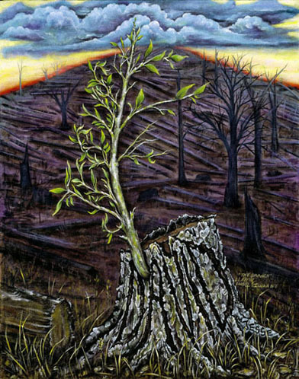
Promise 3
The Branch of the Lord
Isa 4:2-3 – “²In that day the Branch of the Lord will be beautiful and glorious, and the fruit of the earth will be the pride and the adornment of the survivors of Israel. ³It will come about that he who is left in Zion and remains in Jerusalem will be called holy—everyone who is recorded for life in Jerusalem.”
Jer 23:5 – “‘Behold, the days are coming’ declares the Lord, ‘When I will raise up for David a righteous Branch; and He will reign as king and act wisely and do justice and righteousness in the land.”
Jer 33:15 – “ In those days and at that time I will cause a righteous Branch of David to spring forth; and He shall execute justice and righteousness on the earth.”
Zech 3:8 – “Now listen, Joshua the high priest, you and your friends who are sitting in front of you—indeed they are men who are a symbol, for behold, I am going to bring in My servant the Branch.”
Zech 6:12 – “Then say to him, ‘Thus says the Lord of hosts, “Behold, a man whose name is Branch, for He will branch out from where He is; and He will build the temple of the Lord.”’”
Notes:
In one of the worst chapter divisions in the bible, we come to the 3rd of 3 wonderful promises in this section. And after what we just read, boy did they need this promise – Isa 4:2-3. In other words, what will make that “mountain of the house of the Lord” from Isaiah 2 so worth climbing? It will be the Lord’s “Branch”. And in an obvious contrast to the superficial beauty that the daughters of Zion sported, He truly will be beautiful and glorious. What does “Branch of the Lord” mean? Think of the nation of Judah as a forest of trees. As we read in Isa 2:12-13, the people’s pride will cause God to chop down those “oaks” and “cedars”. But judgment won’t be the last word because He is the “Holy One of Israel.” And so, from one of these remaining stumps will spring this beautiful branch, what Isa 6:13 refers to as the “holy seed” and Isa 53:2 refers to as a “tender shoot, a root out of parched ground.” And then as it grows, other sprigs and branches come from it that will display all the beauty of divine glory in stark contrast to that fleeting beauty the daughters of Zion sought to display.
This is an oft repeated OT concept of the Messiah by the prophets Jeremiah and Zechariah. But this is also a NT concept – John 15:5 – “I am the vine, you are the branches; he who abides in Me and I in him, he bears much fruit, for apart from Me you can do nothing.” The fruit of Christ is His remnant, what vs. 3 refers to as “he who is left in Zion”. And the remnant is not holy in and of themselves, but by virtue of being attached to the Branch, the Vine. And that’s how we are able to bear fruit for God. How is it that this Branch will accomplish for us a seemingly impossible holy standard? This is yet to be explained, but John 12:24 – “…unless a grain of wheat falls into the earth and dies, it remains alone; but if it dies, it bears much fruit.” Theme alert.

Slide 6
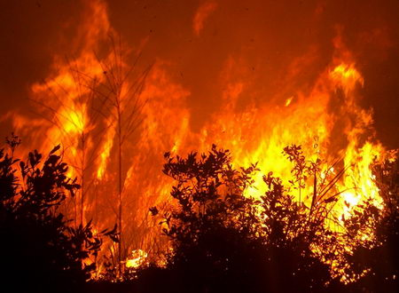
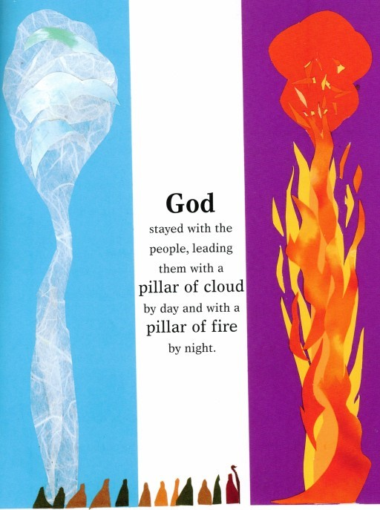
Promise 3
The Branch of the Lord
Isa 4:4-6 – “⁴When the Lord has washed away the filth of the daughters of Zion and purged the bloodshed of Jerusalem from her midst, by the spirit of judgment and the spirit of burning, ⁵then the Lord will create over the whole area of Mount Zion and over her assemblies a cloud by day, even smoke, and the brightness of a flaming fire by night; for over all the glory will be a canopy. ⁶There will be a shelter to give shade from the heat by day, and refuge and protection from the storm and the rain.”
Notes:
Continuing the thought in Isa 4:4 – In other words, before this Branch can come and do His thing, there first has to be a purging of the filth that has killed Judah, and this will come as a result of judgment and fire. The Branch cannot precede this, so as much as we cringe at the thought of judgment, understand that this was a necessary event in order to bring about the Holy Seed from those withered stumps.
Isa 4:5-6 – That word “then” is important. Only after the purging will God create this canopy made of cloud, fire, and smoke over the entirety of Zion. What book does this remind us of? Exodus, the first of many references in Isaiah. The only difference is that while the cloud by day and fire by night rested over the tabernacle and later the temple, now it will rest over the “whole area of Zion”. Why? Because by virtue of the Branch, in the new Zion, all of it will be a holy priesthood. But while God’s fire and cloud presence served as a guide to Israel, vs. 6 says it would also be for their protection. He will provide His people with shelter, refuge, and protection. And notice it’s from “the storm”. God’s presence w/us does not mean we won’t have to endure storms; we’ll have to endure a change in the weather, so to speak. As Christians, we will face trouble. But perhaps the joy of our calling will eclipse these troubles – Matt 18:20 – “And lo I am with you always, even to the end of the age.” And just as God was w/them in Exodus through their suffering then, He’d be w/them through this exodus of suffering.

Slide 7
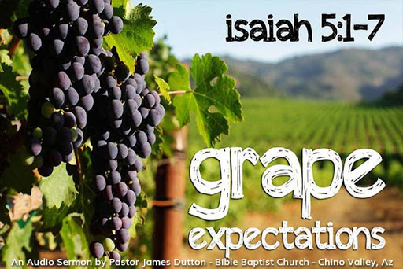
Rebuke & Judgment 7
Didn’t Bear Fruit
Isa 5:1-2 – “¹Let me sing now for my well-beloved a song of my beloved concerning His vineyard. My well-beloved had a vineyard on a fertile hill. ²He dug it all around, removed its stones, and planted it with the choicest vine. and He built a tower in the middle of it and also hewed out a wine vat in it; then He expected it to produce good grapes, but it produced only worthless ones.”
Planted on a hill
Fertile Soil
Removed stones
Choicest Vine
Tower
Wine Vat
Notes:
Isa 5:1a – So, the 7th rebuke is going to concern the lack of fruit Israel bore for God as His chosen nation, but this rebuke will be expressed in poetic song. Music is an age-old, time-tested and effective method of communicating a message. We use it in advertisements because we recognize its power to persuade. Some catchy tunes are hard to purge from our mind. This song of the vineyard is one that they needed to remember. Reminiscent of Nathan’s allegory to David to get him to see his sin more objectively, this allegory sets up Judah in the same way. And so, this is a change of strategy from the previous 6 rebukes. Who is Isaiah’s beloved? It is God, and this is His vineyard.
And God had “grape expectations” for His vineyard – Isa 5:1b-2 – Notice how God’s expectation for Judah was due to His meticulous preparation.
This vineyard wasn’t just planted anywhere in some haphazard manner. If I choose to plant a vineyard in a bad location and it produces bad grapes, no one is to blame but me. But God chose the best location, an exposed hillside where it would get plenty of sun and excellent drainage.
He chose fertile soil of the highest quality, the most well-balanced soil w/the perfect acidity.
He removed every single stone so that the vine would have no trouble taking root.
He planted the purest, choicest vine that could be planted.
He placed a tower in its midst for protection from potential enemies.
And in anticipation of a great harvest, he went ahead and placed a wine vat there.
And in vs. 5 he’s going to mention a wall and a hedge. God had every right to believe this vineyard would produce the richest, most quality grapes imaginable. But it didn’t. The result was a terrible harvest.

Slide 8
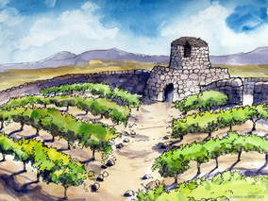
Rebuke & Judgment 7
Didn’t Bear Fruit
Isa 5:3-4 – “³And now, O inhabitants of Jerusalem and men of Judah, judge between Me and My vineyard. ⁴What more was there to do for My vineyard that I have not done in it? Why, when I expected it to produce good grapes did it produce worthless ones?”
Notes:
So, before He announces His judgment, he asks Judah, who are an agrarian people, living and working in agriculture every day, to themselves render a fair judgment – Isa 5:3-4 – No one could empathize w/a farmer’s hard work and expectation like they could. Did the owner do everything He could and if not, what more could be done? And if He did everything He could, why did He get worthless grapes? The implication is that they were blaming God for the condition they find themselves in. But what more could He have done? He gave them new moons, Sabbaths, solemn assemblies, scripture, living oracles, priests, Levites, prophets, etc. What more could He have done that He didn’t do? It’s rhetorical, is it not?

Slide 9
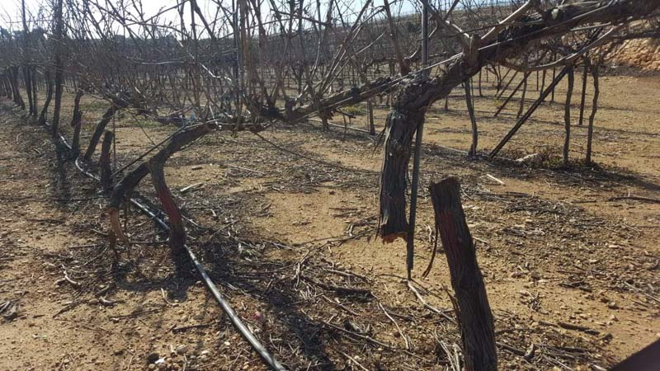
Rebuke & Judgment 7
Judgment
Isa 5:5-6 – “⁵So now let Me tell you what I am going to do to My vineyard: I will remove its hedge and it will be consumed; I will break down its wall and it will become trampled ground. ⁶I will lay it waste; it will not be pruned or hoed, but briars and thorns will come up. I will also charge the clouds to rain no rain on it.”
Hedge removed
Wall broken down
Trampled
Not pruned/hoed
Briars and thorns
No rain
Notes:
So now God, the owner, will render a judgment – Isa 5:5-6. Since they’ve been good for nothing, God will no longer let them trouble Him.
Hedge removed – protection from wild beasts will be removed and even burned w/fire.
Wall broken down – this would be to protect from invaders; no more. By removing their defenses, He’ll make them easy prey for their enemies. As we just read in chapter 4, through the Branch, we’ll have all the protection that we need. But before He comes, God must remove protection from Judah to bring about this purging.
Trampled – w/no protection, invaders will consume what is left of it, laying it waste so as to almost be unusable.
Not pruned/hoed – by laying it waste, there is no work to be done unless one start completely over.
Briars and thorns – Therefore all kinds of immorality would be allowed to grow in the form of briars and thorns, metaphorical of the consequence of sin, given Gen 3:18.
No rain – Rain brings forth new life and growth, but none will come. While everything else could be considered circumstantial w/o divine revelation, this one is most definitively an act of God.

Slide 10
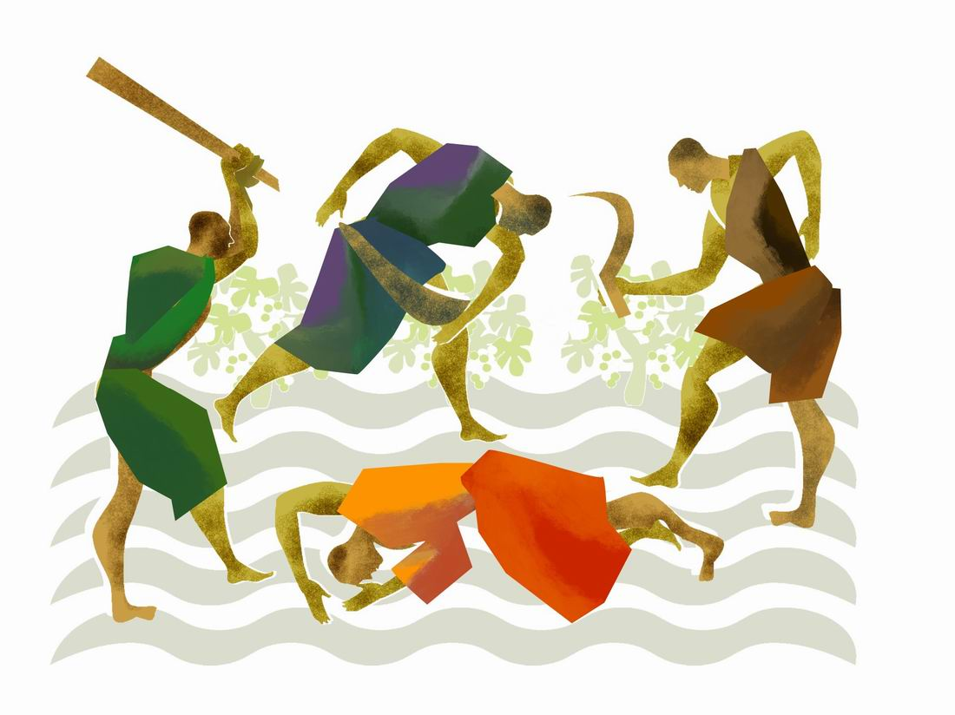
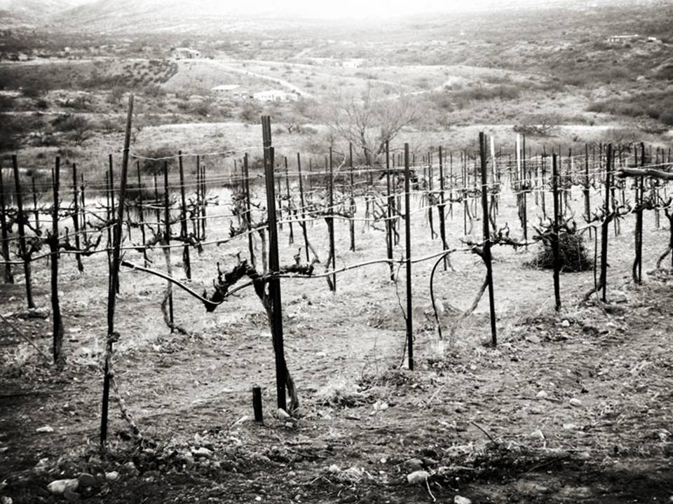
Rebuke & Judgment 7
Judgment
Isa 5:7 – “⁷For the vineyard of the Lord of hosts is the house of Israel and the men of Judah His delightful plant. Thus He looked for justice, but behold, bloodshed; for righteousness, but behold, a cry of distress.”
Notes:
Now Isaiah completely abandons the song and gets straight to the point – Isa 5:7 – So Judah is the vineyard, and the grapes are justice and righteousness. The wild grapes represent bloodshed and cries of distress from those who are being oppressed. If you use an ESV, you may have a footnote at the end of vs. 7. Isaiah is very fond of using a play on words, what is called “paronomasia”, but unless you read Hebrew, you’ll never catch it. The word “justice” is pronounced “mishpat” and the word bloodshed is pronounced “mishpach”. The word “righteousness” is pronounced “tsedakah” and “cry of distress” is pronounced “tseakah”. Other word plays are found in Isa 13:6; 24:17; 28:1; 32:7; 57:6; 61:3; 65:11-12. It adds great beauty to the poetry. The purpose of the word play here is just how different the expectation was to the outcome. The point of this song is that the people enjoyed a special place in God’s purpose, but utterly denied Him and failed in their mission to live according to their calling. These were reasonable expectations – Deut 4:8 – “Or what great nation is there that has statutes and judgments as righteous as this whole law which I am setting before you today?” He gave them reasonable and grape expectations, but now they would lose His favor.
These passages are also important because they serve as the backdrop for several of Jesus’ stories about vineyards in the gospel. In Luke 9, in the week leading up to His death, He said in Luke 20:9 – “A man planted a vineyard…”. Immediately when they hear that, they’re going to be thinking about Isa 5. And they’re going to understand the implications He made.

