Slide 1
Notes:
This study is going to conclude that first 9-chapter section of Isa 40 – 66 in which God has promised to solve one of Israel’s future problem: physical captivity. But chapter 48 is going to raise an even greater issue for the purpose of raising awareness of the severity of Israel’s true problem – sin. And this chapter speaks rather disdainfully about their sin while at the same returning to the larger theme of the book – “Will you trust God?” See, chapters 1 – 39 challenged Israel to trust in God during the Assyrian crisis and He demonstrated the value of that trust in chapter 37 when He defeated Assyria. But that trust could not be sustained, not through a godly man like Hezekiah or any other, and the crisis of Babylonian captivity reveals that same issue of trust is present. And in chapters 40 – 47, where He assures them of their redemption from captivity, so will they even trust Him then?
Keep in mind some of the problems God has laid out so far. Israel was insensitive to the moral issues that led to their captivity (42:18-25), blind and deaf (43:8), weary of the Lord in their offerings (43:22-24), national pride was causing them to question God’s wisdom in sending Cyrus (45:9-13), and His last word to Israel that we saw was in 46:12 was in His diagnosis that they were being stubborn-minded. The interesting thing about chapter 48 is that in tone, it stands out from chapters 40 – 47, but this is not because Israel’s spiritual issues had not already been addressed; it stands out because it is climactic. And given just how far from righteousness Israel has strayed, they really can no longer be called Israel w/any credibility whatsoever. And that’s how chapter 48 is going to begin.

Slide 2
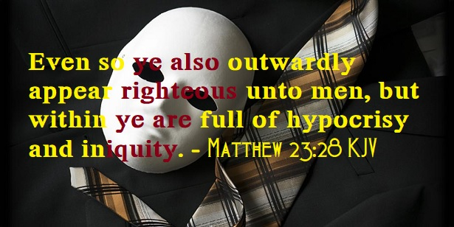
Obstinance of the Jews
Former Things
Isa 48:1-2 – “¹Hear this, O house of Jacob, who are named Israel and who came forth from the loins of Judah, who swear by the name of the Lord and invoke the God of Israel, but not in truth nor in righteousness. ²For they call themselves after the holy city and lean on the God of Israel; the Lord of hosts is His name.”
Notes:
As Isaiah refocuses his attention on God’s people, they are given 3 labels in just one half of a verse, almost as if God wants to remind them of their history.
Isa 48:1a – So, they’re first called Jacob, which means “deceiver” or “grabs by the heel” – this is where they come from. Then they’re called Israel, which means “strives with God”, reminding us of that incident in Gen 32 where Jacob wrestles w/the angel of God and refuses to let Him go unless He blessed Him. God renamed Jacob “Israel” in that moment as if to say that’s what He had been looking for in him all along. And then we get the reminder that they came from the loins of Judah, and if you remember the story from Gen 38, it’s not exactly flattering. Judah ended up not keeping his word to his widowed daughter-in-law Tamar who then tricked Judah into impregnating her. She’d give birth to twins who, in a similar birth story to Jacob and Esau, and the Messianic line would come from the somewhat firstborn son Perez. What a rocky history for these people, and yet they’re the very ones who swear by the Lord and invoke His name, and why shouldn’t they? Of all nations on the earth, they alone should have been preconditioned to hear/obey God’s word.
And yet – Isa 48:1b-2 – So, Israel professes a claim to God, but it’s not genuine, it’s not according to the divine standard of righteousness. There is an outward display of religion, but no inward display. There is a contradiction between their words and actions just as much as there was a contradiction to Jacob and Israel. And so, despite their impending release from physical captivity, freedom from the captivity of sin continues to elude them. But though they are totally lost, they serve a Lord who rescues people from total loss and has made promises He must keep.

Slide 3
Obstinance of the Jews
Former Things
Isa 48:3-5 – “³I declared the former things long ago and they went forth from My mouth, and I proclaimed them. Suddenly I acted, and they came to pass. ⁴Because I know that you are obstinate, and your neck is an iron sinew and your forehead bronze, ⁵therefore I declared them to you long ago, before they took place I proclaimed them to you, so that you would not say, ‘My idol has done them, and my graven image and my molten image have commanded them.’”
Notes:
But because of their history of rebelliousness, God is once again going to explain to them why He has chosen to reveal His plan to them so far in advance.
Isa 48:3-4 – Now, this is familiar language to us by this point in Isaiah. We’ve repeatedly seen the idea that the purpose of God making a bold prediction followed by sudden fulfillment is to demonstrate His sole deity, which would in turn bring Israel into full conviction, and its suddenness would prove He isn’t subject to man’s calendar. And Isaiah gives reason for this. It’s not just to showcase God, but to expose Israel as a historically difficult people. A “neck of iron” would render one incapable of bowing in submission, like an animal digging his heals refusing to submit. A “bronze forehead” is an opiniated person w/a set mind, an animal who likes to butt heads, hard-headed. This is reminiscent of what Stephen told the Jews in Acts 7:51 – “You men who are stiff-necked and uncircumcised in heart and ears are always resisting the Holy Spirit; you are doing just as your fathers did.”
And the suddenness at which He’d do these things was to prevent any clues that might incline one to attribute it to an idol – Isa 48:5 – Bel and Nebo didn’t cause Jerusalem’s fall, nor would they prevent Babylon’s fall or the reoccupying of Jerusalem. God said He’s do it 150 years prior. And so, rather than being ruled by the works of our hands, we are to admit His existence, and thereby admit His right to rule our lives.

Slide 4
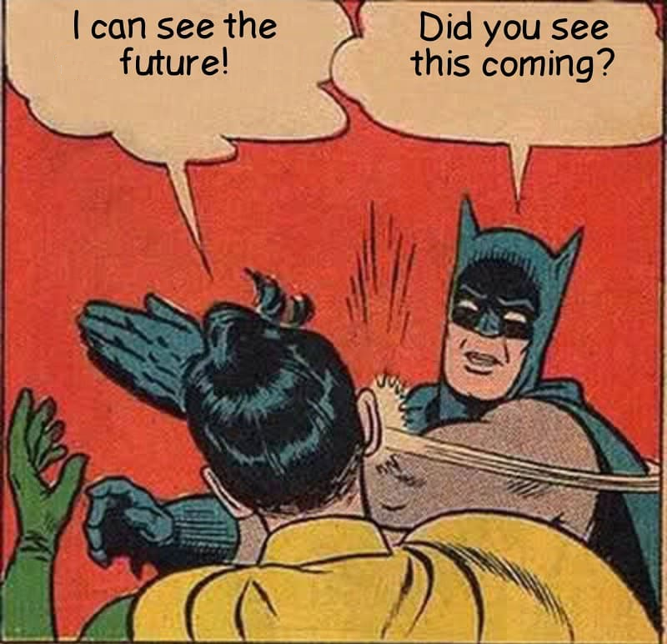
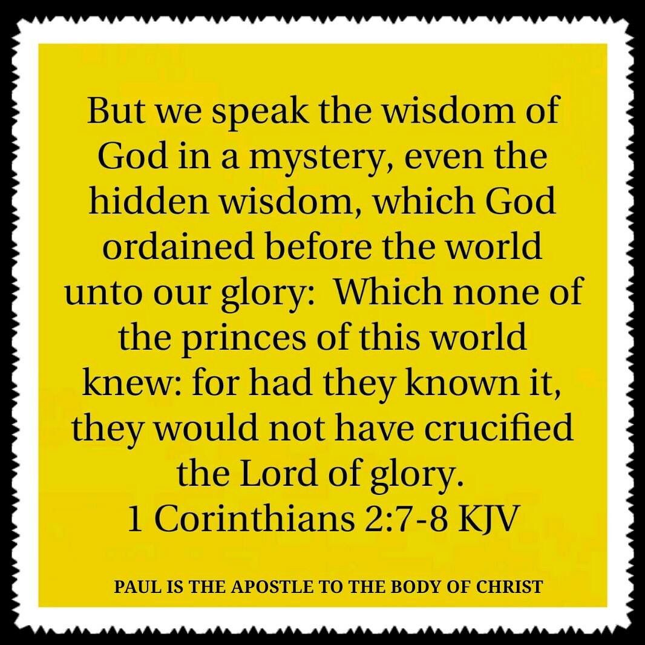
Obstinance of the Jews
New Things
Isa 48:6-8 – “⁶You have heard; look at all this. And you, will you not declare it? I proclaim to you new things from this time, even hidden things which you have not known. ⁷They are created now and not long ago; and before today you have not heard them, so that you will not say, ‘Behold, I knew them.’ ⁸You have not heard, you have not known. Even from long ago your ear has not been open, because I knew that you would deal very treacherously; and you have been called a rebel from birth.”
Notes:
But while history provides evidence, the point in reminding them of these things is to put their trust in future revelation. God wants His people to receive new revelation in confident faith because of the evidence of the past, especially because He’s about to do something new and different from what He had previously done in the life of His people.
Isa 48:6 – They “heard” the prediction, they have “looked” at the fulfillment, and now He appeals for witnesses to declare it. The tone seems to be amazement that they had seen such great power and glory demonstrated, but they were still too stubborn to see its implications. And so, now He’s going to take it a step further by creatively declaring new things, likely the coming Servant and coming glory of Zion, things which they could never have imagined or predicted.
How new are they? – Isa 48:7 – These things would be so new, they never existed until they happened. The idea is that while the former things of antiquity from vs. 1 - 5 were to refute the claims of idols, these new claims are to refute human omniscience.
It’s to prevent prideful man from saying, “Oh, I knew that”, because even claiming to “know” the future can cause us to exchange trust in God for our so-called human wisdom. But no matter how smart we are, any attempt to live independent of God will be frustrated by our true lack of knowledge and insight. End time prophets are subject to this failure.
Isa 48:8 – By “rebel from birth”, Isaiah is not alluding to some kind of inherited sin; he’s alluding back to 46:3 in which he means Israel’s culmination as a nation. And what do we remember about Israel from the Exodus days? No openness to hear the word and no open-mindedness to reflect on its implications. And because of their treacherous nature, God was unwilling to make His full plan known to them. The only way to ensure they wouldn’t abuse such information and attribute it to their own so-called wisdom was to reveal yet conceal.

Slide 5
Obstinance of the Jews
New Things
Isa 48:9-11 – “⁹For the sake of My name I delay My wrath, and for My praise I restrain it for you, in order not to cut you off. ¹⁰Behold, I have refined you, but not as silver; I have tested you in the furnace of affliction.¹¹For My own sake, for My own sake, I will act; for how can My name be profaned? And My glory I will not give to another.”
Notes:
But there’s another reason behind God choosing to do it this way:
Isa 48:9 – So, what compels God not to give these “rebels from birth” exactly what they deserve? His name, His very nature – that fact alone compels Him to defer the full expression of His anger. God has a reputation to uphold, something Moses always pointed out when He interceded for Israel in their youth. Promises were made in the covenant God made w/Israel, and so being that His name is associated w/them, God must act according to His name and not the sinful name they’ve made for themselves. Eph 1:6 says that our adoption as sons through Jesus Christ is “to the praise of the glory of His grace”.
But how does He get Israel to that point? By using their rebellion to better them – Isa 48:10 – Why destruction and captivity? Not because God intends for judgment to be the last word, but rather as an aid to bring them back to their senses. God’s judgment against Israel was a refining, but not a refining as of silver or else there’d be nothing left of them – 1:22 told us they were nothing but dross. The furnace of affliction He chose was the Babylonian exile, and it was for their transformation, not their destruction. Just like Isa 6, which was a microcosm of what God is doing for Israel, the intended result is not judgment, but purification. Whether or not it happens, though, depends on having the kind of repentant attitude that Isaiah did.
Isa 48:11 – So sure is the reason, its repeated. Think about the fact that this new thing God has come up w/must win over both sin and Babylon. Israel’s sinfulness can’t be allowed to override His purposes, lest He end up destroying them and other nations point to God as weak. But He also can’t allow Babylon or its gods be seen as superior. It’s the ultimate heavenly chess match between God and evil, and God is going to win, and only He could be smart enough win, to predict all the moves ahead of time and checkmate the devil.

Slide 6
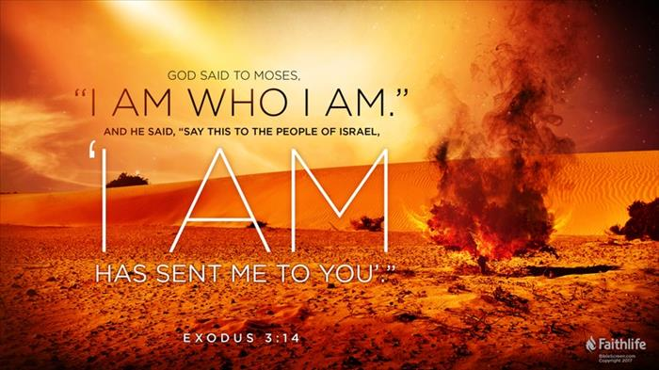
Obstinance of the Jews
Creator’s Purpose
Isa 48:12-14 – “¹²Listen to Me, O Jacob, even Israel whom I called; I am He, I am the first, I am also the last. ¹³Surely My hand founded the earth, and My right hand spread out the heavens; when I call to them, they stand together. ¹⁴Assemble, all of you, and listen! Who among them has declared these things? The Lord loves him; he will carry out His good pleasure on Babylon, and His arm will be against the Chaldeans.”
Notes:
Now, the last 11 verses of this chapter is in many ways a summation of everything we’ve seen in chapter 40 - 47. Since God is sole Creator of the universe and can correctly predict His purpose in advance, they should trust His promise of delivering them from captivity, even if would be by the pagan Gentile Cyrus. In vs. 1 of this chapter, their right to name themselves Israel is questioned. But notice what they are identified as here:
Isa 48:12 – Here they are the Lord’s called ones. The implication once again is that their unfaithfulness does not nullify God’s faithfulness. They will not be ultimately doomed to the consequences of their failures.
How sure is His call? – Isa 48:13-14 – So, how sure is His call? Because what is true of Creation is true of Israel. When God called the heavens and earth together, that call didn’t fail. And Creation continues to stand in attention and readiness to do God’s will. So will the true Israel. Now, what gives God the right to do this and anything else I don’t like? Because He is God of Creation and I am part of His Creation. None of the idols of the stars had predicted the future like God has. But just as the Lord’s hand was involved in Creation, He also “chose” to love Cyrus by enabling him to perform the task of judgment He has for him.

Slide 7
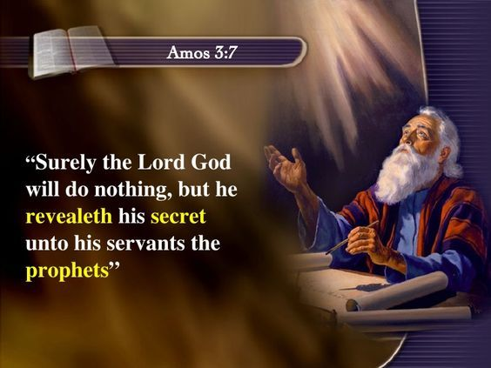
Obstinance of the Jews
Creator’s Purpose
Isa 48:15-16 – “¹⁵I, even I, have spoken; indeed I have called him, I have brought him, and He will make his ways successful. ¹⁶Come near to Me, listen to this: from the first I have not spoken in secret, from the time it took place, I was there. And now the Lord God has sent Me, and His Spirit.”
Notes:
Isa 48:15-16a – The change in pronouns here is really cool. There is an unmistakable emphasis on “I” in the Hebrew, indicating that Cyrus’ actions would be wholly the result of God’s hand in human history. And then we see the pronoun “He”, which indicates that despite this, there is still divine-human cooperation. And so, divine truth was spoken by God through His messengers from the very beginning (the past), as these truths take place, God is there (the present). But what about the future? Remember from earlier in Isaiah that God has said He is going to do new things. So, what new things could be in store?
The tense changes dramatically – Isa 48:16b – Who is the “Me” of this text? Many opinions abound. The “Me” could be Isaiah, and verses like Amos 3:7 could give evidence to that. Or, it could be the mysterious Servant Himself of Isaiah 42, which is the position I take. It’s as if while this heavenly dialog is occurring in which God is assuring us of His part in all this, and Isaiah is expressing His part in all this, that this mysterious Servant then steps out from behind the shadows and introduces Himself in the first person, “And now the Lord God has sent Me, and His Holy Spirit.” A couple reasons why I believe this is referring to Jesus. First, vs. 15 is the last mention of Cyrus in Isaiah – this last mentioning be a way to pave the way for the Servant to now come and do His of rescuing them from spiritual captivity. Secondly, the H.S. is often associated w/the Servant in this book – we saw this in chapter 11 and the first Servant Song of chapter 42. So, what I would suggest that we are seeing here is that while God the Father has been relaying all this to Isaiah, Jesus and the Spirit have always been present in the shadows waiting for their time, and now that time has come, and so He speaks. This could very well be a glimpse into NT times in which, as Heb 1 tells us, “in these last days God has spoken to us by His Son.

Slide 8
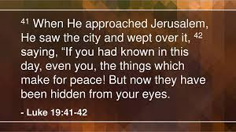
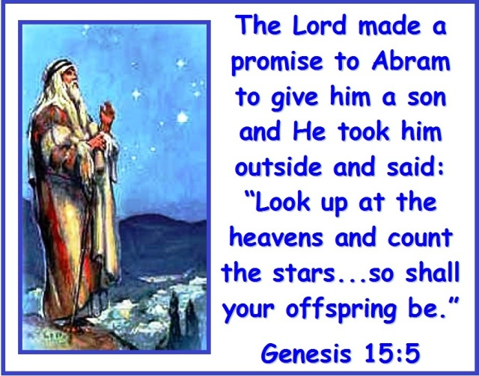
Obstinance of the Jews
Admonition To Listen Now
Isa 48:17-19 – “¹⁷Thus says the Lord, your Redeemer, the Holy One of Israel, ‘I am the Lord your God, who teaches you to profit, Who leads you in the way you should go. ¹⁸If only you had paid attention to My commandments! Then your well-being would have been like a river, and your righteousness like the waves of the sea. ¹⁹Your descendants would have been like the sand, and your offspring like its grains; their name would never be cut off or destroyed from My presence.”
Notes:
But wouldn’t it have been nice if the Servant didn’t have to come and do what He needed to do? It’s not that we wouldn’t love to be around Jesus, it’s just that He didn’t come to Earth to hang out w/us; He came here to suffer and die for our sins. And that is to our shame. And so, the point of the next 3 verses is this: “Oh what might have been” – Isa 48:17-19.
As Redeemer, He sees their need and liberates. As Holy One of Israel, He finds a way to help them while also not overlooking their sin. However, God doesn’t manipulate His people, He teaches them. That phrase “I am the Lord your God” is the exact phrase stated in Ex 20 before God starts dispensing the 10 commandments.
If they had only obeyed, it would have brought them “peace like a river”, something we’ll see alluded to again in chapter 66. The symbolism in this verse is rich – not a small stream that barely fills its bed or noisy brook, but a river in all it’s continuity, abundance, and permanence. A river is able to bare a great amount of weight on its surface and carry all the garbage away. A river provides nourishment to all the surrounding vegetation. That is what their peace could have been like where despite the sin around them they could have honestly sung “it is well with my soul.” “Waves” have power that is seemingly invisible and unending, and righteousness leads to us experiencing God’s power – there is no stopping them. See, both the rivers and the waves have a normal sense of right behavior. But not Israel. And the purpose of this is to prepare them for listening again once the “new things” come.
“Sand” and “grain” would be symbols of vigor, prosperity, and divine blessing and contrasts their current state of only being a “remnant”. If only they will listen, even if they were to be cut off as a nation, they’d never have to fear being cut off individually. It is sobering to think of the unfulfilled potential that we have, and how disobedience keeps us from it.

Slide 9
Obstinance of the Jews
Admonition To Listen Now
Isa 48:20-22 – “²⁰Go forth from Babylon! Flee from the Chaldeans! Declare with the sound of joyful shouting, proclaim this, send it out to the end of the earth; say, ‘The Lord has redeemed His servant Jacob.’ ²¹They did not thirst when He led them through the deserts. He made the water flow out of the rock for them; He split the rock and the water gushed forth. ²²There is no peace for the wicked,’ says the Lord.”
Notes:
And so, we now reach the grand conclusion of chapters 40 – 48.
Isa 48:20 – Rather than getting caught up in Babylon’s impending destruction and change of power, they are called to participate by anticipation, both in personal deliverance and what that deliverance will accomplish for God’s character to a world that would be watching. God has predicted this, so it is no coincidence, and the world needs to take notice that God buys back those in His family, despite their sin. Just as vs. 15 was the last mention of Cyrus, this is the last mention of Babylon. As we begin chapter 49 on Sunday, everything is going to change; bigger thing are now going to take place.
Isa 48:21 – More Exodus imagery, to show them that if there was any doubt about the future, they only need remember the past. Don’t let the grumbling and complaining that they did in the wilderness wandering becoming grumbling and rejecting of God’s plan now. Because the water that would now flow would not be from a rock, but from a human heart set free from sin, a new Exodus in Christ.
However, the last verse of this section ends on a downer – Isa 48:22 – Despite all the promises God has made, despite their freedom from captivity, despite His announcement of new things, this should offer no comfort to those resolved to remain in their wickedness w/no intention of committing themselves to God. And so, we have this epitaph. And I would suggest that the placement of this verse also means that despite a change of scenery, it didn’t bring about a change of heart. Meaning, they would leave Babylon, but they couldn’t leave their own sin. Returning to Canaan, they still did not return to God. Consequently, they have no peace. Something more is needed.

