Slide 1
Notes:
Isaiah is prophesying 100 years in advance that Babylon will be able to go into Jerusalem, burn down God’s temple, destroy its walls, and take God’s people captive to Babylon. And when this happens, will God not be discredited? Why shouldn’t all who witness this not worship Babylon and adopt its gods? That’s where the next 2 sections come in. Jerusalem may have fallen to Babylon, but this was God’s plan, and neither Babylon nor it’s idols would be able stop Cyrus from conquering them. So instead of people looking to Babylon and its idols for strength, they need to look to the one who is bringing all of this about.

Slide 2
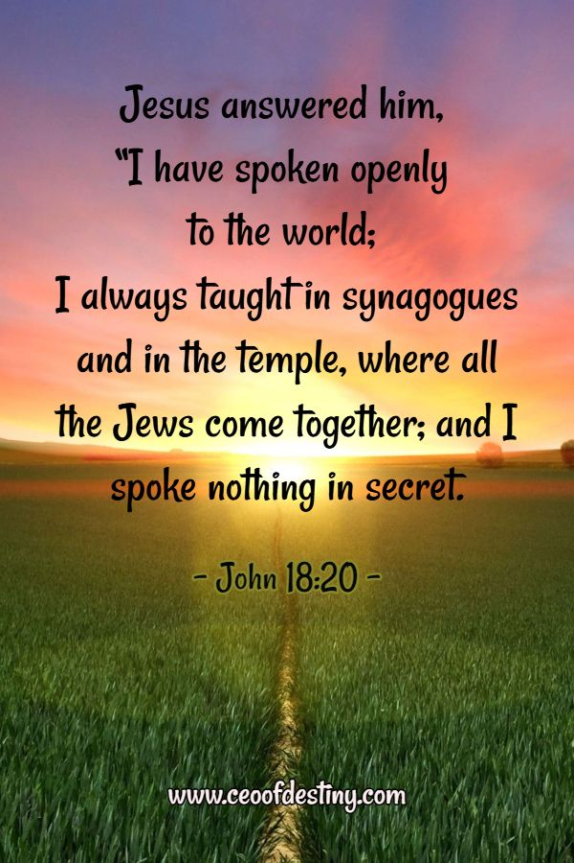
Idols Can’t Redeem
God Saves, Not Idols
Isa 45:18-19 – “¹⁸ For thus says the Lord, who created the heavens (He is the God who formed the earth and made it, He established it and did not create it a waste place, but formed it to be inhabited), ‘I am the Lord, and there is none else. ¹⁹I have not spoken in secret, in some dark land; I did not say to the offspring of Jacob, ‘Seek Me in a waste place’; I, the Lord, speak righteousness, declaring things that are upright.”
Notes:
In contrast to the idols, the end of chapter 45 shows how God works in 4 distinct ways: Creation, Revelation, Salvation, and Affirmation:
1) CREATION – Isa 45:18 – He created, formed, made, and established…and not w/o meaning, but specifically for human habitation. And so, He can deliver Israel from anything, including idols, and He will not fail them. I know this is repetitious in Isaiah, but the purpose of the repetition is to pound it into our awareness.
2) God also works through REVELATION – Isa 45:19 – So He goes from creating to initiating the conversation, and it is plain conversation. The idols’ message came through magic and superstition. God’s word was made plain, open, and accessible to all who wanted it.

Slide 3
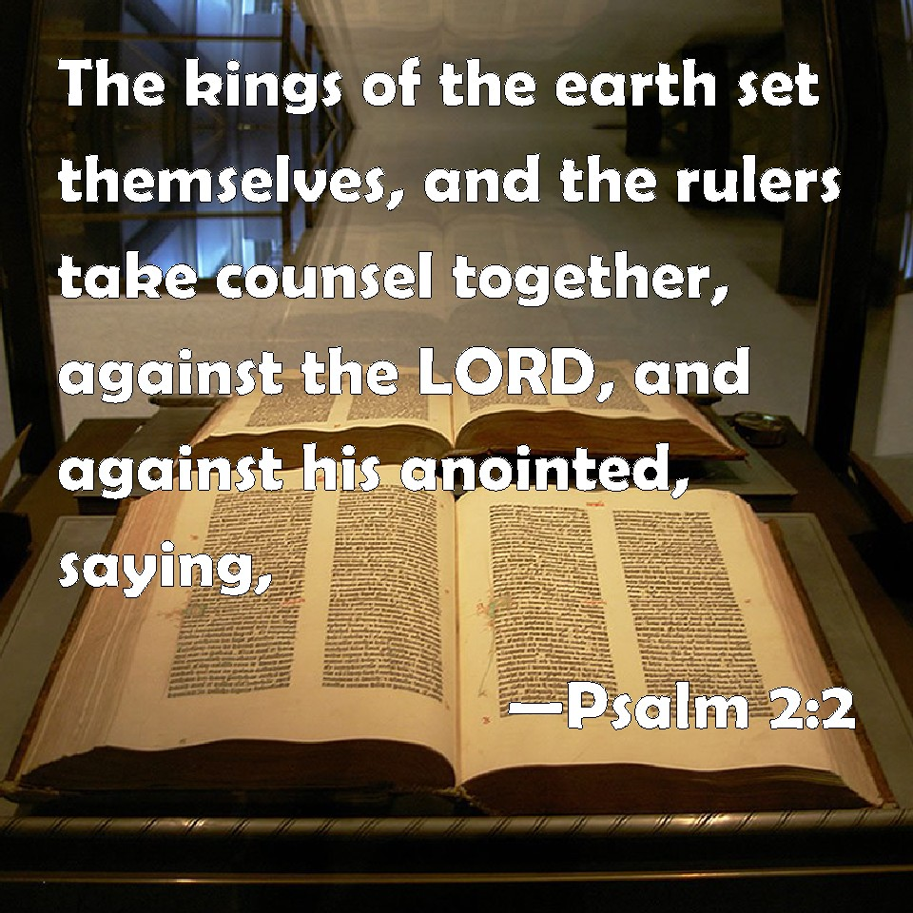
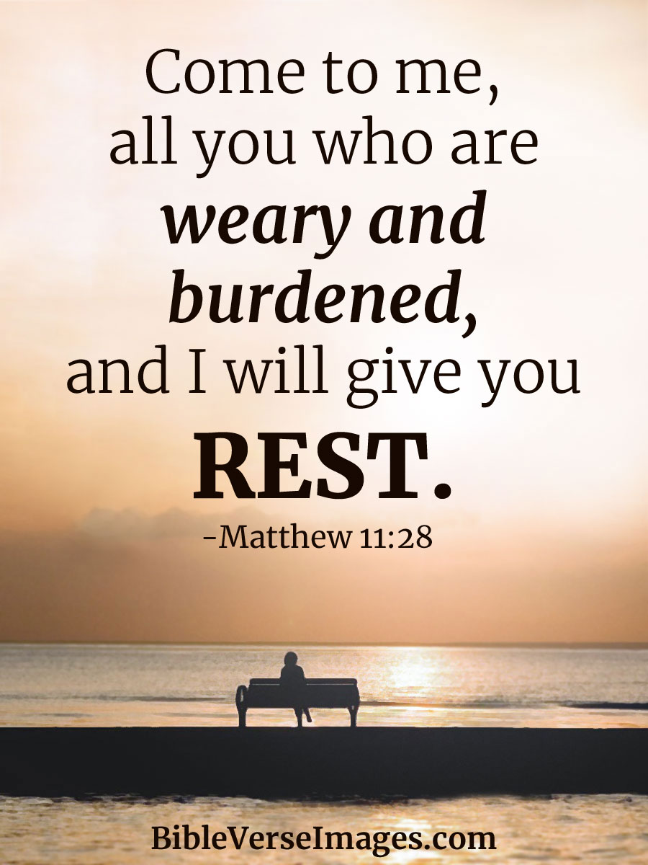
Idols Can’t Redeem
God Saves, Not Idols
Isa 45:20-22 – “²⁰Gather yourselves and come; draw near together, you fugitives of the nations; they have no knowledge, who carry about their wooden idol and pray to a god who cannot save. ²¹Declare and set forth your case; indeed, let them consult together. Who has announced this from of old? Who has long since declared it? Is it not I, the Lord? And there is no other God besides Me, a righteous God and a Savior; there is none except Me. ²²Turn to Me and be saved, all the ends of the earth; for I am God, and there is no other.”
Notes:
God also works through SALVATION – Isa 45:20 – This is reminiscent of chapter 41 in which the Gentiles’ response to Cyrus’ invasion was to make more idols. But this time the Gentiles are labeled fugitives, as if they’re escaping some invasion. They carry their idol because they can’t carry themselves, yet they pray to it because of their helplessness.
So, once again they are challenged to bring forth evidence of predictive ability – Isa 45:21 – Isaiah has already prophesied the gathering of Gentiles to salvation, but God had said it long before Isaiah in Gen 12. But the fact that God describes these things in advance puts God above and beyond any manmade idol. And as time goes on and these prophecies begin to be fulfilled, the heathen would finally recognize Him. This is one of the reasons we see so many God-fearing proselytes in the NT.
And so, the invitation to the Gentile is to turn to Him – Isa 45:22 – Israel’s salvation would not only be seen by the world, the whole would be invited to be saved. Their idol gods have failed them; Israel’s God will not fail them.

Slide 4
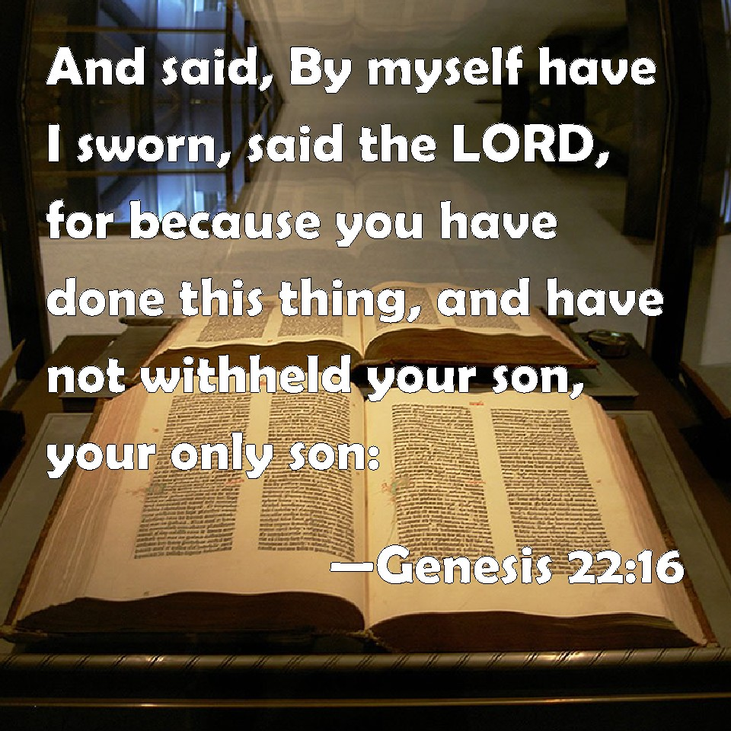
Idols Can’t Redeem
God Saves, Not Idols
Isa 45:23-25 – “²³I have sworn by Myself, the word has gone forth from My mouth in righteousness and will not turn back, that to Me every knee will bow, every tongue will swear allegiance. ²⁴They will say of Me, ‘Only in the Lord are righteousness and strength.’ Men will come to Him, and all who were angry at Him will be put to shame. ²⁵In the Lord all the offspring of Israel will be justified and will glory.”
Notes:
And then lastly, we see God’s work through AFFIRMATON – Isa 45:23-25 – These are familiar verses, quoted in Phil 2 about Jesus.
The phrase in vs. 23 “I have sworn by myself” is word for word w/Gen 22:16 after Abraham offered Isaac – it’s to stress His word will not fail. And what is promised? That every knee will bow. All the earth, on Judgment Day, whether judged or saved by God, will recognize Him as the one true God.
And vs. 24 tells us what the confessing tongue will acknowledge. The world will finally be convinced because of God’s power and His absolute faithfulness and reliance in word and action. And unless there is godly sorrow and shame over sin in which we own up to our foolish ways, there can be no repentance.
In contrast, vs. 25 tells us true Israel’s birthright will be confirmed. Not so they can be arrogant – they’ll bow down w/the rest of the world – but their boast will be in the Lord. And all of this that comes about will require Cyrus, so Israel shouldn’t be questioning God’s judgment, but being thankful.

Slide 5
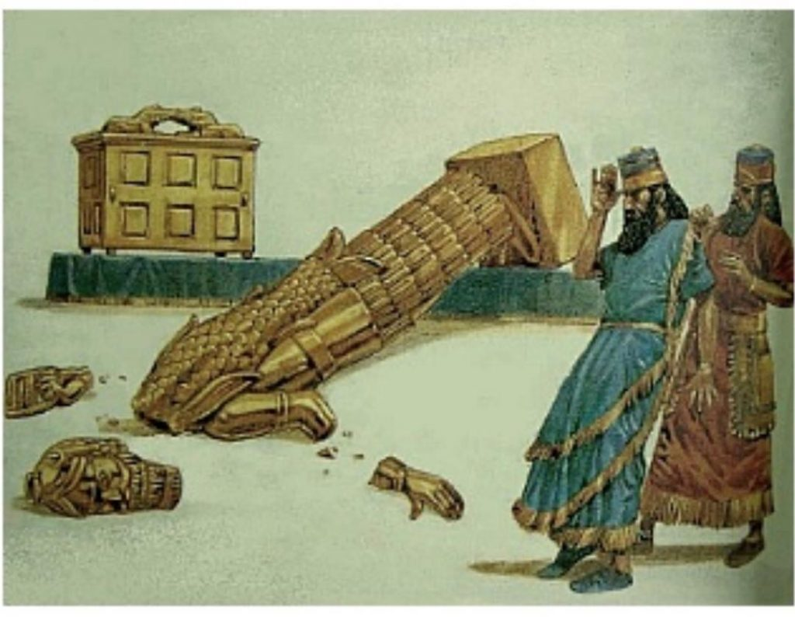
Idols Cannot Redeem
Burden Bearing: God vs. Idols
Isa 46:1-4 – “¹Bel has bowed down, Nebo stoops over; their images are consigned to the beasts and the cattle. The things that you carry are burdensome, a load for the weary beast. ²They stooped over, they have bowed down together; they could not rescue the burden, but have themselves gone into captivity. ³Listen to Me, O house of Jacob, and all the remnant of the house of Israel, you who have been borne by Me from birth and have been carried from the womb; ⁴even to your old age I will be the same, and even to your graying years I will bear you! I have done it, and I will carry you; and I will bear you and I will deliver you.”
Notes:
Now, God, as a Preacher, doesn’t beat around the bush – He calls names. And beginning in chapter 46, He specifically names the parties that will one day bow down to Him.
Isa 46:1-2 – Bel is the shorthand for the god Bel-Marduk, a cognate w/Baal, Babylon’s chief god of their pantheon. Nebo was considered Bel’s son and was the god of learning/writing. Both appear in names like Belshazzar, Nebuchadnezzar, etc. Every year during Babylon’s New Year’s party, Nebo was brought to Babylon to join w/Bel in writing on the “Tablets of Destiny”, which were the fates decreed by the gods for the coming year. But you can be sure they never predicted what God was bringing about, because those who wrote of the city’s fate would be victims of its fate. These images that were once paraded around would be consigned to ox carts for evacuation. Think about that – they’re such a nuisance to carry, they’re assigned to the beasts. So helpless, they sink down to the knees just as the Philistine god Dagon did in 1 Sam 5. Because as we just read, every knee will bow down, these idols will do it before Judgement Day.
In contrast, God has carried Israel from the womb – Isa 46:3-4 – Those beasts didn’t want to bear the weight of those idols anymore than we would, but God wants to bear/carry our weights. Even a child reaches a point where he doesn’t need to be carried. And when he gets older, he may even carry his aged father. But we never outgrow our dependance on God, whether in old age or infancy.

Slide 6
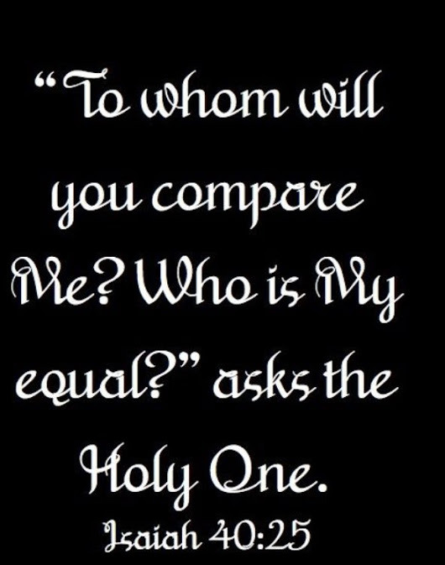
Idols Cannot Redeem
Idols Burdening, Not Saving
Isa 46:5-7 – “⁵To whom would you liken Me and make Me equal and compare Me, that we would be alike? ⁶Those who lavish gold from the purse and weigh silver on the scale hire a goldsmith, and he makes it into a god; they bow down, indeed they worship it. ⁷They lift it upon the shoulder and carry it; they set it in its place and it stands there. It does not move from its place. Though one may cry to it, it cannot answer; it cannot deliver him from his distress.”
Notes:
Remember the song “Nothing Compares” by Prince?
Isa 46:5 – The idea is that not only is no one God’s equal, there is no one even broadly similar to Him. Jehovah is utterly and completely unique.
That’s the case even if you take these idols and wrap them w/the most valuable materials – Isa 46:6 – So much money and attention given to the production and care of worthless idols. That word “indeed” contains that Hebrew participle of irony I’ve brought up before. It would sound like, “You bow, and boy did you ever bring yourselves down in worship.” He is stressing the folly.
Isa 46:7 – The phrase “Though one may cry” contains that same participle of irony to show inherent absurdity to even think one can pray for deliverance to something that stands staring lifelessly into space that needs picking up, carried, and set down. The only time an idol ever moved was in 1 Sam 5. All an idol is good for is being a burden, on our money, our time, our intellect, and our human dignity.

Slide 7
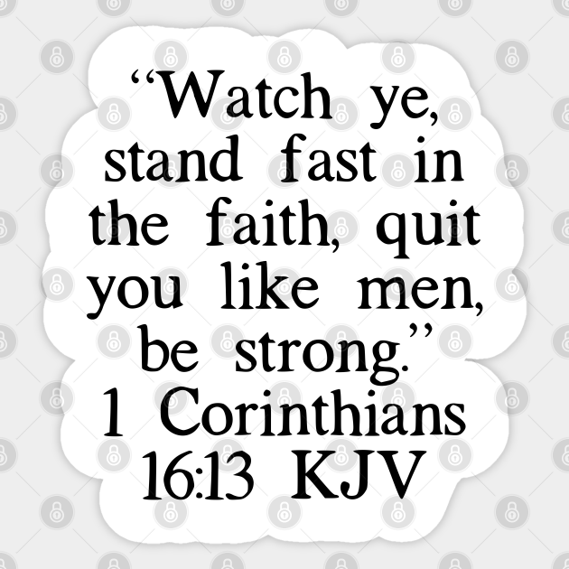
Idols Cannot Redeem
God’s Plans Are Sure
Isa 46:8-11 – “⁸Remember this, and be assured; recall it to mind, you transgressors. ⁹Remember the former things long past, for I am God, and there is no other; I am God, and there is no one like Me, ¹⁰declaring the end from the beginning, and from ancient times things which have not been done, saying, ‘My purpose will be established, and I will accomplish all My good pleasure’; ¹¹calling a bird of prey from the east, the man of My purpose from a far country. Truly I have spoken; truly I will bring it to pass. I have planned it, surely I will do it.”
Notes:
And so, vs. 8 begins a summary of chapters 40 – 46:7, a final appeal for Israel to accept the Lord’s will no matter how unprecedented:
Isa 46:8-9 – Isaiah’s appeal is to reflect on God’s historical record of bearing them and caring for them. “Recall it to mind” is a similar phrase to 1 Cor 16:13 – “show yourselves to be men”, not vacillating weaklings overcome by misfortune, but strong people who are able to reason and respond accordingly. Will they believe God, or choose to dwell on their terrible misfortunes?
Isa 46:10-11 – They may not like it, but God doesn’t play down the fact that Cyrus will come. And if Judah becomes too firmly grounded in national independence, they’d never accept Cyrus as part of God’s plan. And how will they then accept a Messiah who was not according to their hopes?

Slide 8
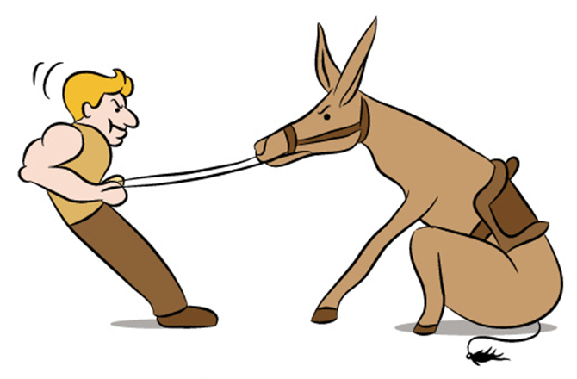
Idols Cannot Redeem
God’s Salvation Is Sure
Isa 46:12-13 – “¹²Listen to Me, you stubborn-minded, who are far from righteousness. ¹³I bring near My righteousness, it is not far off; and My salvation will not delay. And I will grant salvation in Zion, and My glory for Israel.”
Notes:
So, in conclusion…
Isa 46:12-13 – They are far from God’s rightness, but will they stay there clinging to their ways, or will they bow to His? The Hebrew word for “salvation” comes from root word meaning “to make wide”, denoting freedom from that which restricts. See how they restrict themselves? They’ve heard and heard yet not heard. They’ve seen and seen but not seen – because they’re blind. And everything seems far away to the blind. So, God Himself must save. They did not deserve God’s mercy, but God brought salvation because of who He is, not because of who they are.

Slide 9
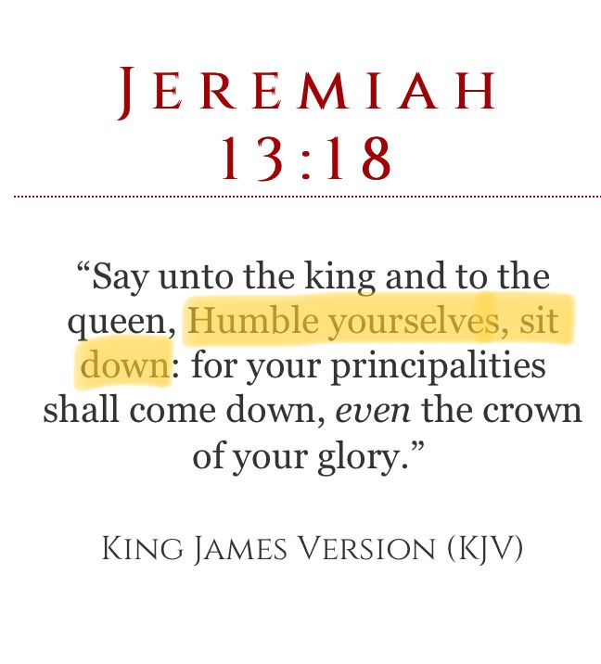
Judgment of Babylon
Babylon’s Humiliation
Isa 47:1-4 – “¹‘Come down and sit in the dust, O virgin daughter of Babylon; sit on the ground without a throne, O daughter of the Chaldeans! For you shall no longer be called tender and delicate. ²Take the millstones and grind meal. Remove your veil, strip off the skirt, uncover the leg, cross the rivers. ³Your nakedness will be uncovered, your shame also will be exposed; I will take vengeance and will not spare a man.’ ⁴Our Redeemer, the Lord of hosts is His name, the Holy One of Israel.”
Notes:
Isaiah now moves from the idols to the main thing God had in mind for Cyrus – conquest of Babylon.
Isa 47:1 – Babylon is represented as a beautiful, arrogant woman who before now had lived in luxury, never experiencing life’s harshness. But all that is over. She’ll now be forced to trade her pretensions for slavery. She’s humbled to sit in the dust, deprived of her former throne.
Notice the graphic language – Isa 47:2-3 – Millstones were considered menial, lowest form of slavery. The veil and long gown were characteristic of the upper class whose beauty was too precious for the commoner to see. But there is no longer anything special about her and such finery would hinder both her slave work and her escaping on foot. Babylon thought they were better than everyone else, but God will expose their shame so that they will be seen for what they truly are.
Who could possibly do this to mighty Babylon? – Isa 47:4 – And for whose sake? Israel’s – He’s the Holy One of Israel. Being their “next-of-kin”, He redeems them.

Slide 10
Judgment of Babylon
Babylon’s Humiliation
Isa 47:5-7 – “⁵Sit silently, and go into darkness, O daughter of the Chaldeans, for you will no longer be called the queen of kingdoms. ⁶I was angry with My people, I profaned My heritage and gave them into your hand. You did not show mercy to them, on the aged you made your yoke very heavy. ⁷Yet you said, ‘I will be a queen forever.’ These things you did not consider nor remember the outcome of them.”
Notes:
Isa 47:5 – They once dictated the rules, now they’re sitting in the silence of despair, w/o freedom or position. As queen, she was once the center of attention. Not anymore.
Isa 47:6 – The view in the ancient world was that the deity of the nation protected them, causing Babylon to think they were stronger than Jehovah. But Babylon was merely a tool in God’s hand. And because they had no regard for who was behind their victories, they disregarded every principle of human decency toward Israel just as Assyria had, even toward the elderly. But while they were unnecessarily cruel, the even greater sin was in thinking no one would call them into account.
Isa 47:7 – Proud, cruel, and presumptuous. They assumed her dominance would be unending, and so they paid no attention to the consequences of their actions, which is always the blind spot for the prideful. They did not take a thoughtful view of their conduct, but they were self-deluded.

Slide 11
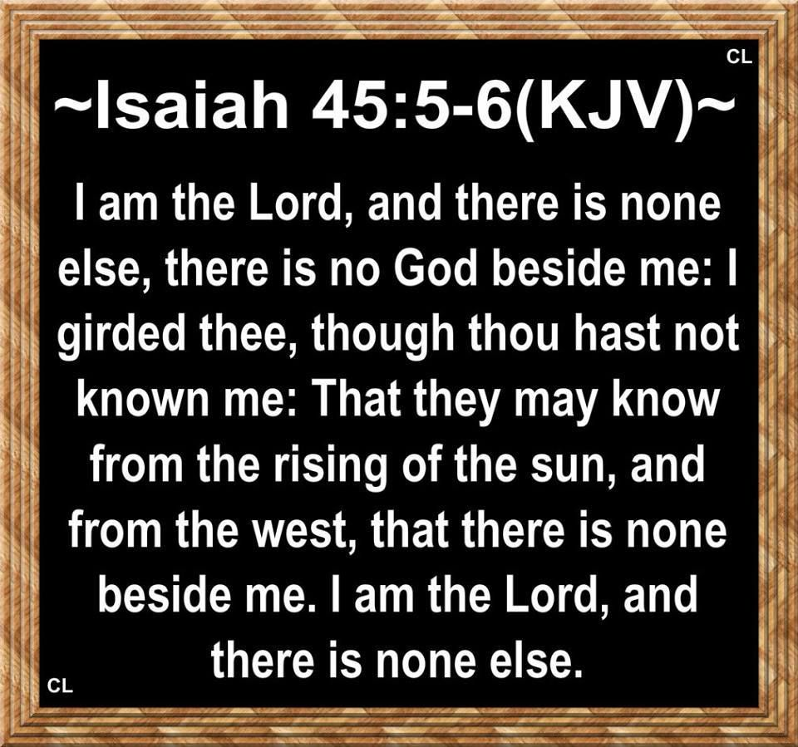
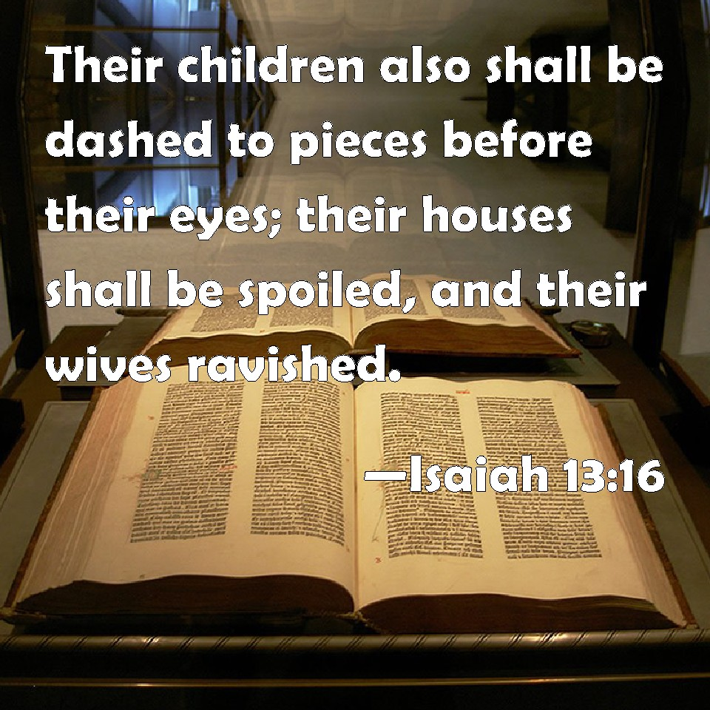
Judgment of Babylon
Babylon’s Sin
Isa 47:8-9 – “⁸Now, then, hear this, you sensual one, who dwells securely, who says in your heart, ‘I am, and there is no one besides me. I will not sit as a widow, nor know loss of children.’ ⁹But these two things will come on you suddenly in one day: loss of children and widowhood. They will come on you in full measure in spite of your many sorceries, in spite of the great power of your spells.”
Notes:
Isa 47:8-9.
That phrase “I am, and there is no one besides me” has already been said about God several times (45:5-6,18,22; 46:9). In fact, the ancient historian Herodotus claims that the people of Babylon laughed at the approaching Persian army. But by thinking this, Babylon is on a collision course w/God. She thinks she’ll never be alone and w/o the support of her children, but she is wrong.
Because, in terrifying suddenness, Babylon would lose both present and future security. This will happen in spite of her many sorceries, and Babylon was proverbial in the ancient world for its magical art, the word “Chaldean” becoming synonymous with “magician”. Many don’t know this, but the names given today to astrological constellations are translated from ones originated by Babylon, that’s how deeply immersed they were in astrology. But it won’t help them.

Slide 12
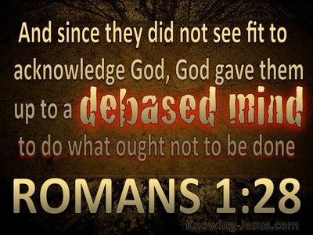
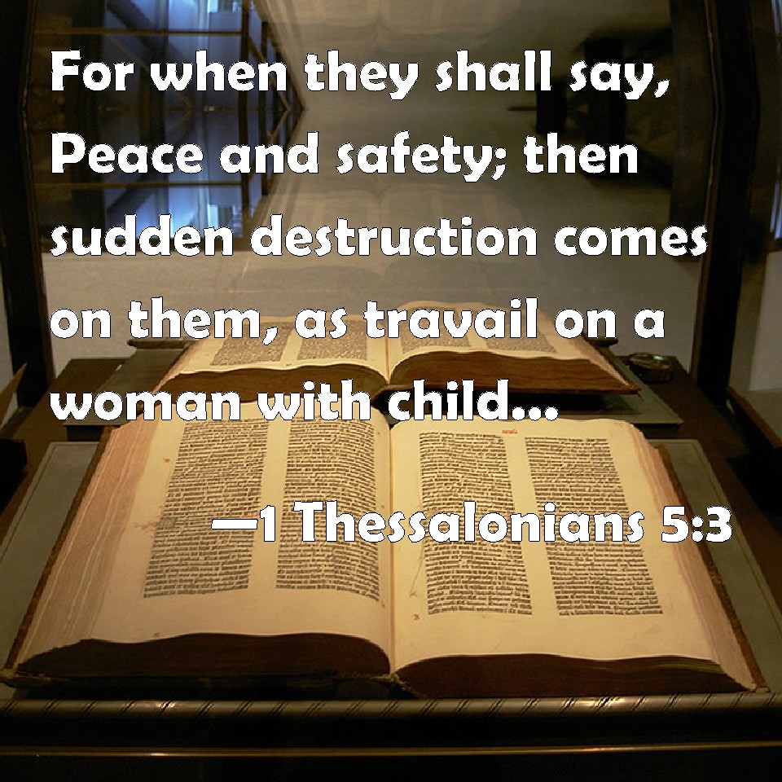
Judgment of Babylon
Babylon’s Sin
Isa 47:10-11 – “¹⁰You felt secure in your wickedness and said, ‘No one sees me,’ your wisdom and your knowledge, they have deluded you; for you have said in your heart, ‘I am, and there is no one besides me.’ ¹¹But evil will come on you which you will not know how to charm away; and disaster will fall on you for which you cannot atone; and destruction about which you do not know will come on you suddenly.”
Notes:
Isa 47:10-11.
In other words, “I answer to no one!” They didn’t believe in a divine, moral arbitrator other than themselves. Ethics had no religious significance to them because her self-deification made her feel accountable to no one. Her pride and arrogance led to self-deception.
But for all their supposed wisdom and knowledge, vs. 11 stresses how much they actually didn’t know, as everything that will happen to them will be unprecedented. Since they embraced evil, evil is what they will get, and there is no magic that can stop it, no price that could be paid by them to atone for their sins and avoid the disaster God has planned, because God resists the proud.

Slide 13
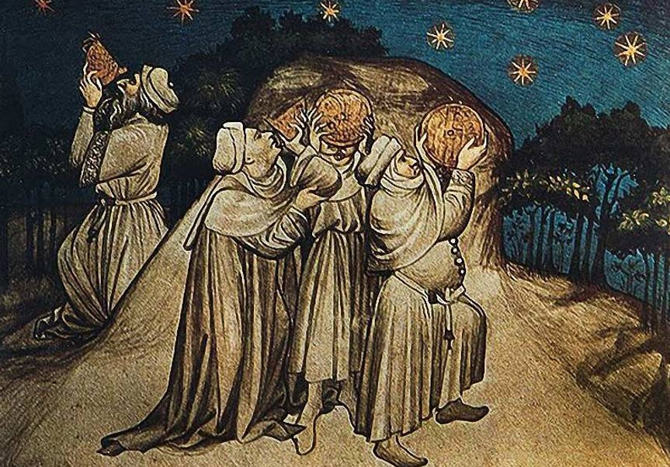
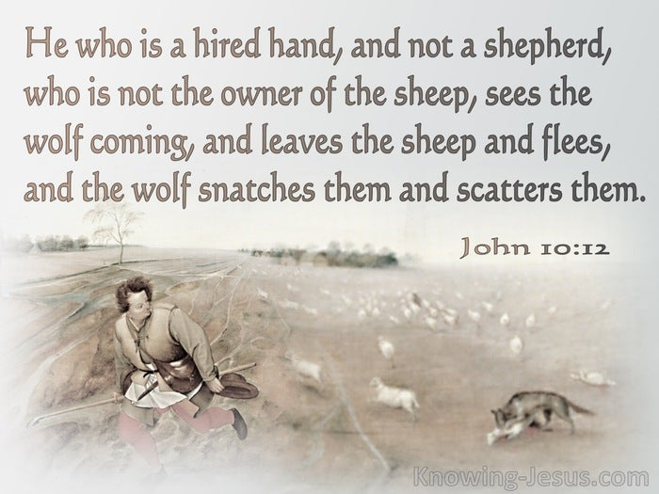
Judgment of Babylon
Babylon’s Useless Religion
Isa 47:12-15 – “¹²Stand fast now in your spells and in your many sorceries with which you have labored from your youth; perhaps you will be able to profit, perhaps you may cause trembling. ¹³You are wearied with your many counsels; let now the astrologers, those who prophesy by the stars, those who predict by the new moons, stand up and save you from what will come upon you. ¹⁴Behold, they have become like stubble, fire burns them; they cannot deliver themselves from the power of the flame; there will be no coal to warm by nor a fire to sit before! ¹⁵So have those become to you with whom you have labored, who have trafficked with you from your youth; each has wandered in his own way; there is none to save you.”
Notes:
And so, God will challenge their entire religious system to stop what’s coming:
Isa 47:12-13 – God already said in vs. 11 that they will not be able to charm this away. But He welcomes them to try. Surely sorcerers who devote so much time and energy to learning its magical arts because of their belief in its power should be able to stop what’s coming, right? Well, commitment and discipline to a religion is commendable, but when that religion is false, it only brings weariness. Their astrologers divided the heavens into segments and studied the movements of the stars and planets to predict earthly events. If their astrologers had any skill in helping their devotees avoid what was coming, now was the time to put that skill into effect.
Isa 47:14-15 – “Stubble” is what it’s magical arts can be compared to, completely worthless and easy to burn. When the fire comes, they won’t be able to deliver themselves let alone their devotees. Thus, fire will reveal their true nature, admired in the eyes of their followers, but nothing in the hands of God. This fire will not be a warm, inviting campfire, but will devour them in its path, and they’ll be fuel for it. Nothing beneficial will be left for them. Not the coal that helped Isaiah in 6:6, but an all-consuming blaze. Like Tyre, Babylon was a center of trade. And these false prophets simply made a trade out of Babylon. And when the market bottoms out, when it’s time to balance the books to see what profit there is, bankruptcy. Their former traders will take a quick exit to attempt to escape danger. End result? No one is left to save them. Yet God will save Israel, and that’s the point of 40 – 48.

