Slide 1
Notes:
Several outlines have been suggested for Isaiah 40 – 66, each w/its own merit. Some consider it should be broken down into 2 sections, 40 – 55 and chapters 56 – 66, and there is definitely a shift from chapter 55 to 56 as well as a chiastic structure to 56 – 66 that is hard to deny. But the other way to break it down, which is my outline of choice, is 3 sections of 9 chapters each. A couple reasons for this. First, there is an inclusio found in the last verse of chapters 48 and 57 – “there is no peace for the wicked” – some would argue that inclusios are God’s way of telling us how He’d like His texts arranged. But the second reason I divide it up this way is because in each of the 9-chapter sections, there is a pinnacle point, a climax, in the middle that the text in each section appears to build up to. 44:24 begins the climactic point of chapters 40 – 48.
So far, God has provided consolation to the Jews by promising He will send some unnamed deliverer to rescue them from captivity. And in redeeming Israel from their captivity, this will ultimately cause Gentiles to abandon their idols and seek the one true God, particularly when God sends His special Servant to bring justice to the nations, opening their eyes and providing them light. In 44:24, God lifts the veil of anonymity of this coming conqueror and actually tells us what his name would one day be. And by speaking w/such specificity, He’ll prove His sovereignty and He’ll prepare the Jews beforehand w/what would actually be a difficult revelation for them to come to terms with. But come to terms w/Cyrus they must, because if they cannot accept God sending a Gentile conqueror to rescue them, how would they ever accept a Jewish conqueror who would one day rescue the Gentiles?

Slide 2
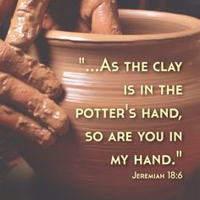
Cyrus the Deliverer
God’s power
Isa 44:24-26 – “²⁴Thus says the Lord, your Redeemer, and the one who formed you from the womb, ‘I, the Lord, am the maker of all things, stretching out the heavens by Myself and spreading out the earth all alone, ²⁵causing the omens of boasters to fail, making fools out of diviners, causing wise men to draw back and turning their knowledge into foolishness, ²⁶confirming the word of His servant and performing the purpose of His messengers.’”
Notes:
Chapter 44 concludes with God declaring His power in a 3-fold relationship w/Israel: past, present, and future:
Past – Isa 44:24 – That He is their “Redeemer” means that He is their next-of-kin who comes to them in their need. That He “formed” them means before they ever existed, He applied His personal touch in bringing them about. And that He is their “Maker” stresses sole creation and thus an abiding relationship. The idea is that throughout Israel’s entire history, from creation to formation to redemption, they have enjoyed a peculiar relationship w/God. And so, He does not want to see them destroyed. He wants to see them rescued.
That was His past power, but this is the present – Isa 44:25-26a – The ancient world of Isaiah’s present was full of diviners and wise men who’d try to explain away events. But God is going to do something so unexpected for their time, they’re all going to be pulling their hair out over how wrong they were because none of them have the power of the sovereign Lord. He can do things that have never been done, confounding all those who have supposed skill. In contrast, vs. 26 tells us that God’s prophets, like Isaiah, are “confirmed”, which is the same verb in 40:8 where we’re told that the word of our God “stands forever”. So, one group gets the message from himself and that message is made ineffectual, the other gets his message from God and is established.

Slide 3
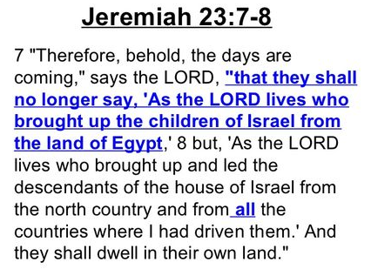
Cyrus the Deliverer
God’s power
Isa 44:26b-28 – “It is I who says of Jerusalem, ‘She shall be inhabited!’ and of the cities of Judah, ‘They shall be built.’ and I will raise up her ruins again. ²⁷It is I who says to the depth of the sea, ‘Be dried up!’ And I will make your rivers dry. ²⁸It is I who says of Cyrus, ‘He is My shepherd! And he will perform all My desire.’ And he declares of Jerusalem, ‘She will be built,’ and of the temple, ‘Your foundation will be laid.’”
Notes:
What message? In the 2nd half of vs.26, God displays His power regarding the specificity at which He is able to reveal future events, and this is the climactic point of Isaiah 40 – 48 – Isa 44:26b-28. Look at this long list of predictions
First, he predicts Jerusalem will be inhabited. After the Nebuchadnezzar's siege in which he destroyed the city of Jerusalem, he took the remaining people prisoner to Babylon, leaving only the poorest of Judah to till the land underneath a governor named Gedaliah. But they killed Gedaliah, and fearing another visit by Nebuchadnezzar, the majority of those left escaped to Egypt, forcing Jeremiah to go w/them. And the so-called wisemen who could see Jerusalem during these 70 years could have easily “predicted” it would never be inhabited, given its state. But God promises something that to man would look impossible – the land will be inhabited. This will be the ultimate slap in the face of the occult and “wise men” who likely all said Israel was done for.
Furthermore, he says it will be built. This goes further than just a land full of farmers living in huts. That it will be rebuilt, and the ruins raised up, implies a return to some degree of nation prominence.
And God goes even further than that by saying the temple will be rebuilt, its foundation laid. And as we know from the book of Ezra, the foundation was indeed laid. And while it stalled for 16 years, God sent the prophets Haggai and Zechariah to encourage the people to finish the job, and finish they did.
Furthermore, he says the depths of the sea will be dried up and the rivers made dry. This is reminiscent of the Red Sea crossing. God did it before and He would do it again. But notice Jer 23:7-8 – This is the new thing referred to in 43:19, that while it will be similar to the Exodus, it would also be significantly differently. And as in Exodus, the Lord’s promise covers both the destination and the journey.
But then, the icing on the cake is that He personally names the man who’d do it. The Israelite Moses led them out of Egyptian captivity, but the Lord has another man in mind for leading Israel out of Babylonian captivity, and he is not an Israelite – Cyrus, the Persian Gentile. And according to historians, how did Cyrus access Babylon? By stopping up the Euphrates, diverting it from Babylon so the Medes could sneak under the walls. This was one way in which God removed obstacles that stood in Israel’s way of going home. Idols can never declare the future w/any specificity like God is doing here. And did you notice how Cyrus is referred to as “My shepherd”? More on that when we get to vs. 9.

Slide 4
Notes:
Keep in mind that in order for the land to be repopulated, the ruins raised up, and the temple rebuilt, the land would first have to lie desolate, the city fall, and temple destroyed. Notice from this timeline how far in advance Isaiah is pronouncing all of this.
Isaiah would die ~685AD, and he is prophesying all this before that time. But Jerusalem would not even fall until 100 years later in 586BC. And Cyrus would not conquer Babylon until 539BC. This means Isaiah is prophesying events about 150 years before it happens w/remarkable specificity. So extraordinary are these prophesies, some have suggested that Isaiah 40 – 66 must have been written sometime after 586BC to make it look like he was prophesying future events when in fact he wasn’t. Yet, the main purpose of chapters 40 – 48 is to prove God’s sovereignty over past, present, and future, proving He is the one true God. The whole point of chapters 40 – 48 is moot if it wasn’t written prior to those events happening.

Slide 5
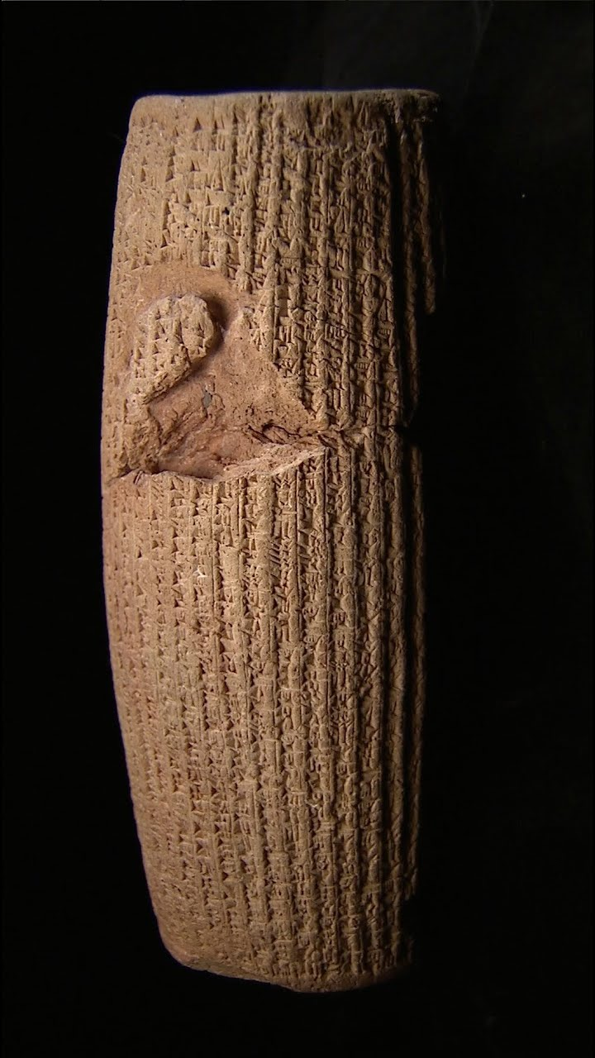
Cyrus the Deliverer
Cyrus the anointed
Isa 45:1-4 – “¹Thus says the Lord to Cyrus His anointed, whom I have taken by the right hand, to subdue nations before him and to loose the loins of kings; to open doors before him so that gates will not be shut: ²I will go before you and make the rough places smooth; I will shatter the doors of bronze and cut through their iron bars. ³I will give you the treasures of darkness and hidden wealth of secret places, so that you may know that it is I, the Lord, the God of Israel, who calls you by your name. ⁴For the sake of Jacob My servant, and Israel My chosen one, I have also called you by your name; I have given you a title of honor though you have not known Me.”
Notes:
Chapter 45 gives us additional details on how God will use Cyrus, w/some similarities to the beginning of chapter 41 – Isa 45:1-4.
Now, “anointed” is not necessarily indicative of holiness. It simply means he would be set apart for the Lord’s purpose. Taken by the right hand means he would be led onto the stage of world history by God. And by loosening the loins, kings will be unable to fight; no city gates could keep him out.
Vs. 2 is familiar language to us, God clearing the way and removing all obstacles that keep Israel from returning home. But what we see here is that God will be doing this by way of Cyrus, who God will go before, and that he will not only level the nations, but open the mighty bronze gates of cities, of which Babylon was famous for having over 100.
Cyrus will also be gifted w/treasure, even those man attempts to hide. And through it all, the evidence is sufficient for him to know that God directed him. The degree that he knew this personally is unknown, and the Cyrus cylinder actually records him attributing his conquests to the Babylonian god Marduk. Pharaoh eventually knew the Lord, too, though he never came to Him. But to whatever degree Cyrus knew the Lord, it caused him to show kindness to the Lord’s people, granting them permission to return to their land, as we see and the beginning of Ezra.
But who is this ultimately for? Israel – they are His chosen servant. God’s people are His chiefest concern, and He doesn’t need the fielty of those He uses.

Slide 6
Cyrus the Deliverer
Cyrus the anointed
Isa 45:5-8 – “⁵I am the Lord, and there is no other; besides Me there is no God. I will gird you, though you have not known Me; ⁶That men may know from the rising to the setting of the sun that there is no one besides Me. I am the Lord, and there is no other, ⁷the One forming light and creating darkness, causing well-being and creating calamity; I am the Lord who does all these. ⁸Drip down, O heavens, from above, and let the clouds pour down righteousness; let the earth open up and salvation bear fruit, and righteousness spring up with it. I, the Lord, have created it.”
Notes:
See, Cyrus was not picked for being the smartest, strongest, or most talented man. God made him what He needed him to be despite the fact Cyrus had not known God.
Isa 45:5-7 – Though girded by God, he does not know He is God’s tool. And he doesn’t need to know this to be God’s tool. And if God can do this for someone who doesn’t know Him, how much more can He do it for those w/mustard seed faith? “rising to the setting of the sun” represents all the inhabited earth. So, this was not just for the Jews. Everything God did through Cyrus was for universal acknowledgement that the God of Israel is the one true God. And He demonstrates this in 2 areas: nature and circumstances. As Creator, He is responsible for everything created, including light/dark, and in circumstances He can cause good fortune and misfortune.
And so, as if in acknowledgment of this, nature is called to bring forth the deliverance God has planned – Isa 45:8 – Just as physical fruit requires rain from heaven, spiritual fruit can only grow by God raining down His Spirit from heaven. God can bring about blessing from every direction, and the opening of the earth is a welcome response.

Slide 7
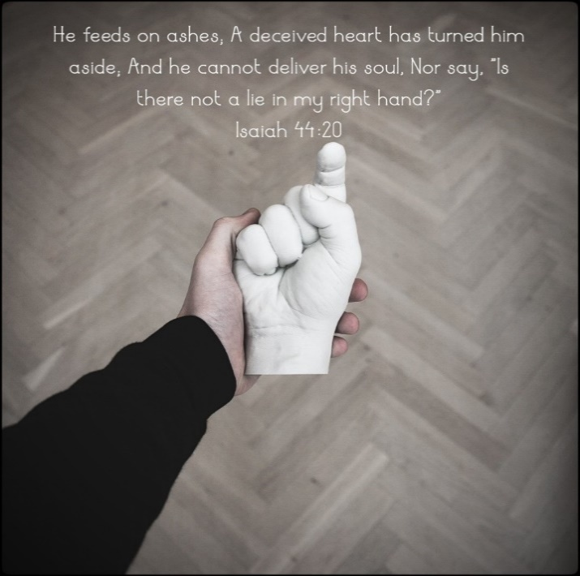
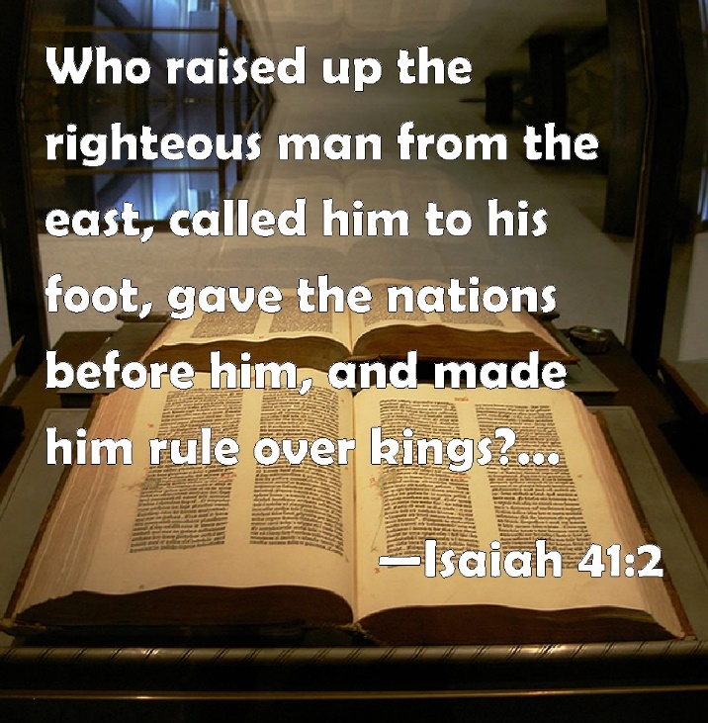
Cyrus the Deliverer
Jewish Objection, God’s answer
Isa 45:9-13 – “⁹Woe to the one who quarrels with his Maker—an earthenware vessel among the vessels of earth! Will the clay say to the potter, ‘What are you doing?’ Or the thing you are making say, ‘He has no hands’? ¹⁰Woe to him who says to a father, ‘What are you begetting?’ Or to a woman, ‘To what are you giving birth?’ ¹¹Thus says the Lord, the Holy One of Israel, and his Maker: ‘Ask Me about the things to come concerning My sons, and you shall commit to Me the work of My hands. ¹²It is I who made the earth, and created man upon it. I stretched out the heavens with My hands and I ordained all their host. ¹³I have aroused him in righteousness and I will make all his ways smooth; he will build My city and will let My exiles go free, without any payment or reward,” says the Lord of hosts.’”
Notes:
But in vs. 9, God appears to anticipate that this revelation about Cyrus would not receive a favorable response. Did they want to be saved from captivity? Yes. Do you think the Jews would be happy to learn beforehand that it would be a Gentile liberator who’d do it? Probably not. Add to that the fact that God calls this Gentiles liberator “My Shepherd” like David, He calls him “His anointed”. He also said he would “take [Cyrus] by the right hand”, which was what He said He would do for Israel in 41:13. Saying this about a Gentile would have been offensive. At least Moses was an Israelite. “Why can’t this 2nd Exodus be done through a miracle like the first? Why is God using providence, and why is He trading one Gentile pagan for another?” God’s answer to these Jewish objections, in short terms, is “None of your business.”
Isa 45:9-10 – Why “Woe”? Because they’re refusing to let God be God. They must realize their place as the created. And if the potter shouldn’t be questioned, neither should the parent. Certainly children brought to birth don’t know what the parents do. It’s an absurdity, and that’s the point. Just because I don’t understand why God would do something a certain way does not in any way equate to knowledge or wisdom. He is sovereign, that’s where the matter ends.
Who are we to question the God who does the following? – Isa 45:11-13 – Did you notice the personal pronouns? The hands of craftsmen make idols, but God’s hands make humans. And having created all things, He has the power and the right to do what He wants. And not only did Cyrus arise by God’s own choice, God aroused him in “righteousness”, which I take to mean that God is doing the “right” thing. No matter Israel’s objection, they’re in no position to challenge His righteous choices. Rather, as vs. 11, they simply needed to ask Him concerning things to come.

Slide 8
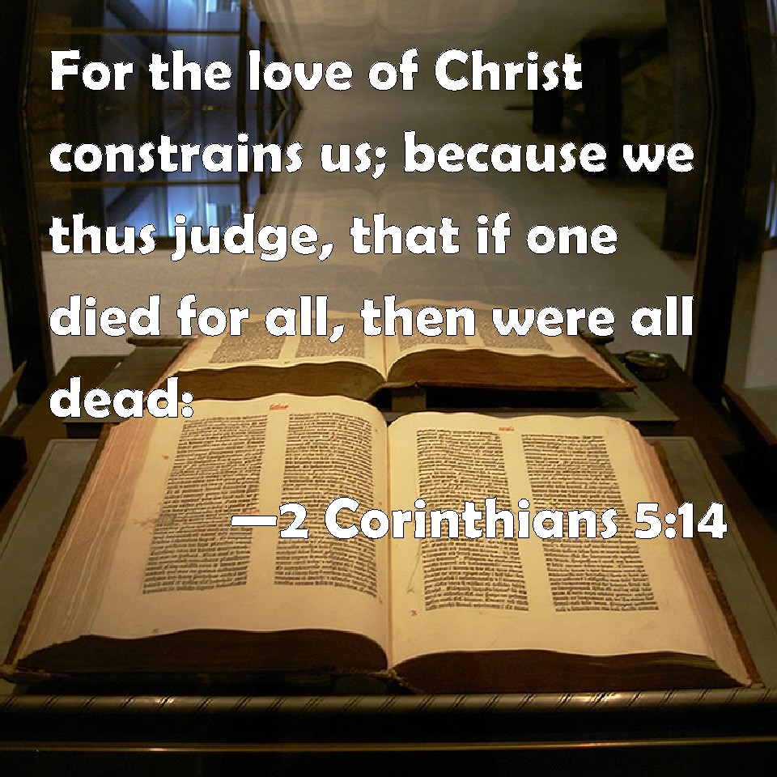
Cyrus the Deliverer
Gentile submission, Israel’s glory
Isa 45:14-17 – “¹⁴Thus says the Lord, ‘The products of Egypt and the merchandise of Cush and the Sabeans, men of stature, will come over to you and will be yours; they will walk behind you, they will come over in chains and will bow down to you; they will make supplication to you: ‘Surely, God is with you, and there is none else, no other God.’” ¹⁵Truly, You are a God who hides Himself, O God of Israel, Savior! ¹⁶They will be put to shame and even humiliated, all of them; the manufacturers of idols will go away together in humiliation. ¹⁷Israel has been saved by the Lord with an everlasting salvation; you will not be put to shame or humiliated to all eternity.”
Notes:
Now, they may not like this revelation about Cyrus, but Israel is still at the center of God’s plans, and so notice what God says the Gentiles will bring to them.
Isa 45:14 – The idea is that the Gentiles will come to them w/wealth (resources) and prowess (ability), just as what occurred at the Exodus. This is a genuine submission in which Gentiles gladly walk behind Israel and pay homage and supplication. Nations are not mistaking Israel for God, but going from lording it over Israel to seeking their mercy because they recognize God is w/Israel. This is a role reversal – as Israel was led away in chains by Gentiles, Gentiles will now be in chains to the Jews.
But I don’t think this is talking about literal chains per se. This cannot be a Gentile captivity like what Israel experienced in Babylon, because notice the excitement – Isa 45:15-16 – With such astonishment and excitement. What kind of captivity could prompt such an outburst of joy? A captivity of the heart. Remember that sometimes the “captivity” language of 40- 48 looks a little more like deliverance from spiritual captivity. It’s as if having concluded the climax of this section, Isaiah is starting to set the stage for the next 9-chapter section. We’re seeing a contrast between how the Jews and Gentiles will respond to their deliverance. The Jews are initially complaining – it’s upsetting their nationalistic sensibilities. But the Gentiles are recognizing how God’s purpose to put Israel into captivity was ultimately a good thing because it led not just to Israelite deliverance, but Gentile deliverance as well, in which they’ll experience shame over their idolatry. How amazing is God? Only He could bring Gentiles into submission to Israel by appearing to do the reverse (55:8-9).
But though Israel will take longer to get this than the Gentiles, they’ll ultimately be vindicated – Isa 45:17 – But though we still may suffer as God’s people, God will deliver us in the end.
(don’t click) Now, before continuing, why would it be important for Israel to get used to God doing this 2nd Exodus differently than they imagined? How is sending a pagan Gentile conqueror to free them from physical captivity going to also help them in the future? Because Cyrus is a type of another liberator and conqueror who God is revving up to send, the Messiah, and He’s not going to be anything like they expected either, is He? Cyrus is a type of Christ, but he is also an aid to receiving the first coming of Jesus Christ.

