Slide 1
Notes:
The theme of Isaiah 40 – 48 is God announcing Israel’s deliverance from their physical captivity well almost 100 years before they even go into captivity. He begins by offering comfort to these discouraged Jews, assuring them in chapter 40 that He is willing to rescue them (40:1-11), He is able to rescue them (40:12-26), and that He absolutely will do it (40:27-31). How? Chapter 41 reveals God would send a conqueror to judge the nations, and to this conqueror, that would be Nerf ball (41:1-4). But the Gentiles reaction to this coming conqueror is to build even larger, more elaborate idols to counter it (41:5-8), showing just how backwards they are. But Israel? God identifies them as His servant, and He will not only save Israel, but use them to further thresh the nations (41:9-19). 41:20 is a fitting conclusion to this section on the consolation of the Jews because it reveals why He allowed them to go into captivity in the first place. It was so that by rescuing them, they’d recognize that God, and not the idols, did it all, foretelling He’d do it long before it happened.
After consoling the Jews, God next consoles the Gentiles – they too will not be forgotten. But in order to deliver the Gentiles, He must expose the folly of their biggest stumbling block – idolatry. And so, Isaiah contrasts the predictive power of Jehovah vs. the idols to set the stage for their redemption (41:21-29). And just how will the nations be delivered from the idols that held them captive? In chapter 42, God promises to send a Servant to rescue them. This servant will bring forth justice to the nations, and they will wait expectantly for His law. This Servant will be a light to the nations, cure their blindness, and bring them out of their self-imposed “prisons” (42:1-9). And the response by the Gentiles to this Servant will be so overwhelmingly positive, they’ll rejoice in the one true God. And so, what we learn from these first 2 sections of consolation is that not only will God lead Israel to victory, but also the Gentiles (Isa 42:10-17).
Now, w/o the benefit of hindsight, the Jews would no doubt think that the Servant from chapter 42:1 is referring to them. After all, God called Israel His servant in 41:9. And yet, it becomes quickly apparent that Israel cannot ultimately be that Servant because in 42:18, Israel is shown to be just as blind as the Gentiles, despite all the advantages they’d received as God’s special nation, and this is what led to their captivity (Isa 42:18-25). And so, both Jews and Gentiles seem to be suffering from the same consequences for sin. Yet, God will redeem Israel, and this is the 3rd section we’ll be concluding today. But He won’t deliver them because they’re worthy, but because God has attached His name to them, making Him their next-of-kin, which will allow Him to redeem them (Isa 43:1-7). And the added benefit to this is that by Israel’s redemption, they will be witnesses to the entire world as to the blessing of belonging to God. And in a stunning twist, He identifies Israel again as His servant in 43:10, implying that while they are God’s servant, they cannot be His Servant in the ultimate sense (Isa 43:8-13). And in what way will He deliver them from Babylonian captivity? In a similar way as He delivered them from Egyptian slavery, by judging Babylon, calling Israel out, and removing all obstacles in the process. And this will result in Israel’s praise. And yet, even as God says that their deliverance will be similar to the Exodus, He also says it will be different. 43:19 says this is going to be a new thing, something similar to the prior Exodus, yet unexpected (Isa 43:14-21). What is this new thing? Stay tuned.

Slide 2
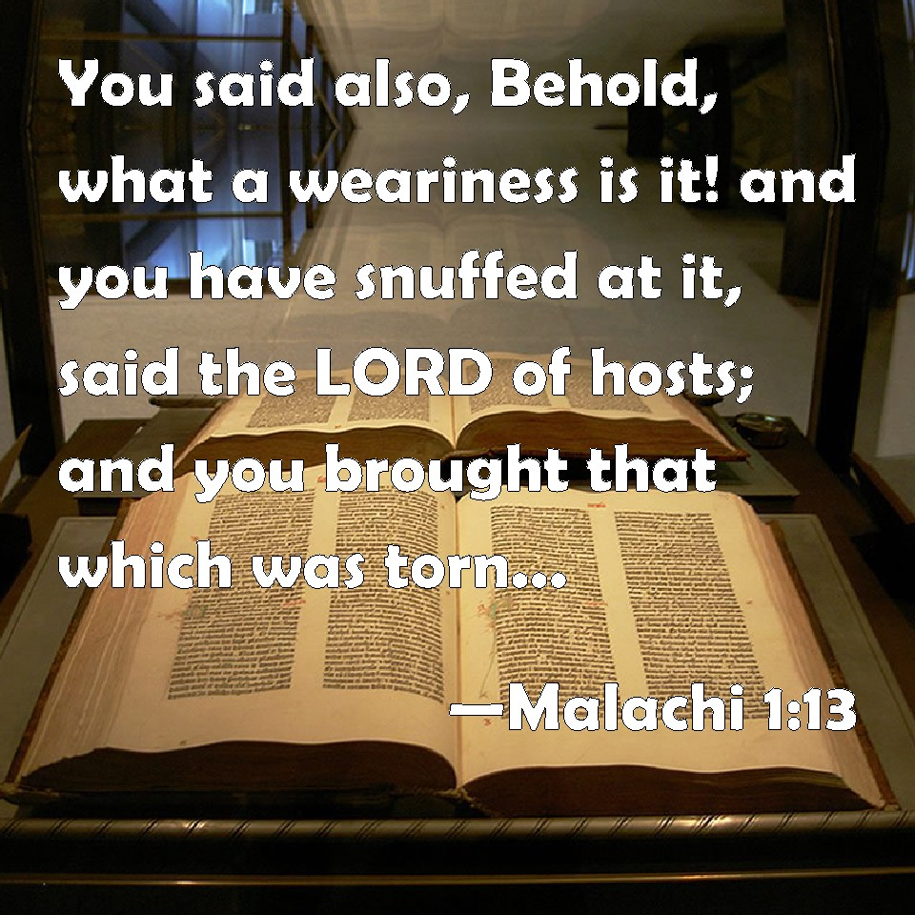
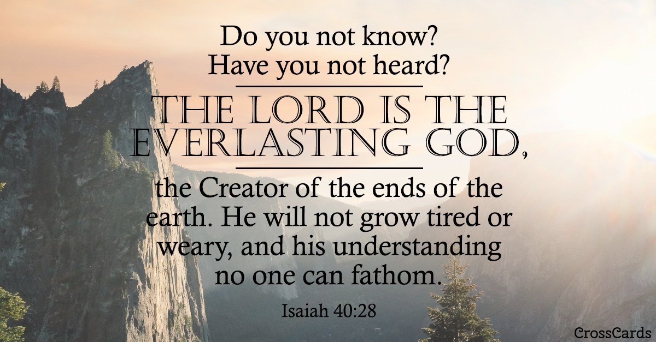
Israel Redeemed By God
Sin Exposed
Isa 43:22-24 – “²²Yet you have not called on Me, O Jacob; but you have become weary of Me, O Israel. ²³You have not brought to Me the sheep of your burnt offerings, nor have you honored Me with your sacrifices. I have not burdened you with offerings, nor wearied you with incense. ²⁴You have bought Me not sweet cane with money, nor have you filled Me with the fat of your sacrifices; rather you have burdened Me with your sins, you have wearied Me with your iniquities.”
Notes:
As we conclude this section on Israel’s redemption by God, we’re going to again see the pendulum swing in full affect. God will redeem His servant Israel, but they were wholly unworthy of this redemption because of their sin. The deeper issue is now more fully explored – Isa 43:22-24.
This is a bit of a repeat from 1:10-11. By treating the Levitical sacrifices as a ritual, they deprived themselves of the benefits it was intended to bring. The Levitical sacrifices were designed to demonstrate Israel’s inability to meet the demands of the law and their need for substitutionary atonement. But by turning it into ritual, it made the offerings more about what they thought God needed rather than what they needed, and this in turn made it a wearisome thing to Israel rather than becoming a means of joyful fellowship w/God.
They drenched the altar w/fat, but it was all mechanical, which in turn nullified its worth to God because there was no genuine submission or change of heart. God never wanted the sacrifices by themselves; He wanted the moral character that they could produce. But by perverting the system, they were actually bringing Him their moral iniquities. “You think you’re weary of bringing these offerings? Try being Me!” The word “wearied” could be a play on its use in 40:28 where we learned that God cannot become weary. So, which is it? Well, in ability, God cannot become weary; that’s what 40:28 is saying. But by treating the sacrifices as rituals to manipulate God into winking at their sins, this wearied God’s willingness to forgive them.

Slide 3
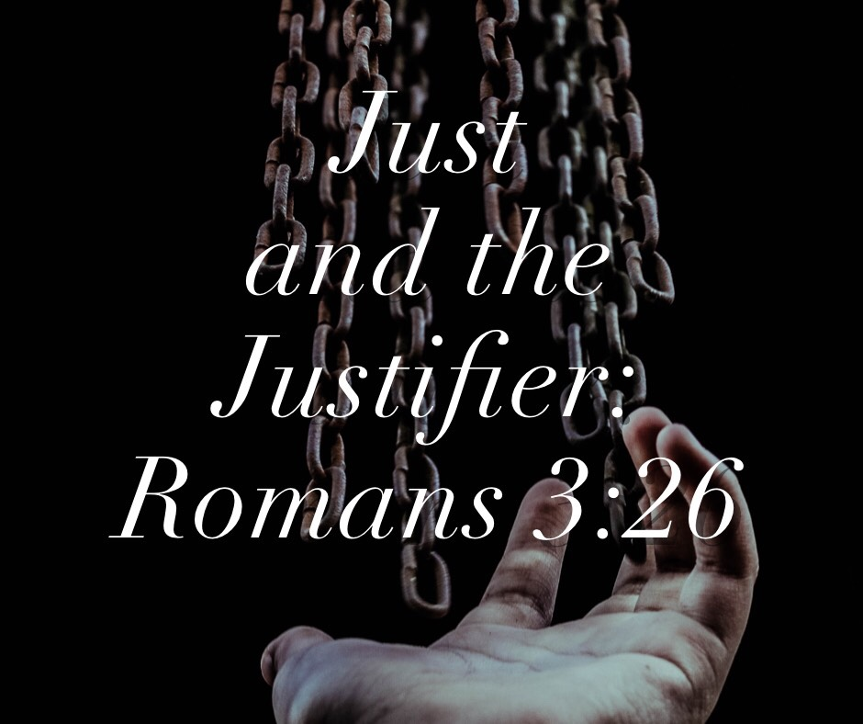
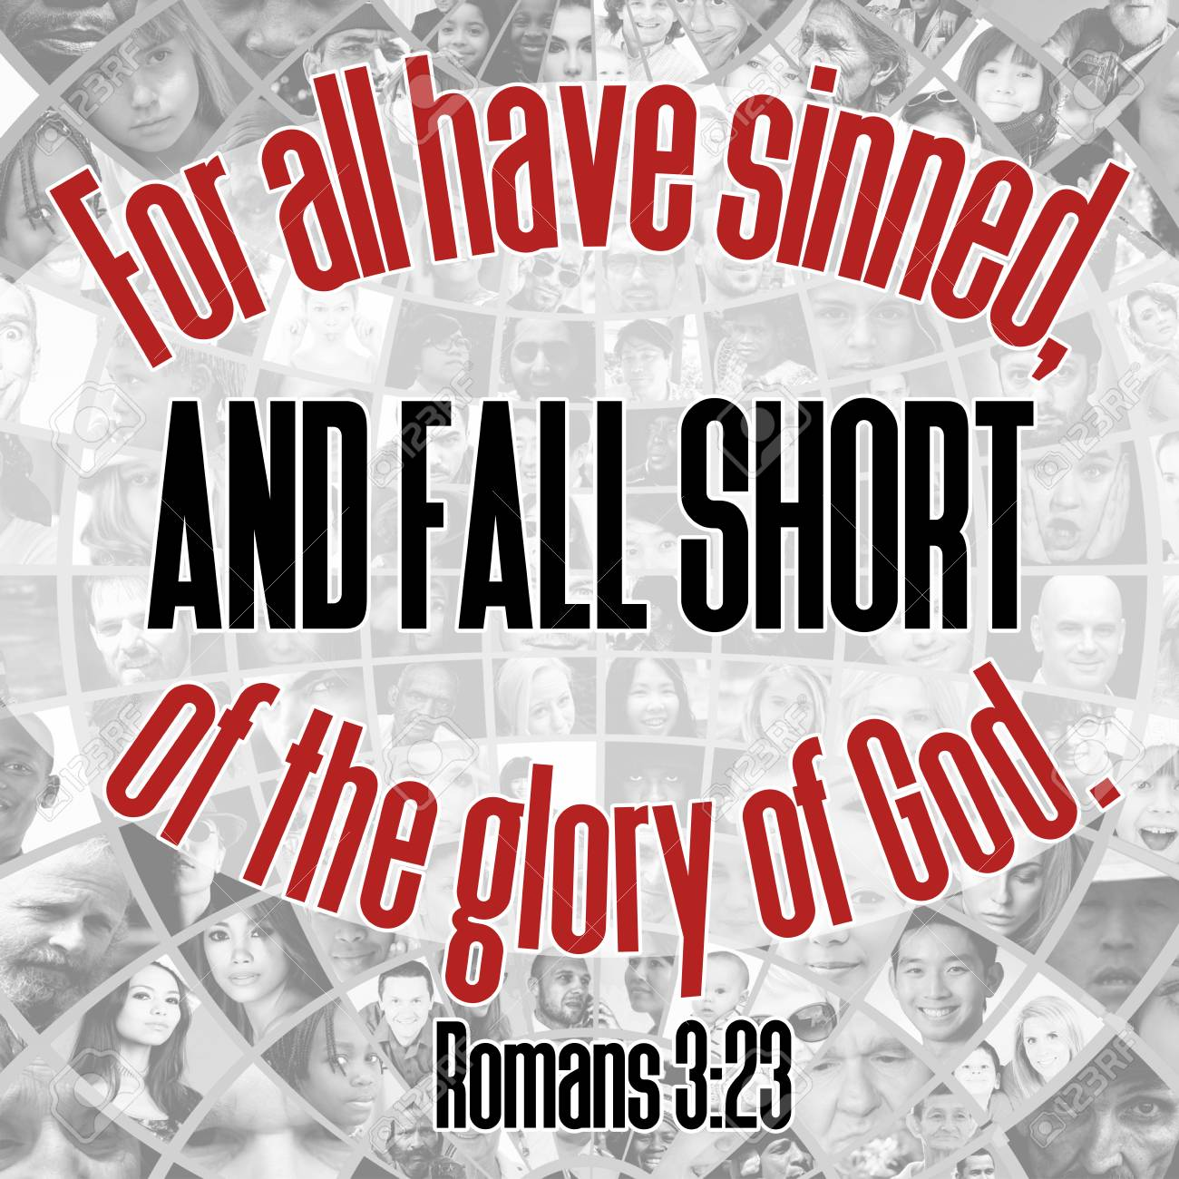
Israel Redeemed By God
Sin Exposed
Isa 43:25-28 – “²⁵I, even I, am the one who wipes out your transgressions for My own sake, and I will not remember your sins. ²⁶Put Me in remembrance, let us argue our case together; state your cause, that you may be proved right. ²⁷Your first forefather sinned, and your spokesmen have transgressed against Me. ²⁸So I will pollute the princes of the sanctuary, and I will consign Jacob to the ban and Israel to revilement.”
Notes:
And if that is true, what hope is there? The pendulum swings back in Isa 43:25-28.
“I, even I” is a repetition intended for emotional intensity. Despite everything they’d done to hurt God, He will be the one to save them? “God?” Yes, He, even He. Notice how Isaiah is beginning to build the bridge to chapters 49 – 57, that Israel’s main problem isn’t physical bondage, but what led to it: spiritual bondage. And an even bigger question than whether idols can defeat God is whether Israel’s sin can defeat His love for them. “No”. Remember the Prodigal Son, who felt his father was a weary burden to be relieved of and so went his own way? His father still loved him and was ready to forget his sin if he’d just return. How can God forget our sins? Well, Clara Barton, the founder of the Red Cross, had a friend who once reminded her of a very cruel thing someone had done to her years prior. And Clara Barton couldn’t remember what it was. And so, her friend said, “Don’t you remember?” And Clara Barton said, “No, I distinctly remember forgetting it.” God forgives sins by distinctly remembering to forget them. He does this for His own sake, not theirs.
Vs. 26 is heavily sarcastic courtroom language. It’s God’s way of saying, “You’re free to remind Me of anything in your favor I may have forgotten”. See, as big of a game as we can talk about grace, many don’t want grace. Many think they’ve merited favorable treatment from God. But until we acknowledge grace, all our energies will be fruitlessly spent on self-justification rather than giving glory to God. Only God can be both just and the justifier (Rom 3:26).
"
That phrase “first forefather” in vs. 27 could refer to Jacob, Abraham, or even Adam, but it doesn’t matter. The point is that sin can be found as far back in their ancestry as they wish to go and has continued on. Hence, no self-justification can be found – all have sinned. Mankind’s history is simply embarrassing, isn’t it? The OT is not primarily designed to make Israel look good.
And so, with no valid self-justification, the verdict is reached: guilty. They will be held responsible for their sin. The princes of the sanctuary from vs. 28 are the priests (1 Chron 24:5). They’d spent all their lives dedicated to the holy things and now they’d be taken away from them. “Consigned to the ban” is the same phrase from Josh 6 pertaining to the conquering of Jericho. And that’s the state they find themselves in regard to their captivity.

Slide 4
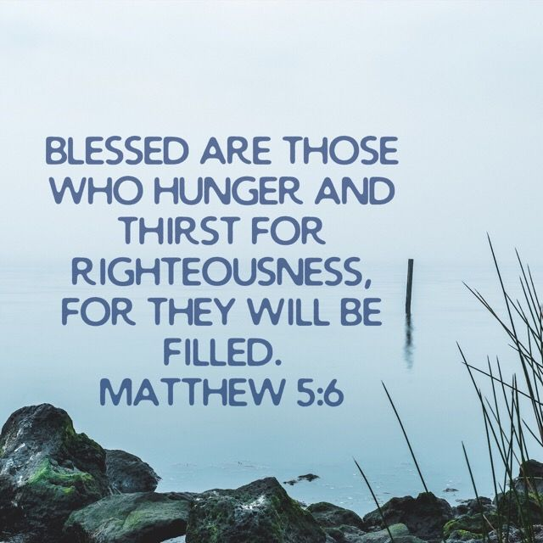
Israel Redeemed By God
Future Blessings
Isa 44:1-5 – “¹But now listen, O Jacob, My servant, and Israel, whom I have chosen: ²Thus says the Lord who made you and formed you from the womb, who will help you, ‘Do not fear, O Jacob My servant; and you Jeshurun whom I have chosen. ³For I will pour out water on the thirsty land and streams on the dry ground; I will pour out My Spirit on your offspring and My blessing on your descendants; ⁴and they will spring up among the grass like poplars by streams of water.’ ⁵This one will say, ‘I am the Lord’s’; and that one will call on the name of Jacob; and another will write on his hand, ‘Belonging to the Lord,’ and will name Israel’s name with honor.”
Notes:
But in chapter 44 the pendulum swings back again. While it is true that their sin has removed any obligation, God assures them judgment will not be the last word; their status before Him as a servant and witness is unchanged.
Isa 44:1-2 – The name “Jacob” means “deceiver” and that is in contrast to the name “Jeshurun”, which means “upright”, a name Israel is referred to as 3 times in Deuteronomy (Deut 32:15; 33:5; 33:26). This contrast is likely used to magnify the astonishment that God’s love actually continues despite their sin. They are His chosen servant, but they can’t demand deliverance on the basis of merit – it’s wholly grace. And the point of the pendulum swing could be to teach them to live in the reality of present grace while remembering past sin. God is not calling this deeply sinful people “upright” because they are upright, but because He holds them “upright” in His heart. Because even before Israel was born, God was forming her. They were “in the womb” during the Patriarchal period and during Egyptian bondage. This fact alone is evidence for why they should “fear not”.
Isa 44:3-4 – We saw this imagery back in chapters 32 and 35. By “rain from heaven”, He means the life-giving Holy Spirit which will transform the spiritual drought that was their lives. Not just a few drops, but “pour”. And not on just anyone, but the “thirsty”. God will not give up the multiplied descendants promised to Abraham. What was once dead and dry from drought will bloom abundantly. God will turn what is dead into life. See, drought is not always a bad thing; it causes the thirsty plants to sink their roots deep to look for water.
The result? – Isa 44:5 – These are Jews becoming true Israelites in spirit. Rather than being a nation mocked at, Israel will be a nation in which it would be an honor to be a member. There will be individual commitment. Not the act of an unthinking herd, but individuals who step forward to consciously give themselves to God. Through all possible modes of expression, mankind will declare they belong to the Lord.

Slide 5
Israel Redeemed By God
Certainty of blessings
Isa 44:6-8 – “⁶Thus says the Lord, the King of Israel and his Redeemer, the Lord of hosts: ‘I am the first and I am the last, and there is no God besides Me. ⁷‘Who is like Me? Let him proclaim and declare it; yes, let him recount it to Me in order, from the time that I established the ancient nation. And let them declare to them the things that are coming and the events that are going to take place. ⁸Do not tremble and do not be afraid; have I not long since announced it to you and declared it? And you are My witnesses. Is there any God besides Me, or is there and other Rock? I know of none.’”
Notes:
And central to God delivering His people is His uniqueness – Isa 44:6-8.
As their King, He will not allow Israel’s story to end in captivity. As Redeemer, He plays the part of the near kinsman to deliver His relative from tragedy. As Lord of Hosts, God has the power to carry out these wishes whenever He wants, in contrast w/the idols. The idea is that though the idols exert no real power, Jehovah is every type of power. Idols can’t be first because they need someone to make them; idols can’t be last because they’re subject to the elements, wearing out and breaking. But God is the first and the last, self-existing, self-sufficient.
And so, vs. 7 is a challenge in the form of conditions that’d have to be met for anyone to claim comparison w/God. He is asking for specific examples. Who can claim, declare, and recount events in order as God has done w/Israel since before its birth? And since God is now declaring future things, let idols/men do so correctly if they can. Only the first and last, who exists outside time, can do this. This is a repetitive challenge in 40 – 48 that is never taken up.
And if God is so unique, Israel can find security in Him. If He has their best interests in mind, that should erase all fears. And because of their knowledge of true divinity, they can be witnesses to the fact that since God had predicted captivity and return, He also has the power to promise and make it come true again. The character of God is the ultimate assurance of Israel. “Rock” = trustworthiness, changeless integrity. He is the only solid ground in which to build our life (Matt 7:24-27). “No other Rock” = nothing/no one reliable to rest on but Him.

Slide 6
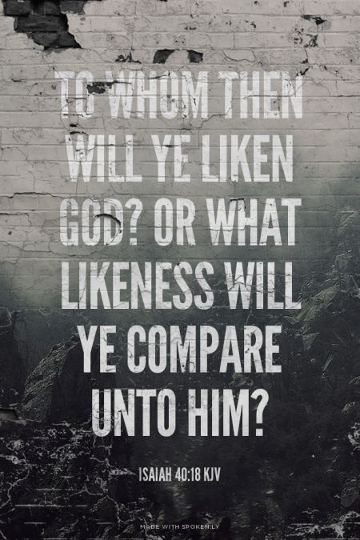
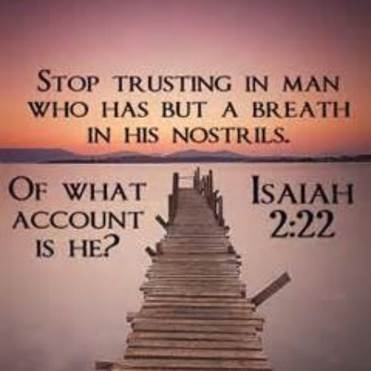
Israel Redeemed By God
Folly of idolatry
Isa 44:9-11 – “⁹Those who fashion a graven image are all of them futile, and their precious things are of no profit; even their own witnesses fail to see or know, so that they will be put to shame. ¹⁰Who has fashioned a god or cast an idol to no profit? ¹¹Behold, all his companions will be put to shame, for the craftsmen themselves are mere men. Let them all assemble themselves, let them stand up, let them tremble, let them together be put to shame.”
Notes:
Now, 44:9-20 is arguably one of the greatest sections of scripture that demonstrates the absolute folly and lunacy of idolatry. This is God now turning to the idol’s witnesses. What evidence do they have that their gods are supreme?
Isa 44:9 – The simplest definition of idolatry is “making God what you want Him to be”. But interestingly, there wouldn’t be an idol if Jehovah hadn’t provided the material, and man hadn’t fashioned the material to make it. But once they fashion it, it becomes a “precious thing”, inspiring infatuation. Yet what we call “precious” God calls “futile”, which is the same word for “formless” in Gen 1:2. So think about that – they are forming what is formless. And so, the idols’ witnesses have no credibility; they are writing their own fiction. They’re not innocent, but purposefully do so to their own disgrace.
Isa 44:10-11 – This is another Hebrew phrase intended to be sarcastic. Another way of saying it is, “Who would want to profit so little and to be so blind as to attempt to make God?”. If they’d simply stand back and look at their finished product w/consideration, they’d actually tremble at what they’d just done as their folly would finally striking home, because humans cannot make what is truly divine. But because they’re not seeing the implications of what they’d done, everyone linked in idolatry, both crafters and devotees, will be put to shame.

Slide 7
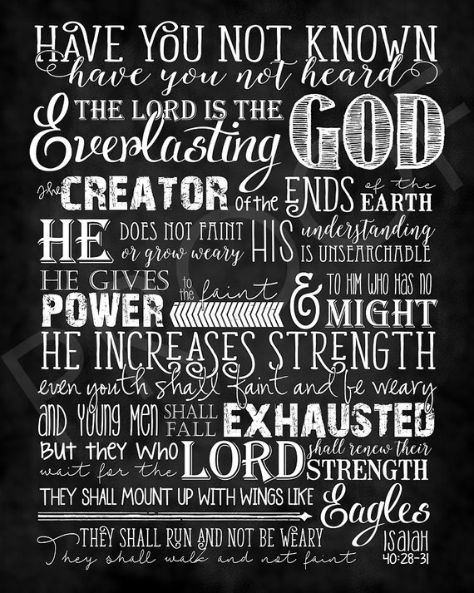
Israel Redeemed By God
Folly of idolatry
Isa 44:12-14 – “¹²The man shapes iron into a cutting tool and does his work over the coals, fashioning it with hammers and working it with his strong arm. He also gets hungry and his strength fails; he drinks no water and becomes weary. ¹³Another shapes wood, he extends a measuring line; he outlines it with red chalk. He works it with planes and outlines it with a compass, and makes it like the form of a man, like the beauty of man, so that it may sit in a house. ¹⁴Surely he cuts cedars for himself, and takes a cypress or an oak and raises it for himself among the trees of the forest. He plants a fir, and the rain makes it grow.”
Notes:
Isa 44:12-14 – There are 3 things honed in on:
1) The blacksmith: skillful, but dependent on diminishing strength that is in constant need of outside sustenance. How then can he make something of supernatural, self-sustaining strength? The idol makes no provision for this. The idol is in contrast w/the God who formed us so that we need not be weary (40:28-31). He carries us, we do not carry Him (45:20; 46:3). We have no need to hunger/thirst because He provides sustenance (43:19-20).
2) Carpenter: skillful, but has nothing in which to conceptionally draw on except the highest thing he knows: himself. Like a man, an idol needs a roof over its head to keep out the rain and four walls to keep out marauders. Throughout the entire procedure, the idol is passive, provides no aid to the carpenter, and exercises no control over its own appearance or dwelling. This is the doctrine of humanism at its core – we will be God, and God will be us.
3) Material: the chance way it suddenly becomes divine. Vs. 14 begins w/the felling and ends w/planting. Isaiah’s intention is to trace origin. While a tree is impressive, it derives from a seed which needs planting and nourishment. It is totally dependent on external forces over which the idol and maker has no control.

Slide 8
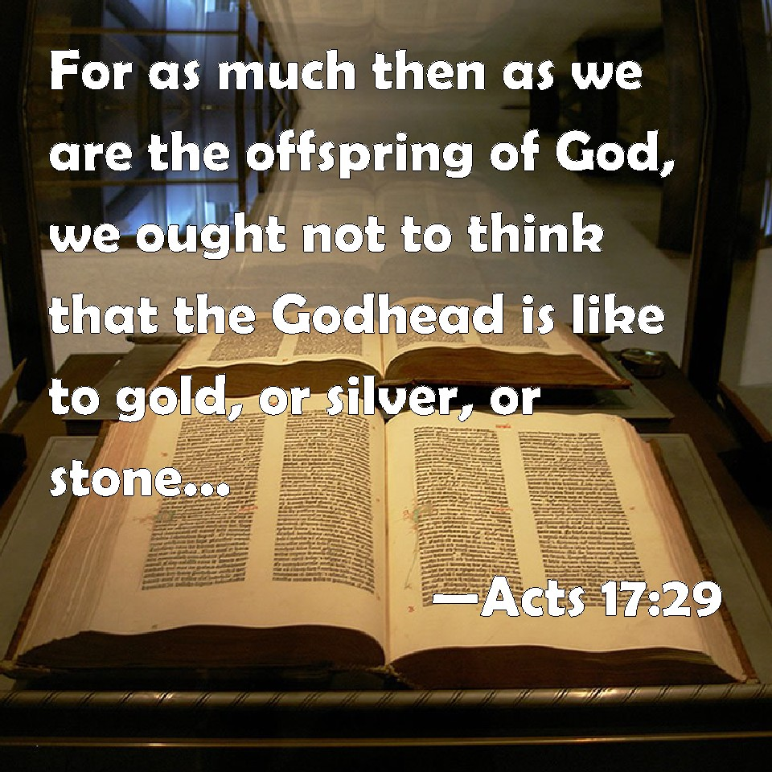
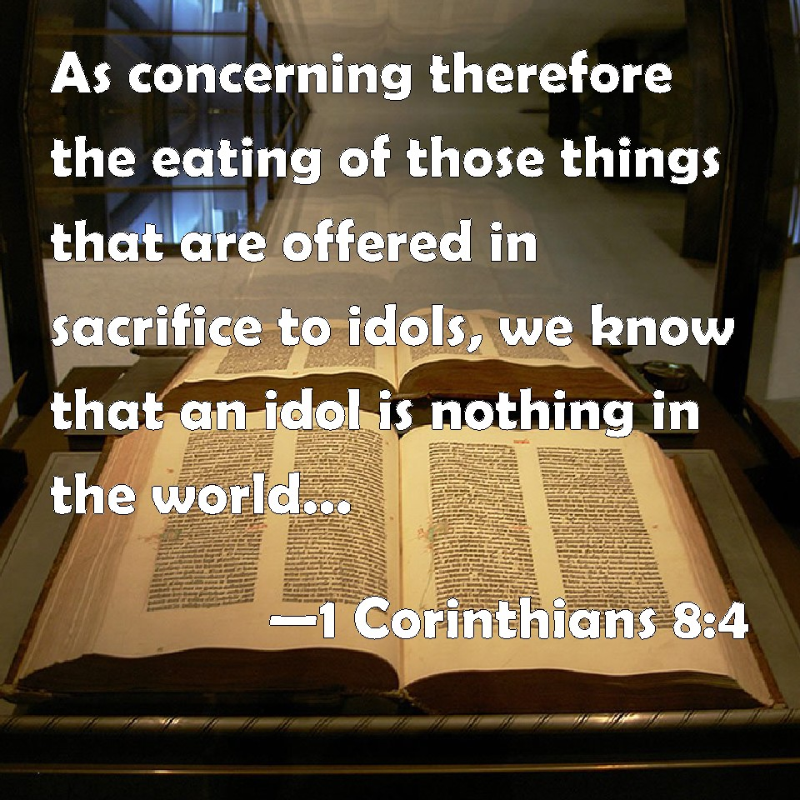
Israel Redeemed By God
Folly of idolatry
Isa 44:15-17 – “¹⁵Then it becomes something for a man to burn, so he takes one of them and warms himself; he also makes a fire to bake bread. He also makes a god and worships it; he makes it a graven image and falls down before it. ¹⁶Half of it he burns in the fire; over this half he eats meat as he roasts a roast and is satisfied. He also warms himself and says, ‘Aha! I am warm, I have seen the fire.’ ¹⁷But the rest of it he makes into a god, his graven image. He falls down before it and worships; he also prays to it and says, ‘Deliver me, for you are my god.’”
Notes:
Isa 44:15-17 – These 3 verses express incredulity on the part of God.
How can a log, put in service for human needs, also become a god demanding human service and offering deliverance? They make a god from the same material from which they cook food and warm themselves when, in reality, the gift of wood should be provoking thanksgiving toward the Creator (Rom 1:18-23).
And if half was used for burning and the other half for cooking, where did the idol actually come from? A word we’re used to hearing a lot of around Thanksgiving – Leftovers! The wood couldn’t save itself from the axe, being burned, and being carved, but now suddenly the surviving material becomes something that can save and deliver them. You see the folly? To believe that divinity resides in a block of wood that was a tree until someone cut it down and wrapped it in precious metal is crazy. If idols are a part of this world, how can they transcend and reshape the world? How can that which derives from great human care and craftsmanship then turn around and care for humans?

Slide 9
Israel Redeemed By God
Folly of idolatry
Isa 44:18-20 – “¹⁸They do not know, nor do they understand, for He has smeared over their eyes so that they cannot see and their hearts so that they cannot comprehend. ¹⁹No one recalls, nor is there knowledge or understanding to say, ‘I have burned half of it in the fire and also have baked bread over its coals. I roast meat and eat it. Then I make the rest of it into an abomination, I fall down before a block of wood!’ ²⁰He feeds on ashes; a deceived heart has turned him aside. And he cannot deliver himself, nor say, ‘Is there not a lie in my right hand?’”
Notes:
It is the very definition of lunacy, begging the question of how a person gets to this kind of place in life – Isa 44:18-20.
Such an abandonment of reason is the result of a corrupt heart. Remember that when Pharaoh repeatedly hardened his heart, God hardened it further. In the same way, when the idolator chooses delusion, he becomes even more deluded, the price for his desire being intellectual suicide (Rom 1:20-28). We don’t want a sovereign God to be grateful and obedient to. We want lives dictated by us. So, what the idolator does is bad enough, but failing to see it is worse.
They have no knowledge, meaning no facts to think about, and no understanding, meaning no ability to perceive the implications of the facts even if they had them. That they are resting their destiny on a piece of wood is an abomination in its strictest sense.
“Ashes” are totally void of life-giving properties yet made of the same material as their god. They might as well pray to dead embers. He may hold the idol in his hand, but the idol holds him in the bondage of deception. It gives an impression of being what it’s not, deceiving the one who trusts in it.

Slide 10
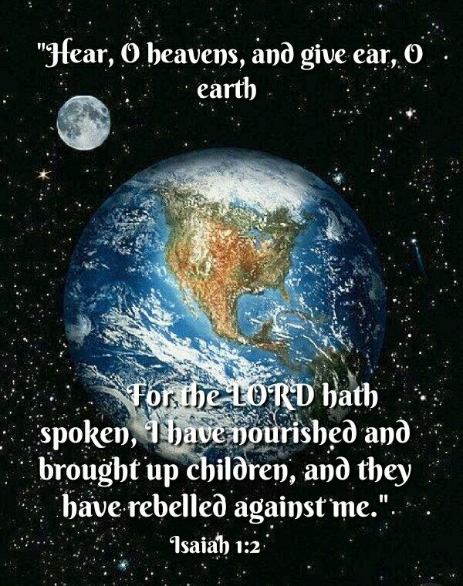
Israel Redeemed By God
Worldwide implications of blessing
Isa 44:21-23 – “²¹‘Remember these things, O Jacob, and Israel, for you are My servant; I have formed you, you are My servant, O Israel, you will not be forgotten by Me. ²²I have wiped out your transgressions like a thick cloud and your sins like a heavy mist. Return to Me, for I have redeemed you.’ ²³Shout for joy, O heavens, for the Lord has done it! Shout joyfully, you lower parts of the earth; break forth into a shout of joy, you mountains, O forest, and every tree in it; for the Lord has redeemed Jacob and in Israel He shows forth His glory.”
Notes:
And now He gives the implications of this – it is to remember Whose servant they truly are – Isa 44:21-23.
To “remember” is of central importance for us. By remembering, they are able to be His servants. He formed them for special service. That God has not forgotten means He remembers them, and so they need to remember Him. So, that they will be in captivity doesn’t mean He’s abandoned them, just that the fullness of time hasn’t yet arrived.
Again, physical deliverance was not Israel’s greatest need. The real cause of exile was sin, and the greater exile is sin. But God’s initiative alone won’t accomplish what they need. Rather than succumbing to the despair of exile, Israel must respond in faith by returning in repentance, one of Ezekiel’s primary goals. The greatest danger of exile was not God’s inability or unwillingness to act on their behalf, but Israel’s unwillingness to repent.
And since Israel’s Redeemer is also Creator, redemption will always have creation consequences. Remember from 1:2 that the universe was called on to witness Israel’s rebellion. Now, however, they’re called on to witness Israel’s salvation. All nature is bound up w/mankind’s history. Mountains are not to be locations for idol worship and trees are not to be used as such. God made them, and Israel’s redemption should bring rejoicing that they are no longer used for abominable practices. Ultimately, though, vs. 23 teaches that the world will feel the awesome implications for themselves of Israel’s redemption.

