Slide 1
Notes:
Hindsight allows us to see that Servant Song #1 is talking about Jesus. But the Jews would have looked at it as talking about them. So that there is no misunderstanding, Isaiah is going to explain how Israel’s blindness and deafness makes her unqualified to be this mystical servant. But despite what Israel has done to herself, God will reverse their disaster by delivering them from their captivity.

Slide 2
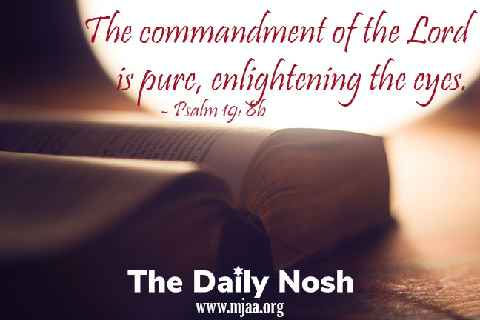
Israel Redeemed By God
Israel, the blind servant
Isa 42:18-22 – “¹⁸Hear, you deaf! And look, you blind, that you may see. ¹⁹Who is blind but My servant, or so deaf as My messenger whom I send? Who is so blind as he that is at peace with Me, or so blind as the servant of the Lord? ²⁰You have seen many things, but you do not observe them; your ears are open, but none hears. ²¹The Lord was pleased for His righteousness’ sake to make the law great and glorious. ²²But this is a people plundered and despoiled; all of them are trapped in caves, or are hidden away in prisons; they have become a prey with none to deliver them, and a spoil, with none to say, ‘Give them back!’”
Notes:
Having spoken to the blind/deaf of the Gentiles (42:16), He now calls out the deaf and blind servant: Israel (6:9-10)
Isa 42:18-19 – None were so blind as the nation God had chosen to bring light to the Gentiles. But while the Gentiles had been too blind to see the one true God, “deafness” is the unique failure for Israel because they had the law but would not “hear” it. The people most in need of these gifts has the least of them. This was willful, self-imposed blindness/deafness by the “Valley of Vision” (chapter 22). And the blind can’t be servants and the deaf can’t be messengers. And so, Servant Song #1 could not be fulfilled by literal Israel; this could only be accomplished by One who embodied the ideals and requirements of a servant (Jesus).
The worst part of it was they had what they needed, but didn’t use it – Isa 42:20 – They possessed divine revelation but ignored it. To have the faculties to see and hear yet deliberately decide not to use them is a heart problem. And they will remain blind and deaf as long as they can’t admit their need (John 9:39-41).
Isa 42:21 – In other words, the weakness was not in the law – it was in the people. The commandment of the Lord is pure, enlightening the eyes (Psa 19:8). The phrase “the Lord was pleased” is the same as in 53:10. But for the law to truly be great, the penalties for not keeping it would have to be executed, otherwise it’s meaningless (Rom 7:12).
Hence, Israel’s current physical condition – Isa 42:22 – The purpose of God’s law was never achieved because Israel, through her sin, activated judgment that empowered other nations over them. They are far from able to lead the blind as they themselves are blind and need deliverance. They are in pain, devastation, and no one but God alone is even seeking their return from the very captivity they brought on themselves. These contain the root Hebrew words for Maher-shalal-hash-baz (8:3).

Slide 3
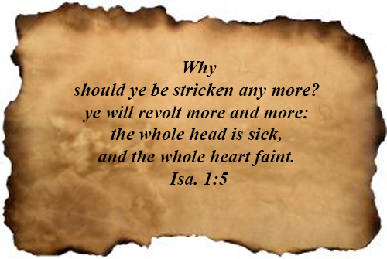
Israel Redeemed By God
Israel, the blind servant
Isa 42:23-25 – “²³Who among you will give ear to this? Who will give heed and listen hereafter? ²⁴Who gave Jacob up for spoil, and Israel to plunderers? Was it not the Lord, against whom we have sinned, and in whose ways they were not willing to walk, and whose law they did not obey? ²⁵So He poured out on him the heat of His anger and the fierceness of battle; and it set him aflame all around, yet he did not recognize it; and it burned him, but he paid no attention.”
Notes:
Isa 42:23 – In other words, Isaiah is preparing the people to be in a position in the “hereafter” to interpret unwelcome events as they unfold. Expresses an earnest desire that someone would draw the appropriate conclusions to their past judgments as to be positively affected in the future (Rom 15:4).
Isa 42:24 – “We” turns to “they”, as if while Isaiah does associate himself w/national sin (6:5), he disassociates himself w/national refusal of the Lord’s law (8:16-20). This is the reason behind Israel’s unfitness to be God’s true servant, and the necessity of Servant Song #1. Some might answer these questions wrongly (idols, God doesn’t love me, blame game, etc.). But idols weren’t strong enough to send Israel into captivity, nor strong enough to keep her there. God did this. Not because He is unloving, but as an expression of His holiness. Not for someone else’s sins, but for their sins (Ezek 18:1-3). But in order for them to return, there would have to be a change of the attitude that got them there.
Isa 42:25 – This tells us who the Servant cannot be. Judah is so blind, even the heat of God’s anger is not enough to provoke a spiritual reaction. When we’re so numb to our sin that we don’t hurt over it (1:5), drastic measures must be taken. God only used these measures after He exhausted far gentler measures. The fire, rather than burning away the sin and impurity, just made them blacker and harder.

Slide 4
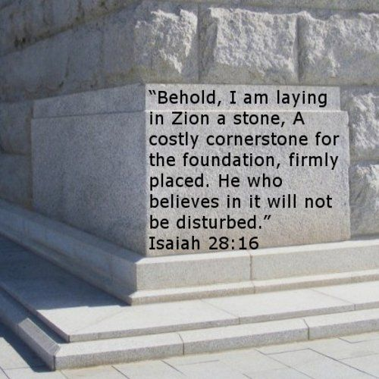
Israel Redeemed By God
Disaster reversed, Israel redeemed
Isa 43:1-3 – “¹But now, thus says the Lord, your Creator, O Jacob, and He who formed you, O Israel, ‘Do not fear, for I have redeemed you; I have called you by name; you are Mine! ²When you pass through the waters, I will be with you; and through the rivers, they will not overflow you. When you walk through the fire, you will not be scorched, nor will the flame burn you. ³For I am the Lord your God, the Holy One of Israel, your Savior; I have given Egypt as your ransom, Cush and Seba in your place.’”
Notes:
And yet, the fire will not have the last word. There will be grace. This is one of the great “You sinned…but God” passages in the bible (like Eph 2).
Isa 43:1 – Exile should not rob them of their sense of identity because the Lord cannot go back on what He’s promised. If He “created” (37:15), He controls. He “formed” (Gen 2:7) them w/the intimate, painstaking care as a potter’s hand, putting the exact amount of pressure to yield a finished spec. He “redeemed” them, giving His helpless “relative” the rights of next-of-kin. To “call them by name” (4:1) is to betroth them to Himself. All 4 description show undisputedly the degree to which His people are truly His.
Isa 43:2 – An encouragement not to equate the rigors of captivity w/the absence of God’s care (Rom 8:31-39). Water and fire suggests total judgment. “When”, not “if” suggests the inevitability of extreme hardships imposed on captives. Walking” rather than “running” through fire shows calmness and clarity (Isa 28:16). Joseph’s story replete with “God was with him”. A literal demonstration given in Dan 3:27. What is true of Israel is equally true w/the church.
Isa 43:3 – The One who calls Israel by His name now gives His names. In all 3 cases, emphasis is on whose He is. Your God, of Israel, your Savior. Israel is the Lord’s, but the Lord is Israel’s. “The Lord your God” is an Exodus title (Ex 3:14; 6:3; 20:2). Egypt, Cush, and Sheba appear to have become the vicarious compensation for Israel’s deliverance. If the innocent can be a ransom for the righteous (2 Cor 5:21; Matt 20:28), why can’t the wicked? (Prov 21:18).

Slide 5
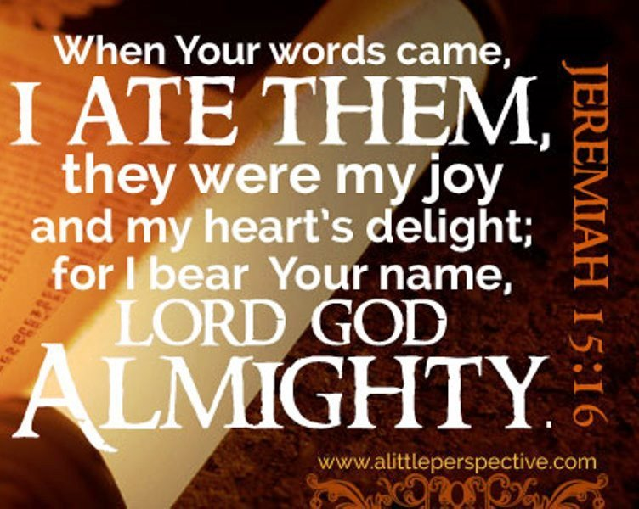
Israel Redeemed By God
Disaster reversed, Israel redeemed
Isa 43:4-7 – “⁴Since you are precious in My sight, since you are honored and I love you, I will give other men in your place and other peoples in exchange for your life. ⁵Do not fear, for I am with you; I will bring your offspring from the east, and gather you from the west. ⁶I will say to the north, ‘Give them up!’ And to the south, ‘Do not hold them back.’ Bring My sons from afar and My daughters from the ends of the earth, ⁷everyone who is called by My name, and whom I have created for My glory, whom I have formed, even whom I have made.””
Notes:
Any why is He so willing to find a ransom?
Isa 43:4 – Not due to intrinsic worth, but because of who God is. Language is of what a groom would think of his bride – others may fail to see her qualities, but to him she is worth it. That He knows how sinful they are (42:18-25) makes them no less precious. Love involves choice and exclusion (John 3:16).
Isa 43:5-6 – Confirms the promise made by Moses in Deut 30:3-6. The fact is, any nation, whether Egypt, Babylon, etc. that seeks to prevent God’s people from coming to Him will be dealt with. So, while literally true of Babylonian captivity, anyone that wishes to come to God can do so, for the kingdom is “within you” (Luke 17:21). Lost sinners, no matter where they are, will return to Him w/their whole heart (Jer 24:7). They are not just considered a bride, but sons and daughters. It’s as if in these verses, God is covering every relationship of any intimacy imaginable to show God’s feelings towards those He chooses for Himself.
Isa 43:7 – Chiastic end to vs. 1. Their special relationship w/God offers security (vs. 1 – 7) and now affirms the certainty of future hope (vs. 4 – 7). The only thing that qualifies them for restoration is that God has called them by His name (Deut 28:10; Jer 14:9; 15:16; Ezek 36:20). He does this for His glory and that means He cannot allow them to stay in exile. This is a new “creation” in which we’re created for a purpose: to bring God glory. We cannot do so while still in exile. He is infinitely greater than the idols and must prove it.

Slide 6
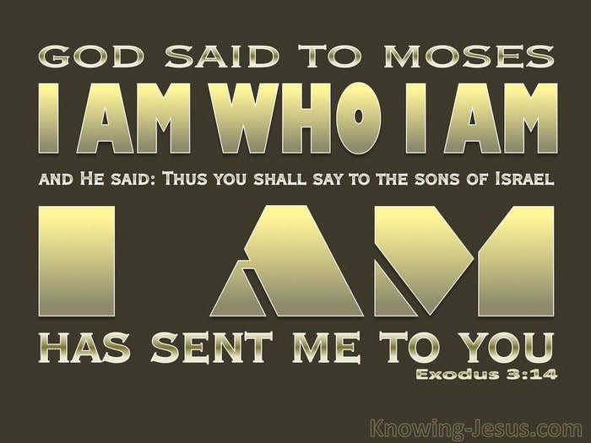
Israel Redeemed By God
Certainty of God’s promises
Isa 43:8-10 – “⁸Bring out the people who are blind, even though they have eyes, and the deaf, even though they have ears. ⁹All the nations have gathered together so that the peoples may be assembled. Who among them can declare this and proclaim to us the former things? Let them present their witnesses that they may be justified, or let them hear and say, ‘It is true.’¹⁰‘ You are My witnesses,’ declares the Lord, ‘And My servant whom I have chosen, so that you may know and believe Me and understand that I am He. Before Me there was no God formed, and there will be none after Me.”
Notes:
Back to the courtroom:
Isa 43:8 – The theme is “witnesses”. One party is Gentile. Can the idols produce Gentile witnesses that confirm their ability? Another party is the blind and deaf (42:18-25; 43:22-28). No one would call on the blind/deaf to witness unless the evidence was irrefutable, and since captivity and deliverance had been predicted w/clarity and precision, even the blind/deaf can come to trial as star witnesses. They may be insensitive to the meaning of their experiences, but they can still testify to its facts.
Isa 43:9 – This is the gathering of the nations for a trial. Large nations, which could serve as inspiration for the judgment scenes in Rev. The capacity to say what one will do and then do it w/o hindrance is a true mark of deity. So, it is foolishness to depend on idols or to fear them. To ask the idols to present witnesses is either dangerous or bold, but speaks to God’s certainty that none can match Him. And so, listen to God. What He says is truth.
Isa 43:10 – Servant status (42:19) carries the responsibility of witnessing. They are not to simply be spectators at the trial, but to testify of His unique deity. They must first know themselves that He is God, then others. However, they were never able to fulfill this ideal, only Jesus could (Heb 10:9). Calling on them to see Him as He identified Himself to Moses in Ex 3:14 – I AM. The Lord proceeds from none and is succeeded by none. Before gods were made, He was. After all the gods are gone, He will be. “Formed” likely sarcasm. There are no “junior gods”.

Slide 7
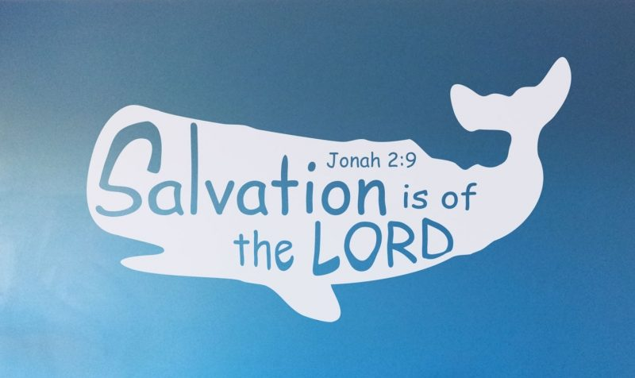
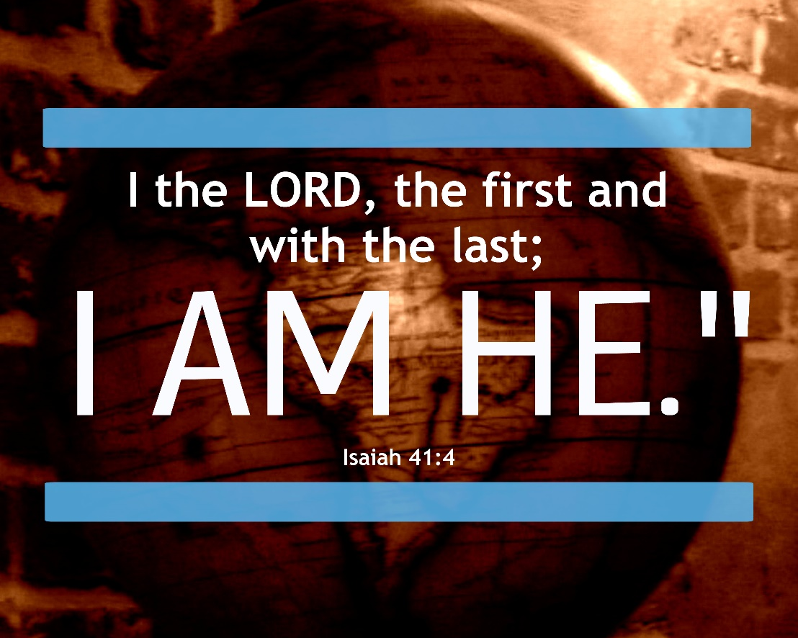
Israel Redeemed By God
Certainty of God’s promises
Isa 43:11-13 – “¹¹‘I, even I, am the Lord, and there is no savior besides Me. ¹²It is I who have declared and saved and proclaimed, and there was no strange god among you; so you are My witnesses,’ declares the Lord, ‘And I am God. ¹³Even from eternity I am He, and there is none who can deliver out of My hand; I act and who can reverse it?’”
Notes:
12 out of the 29 Hebrew words in vs. 11 – 13 are first person singular, emphasizing monotheism.
Isa 43:11 – Exodus events clearly in mind (Ex 3:14-15; 33:19-34:8). Not only has He demonstrated His character, but also His capacity to save above all odds (Jon 2:9). He both predicts salvation and actually saves.
Isa 43:12 – No other agency, human or god, can save as God can. God saved them in the absence of other gods, whether through Abraham, Exodus, Judges, Assyria, etc., no god did or will do for Israel what God does. Israel is a witness, by their mere survival, that their God is one. We should turn to Him as our Savior as a first resource and not last resort.
Isa 43:13 – Still a court scene. God now assumes the role of presiding Judge and announces the verdict. He was present w/the first generation and he will be w/the last (41:4). Before there was ever a day, God was. So, who can hinder His sovereign choices? None.

Slide 8
Israel Redeemed By God
A new exodus
Isa 43:14-15 – “¹⁴Thus says the Lord your Redeemer, the Holy One of Israel, ‘For your sake I have sent to Babylon, and will bring them all down as fugitives, even the Chaldeans, into the ships in which they rejoice. ¹⁵I am the Lord, your Holy One, the Creator of Israel, your King.’”
Notes:
Babylon is now mentioned for first time since 39:3-6, and its overthrow promised.
Isa 43:14 – As Redeemer, He sees to all the needs of His people. As the Holy One of Israel, He must punish sin. Though He’d send Cyrus to Babylon, it was by His power. Babylon would themselves become fugitives, rushing for the very Chaldean ships that once brought them so much wealth on the Euphrates (13:14). The object of their pride thus becomes the object of their shame.
Isa 43:15 – As their Holy One and Creator, He will continue w/purposeful care. This is not because of who they are, but who He is and Who they belong to. As King (2 Sam 7), He’ll deliver them according to His own pleasure.

Slide 9
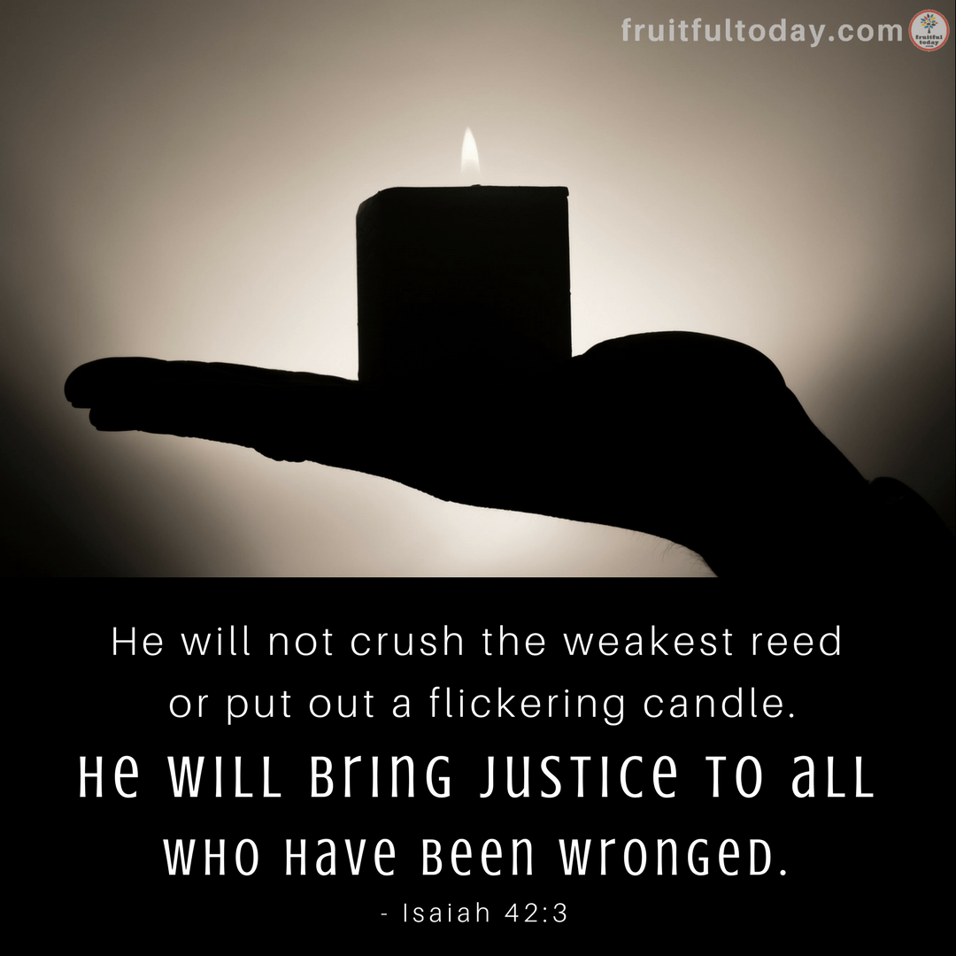
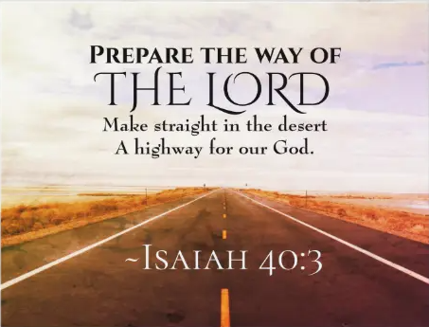
Israel Redeemed By God
A new exodus
Isa 43:16-19 – “¹⁶Thus says the Lord, Who makes a way through the sea and a path through the mighty waters, ¹⁷Who brings forth the chariot and the horse, the army and the mighty man (They will lie down together and not rise again; they have been quenched and extinguished like a wick): ¹⁸‘Do not call to mind the former things, or ponder things of the past. ¹⁹Behold, I will do something new, now it will spring forth; will you not be aware of it? I will even make a roadway in the wilderness, rivers in the desert.”
Notes:
Isaiah now takes the Highway of Holiness and combines it w/an Exodus theme.
Isa 43:16-17 – “Red Sea” becomes opening for Israel and a pit for her enemies. Israel’s faith is not to be in the events themselves, but in the Object behind the event: God. In contrast to the Servant in 42:3, the wicks of God’s enemies will be extinguished (Psa 76:5-6). God, not Egypt/Babylon, is the leader of their armies. Their lying down and quenching is permanent.
Isa 43:18 – So, in one sense, we must remember the past (vs. 16-17). In another sense, we must forget it. The Exodus can be a teaching tool, but our gaze must continue to be forward to what God will do (46:9). Going “Uncle Rico” can cause us to miss God’s new actions (Mark 9:5-6; John 1:11). It’s a new exodus that stands out in its own right (Jer 23:7-8).
Isa 43:19 – The new thing is a Babylonian deliverance patterned after the Exodus. In deserts, where men are so easily lost because there is no way of travel, God will create waterways, places easily traveled (40:1-4). It is starting to spring forth even if well before its time, and they need to be aware of it even before captivity begins.

Slide 10
Israel Redeemed By God
A new exodus
Isa 43:20-21 – “²⁰The beasts of the field will glorify Me, the jackals and the ostriches, because I have given waters in the wilderness and rivers in the desert, to give drink to My chosen people. ²¹The people whom I formed for Myself will declare My praise.”
Notes:
The redeemed are the center of humanity, and humanity is the center of Creation. So, what God will do for His people ultimately brings the entire world in harmony.
Isa 43:20 – God’s blessings to His faithful always become blessings to “desert dwellers”, those who dwell in darkness. All creation benefits (Job 38:7; Psa 96:12-13; Isa 55:12). In Exodus, God’s plagues killed the fish and beasts of the land. Now they’ll give honor.
Isa 43:21 – We don’t form God. He forms us (29:16; 41:7; 43:1,7). Pottery imagery. God’s people are applied w/the perfect pressure from the Craftsman’s hand to be the ultimate source of praise toward God – 1 Pet 2:9.

