Slide 1
Notes:
Chapters 40:1 – 41:20 gives consolation to the Jews who are in captivity by proving that God is sovereign over world history. He will rescue them from their slavery and judge those who have enslaved them in the process. But is that the end of the story for the Gentiles? What can God to for them, who in their spiritual infancy, continue to cling to idols in their moments of distress (41:5-7)? What can God do to help Gentiles in their need? First, He will continue to expose the foolishness of idolatry. Secondly, He will introduce them to a Servant who will “bring justice to the nations”. The Gentile world’s reaction to this will be to one day sing for joy.

Slide 2
Consolation of the Gentiles
Lord’s Verdict
Isa 41:25-26 – “²⁵‘I have aroused one from the north, and he has come; from the rising of the sun he will call on My name; and he will come upon rulers as upon mortar, even as the potter treads clay.’ ²⁶Who has declared this from the beginning, that we might know? Or from former times, that we may say, ‘He is right!’? Surely there was no one who declared, surely there was no one who proclaimed, surely there was no one who heard your words.”
Notes:
Since the idols are silent and cannot predict the future or interpret the past, God once again returns to the subject of Cyrus who was introduced in vs. 2.
Isa 41:25 – Rising of the sun = east. By his actions he will proclaim the name of the Lord, and he’ll recognize the source of his commission (2 Chron 36:22-23; Ezra 1:2). Cyrus’ defeat of the rulers will be ruthless and they will be powerless to stop him since He is doing this by God’s will.
Isa 41:26 – Point: the Lord is awarded the verdict. No one has predictive power except Him. And He spoke this prediction so clearly, all would know. History works like scientific theory; if someone claims to understand a process, then he must be able to predict how that process will unfold given certain circumstances. It is a triad that progresses from revealer to listener: none revealed, none made anyone hear, none heard. The people aren’t disregarding the idols; they don’t even hear such words.

Slide 3
Consolation of the Gentiles
Lord’s Verdict
Isa 41:27-29 – “²⁷‘Formerly I said to Zion, ‘Behold, here they are.’ And to Jerusalem, ‘I will give a messenger of good news.’ ²⁸But when I look, there is no one, and there is no counselor among them who, if I ask, can give an answer. ²⁹Behold, all of them are false; their works are worthless, their molten images are wind and emptiness.”
Notes:
Isa 41:27 – Prediction now becomes interpretation. Not just foretelling future events, but drawing out meaning and significance surrounding the event, that Zion will be the one delivered and that Cyrus (or the true prophets as opposed to silent idols?) would be the one to give the good news that the Jews may return home.
Isa 41:28-29 – Court case summed up a 2nd time, exposing the shallowness of idols, particularly of those who make them and rely on them for help. It is a hushed silence in the courtroom. The Gentile world is w/o a sure voice and revelation of what is to come. It’s fraudulent religion. Who can give counsel to Wonderful Counselor? (9:6). Molten images, all of them, are part of creation, and creation cannot know what it has not yet experienced. Zion’s God is the only source of salvation, a repetitive theme.

Slide 4
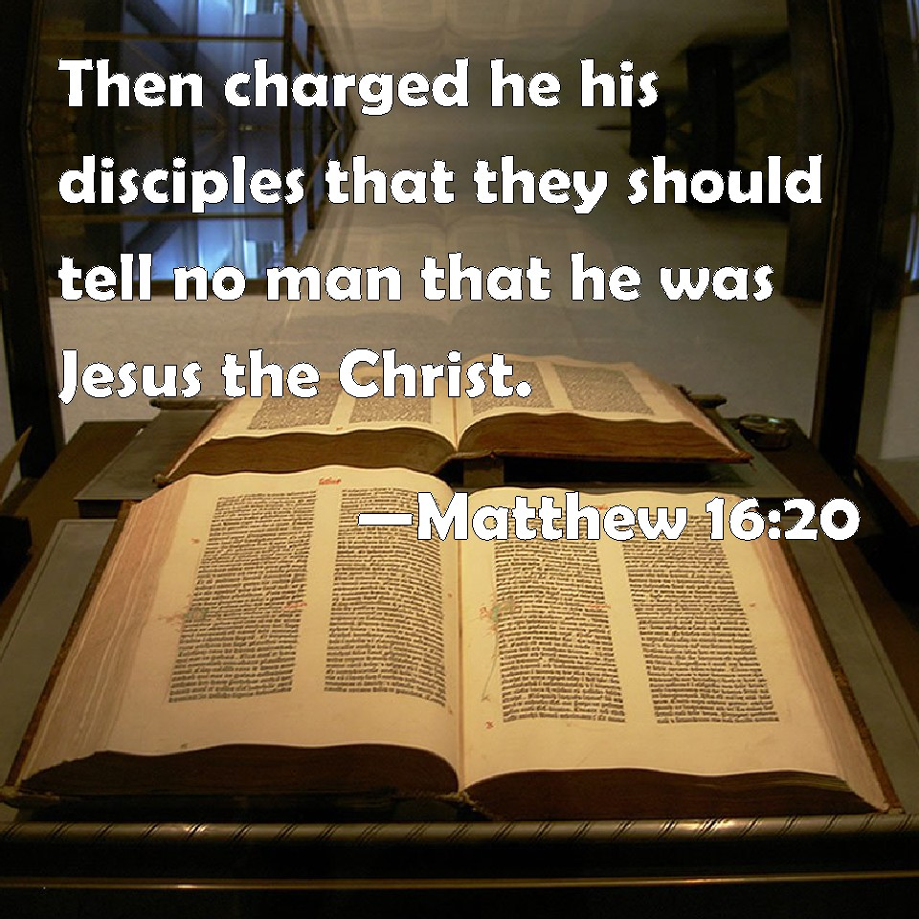
Consolation of the Gentiles
Servant Song #1
Isa 42:1-2 – “¹Behold, My Servant, whom I uphold; My chosen one in whom My soul delights. I have put My Spirit upon Him; He will bring forth justice to the nations. ²He will not cry out or raise His voice, nor make His voice heard in the street.”
Notes:
Isa 42:1 – “Behold” idol gods (41:24), idolators (41:29), and now God’s servant – 42:1. Links and sharply contrasts chapter 41 w/Servant Song #1. Jesus is the remedy for all the emptiness of idolatry and lack of insight (41:28). Quoted in Matt 12:15-21. “Servant” can be corporate (Israel) or individual (Messiah), but through Jesus’ perfect obedience, He’ll become the ideal of corporate Israel that will bless the nations (Gen 12:3). Theme of Servant Song #1 is justice, in scope, perseverance, and reliability. Having found no justice in Jerusalem, He’ll bring justice w/Him. “Uphold” = “to grip fast” – the Master takes care of His Servant. Not just chosen by God, but w/deep affections (Matt 3:13-17; 17:5). Spirit = God’s personal presence.
Isa 42:2 – Conquerors forced their religion on the conquered. Jesus’ ministry will be unaggressive (53:7). Rather than force the message through shouting, bluster, and calling attention to Himself, He would calmly present truth and let it alone do the transforming – John 7:46. He didn’t come to “toot His own horn”. Redpath – “Think for a moment about the modesty of God. He is always at work: He guides the sun, the stars, and the universe. He controls every galaxy. He refreshes the earth constantly. But He works so quietly that many people now try to make out there is no God at all… That is the hallmark of reality in service. God’s artists do not put their signatures to the pictures they create. His ambassadors do not run after the photographer all the time to get their pictures taken. It is enough that they have borne witness to the Lord.”

Slide 5
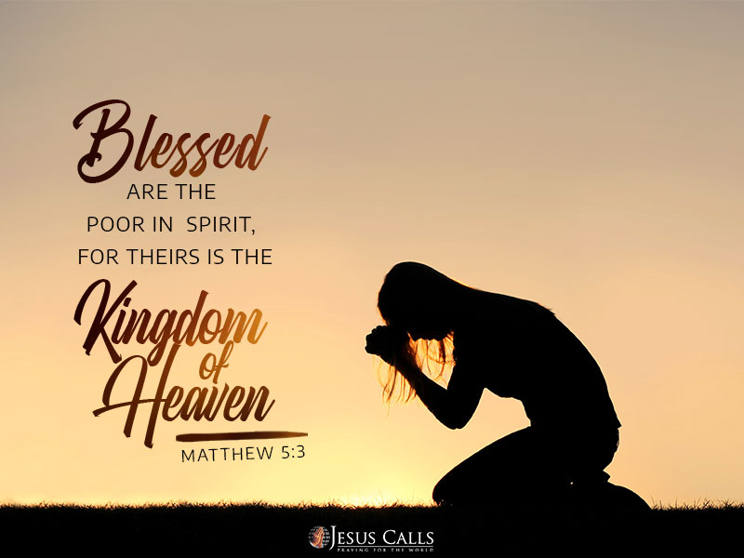
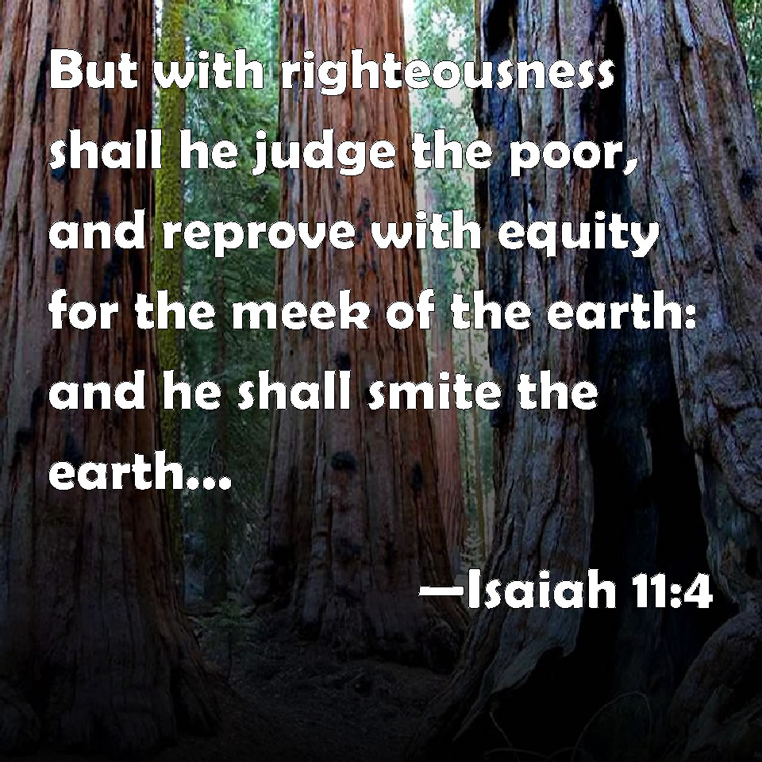
Consolation of the Gentiles
Servant Song #1
Isa 42:3-4 – “³A bruised reed He will not break and a dimly burning wick He will not extinguish; He will faithfully bring forth justice. ⁴He will not be disheartened or crushed until He has established justice in the earth; and the coastlands will wait expectantly for His law.”
Notes:
Isa 42:3 – Nothing is so weak, useless, or broken that He cannot help them. Redpath – “Think again of that reed: something that has been crushed, or hurt by unkindness, a life that is somehow bent and bruised and shattered, without strength or beauty. There is nothing attractive about a reed, and there is certainly nothing very pleasant about the circumstances in which it lives! Usually it grows in a smelly, unsavory swamp.” All life is precious. Like the child of ch. 9 and the branch of ch. 11, He can empower the powerless beyond all comprehension (Matt 5:3-12). Also, the oppression that broke them will meet faithful justice (11:3-4). The fruit He yields will prove that violence and oppression are not justifiable means for accomplishing anything, unless it is He Himself who is oppressed for others (52:13-53:12). Characterized by such a gentle spirit, this servant cannot possibly be Cyrus.
In contrast, He will not succumb to the pressures that immobilize others – Isa 42:4 – This opens the door for the fact that something may happen to the Servant that would discourage most. And what we’re going to see later is that each Servant Song increases in hostility and opposition. “Established” used in Deut 4:44 of Moses setting the Law before Israel. However, what was the privilege of a few would become worldwide, and the Gentiles would stake their future on what he reveals to them (Mal 2:17-3:1). Links up w.11:4, proving it is the same person.

Slide 6
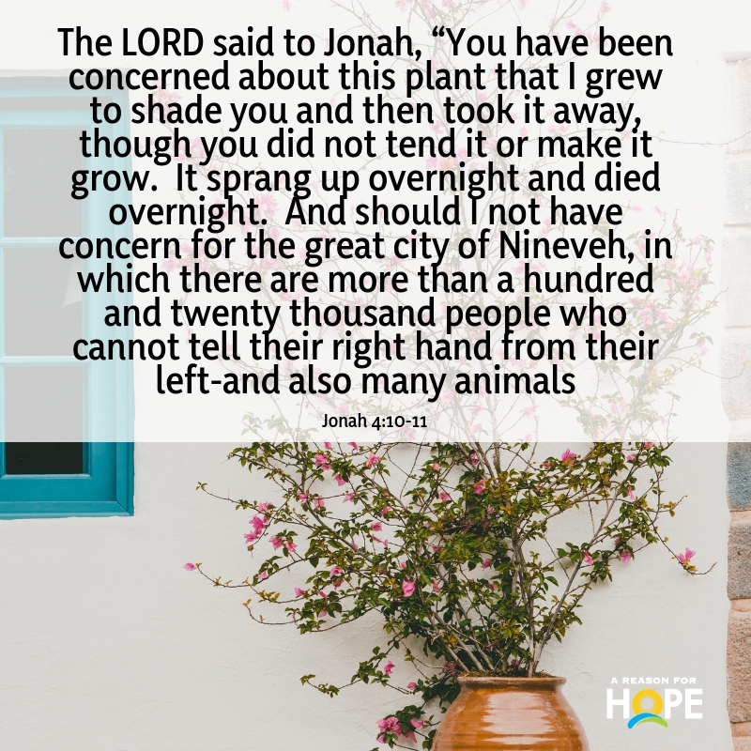
Consolation of the Gentiles
Servant Song #1
Isa 42:5-7 – “⁵Thus says God the Lord, Who created the heavens and stretched them out, Who spread out the earth and its offspring, Who gives Who gives breath to the people on it and spirit to those who walk in it, ⁶‘I am the Lord, I have called You in righteousness, I will also hold You by the hand and watch over You, and I will appoint You as a covenant to the people, as a light to the nations, ⁷to open blind eyes, to bring out prisoners from the dungeon and those who dwell in darkness from the prison.”
Notes:
Each Servant Song concludes w/confirmatory comments. The One making the promise states His credentials, providing a “credit check”.
Isa 42:5 – 40:12 was designed to show Judah that the Almighty God would not forget them (37:16), but this promise now turns to the world. Judah’s God is truly “God the Lord” over all universal life. Just look up (5a), look down (5b), and look inside (5cd). The Giver of life has concern for everyone’s spiritual well-being (Jon 4:10-11).
Isa 42:6-7 – Air of certainty w/the calling – “I am the Lord”. Called in righteousness like Cyrus (41:2). But in contrast to the destroying servant, this is a beneficent Servant. The conquering servant drives the nations to more idolatry (41:5-7), but this Servant brings them to God. Each has a place in God’s plans. With the call, He accompanies, safeguards, and accomplishes settled plans of keeping a people as His own possession by covenant (Ex 6:2-7). “Light” = truth. He will heal spiritual blindness (29:18; 35:5; Acts 26:17-18). He will end restrictions imposed by others. The light of truth will pierce the darkest of prisons (John 8:31-36; Gal 4:8).

Slide 7
Consolation of the Gentiles
Servant Song #1
Isa 42:8-9 – “⁸I am the Lord, that is My name; I will not give My glory to another, nor My praise to graven images. ⁹Behold, the former things have come to pass, now I declare new things; before they spring forth I proclaim them to you.’”
Notes:
Isa 42:8-9 – God doesn’t exist incognito in a world of gods. His identity is His name; His glory cannot be shared. He alone explains the course of history and accurately predicts in advance what He’ll do. If God were to leave Israel in bondage, the world would’ve believed He was just another idol. He must deliver them from bondage to take away glory and praise from the idols (48:11; Ezek 36:19-25). That God will not share His glory w/another is proof that Jesus is God (John 17:5). On the basis of prophecies already fulfilled (Hezekiah, Ahaz, etc.), the people should believe that the new things (Cyrus & Jesus) will also occur, further confirmation of who the true God is. If God is Master of both the past and future, He has the present well in hand.

Slide 8
Consolation of the Gentiles
Rejoicing Over The Lord’s Victory
Isa 42:10-12 – “¹⁰Sing to the Lord a new song, sing His praise from the end of the earth! You who go down to the sea, and all that is in it. You islands, and those who dwell on them. ¹¹Let the wilderness and its cities lift up their voices, the settlements where Kedar inhabits. Let the inhabitants of Sela sing aloud, let them shout for joy from the tops of the mountains. ¹²Let them give glory to the Lord and declare His praise in the coastlands.”
Notes:
In the bible, when God does something amazing, it calls for a new song. And being a light to all the nations, everyone joins in the song.
Isa 42:10 – What God will accomplish through His Servant is so exciting, Isaiah breaks into an ecstatic song of praise. The entire world is brought into the chorus, as this will be worldwide salvation for all touched by the Servant. “New song” = response to the fresh realization of God’s goodness of the “new things” from vs. 9 (Psa 98:1; Rev 5:9-10). Cyrus provoked terror in the Gentiles; Jesus provokes song.
Isa 42:11 – These were neighboring Gentile areas in Palestine. Kedar was Ishmael’s 2nd son (Gen 25:13; Isa 21:16-17). Likely represented a nomadic Arabian tribe then. Sela was a prominent Edomite city, later known as Petra (16:1). Even Edom, w/all its formal hostility, will find reason to rejoice (34) suggesting those most at odds w/God and His people can still come to Him.
Isa 42:12 – This vs. is merely a recapitulation. The song was first heard from the lips of the seraphim (6:3). Now it extends to all the world to its farthest extent. And since God will not give His glory or praise to another (vs. 8), all are to give glory and praise to Him. This audible praise will not just be an effect, but a cause for others to come to Him.

Slide 9
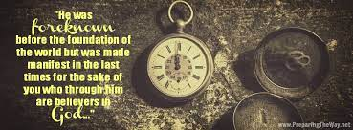
Consolation of the Gentiles
Rejoicing Over The Lord’s Victory
Isa 42:13-15 – “¹³The Lord will go forth like a warrior, He will arouse His zeal like a man of war. He will utter a shout, yes, He will raise a war cry. He will prevail against His enemies. ¹⁴‘I have kept silent for a long time, I have kept still and restrained Myself. Now like a woman in labor I will groan, I will both gasp and pant. ¹⁵I will lay waste the mountains and hills and wither all their vegetation; I will make the rivers into coastlands and dry up the ponds.”
Notes:
Isa 42:13 – Vs. 13-15 = noise, silent, noise. Though it seems as if God is being idle during our distress, He will burst forth for His people when the timing is right. The foolishness of trusting in idols will then be exposed. Warrior = God fighting on behalf of His people (Ex 15:3). Israel wanted a king to fight for them in 1 Sam 8:20. God, not Cyrus, will ultimately deliver Israel from her captives. But when He is done bruising the serpent’s heal, it is His own blood that stains His garments (52:13-53:12). What a contrast to 42:2!
Switches to 1st Person: God’s own promise. Isa 42:14 – “Long time” = “from eternity”. God has been eager to send the Servant from eternity (1 Pet 1:20). This longing is compared to a mother anxiously wanting to deliver her baby. It has been difficult for Him to hold His peace and constrain Himself while idolatrous nations hurt His people and attempt to undo His plans. Now He will intensely achieve His purposes, w/pent up zeal about to explode (Acts 17:30; Rom 3:25). Just because it seems as if nothing is happening doesn’t mean He has forgotten us.
Isa 42:15 – Contrast w/41:18-19. While God provides sustenance for His desert travelers, He also removes the obstacles that prevent them from getting to Him – 35; 40:4. No obstacle can get in the Lord’s way from doing what He has purposed, which Isa 40 so ably shows.

Slide 10
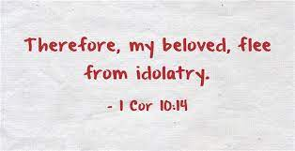
Consolation of the Gentiles
Rejoicing Over The Lord’s Victory
Isa 42:16-17 – “¹⁶I will lead the blind by a way they do not know, in paths they do not know I will guide them. I will make darkness into light before them and rugged places into plains. These are the things I will do, and I will not leave them undone.’ ¹⁷They will be turned back and be utterly put to shame, who trust in idols, who say to molten images, ‘You are our gods.’”
Notes:
In addition to removing all obstacles, God will remove the obstacles we ourselves create. He rescues those incapacitated through blindness.
Isa 42:16 – The blind do pretty well in familiar territory, but in “paths they do not know”, they need a guide. So, unless God guides us, we are helpless (42:7). He also cures the blindness by making “darkness into light” (1 Cor 2:9). And He removes rugged places in which one might stumble. The magnitude of what He is predicting sounds impossible, and it can only be accomplished by God.
Isa 42:17 – So there will be those who are saved and those who will cling harder to perdition. The blind can never transcend their blindness, only sink deeper into disgrace (John 3:19-21). They go “back”wards, not forwards (vs. 16). The tragedy of their choice will run its course.

