Slide 1
Notes:
The book of Isaiah is about learning to trust in God. And throughout the first 39 chapters of this book, God demonstrates His trustworthy while at the same time demonstrating the uselessness of trusting in self or other people. The climax of this was in chapters 36 – 37 where God’s miraculous defeat of the Assyrian army makes plain that God can indeed be trusted. Yet chapters 38-39 taught us that even the best of God’s people struggle to maintain this trust as Hezekiah failed to glorify God to the Babylonians. And it is this fundamental flaw in humanity, our sinfulness, which prompted God to foretell the future destruction of Jerusalem by these same Babylonians.
This brings us to chapter 40 in which Isaiah is allowed to peek into not only the future Babylonian captivity of God’s people, but also their restoration. As most of us are aware, Isa 40 is one of the greatest chapters in the entire bible. Volumes have been written about it, attempting to explore every depth of its wonderful teaching. But for the purposes of this class, we’re going to try to steer clear of the tangents that we could easily stray on and look at the reasons why we have such an awesome chapter as this.

Slide 2
Consolation of the Jews
Israel’s Complaint
Isa 40:27 – “²⁷Why do you say, O Jacob, and assert, O Israel, ‘My way is hidden from the Lord, and the justice due me escapes the notice of my God’?”
Obstacles of Captivity
Nations
Religion
Rulers
Hurt Feelings
Purpose of chapter 40
Does God want to save us? (vs. 1-11)
Is God able to save us? (vs. 12-26)
Yes. God will act (vs. 27-31)
Notes:
I mentioned a while back that sometimes Isaiah lays out arguments in reverse. Meaning, sometimes he answers an argument before he ever lays out the premise for that argument. Most of what is written starting in vs. 12 appears to be God’s response to a complaint that He knew would arise amongst those Jews in Babylonian exile.
Isa 40:27 – This is the complaint of a discouraged people done in. They are overwhelmed, despondent, and assumed that God was unconcerned for their adversity and had just written them off. Add to that the fact that Babylon was just so strong, surpassing in strengthen the former Assyrian empire, and had demonstrated their strength by burning Jerusalem to the ground and transporting the Jews away to a hostile place whose religion was the antithesis of everything they had known.
And so, as exiles, God’s people face 3 seemingly insurmountable obstacles: the nation, its religion, and its rulers, and these obstacles dominated every aspect of their daily lives. Combine that w/the fact that they were starting to wonder if God had abandoned them, and now we’ve arrived at the purpose of chapter 40.
No sooner did Isaiah announce disaster for Jerusalem at the end of Isaiah 39 than we see a message of comfort in Isa 40:1-11 answers the question, “Does God want to deliver us?” Isa 40:12-26 answers the question, “Is God able to deliver us?” Then Isa 40:27-31 assures us, “Yes. God will act.” And so, the remainder of Isa 40 is going to answer 2 things about God: His power (ability) and His desire (willingness), which are the partitions of “trust”, “Is He able and is He willing?” To address these issues, chapter 40 presents an idea that is going to appear over and over and over again through chapter 48 – “To whom will you liken God?” The reason for the repetition is this: if the Jews concern is that their captivity is because God has been overpowered, they better think again. It ain’t happening, whether by a nation or an idol. Jehovah is incomparable, beyond compare.

Slide 3
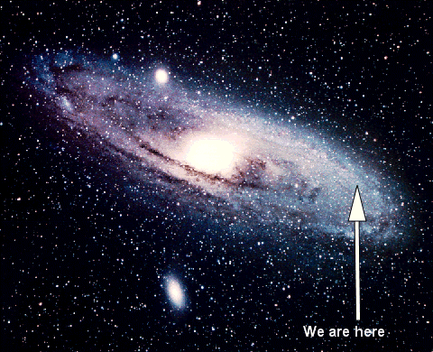
Consolation of the Jews
God Vs. Creation
Isa 40:12-14 – “¹²Who has measured the waters in the hollow of His hand, and marked off the heavens by the span, and calculated the dust of the earth by the measure, and weighed the mountains in a balance and the hills in a pair of scales? ¹³Who has directed the Spirit of the Lord, or as His counselor has informed Him? ¹⁴With whom did He consult and who gave Him understanding? And who taught Him in the path of justice and taught Him knowledge and informed Him of the way of understanding?”
Notes:
Isa 40:12a – Meaning, as vast and as deep as our oceans, covering 71% of our planet, the God of heaven can scoop them up and hold them in the hollow of His hand. I can hold 1 to 2 tablespoons of water in my hand, but God can carry all the water on this planet in the hollow of His hand.
Isa 40:12b – A span is the distance between the tip of the thumb to the end of the middle finger, and it was used for judging very small distances. God is so great, He can use His hand to measure the universe. To Him, it is but a small distance.
Isa 40:12c – The idea is that God is so big, every granule of sand on this planet, of which we couldn’t count in a thousand lifetimes, to God, it might as well be something put in a measuring cup.
Isa 40:12de – Think about what men go through to hike Mt. Everest. They get in tip top shape, buy thousands of dollars in equipment, and many of them still die just trying to get to the top. Yet God can take that mountain along w/all the lesser mountains, and every hill, and He can weigh them on a scale as we would weigh light objects.
Isa 40:13-14 – In other words, if God measures those things which to us are immeasurable, that makes Him infinitely more immeasurable. So, who here on this Earth is going to tell God something He doesn’t already know? Who is going to counsel Him? A person counseled is someone who knows more, yet who knows more than our God? There’s no heavenly committee, and there is certainly no earthly committee. He is “Wonderful Counselor, Mighty God”. And while everyone questions God at some point, may that question cause us to realize our lack of knowledge and foresight. Though men may search, they cannot find, for God alone does understand.

Slide 4
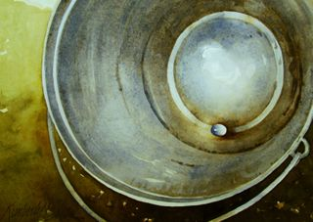
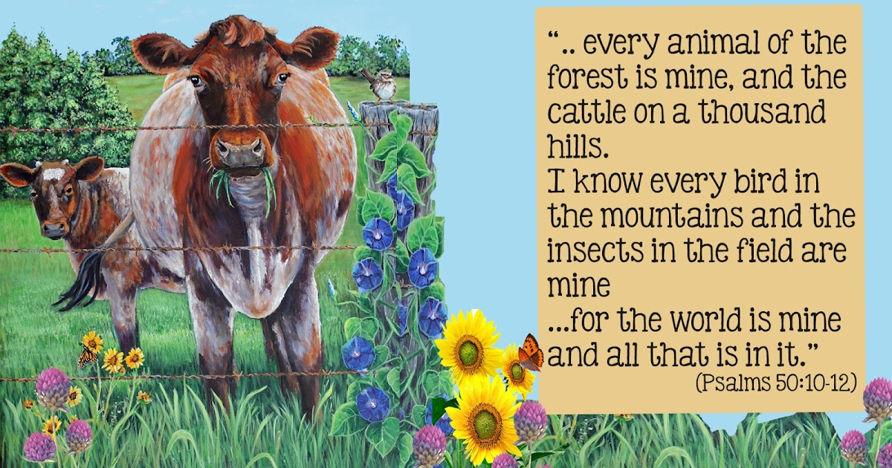
Consolation of the Jews
God Vs. Nations
Isa 40:15-17 – “¹⁵Behold, the nations are like a drop from a bucket, and are regarded as a speck of dust on the scales; behold, He lifts up the islands like fine dust. ¹⁶Even Lebanon is not enough to burn, nor its beasts enough for a burnt offering. ¹⁷All the nations are as nothing before Him, they are regarded by Him as less than nothing and meaningless.”
Notes:
Now, in vs. 15, Isaiah is going to move from the mighty work and wisdom of Creation, to its end result. Compared to God, what are the nations of this planet like? And can such “strength in numbers” thwart God and His purposes? Not a chance.
Isa 40:15 – So, for the God who holds the oceans in the hollow of His hand, to compare the nations to a mere drop in a bucket is actually quite generous. The strongest nation is but a speck of dust on a scale, negligible on a scale in weight and in comparison to God; their power is insignificant in His eyes. Take the most powerful nation of our Earth, regardless of era, and as imposing as that nation may be to those of us who live under its yoke, that nation doesn’t tilt the balance of power one bit. In Matt 4, when Satan offered Jesus all the kingdoms of the world if He’d just bow down to him, Jesus wasn’t impressed in the least. Because nations like Rome, Greece, Persia, Babylon, Assyria, though these collectives strengths dominated everyone in their path in their own time, where are they now? Reduced to relics, banished to the archives of history, its remnants carted off to museums, all subject to rust and decay. But our God? He is alive, in Him we live, and we survive.
Isa 40:16 – If you want to make God an offering worthy of Him, you could take all the trees from the place best known for trees and burn them all up and not even come close. In other words, if Lebanon w/all its mighty cedars became the fuel for the fire upon the altar, and all the abundance of its livestock were offered upon it, it would still be wholly unworthy of our God. After all, they’d only be offering what God Himself created – Psa 50:10-12 – “For every beast of the forest is Mine, the cattle on a thousand hills. I know every bird of the mountains, and everything that moves in the field is Mine. If I were hungry I would not tell you, for the world is Mine, and all it contains.” God created it all. So, what can we give Him that isn’t already His?
Isa 40:17 – Now, nothing is nothing, so how can something be less than nothing? Well, when God is the object of comparison, nothing isn’t nothing enough. That doesn’t mean He doesn’t care about the nations. The gospel proves otherwise. They’re simply nothing “before” Him, meaning in comparison to Him. Nations have risen and vanished into oblivion, but our God? He is alive, in Him we live, and we survive.

Slide 5
Consolation of the Jews
God Vs. The Idols
Isa 40:18-20 – “¹⁸To whom then will you liken God? Or what likeness will you compare with Him? ¹⁹As for the idol, a craftsman casts it, a goldsmith plates it with gold, and a silversmith fashions chains of silver. ²⁰He who is too impoverished for such an offering selects a tree that does not rot; he seeks out for himself a skillful craftsman to prepare an idol that will not totter.”
Notes:
Isaiah then compares God to the idols.
Isa 40:18 – It’s another rhetorical question. How could any manmade image, no matter how creatively made, ever truly represent the awesomeness that is our God? Since He is so transcendent, any likeness of Him, by virtue of His greatness, will by necessity be wrong. And so how truly pathetic is idolatry? It’s merely the product of human workmanship, representing a glory only humans can render it. An idol is a material god made from material hands. So how can men, made in God’s image, create a likeness of God? It’s demeaning, and it simply plays into the hands of mankind’s sinful desire to make God controllable.
Notice the construction workflow – Isa 40:19-20 – You see the care that one must give his idol? First, he has to choose good wood because no one is going to worship a rotting god. Then he has to choose a good craftsman because no one is going to want to worship a poorly designed god. Then it has to be designed to stand on its own, because no one is going to want to worship a god that keeps getting knocked over by the wind. Idols are so weak, so frail, man has to look for ways to make them last. The entire process is a mockery of deity, pointless, the epitome of folly, doing nothing more than reflecting the resources of the one who commissioned it. This is why idolatry is such a profoundly insulting sin against God, because no matter what you make it out of and how well you make it, you’re always comparing God to something He created. Who did all the work? Man. And after it’s made, what is the idol? Nothing.
And as we think about this, it’s easy to dismiss this point as merely a struggle of the unintelligent of bygone days, and therefore irrelevant to our modern-day struggles. But the problem of idolatry has never gone away, nor will it ever. The gods we fashion today are the ones formed in the mind. There is the god of my cause, the god of my personal understanding, the god of my personal experience, the god of my comfort, the god of my ambitions, etc. These may not be idols constructed by hand, but they are constructed in the mind as we futilely attempt to make God more manageable by forcing Him to comply w/my wants and needs, how I want to live my life. But the idols of the mind are just as dead and subject to decay as those made w/hands, and they cannot measure up to the immeasurable, awe-inspiring, formidable being that is our God. Limiting God to my character and my desire will not bring me closer to Him and His greatness, it’ll only drive me further away

Slide 6
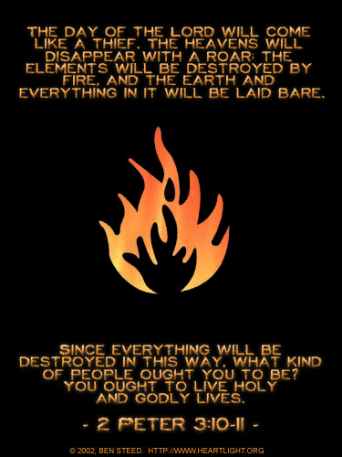
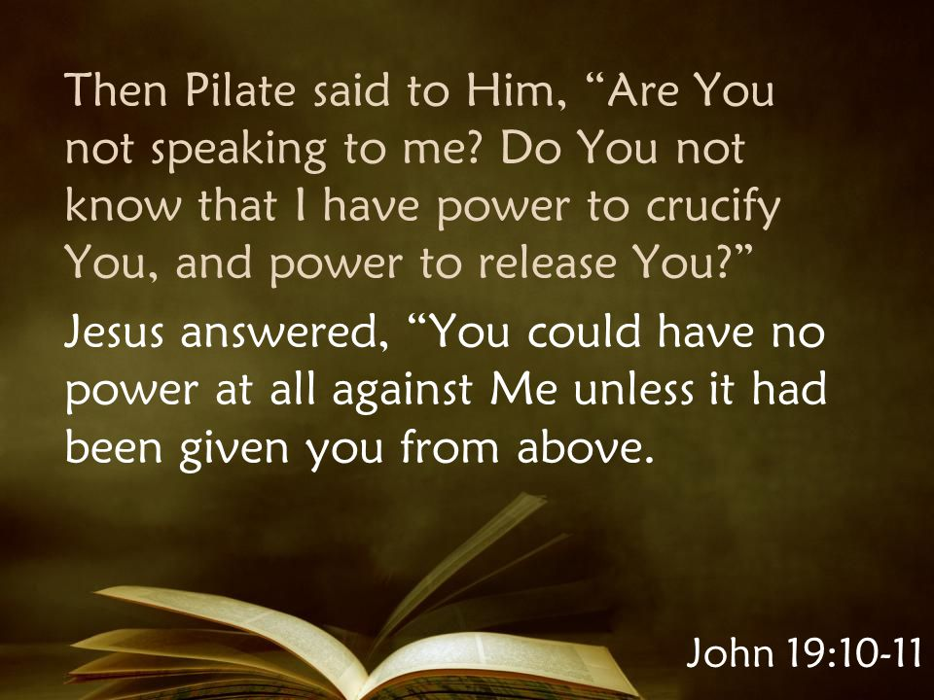
Consolation of the Jews
God Vs. The Rulers
Isa 40:21-24 – “²¹Do you not know? Have you not heard? Has it not been declared to you from the beginning? Have you not understood from the foundations of the earth? ²²It is He who sits above the circle of the earth, and its inhabitants are like grasshoppers, who stretches out the heavens like a curtain and spreads them out like a tent to dwell in. ²³He it is who reduces rulers to nothing, Who makes the judges of the earth meaningless. ²⁴Scarcely have they been planted, scarcely have they been sown, scarcely has their stock taken root in the earth, but He merely blows on them, and they wither, and the storm carries them away like stubble.”
Notes:
Isa 40:21-22a – God is not a part of this Earth, He sits enthroned above it. And so, who are we to Him?
Isa 40:22bcd – Compared to God, we are minute, totally dependent on Him, living in a universe that may seem colossal to us, but it’s like a tent to God. This implies that it is temporary in nature, just like us. Our universe is to God as steel is to cobwebs. He spreads it out w/ease, hanging it as we would hang a simple curtain. And one day, He’ll rip it away and reveal Himself in the fullness of His glory. 2 Pet 3:10 – “But the day of the Lord will come like a thief, in which the heavens will pass away with a roar and the elements will be destroyed with intense heat, and the earth and its works will be burned up.”
And so, consider the greatest of Earth’s inhabitants, its rulers. If Creation is a result of God’s executive rule, who are Earth’s leaders compared to God? Isa 40:23 – And so all authority and exercising of lordship given to any man on this planet, no matter what area of rule, is temporary. Earth’s rulers are on borrowed time. And at the time that God deems, they are reduced to nothing. John 19:10-11a – Pilate was on borrowed time. Think of the most prideful, most despicable ruler that you can, right now. What leader or ruler is in your mind right now that is the epitome of cruelness and deceit and deplorable character and boastful behavior, but they get away w/it because of their wealth; they have law enforcement and judges in their pocket? Who are you thinking of in your mind that fits that description? That person’s days are numbered.
Isa 40:24 – See God does not simply have infinite power; He exercises that power through sovereign action. He plants these leaders, and then just as quickly as He lets them grow to full flower and power, He blows them away like chaff, no sooner having made an entrance do they make an exit, as we saw previously from vs. 6 - 8. And removing them requires no strenuous, physical exertion on God’s part. Divine judgment will remove them all, and they will give account of their works before the eternal, constant, supreme authority in the heavenly places.

Slide 7
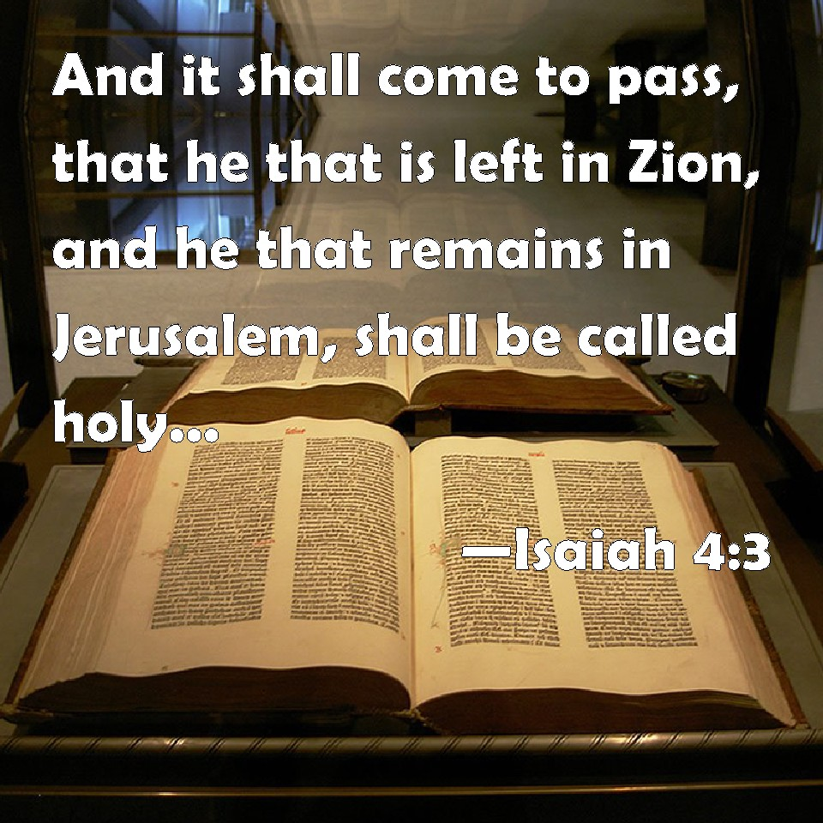
Consolation of the Jews
Concluding arguments
Isa 40:25-26 – “²⁵‘To whom then will you liken Me that I would be his equal?’ says the Holy One. ²⁶Lift up your eyes on high and see who has created these stars, the One who leads forth their host by number, He calls them all by name; because of the greatness of His might and the strength of His power, not one of them is missing.”
Notes:
The next 2 verses form a conclusion to vs. 12 – 24, repeating the questions of vs. 18.
Isa 40:25 – “Says” means “keeps saying”. Meaning, this is not the first time God has had to remind man of this and it won’t be the last. Above all other qualities, the fact He is “holy” puts Him beyond compare. God is morally perfect, which alone puts Him in a class of His own. Yet He wishes to share this character w/His unholy people (4:3-4; 62:12).
Isa 40:26 – “Lift up” used of astral worship in Deut 4:19, which was popular in Babylonian worship. Israel was also tempted to worship the “host of heaven” (Kings 17:16; 21:3; Amos 5:26; Jer 7:18; 8:2; 44:17). But as impressive as they are, they are merely God’s handiwork, and He’d have us to view them w/this thought in mind. They are in the exact place He wants them, despite their totality, and named according to His will, meaning He knows them individually. Astronomers continue to name and classify stars, but God completed His census a long time ago. Point: if God knows every item in His Creation, how can He be accused of forgetting His people? He knows the inanimate objects by name, so certainly He looks after His sons and daughters (Luke 12:7).

Slide 8
Consolation of the Jews
Israel’s Complaint
Isa 40:27 – “²⁷Why do you say, O Jacob, and assert, O Israel, ‘My way is hidden from the Lord, and the justice due me escapes the notice of my God”?”
Notes:
And so, let’s look again at that complaint in vs. 27, the grievances that prompted all these truths.
Isa 40:27 – Haven’t we all felt that way? We may not be in physical bondage as Israel was in Babylon, but we’re held captive to this wicked world every day. We’re enslaved to a fallen, decaying planet that though created by God in perfection, has since been ruined by sin. And more than that, we’re in personal, spiritual bondage to sin, having become our own worst enemy, hurting ourselves and others in our quest for significance. The complaint in vs. 27 is basically this – “I am hurting, it doesn’t seem like God notices, and if He is so great, where is He?”. It’s the same question that we asked in the last study when we were looking at vs. 10-11: “How can God be so strong as to rule w/His arm in might, while at the same time carrying in those same arms the nursing ewes in His bosom?” And the point of Isa 40 is to show that God is indeed great, but He is not too great to care. Rather, He is too great to fail His people – That’s the point of Isaiah 40. This is why knowing God’s nature is so important. Just because God is with us does not mean He is like us. And if we make the mistake of thinking God is like us, we’ll think He can get worn out like we do.

Slide 9
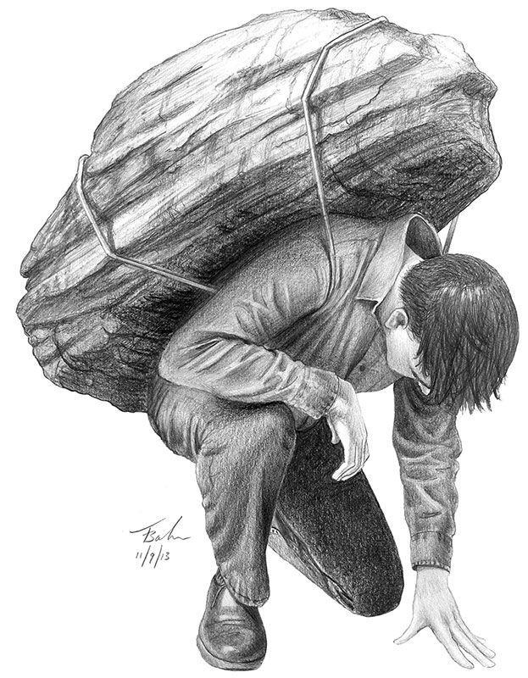
Consolation of the Jews
The Everlasting God
Isa 40:28-29 – “²⁸Do you not know? Have you not heard? The Everlasting God, the Lord, the Creator of the ends of the earth does not become weary or tired. His understanding is inscrutable. ²⁹He gives strength to the weary, and to him who lacks might He increases power.”
Notes:
But God cannot get worn out like we do. He’s God. And so, in assuring His people that He will act, He challenges them/us in this way:
Isa 40:28 – The point is this: yes, we hurt. But God’s greatness is not fickle like our emotions are. And in times of trial, we need to learn how to tap into the objective part of our psyche, to think, and listen, and observe. Our hurt is not indicative of God’s indifference or His abandonment – He doesn’t grow weary. Creation is what’s wearing out; God does not. Our patience in waiting for God, that too may wear out, but God does not. He is everlasting. His greatness and His power are perpetual and without limit, and this makes Him uniquely different than anything else in this universe. Everything we get our hands on down here has a shelf life, from our food to our cars to our own bodies. Can you even imagine getting your hands on something that will never go bad? Milk that never expires, a car that never needs maintenance, a pet that never dies. Nothing like that exists in this corruptible, fading universe. And so, if the best of man eventually collapses, what hope is there for the rest of us? The Everlasting God, that’s who.
And He assures us we can tap into His strength – Isa 40:29 – Not just in physical ability, though He is fully capable of doing that too. Rather, it’s in all those spiritual necessities that begin to wane when we get tired and worn out. When we’re going through trial and our patience is running low, and our joy is depleting, and our endurance is fading, and we’re tempted to go Debbie Downer, God has a way of picking us up. See, all that sovereign strength He exerts? He doesn’t horde it for Himself. He is standing able and willing to supply us a healthy portion of that strength and then some. Matt 11:28 – “Come to Me, all who are weary and heavy-laden, and I will give you rest.” And it does not exhaust Him in the least to do so. Have you ever seen someone w/a need and you want to help them, but you just don’t have anything left in the tank to give them? This is not the case w/the Everlasting God. His tank never goes empty. It never even goes down. He is the only self-sustaining power in this universe, and He wants to provide us w/His power to help us in time of need.

Slide 10
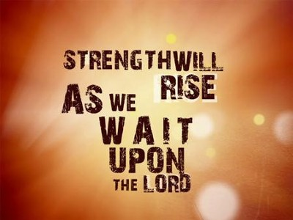
Consolation of the Jews
The Everlasting God
Isa 40:30-31 – “³⁰Though youths grow weary and tired, and vigorous young men stumble badly, ³¹yet those who wait for the Lord will gain new strength; they will mount up with wings like eagles, they will run and not get tired, they will walk and not become weary.”
Notes:
So then if I believe all of this about God, what should I do? What does it take to tap into His power? Learn to wait.
Isa 40:30-31a – That’s when replenishment occurs, when we wait on the Lord. And waiting is having the confidence that He will eventually act on our behalf. Waiting is not killing time, it’s confident expectation that our cup of strength will continue to be filled from God’s infinite, eternal reservoir. And I know that waiting is one of the most difficult exhortations in scripture. Because, as a part of fallen humanity, we are so prone to just take matters into our own hands and to follow our own schemes. Life’s waiting room is worse than the waiting room at the doctor’s office. It’s a place where time seemingly stands still. It is a place where life is put on hold. We don’t like to wait, we like “buy now, pay later.” But while it’s good to get some things instantly, it’s not good to get other things instantly, is it? Parents, when your kids get everything they want when they want it, does that help them to be better people or worse people? If we always get what we want when we want it, but then something happens that is out of our control, and we no longer have the ability to get what we need when we want it, where will that leave us? The Patriarch Jacob is such a good example. He lived the first part of his life as a “self-made man”. When he wanted the birthright, he took it. When Jacob wanted the blessing of the firstborn, he took it. But 20 years later when he is a small caravan traveling back home, and Esau is riding to meet him w/an entourage of 400 men, Jacob’s ingenuity was not going to be enough. He was going to need God’s help to get out of that pickle. That’s why we need to learn to wait. Because while there are things I can control, there are far more things that I cannot. And waiting on the Lord is about building trust, and taking all that control that I want and surrendering it into His hands. And that builds the kind of character and endurance that it takes to live in a perishing world where nothing is sustainable. Because as everything on this planet reaches its shelf-life, that very inevitably brings pain and suffering of which I have no control over.
But those who wait on the Lord? – Isa 40:31b – And an eagle is not like a normal bird. When a normal bird gets flustered, it flaps its wings erratically, and uses all its strength to get out of harm’s way. Eagles don’t flap, they mount up. An eagle is very much like the man who built his house on the rock; it can see when a storm is approaching long before it comes. So, before the winds come, the eagle will fly to a high spot and wait for the storm. Then when the wind starts to pick up, it sets its wings so that the wind will pick it up and lift it above the storm. And so, as the storm rages below, the eagle is soaring above it. See the eagle doesn’t attempt to escape the storm like other birds do; rather it uses the storm to lift it higher. It rises on those winds that the storm brings. Brethren, there are some who when the winds of life come, it knocks them down. And there are others in which the winds cause them to soar even higher, seemingly w/ease, and those are the eagles. And the key to mounting up w/wings like an eagle is surrendering control to God by waiting through trial, so that we can rise above them, our minds wholly and utterly focused on God.
The result? – Isa 40:31cd – Meaning, God’s supernatural resources keep us moving forward through the tough times, whether we’re in the “walk” of life or when we’re “running” the race that is set before us. The irony of Isa 40 is that it is a chapter designed to show us just how far below God’s greatness we truly are. And yet because of that exceeding greatness, He will never deny strength to those who love Him and wait for Him. Israel’s distressing cry from vs. 27 was not a result of God’s weakness, but from their need for humility, and patient waiting.

