Slide 1
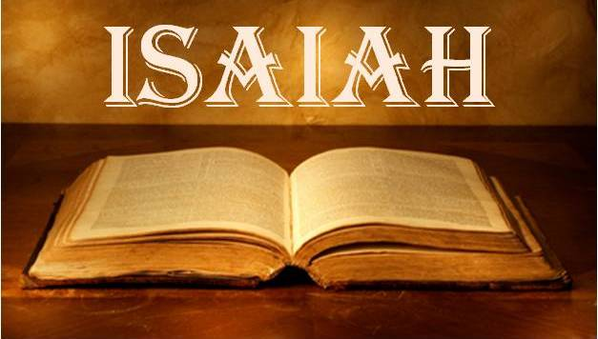
Notes:
Before we begin Isaiah 40, it would be helpful to spend some time reviewing the first 39 chapters. This will help us to remember some things we may have forgotten as well as help those who joined us last month to get a bit more caught up.
There have been many themes suggested for the book of Isaiah, but the theme we’ve been working w/is, “Trust God.” Some would expect a deeper them because the simple statement “trust God” sounds overly simplistic for a book that spans 66 chapters. But one way to look at this is to simply remember that trusting God is a challenge that we face throughout out entire life, and our life is a lot longer than 66 chapters. And getting the Jews of Isaiah’s day to trust God was the biggest challenge He faced in his ministry and beyond.

Slide 2
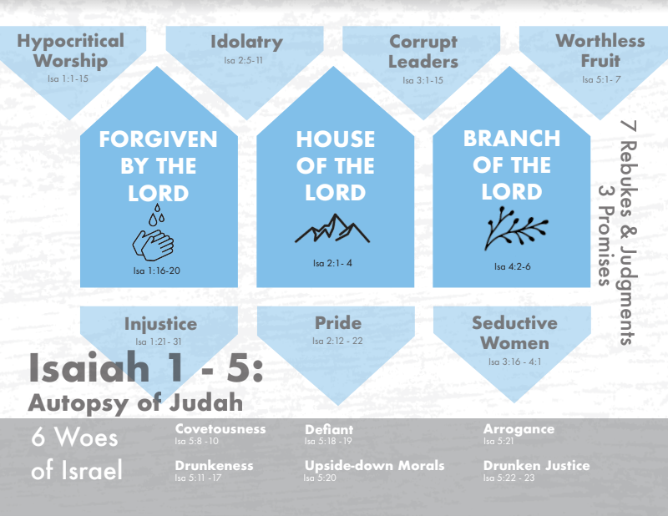
Notes:
The beginning of Isaiah’s ministry begins during the reign of Uzziah and then his son Jotham, who were both great kings. But despite their successful reigns, the people were spiritually complacent and given to a variety of sins. And so, chapters 1 – 5 serve as an introduction to Judah’s issues in which Isaiah performs an autopsy on the spiritual body of Judah to see what is going wrong, and he addresses 7 sins in the form of rebukes and judgments: hypocritical worship, injustice, idolatry, pride, corrupt leadership, seductive women, and the fact they were bearing worthless fruit. And as he’s examining them, Isaiah is noticing a recurring theme – they’re supplanting trust for God w/trust in man – Isa 2:22 – “Stop regarding man, whose breath of life is in his nostrils; for why should he be esteemed?” So, to fix the problem, God will remove those things which they’re putting their trust. It’s important that we memorize these 7 sins because each of them are going to be revisited time and again, but more importantly, Isaiah is going to show us how God is going to bring this dead body back to life.
But even while God promises these judgments, He has not forgotten His promise to Abraham, that through His seed all nations of the earth would be blessed. And one day, this seed is going to spring from a stump and become a branch. It will be set on a mountain so great that all nations would climb to it. And through this Branch, forgiveness of sins can be achieved as we repent of those sins.
What we see in these chapters is a pendulum swing. He goes from hope and salvation to catastrophe and judgment right back to hope and salvation only to pronounce more judgment. Reading this book will give you whiplash. And the reason for this pendulum effect is a phrase that appears 31 times in the OT, but 26 of those times are this one book – “The Holy One of Israel”. What is the significance of this phrase? God’s holiness is an expression of His magnitude, His worth, His transcendence, perfect purity, the ultimate goodness, the summation of all qualities that make Him divine. When the bible refers to God’s holiness, it means His “otherness” or “apartness”. So, all sin, being in contrast to His holy demand, will be dealt w/severely. But that He is the Holy One “of Israel” means He hasn’t forgotten His promises, and so there must be grace. This is the reason behind the pendulum swing.
And then chapter 5 beginning in vs. 8 announces 6 woes: covetousness, drunkenness, defiance, upside-down morals, arrogance, and drunken justice. What does “woe” mean? “You’re as good as dead” – the chapter concludes by God promising to send a nation to punish them, which we learn later is the Assyria empire. But the #6 is incomplete. Shouldn’t there be a 7th woe?

Slide 3
Notes:
Well, in Isa 6, Isaiah receives his commission from God in the last year of Uzziah’s life. Some believe this should be the first chapter and not the 6th. But theologically, it is exactly where it needs to be, because as Isaiah observes the holiness and glory of God Almighty reigning from His throne, seeing God causes him to see himself. And so, in Isa 6:5, he pronounces the 7th woe on himself – “Woe is me, for a I am a man of unclean lips”. He is then cleansed from that sin and commissioned by God to preach to a people who not only will not listen to him, but will be hardened even more by his preaching. And he is to do this until the land is devastated and w/o inhabitant.
In chapters 7 – 12, we see him putting this commission into effect for the first time. Jotham’s son Ahaz is now king, and he and the nation of Judah are facing a crisis. The northern kingdom of Israel has formed a coalition w/Syria against Judah because Ahaz wouldn’t join them in fighting against the rising Assyrian empire. So, God sends Isaiah to counsel Ahaz to trust God’s ultimate protection for Judah, offering him any sign he should choose. But wicked Ahaz has already decided to put his trust in Assyria to save him, so God decides to give him a sign anyway, the virgin birth of Immanuel – “God is with us”. And what this means is that whatever judgment God brings to Judah, and judgment was certain, it would not be the last word. The Messiah will one day come, but Ahaz will have no part of it. But this theme of “God is with us” is the dominant theme of chapters 7 – 12, because even as God assures Judah of Israel and Syria’s demise, as well as Judah’s own judgment by Assyria, who will reach up to its neck and usher in darkness, they would one day see a great light – a child would be born to the who will usher in a righteous government unlike any they had ever experienced; a righteous Branch who will bring in a kingdom of peace and spiritual prosperity. But before this happens, Israel will be judged, Syria will be judged, and Assyria will be put to an end.

Slide 4
Notes:
Then in chapters 13 – 27, God shows us that protecting Judah from Israel, Syria, and Assyria is not some one-off exercise. What He’ll do to those nations that threaten His plan w/Judah is going to happen to every nation. And in chapters 13 – 23, the lesson is, “Stop leaning on these nations to bail you put of trouble. Stop submitting to human authority. Because one day they’re going to be coming to you to learn more about Jesus. You don’t need them, they need you. God is with us.” And chapters 24 – 27 broaden that idea from a worldwide to a universal scale. And remember, this trust must exist not just in times of certainty, but also times of uncertainty, and must expand even into the future when promises are made in which we must patiently wait on the Lord to demonstrate His predictive word.

Slide 5
Notes:
Now, there were 2 climactic points in chapters 13 – 27 where Isaiah prophesied that 2 of the world’s superpowers, Egypt and Assyria, would be brought into full membership w/the Lord’s people.
Isa 19:24-25 – “In that day Israel will be the third party with Egypt and Assyria, a blessing in the midst of the earth, whom the Lord of hosts has blessed, saying, ‘Blessed is Egypt My people, and Assyria the work of My hands, and Israel My inheritance.’”
Isa 27:13 – “It will come about also in that day that a great trumpet will be blown, and those who were perishing in the land of Assyria and who were scattered in the land of Egypt will come and worship the Lord in the holy mountain at Jerusalem.”
It is these 2 nations, along w/Judah, that occupy much of Isaiah’s message in chapters 28 – 35. In this section, Hezekiah is now king, and the same problems from chapters 7 – 12 have presented themselves yet again. Only this time, Assyria is the nation threatening Judah and Egypt is the nation Judah is being tempted to seek help from. And so, Isaiah makes 3 main points in these chapters: 1) Judah is going to be judged, but in the 11th hour she will be saved. 2) Egypt, that old abusive ex-boyfriend, will not be the one to come to Judah’s rescue. 3) When it comes time for Assyria to be dealt with, God will be the one to do it. And all throughout these chapters, Isaiah constantly drops phrases and words that allude back to the book of Exodus, as if while counseling the people, He wants them to also read between the lines – “If I can defeat Egypt like I did in Exodus, not only am I stronger and more reliable than they, but I can defeat Assyria, too.” These chapters are wonderfully constructed around a mosaic of 6 “woes”, to suggest that if Judah persists in committing herself to fickle Egypt, “its their funeral”. The 3 “woes” develop the principles, and the last 3 “woes” apply the principles of its companion “woe”.

Slide 6
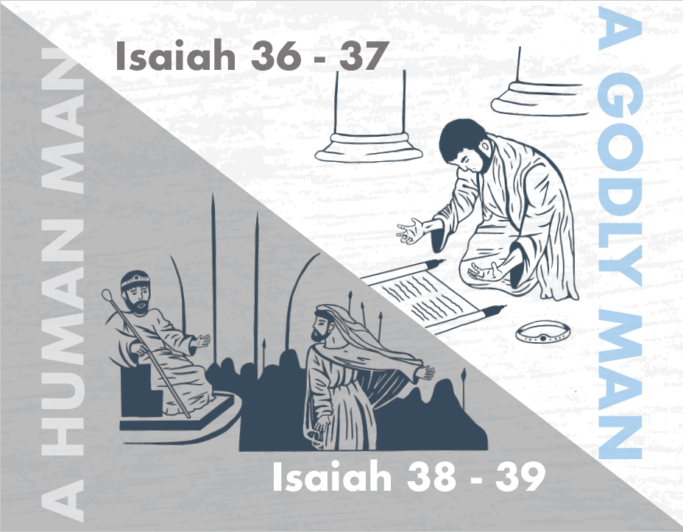
Notes:
And then we just finished up chapters 36 – 39, what are often referred to as Isaiah’s “halftime show”, w/chapters 36 – 37 being the grand finale of the prior chapters, showing the outcome of a godly man’s faith. In these chapters, God demonstrates what He had been predicting for 35 chapters of Isaiah, that any who try to take down His people are going to get it. And now Assyria is knocking on Jerusalem’s doors and God demonstrates the very power He had been predicting through Isaiah for decades by sending an angel to kill 185,000 Assyrian troops. And they tuck tail and go home. This great victory through Hezekiah’s faith was a high point for God’s people. Maybe everything will be fine going forward. Syria’s gone, the northern kingdom is gone, Assyria has run back home. Could Hezekiah be the promised Savior of Judah? Not quite.
Because in chapters 38 and 39, despite God saving Hezekiah’s physical life when he got sick, Hezekiah gives into pride. In chapter 39, emissaries from Babylon come to visit Hezekiah and to inquire about the great things God had done for Judah. But rather than using this moment to give glory to God, Hezekiah is flattered and gives into pride, showing that even the godliest of men are still human. This prompts Isaiah to predict Judah’s future captivity by these very same Babylonians, though it would not occur until after Hezekiah’s death. It’s in this chapter that we really start to see that the threat of the nations, the threat of captivity, was never really the root problem. The problem has always been sin. And until that problem is ultimately addressed, we’re just going to see a repeat of all the things we’ve seen in Isaiah so far.

Slide 7
Notes:
This brings us to chapters 40 – 66. Though Isaiah prophesied a future Babylonian captivity in chapter 39, it wouldn’t actually take place for over a hundred years later. But beginning in chapter 40, Isaiah assumes this captivity, and he looks forward not to the time when they would be taken captive, but to the time when God would rescue them from captivity. And he’s going to answer one very important question: why did captivity happen? Is it because the idols overpowered and defeated God? Is it because Babylon is stronger than God? Is it because God doesn’t care about His people and is no longer committed to the promise He made to Abraham? Not at all. And so, Isaiah is going to spend chapters 40 - 48 showing that the true God’s power is beyond compare. Not only did He allow captivity, He is also allowing Isaiah to predict 100 years beforehand the destruction of the idols, the return of Israel from captivity back to their land in order to show His people He has not forgotten His promises, and He will even personally name the king who would deliverer them long before this man was even born. All of this is to show His sovereignty; His sovereignty over Babylon, which was the most powerful nation the world had ever seen, His sovereignty over the idols, and His sovereignty over the Jews’ hurt feelings. Chapters 40 – 48 can be arranged chiastically, with the meat of the sandwich being the announcement of Cyrus as their deliverer from physical captivity. But before we get to the meat of the sandwich, we need to work our way through the mustard, mayonnaise, and lettuce first. And the first layer of the sandwich is found in 40:1 – 41:20 in which God will give “Consolation to the Jews”.

Slide 8
Introduction to Isa 40 – 66
Comfort
Isa 40:1-2 – “¹‘Comfort, O comfort My people,’ says your God. ²‘Speak kindly to Jerusalem; and call out to her, that her warfare has ended, that her iniquity has been removed, that she has received of the Lord’s hand double for all her sins.’”
Isa 40 – 48
Warfare
has
ended
Isa 49 – 57
Iniquity
has
been removed
Isa 58 - 66
Received
double
for
all
her
sins
Notes:
Isa 40:1 is one of the most famous verses in the bible in one of the most famous chapters in the bible, and it sets the tenor for the remainder of the book, beginning this way:
Isa 40:1 – For the first 11 verses, we’re witnessing a heavenly dialog, and because of the pronouns used, we’re only told who one side of the conversation is (God), who is wanting to comfort His people who are in captivity. The other speakers are unidentified, and rather than delving into too much speculation, it’s best to just think of them as all who would speak for God. These messengers are called on by God to “comfort” His people, a word that is derived from “the heavy panting of a horse”, suggesting intense suffering that the people have endured in captivity and God’s desire to end that suffering. Comfort who? “My people” being comforted by “your God” – this is the language of a continued covenant, not the scornful “this people” of 6:9, 8:6. The idea is this: despite their sin, despite the punishment they are experiencing in captivity for their sin, God won’t forget His promises. This is the overall theme for the remainder of the book.
And vs. 2 breaks down this theme into a 3-fold refrain – Isa 40:2. Now, I’ve chosen to divide up chapters 40 – 66 into 3 sets of 9 chapters according to an inclusio that we find in the last verse of chapter 48 and the last verse of chapter 57. And I believe Isaiah 40:2 gives us all 3 themes of these 9-chapter sections.
That “her warfare has ended” is the theme of chapters 40 – 48, God’s assurance of both their rescue from captivity as well as judgment against their captor Babylon.
That “her iniquity has been removed” is the theme of chapters 49 – 57, wherein we’re given astonishing detail about God’s radical plan to fix the problem of sin that led to their captivity to begin with, and to fix it once and for all.
And that “she has received of the Lord’s hand double for all her sins” is the theme of chapters 58 – 66, wherein we’re given a picture of spiritual Israel’s glorious future in which she receives a double portion due the first born, despite her sin (61:7). All 3 outlines will be arranged chiastically, just as we are doing with chapters 40 – 48, and if you’re familiar at all with the next 18 chapters, I bet you can guess what the meat of the sandwich is in section 2 and section 3.

Slide 9
Consolation of the Jews
Voice #1
Isa 40:3-5 – “³A voice is calling, ‘Clear the way for the Lord in the wilderness; make smooth in the desert a highway for our God. ⁴Let every valley be lifted up, and every mountain and hill be made low; and let the rough ground become a plain, and the rugged terrain a broad valley; ⁵then the glory of the Lord will be revealed, and all flesh will see it together; for the mouth of the Lord has spoken.”
Notes:
Now, beginning in vs. 3, we’re going to be introduced to 3 separate voices of consolation being spoken to the future remnant in captivity.
Isa 40:3 – Remember from Ezek 11, that Ezekiel was shown this vision of God leaving the temple? And now after all this time, He’s returning, and He’s bringing His people back w/Him, and so any obstacle to this journey is to be eliminated. Now, the wilderness is where Israel was before they entered the promised land when they were preparing to receive God’s blessings. But what is this pointing to? Who is this quoted about in the NT?
John the Baptist, the forerunner of Jesus Christ. Ok, then what is this talking about? Is this talking about preparing the way for God’s people to return from Babylonian captivity, or preparing the way for Jesus to come to His people? This is not a dichotomy. The answer is both. Important point: as we’re studying chapters 40 – 48, we’re going to see a lot of captivity language that looks like it could have a double meaning between the rescue from physical captivity and the rescue from the spiritual captivity of sin. This is by design. The main point of chapters 40 – 48 is that as He rescues His people from physical captivity, He’s revealing to both the Jews and the world His sovereignty and His superiority to the nations and the idols. But as we’re learning this, there’s something going on in the background, too. He is developing a framework by which they and we need to learn to view sin. Because sin brings us under bondage, too; it puts us into spiritual captivity. And so, all the lessons of rescue from physical captivity need to also be thought of in terms of release from spiritual captivity as well, because Isaiah is ultimately trying to get us to the middle chapter of 40 – 66, Isaiah 53, to show God’s ultimate purpose. Point: God uses physical captivity as a framework to develop the idea of what spiritual captivity is actually like.
Hence Isa 40:4 – See, we understand if God wants to rescue His people from physical captivity, every obstacle between Babylon and Jerusalem needs to be eliminated. But there’s more to it than even that. Spiritually speaking, it speaks of the things that need to happen to the sinner in captivity if he’s ever going to get back to God. So spiritually speaking, this would speak of the action needed from those formerly paralyzed by hopelessness and despair (the “valleys” that need to be lifted up), those hindered by pride (the “mountains” that need to be brought low), as well as the lives wrecked by sin needing to be made whole again (the rough and rugged ground). This ultimately pictures the obstacles and difficulties that have kept God from His people, and so whatever is wrong in the paths we’ve been taking need to be corrected. And that’s what John the Baptist was trying to get people ready for, which is why he pushed repentance so hard.
Isa 40:5 – Meaning, when the way is straight, level, and free of obstacle, Christ can arrive w/o fail and w/o difficulty, undelayed by hindrances. Only prepared hearts will see the Lord, and that was what John the Baptist was aiming to achieve. And one day this would extend to “all flesh”, and that the Lord has spoken stresses its inevitable fulfillment.

Slide 10
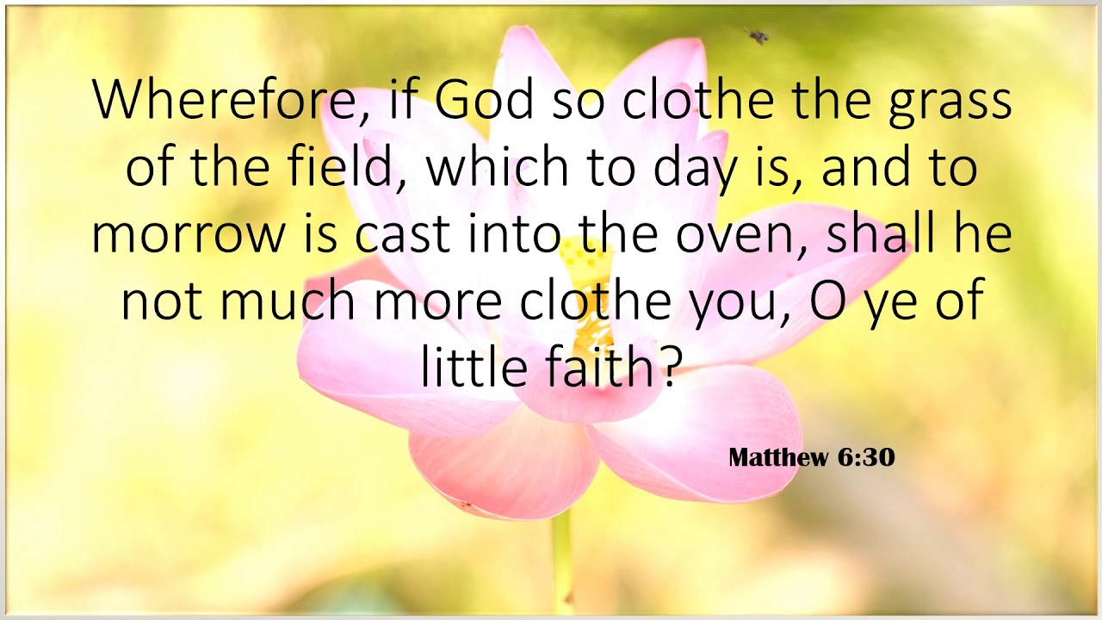
Consolation of the Jews
Voice #2
Isa 40:6-8 – “⁶A voice says, ‘Call out.’ Then he answered, ‘What shall I call out?’ All flesh is grass, and all its loveliness is like the flower of the field. ⁷The grass withers, the flower fades, when the breath of the Lord blows upon it; surely the people are grass. ⁸The grass withers, the flower fades, but the word of our God stands forever.”
Notes:
Now, I’d suggest that voice #2 is God’s answer to what may have seemed to the Jews as a flaw in God’s plan. The objection would be the following – “Big words, Isaiah, but we’re being held captive by the most powerful nation in the world, Babylon, who destroyed God’s city. So, what can God do against this great nation who has seemingly already defeated Him?”
The answer – Isa 40:6 – Since all flesh is like grass, we are transient. God does give us physical glory despite our brevity, but we’re still temporary – here today, gone tomorrow. And morally speaking, we sway as easily as grass in the wind. Despite how high we may hold ourselves spiritually, we fail just as Hezekiah did. That’s how the barren wilderness and desert of vs. 3 and chapter 35 came about to begin with.
Isa 40:7-8a – God’s breath, the Spirit, gives life even if temporary, but also brings death to human strength and glory, preventing mankind from surviving any conflict w/God. This applies both to oppressor and oppressed. Now, there’s a double purpose here: first, it means great nations like Babylon won’t prevail against God. But secondly, it also means we can’t possibly save ourselves. And since man is both physically and morally transient (as we was the case w/Hezekiah both physically and morally), the solution must be found in something incorruptible. What is that?
Isa 40:8b – Boy is that a voice of comfort. Like Hezekiah in chapter 38, we’re physically fragile, and like Hezekiah of chapter 39 we’re morally fragile. And the Apostle Peter quoted these verses in 1 Pet 1:22-25 as evidence for why we should fervently love one another from the heart. Does the word of God indeed live forever? French philosopher Voltaire said in the 19th century, “In 100 years, the Bible will be a forgotten and unknown book.” Yet a 100 years after he died, the Geneva Bible Society occupied his home. Voltaire is dead and gone. All people come and go, but God’s word lives on. Voltaire would not be the first to have this view, and he won’t be the last. All those in history who went against the bible are dead, but His word lives on.

Slide 11
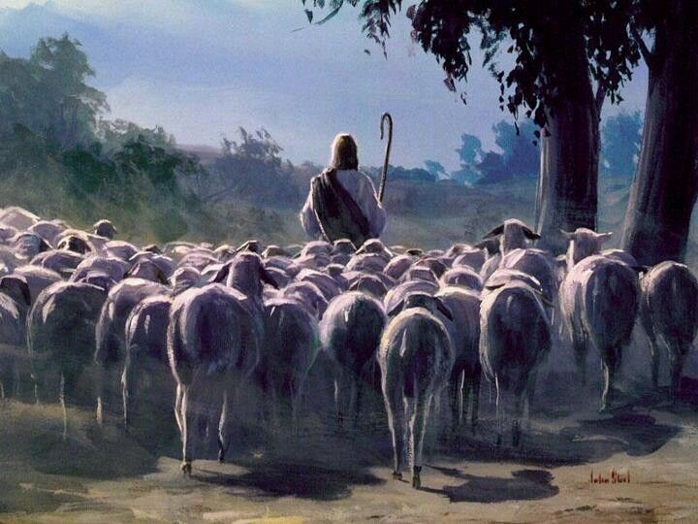
Consolation of the Jews
Voice #3
Isa 40:9-11 – “⁹Get yourself up on a high mountain, O Zion, bearer of good news, lift up your voice mightily, O Jerusalem, bearer of good news; lift it up, do not fear. Say to the cities of Judah, ‘Here is your God!’ ¹⁰Behold, the Lord God will come with might, with His arm ruling for Him. Behold, His reward is with Him and His recompense before Him. ¹¹Like a shepherd He will tend His flock, in His arm He will gather the lambs and carry them in His bosom; He will gently lead the nursing ewes.
Notes:
And this kind of confidence in God ought to activate in us an evangelistic zeal that is unfathomable, hence the 3rd voice of comfort:
Isa 40:9 – That phrase “good news”, in the Septuagint, is the Greek word “evangelizo”, where we get our word “evangelism”. Zion is to be the herald of good news, to take the good news and propagate it to the townships that are outside Jerusalem. A high mountain is chosen as their pulpit so all can hear. The church cannot keep this message to itself. Point: the Lord has come for them, so there is no need to fear being cast off or that His word will fail, and no need to fear any national, human power. “He comes” – no longer will the message be from angels or prophets, but coming from Himself personally – Heb 1:1-2a. This is God with us (7:14). There is no greater message than for one to behold their God, in His character, word, faithfulness, and love.
Isa 40:10 – Now, this is the debut of God’s “arm” in chapters 40 – 66, and it is used as a symbol of strength in action, as if He is rolling up His sleeves to get to work. Unlimited power, as opposed to flesh that us like “grass”, saving them from bondage as He did for Israel in Exodus. He both rewards the redeemed and the redeemed are His reward, the flock of His people who He has won over by His love.
Isa 40:11 – What do you know, a shepherd like David. But how can such a mighty arm carry the lambs in His bosom (close to his heart) w/o breaking them? Because only God can be so strong and yet so caring. Two complementary sides of God, which we also see taught in John 10 – First, as John 10:12 says, He is not a hireling who flees at the first sign of danger because He’s strong enough to ward off all enemies. Secondly, as John 10:11 says, He is the Good Shepherd. In addition, He is referred to in the NT as the Great Shepherd (Heb 13:20) and Chief Shepherd (1 Pet 5:4). The nursing ewes are the weakest, youngest of the flock who cannot take care of themselves (35:8e), and so God will.

